Slide 1
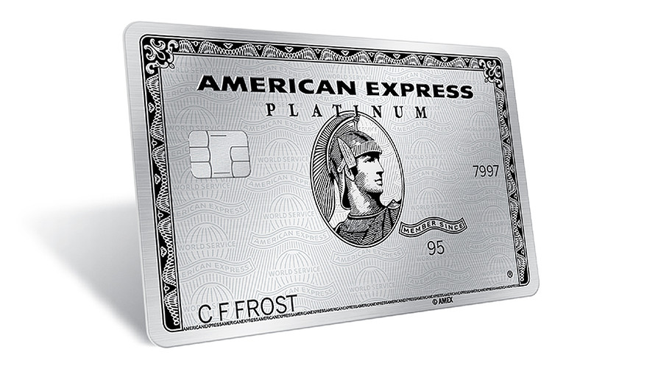
American Express Strategy Analysis

Slide 2
Table of contents
01
02
03
04
05
06
External Analysis
Internal Analysis
Business Strategy
Corporate Strategy
International Strategy
Conclusions and Recommendation

Slide 3
American Express Story
How American Express was found?
Founded in 1850 and headquartered in New York, American Express is a global payments company with a wide network accepted by millions worldwide.
What is their business model?
American Express operates a closed-loop business model as both card issuer and network, employing 74,600 people.
What is their strategic focus?
American Express aims to expand its leadership in premium consumer services, strengthen commercial payments, enhance its global network, and leverage its unique presence to attain strategic goals.

Slide 4
01
External Analysis

Slide 5
PESTLE Analysis
Political | The financial services industry is highly regulated, requiring compliance with federal laws like the Dodd-Frank Act and CFPB regulations. Government policies: tax reforms.
Economic | U.S. economic factors and downturns impact consumer spending and credit card defaults. Exchange rates fluctuation affected by international transactions.
Social | Changes in consumer behavior impact card usage and transaction volumes. Demographics, age groups, and financial literacy affect card adoption.
Technological | Digital advances like mobile payments and data analytics are reshaping U.S. financial services. Cybersecurity and PCI DSS compliance are vital for data protection and fraud prevention.
Environmental | Geopolitical conditions, terrorist attacks, military conflicts, natural disasters, severe weather, widespread health emergencies or pandemics.
Legal | AMEX must comply with complex regulations including consumer protection and anti-money laundering laws. Antitrust Laws: Navigating fair competition.

Slide 6
Moderate-High Bargaining Power of Buyers
AMEX serves a diverse customer base in the credit card segment, including individual cardholders, corporate clients, and merchants.
Individual cardholders have various payment alternatives and low switching costs.
Corporate clients from large firms to SMEs negotiate customized terms for business agreements.
Merchants and large retailers like Amazon and Walmart can negotiate fees and may offer their own credit cards, reducing reliance on AMEX.

Slide 7
High Industry Rivalry
Closed Loop System: AMEX manages its own issuing, networking, and acquiring, enhancing control but facing widespread competition.
Competitive Rivalry: AMEX faces intense competition from global banks, other card issuers like Visa and Mastercard.
Differentiation: Competitors in the US credit card market differentiate through rewards, fees, and targeting specific demographics.
Market Dynamics: Expansion is easier than exiting in this growth-oriented market.
Technological Innovation: Rivalry is driven by ongoing technological advancements, with firms innovating to stay ahead.

Slide 8
Low Threats of Entry
AMEX faces a low threat from new entrants due to regulatory demands, economies of scale, and high initial investments in the financial services industry.
Regulatory Challenges: Compliance with complex regulations requires significant investment, deterring newcomers.
Established Network and Loyalty: AMEX's large, loyal customer base and extensive merchant network may deter new competitors.
Investment Requirements: High startup costs in technology and marketing reinforce entry barriers.
Despite potential for innovative disruption, the industry’s high entry barriers protect established firms like AMEX.

Slide 9
Moderate Bargain Power of Suppliers
Third-Party Collaboration: AMEX utilizes third-party services for essential transaction processing and data management.
Co-brand Partnerships: AMEX maintains co-branded card partnerships with companies like Delta, actively managing these relationships amid competition.
Financial Infrastructure: AMEX's proprietary closed-loop network minimizes external dependencies and distinguishes it from rivals.
Technology and Marketing: AMEX strategically develops and outsources technology to remain competitive.
Consumer Reporting Agencies: Agencies like Experian provide vital credit information to AMEX.

Slide 10
Moderate-High Substitute Competition
AMEX is challenged by various alternative payment methods and fintech innovations, including traditional bank transfers, digital wallets like Apple Pay.
Additionally, merchant-specific credit cards from retailers like Walmart and contactless options, along with platforms like Venmo and Buy Now, Pay Later services, further threaten AMEX's market share.

Slide 11
02
Internal Analysis

Slide 12
Brand Recognition
Resources
Competency Evaluation
American Express strengthens brand recognition with strategic marketing and branding guidance, while maintaining visual consistency through strict communication guidelines and enhancing visibility via a supplier management program.
Brand recognition is definitely a core competency for American Express. It differentiates the company from its competitors by positioning it as a premium service provider. This brand positioning attracts high-spending customers and ensures a loyal customer base willing to pay a premium for perceived value.
Capability
American Express is known for luxury and premium services, bolstered by partnerships and sponsorships of events like the U.S. Open and global fashion weeks.
Valuable
Rare
Imitable
Sustainable

Slide 13
Service Excellence
Resources
Competency Evaluation
American Express boosts service excellence with advanced card management tools and employee development, including leadership training and pay equity, enhancing customer support and workforce motivation.
While American Express excels in customer service, it's not a unique core competency since premium financial services like JP Morgan Chase and Citibank offer similar levels of support. Additionally, outsourcing its customer service creates barriers to further improvement.
Capability
American Express is known for high-quality customer service, offering responsive support and extras like travel assistance and insurance, enhancing its luxury brand image.
Valuable
Rare
Imitable
Sustainable

Slide 14
Niche Market Focus
Resources
Competency Evaluation
American Express's luxury partnerships with elite retailers and hotels provide unique market leverage and enable exclusive, high-value offerings like tailored rewards and high credit limits.
American Express's focus on a niche upscale market has built a distinctive brand and loyal base, yet it's not a core competency since competitors like Chase with its Sapphire cards target similar demographics with comparable offerings, showing that this strategy doesn't offer a sustainable, unique competitive advantage.
Capability
American Express uses its luxury partnerships to meet the high expectations of its affluent clientele, offering standout services and products in the competitive premium market.
Valuable
Rare
Imitable
Sustainable

Slide 15
Closed Loop Business Model
Resources
Competency Evaluation
American Express operates its own network and manages direct relationships with cardholders and merchants, enhancing loyalty programs and value. The company invests heavily in technology and security to support these operations.
American Express's closed-loop model provides a distinct advantage by controlling the entire payment process. This allows for consistent service and a deeper understanding of customer behaviors, enabling tailored services that align closely with market demands and individual preferences.
Capability
American Express operates a closed-loop network as both card issuer and network, enabling direct management of relationships and use of transaction data to understand consumer behavior effectively.
Valuable
Rare
Imitable
Sustainable

Slide 16
03
Business Strategy

Slide 17
Premium Positioning
American Express targets affluent customers with premium cards offering exclusive benefits and luxury partnerships, appealing to those seeking status and high-end services.

Slide 18
Business Strategy
Affluent individuals and frequent travelers seeking exclusive, personalized experiences
Who are they?
Luxury card features such as VIP airport lounge access, concierge services, extensive travel perks, cashback options, and rewards.
Premium Card holder
What do they need?
Premium cards, which provide a suite of luxury benefits, rewards, exclusive membership experiences.
What does Amex provide?

Slide 19
Business Strategy
Entrepreneurs seeking tools to expand their businesses.
Who are they?
Business Owners
What do they need?
Resources for financial management including cost tracking, cash flow control, and rewards.
Credit and charge cards, expense monitoring tools, invoicing, vendor payments, and educational resources for growth.
What does Amex provide?

Slide 20
Business Strategy
Large enterprises and governmental entities requiring sophisticated payment and expense management solutions.
Who are they?
Efficient cost-management systems, effective payment processing, fraud detection and tailored financial solutions.
Corporate Clients
What do they need?
Customized business cards and expense management tools, supported by data analytics to optimize spending.
What does Amex provide?

Slide 21
Business Strategy
Retailers and service providers in need of reliable payment processing and customer engagement tools.
Who are they?
Dependable payment processing capabilities, customer engagement strategies, and insights into customer behavior.
Merchants
What do they need?
What does Amex provide?
Offers payment processing, marketing tools with data analytics to boost customer engagement.

Slide 22
What makes Amex Different?

Slide 23
Targeting Only Affluent Consumers
American Express targets affluent clients, allowing higher fees and exclusive benefits that meet their spending expectations.
Direct Issuance of Cards
Issues cards directly, managing customer relationships and credit risk, allowing them to charge both cardholders and merchants.
Strategic Growth Initiatives
American Express boosts its premium offerings by acquiring ‘Resy’ for exclusive dining and partnering with Delta Airlines to enhance services.
Security and Trustworthiness
Enhances security with investments in EMV chips, fraud monitoring, and encrypted transactions, reinforcing its reputation as a reliable financial partner.

Slide 24
Business Model Assessment
Strength
Weakness
Brand Loyalty and Image: Targets affluent customers to enhance its premium image.
Revenue Opportunities: High spending limits increase fee generation from card and transaction fees.
Control Over Customer Experience: Direct issuance allows personalized service and direct issue resolution.
Investment Costs: High financial risk from acquiring new platforms.
Flexibility Limitations: Fewer merchants may accept American Express due to its closed-loop model.
Human Resource Demands: Closed-loop system requires more staff, raising operational costs.

Slide 25
04
Corporate Strategy

Slide 26
Porter’s Value Chain of AMEX
FIRM INFRASTRUCTURE AMEX’s Corporate structure, Leadership, and Governance.
HUMAN RESOURCE MANAGEMENT Recruiting, Training, and Implementing incentive systems.
TECHNOLOGY DEVELOPMENT Transaction processing, Fraud prevention & Data analytics.
PROCUREMENT Sourcing Card materials, Advertising, Technology, and Services.
INBOUND LOGISTICS Data Collection, Resources flow for card issuance, and Data Storage. | OPERATIONS Product Design, Transaction processing and Payment network management. | OUTBOUND LOGISTICS Management of card logistics and settlement. | MARKETING AND SALES Campaigns, Partnerships, and Sales Channels. | SERVICE Customer support and Complaint resolution.

Slide 27
Outsourcing
Vertical Integration
Backward
Customer service
IT
Card manufacturing
800 service providers for products and Services
Payment processing infrastructure
Collaborates with technology partners to enhance security and operational efficiency
Forward
Operates a network of credit card issuance, merchant services, and customer support to control the customer journey better.

Slide 28
Assessment
Strategic Alignment
AMEX uses vertical integration for control over key operations and outsourcing to tap external expertise, enhancing efficiency and customer experience.
Asset Specificity
This strategy allows AMEX to control specialized assets like payment processing infrastructure, mitigating lock-in situations and prohibitive switching costs.
Risk Management
AMEX manages outsourcing risks like data security and quality by carefully choosing and overseeing supplier partnerships, ensuring the integrity of critical processes.

Slide 29
05
Product Diversification

Slide 30
Travel Service
Insurance
Financial Services
Travel insurance, booking, and rewards
Travel, accident, and purchase protection plans
Business loans, financing, management solutions
Digital Payment
Data Analytics
Co-Branded
AMEX Pay and mobile wallet services
Transaction processing, security, and data analytics
Industry-specific rewards programs in travel, dining, and retail
“These diversifications are to complement their credit card business”

Slide 31
Assessment
Porter’s “Essential Tests”
01
02
03
Motive
Attractiveness
Cost-of-Entry
Better-Off
AMEX's diversification is motivated by growth, expanding into related financial services and capitalizing on synergies.
AMEX targets sectors like business services and digital payments, focusing on attractive markets.
AMEX enters related industries using existing capabilities, ensuring a reasonable cost that preserves future profits.
AMEX's diversification into digital payments leverages shared resources for competitive advantage in a digital market.

Slide 32
Competitive Advantage
Economy of Scope
Parenting Advantage
Internalizing Transactions
Brand reputation, technology and data analytics, shared services, cross-selling, risk management
Internalizing services can streamline transactions and reduce costs, aligns with AMEX's strategic movements.
Through Brand reputation, advanced technological infrastructure, and extensive customer base

Slide 33
06
International Strategy

Slide 34
Assessment
Adaptation
Tailoring its offerings and marketing to meet local preferences, leveraging its brand strength and recognizing the need for more localization.
Aggregation
Expands its global network through strategic alliances enhancing integration and reducing costs with services like fraud prevention and data analytics.
Arbitrage
AMEX reduces costs by outsourcing customer support to lower-cost countries, maintaining quality service economically.

Slide 35
06
Recommendation

Slide 36
Recommendation
Digital Integration
Localize International
Enhance customer service by integrating AI to personalize and improve customer interactions.
Tailoring products to local markets and leveraging customer data to enhance relevance and reach.
Digital Bank
Strengthening ESG
Increase by adding tailored wealth management, enhancing interfaces for a better premium client experience.
Boost its ESG profile by embedding sustainability in operations, focusing on emissions, vendor practices, and green financing.

Slide 37
Thank you

Slide 38
Q&A

