Slide 1
Welcome to the
Xenos Parenting Meeting
For past teachings: xenos.org/parenting

Slide 2
Special Evening Parenting Meeting
Wednesday, March 22 7:00pm
Appropriate Forms of Touch
Bev DeLashmutt

Slide 3
Expectations
Do’s and Don’ts

Slide 4
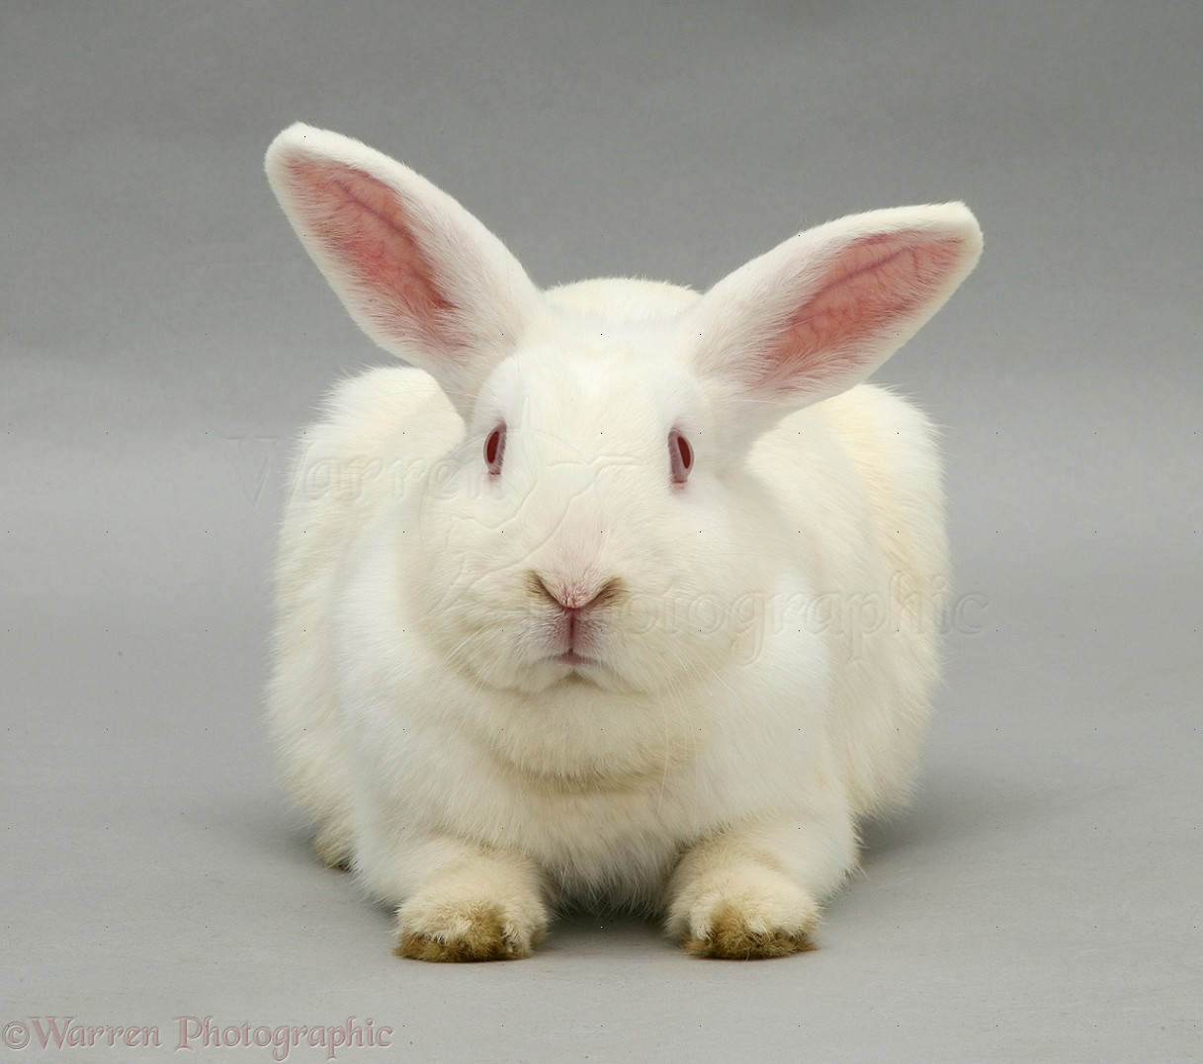

Slide 5
Expectations: Introduction
Manage expectations:
Goal: Become more mindful/thoughtful about the negative expectations we may have of ourselves, our children or may be unintentionally creating in our kids
Become intentional to create positive expectations.
Notes:
White Rabbit: I bet you didn’t EXPECT that to be the first thing out of my mouth….Not going to explain just yet….want to keep you on the edge of your seats or just in your seats….
Talk about the Negative Ones first, then the positive: The Don’ts first, then the Do’s.

Slide 6
Expectations: What do we mean?
Two ways to understand this word:
Anticipation: Expectant mother
Wrong thinking sometimes contains an element of demand
“There is a way that seems right, but in the end it leads to destruction.” Proverbs 14:12, 16:25
Notes:
Impossible to completely eliminate them: But to recognize them and evaluate them for their veracity-are these true or not?

Slide 7
Expectations: What do we mean?
Thoughts that are wrong: Not true or consistent with reality as God has revealed– Example: Kids are basically good
Wrong in the sense of an unrealistic expectation-
Wrong in the sense of unnatural to the child-

Slide 8
Expectations: How do we know?
Emotions: Disappointment, Anger, Sadness, anxious, excited
Speech: You should….
Thoughts
Behavior:
God’s word/Spirit/Others

Slide 9
Expectations: Where do they come from?
Recurrent Events:
Promises:
Family taught or caught
Culture
Notes:
Recurrent: Sunrise….
Promises: what someone says they will do..will expect
Family taught-expressed, clear, obvious.
Family caught-Less on the surface, may not be able to discern easily, may have to be uprooted or may come out later like when you are married to someone with different family expectations….
Culture: Enough to eat….Importance of being on time….American 2pm appt means you’ll be there…other cultures…means 2pm or as soon as I can get there

Slide 10
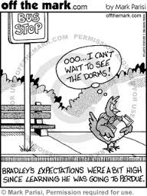
Wrong Expectations: What’s the harm?

Slide 11
Wrong Expectations: What’s the harm?
Can communicate incompetence-if too high an expectation
Restrict freedom where there is freedom

Slide 12
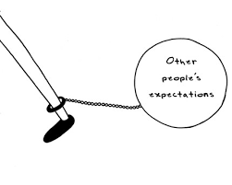

Slide 13
Wrong Expectations: What’s the harm?
Can communicate incompetence-if too high an expectation
Restrict freedom where there is freedom
Crush joy in relationship as fail to meet my demands
Could create in child attempt to please parent rather than God
Communicate disappointment instead of delight

Slide 14
Expectations in Parent/Child relationship
Wrong or Too High Expectations Parents Have of Themselves
Parents Have of Children
Expectations Parents may unintentionally be creating in children
Notes:
Could discuss expectations children have of themselves….Big topic…beyond the scope

Slide 15

Expectations Parents Have of Themselves
Wrong thinking: “If I parent my children well or correctly, they will….turn out all right”
  …..want to follow Jesus”
Notes:
These are all good desires for our children. Especially for Christian parents who have come to know Jesus Christ and enjoy a personal relationship with God. It can become the most important desire. Not something we can control. Understand that according to the Bible, all of us, each individual is born separated from God. God couldn’t stand the separation like any parent. He did what he could to heal the separation. He sent his own Son to die in our place, the punishment we deserve for rebelling against God, sinning. Provided a way through his Son and asks each of us to receive that gift, that provision. He offers us the choice of that relationship…He won’t force it-We and every individual has to choose. So does each one of our children. When we experience the joy and all the benefits of a relationship with God-can become our greatest desire for them…BUT WE CAN”T FORCE IT.

Slide 16
Expectations Parents have of themselves
If I parent well… give my child the right advantages or opportunities my child will be happy, or will succeed….in sports, music, art, academics…:
….taking too much control onto ourselves
Often getting my identity…taking from my child…
Notes:
Extreme example: IMG Academy: 30 buildings, 90,000 dollars high school tuition: 6 flags of famous people who made it big. SPORTS: Soccer- coach created the expectation if give them opportunity to play travel soccer then will get a college scholarship….

Slide 17
Expectations Parents have of themselves
I can parent perfectly or without mistakes….or create perfect children
Can’t teach or coach the sin completely out of our children
Prov. 22:6: Train a child in the way he should go and when he is old he will not turn from it….

Slide 18
Expectations Parents Have of Children
Unrealistic Developmental Expectations:
An area of study called child development (that is, the normal progression of physical, mental, emotional changes that occur as children grow) has confirmed that children develop in predictable ways at predictable times. Parents who do not understand normal child development often hurt their child unintentionally. This contributes to unnecessary and undeserved shame in the child. Hurt People Hurt People, p 50 Dr. Sandra D. Wilson
Notes:
Preschooler won’t spill milk, or will stop wriggling in chair,nnLaundry until can reach the machine, Megan tying shoe…..Impossible to satisfy expectations end up as hurtful messages for children who receive them…p 61

Slide 19
Expectations Parents have of children
My child will be interested in… …whatever I am interested in
My child will be successful in…sports, academics, music, art…
Discover and Celebrate God’s unique design…
Prov. 22:6: Train a child in the way he should go and when he is old he will not turn from it….Not a promise or guarantee but more a call for parents to educate and nurture the child’s uniqueness
Notes:
Gospel: born with a tendency to do wrong….ignore or rebel against God. God who made us, parent and couldn’t stand the separation between us-so he sent his Son, Jesus Christ to pay for our sin debt to bridge the separation between us and God. All we have to do is tell God yes we want that relationship with him, open ourself up to beginning a relationship with God our father. Every person needs to make that choice-Can’t choose for our kids…

Slide 20
Expectations Parents have of children
“The answer is for parent to love their children equally and not have the same expectations for all the children. One child may be good with technical things, while another may be good at academics. Each has his or her unique gifting, and parents need to look for those gifts and encourage them.”
Ch. 11: Fun, Traditions and Security for Children from The Family Life of a Christian Leader, 167,
                Ajith Fernando
Notes:
Gospel: born with a tendency to do wrong….ignore or rebel against God. God who made us, parent and couldn’t stand the separation between us-so he sent his Son, Jesus Christ to pay for our sin debt to bridge the separation between us and God. All we have to do is tell God yes we want that relationship with him, open ourself up to beginning a relationship with God our father. Every person needs to make that choice-Can’t choose for our kids…

Slide 21
Expectations Parents have of children
My child should want a relationship with me
My child should relate with me in the way I expect
My child will behave perfectly, never disobey, speak disrespectfully

Slide 22
Expectations Parents Have of Children
What about obedience?
Eph. 6:1 Children, obey your parents in the Lord for this is right
Eph. 6:2 Do not exasperate your children. Bring them up in the instruction and discipline of the Lord.
Teach them to obey or suffer a consequence. Young children are supposed to learn to obey their parents SO THAT they can learn to follow and obey God.

Slide 23
Expectations Parents Have of Children
Realistic expectation: If we don’t live according to the design of God-we will suffer-there will be negative consequences.

Slide 24
Expectations we may create in children
If you give your child a lot of stuff, or nice stuff, or every time they ask….may come to expect/demand stuff
If you always entertain your child, might look to you for entertainment
If you always bail your child out , will come to expect/demand it
Raising Grateful Kids in an Entitled World, Kristin Welch

Slide 25
Creating Good Expectations
Discipline: Consistent, logically….If you do …..this will be the consequence….thoughtful principles based on God’s ways
Clearly communicate expectations for obedience:
Older children can discuss the expectations, the principles behind them and the consequence

Slide 26
Creating Good Expectations
Discipline:
Takes work! To follow through and be consistent
Creating security for the child! Establishing a God-based principle
Notes:
So less personal disappointment of expectation;

Slide 27
Creating Good Expectations
PROMISES: As much as possible, keep your promises to your children-don’t make them too quickly
Creates an expectation of trustworthiness in relationship

Slide 28
Creating Good Expectations
Traditions:
Repeated events, activities….creates security
Creates a sense of identity in the child: I belong
Notes:
Security in the expected…..security encourages good risk taking….
Identity: Israelites: Maintained their identity as a people for thousands of years and despite being scattered…..God chose them but maybe also God used their rituals and festivals: To teach, Esther

Slide 29
Creating Good Expectations
Traditions: to teach and Fun
FUN: “When children and youth grow up enjoying clean and healthy fun at home, they will not be as vulnerable to the lure of sinful fun that will soon hit them with great force.” 153, Family Life of a Christian Leader
Israel
Notes:
Security in the expected…..security encourages good risk taking….
Identity: Israelites: Maintained their identity as a people for thousands of years and despite being scattered…..God chose them but maybe also God used their rituals and festivals: To teach, Esther

Slide 30
Creating Good Expectations
Israel: Private feasts: Wedding, Weaning of a Child, Visit of a Guest, Beginning of Harvest, Birthdays
Communal Feasts: Sabbath, New Moon Festivals, Three Annual feasts: Passover-God rescued them.
Joshua: create memorials to remember God’s faithfulness: create a rock garden write on ways God has provided, supernatural
p 137 Family Life..
Esther: Purim-Annual feast to Celebrate God’s rescue Esther 9:27

Slide 31
Some Ideas to create traditions
Daily: Dinner together, bedtime routines-bible story, daddy story, secret family handshake-wedding day
Weekly or Monthly: Family devotions-Family Nights Tool chest: 12 books,-Fun Turn off technology Tuesday, Monday-Rice and Beans,
Monthly: “White Rabbit”-1st day of the month, Rubber Band on the wrist-snap yourself every time complain, Family HUG-chased by parents

Slide 32
Ideas to create traditions
Seasonal/Annual:
Anniversary of Day turned to Christ-Celebrate-tell the story
Birthdays-Mordita? Bite the cake, Tell the story of their birth

Slide 33
Ideas to create traditions
Seasonal/Annual:
Holidays: upside down Christmas tree, ugliest Christmas tree-only kids decorate. Easter: hunt for baskets, scavenger hunt that starts at an empty tomb-book-Is Easter just for bunnies? Frozen Fever…followed a string to find their Easter baskets
FAT BOWL: with other families in our home groups
Outdoors: Mushroom hunting-in spring, Frog gigging, arrowhead hunting, gather buckeyes, paw paw hunting
Notes:
Sports

Slide 34
Ideas to create tradition
Seasonal/Annual:
Turn off technology week: No tv, nothing….hard but by the end of the week-end of April…playing together, thinking creatively…. “I’m bored” “I’ve got something for you to do”
Vacations, Camping for a weekend-read top 5 memories…Rent a Camp for a weekend

Slide 35
Conclusion
Read/Learn God’s Word-Discuss how it applies with others.
Be thoughtful, pray for awareness of negative expectations of self and children
What we repeatedly do and say will create expectations:
Watch for expectations we may be creating in our children
Be intentional with the good expectations

Slide 36
Ideas to create traditions
www.keeperofthehome.org http://theartofsimple.net/family-traditions-10-ideas-to-get-you-started/
http://www.artofmanliness.com/2013/10/16/60-family-tradition-ideas/
www.mommypotamus.com/family-tradition-ideas/
www.parents.com › ... › Traditions › 14 Fun Family Traditions to Start Today
http://teachmama.com/26-cool-new-family-traditions-start-new-year/

Slide 37
Questions?

Slide 38
Questions to discuss
What negative expectations do you realize you might have
  Of yourself?
  Of your kids?
  What expectations might you be unknowingly creating in children?
  What books or resources for discerning child development?
  What are some ideas for family traditions?

