Slide 1
Boundaries
When to Say Yes and How to Say No to Take Control of Your Life

Slide 2
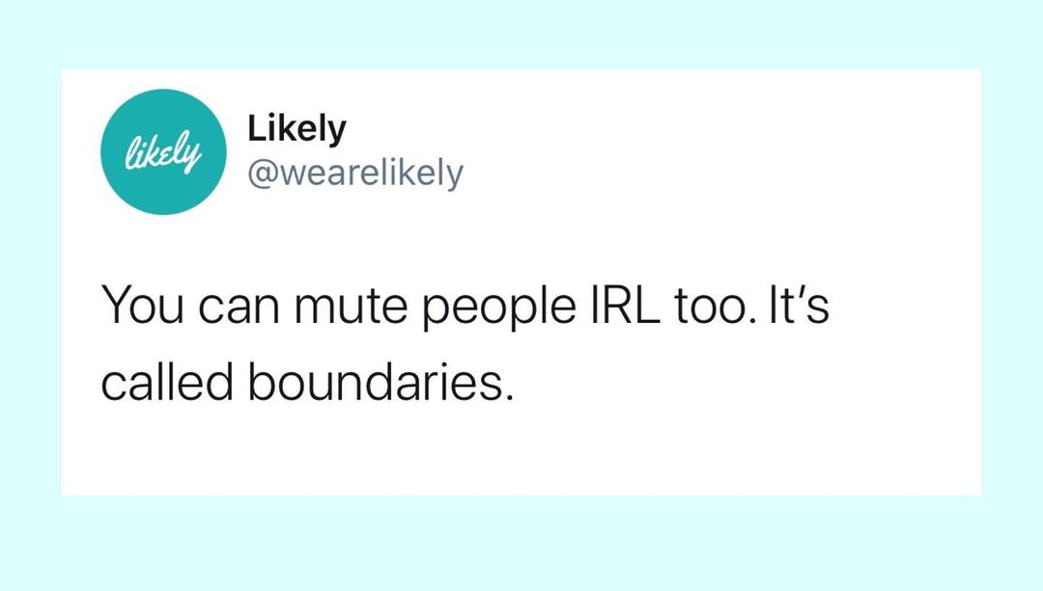

Slide 3
Premise
Being a human is confusing

Slide 4
Premise
Being a human is confusing
Relationships are confusing

Slide 5
Premise
Being a human is confusing
Relationships are confusing
who’s responsible for what?
how come I can’t control you?
how’s come I keep doing things that I don’t really want to do?

Slide 6
Premise
Being a human is confusing
Relationships are confusing
who’s responsible for what?
Boundaries
how come I can’t control you?
how’s come I keep doing things that I don’t really want to do?

Slide 7

Cloud, H., & Townsend, J. S. (2017). Boundaries. Zondervan.

Slide 8

What does a boundary look like?

Slide 9
What does a boundary look like?
“Knowing what I am to own and take responsibility for gives me freedom.” p31

Slide 10
Responsible to vs for

Slide 11
Responsible to vs for
² Carry each other’s burdens, and in this way you will fulfill the law of Christ… ⁵ for each one should carry their own load. Galatians 6:2,5

Slide 12


Responsible to vs for
² Carry each other’s burdens, and in this way you will fulfill the law of Christ… ⁵ for each one should carry their own load. Galatians 6:2,5

Slide 13
Responsible to vs for
² Carry each other’s burdens, and in this way you will fulfill the law of Christ… ⁵ for each one should carry their own load. Galatians 6:2,5
“Problems arise when people act as if their ‘boulders’ are daily loads and refuse to help, or as if their ‘daily loads’ are boulders they shouldn’t have to carry.” p33

Slide 14
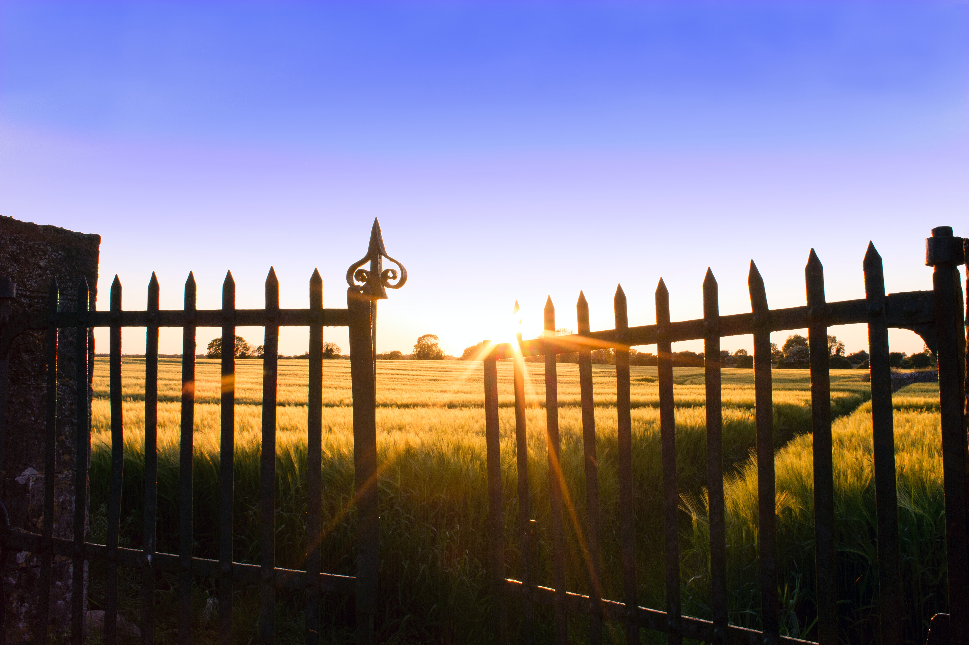
Let in the good and keep out the bad

Slide 15

Let in the good and keep out the bad

Slide 16
Basic forms of boundaries

Slide 17
Basic forms of boundaries
Skin

Slide 18
Basic forms of boundaries
Skin
Words

Slide 19
Basic forms of boundaries
Skin
Words
“The most basic boundary-setting word is no… Your words also define your property line for others as you communicate your feelings, intentions, or dislikes.” p36

Slide 20
Basic forms of boundaries
Skin
Words
Geographical distance

Slide 21
Basic forms of boundaries
Skin
Words
Geographical distance
Time

Slide 22
Basic forms of boundaries
Skin
Words
Geographical distance
Time
Emotional distance

Slide 23
Basic forms of boundaries
Skin
Words
Geographical distance
Time
Emotional distance
But Jesus would not entrust himself to them, for he knew all people. John 2:24

Slide 24
Basic forms of boundaries
Skin
Words
Geographical distance
Time
Emotional distance
Other people

Slide 25
Basic forms of boundaries
Skin
Words
Geographical distance
Time
Emotional distance
Other people
Consequences

Slide 26
Basic forms of boundaries
Skin
Words
Geographical distance
Time
Emotional distance
Other people
Consequences
“They let people know the seriousness of the trespass and the seriousness of our respect for ourselves. This teaches them that our commitment to living according to helpful values is something we hold dear and will fight to protect and guard.” p40

Slide 27
Basic forms of boundaries
Skin
Words
Geographical distance
Time
Emotional distance
Other people
Consequences

Slide 28
What are my responsibilities?

Slide 29
What are my responsibilities?
How could knowing what you are to own and take responsibility for give you freedom?

Slide 30
What are my responsibilities?
Feelings

Slide 31
What are my responsibilities?
Feelings
Attitudes and beliefs

Slide 32
What are my responsibilities?
Feelings
Attitudes and beliefs
“Attitudes have to do with your orientation toward something… Beliefs are anything that you accept as true.” p42

Slide 33
What are my responsibilities?
Feelings
Attitudes and beliefs
Behaviors

Slide 34
What are my responsibilities?
Feelings
Attitudes and beliefs
Behaviors
“Parenting with love and limits, with warmth and consequences, produces confident children who have a sense of control over their lives.” p43

Slide 35
What are my responsibilities?
Feelings
Attitudes and beliefs
Behaviors
Choices

Slide 36
What are my responsibilities?
Feelings
Attitudes and beliefs
Behaviors
Choices
“We need to realize that we are in control of our choices, no matter how we feel.” p43-44

Slide 37
What are my responsibilities?
Feelings
Attitudes and beliefs
Behaviors
Choices
“We need to realize that we are in control of our choices, no matter how we feel.” p43-44
But if serving the Lord seems undesirable to you, then choose for yourselves this day whom you will serve. Joshua 24:15

Slide 38
What are my responsibilities?
Feelings
Attitudes and beliefs
Behaviors
Choices
Values

Slide 39
What are my responsibilities?
Feelings
Attitudes and beliefs
Behaviors
Choices
Values
Limits

Slide 40
What are my responsibilities?
Feelings
Attitudes and beliefs
Behaviors
Choices
Values
Limits
“This is the component that we most often hear about when we talk about boundaries. In reality, setting limits on others is a misnomer. We can’t do that. What we can do is set limits on our own exposure to people who are behaving poorly; we can’t change them or make them behave right…

Slide 41
What are my responsibilities?
Feelings
Attitudes and beliefs
Behaviors
Choices
Values
Limits
… [We also need to set internal limits] - We need to have spaces inside ourselves where we can have a feeling, an impulse, or a desire without acting it out… We need to be able to say no to ourselves.” p45

Slide 42
What are my responsibilities?
Feelings
Attitudes and beliefs
Behaviors
Choices
Values
Limits
Resources and gifts

Slide 43
What are my responsibilities?
Feelings
Attitudes and beliefs
Behaviors
Choices
Values
Limits
Resources and gifts
Thoughts

Slide 44
What are my responsibilities?
Feelings
Attitudes and beliefs
Behaviors
Choices
Values
Limits
Resources and gifts
Thoughts
Desires

Slide 45
What are my responsibilities?
Feelings
Attitudes and beliefs
Behaviors
Choices
Values
Limits
Resources and gifts
Thoughts
Desires
“We often do not actively seek our desires from God, and those desires are mixed up with things that we do not really need.” p48

Slide 46
What are my responsibilities?
Feelings
Attitudes and beliefs
Behaviors
Choices
Values
Limits
Resources and gifts
Thoughts
Desires
Love

Slide 47
What are my responsibilities?
Feelings
Attitudes and beliefs
Behaviors
Choices
Values
Limits
Resources and gifts
Thoughts
Desires
Love
What’s the difference between influence and control?

Slide 48
Reality Check

Slide 49
Reality Check
Cause and effect

Slide 50
Reality Check
Cause and effect
…for whatever a person sows, this he will also reap. Galatians 6:7

Slide 51
Reality Check
Cause and effect
“... people can interfere with the law of Cause and Effect by stepping in and rescuing irresponsible people. Rescuing a person from natural consequences of his behavior enables him to continue in irresponsible behavior.” p. 87

Slide 52
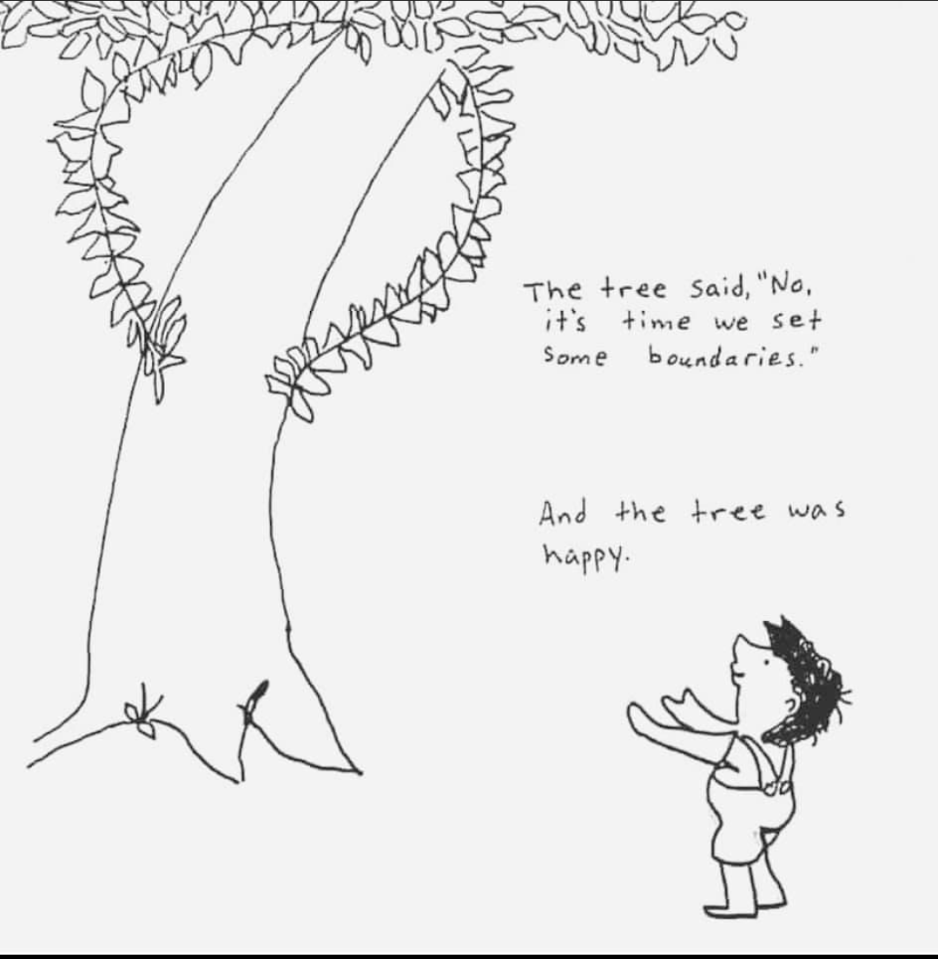
Reality Check
Cause and effect
“... people can interfere with the law of Cause and Effect by stepping in and rescuing irresponsible people. Rescuing a person from natural consequences of his behavior enables him to continue in irresponsible behavior.” p. 87

Slide 53
Reality Check
Cause and effect
“... people can interfere with the law of Cause and Effect by stepping in and rescuing irresponsible people. Rescuing a person from natural consequences of his behavior enables him to continue in irresponsible behavior.” p. 87
CODEPENDENT

Slide 54
Reality Check
Cause and effect
Responsibility

Slide 55
Reality Check
Cause and effect
Responsibility
Rather, use your freedom to serve one another in love; that’s how freedom grows. For everything we know about God’s Word is summed up in a single sentence: Love others as you love yourself. That’s an act of true freedom. Galatians 5:13-14

Slide 56
Reality Check
Cause and effect
Responsibility
  Sometimes giving, sometimes setting limits
Rather, use your freedom to serve one another in love; that’s how freedom grows. For everything we know about God’s Word is summed up in a single sentence: Love others as you love yourself. That’s an act of true freedom. Galatians 5:13-14

Slide 57
Reality Check
Cause and effect
Responsibility
Power

Slide 58
Reality Check
Cause and effect
Responsibility
Power
God, grant me the serenity to accept the things I cannot change, courage to change the things I can, and wisdom to know the difference. Serenity Prayer

Slide 59
Reality Check
Cause and effect
Responsibility
Power
Respect

Slide 60
Reality Check
Cause and effect
Responsibility
Power
Respect
  The Golden Rule

Slide 61
Reality Check
Cause and effect
Responsibility
Power
Respect
  The Golden Rule
“Our real concern with others should not be, ‘Are they doing what I would do or what I want them to do?’ but “Are they really making a free choice?’ When we accept others’ freedom, we don’t get angry, feel guilty, or withdraw our love when they set boundaries with us.” p.92

Slide 62
Reality Check
Cause and effect
Responsibility
Power
Respect
Motivation

Slide 63
Reality Check
Cause and effect
Responsibility
Power
Respect
Motivation
Each of you should give what you have decided in your heart to give, not reluctantly or under compulsion, for God loves a cheerful giver. 2 Corinthians 9:7

Slide 64
Reality Check
Cause and effect
Responsibility
Power
Respect
Motivation
Evaluation

Slide 65
Reality Check
Cause and effect
Responsibility
Power
Respect
Motivation
Evaluation
“Do the right thing – not necessarily the thing that feels right.”

Slide 66
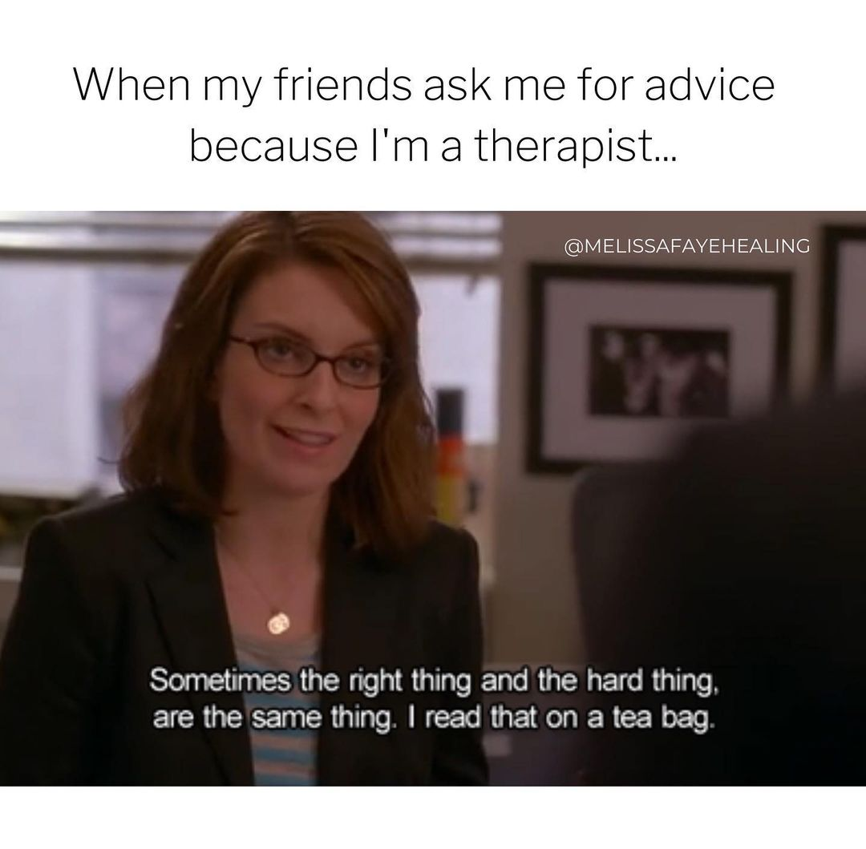
Reality Check
Cause and effect
Responsibility
Power
Respect
Motivation
Evaluation
“Do the right thing – not necessarily the thing that feels right.”

Slide 67
Reality Check
Cause and effect
Responsibility
Power
Respect
Motivation
Evaluation
Proactivity

Slide 68
Reality Check
Cause and effect
Responsibility
Power
Respect
Motivation
Evaluation
Proactivity
Envy

Slide 69
Reality Check
Cause and effect
Responsibility
Power
Respect
Motivation
Evaluation
Proactivity
Envy
Activity

Slide 70
Reality Check
Cause and effect
Responsibility
Power
Respect
Motivation
Evaluation
Proactivity
Envy
Activity
“[what] God rebukes is not trying and failing, but failing to try.” p 101

Slide 71
Reality Check
Cause and effect
Responsibility
Power
Respect
Motivation
Evaluation
Proactivity
Envy
Activity
Exposure

Slide 72
Reality Check
Cause and effect
Responsibility
Power
Respect
Motivation
Evaluation
Proactivity
Envy
Activity
Exposure
Why is it hard to accept these concepts? Where do we get into trouble here?

Slide 73
Boundary Problems

Slide 74
Boundary Problems
Compliants – saying yes to the bad

Slide 75

Boundary Problems
Compliants
No
I disagree
I will not
I choose not to
Stop that
It hurts
It’s wrong
That’s bad
I don’t like it when you touch me there

Slide 76
Boundary Problems
Fear of hurting the other person’s feelings
Fear of abandonment and separateness
A wish to be totally dependent on another
Fear of someone else’s anger
Fear of punishment
Fear of being shamed
Fear of being seen as bad or selfish
Fear of being unspiritual
Fear of one’s overstrict, critical conscience
Compliants

Slide 77
Boundary Problems
Compliants
“Matthew 9:13 says that God desires ‘compassion, and not sacrifice.’ In other words, God wants us to be compliant from the inside out (compassionate), not compliant on the outside and resentful on the inside (sacrificial). Complaints take on too many responsibilities and set too few boundaries, not by choice, but because they are afraid.” p. 53,54

Slide 78
Boundary Problems
Compliants – saying yes to the bad
Avoidants – saying no to the good

Slide 79
Boundary Problems
Compliants
Avoidants
“Their boundaries become walls and no one touches them… The avoidant person often experiences their problems and legitimate wants as something bad, destructive, or shameful.”p54,55

Slide 80
Boundary Problems
Compliants – saying yes to the bad
Avoidants – saying no to the good
Controllers – not respecting others

Slide 81
Boundary Problems
Compliants – saying yes to the bad
Avoidants – saying no to the good
Controllers – not respecting others
Non-responsives – not hearing needs

Slide 82
Boundary Problems
Compliants
Avoidants
Controllers
Non-responsives
Do not withhold good from those to whom it is due, when it is your power to act. Proverbs 3:27

Slide 83

Boundaries Toolbox

Slide 84
Boundaries Toolbox
Do I tend toward compliance, avoidance, control, or nonresponsiveness?
Am I operating out of fear or freedom?
What move do I need to make to let in the good and keep out the bad?
What’s it going to cost me?
How do I feel? What do I want? What do I dislike?
Who needs to take responsibility?
To whom do I need to communicate my boundary?

Slide 85
Boundaries Toolbox
Do I tend toward compliance, avoidance, control, or nonresponsiveness?
Am I operating out of fear or freedom?
What move do I need to make to let in the good and keep out the bad?
What’s it going to cost me?
How do I feel? What do I want? What do I dislike?
Who needs to take responsibility?
To whom do I need to communicate my boundary?
When boundaries aren’t respected
Look at yourself
Ask them
Grab a 3rd party

Slide 86
Questions? Comments?

