Slide 1
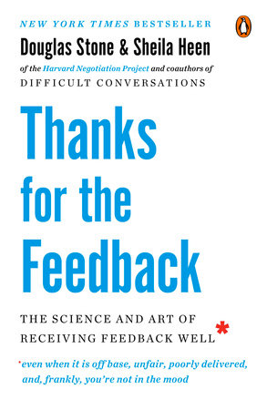
Thanks for the Feedback:
The Science and Art of Receiving Feedback Well…
even when it is off base, unfair, poorly delivered and, frankly, you’re not in the mood
By Douglas Stone & Sheila Heen

Slide 2
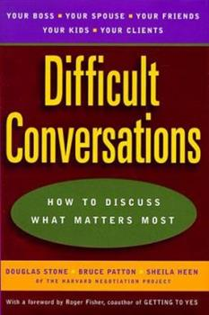
Introduction
2 Reasons:
I read Difficult Conversations- benefited
I struggle with receiving feedback- improve

Slide 3
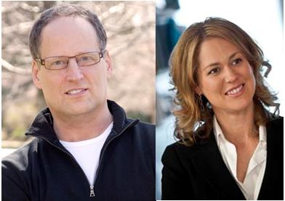
Douglas Stone & Sheila Heen
Lecturers on Law at Harvard Law School and cofounders of Triad Consulting. Their clients include the White House, Citigroup, Honda, Johnson & Johnson, Time Warner to name a few.

Slide 4
Introduction
Why the authors wrote this book:
When we give feedback, we notice that the receiver isn’t good at receiving it.
When we receive feedback, we notice that the giver isn’t good at giving it.

Slide 5
Introduction
They wondered: What is it that makes feedback such a conundrum for both givers and receivers?
As they worked to develop ways to approach feedback differently, they soon realized that the key player is not the giver, but the receiver.
And they came to see how this could transform not just how people handle performance reviews on the job, but how people learn, lead, and behave in their professional roles and personal lives (3).

Slide 6
The Authors’ Purpose
…our primary purpose is to take an honest look at why receiving feedback is hard and to provide a framework and some tools that can help you metabolize challenging, even crazy-making information and use it to fuel insight and growth (2).

Slide 7
My Burden
As Leaders, we need to learn how to receive feedback well in order to give feedback well.

Slide 8
Luke 6:41-42
Why do you look at the speck of sawdust in your brother’s eye, when you pay no attention to the plank in your own eye? How can you say to your brother, ‘Brother, let me take the speck out of your eye, when you yourself fail to see the plank in your own eye? You hypocrite, first take the plank out of your eye, and then you will see clearly to remove the speck from your brother’s eye.
What would my HC be like if everyone took feedback the way I do?

Slide 9

God made sure I had a fresh example
Joe gave me feedback about how I related with some family members
My initial reaction?
defensiveness!

Slide 10
My Burden
Start with understanding our own reactions to feedback
DQ: Why is feedback so difficult to receive?
DQ: What are some reactions to feedback?

Slide 11
Why we struggle with feedback:
We are naturally wired to learn. The drive to learn is evident from infancy and rampant by toddlerhood. Research on happiness identifies ongoing learning and growth as a core ingredient of satisfaction in life.

Slide 12
Why we struggle with feedback:
In addition to our desire to learn and improve, we long for something else that is fundamental:
to be loved, accepted, and respected just as we are.

Slide 13
Why we struggle with feedback:
And the very fact of feedback suggests that how we are is not quite okay. So we bristle: Why can’t you accept me for who I am and how I am? Why are there always more adjustments, more upgrades? Why is it so hard for you to understand me?

Slide 14
Why we struggle with feedback:
Receiving feedback sits at the intersection of these two needs—our drive to learn and our longing for acceptance (8).

Slide 15
Both needs are Biblical
Acceptance - Romans 15:7 Accept one another, then, just as Christ accepted you, in order to bring praise to God.
Yet we need transformed –
Romans 12:2 Do not conform any longer to the pattern of this world, but be transformed by the renewing of your mind.

Slide 16
Biblical View of Feedback
Proverbs
16 times- “reproof” or “reprove”
5 times- “rebuke”
6 times as “correct” or “correction”
Proverbs 15:22 Plans fail for lack of counsel, but with many advisers they succeed.

Slide 17
Biblical View of Feedback?
Proverbs
16 times- “reproof” or “reprove”
5 times- “rebuke”
6 times as “correct” or “correction”
Proverbs 12:15 The way of a fool seems right to him, but a wise man listens to advice.
And so many others- 1:7; 11:14; 19:20; 19:21; 28:26

Slide 18
God encourages us to be learners
Matthew 11:29
Take my yoke upon you and learn from me, for I am gentle and humble in heart, and you will find rest for your souls.
2 Peter 3:18; 1 Peter 2:2; Ephesians 4:15-16

Slide 19

God often uses others
By Watchman Nee

Slide 20
Why is it that after many years of dealing some remain the same? We believe there are two main reasons.
First, many who live in darkness are not seeing the hand of God. While God is working, while God is breaking, they do not recognize it as being from Him.

Slide 21
They are devoid of light, seeing only men opposing them. They imagine their environment is just too difficult, that circumstances are to blame. So they continue in darkness and despair.

Slide 22
They are devoid of light, seeing only men opposing them. They imagine their environment is just too difficult, that circumstances are to blame. So they continue in darkness and despair.
May God give us revelation to see what is from His hand, that we may kneel down and say to Him, “It is You; since it is You, I will accept.” (p13)

Slide 23
Understand our Reactions to Feedback
Authors call our reactions = triggers
They can be obstacles to us receiving feedback because they keep us from engaging skillfully in the conversation.
But they aren’t only obstacles; they also are information.

Slide 24
Three Feedback Triggers
Understanding our triggers and sorting out what set them off are the keys to managing our reactions and engaging in feedback conversations with skill (4).

Slide 25
Three Feedback Triggers
3 Conversations
What Happened?
Feelings?
Identity?
Truth Triggers
Relationship Triggers
Identity Triggers

Slide 26
Truth Triggers
Truth triggers are created by our cognitive and emotional reaction to feedback when it seems wrong or off target.

Slide 27
Truth Triggers
Truth triggers are created by our cognitive and emotional reaction to feedback when it seems wrong or off target.
it’s somehow off, unhelpful, or simply untrue.

Slide 28
Truth Triggers
Truth triggers are created by our cognitive and emotional reaction to feedback when it seems wrong or off target.
it’s somehow off, unhelpful, or simply untrue.
In response we feel indignant, wronged, and exasperated.
Example: My Mother-in-law

Slide 29
What helps?
Identify the kind of Feedback
3 Kinds:
Appreciation- thanks
Coaching- Here’s a better way to do it
Evaluation- Here is where you stand

Slide 30
How does that help?
Maybe the receiver wants or hears one kind of feedback, while the giver actually means another
First identify the purpose of the feedback then discuss it

Slide 31
Example
Someone asks you for input about their HC teaching
It might be good to clarify what kind of feedback they want
What if they really want encouragement and you give them an evaluation.

Slide 32
What also helps Truth Triggers?
Shift from “What’s wrong”
to “Tell me more”
We often will listen to feedback with the question in mind:
“What is wrong with this feedback?”
“Wrong Spotting”
Pharisees

Slide 33
What also helps Truth Triggers?
Instead of wrong spotting– seek to understand what the giver means.
Don’t look to agree or disagree, defend or accept.
The goal is to understand.

Slide 34
Ask Questions:
What do you see?
What are you worried about?
What do you recommend?

Slide 35
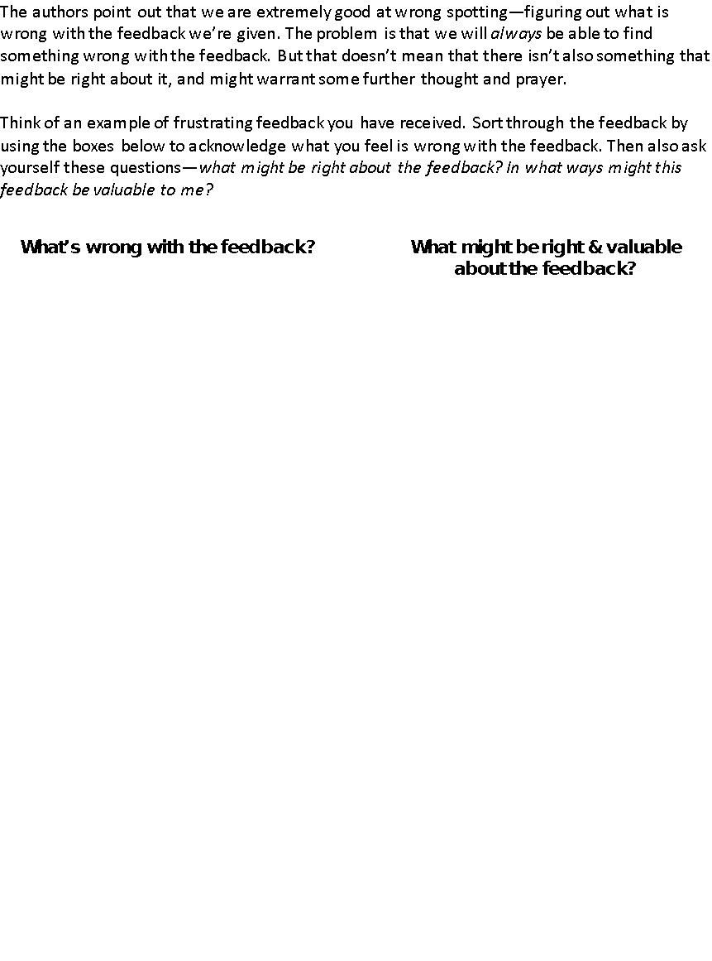
Wrong Spotting Worksheet

Slide 36
Another helpful Tip with Truth Triggers:
Discover how you come across
Everyone has blind spots because:
We can’t see our face
We can’t hear our tone of voice
We are often unaware of our patterns of behavior or impact

Slide 37
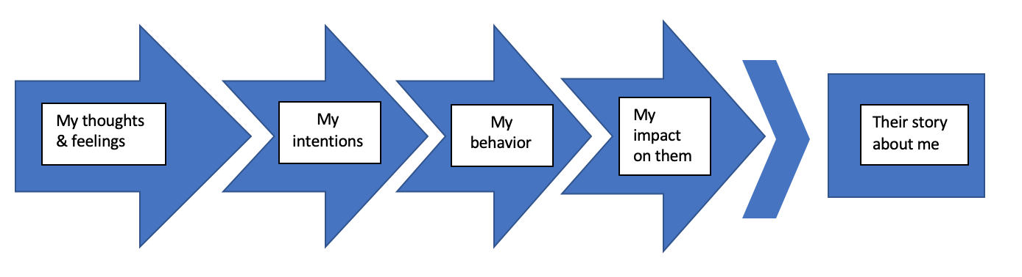
Gap Map
(between the way I mean to be seen and the way that I am actually seen)
Their feedback to me

Slide 38
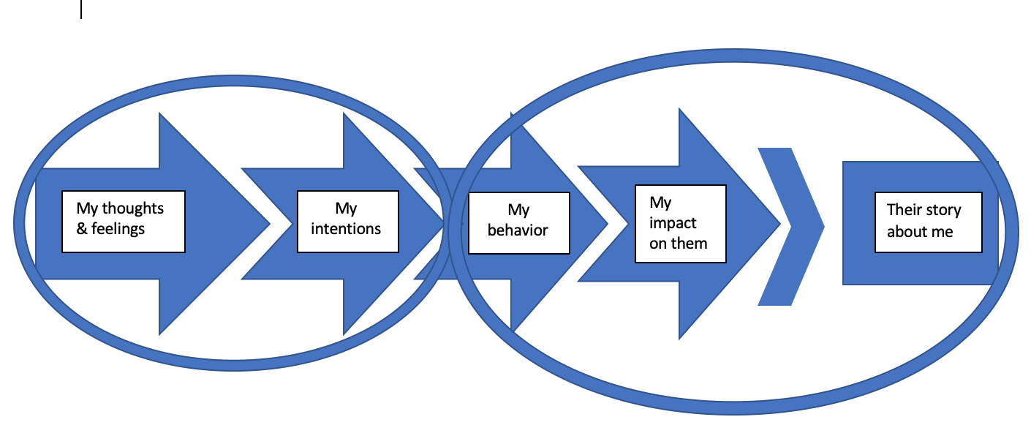
Blind Spots
What I am aware of
What you are aware of
Notes:
If we circle on the map the things I am aware of and the things you are aware of, it turns out that my behavior is in your awareness and mostly not in my awareness.
For example- Who can see your face? Everyone. Who can’t see your face? You.

Slide 39

Example
My Teacher Voice

Slide 40
Questions to ask:
Yourself: I wonder if this feedback is sitting in my blind spot?
The giver: “What do you see me doing, or failing to do, that is getting in my own way?”

Slide 41
Three Feedback Triggers
Truth Triggers
Relationship Triggers

Slide 42
Relationship Triggers
Set off by the particular person who is giving the feedback. All feedback is colored by the relationship between the giver and receiver, and we can have reactions based on what we believe about the giver.

Slide 43
Relationship Triggers
The focus shifts from the feedback itself to the person delivering it.

Slide 44
Relationship Triggers
The focus shifts from the feedback itself to the person delivering it. We disqualify the feedback because how, when, where, and why it arrives– says something damning about the one who gave it.

Slide 45

Relationship Triggers
Therefore I don’t have to listen
2 Relationship Triggers
What we think about them
Do we trust them?
Do they have credibility?
Do they lack discernment?

Slide 46
Relationship Triggers
Therefore I don’t have to listen
2 Relationship Triggers
What we think about them
How we feel treated by them
Do they give me space or control me?
Do they appreciate me?
Do they respect and accept me?

Slide 47
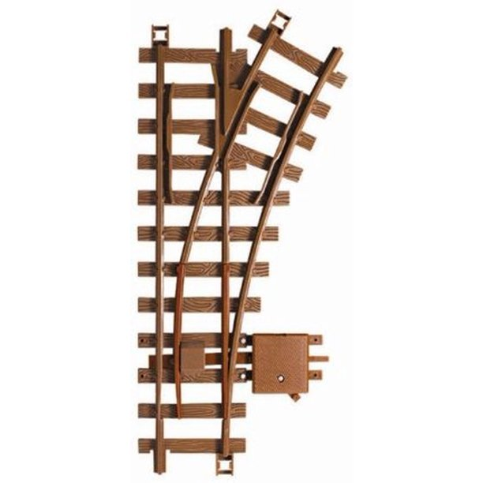
What Helps?
Separate the what from the who
Relationship Triggers often create 2 conversations in one
“switchtrack”

Slide 48
Example
Daughter: Mom, you never let me go out. You treat me like a child. Don’t you trust me?
Mom: You should be grateful you have a mother who cares.

Slide 49

Problem arises when…
We don’t realize there are 2 conversations
Spot the 2 topics

Slide 50
What are the 2 topics?
Daughter: Mom, you never let me go out. You treat me like a child. Don’t you trust me?
Mom: You should be grateful you have a mother who cares.
How could the mom respond differently?

Slide 51
Silent Switchtracking
Second track is in our head not out in the open
Wow! You’re telling me to calm down? You’re the most tightly wound person I’ve ever met in my life. And I guess I now have to add self-unaware!

Slide 52
Lucky Louie “Switchtrack” handout
What are the 2 conversations?

Slide 53
Listen for the relational issues lurking beneath their advice
Some givers say they are giving friendly advice to help a person improve, when really they are raising a deeper relationship issue between them.

Slide 54
Examples:
“You might want to be more responsive.”
might mean: I’m frustrated that you don’t return my calls.

Slide 55
Examples:
“I think you’d be happier if you didn’t think about work night and day.”
might mean: You’re so preoccupied with work that it’s lonely for me.

Slide 56
Ask Yourself:
Is this about helping me grow and improve?
Is this the giver’s way of raising an important relationship issue that has been upsetting them?

Slide 57
Three Feedback Triggers
Truth Triggers
Relationship Triggers
Identity Triggers

Slide 58
Identity Triggers
The focus is neither on feedback nor on the person offering it.
Identity triggers are all about us.
Identity is the story we tell ourselves about ourselves

Slide 59
Identity Triggers
The feedback has caused our identity—our sense of who we are—to come undone.
We feel overwhelmed, threatened, ashamed, or off balance.
We are suddenly unsure what to think about ourselves, and question what we stand for

Slide 60
Example- Joe’s feedback
Joe- When you were “serving” today it seemed like it is more for you than the person you were serving.
I thought of myself as someone who loves to serve my family
I felt thrown off; and shook up

Slide 61
Understand Your Wiring & Temperament
What Helps?
It will help you understand your emotional reactions when receiving feedback.
Do you tend to be happy or sad?
Do your emotions swing wide or barely budge?
How long does it take for you to return to your well-being?

Slide 62
Understand Your Wiring & Temperament
 | Long Sustain of Positive | Short Sustain of Positive
Quick Recovery from Negative | “I Love Feedback” | “No big deal either way”
Slow Recovery from Negative | “I’m Hopeful but Fearful” | “I hate feedback”

Slide 63
What also helps?
Separate the strands:
  What do I feel?
  What’s the story I’m telling (and inside that story, what’s the threat)?
  What’s the actual feedback?

Slide 64
What also helps?
Separate the strands:
  I felt ashamed

Slide 65
What also helps?
Separate the strands:
  I felt ashamed
  threat? I don’t love or serve my family

Slide 66
What also helps?
Separate the strands:
  I felt ashamed
  threat? I don’t love or serve my family
  What’s the actual feedback?- my serving today seemed more for myself than the other person

Slide 67
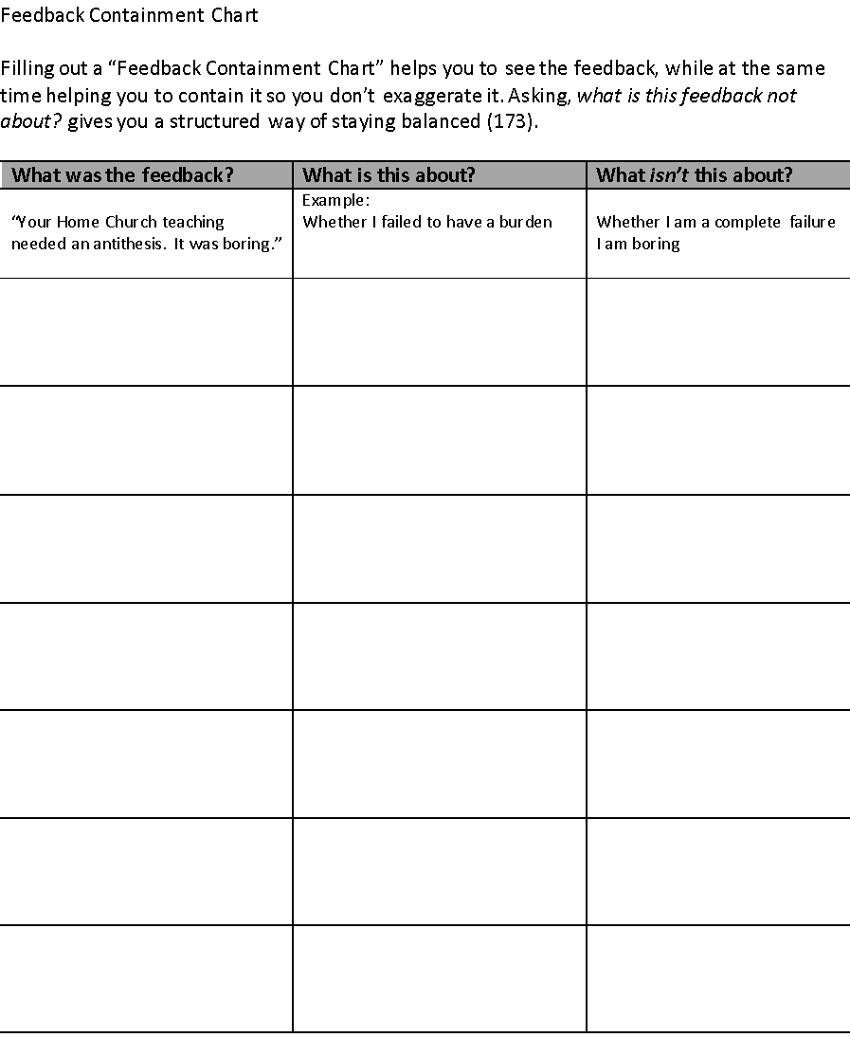
Contain the Story

Slide 68
Cultivate a Growth Identity
Shift from a fixed mindset
to a growth mindset
Are you more inclined to live your life in a Testing Room?
or a Learning Room?

Slide 69
Shift from a fixed to a growth mindset
Identity Questions | Fixed | Growth

Slide 70
Shift from a fixed to a growth mindset
Identity Questions | Fixed | Growth
Who am I? | I’m fixed. I am who I am. | I change, learn, grow

Slide 71
Shift from a fixed to a growth mindset
Identity Questions | Fixed | Growth
Who am I? | I’m fixed. I am who I am. | I change, learn, grow
What’s the goal? | Success. The outcome is what matters. | The process of learning is what’s rewarding. Success is a by-product

Slide 72
Shift from a fixed to a growth mindset
Identity Questions | Fixed | Growth
Who am I? | I’m fixed. I am who I am. | I change, learn, grow
What’s the goal? | Success. The outcome is what matters. | The process of learning is what’s rewarding. Success is a by-product
Response to challenge | Threat! I may be exposed. | Opportunity! I can learn something and improve

Slide 73
Shift from a fixed to a growth mindset
Identity Questions | Fixed | Growth
Who am I? | I’m fixed. I am who I am. | I change, learn, grow
What’s the goal? | Success. The outcome is what matters. | The process of learning is what’s rewarding. Success is a by-product
Response to challenge | Threat! I may be exposed. | Opportunity! I can learn something and improve
Most comfortable environment | Safely within my abilities and comfort zone | Just outside my abilities to stretch my capabilities

Slide 74
Practice- “Know” “Consider” “Present”
Know: Philippians 1:6 For I am confident in this very thing, that He who began a good work in you will perfect it until the day of Christ Jesus.
Consider: God’s work in your life
Present: Yourself to God for Him to grow you
Notes:
Practicing Know Consider Present will help us have a growth mentality

Slide 75
My Personal Example
Talk it over with God
Psalm 139- He knows us better than anyone on this earth
Even better than ourselves!

Slide 76
Conclusion:
To receive feedback well…
Security!
Humility!

Slide 77

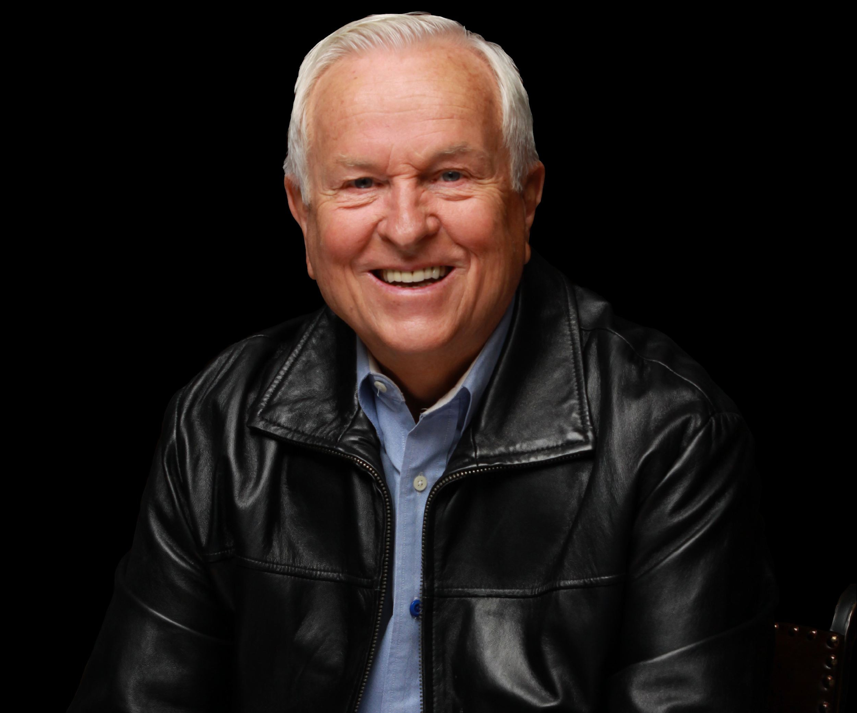
People secure in their identity in Christ receive feedback well!
Josh McDowell

Slide 78
Humility
1 Peter 5:5b-6
All of you, clothe yourselves with humility toward one another, because “God opposes the proud but gives grace to the humble.” ⁶ Humble yourselves, therefore, under God’s mighty hand, that he may lift you up in due time.

Slide 79
Humility, by Andrew Murray
Pride can degrade the highest angels into devils,

Slide 80
Humility, by Andrew Murray
Pride can degrade the highest angels into devils;
humility can raise fallen flesh and blood to the thrones of angels.

Slide 81
Remember!!
By Watchman Nee

Slide 82
No one is equipped to work simply because he has learned some teachings. The basic question is still: What kind of man is he? Can one who inner workings are wrong, but whose teaching is right, supply the need of the church?

Slide 83
No one is equipped to work simply because he has learned some teachings. The basic question is still: What kind of man is he? Can one who inner workings are wrong, but whose teaching is right, supply the need of the church?
The basic lesson we must learn is to be transformed into a vessel fit for the Master’s use. This can only be done by the breaking of the outward man.

Slide 84
God is at work in our lives unceasingly. Many years of sufferings, trial, hindrances– this is the hand of God, daily seeking to carry on His work of breaking us.

Slide 85
God is at work in our lives unceasingly. Many years of sufferings, trial, hindrances– this is the hand of God, daily seeking to carry on His work of breaking us.
Do you see what God is doing in this endless round of difficulties? If not, you should ask Him, “O God, open my eyes that I may see Thy hand.”

Slide 86
All that comes to us is ordered by God. To a Christian, nothing is accidental. We should ask God to open our eyes that we may see that He is striking us in all things and in all areas of our life.

Slide 87
All that comes to us is ordered by God. To a Christian, nothing is accidental. We should ask God to open our eyes that we may see that He is striking us in all things and in all areas of our life. One day, when by His grace upon us we are able to accept the ordering of God in our environment, our spirit will be released and ready to function (35-36).

Slide 88
My Burden
As Leaders, we need to learn how to receive feedback well in order to give feedback well.
Let’s model this for our people!

Slide 89

Resources & Book Overview

Slide 90
Thanks for Coming!!!

