Slide 1
Healing in The Body of Christ

Slide 2
FYI: this powerpoint and the resource list will be posted online.

Slide 3
Counseling ‘versus’ the Body of Christ
I have been seeing clients as a pastoral counselor for several years
I have sent both clients and disciples in for clinical counseling
I have seen medication play an important role in people’s healing

Slide 4
Value
Counseling
Body of Christ

Slide 5
Value
Counseling
Body of Christ

Slide 6
Value
Counseling
Body of Christ

Slide 7
Value
Counseling
Body of Christ

Slide 8
Benefits to Professional Counseling
Licensed counselors have a high level of training (ever hear of EMDR?)
Some issues require professional help
It can be helpful at times to outsource some of our people’s healing needs
Notes:
Eye Movement Desensitization and Reprocessing
Joke about trying to do it myself?

Slide 9
Limitations to Professional Counseling
High cost
Low availability
Less relational connection than we have with each other
A counselor works with the client’s self-report; we see them in real life

Slide 10
Counseling ‘versus’ the Body of Christ
Surgery vs. healthy living
  So these are not pitted against each other
Professional counseling was not available in NT times but people still experienced substantial healing
Whether our people get clinical help or not, we always play a key role

Slide 11
Biblical Case for the Body Of Christ
Romans 15:14 – And concerning you, my brethren, I myself am convinced that you yourselves are full of goodness, filled with all knowledge and able also to admonish [instruct] one another.

Slide 12
Biblical Case for the Body Of Christ
Gal 6:1 – Brethren, even if anyone is caught in any trespass, you who are spiritual, restore such a one in a spirit of gentleness…

Slide 13
Biblical Case for the Body Of Christ
Eph 4:15 – but speaking the truth in love, we are to grow up in all aspects into Him who is the head, even Christ…

Slide 14
Biblical Case for the Body Of Christ
James 5:16 – Therefore confess your sins to one another, and pray for one another, so that you may be healed.

Slide 15
Current Challenges
“Concept Creep”

Slide 16

Lukianoff and Haidt
Lawyer and Social Psychologist (respectively)
Lukianoff and Haidt, The Coddling of the American Mind (Penguin Press: NY, 2018), p. 25-26
[Australian Psychologist Nick Haslam wrote a 2016 article titled “Concept Creep: Psychology’s Expanding Concepts of Harm and Pathology.”].

Slide 17
Lukianoff and Haidt
Lawyer and Social Psychologist (respectively)
Lukianoff and Haidt, The Coddling of the American Mind (Penguin Press: NY, 2018), p. 25-26
Haslam examined a variety of key concepts in clinical and social psychology – including abuse, bullying, trauma, and prejudice – to determine how their usage has changed since the 1980s.

Slide 18
Lukianoff and Haidt
Lawyer and Social Psychologist (respectively)
Lukianoff and Haidt, The Coddling of the American Mind (Penguin Press: NY, 2018), p. 25-26
He found that their scope has expanded in two directions: the concepts have crept “downward,” to apply to less severe situations, and “outward,” to encompass new but conceptually related phenomena.

Slide 19
Lukianoff and Haidt
Lawyer and Social Psychologist (respectively)
Lukianoff and Haidt, The Coddling of the American Mind (Penguin Press: NY, 2018), p. 25-26
[Ex: “Trauma” – PTSD used to be diagnosed based on an objective criteria]:
war, rape, and torture were included in this category.

Slide 20
Lukianoff and Haidt
Lawyer and Social Psychologist (respectively)
Lukianoff and Haidt, The Coddling of the American Mind (Penguin Press: NY, 2018), p. 25-26
Divorce and simple bereavement (as in the death of a spouse due to natural causes), on the other hand, were not, because they are normal parts of life, even if unexpected.

Slide 21
Lukianoff and Haidt
Lawyer and Social Psychologist (respectively)
Lukianoff and Haidt, The Coddling of the American Mind (Penguin Press: NY, 2018), p. 25-26
These experiences were sad and painful, but pain is not the same as trauma.
People in these situations that don’t fall into the “trauma” category might benefit from counseling, but they generally recover from such losses without therapeutic intervention.

Slide 22
Lukianoff and Haidt
Lawyer and Social Psychologist (respectively)
Lukianoff and Haidt, The Coddling of the American Mind (Penguin Press: NY, 2018), p. 25-26
In fact, even most people who do have traumatic experiences recover completely without intervention.

Slide 23
Lukianoff and Haidt
Lawyer and Social Psychologist (respectively)
Lukianoff and Haidt, The Coddling of the American Mind (Penguin Press: NY, 2018), p. 25-26
By the early 2000s, however, the concept of ‘trauma’ within parts of the therapeutic community had crept so far down that it included anything ‘experienced by an individual as physically or emotionally harmful…’

Slide 24
Lukianoff and Haidt
Lawyer and Social Psychologist (respectively)
Lukianoff and Haidt, The Coddling of the American Mind (Penguin Press: NY, 2018), p. 25-26
The subjective experience of ‘harm’ became definitional in assessing trauma.

Slide 25
Current Challenges
“Concept Creep”
  “I have depression,” “I have social anxiety,” “I have PTSD” – we can ask what they mean by that
  Our people are experiencing true pain, but they sometimes use words that appropriate more damage than necessary
    Not that we’re the language police
Notes:
Meagan Wolfe

Slide 26
Current Challenges
“Concept Creep”
Precipitous rise in mental health issues

Slide 27
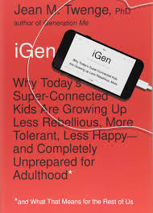
Jean Twenge
Professor of Psychology
Twenge, iGen (Simon & Schuster: NY, 2017), p. 109
Figure 4.10. Percentage of 12- to 17-year-olds experiencing a major depressive episode or a major depressive episode with severe impairment in the last 12 months, overall and by sex. National Survey on Drug Use and Health, US Department of Health and Human Services, 2004–2015.

Slide 28
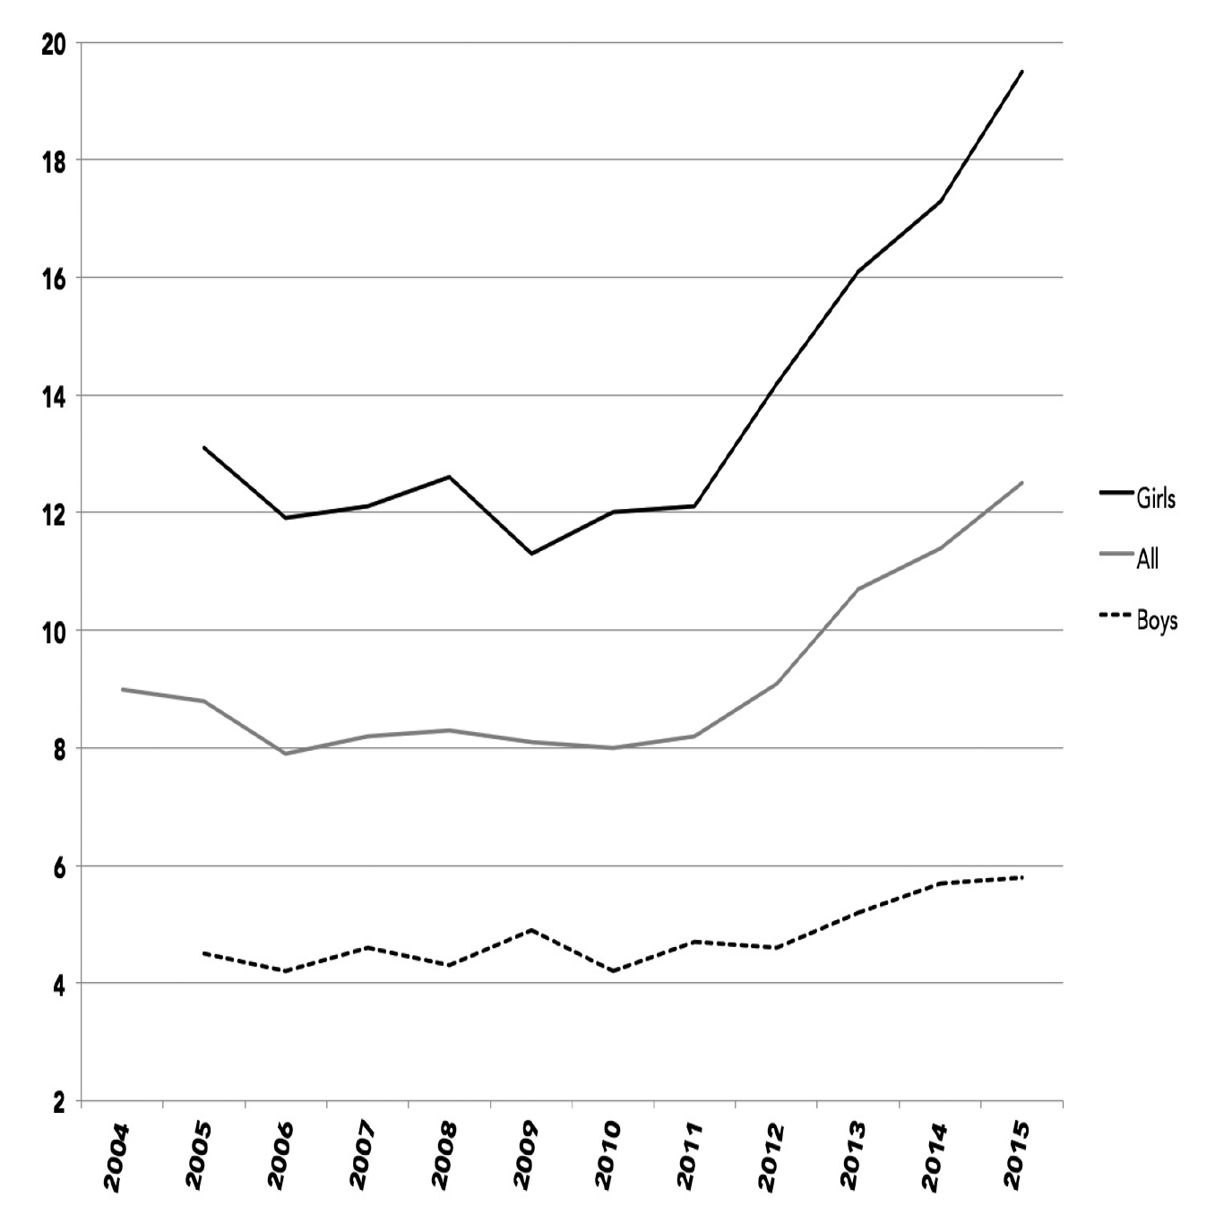
12- to 17-year-olds
a major depressive episode
in the last 12 months

Slide 29
Current Challenges
“Concept Creep”
Precipitous rise in mental health issues
On the one hand, things are getting worse
On the other hand, the solutions are the same as they’ve always been
We have the words of life!

Slide 30
How Change Works
You have someone in your group who:
Can’t keep jobs because they can’t get out of bed
Avoids large groups because of anxiety
Has serious marital issues
Can’t pass their classes and might never finish school
Notes:
Adult examples: chronic illnesses, dying parents, can’t get out of bed to go to work

Slide 31
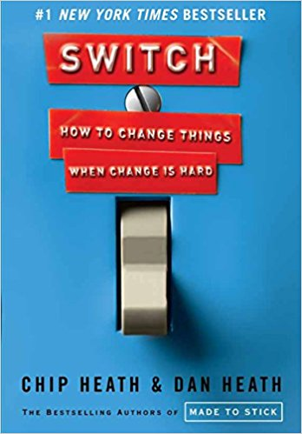
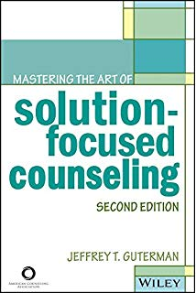

Slide 32
How Change Works
What looks like resistance might be lack of clarity

Slide 33
Heath & Heath
Professor, Senior Fellow
Heath & Heath, Switch (NY, NY: Broadway Books, 2010) p. 17
What looks like resistance is often lack of clarity.

Slide 34
Heath & Heath
Professor, Senior Fellow
Heath & Heath, Switch (NY, NY: Broadway Books, 2010) p. 15
Ex: The number of ways to ‘eat healthier’ is limitless, especially given the starting place of the average American diet.
This is exactly the kind of situation where [a person] will spin his wheels, analyzing and agonizing and never moving forward.

Slide 35
Heath & Heath
Professor, Senior Fellow
Heath & Heath, Switch (NY, NY: Broadway Books, 2010) p. 53
Big-picture, hands-off leadership isn’t likely to work in a change situation, because the hardest part of change – the paralyzing part – is precisely in the details.

Slide 36
How Change Works
What looks like resistance might be lack of clarity
  People might really not know what to do
  Start by assuming that people want to change (especially because we know the Holy Spirit is at work!)

Slide 37
How Change Works
What looks like laziness might be exhaustion
  We can:
    Suggest a good place to start
    Shrink down the number of decisions
    Make the steps small enough
  “Snowball effect”

Slide 38
Guterman
Psychiatrist
Guterman, Mastering the Art of Solution-Focused Counseling (Alexandria, VA: American Counseling Association, 2013) p. 7
Principle of Inertia – Once a person initiates an activity, that is, when they make small albeit significant effort, then this often leads to progress.
The person often finds it easier to stay in motion and proceed with the activity.

Slide 39
How Change Works
What looks like laziness might be exhaustion
  People want to change (especially because we know the Holy Spirit is at work!)
  We can:
    Suggest a good place to start
    Shrink down the number of decisions
    Make the steps small enough
  “Snowball effect”
Matt 6:34 – Do not worry about tomorrow, for tomorrow will worry about itself. Today has enough trouble of its own.

Slide 40
How Change Works
Analysis can help, but we can also analyze a problem to death
  People are far more likely to focus on the negative

Slide 41
Heath & Heath
Professor, Senior Fellow
Heath & Heath, Switch (NY, NY: Broadway Books, 2010) p. 35
A psychologist analyzed 558 emotion words – every one that he could find in the English language –
And found that 62 percent of them were negative words.

Slide 42
Heath & Heath
Professor, Senior Fellow
Heath & Heath, Switch (NY, NY: Broadway Books, 2010) p. 35
We seem wired to focus on the negative.

Slide 43
How Change Works
Analysis can help, but we can also analyze a problem to death
  People are far more likely to focus on the negative
    Why does this matter?

Slide 44
Heath & Heath
Professor, Senior Fellow
Heath & Heath, Switch (NY, NY: Broadway Books, 2010) p. 35
Marriage therapist Michele Weiner-Davis, in her book Divorce Busting, [explains],
“My clients would frequently plead, ‘Now I see that we are reenacting our parents’ marriages, but what do we do about it? We can’t stop fighting.’”

Slide 45
Heath & Heath
Professor, Senior Fellow
Heath & Heath, Switch (NY, NY: Broadway Books, 2010) p. 35
Understanding a problem doesn’t necessarily solve it – knowing is not enough.
Ps 51:5 – Surely I was sinful at birth, sinful from the moment my mother conceived me.
Notes:
Understanding the problem – maybe I have an anger problem because my dad had an anger problem, and because it’s because sometimes I feel like my needs aren’t being met, and because…
Ps 51, really

Slide 46
How Change Works
Small changes lead to big changes
  This is so hard for people to believe!

Slide 47
How Change Works
We’re trying to help people learn new habits – in their thoughts, relationships, choices, etc.

Slide 48
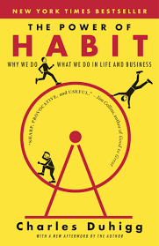
Charles Duhigg
Journalist & Author
Duhigg, The Power of Habit, (NY, NY: Random House, 2014), p63.
The ‘Golden Rule of Habit Change’: You can’t extinguish a bad habit, you can only change it.

Slide 49
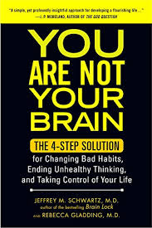
Schwartz, M.D., & Gladding, M.D.
UCLA Psychiatrists
Schwartz & Gladding, You Are Not Your Brain, (NY, NY: Penguin Group, 2011), p13.
Whenever you repeatedly do something pleasurable or avoid some kind of overtly painful sensation,
your brain “learns” that these actions are a priority and generates thoughts, impulses, urges, and desires to make sure you keep doing them again and again.

Slide 50
Schwartz, M.D., & Gladding, M.D.
UCLA Psychiatrists
Schwartz & Gladding, You Are Not Your Brain, (NY, NY: Penguin Group, 2011), p13.
[Your brain] does not care that the action ultimately is bad for you.

Slide 51
How Change Works
We’re trying to help people learn new habits – in their thoughts, relationships, choices, etc.
  It helps to view problems (anxiety, depression, marriage issues, etc.) as a collection of habits

Slide 52
How Change Works
The role of time in healing

Slide 53

Dr. Linda J Waite et al
Professor of Sociology – Univ of Chicago
Waite et al, Does Divorce Make People Happy? (IAV, 2002), p5.
Among those who rated their marriages as very unhappy, almost eight out of ten who avoided divorce were happily married five years later.

Slide 54
Dr. Linda J Waite et al
Professor of Sociology – Univ of Chicago
Waite et al, Does Divorce Make People Happy? (IAV, 2002), p5.
The most unhappy marriages experienced the most dramatic turnarounds: Seventy-eight percent of adults who said their marriages were very unhappy and who avoided divorce
ended up happily married five years later.

Slide 55
How Change Works
The role of time in healing

Slide 56
How Change Works
The role of time in healing
LET’S TAKE A 10-MINUTE BREAK

Slide 57
Areas to Address
Time with the Lord
Ps 119:50 – Your word revives me; it comforts me in all my troubles.
2 Peter 1:3 – Seeing that His divine power has granted to us everything pertaining to life and godliness, through the true knowledge of Him who calls us by his own glory and excellence.
Notes:
Have you ever wondered what it is that counselors address? Like sitting in on a Presidential cabinet meeting?
This is the FIRST THING I check
Any stories of how this helped a client?

Slide 58
Areas to Address
Time with the Lord
Romans 8:6 – For the mind set on the flesh is death, but the mind set on the Spirit is life and peace.

Slide 59
Areas to Address
Time with the Lord
  All habits start small – keep their expectations realistic
  Reduce ambiguity for them: suggest finding a reading plan
  External habits (same music/place, reminders, prayer lists)

Slide 60
Areas to Address
Time with the Lord
  Transitions/change? (New job, kids, vacation, etc.)
  Takings thoughts captive – journaling
    This also reveals Satanic lies

Slide 61
Areas to Address
Time with the Lord
Openness in the BOC
  Make the Biblical case (James 5:16 – “So that you may be healed.”)
  Transparency reduces shame (which many mistake for guilt)
John 3:21 – But whoever lives by the truth comes into the light, so that it may be seen plainly that what they have done has been done in the sight of God.
Notes:
Transparency: this is what worldly support groups provides
- Just getting things out into the light

Slide 62

Areas to Address
Time with the Lord
Openness in the BOC
Gratitude

Slide 63
Areas to Address
Time with the Lord
Openness in the BOC
Gratitude
  Just Google ‘Gratitude and Mental Health’
  Best marital advice I ever got

Slide 64
Areas to Address
Time with the Lord
Openness in the BOC
Gratitude
Sacrificial love output
John 13:17 – “Now that you know these things, you are blessed if you do them.”
Acts 20:35 – the words of the Lord Jesus himself, “It is more blessed to give than to receive.”

Slide 65
Areas to Address
Time with the Lord
Openness in the BOC
Gratitude
Sacrificial love output
  Teachings on ‘Love Therapy’
  Help people start small

Slide 66
Areas to Address
Crises: The value of our support ministries
  HOPE, HEART, GRACE, GriefShare, etc.
Physical health
  Exercise: “Let’s Get Physical” from Gary Thomas’ book Every Body Matters
Notes:
These also can get people to the point where they are not just a recovering victim but someone who is able to help other people – that’s the vision they need

Slide 67
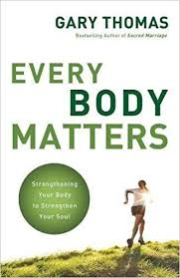
Gary Thomas
Pastor and Author
Thomas, Every Body Matters () p. 115-117
In the short term, becoming fitter is about the quickest, easiest way to improve your overall quality of life…

Slide 68
Gary Thomas
Pastor and Author
Thomas, Every Body Matters () p. 115-117
Tim Church, director of preventative medicine research at the Pennington Biomedical Research Center in Baton Rogue, LA, found that women who did even ten minutes more exercise on a daily basis

Slide 69
Gary Thomas
Pastor and Author
Thomas, Every Body Matters () p. 115-117
“felt more confident about doing everyday tasks…and they felt better about themselves when they were in social situations.”

Slide 70
Gary Thomas
Pastor and Author
Thomas, Every Body Matters () p. 115-117
In this same study, “exercisers reported improvements in all areas of quality of life: agility, energy, overall health, mental health, emotional well-being, and functioning in social situations…
The more women exercised, the greater their improvements.”

Slide 71
Gary Thomas
Pastor and Author
Thomas, Every Body Matters () p. 115-117
Dr. David Kessler states, “A substantial body of science tells us that exercise engages the same neural regions [in our brains] as other mood-enhancing rewards and produces similar chemical responses.”

Slide 72
Gary Thomas
Pastor and Author
Thomas, Every Body Matters () p. 115-117
[Harvard Medical School psychiatry professor Dr. John Ratey] also cites exercise’s ability to reduce stress.

Slide 73
Areas to Address
Crises: The value of our support ministries
  HOPE, HEART, GRACE, GriefShare
Physical health
  Exercise: “Let’s Get Physical” from Gary Thomas’ book Every Body Matters
    Realistic expectations: start with 10 minutes
    Go with them
Notes:
Scott and I walk a lot with our disciples – it helps us, and we want them to develop a love for it

Slide 74
Areas to Address
Crises: The value of our support ministries
  HOPE, HEART, GRACE, GriefShare
Physical health
  Exercise: “Let’s Get Physical” from Gary Thomas’ book Every Body Matters
  Sleep
    Screen time (addressed next)

Slide 75
Areas to Address
Habits/Addictions
  Porn – Roch’s material
  Screen – Kate Mizelle’s XSI workshop, chapters from iGen

Slide 76
Areas to Address
God’s character
  God’s grace is the answer to our guilt
  God’s sovereignty is the answer to our anxiety

Slide 77
Areas to Address
Eternal Perspective
2 Cor 5:2 – for indeed in this tent we groan, longing to be clothed with our dwelling from heaven.
1 Thes 4:17b-18 – and so we shall always be with the Lord. Therefore comfort one another with these words.

Slide 78
Areas to Address
Still stuck?
  Ask your HC coach

Slide 79
Hebrews 12
12 Therefore, strengthen the hands that are weak and the knees that are feeble,
13 and make straight paths for your feet, so that the limb that is lame may not be put out of joint, but rather be healed.

Slide 80
Healing in the Body of Christ
Questions?
Comments?
Experiences?
Chris.risley@gmail.com
See the Counseling page on the Xenos website

