Slide 1
Ministering to the Addicted
Kaitlin Casassa, LISW
Daniel Rogers, LPC

Slide 2
Why should we discuss this?

Slide 3
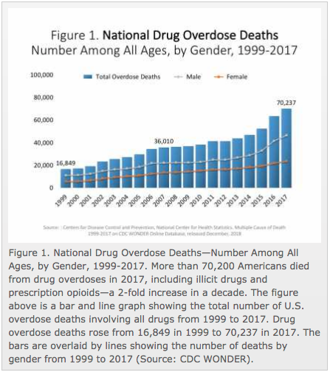

Slide 4
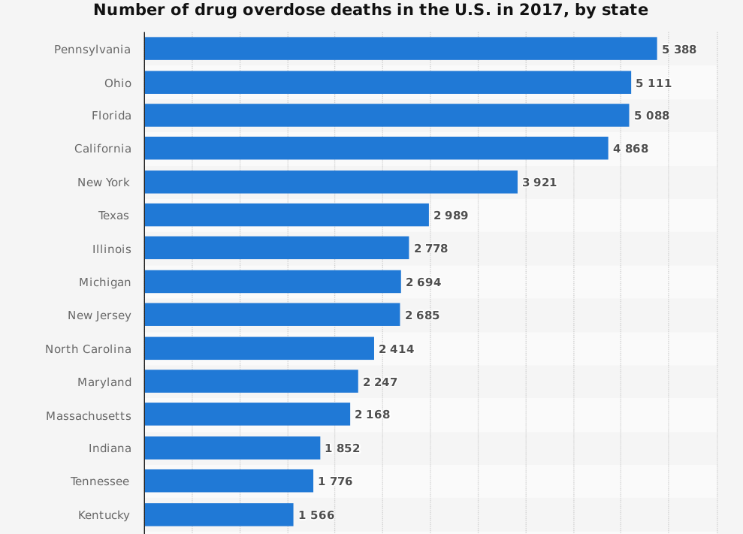

Slide 5



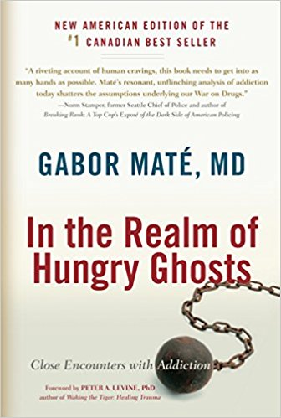
How can I learn more?

Slide 6
Understanding Addiction

Slide 7
Defining Addiction

Slide 8
Defining Addiction
Addiction is any repeated behavior, substance-related or not, in which a person feels compelled to persist, regardless of its negative impact on his life and the lives of others.

Slide 9
Defining Addiction
“Any passion can become an addiction; but then how to distinguish between the two? The central question is: who’s in charge, the individual or their behavior? The addiction is the repeated behavior in which a person keeps engaging, even though he knows it harms himself or others. How it looks externally is irrelevant. The key issue is a person’s internal relationship to the passion and its related behaviors.”
- Gabor Maté
Addiction is any repeated behavior, substance-related or not, in which a person feels compelled to persist, regardless of its negative impact on his life and the lives of others.

Slide 10
Defining Addiction
“Any passion can become an addiction; but then how to distinguish between the two? The central question is: who’s in charge, the individual or their behavior? The addiction is the repeated behavior in which a person keeps engaging, even though he knows it harms himself or others. How it looks externally is irrelevant. The key issue is a person’ internal relationship to the passion and its related behaviors.”
- Gabor Maté
Addiction is any repeated behavior, substance-related or not, in which a person feels compelled to persist, regardless of its negative impact on his life and the lives of others.
1 Corinthians 6:12
“I have the right to do anything,” you say—but not everything is beneficial. “I have the right to do anything”—but I will not be mastered by anything.

Slide 11
Distinguishing Casual Use from Addiction

Slide 12
Distinguishing Casual Use from Addiction
Should be thought of as more of a continuum than binary yes or no; avoid arbitrary cut off point

Slide 13

Distinguishing Casual Use from Addiction
Should be thought of as more of a continuum than binary yes or no; avoid arbitrary cut off point
“Abuse” + “Dependence” not diagnosed terms anymore
Instead “Substance Use Disorder,” ranging in severity

Slide 14
Recognizing Addiction - Impaired Control
Using for longer than intended, or using larger amounts than intended
Wanting to reduce use, yet being unsuccessful doing so
Spending excessive time getting/using/recovering from the drug use
Cravings so intense it’s difficult to think about anything else

Slide 15
Recognizing Addiction - Social Impairment
Problems with work, school or family/social obligations
Continues use despite having interpersonal problems because of the use
Important and meaningful social and recreational activities may be given up or reduced because of use

Slide 16
Recognizing Addiction - Risky Use
Repeatedly uses in physically dangerous situations
Continues to use even though he/she is aware it is causing or worsening physical and psychological problems

Slide 17
Recognizing Addiction - Pharmacological Indicators
Tolerance
Withdrawal

Slide 18
What causes Addiction?

Slide 19
Etiology of Addiction is a Constant Source of Debate

Slide 20
Etiology of Addiction is a Constant Source of Debate
Personal Responsibility Models

Slide 21
Etiology of Addiction is a Constant Source of Debate
Personal Responsibility Models
Ephesians 5:18
“Do not get drunk on wine, which leads to debauchery. Instead, be filled with the Spirit”

Slide 22
Etiology of Addiction is a Constant Source of Debate
Personal Responsibility Models
Agent Models

Slide 23
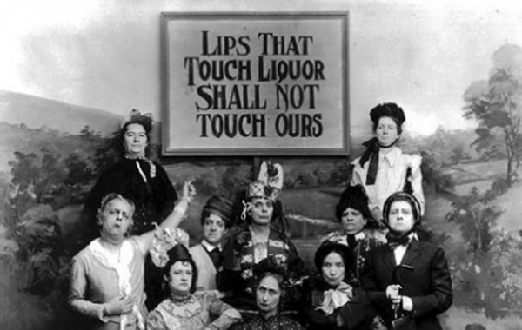
Etiology of Addiction is a Constant Source of Debate
Personal Responsibility Models
Agent Models

Slide 24
Etiology of Addiction is a Constant Source of Debate
Personal Responsibility Models
Agent Models
32% of people who used nicotine even once went on to long-term habitual use
For alcohol, marijuana, and cocaine the rate is about 15%
23% for heroin
(1994, Warner + Kessler, Experimental and Clinical Psychopharmacology)

Slide 25
Etiology of Addiction is a Constant Source of Debate
Personal Responsibility Models
Agent Models
Medical (Disease) Models

Slide 26
Etiology of Addiction is a Constant Source of Debate
Personal Responsibility Models
Agent Models
Medical (Disease) Models
Social Learning Models

Slide 27
Etiology of Addiction is a Constant Source of Debate
There’s no single answer!
Personal Responsibility Models
Agent Models
Medical (Disease) Models
Social Learning Models

Slide 28
A Holistic Approach
““We need to view it simultaneously from many different angles—or, at least, while examining it from one angle, we need to keep the others in mind. Addiction has biological, chemical, neurological, psychological, medical, emotional, social, political, economic and spiritual underpinnings—and perhaps others I haven’t thought about.”
- Gabor Maté

Slide 29
The Role of Development

Slide 30
The Role of Development
Brain development in the uterus and during childhood is the single most important biological factor in determining whether or not a person will be predisposed to addiction.
Gabor Maté

Slide 31
The Role of Development
75% of brain growth takes place outside the womb
by age 3 brain is 90% of adult size; body is only 18% of adult size
Expression of genetic potentials is mostly contingent on environment
Brain development in the uterus and during childhood is the single most important biological factor in determining whether or not a person will be predisposed to addiction.
Gabor Maté

Slide 32
The Role of Development
Emotional nurturance is necessary for healthy brain development
Children need attachment relationship with 1+ reliably available, protective, psychologically present, and reasonably non-stressed adult
Often void isn’t parent’s love or commitment, but in child's perception

Slide 33
The Role of Development
What happens with a lack of emotional nurturing or attachment?
→ chronic stress

Slide 34
The Role of Development
What happens with a lack of emotional nurturing or attachment?
→ chronic stress
Universal causes of stress = uncertainty, lack of information, loss of control, overwhelming conflict, isolation from emotionally supportive relationships

Slide 35
The Role of Development
Lower set point for child's internal stress system
More vulnerable to the pleasurable experience of substances (water in the desert)
Chronically high levels of cortisol → shrinks hippocampus
Diminishes opioid and dopamine receptors
Inhibits emotional maturity, ability to self regulate
What happens with a lack of emotional nurturing or attachment?
→ chronic stress
Universal causes of stress = uncertainty, lack of information, loss of control, overwhelming conflict, isolation from emotionally supportive relationships

Slide 36
The Role of Development
Parental nurturing affects brain’s levels of endorphins, dopamine, serotonin, benzodiazepines, norepinephrine, oxytocin
  Attuned interactions stimulate release of natural opioids (endorphins) → promotes development of child’s opioid and dopamine circuitry
The less effective internal chemical happiness system is, the more driven one is to seek joy/relief via drugs

Slide 37
The Role of Development
Parental nurturing affects brain’s levels of endorphins, dopamine, serotonin, benzodiazepines, norepinephrine, oxytocin
  Attuned interactions stimulate release of natural opioids (endorphins) → promotes development of child’s opioid and dopamine circuitry
The less effective internal chemical happiness system is, the more driven one is to seek joy/relief via drugs
Drugs influence how we act and feel because they resemble the brain’s own natural chemicals

Slide 38
The Role of Trauma
Addiction is almost always rooted in some sort of pain
ACE’s study
  for each adverse childhood experience, risk for early initiation of substance use increases 2 to 4 times
  5 or more ACES = 7 to 10x greater risk for substance use

Slide 39
The Role of Trauma
It's not what happened in the past that creates our present misery but the way we have allowed the past events to define how we see and experience ourselves in the present. The greatest damage done by neglect, trauma, or emotional loss is not the immediate pain they inflict but the long-term distortions they induce in the way a developing child will continue to interpret the world and her situation in it.
- Gabor Maté
Addiction is almost always rooted in some sort of pain
ACE’s study
  for each adverse childhood experience, risk for early initiation of substance use increases 2 to 4 times
  5 or more ACES = 7 to 10x greater risk for substance use

Slide 40
The Role of Trauma
It's not what happened in the past that creates our present misery but the way we have allowed the past events to define how we see and experience ourselves in the present. The greatest damage done by neglect, trauma, or emotional loss is not the immediate pain they inflict but the long-term distortions they induce in the way a developing child will continue to interpret the world and her situation in it.
- Gabor Maté
Drug offers…
emotional anesthetic
antidote to emptiness
tonic against fatigue, boredom, alienation, sense of personal inadequacy
stress reliever
social lubricant
Addiction is almost always rooted in some sort of pain
ACE’s study
  for each adverse childhood experience, risk for early initiation of substance use increases 2 to 4 times
  5 or more ACES = 7 to 10x greater risk for substance use

Slide 41
The Role of Trauma
Addiction is almost always rooted in some sort of pain
ACE’s study
  for each adverse childhood experience, risk for early initiation of substance use increases 2 to 4 times
  5 or more ACES = 7 to 10x greater risk for substance use
… What about someone who doesn’t seem to have a traumatic history?

Slide 42
The Role of Trauma
“Many junkies come from prosperous, apparently harmonious families. Why would they become Junkies? Dislocation sometimes grows from devastating inabilities to meet highly internalized standards of achievement, rendering them unacceptable failures in their own estimation. In addition, some prosperous but frigid families maintain an impenetrable veneer of warmth that camouflages subtle cruelty or dysfunction. Alternatively, dislocation in junkies-to-be may come from painful rejection by their peers. Embracing the most feared and despised of all drugs is a bold counterattack upon the emptiness and boredom that often fills an affluent life.
Addiction is almost always rooted in some sort of pain
ACE’s study: for each adverse childhood experience, risk for early initiation of substance use increases 2 to 4 times
… What about someone who doesn’t seem to have a traumatic history?

Slide 43
The Role of Trauma
To be a junkie is to kick sand in the face of respectability with its myriad hypocrisies. It is to work a terrible revenge on resented parents. To be a junkie is to be feared as well as pitied, to provoke awe as well as to endure humiliation. It is a starkly honest position. It is preferable to be infamous than to be utterly inconsequential or a contradictory bundle of identity fragments, as Erikson put it. The psychosocial benefits of being a junkie, including a compelling sense of purpose, a well-recognized identity, the release of boredom, and the power to shock and horrify “straight” people, have been extensively documented by therapists, social scientists, and junkie authors.” -Bruce K. Alexander
Addiction is almost always rooted in some sort of pain
ACE’s study: for each adverse childhood experience, risk for early initiation of substance use increases 2 to 4 times
… What about someone who doesn’t seem to have a traumatic history?

Slide 44
At the root... A Spiritual Issue

Slide 45
At the root... A Spiritual Issue
Researchers, clinicians, doctors can’t help themselves…

Slide 46
At the root... A Spiritual Issue
Researchers, clinicians, doctors can’t help themselves…
“One consequence of spiritual deprivation is addiction, and not only to drugs. At conferences devoted to science-based addiction medicine, it is more and more common to hear presentations on the spiritual aspect of addictions and their treatment. At the core of all addictions there lies a spiritual void.”

Slide 47
At the root... A Spiritual Issue
“We have something in or about us that transcends the firing and wiring of neurons in the actions of chemicals. The Mind may reside mostly in the brain, but it is much more than the sum total of the autonomic neurological programs rooted in our pasts. And there is something else in us and about us: it is called by many names, spirit being the most democratic and least denominational or divisive in a religious sense.”
- Gabor Maté
Researchers, clinicians, doctors can’t help themselves…

Slide 48
At the root... A Spiritual Issue
Researchers, clinicians, doctors can’t help themselves…
What is the issue? → Idolatry

Slide 49
At the root... A Spiritual Issue
Researchers, clinicians, doctors can’t help themselves…
What is the issue? → Idolatry
Ephesians 4:22
”that, in reference to your former manner of life, you lay aside the old self, which is being corrupted in accordance with the lusts of deceit”

Slide 50
At the root... A Spiritual Issue
“Lusts of deceit”

Slide 51
At the root... A Spiritual Issue
“Lusts of deceit”
Warped Desire

Slide 52
At the root... A Spiritual Issue
Addictions, even as they resemble normal human yearnings, are more about desire than attainment. In the addicted mode, the emotional charge is in the pursuit and the acquisition of the desired object, not in the possession and enjoyment of it. The greatest pleasure is in the momentary satisfaction of yearning. The fundamental addiction is to the fleeting experience of not being addicted. The addict craves the absence of the craving state. For a brief moment he’s liberated from emptiness, from boredom, from lack of meaning, from yearning, from being driven or from pain. He is free. His enslavement to the external- the substance, the object, or the activity- consists of the impossibility, in his mind, of finding within himself the freedom from longing or irritability.
“Lusts of deceit”
Warped Desire

Slide 53
At the root... A Spiritual Issue
“Lusts of deceit”
promise happiness but destroy rather than satisfy

Slide 54
At the root... A Spiritual Issue
Recovery from Addiction does not mean a cure for a disease but the creation of new resources, internal and external, that can support different healthy ways of satisfying one's genuine needs
“Lusts of deceit”
promise happiness but destroy rather than satisfy

Slide 55
At the root... A Spiritual Issue
Recovery from Addiction does not mean a cure for a disease but the creation of new resources, internal and external, that can support different healthy ways of satisfying one's genuine needs
“Lusts of deceit”
promise happiness but destroy rather than satisfy
Jonah 2:8
"Those who cling to worthless idols turn away from God's love for them.”

Slide 56
What is Xenos doing?

Slide 57
Xenos Ministries
Hope
Never Alone
Promise

Slide 58
How can we help?

Slide 59
Resist & Replace

Slide 60
Resist & Replace
Fix What is Broken vs. Building Something New

Slide 61
Resist & Replace
Fix What is Broken vs. Building Something New
  Biblical Perspective: Old self → New self, darkness →light, death→life

Slide 62
Resist & Replace
Fix What is Broken vs. Building Something New
  Biblical Perspective: Old self → New self, darkness →light, death→life
  2 Timothy 2:22 → “Flee the evil desires of youth and pursue righteousness, faith, love and peace, along with those who call on the Lord out of a pure heart.”

Slide 63
Resist & Replace
Fix What is Broken vs. Building Something New
  Biblical Perspective: Old self → New self, darkness →light, death→life
  2 Timothy 2:22 → “Flee the evil desires of youth and pursue righteousness, faith, love and peace, along with those who call on the Lord out of a pure heart.”
    A problem of desire?

Slide 64
Resist & Replace
Fix What is Broken vs. Building Something New
  Biblical Perspective: Old self → New self, darkness →light, death→life
  2 Timothy 2:22 → “Flee the evil desires of youth and pursue righteousness, faith, love and peace, along with those who call on the Lord out of a pure heart.”
    A problem of desire?
      Desire & Dopamine

Slide 65
Resist & Replace
Fix What is Broken vs. Building Something New
  Biblical Perspective: Old self → New self, darkness →light, death→life
  2 Timothy 2:22 → “Flee the evil desires of youth and pursue righteousness, faith, love and peace, along with those who call on the Lord out of a pure heart.”
    A problem of desire?
      Desire & Dopamine
        Desire for pleasure→desire to meet deeper needs

Slide 66
“The Expulsive Power of a New Affection”

Slide 67
“The Expulsive Power of a New Affection”
“The grasping tendency of the human heart”

Slide 68
“The Expulsive Power of a New Affection”
“The grasping tendency of the human heart”
  Vacant heart = Hunger

Slide 69
“The Expulsive Power of a New Affection”
“The grasping tendency of the human heart”
  Vacant heart = Hunger
    “Dry Drunk”

Slide 70
“The Expulsive Power of a New Affection”
“The grasping tendency of the human heart”
  Vacant heart = Hunger
    “Dry Drunk”
“A more effective path to removing an undesired affection is to set the mind’s eye on a more alluring object.”

Slide 71
What is the “More Alluring Object?”

Slide 72
What is the “More Alluring Object?”
Christ’s Promises to satisfy a deeper hunger and thirst

Slide 73
What is the “More Alluring Object?”
Christ’s Promises to satisfy a deeper hunger and thirst
  Expose unsatisfied desire
  John 4 “Living water” & John 6 “The bread of life”

Slide 74
What is the “More Alluring Object?”
Christ’s Promises to satisfy a deeper hunger and thirst
  Expose unsatisfied desire
  John 4 “Living water” & John 6 “The bread of life”
A New Identity

Slide 75
What is the “More Alluring Object?”
Christ’s Promises to satisfy a deeper hunger and thirst
  Expose unsatisfied desire
  John 4 “Living water” & John 6 “The bread of life”
A New Identity
  Trauma & memories of the past

Slide 76
What is the “More Alluring Object?”
Christ’s Promises to satisfy a deeper hunger and thirst
  Expose unsatisfied desire
  John 4 “Living water” & John 6 “The bread of life”
A New Identity
  Trauma & memories of the past
  2 Corinthians 5:17 “new creation...old has passed away… new has come”

Slide 77
What is the “More Alluring Object?”
Christ’s Promises to satisfy a deeper hunger and thirst
  Expose unsatisfied desire
  John 4 “Living water” & John 6 “The bread of life”
A New Identity
  Trauma & memories of the past
  2 Corinthians 5:17 “new creation...old has passed away… new has come”
Unconditional Affirmation and Acceptance

Slide 78
What is the “More Alluring Object?”
Christ’s Promises to satisfy a deeper hunger and thirst
  Expose unsatisfied desire
  John 4 “Living water” & John 6 “The bread of life”
A New Identity
  Trauma & memories of the past
  2 Corinthians 5:17 “new creation...old has passed away… new has come”
Unconditional Affirmation and Acceptance
  Perpetual guilt and shame

Slide 79
What is the “More Alluring Object?”
Christ’s Promises to satisfy a deeper hunger and thirst
  Expose unsatisfied desire
  John 4 “Living water” & John 6 “The bread of life”
A New Identity
  Trauma & memories of the past
  2 Corinthians 5:17 “new creation...old has passed away… new has come”
Unconditional Affirmation and Acceptance
  Perpetual guilt and shame
  Romans 8:31-39 “Nothing can separate us from the love of Christ”

Slide 80
What is the “More Alluring Object?”
A Sense of Purpose

Slide 81
What is the “More Alluring Object?”
A Sense of Purpose
  “Aimless wandering”

Slide 82
What is the “More Alluring Object?”
A Sense of Purpose
  “Aimless wandering”
    Ephesians 2:10 “Good works prepared in advance”

Slide 83
What is the “More Alluring Object?”
A Sense of Purpose
  “Aimless wandering”
    Ephesians 2:10 “Good works prepared in advance”
      “He who has a why to live can bear almost any how”-Friedrich Nietzsche

Slide 84
What is the “More Alluring Object?”
A Sense of Purpose
  “Aimless wandering”
    Ephesians 2:10 “Good works prepared in advance”
      “He who has a why to live can bear almost any how”-Friedrich Nietzsche
An Invitation to Community

Slide 85
What is the “More Alluring Object?”
A Sense of Purpose
  “Aimless wandering”
    Ephesians 2:10 “Good works prepared in advance”
      “He who has a why to live can bear almost any how”-Friedrich Nietzsche
An Invitation to Community
  Dislocation

Slide 86
What is the “More Alluring Object?”
A Sense of Purpose
  “Aimless wandering”
    Ephesians 2:10 “Good works prepared in advance”
      “He who has a why to live can bear almost any how”-Friedrich Nietzsche
An Invitation to Community
  Dislocation
  Galatians 3:28 “You are all one in Christ Jesus”

Slide 87
Our Role in the Helping Process

Slide 88
Our Role in the Helping Process
Assess the person’s awareness of their problem

Slide 89
Our Role in the Helping Process
Assess the person’s awareness of their problem
  The destructive nature of addiction makes it easy to skip this step

Slide 90
Our Role in the Helping Process
Assess the person’s awareness of their problem
  The destructive nature of addiction makes it easy to skip this step
    “The Righting Reflex”

Slide 91
Our Role in the Helping Process
Assess the person’s awareness of their problem
  The destructive nature of addiction makes it easy to skip this step
    “The Righting Reflex”
  To what degree do they realize their substance use is an issue?

Slide 92
Our Role in the Helping Process
Assess the person’s awareness of their problem
  The destructive nature of addiction makes it easy to skip this step
    “The Righting Reflex”
  To what degree do they realize their substance use is an issue?
Assess their readiness for change

Slide 93
Our Role in the Helping Process
Assess the person’s awareness of their problem
  The destructive nature of addiction makes it easy to skip this step
    “The Righting Reflex”
  To what degree do they realize their substance use is an issue?
Assess their readiness for change
  Working from where the person is at

Slide 94

The Stages of Change
Pre-contemplation
Contemplation
Preparation
Action
Maintenance
Relapse

Slide 95
Stage | Helper’s Role | Helper’s Goal
Pre-Contemplation “I don’t have a problem you do.” | Ask questions to help them consider their use from a different perspective “How would you know if it was a problem?” “Has it ever caused you problems?” “Why do other people think it is a problem?” “Why do you use? Do you ever get those feelings without using? | Raise doubt about current perspective on use
Contemplation “Maybe I have a problem.” | Help them continue to question their use What changed? Empathize with them “That sounds tough. So you think the drugs play a role in that?” Reflect back the issues they point out “I see, so your saying…” | Tip the decisional balance in favor of change
Preparation “I have been thinking about things I could do to work on this” | Reinforce thoughts about change “What kind of things have you thought of?” “What is appealing about quitting?” “What do you think the first step is?” | Develop a plan for action

Slide 96
Stage | Helper’s Role | Helper’s Goal
Action “I am currently doing these things to get some help.” | Support, empathize, encourage... “How has that been helpful?” “Man, that sounds brutal, I don’t blame you for feeling that way.” | Help them utilize resources/tools
Maintenance “I haven’t struggled with this in a while.” | Help them to move beyond addiction as a defining feature in their life Help them to move beyond addiction as a defining feature Point out different areas of growth Appeal to the bigger picture God has for their life. “It’s not about what God has saved you from but what he has called you to.” | Ongoing growth
Relapse “I screwed up” | Remind them of what they have already learned What resources they have already been using, perspective on where they are at... | Prevent fatalism and maintain forward momentum

Slide 97
Considerations in Ministry Decisions

Slide 98
Considerations in Ministry Decisions
Prior to Action

Slide 99
Considerations in Ministry Decisions
Prior to Action
Casual Follow Up/Friendship Building

Slide 100
Considerations in Ministry Decisions
Prior to Action
Casual Follow Up/Friendship Building
Exposure to fellowship

Slide 101
Considerations in Ministry Decisions
Prior to Action
Casual Follow Up/Friendship Building
Exposure to fellowship
  Retreats, HC events, etc.

Slide 102
Considerations in Ministry Decisions
Prior to Action
Casual Follow Up/Friendship Building
Exposure to fellowship
  Retreats, HC events, etc.
Maybe a short study on one of the above topics

Slide 103
Considerations in Ministry Decisions
Prior to Action
Casual Follow Up/Friendship Building
Exposure to fellowship
  Retreats, HC events, etc.
Maybe a short study on one of the above topics
Take few risks

Slide 104
Considerations in Ministry Decisions
Prior to Action
Casual Follow Up/Friendship Building
Exposure to fellowship
  Retreats, HC events, etc.
Maybe a short study on one of the above topics
Take few risks
  Not in house or discipleship

Slide 105
Considerations in Ministry Decisions
Prior to Action
Casual Follow Up/Friendship Building
Exposure to fellowship
  Retreats, HC events, etc.
Maybe a short study on one of the above topics
Take few risks
  Not in house or discipleship
MAINTAIN BOUNDARIES

Slide 106
Boundaries
What are boundaries?

Slide 107
Boundaries
What are boundaries?
  Boundaries require knowing where you begin and end

Slide 108
Boundaries
What are boundaries?
  Boundaries require knowing where you begin and end
    I can give but I cannot make you receive, I can offer counsel but cannot make you change etc…

Slide 109
Boundaries
What are boundaries?
  Boundaries require knowing where you begin and end
    I can give but I cannot make you receive, I can offer counsel but cannot make you change etc…
Crossing boundaries leads to:

Slide 110
Boundaries
What are boundaries?
  Boundaries require knowing where you begin and end
    I can give but I cannot make you receive, I can offer counsel but cannot make you change etc…
Crossing boundaries leads to:
  Enabling

Slide 111
Boundaries
What are boundaries?
  Boundaries require knowing where you begin and end
    I can give but I cannot make you receive, I can offer counsel but cannot make you change etc…
Crossing boundaries leads to:
  Enabling
  Codependency

Slide 112
Boundaries
What are boundaries?
  Boundaries require knowing where you begin and end
    I can give but I cannot make you receive, I can offer counsel but cannot make you change etc…
Crossing boundaries leads to:
  Enabling
  Codependency
How do I know I am crossing boundaries?

Slide 113
Boundaries
What are boundaries?
  Boundaries require knowing where you begin and end
    I can give but I cannot make you receive, I can offer counsel but cannot make you change etc…
Crossing boundaries leads to:
  Enabling
  Codependency
How do I know I am crossing boundaries?
  Guilt

Slide 114
Boundaries
What are boundaries?
  Boundaries require knowing where you begin and end
    I can give but I cannot make you receive, I can offer counsel but cannot make you change etc…
Crossing boundaries leads to:
  Enabling
  Codependency
How do I know I am crossing boundaries?
  Guilt
  Bitterness

Slide 115
Boundaries
What are boundaries?
  Boundaries require knowing where you begin and end
    I can give but I cannot make you receive, I can offer counsel but cannot make you change etc…
Crossing boundaries leads to:
  Enabling
  Codependency
How do I know I am crossing boundaries?
  Guilt
  Bitterness
  Instability

Slide 116
Boundaries
Creating a Bottom vs Setting Boundaries
  “Hitting Rock Bottom”

Slide 117
Boundaries
Creating a Bottom vs Setting Boundaries
  “Hitting Rock Bottom”
    We cannot create a bottom for someone

Slide 118
Boundaries
Creating a Bottom vs Setting Boundaries
  “Hitting Rock Bottom”
    We cannot create a bottom for someone
  Boundaries allow us to continue supporting without removing natural consequences

Slide 119
Considerations in Enforcing Boundaries

Slide 120
Considerations in Enforcing Boundaries
How to deal with defensiveness

Slide 121
Considerations in Enforcing Boundaries
How to deal with defensiveness
  Don’t lose the forest for the trees

Slide 122
Considerations in Enforcing Boundaries
How to deal with defensiveness
  Don’t lose the forest for the trees
How close should you get to someone?

Slide 123
Considerations in Enforcing Boundaries
How to deal with defensiveness
  Don’t lose the forest for the trees
How close should you get to someone?
  Close enough to communicate ongoing support without crossing that line of enabling

Slide 124
Considerations in Enforcing Boundaries
How to deal with defensiveness
  Don’t lose the forest for the trees
How close should you get to someone?
  Close enough to communicate ongoing support without crossing that line of enabling
What if someone will not change?

Slide 125
Considerations in Enforcing Boundaries
How to deal with defensiveness
  Don’t lose the forest for the trees
How close should you get to someone?
  Close enough to communicate ongoing support without crossing that line of enabling
What if someone will not change?
  My Perspective:

Slide 126
Considerations in Enforcing Boundaries
How to deal with defensiveness
  Don’t lose the forest for the trees
How close should you get to someone?
  Close enough to communicate ongoing support without crossing that line of enabling
What if someone will not change?
  My Perspective: I want to know I offered what I could if I end up at the person’s funeral

Slide 127
Considerations in Enforcing Boundaries
How to deal with defensiveness
  Don’t lose the forest for the trees
How close should you get to someone?
  Close enough to communicate ongoing support without crossing that line of enabling
What if someone will not change?
  My Perspective: I want to know I offered what I could if I end up at the person’s funeral
    Did I communicate I cared?

Slide 128
Considerations in Enforcing Boundaries
How to deal with defensiveness
  Don’t lose the forest for the trees
How close should you get to someone?
  Close enough to communicate ongoing support without crossing that line of enabling
What if someone will not change?
  My Perspective: I want to know I offered what I could if I end up at the person’s funeral
    Did I communicate I cared?
    Did I communicate I wanted to support?

Slide 129
Considerations in Ministry Decisions
2. Early on in Change

Slide 130
Considerations in Ministry Decisions
2. Early on in Change
Casual Follow Up/Friendship Building

Slide 131
Considerations in Ministry Decisions
2. Early on in Change
Casual Follow Up/Friendship Building
  Go visit them in treatment centers/Jail
  Anticipate extremes

Slide 132
Considerations in Ministry Decisions
2. Early on in Change
Casual Follow Up/Friendship Building
  Go visit them in treatment centers/Jail
  Anticipate extremes
  Build strong individual relationships
    Win their trust

Slide 133
Considerations in Ministry Decisions
2. Early on in Change
Casual Follow Up/Friendship Building
  Go visit them in treatment centers/Jail
  Anticipate extremes
  Build strong individual relationships
    Win their trust
Consider Taking Risks

Slide 134
Considerations in Ministry Decisions
2. Early on in Change
Casual Follow Up/Friendship Building
  Go visit them in treatment centers/Jail
  Anticipate extremes
  Build strong individual relationships
    Win their trust
Consider Taking Risks
  Discipleship/moving into the house dependent on traction in spiritual growth
    Maybe conditional on counseling, addiction meetings etc...

Slide 135
Considerations in Ministry Decisions
3. Long Term
More involved follow up/Discipleship

Slide 136
Considerations in Ministry Decisions
3. Long Term
More involved follow up/Discipleship
  Teach distinguishing truth from emotion

Slide 137
Considerations in Ministry Decisions
3. Long Term
More involved follow up/Discipleship
  Teach distinguishing truth from emotion
    “Position vs. condition
    Disputing thoughts with scripture
      1 John 3:20 “God is greater than your heart…”

Slide 138
Considerations in Ministry Decisions
3. Long Term
More involved follow up/Discipleship
  Teach distinguishing truth from emotion
    “Position vs. condition
    Disputing thoughts with scripture
      1 John 3:20 “God is greater than your heart…”
Considerations in the Ministry house

Slide 139
Considerations in Ministry Decisions
3. Long Term
More involved follow up/Discipleship
  Teach distinguishing truth from emotion
    “Position vs. condition
    Disputing thoughts with scripture
      1 John 3:20 “God is greater than your heart…”
Considerations in the Ministry house
  Not a sober house

Slide 140
Considerations in Ministry Decisions
3. Long Term
More involved follow up/Discipleship
  Teach distinguishing truth from emotion
    “Position vs. condition
    Disputing thoughts with scripture
      1 John 3:20 “God is greater than your heart…”
Considerations in the Ministry house
  Not a sober house
    Balance with 1 Cor 8:13

Slide 141
Considerations in Ministry Decisions
3. Long Term
More involved follow up/Discipleship
  Teach distinguishing truth from emotion
    “Position vs. condition
    Disputing thoughts with scripture
      1 John 3:20 “God is greater than your heart…”
Considerations in the Ministry house
  Not a sober house
    Balance with 1 Cor 8:13
      Don’t keep alcohol in the fridge, don’t hang at bars etc...

Slide 142
Considerations in Ministry Decisions
3. Long Term
WHAT ABOUT RELAPSE?

Slide 143
Considerations in Ministry Decisions
3. Long Term
WHAT ABOUT RELAPSE?
  Self medicating or pleasure seeking

Slide 144
Considerations in Ministry Decisions
3. Long Term
WHAT ABOUT RELAPSE?
  Self medicating or pleasure seeking
  To what degree are they utilizing the resources they have?

Slide 145
Considerations in Ministry Decisions
3. Long Term
WHAT ABOUT RELAPSE?
  Self medicating or pleasure seeking
  To what degree are they utilizing the resources they have?
  To what degree are they trying to give out spiritually?

Slide 146
Considerations in Ministry Decisions
3. Long Term
WHAT ABOUT RELAPSE?
  Self medicating or pleasure seeking
  To what degree are they utilizing the resources they have?
  To what degree are they trying to give out spiritually?
  At what point should we consider church discipline?

Slide 147
A Personal Testimony

