Slide 1
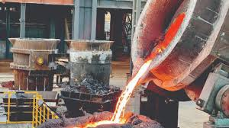
MINING SECTOR PERFORMANCE AND OUTLOOK.
ENG K MLANGENI – PROVINCIAL MINING DIRECTOR.
“Towards Inclusive Socio-Economic Transformation; Leaving No One and No Place Behind”
Notes:
Promoting Mining through Mineral Beneficiation
Value Addition
We now have the iron to craft our own beneficiation and value addition plants.
institutions, craftsmen and women, laboratories and researchers

Slide 2
OUTLINE
Introduction
Current Performance
Challenges
Opportunities
Future Outlook
Conclusion

Slide 3
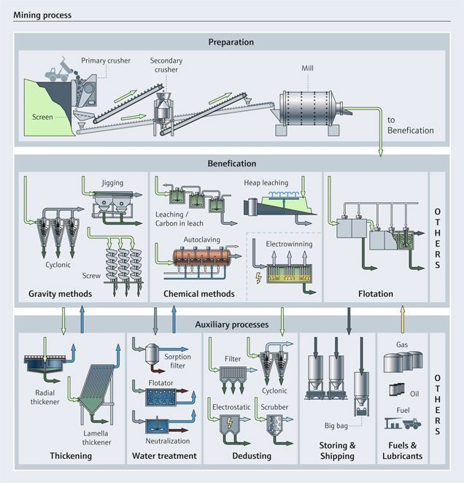
Notes:
Mineral beneficiation and Value Addition are the cornerstone of reaching the Vision 2030
Minerals include- ANTIMONY ,COPPER, CHROME, COAL, GOLD, PGMs

Slide 4
INTRODUCTION
Economic Contribution of mining was 22.7% of provincial GDP as at 2022.
SOURCE:ZIMSTAT 2023
Mining sector employment is approximately at 51 000 people
SOURCE :MINISTRY OF MINES AND MINING DEVELOPMENT DECLARATIONS
10.3% growth was experienced in the province from 2021 going into 2022 with a projected growth of 8.3 in 2024
SOURCE:MIDLANDS PEDP

Slide 5
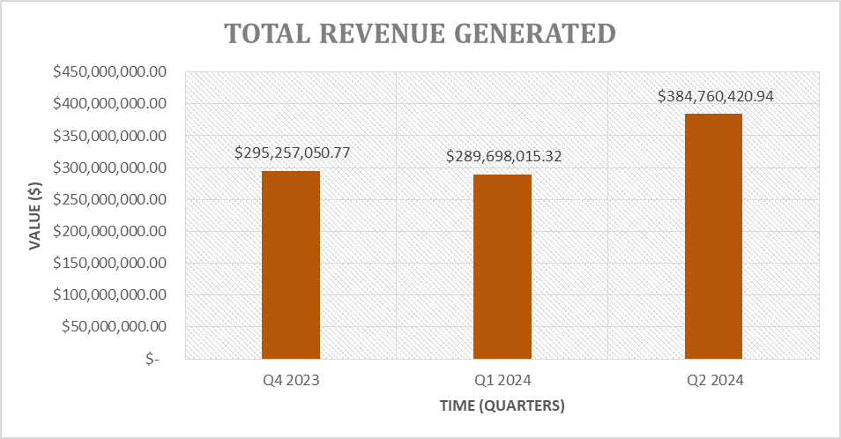
REVENUE GENERATED BY MINERALS SINCE Q4 2023
Source: Ministry of Mines Declarations.
Disclaimer: All values are in USD

Slide 6
Contribution of Minerals by tonnage 2023
Gold
Platinum
Chrome
Diamonds
Lithium
4.9 t
8.4 t
0.165Mt
412 000 carats
0.3Mt
Disclaimer : The data is from compliant miners who furnish the Mines office with declarations.

Slide 7
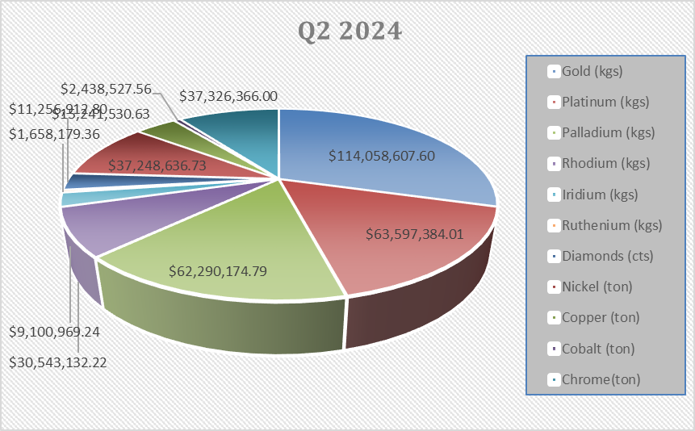
Contributions to the Mining sector in terms of Revenues
GOLD
LITHIUM
DIAMONDS
PGMs
CHROME
Disclaimer: Revenue is in USD

Slide 8
Districts and Minerals Found
Gokwe North : Coal, Copper
Kwekwe : Gold, Iron Ore, Antimony, Barites, Cobalt, Chromium
Chirumhanzu: Gold, Chrome, Copper
Gweru : Gold, Chrome, Iron, Asbestos, Platinum
Shurugwi : Gold, Chrome, Copper
Zvishavane : Platinum, Gold, Chrome, Asbestos
Mberengwa : Gold, Chrome, Asbestos, Emerald
Gokwe South: Gold

Slide 9
Mineral Beneficiation Opportunities
Heap Leaching
Gravity Separation
Bioleaching
Washing plants
Flotation plants
Dense Media Separation
Notes:
1. Heap Leaching: Effective for extracting gold and copper from low-grade ores.
2. Gravity Separation: Useful for separating minerals like gold and chrome from ore using gravity.
3. Bioleaching: Utilizes bacteria to extract metals from ores, particularly useful for copper and gold.
4. Solar Power: Reduces energy costs for mining operations, especially in remote areas.

Slide 10
Investment Opportunities
MINERALS WHICH NEED VALUE ADDITION
Tungsten
Molybdenum
Asbestos
Emeralds(Precious Stones)
Coal
Talc
Tantalite
Copper/Zinc /Lead
Beryllium
Diamonds
Gold
PGMs
Chromite
Iron
Lithium

Slide 11
MINERALS WITH OPPORTUNITIES FOR INVESTMENT AND EXPLOITATION
POTENTIAL CONTRIBUTORS
WHERE THERE ARE FOUND
TUNGSTEN
MOLYBEDNUM
NICKEL
COAL/Coal Bed Methane
TANTALITE
EMERALDS
BERYLIUM
SHURUGWI,SOMABHULA,GUNIEA FOWL
LOWER GWERU, NSUKUMINI, HUNTERS
HUNTERS,EMPRESS ZHOMBE,
SENGWA.SESSAMI,KAONGA(ALL IN GOKWE)
MBERENGWA(CLOSE TO SAVIRIMA RIVER)
ALONG MWEZA RANGE (MBERENGWA)
CLOSE TO SUNGAI AND NJORO RIVER (MBERENGWA),CLOSE TO NGEZI RIVER (SOMABHULA)
Notes:
Most of the potential contributors are alloying elements of steel which are expected to be in demand since DISCO has commenced operations.
Coal exploration was done thoroughly and investors are being invited to put their offers.

Slide 12
National Development Strategy 1 (NDS1) and Vision 2030
Emphasizes the importance of mineral beneficiation and value addition to drive economic growth.
Investment in the Midlands province's mining sector can significantly contribute to these goals by:
Job creation
Boosting local economy
Enhancing export revenues
Technological advancements
Sustainable practices
Notes:
1. Creating Jobs: Increased mining activities will generate employment opportunities, reducing unemployment rates.
2. Boosting Local Economies: Investments will stimulate local businesses and infrastructure development.
3. Enhancing Export Revenues: Value-added products like refined metals and alloys fetch higher prices on the international market, increasing export revenues.
4. Technological Advancements: Adoption of modern, low-cost technologies will improve efficiency and productivity in the mining sector.
5. Sustainable Practices: Investments can promote environmentally friendly mining practices, aligning with global sustainability standards.

Slide 13
PROVINCIAL DEVELOPMENT CHALLENGES
Technical knowledge
Mining related diseases (silicosis, pneumoconiosis,…)
Safety, Health and Environment Awareness
Illegal mining
Notes:
Use of trains to transport ores to lessen pressure on the roads and cost efficiency
Gokwe could be an energy hub which may develop and enhance the mining activity
Institutions such as MSU, Gweru Polytechnic and Kwekwe Polytechnic college to research on cheap extraction and value addition methods
Health checks and Mobile Clinics
Ramping up SHE awareness campaigns
Training and education of communities in mineralized areas.

Slide 14
Infrastructure available for Mineral Beneficiation in Midlands Province
Transport Networks
Energy Supply
Water Supply
Processing Facilities
    Milling Centers
    Concentration Plants
    Smelters
    Washing plants
Communication Networks
Support Services
Notes:
1. Roads: Well-maintained highways and roads connect mining districts to major cities and export points.
Railway: Rail lines facilitate the transport of bulk minerals to processing plants and ports.
Airports: Proximity to airports in Gweru and nearby cities for quick transport of high-value minerals.
2. Electricity: Reliable power supply from the national grid, with ongoing projects to enhance capacity.
Renewable Energy: Increasing use of solar and hydroelectric power to support sustainable mining operations.
3. Dams and Reservoirs: Adequate water resources for mining and beneficiation processes.
Water Treatment Plants: Facilities to ensure clean water supply and manage wastewater.
4.Smelters and Refineries: Existing plants for processing gold, chrome, and other minerals.
Custom Milling Centers: Small-scale facilities for initial ore processing.
5.Internet and Telecommunication: Robust network coverage for efficient communication and data management.
IT Infrastructure: Advanced systems for monitoring and managing mining operations.
6.Financial Institutions: Banks and financial services offering investment and operational funding.
Technical Expertise: Availability of skilled labor and technical experts in mining and beneficiation.

Slide 15
INVESTMENT ENTRY POINTS
Access to prospecting and mining ground may be easily obtained by acquisition of prospecting licence
Pegging and registration of mining claims
Purchase/Lease /Tributing of existing properties
Entering into joint ventures (ZMDC , private title holders) with existing mining projects.

Slide 16
INCENTIVES IN THE MINING SECTOR
Rebate of duty on importation of mining capital equipment
Deferment of Value Added Tax of up to 90 days for companies
Indefinite tax loss carryovers

Slide 17
OTHER OPPORTUNITIES
Polishing and Faceting facilities for precious and semi precious metals
Base Metal Refinery
Institute of Mining Research (Branch)
Metallurgical Laboratory
Foundries
Jewelry Industry
Notes:
Grading and Valuation of precious and Semi precious stones
Construction of precious metal and base metal refineries
A research laboratory for mineralogy, mineral processing and value addition (Partnering SIRDC and IMR)
Foundry technologies for the making and shaping of steels.

Slide 18
FUTURE OUTLOOK
Increase in PGM /Chrome/ Gold / Antimony production
Better rehabilitation and reclamation
Professionalism and better technical knowledge
Employment of Environmentally friendly methods of processing
Jewelry production in the province
Notes:
Tree planting programs
Closing of shallow digs in the province
Research on environmentally friendly methods of processing.

Slide 19
CONCLUSION
Vision 2030 can be achieved through investment in processing plants, refineries, laboratory, faceting and polishing plants.
Roping in institutions such as Midlands State University , Gweru and Kwekwe Polytechnic to train miners and do research on sustainable and environmentally friendly extraction methods.
Utilization of manpower from communities and training them to improve human capital development in the province.
Attracting skilled people and craftsmen from outside the province and transferring those skills to local Midlanders.

