Slide 1
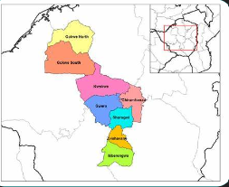
MIDLANDS PROVINCIAL DEVELOPMENT DIALOGUE,
FAIRMILE HOTEL, GWERU

Slide 2
Key infrastructure challenges across various sectors
Energy Infrastructure
Transport Infrastructure
Water and Sanitation Infrastructure
Housing and Urban Infrastructure
ICT Infrastructure
Healthcare Infrastructure
Education Infrastructure

Slide 3
Energy Infrastructure
1. Inadequate power generation and transmission
2. Frequent power outages and load shedding
3. Limited access to electricity in rural areas
4. Aging infrastructure and lack of maintenance
5. Insufficient investment in renewable energy sources
Notes:
Generation
Tarrific setting.
Prioritisation of Water and Sewer Installation.
Non strategic institution.
Vandalism (copper)

Slide 4
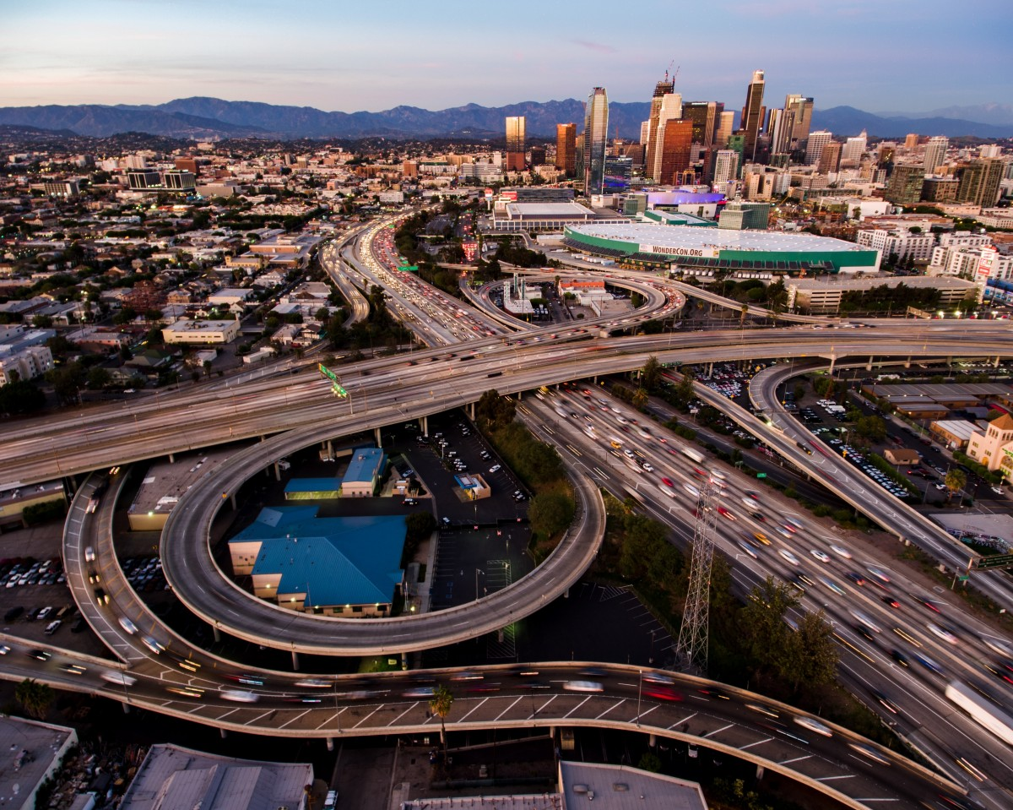
Transport Infrastructure:
1. Road conditions and lack of maintenance
2. Inefficient public transportation systems
3. Congested airports and inadequate air traffic control
4. Limited rail network and outdated rolling stock
5. Inadequate port infrastructure and inefficient cargo handling

Slide 5
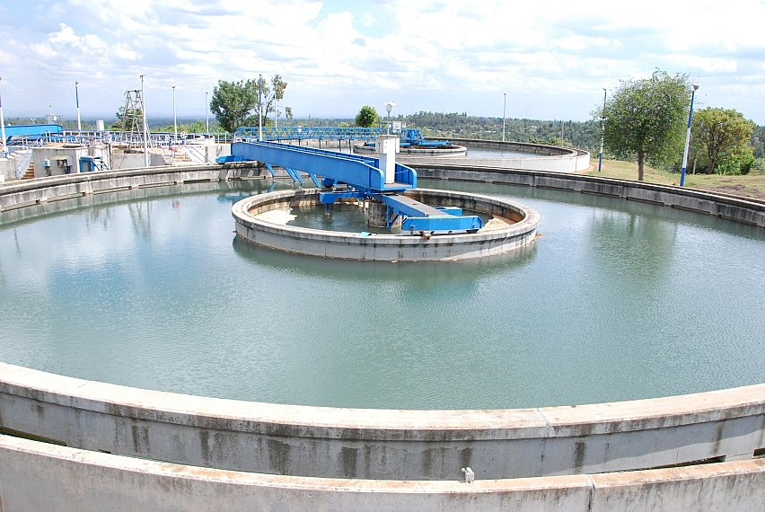
Water and Sanitation Infrastructure
1. Aging and leaky water pipes
2. Inadequate water treatment and purification
3. Limited access to clean water in rural areas
4. Insufficient sanitation facilities and wastewater management
5. Flooding and stormwater management issues
This Photo by Unknown Author is licensed under CC BY-SA

Slide 6
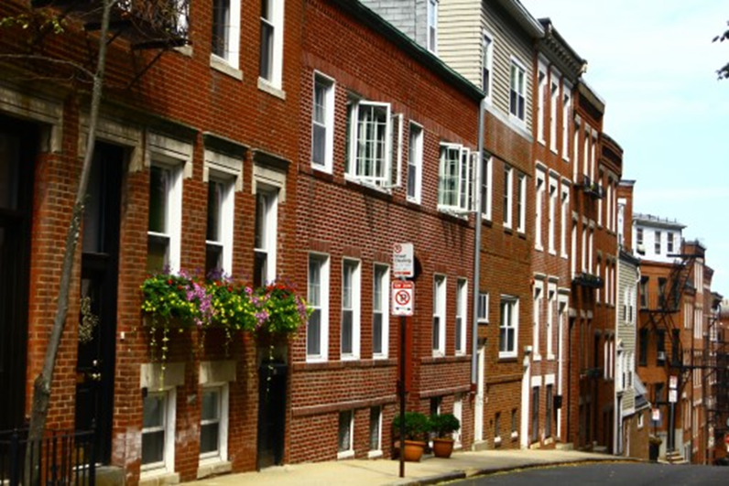
Housing and Urban Infrastructure
1. Housing shortages and affordability issues
2. Overcrowding and slum development
3. Inadequate waste management and disposal
4. Limited access to community facilities (e.g., healthcare, education)
5. Poor urban planning and lack of green spaces

Slide 7
ICT Infrastructure
1. Limited internet penetration and connectivity
2. Slow and unreliable internet speeds
3. Inadequate data storage and security
4. Limited access to digital payment systems
5. Outdated telecommunications infrastructure
This Photo by Unknown Author is licensed under CC BY

Slide 8
Healthcare Infrastructure:
1. Inadequate hospital facilities and equipment
2. Shortage of healthcare professionals
3. Limited access to healthcare services in rural areas
4. Inefficient healthcare management systems
5. Insufficient investment in healthcare technology
This Photo by Unknown Author is licensed under CC BY-SA

Slide 9
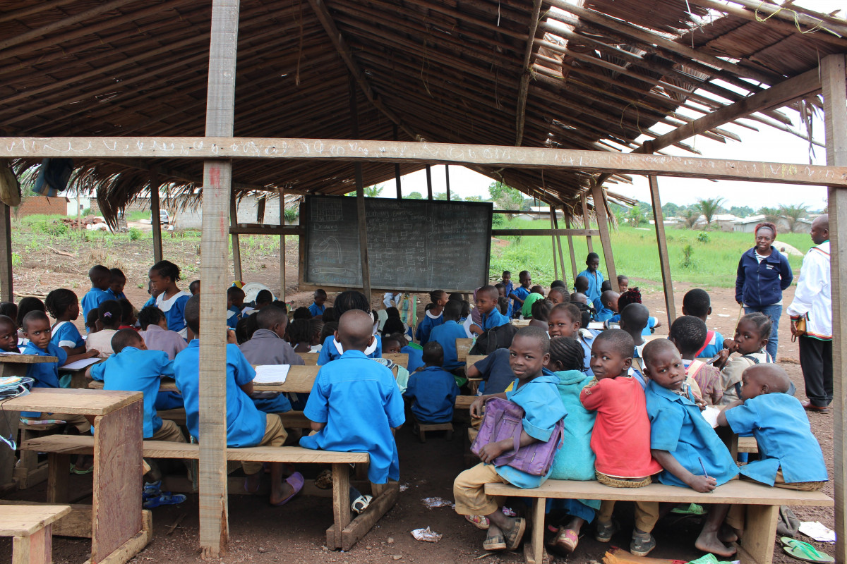
Education Infrastructure
1. Overcrowded and dilapidated schools
2. Limited access to educational resources (e.g., textbooks, technology)
3. Shortage of qualified teachers
4. Inefficient education management systems
5. Limited investment in vocational training and skills development

Slide 10
CONCLUSION
Addressing these infrastructure challenges requires a coordinated effort from governments, private sector investors, and international organizations to improve the quality of life, economic growth, and competitiveness.

Slide 11
THANK YOU

