Slide 1
Agriculture in Midlands Province: Opportunities, Challenges and Possible Solutions
Mavankeni B
PD Midlands Province
Ministry Of Lands, Agriculture, Fisheries, Water and Rural Development

Slide 2
INTRODUCTION
Zimbabwe has a Vision “To become a Prosperous and an Empowered Upper Middle Income Society by 2030”
This will be achieved through the implementation of the National Development Strategy 1 (NDS1): 2021-2025 and NDS2: 2026-2030.
The Ministry’s Vision is “A Prosperous, Inclusive, Diverse, Sustainable and Competitive Agriculture Sector by 2030” and
Its Mission is “To facilitate the Growth of a Modern, Sustainable and Viable Climate-Smart Agriculture Sector by 2025”

Slide 3
INTRODUCTION CONT’D
The Mission will be accomplished through “The Agriculture, Food Systems and Rural Transformation Strategy (AFSRTS) (2023-2025) which has six objectives:
To increase Crop, Livestock and Fisheries production and productivity for national food and nutrition security, and for food sovereignty and build a USD13.75 billion agricultural sector;
To improve livelihoods for accelerated rural agro-centred development;
To build a modern, technology-driven, diverse, resilient, inclusive and climate-smart agriculture sector;
To broaden and diversify agricultural markets and trade;
To enhance value addition and beneficiation of agricultural produce through aggregation and agro-industrialisation; and
To catalyse public and private sector reform and mobilise investments for accelerated agricultural development.

Slide 4
INTRODUCTION CONT’D
Midlands Province is located at heart of the country with vast potential for growth due to favorable elements
Agriculture and mining are the major economic activities
The province has lots of opportunities which can be explored
Despite its potential, the province is bedeviled by numerous challenges affecting agricultural production and productivity.
This presentation will explore potential and existing opportunities, challenges and discuss possible solutions to address the challenges.
Notes:
As a Ministry, we are Pre-Occupied by national development trajectory engraved in NDS1 Th presentation will 1. start by examining the current agricultural status of the province, 2. find potential areas for growth and development, 3. Identify challenges and 4. Propose strategies to address some of the challenges bedeviling the province The ultimate goal is to spark a conversation that will inspire action towards unlocking the full potential of the province to contribute towards Zimbabwe’s overall agricultural development agenda (ie, to improve production, farmer income, enhance food security and accomplish NDS1)

Slide 5
Overview of the Midlands Province
The Midlands Province has 8 districts with different economic activities defined by climatic conditions.
Population size is around 1,811,908, 941,244 (51,2%) are females (ZimStat, 2022).
Notes:
Fertile soils, favorable climate for diversified farming, abundant water resources and its position. #. Kwekwe and Zvishavane: Known for mixed farming involving crop and livestock production #. Rest of the drier districts: Major in livestock production with some districts into crop production (small grains as drought Mitigation strategy) Population Data: At least 1 million live in rural areas and depends on Agric More than 240 000 employed in Agric sector Most expansive provinces in the country covering 49 166 square kilometres (4 916 600hectares) The province is predominantly agro ecological zone 3, few areas falling under natural region 4 and 5, hence is classified as a semi-intensive agricultural production region. Third most populous with a population of at least 1,6million (ZIMSTAT 2012) of which 51.9% are females At least 1 million live in rural areas, 240 000 employed in the Agriculture sector The province tops on national GDP contribution agricultural production and mining.

Slide 6
Crop production (targets and trends)
The major crops grown include maize and wheat (cereals), soybeans and cotton.
Hectarage under maize for 2023/24 season was 392,685 a drop from 458,898ha 2022/23 season.
The average yield for 2023/24 was 0.14t a decline from 0.9t in the 2022/23 season.
Wheat production has been showing stead increase with a record of 375,000 tonnes harvested 2022/23 season.
The province is doing well in small grains like sorghum, roundnuts and cowpeas production (3rd high roundnuts producer in the country)
Notes:
Crop production: A lot of cereals and small grains are grown. Maize Production: Despite harsh climatic conditions, Command Farming, Pfumvudza/Intwasa Programs implementation resulted in increased area planted and yeild per hectare Wheat production: Production has been increasing steady since 2020, with a significant jump in 2022 To achieve food self sufficiency the province has 12 000ha of wheat planted this season (2024 winter cropping), expected to produced at least 60 000 tonnes of wheat Cotton production: The province is also the second highest producer of cotton in the country. 2020/2021 had a decrease duecto poor weather conditions. Bounced back in 2022/2023 season targeting 160,000tones (14.3% increase)

Slide 7
Livestock production (targets and trends)
Drier parts of the province are dominated by livestock production ventures.
Cattle production has decreased from 1,2million in 2018 to 1million in 2020 (Theileriosis, FMD, Anthrax outbreaks)
Shoats (sheep and goats) has seen a positive trajectory from 800,000 to over 100,000 collectively.
The agric sector is expected to grow by a revised 9,7% in 2023 from 14,1% down turn in 2022
Notes:
Livestock production venture ranging from communal to commercial production systems. Theileriosis (January Disease), Foot and Mouth Disease (FMD) and Anthrax related cattle deaths reduced production targets to 1million Vaccine production (JD vaccine), vaccinations, tickgrease bliss, dip tank rehab among other interventions has resulted in Dpt of Vet being on top of the situation

Slide 8
OPPORTUNITIES AVAILABLE
Government Support initiatives and Public Private Partnerships (PPPs)
Good soils, water resources and potential/existing irrigation schemes
Potential/existing value addition and processing hubs
Institutions of higher learning supporting agriculture
Market opportunities (Harare and Bulawayo)
Notes:
PPPs and Gvt Support Initiatives: 1. Establishment of VBUs and SBUs set up through Gvt, SIRP and SACP Partnerships 2. Agric4She initiative by First Lady to provide inputs, training and support for WOMEN EMPOWERMENT Water Sources and Irrigation: 109 Presidential Boreholes and 135 by local authorities drilled at Primary Healthcare facilities and in villages Potential for Value Addition: Availability of non agricultural economic activities like mining presents opportunities for industrialisation which would include Agro Industries supporting value addition Institutions of Higher Learning: 1. MSU and Mlezu offering various programs in research in various areas of agriculture 2. Provides Farmer and Extension Worker traininings to enhance production and productivity

Slide 9
AGRICULTURAL CHALLENGES
There are quiet a number of challenges affecting agriculture in Midlands Province
These challenges impacts on individual and household food security, income generation and productivity
Examples:
Climate change and variability
Land degradation and soil erosion
Limited access to credit and financial services
Limited market information
Price and market volatility
Notes:
The presentation acknowledges the existence of quiet a number of challenges bedeviling the Agriculture sector in Midlands, BUT narrows down to a few below due to their DELETERIOUS IMPLICATIONS on Agricultural PRODUCTION and PRODUCTIVITY Upon us is Climate Change and Variability 1. Climate change and variability 2. land degradation and soil erosion 3. limited access to financing and credit Other challenges (Source: PAIP Document) 1. The non-viability of the cotton and small grains value chains: This has been caused by the advent of producers that were producing high yielding genetically modified varieties in countries like China. The high yielding varieties have the impact of reducing the cost of production per kilogram, causing the reduction of producer prices to levels that are not viable for Zimbabwean farmers. 2. Heavy reliance on government to provide inputs through state funded schemes: Agricultural inputs distributors have diminished their presence in the farming areas citing decreased business volumes. 3. The business enabling environment has remained unfavourable to support organic and new investment within agricultural value chains. 4. The extension services are overstretched due to high breath of the coverage areas and the limited resources at their disposal. 5. Climate change has increased the incidences of drought seasons or poorly distributed rainfall patterns. The country imports over 60% of its agricultural inputs requirements, thereby exposing the country to the vagaries of global supply chain constraints and price movements. 6. There is limited value addition taking place within the provinces, thus negatively impacting the cost of production and cost of the end products that are produced centrally in larger cities like Harare and Bulawayo. 7. The shortage of tractors, implements and harvesting machinery, thus impacting the process of mechanization in the province. Farmers are failing to perform enterprise duties on time. 6. Farmers are experiencing high post-harvest losses due to lack of aggregation facilities, cold chain for fresh produce and storage facilities. 7. The road network in all areas is in a bad state of repair resulting in high cost of inputs and produce. The protracted logistical movements to production areas has increased the cost of production. 8. The food security in the province has generally been characterized by levels of low food sufficiency in most districts. The 2020/21 season was an exceptional season for some time as the good rainfalls resulted in high food sufficiency for most of the districts. 9. Farmers continue to experience low yields despite being provided with hybrid seed, fertilizer, and other inputs under the state funded input schemes. 10. Provincial production levels are too low to attract investment in processing facilities 11. The activities of small-scale miners are causing environmental degradation and polluting water bodies. 12. Lack of progression on the genetics of cotton, small grains and groundnut seed is affecting the yield potential for farmers

Slide 10
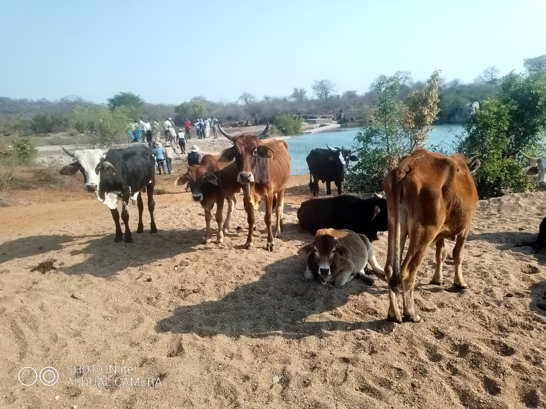
1. Climate Change And Variability
Notes:
Effects of elnino on crops

Slide 11
Climate Change And Variability (continue..)
Changes in climatic conditions and weather patterns results in:
distortion in rainfall pattern and distribution
Flactuations in temperatures
Droughts and floods
2023/2024 farming season was declared a failed season characterised by massive crop failure and livestock losses – poverty deaths
About 908 004 ha of crops were declared right off countrywide.
Of the 908 004 ha, Midlands Province contributed 273 122 ha (30,1%).
Notes:
Addressed through implementing the "Adaptation and Mitigation Action" Plan ADAPTATION ACTIONS Def: Adjustment of farming practices in response to CHANGE in Climate, Environmental Factors and other Stressers MITIGATION ACTIONS Def: Practices and Strategies used to reduce the negative effects of agricultural activities on natural environment, climate and ecosystems 1. Promote climate-smart, sustainable agricultural practices - GAPs (conservation agriculture, crop rotation and intercropping, livestock management, precision agriculture, organic farming) 2. Reduce use of synthetic fertilisers and pesticides (through Intergrated Pest Management (IPM), Intergrated Nutrient Management (INM) 3. Supporting climate-resielient agriculture research and development ( initiative by Institutions of Higher Learning)

Slide 12
Adaptation actions
Adjustment of farming practices in response to change in climate by the Privince include:
Dam Construction programs
Establishment of smallholder irrigation schemes
Production of drought and heat tolerant livestock breeds and crop varieties.
Use of biofortified small grains in drier areas (sorghum, cowpeas)
Use of best agronomic practices (Pfumvudza/Intwasa)
Notes:
ADAPTATION: Adjustment of farming practices in response to CHANGE in Climate, Environmental Factors and other Stressers Irrigation and Water anagement: 1. Vungu dam construction project on 15% water to be used in Zibangwe upon completion 2. Establishment of smallholder irrigation schemes eg Mayorca smallholder irrigation scheme in Kwekwe, Mundi-Mtanga Biri Extension irrigation scheme in Mberengwa, Mtangwe irrigation scheme (134ha) in Gokwe South 3. Borehole drilling and powering which is pivotal in establishment of VBUs/SBUs (eg Vungu High Sch Garden) other schools (Riverton Academy, Mkoba Hugh, Zvishavane High, etc..) have Agric as subject plus a garden Livestock Adaptation: 1. Livestock Adaptation programs aimed at producing climate change resilient and heat torelant breeds. 2. Feed production and Value Addition (Hay bailing and Fodder Ammoniation Process, commercial feed distribution to achieve a health resielient herd. Eample - The Livestock Production Systems in Zimbabwe (LIPS-Zim) project Promoting adaptive livestock feeding practices and adaptive breeds, disease surveillance and control NB: ANIMAL HEALTH MANAGEMENT, IMPROVED BREEDS AND IMPROVED FEEDS are key in vulnerability reduction and resilience enhancement Crop Adaptation: 1. Use of biofortified seeds 2. Growing climate change resilient crop varieties (especially sorghum & cowpeas) in drier districts 3. Use of sound agronomic practices like soil and fertility conservation, intergrated disease and pest management (as in Pfumvudza/Intwasa Programs)

Slide 13
Mitigation strategies
To reduce impacts of climate change on agric activities, the province is:
Promoting climate-smart and sustainable agricultural practices e.g. Good Agronomic Practices (GAPs).
Reducing the use of synthetic fertilizers and pesticides through IPM, INM.
Promoting and supporting research and development of climate-resilience agriculture spearheaded by Institutions of Higher Learning and Research Directorate.
Feed value addition and mitigatory feed distribution
Notes:
Definition Mitigation refers to practices and strategies used to reduce the negative effects of agricultural activities on natural environment, climate and ecosystems GAPs-Good Agronomic Practices IPM-Integrated Pest Management INM-Integrated Nutrient Management R&D-Research and Development NB: Other initiatives are achieved through individual farmer visits, farmer training programs by Agritex and Vet, Radio listening programs offered on air

Slide 14
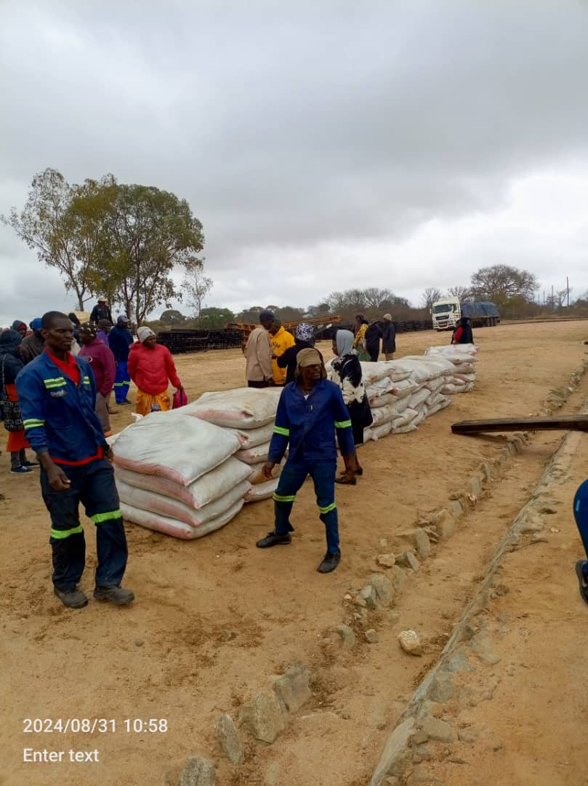
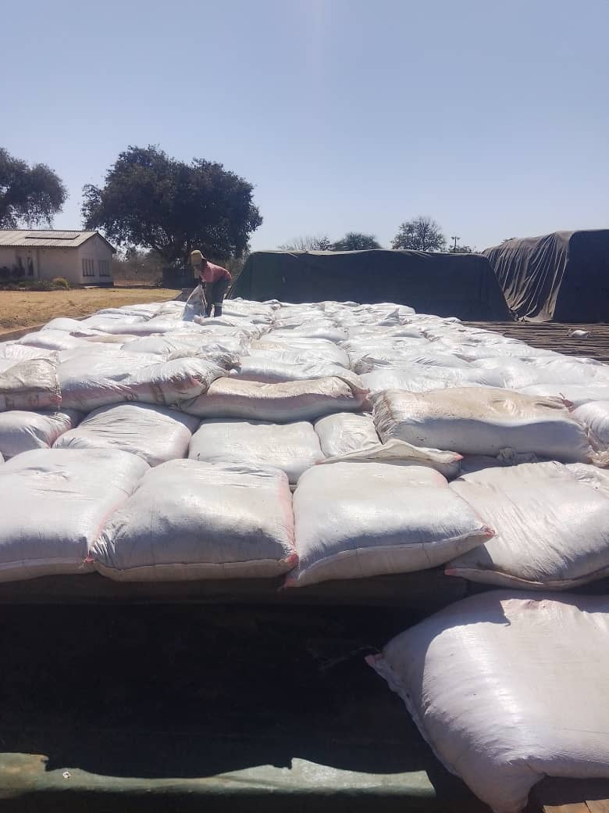
Livestock Feed Distribution

Slide 15
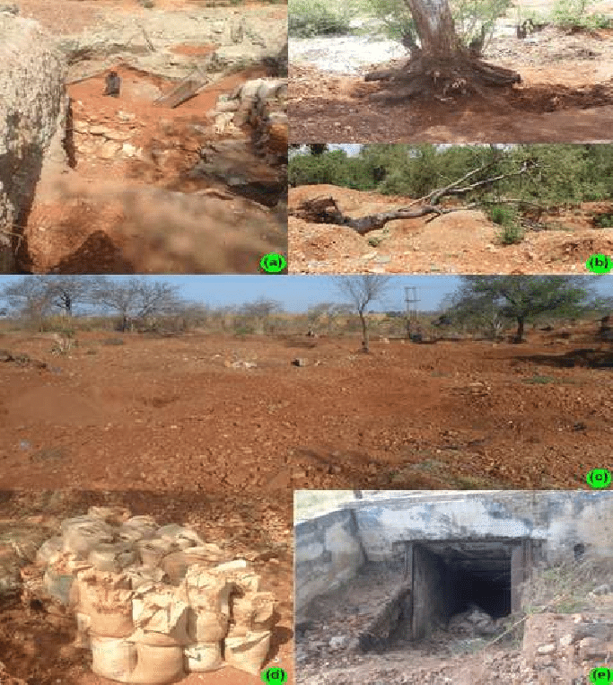
2. Land Degradation And Erosion
Product of small scale artisanal mining activities causing gullies and open pits.

Slide 16
Land degradation and erosion (continued)
Land degradation is mainly as a result of mining activities by artisanal miners
Gullies, open pits, water pollution affects animal and crop production
Strategies to address are:
Policy Harmonization
Inter-Ministerial Collaboration
Sustainable Mining Practices
Monitoring and Evaluation
Notes:
Policy Harmonisation: 1. Government is addressing issues of policy conflict between Agriculture and mining. Currently the government working on modernising The Mines and Minerals Act of 1961 in an attempt to balance different land uses, with the President's rights to mine superseding other land rights (The President reserves ownership of all minerals and only him can grant licenses to companies and individuals). Very little progress on this aspect This approach borrows largely from Intergrated Land-Use Planning where the two mimisteries develop a comprehensive land-use plan that balances agriculture and mining activities to avoid conflict over land use. Inter-Ministerial Collaboration: Close collaboration between the Ministries of Mines and Agriculture to ensure alignment of policies and regulations Sustainable Mining Practices: The government is working towards adoption of environmentally friendly practices which do not only address concerns of land degradation, but addresses issues of water pollution and Protecting agricultural lands. M&E: The government has established the Department of Monitoring and Evaluation tasked to establish a framework to track progress, address challenges, and make recommendations, adjustments to polices and prorams

Slide 17
3. Limited Access to Financing and Credit
Due to:
low banking penetration (few banks have branches in small towns hindering access to financial services)
Collateral security and high interest rates by banks and building societies preventing smallholder farmers access to financing
Possible solutions
Government financing programs – AFC, CBZ
V30 Accelerator Model [ARDA & Small Holder Irrigation Scheme]
Private sector microfinance institution involvement
Notes:
Private sector microfinance institutions
1. National Enhanced Agricultural Productivity Schemes (NEAPs) by CBZ, AFC (new command farming)
2. Zimbabwe Women`s Microfinance Bank
3. Midlands Microfinance Trust
4. Vision Fund Zimbabwe
NB: these institutions offer different services like loans, saving Account for farmers, Insurance products in case of failures, financial training and capacity building to enhance financial literacy and productivity.

Slide 18
Conclusion
Midlands province has a significant agricultural potential.
Dealing with challenges and capitalizing on opportunities will help the province unlock and attain its potential.
Success is pinned on effective collaboration among stakeholders i.e. farmers, government, and the private sector.

Slide 19
THANK YOU

