Slide 1
Packaging Investment Opportunities in Midlands Province
Tapindwa Chipunza
INVESTMENT PROMOTION OFFICER
tchipunza@zidainvest.com

Slide 2
Who is ZIDA
Investment Facilitation
Investment Promotion
Investment Protection

Slide 3
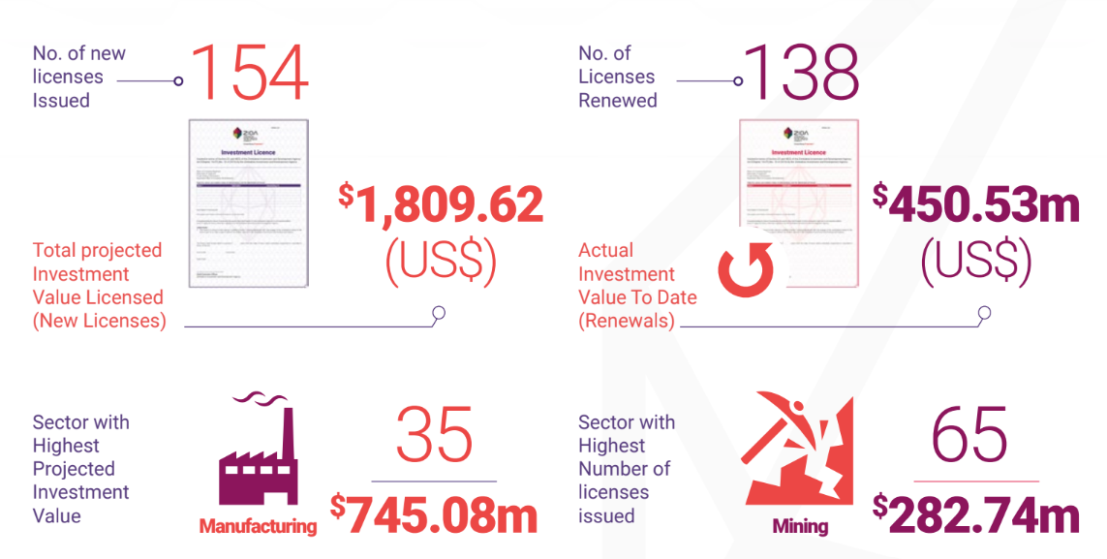
Q2 2024 – Key Statistics

Slide 4
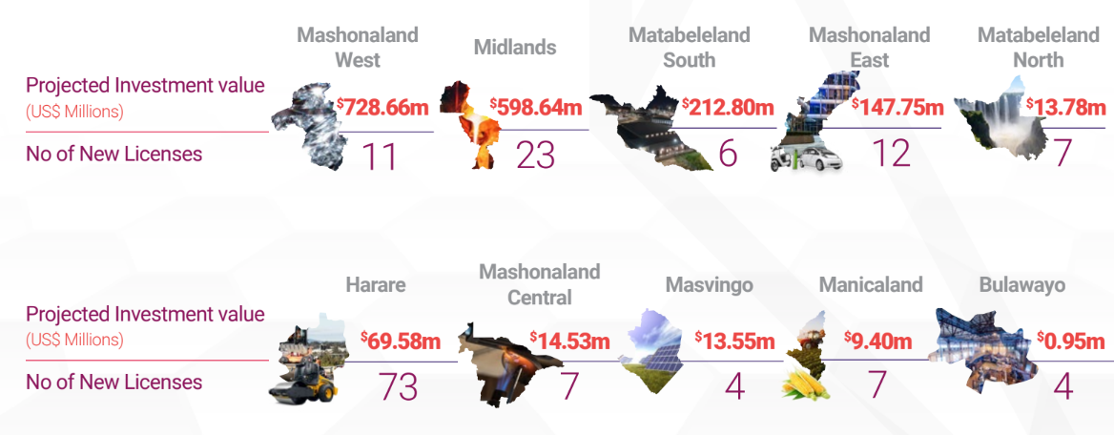
Q2 2024 – Key Statistics

Slide 5
Key Statistics – 2022 to 2024
Projected Investment Value by year
Sector | 2022 | 2023 | Q2 2024
Agriculture | 179.3 | 32.48 | 6.05
Construction | 4.30 | 1,961.33 | 0.25
Energy | 281.85 | 3,525.30 | 0.12
Manufacturing | 920.41 | 250.89 | 180.90
Services | 104.13 | 1,275.76 | 217.37
Tourism | 3.14 | 2.24 | 1.10
Transport | 11.41 | 19.49 | -

Slide 6
Q2 2024 – Midlands Statistics 2020 to date
Sector # of Projects Value
Mining 148 USD$1,137,968,240
Energy 8 USD$817,694,600
Manufacturing 15 USD$799,381,828
Services 6 USD$3,800,000
Construction 3 USD$1,400,000
Agriculture 2 USD$1,325,500
Tourism 1 USD$1,020,939
Transport 2 USD$573,960
ICT 1 USD$200,000

Slide 7
Elements of Packaging Investment Opportunities
Understanding the Product
Mashonaland
West
Mashonaland
Central
Zimbabwe’s Value proposition
Provinces Value Proposition
Unique Offering
Available Opportunities
Mashonaland East
Matebeleland
North
Manicaland
Midlands
Manicaland
Matebeleland
South
Masvingo

Slide 8
Research
In line with the National Development Strategies
Regional and International benchmarks
Information analysis on lead sectors and investor targets.
Understanding Investor sentiments.

Slide 9
Project Development
Identification of project/investment opportunities. Working with MDAs and the Private Sector as Project Promoters.
Development/appraisal of projects - process ideas into projects whether they be public or private driven. Establishing a Provincial bankable project pipeline.
A project is bankable when its risk-return profile meets investor criteria can secure financing.
A bankable project is a project which is investment ready/finance ready.
ZIDA works closely with Project Promoters to address issues of bankability. Feasibility Studies are important

Slide 10
Attracting the Investor & Right Investment
STAGE 1
STAGE 2
STAGE 3
Who and Where
Are they
When, Where, How
They are investing
What
Are they seeking
?

Slide 11
Creating the Narrative for Investor Attraction
Real live Stats and Data on Provinces
Content Development (Designs & Messaging)
Adoption of effective communication Channels
Scoping missions and meetings
Local, Regional, International events participation
Stakeholder capacity building initiatives

Slide 12
Categories of Investment
General Investments
Public Private Partnership
Special Economic Zones
These are investments wherein private investors deploy their capital in chosen projects without a requirement for partnership with government or any of its entities.
Contractual arrangement between Government and Private Sector
High value Projects
Mainly infrastructure based
A Special Economic Zone (SEZ) refers to:
A Geographically demarcated and secured area.

Slide 13
The Investor Journey
Monitoring &
Evaluation
Pre-Licensing
Licensing
Establishment
Aftercare
Investor Enquiries
Opportunities information
Establishment Processes
Company Registration
Online DIY Portal application
Company documents
Summarised business activity
Land and assets
Permits & Licenses
Support services
Relationship
Resolution and Advocacy
Retention
Re-investment
Tracking progress
Review and analysis
Investment impact

Slide 14
The Ease of Doing Business – Digitalisation
MANUAL SYSTEM
CRM MODULE
DIY PORTAL
Average Processing Time
Average Processing Time
Average Processing Time
Pre-Digitalization Phase
Pre-Digitalization Phase
21 Days
7 Days
5 Days
Manual System involved:
physical submission of applications,
physical movement of files,
manual processing and paper-based registry
Physical enquiry handling
Long turnaround
Lost enquiries
Inquiry Handling Module,
Licencing Module (GI and SEZ Investor Licensing)
Automated Application submission and processing
Online Registry
Electronic Aftercare & M&E
Faster turnaround
Efficient enquiry handling
No loss of enquiries (MOM)
Self-Service platform for Investors (Submission of Application, Renewals, Progress Reports & Investor Interface)
Handling enquiries
Service Charter

Slide 15
ZIDA – Licensing Requirements
Company Registration
Register on the ZIDA DIY Portal
Reduction of turnaround time due to digitalization FROM
Upload all requirements and pay US$500 application fee
Business Plan/ Concept
Certified Company Registration documents
IDs for shareholders
Company profile in a case where shareholder is a company
Power of Attorney where application is made by 3rd party
21 days
License application approval and notification
7 days
Pay a license fee of US$4500 on approval
5 days
Receive digital copy of licence or collect hard copy at ZIDA
OSISC facilitation

Slide 16
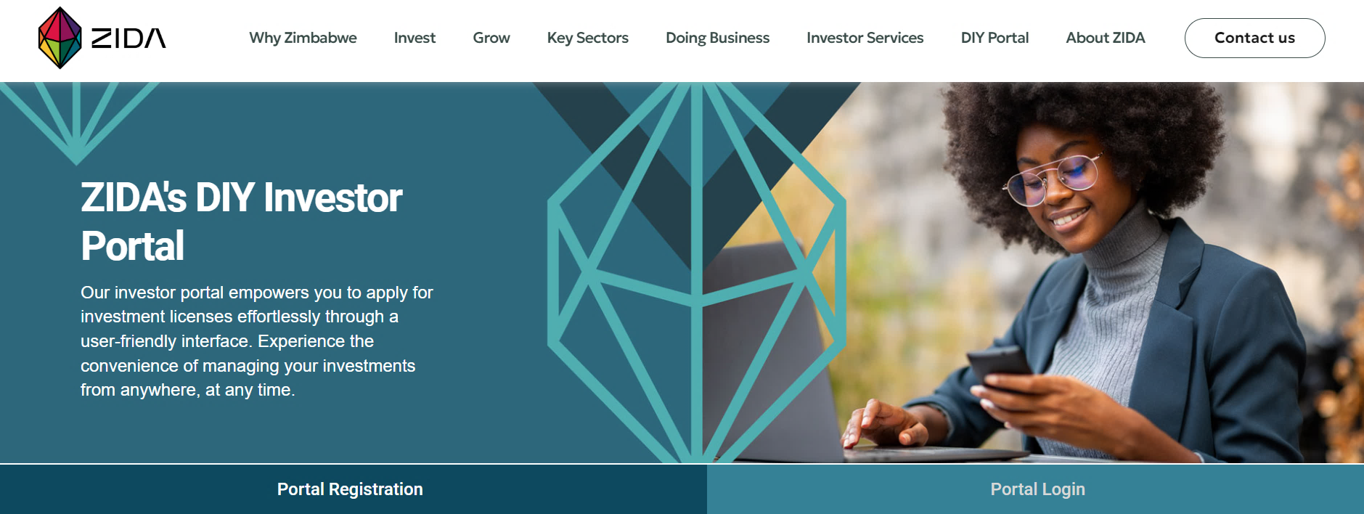
DIY Portal
Shortens licensing processing
Convenient
Comprehensive Information
Efficiency
Effective 1 September 2024 all license applications processed exclusively on the DIY Portal

Slide 17
Investors have the right to…
Establish companies in Zimbabwe with 100% foreign ownership, without any restrictions on the percentage of foreign shareholding.
Engage directly with ZIDA without the involvement of any third parties
Freely repatriate their capital, profits, dividends, interest, and other approved payments out of Zimbabwe
Access various investment incentives, such as those offered under Special Economic Zones
Access relevant information about investment regulations, procedures, and opportunities in Zimbabwe
Acquire land and property in Zimbabwe for their investment projects

Slide 18
Thank You
For more information on:
General Investments, SEZs, PPPs & the One Stop Investment Service Centre
Email us on:
info@zidainvest.com
Tel: +263 8688 002 640-3
www.zidainvest.com

