Slide 1


Business and Policy Opportunities
From Zimbabwe’s Structural Transformation Ambition

Slide 2
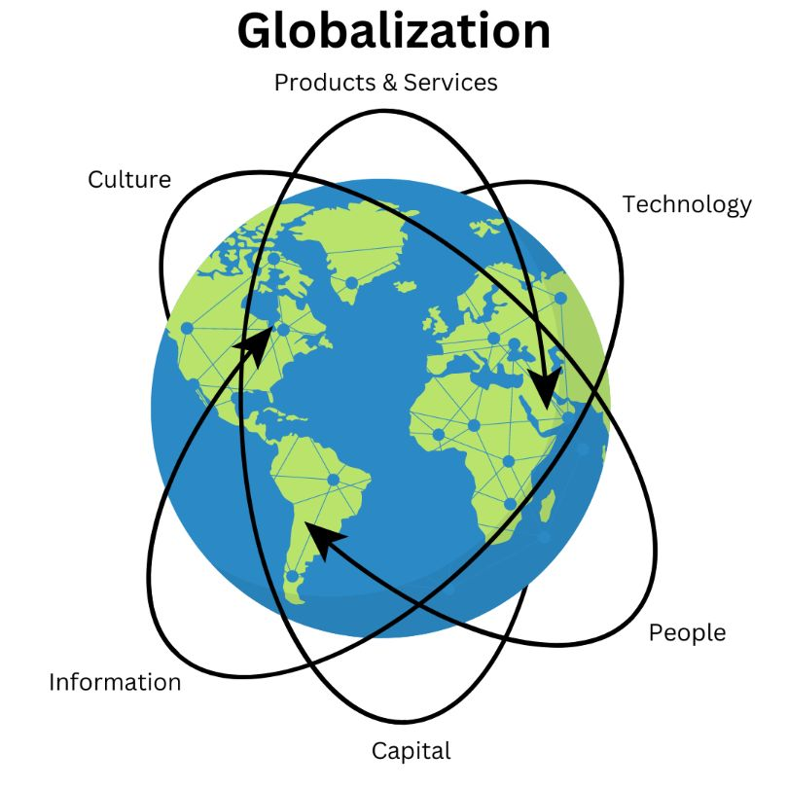
The Global Context
We are firmly in the 5th Industrial Revolution (Industry 5.0) emphasising human centricity and sustainability vs rapidly changing technology
The world getting ‘smaller’. Markets and competition defined more globally.
Supply (and value) chains more interconnected, and interdependent; so are associated risks
Technology lowering boundaries and borders
Greater need to extract the benefits of globalisation, whilst ensuring local resilience

Slide 3
Transformation investment case (NDS2)
From
To
High informality and exclusion
Shallow local markets, high import bill
Infrastructure and energy bottlenecks
Elevated country risk perception
Limited absorption of skills
Relatively high cost of doing business
Limited sources of capital and finance
GDP strongly correlated to commodities
Shallow value addition
New, growing and more resilient markets
More regionally competitive economy
Coordinated infrastructureinvestment (PPP)
Improved risk/return profile
More jobs, skills and knowledge utilization
Efficient value chains, wider and tax base
Deeper and more efficient capital markets
More diversified economy, reduced GDP sensitivity to external shocks.
Deeper manufacturing value & innovation

Slide 4

Value proposition
The levers of transformation – endowment and capability advantage
Good climate and productive soils, wide mineral base, strategic regional location, digital connectivity, people.
Capabilities
Opportunity
Well orchestrated Execution
Vision
Transformation drivers – NDS2 pillars
Value addition and beneficiation, industrialization, infrastructure investment, financial sector deepening, technology and innovation, private sector led modernization (State supported).
Endowments

Slide 5
Business and policy opportunities
Mineral Beneficiation
discouraging raw exports
Lithium salts and batteries, iron and steel, mineral refining
Industrialization
- value enhancement
Aggregation and export hubs, cold chain logistics, fertilizer production, agriculture mechanisation, chemicals, pharmaceuticals
Services
- skills development, innovation
International service provision, leveraging local skills and technology, logistics hub

Slide 6
Business and policy opportunities
Infrastructure
Energy, roads, rail, water, health, education and housing.
Financing Channels
Capital markets, financing structures, Public-private-partnerships (PPPs), SEZ incentives, sovereign wealth capital.
Digital & Innovation
Broadband, remote service centres, Fintech, AgriTech

Slide 7

People and sustainability
People and culture underpin the success we desire. Business and policy need to combine effort to develop the people that will underwrite the success we seek
Embracing sustainability future proofs development plans and initiatives

Slide 8
Transformation anchors
Business Leaders
Policymakers
Align strategy with priority value chains.
Leverage policy-backed demand
Position to partner national development priorities
Be future fit (tech) and localize capacity
Think resilience and sustainability
Sustain clear and consistent directional policy thrust
Continue ‘Ease of doing Business’ Reforms
Uphold transparency, to foster credibility
Sustain open dialogue and sound research in developing robust policies

Slide 9
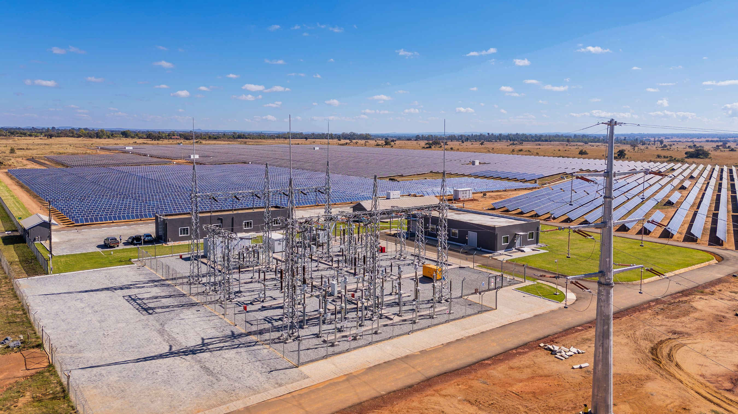
In summary
Zimbabwe’s structural transformation ambition creates:
New markets
New industries
New partnerships
The transformation factor in NDS2 presents policy backed opportunity for steeper growth.
The confluence between policy and business yields greater momentum

Slide 10

You are most appreciated, ladies and gentlemen

