Slide 1


Healthcare Imperatives in Zimbabwe’s Structural Transformation Agenda
22 April 2026 I Vuli Ndlovu

Slide 2

Foundational sectors for successful transformation
Agriculture
Tourism
Health
Education
Notes:
Invest in colleges??

Slide 3
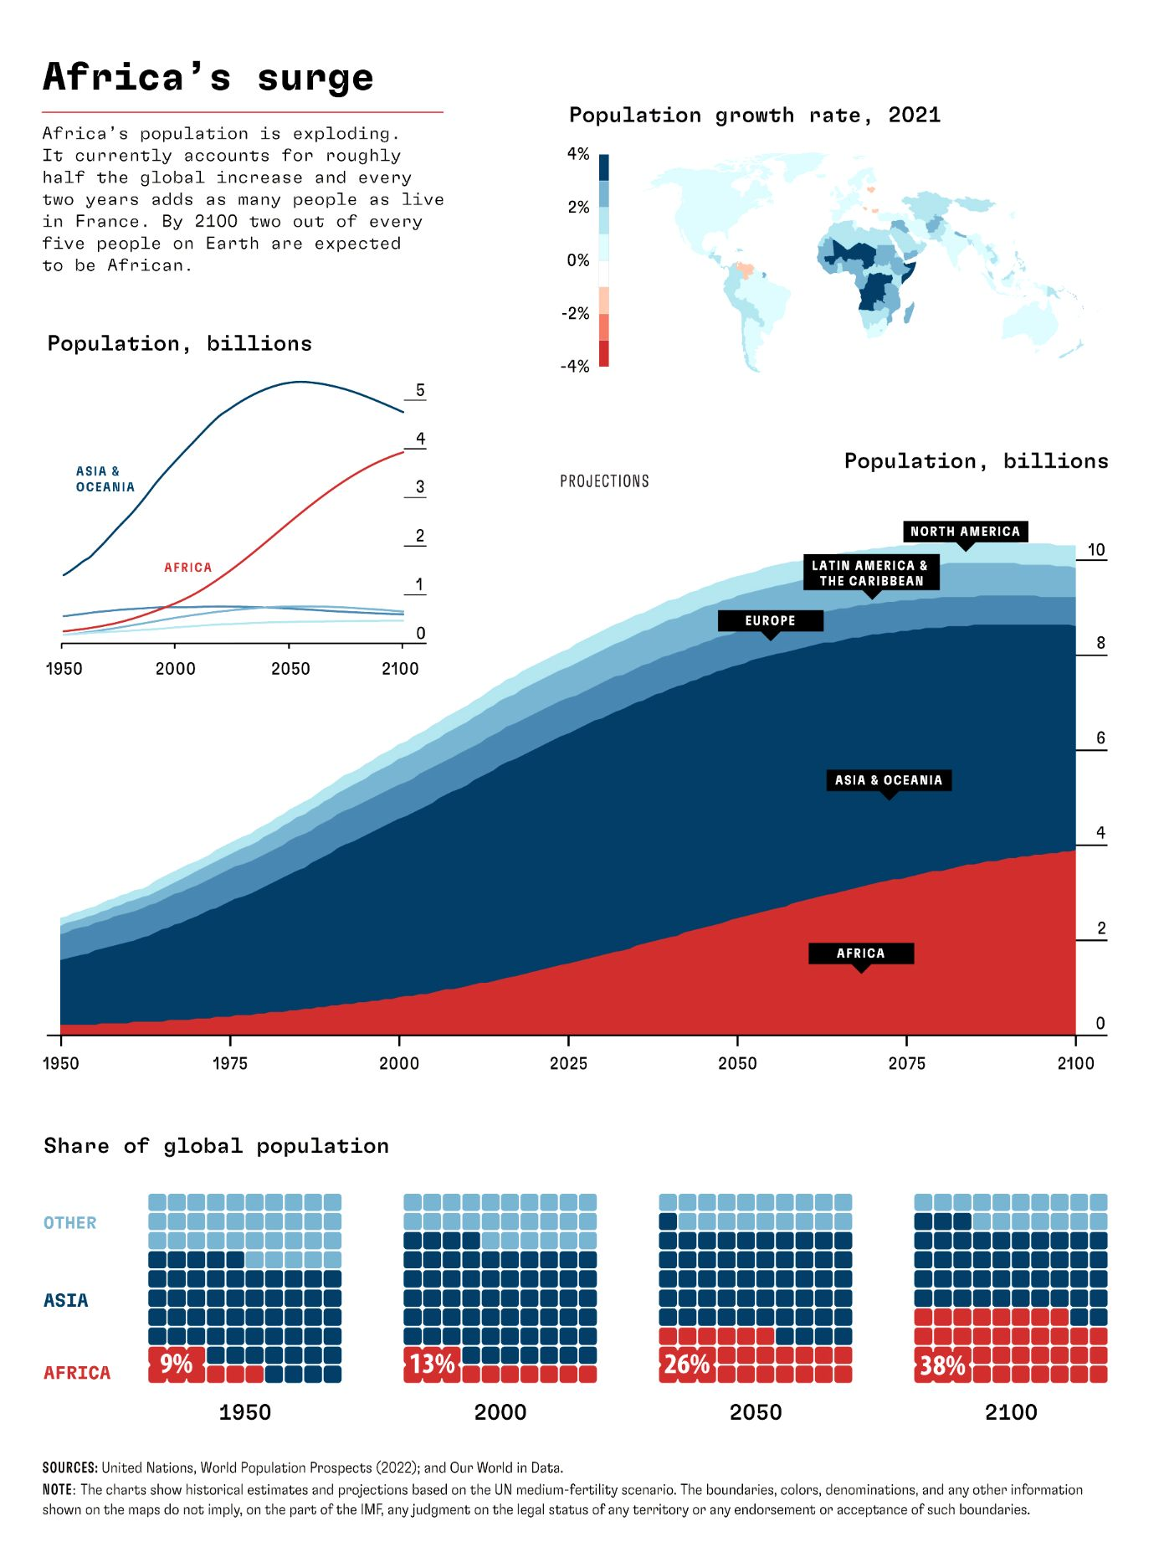
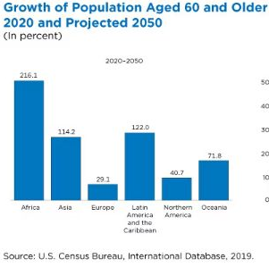
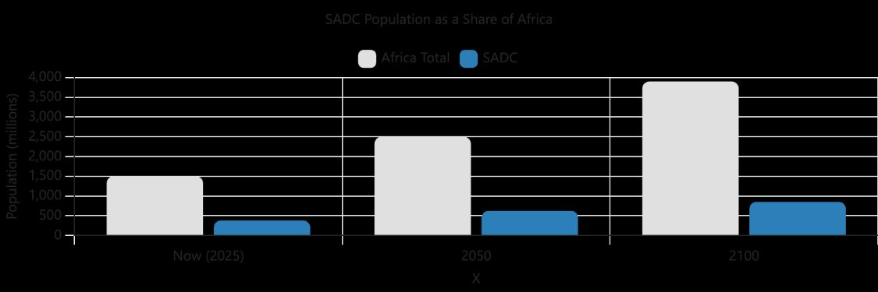
The future of Africa
Notes:
Invest in colleges??

Slide 4
Zimbabwe’s Health Gains Are Real
Maternal mortality down
Under-5 mortality down
→
→
651
212
102
69
deaths per 100,000 live births
deaths per 1,000 live births
2015 to 2023–24
1999 to 2023–24
Zimbabwe Demographic and Health Survey
Zimbabwe Demographic and Health Survey
Source: Zimbabwe Demographic and Health Survey 2023–24

Slide 5
Structural realities making healthcare urgent
Access and Coverage
90%+ uninsured
Out of pocket health Spending vs Demand
Government foresight: Sugar tax, NHI
Universal Health Coverage
Grow the insured public
Improve access
Prevention and primary care
Patient centred policy
Notes:
Invest in colleges??

Slide 6
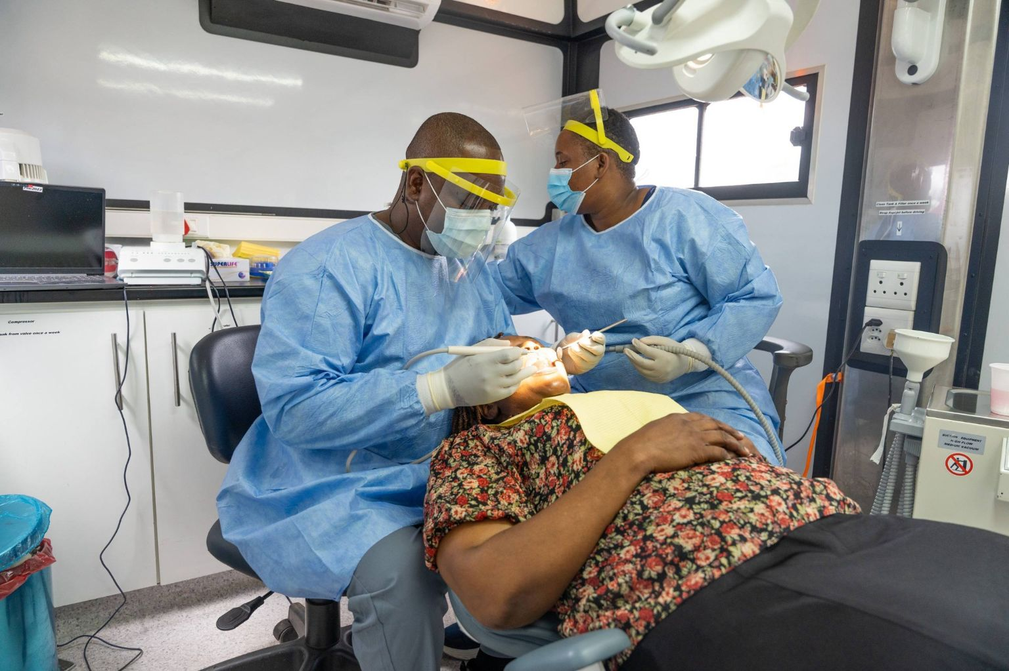

Scaling up primary care: Enablers
Skills
Infrastructure
Partnership and technology
Notes:
Invest in colleges??

Slide 7

Possibilities for Zimbabwe
Agriculture : meet Tariro Magase

Slide 8
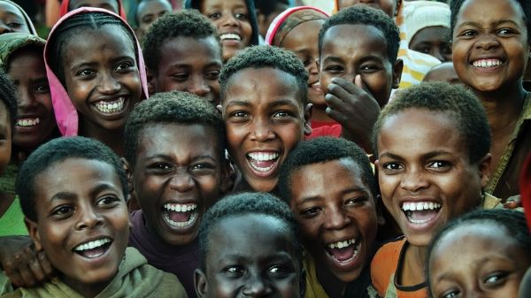
Together we make a difference

