Slide 1







Place Evaluation and Learning Asset Mapping Exercise
An introduction from the
National Evaluation & Learning Partnership (NELP)

Slide 2
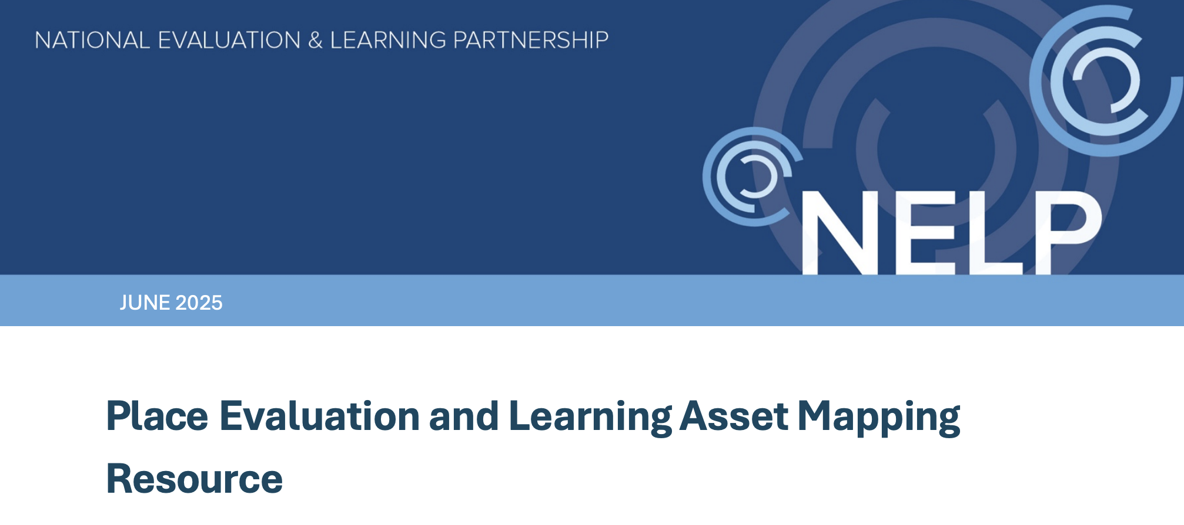
Contents
What is the Evaluation and Learning Asset Mapping Exercise?
Why is it important?
How will it be implemented?
Notes:
Influences on physical activity are complex

Slide 3

The ELAM is informed by Cycles of learning and action
There are appropriate methods in place to learn from experience and, over time, improve place-based working to address physical inactivity.
Sub-condition | Embedded in practice
GEN 1 | Learning culture
Sector integration of physical activity | Continuous learning culture is established as a core part of the place-based systemic approach. This includes paying attention to the different kinds of value that this can bring to everyone engaged or affected. Feeling ‘uncomfortable’ and accepting uncertainty is commonly accepted. People widely see uncertainty as an opportunity for learning and are ready to learn from initiatives that have not gone to plan, and to adapt their approach accordingly.
GEN 2 | Embedded learning processes
Strengthening community & individual capacities | Learning policies, processes, training and resources are supported and prioritised across the system as a core tool for operationalising a place based systemic approach. Inclusive learning processes are embedded in partnerships and individual organisations. These pay attention to local people’s experiences and wider evidence, in a continuous cycle of reviewing actions, with insights and learning leading to adaptation and improvement. This includes permission to stop doing things that are not working.
GEN 3 | Evaluation uses appropriate methods for place-based working
Tackling structural inequalities | Evaluation methods appropriate for whole-system place-based approaches are widely understood and adopted across the place partnership and inform adaptive ways of working. Local people with lived experience of physical inactivity, those implementing PA activities or involved in agencies locally are contributing to the framing, design, and implementation of evaluation/learning processes and providing insights into what makes a difference locally. Evaluation data is shared in accessible formats and in welcoming spaces so that people can make sense of the data to inform action.

Slide 4
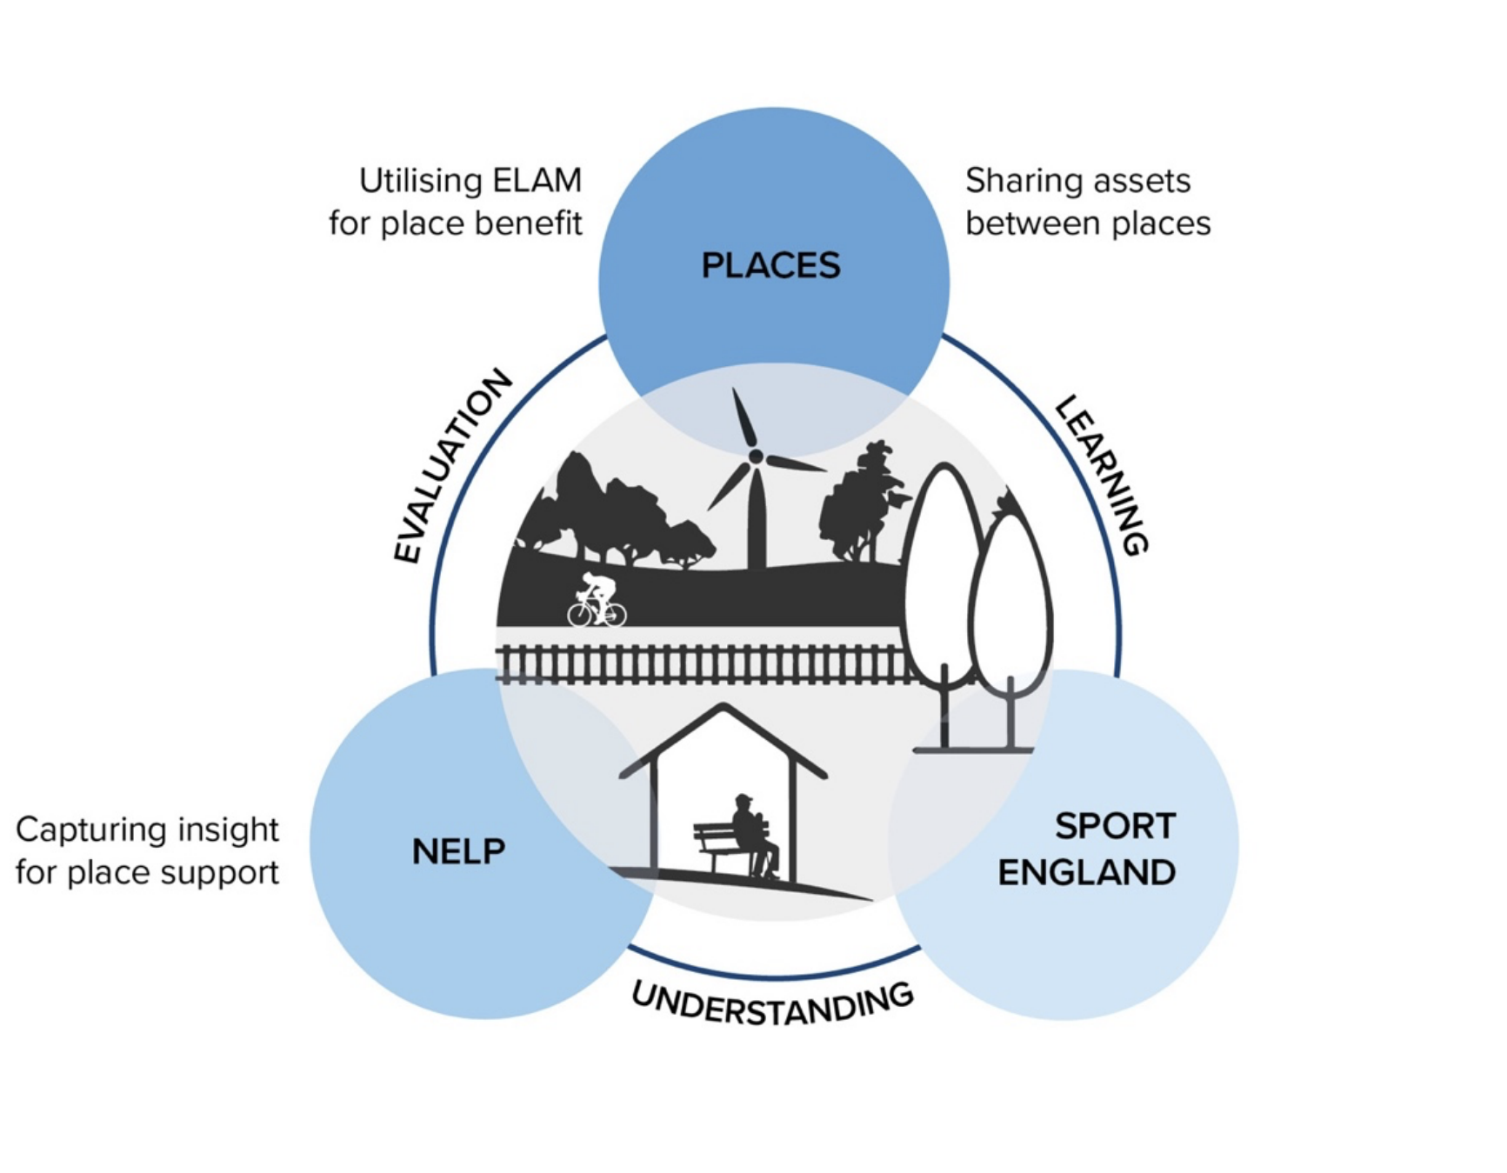
What is the ELAM and why is it important?
We are holding a key question of what does evaluation and learning look like in a place?
Places can use this exercise to inform their evaluation and learning practices.
NELP and Sport England can better understand local evaluation assets and needs.
Informs how NELP can support places locally and proportionately.

Slide 5
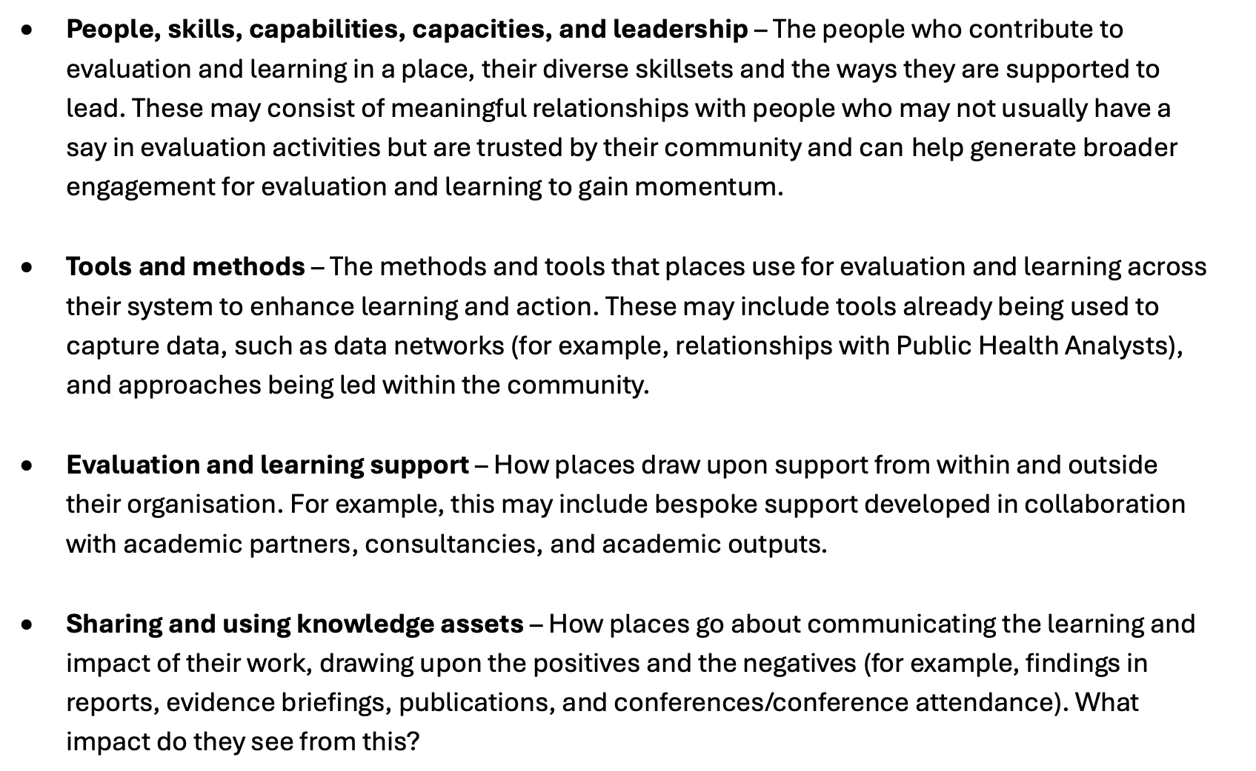
What is an asset?

Slide 6
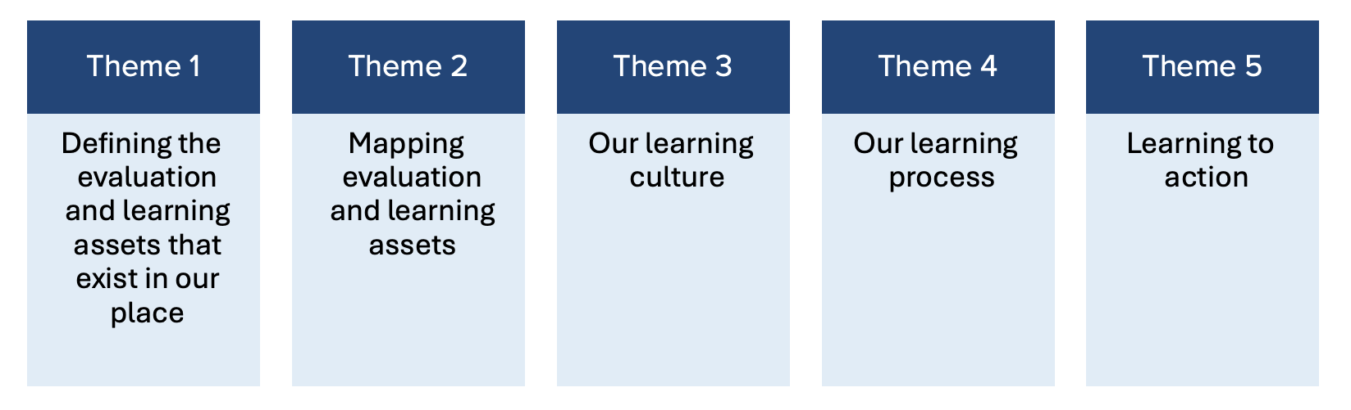
How will it be implemented?
Data driven exercise coordinated by NELP
ELAM meeting exploring the following themes
Findings gathered and shared back with places
*Places can start engaging and making use of the ELAM.

Slide 7
Developmental use for Cycles of Learning and Action
ELAM can help places establish the foundations for Evaluation and Learning.
ELAM can build on what currently exists in Evaluation and Learning in a place.
An ongoing developmental tool that can inform the maturity of Cycles of Learning and Action.

Slide 8
Questions? Contact: nelp@shu.ac.uk

