Slide 1
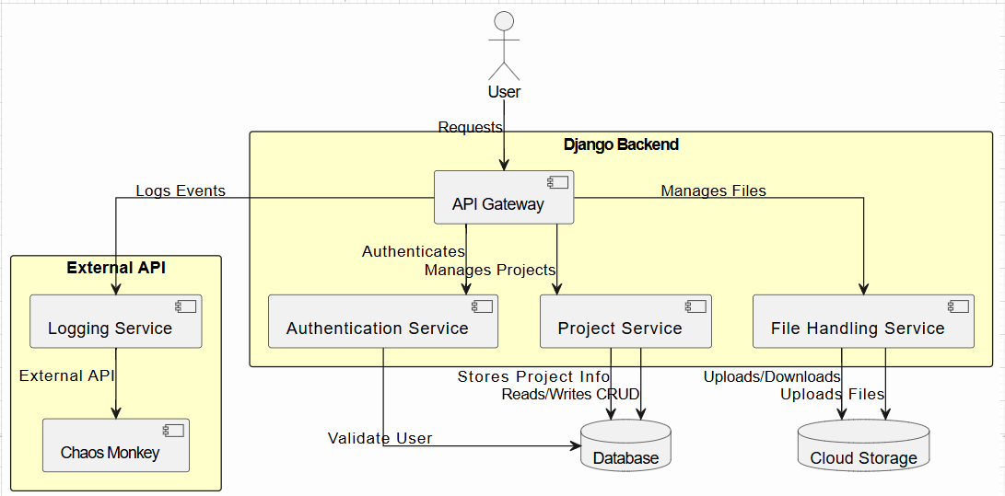
ARCHITECTURE DIAGRAM

Slide 2
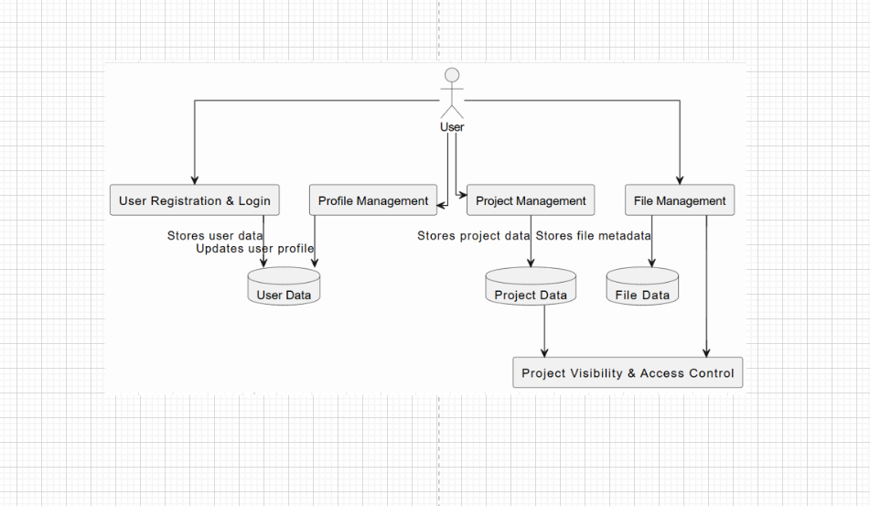
DATA FLOW DIAGRAM

Slide 3
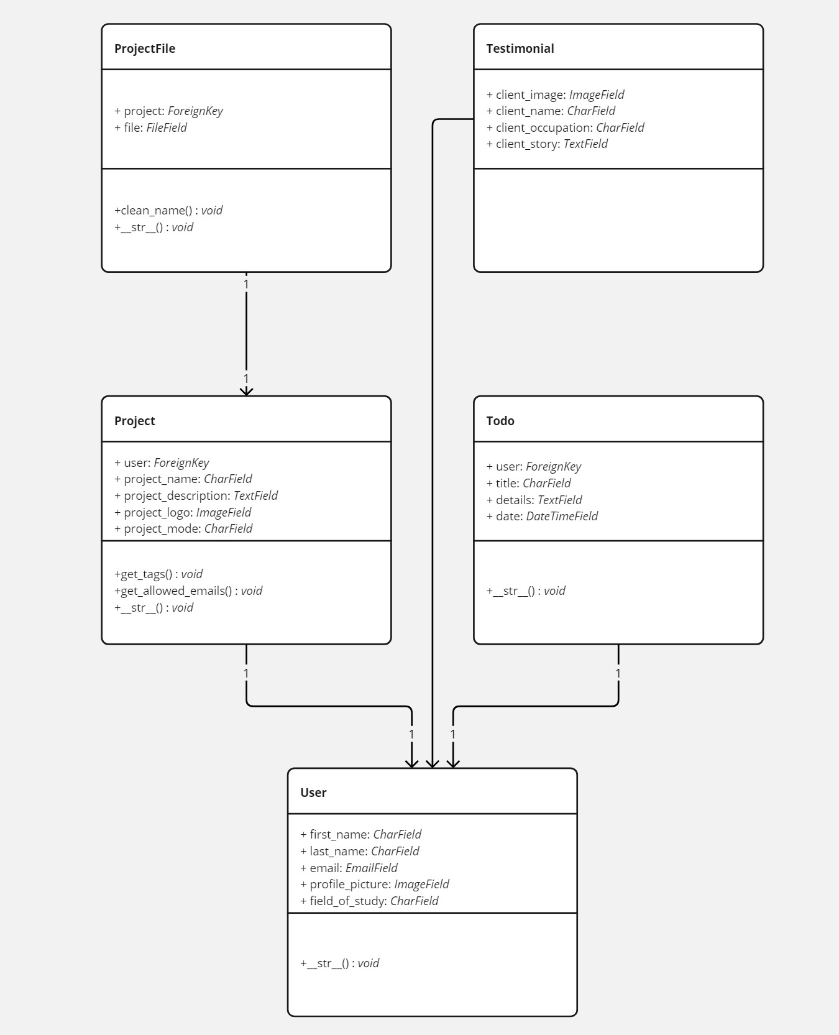
CLASS DIAGRAM

Slide 4
ACTIVITY DIAGRAM

Slide 5
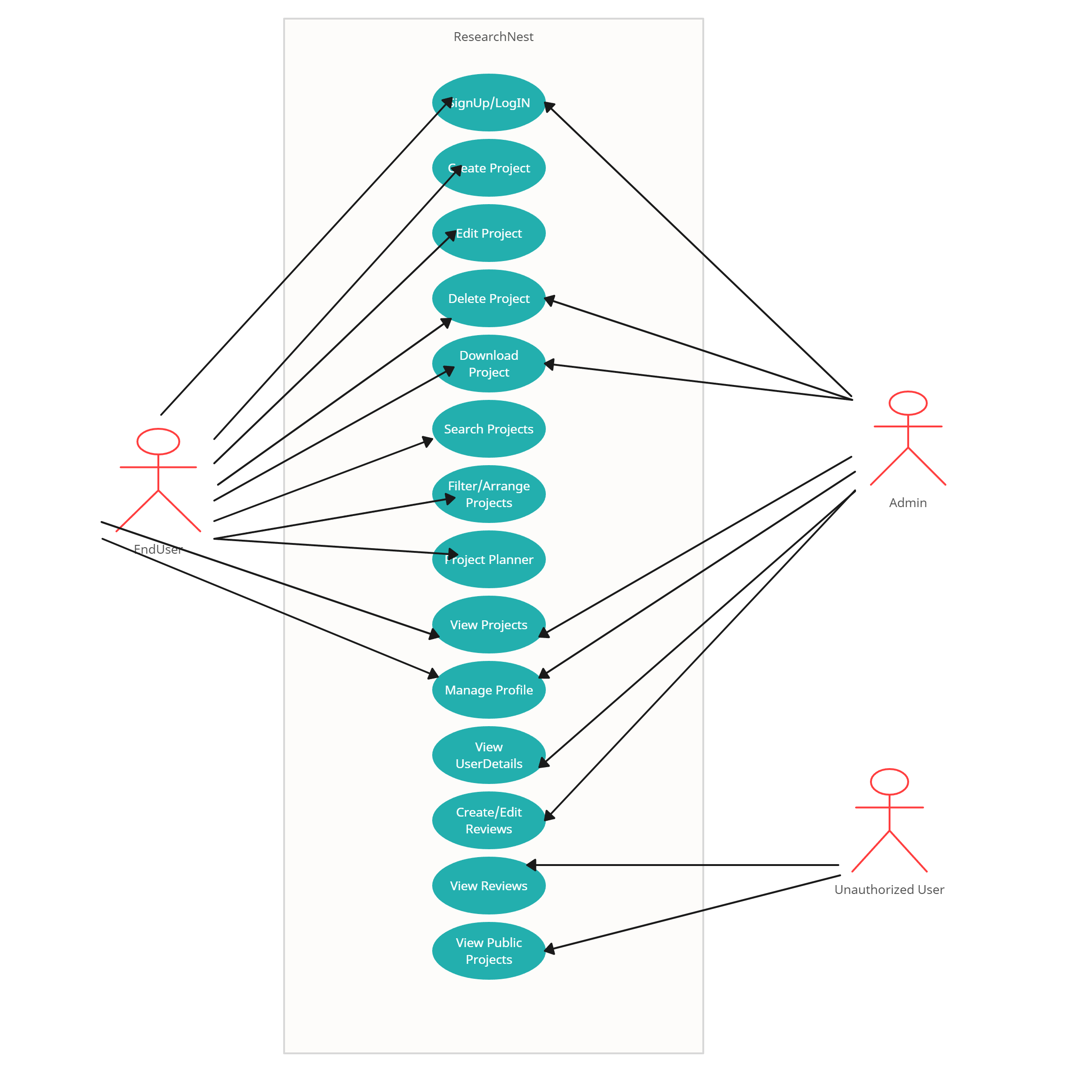
USECASE DIAGRAM

Slide 7
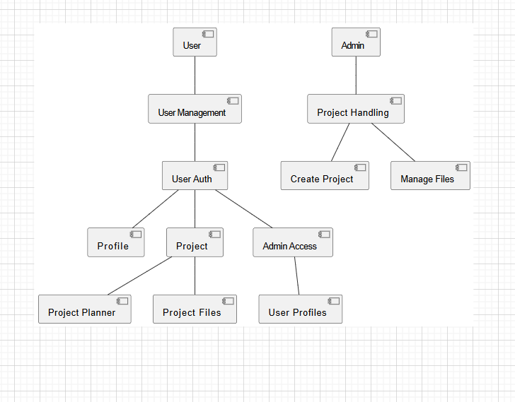
COMPONENT DIAGRAM

Slide 8
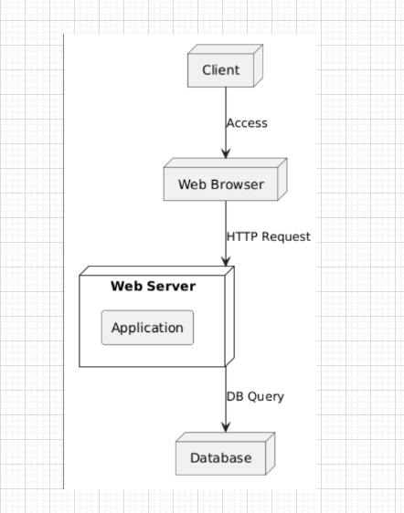
DEPLOYMEENT DIAGRAM

