Slide 1
Code:
Settings.py :

Slide 2
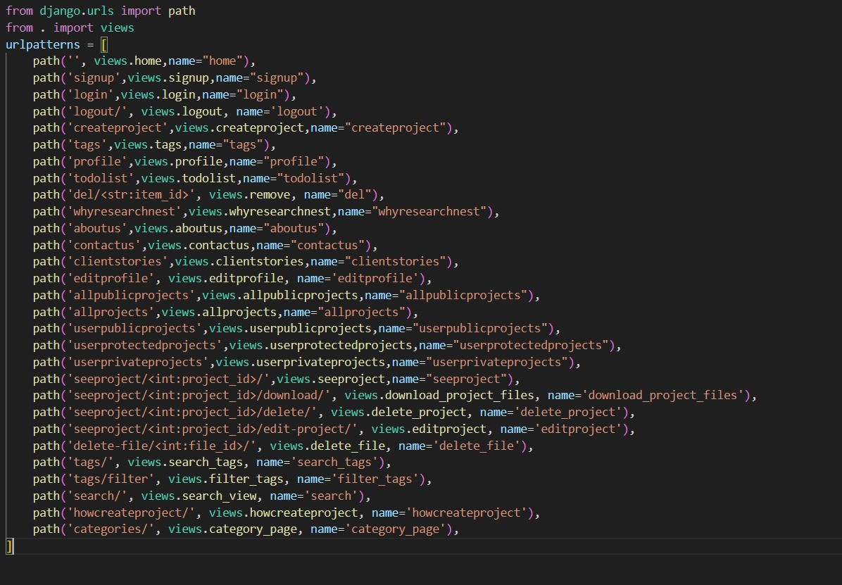
urls.py :

Slide 3
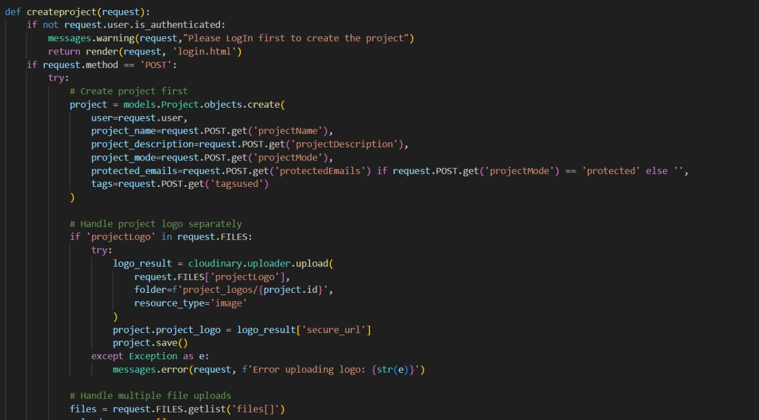
Project_creation.py :

Slide 4
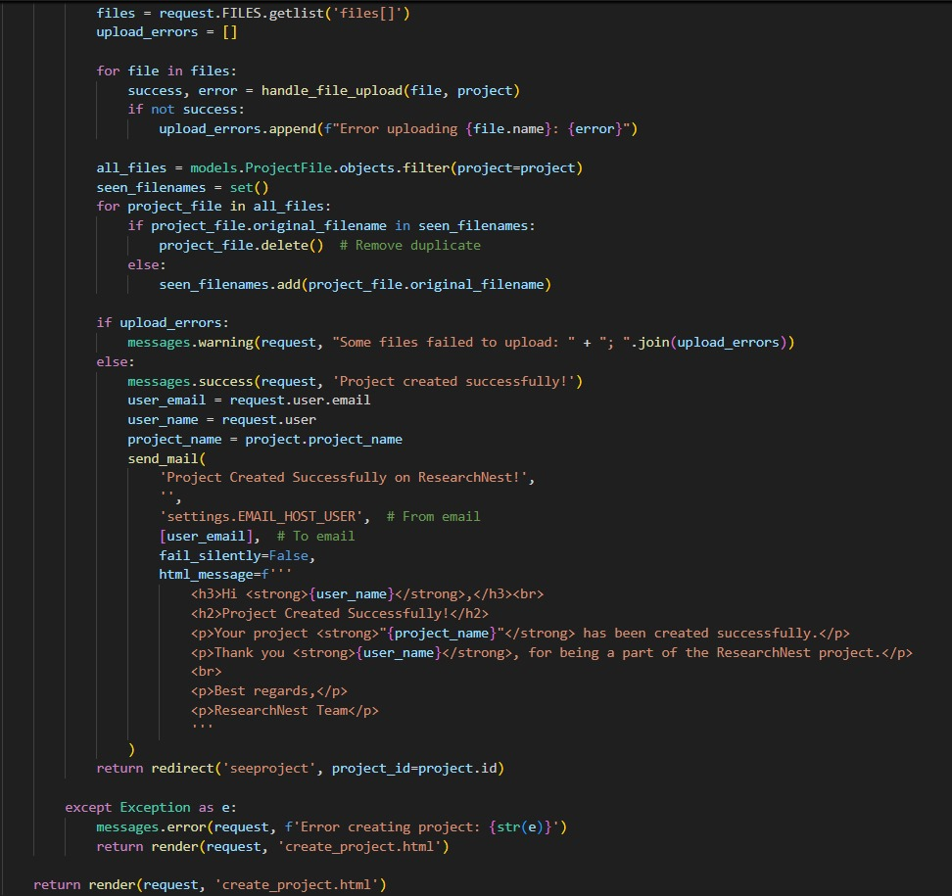
Project_creation.py (Part-2):

Slide 5
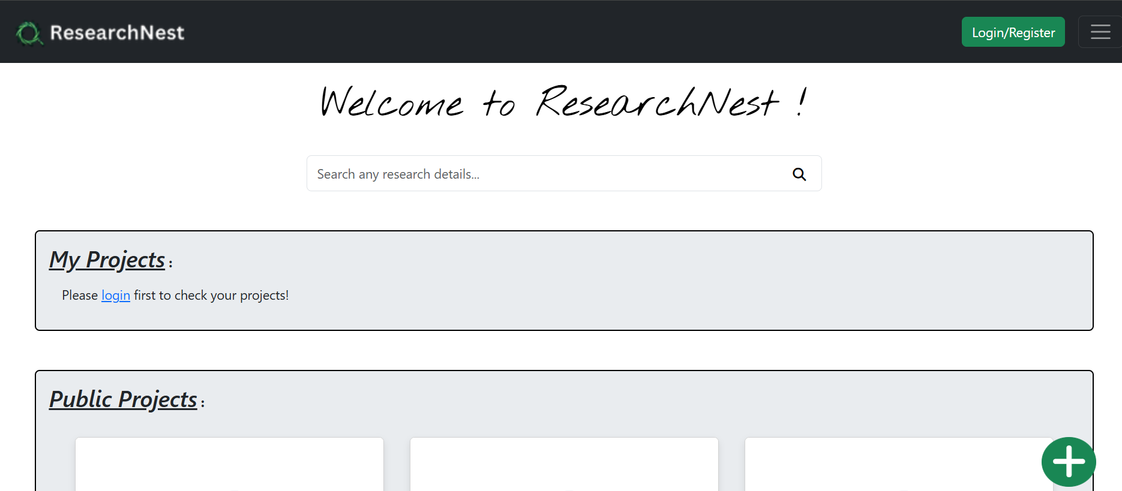
Output :
Landing Page :

Slide 6
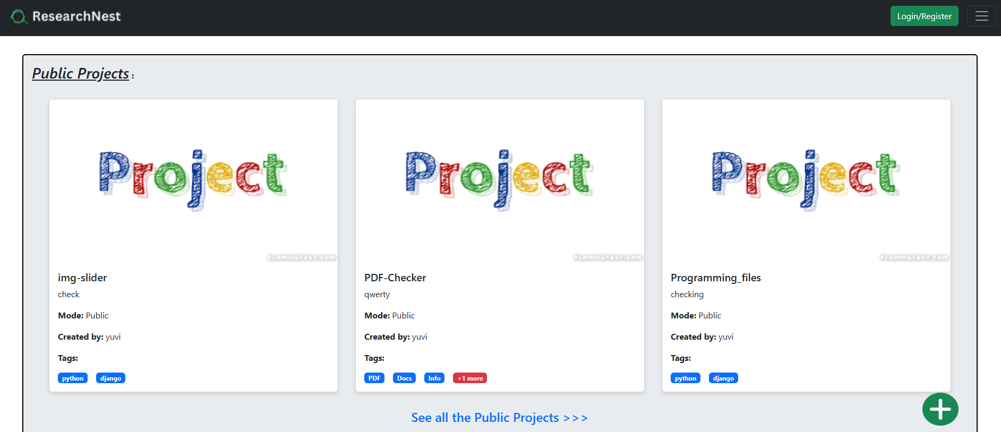
Public Projects Page :

Slide 7
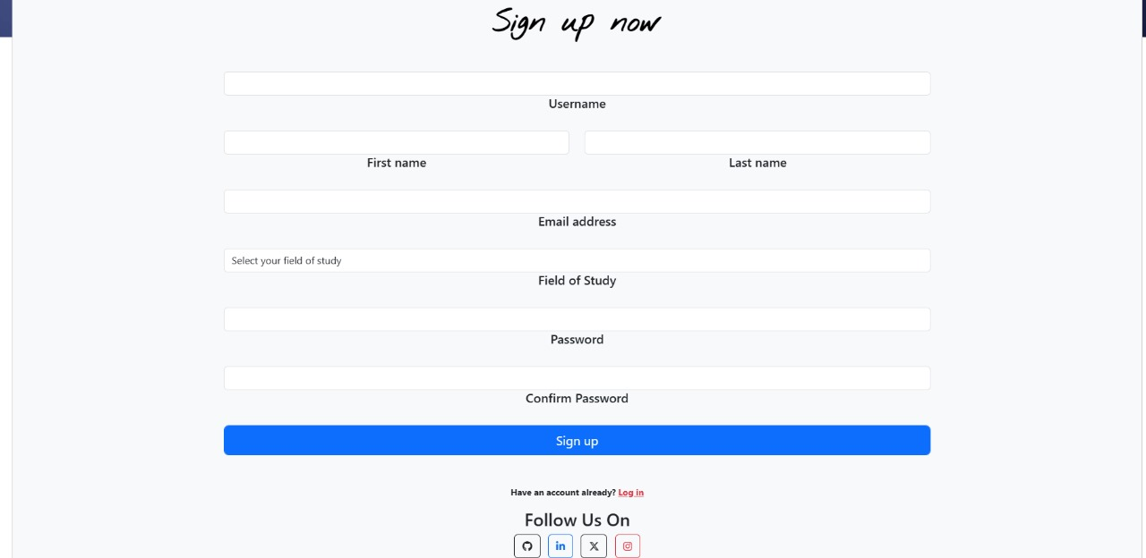
Sign Up page :

Slide 8
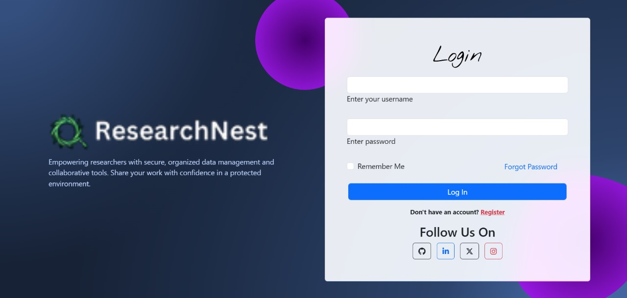
Login page :

Slide 9
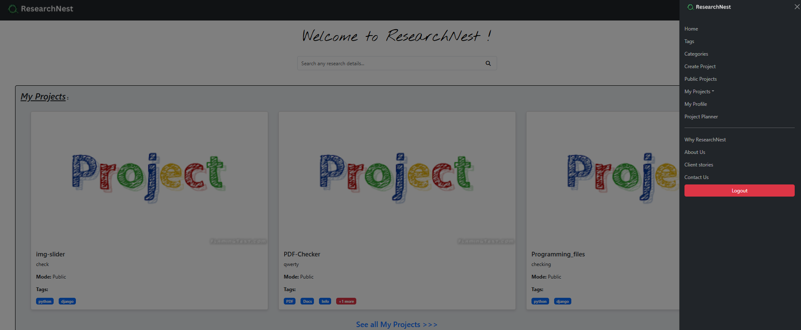
Landing page :

Slide 10
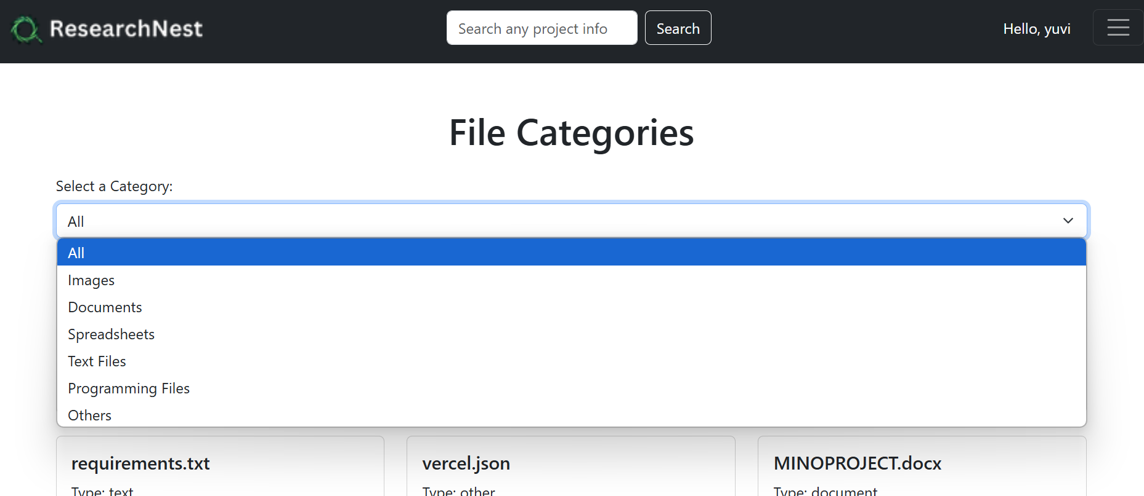
File Filtering page :

Slide 11
Project Upload page :

Slide 12
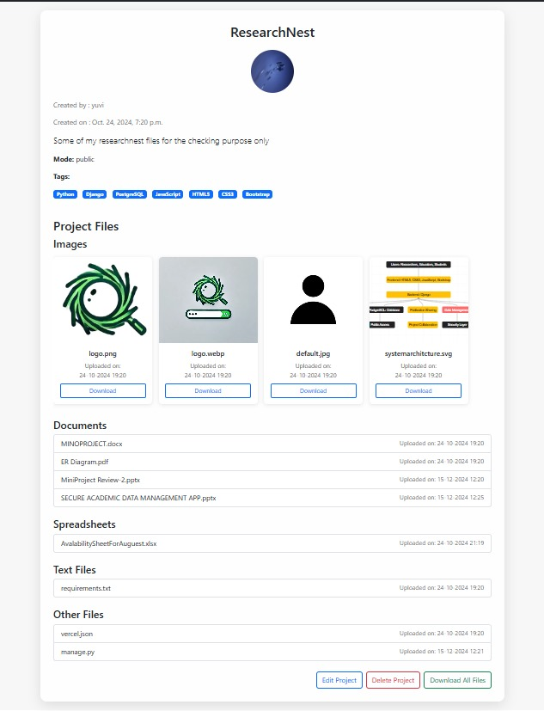
Sample Project Page :

Slide 13
Conclusion :
Efficient and secure research data management is a critical requirement in the academic and research community. Existing solutions, such as RIMS and general-purpose cloud storage platforms, have limitations in addressing the unique needs of this sector, particularly in areas such as security, accessibility, and compliance with data protection regulations. The Secure Research Data Management App offers a promising solution by combining advanced features tailored for academia, such as fine-grained access control, diverse file format support, and seamless collaboration tools. Additionally, the proposed future enhancements will ensure that the platform evolves with the changing demands of researchers, educators, and students, making it a sustainable and innovative solution for the academic community.

Slide 14
Future Enhancements :
The Secure Research Data Management App can be further developed and
enhanced in the following ways to meet evolving needs and challenges in academia:
Real-Time Collaboration: Introduce advanced collaboration features, such as live document integrated
video conferencing, and discussion threads, to facilitate teamwork in real time.
Data Versioning and Recovery: Implement robust version control systems to track changes in data and
enable users to recover previous versions or deleted files seamlessly.
Interdisciplinary Collaboration: Facilitate interdisciplinary research by introducing features that
recommend related projects or datasets across different fields of study.

