Slide 1
SECURE RESEARCH DATA MANAGEMENT APP
Ace Engineering College
An Autonomus Institution
Ghatkesar, Medchal (Dist), Hyderabad, Telangana State – 501 301
(NBA Accredited B.Tech Courses Accredited NAAC with A Grade 3.20 CGPA)
DEPARTMENT OF INFORMATION TECHNOLOGY
21AG1A1232 - Lokesh Choudhary
21AG1A1220 - Yuva Prakash Sai Gunupuru
21AG1A1231 - Kurapati Vamshi Tejan
Guided by : G. Prasad Sir, Assistant professor

Slide 2
ABSTRACT OF THE PROJECT
The project aims to develop a secure application for the Research and Academia sector, enabling efficient data management with configurable public and private access with a website named “ResearchNest”. Researchers, educators, and students can store, organize, and share their work, ensuring collaboration while protecting sensitive information. Key features include research data management, publication sharing, and project collaboration. The app aims to enhance academic workflows and promote open knowledge sharing. This innovative solution addresses the critical need for secure and efficient data handling in academia.

Slide 3
INTRODUCTION TO THE PROJECT
In the rapidly evolving landscape of research and academia, efficient data management and sharing are critical for collaboration, advancing knowledge, and maintaining data integrity. This project proposes the development of an innovative application designed to store, manage, and share data with configurable public and private access. Tailored specifically for the Research and Academia sector, the app offers a comprehensive platform where researchers, educators, and students can securely upload, organize, and disseminate their work.
The application supports a diverse range of functionalities, including the storage of research data, publications, and educational resources, with fine-grained access controls. Users can publish findings and share educational materials publicly while keeping sensitive data and internal communications restricted to authorized persons. Key features include display of data in various formats: all data, documents only, images only, videos only, code only and also a search filter to get user required information.

Slide 4
LITERATURE SURVEY
S No | Title of the paper, Authors | Journal Details | Key Findings
1. | The conundrum of sharing research data(2012) , Christine L. Borgman Key. | Journal of the American Society for Information Science and Technology, 63(6), 1059-1078. | Researchers face technical, social, and institutional barriers to data sharing
2. | Virtual research environments: An overview and a research agenda(2013), Leonardo Candela, Pasquale Pagano. | Virtual research environments: An overview and a research agenda. Data Science Journal, 12, GRDI75 - GRDI81. | Key features of Virtual Research Environments include version control, access management.
3. | The academic, economic and societal impacts of Open Access(2016), Jonathan P. Tennant | The academic, economic and societal impacts of Open Access: an evidence-based review. F1000Research, 5. | Open Access can accelerate the pace of scientific discovery and innovation
4. | Research data management and libraries: Current activities and future priorities (2014), Andrew M. Cox, Stephen Pinfield | Journal of Librarianship and Information Science, 46(4), 299-316 | Key challenges include skills gaps, cultural change, and resource allocation

Slide 5
LITERATURE SURVEY
The challenges of academic data sharing and management are widely acknowledged. Borgman (2012) identified significant barriers that researchers face, including technical difficulties, social constraints, and institutional resistance, which hinder effective data sharing.
Virtual Research Environments (VREs) provide solutions to these challenges. Candela and Pagano (2013) outlined the key features of VREs, such as version control and access management, which support efficient research collaboration and data organization. These tools are essential for modern academic workflows.
In the context of publishing and data access, Tennant (2016) highlighted the positive impacts of Open Access, showing how it accelerates the pace of scientific discovery and innovation. Cox and Pinfield (2014) further explored challenges in research data management within libraries, noting issues like skills gaps, cultural shifts, and resource allocation as key priorities for future improvements.

Slide 6
EXISTING SYSTEM
ANALYSIS OF THE CURRENT SYSTEM
Research Information Management Systems (RIMS)
These systems focus on tracking and reporting research activities and outputs.
Examples: Pure, Symplectic.
Limitations:
May lack robust security features for sensitive data
Often lack robust data storage and sharing capabilities
General Cloud Storage Services
Many researchers use general-purpose cloud storage for data management and sharing.
Examples: Dropbox, Google Drive, Microsoft OneDrive
Limitations:
User interface is not user-friendly (data is not organized)
Limited access control granularity
May not comply with data protection policies

Slide 7
PROPOSED SYSTEM
THE PROPOSED SECURE APPLICATION
The proposed system will be a unified platform for storing, organizing, and sharing various types of academic content, including research data, publications, educational resources, and project documentation.
Key Features:
Support for multiple file formats (documents, images, videos, code, datasets)
Role-based access management (e.g., researcher, collaborator, public)
End-to-end encryption for sensitive data
Public profiles for researchers & Customizable public project pages
Faceted search with multiple filters (e.g., content type, date, author, tags)
This proposed system addresses the limitations of existing solutions by offering a comprehensive, secure, and flexible platform specifically designed for the Research and Academia sector. It combines robust data management capabilities with customizable sharing options, support for multiple file formats and powerful search. The system's focus on security, usability, and integration with existing academic workflows positions it as an innovative solution to meet the evolving needs of researchers, educators, and students.

Slide 8
Software and Hardware details
Software Requirements :
Front-End
CSS Framework – Bootstrap
Frontend Framework – Django Templates
Back-End
Python Web Framework - DJANGO
DataBase
PostgreSQL
Cloud Storage
Cloudinary
Hardware Requirements :
RAM (4GB)
Processor (Dual-core CPU, 2 GHz or higher)

Slide 9
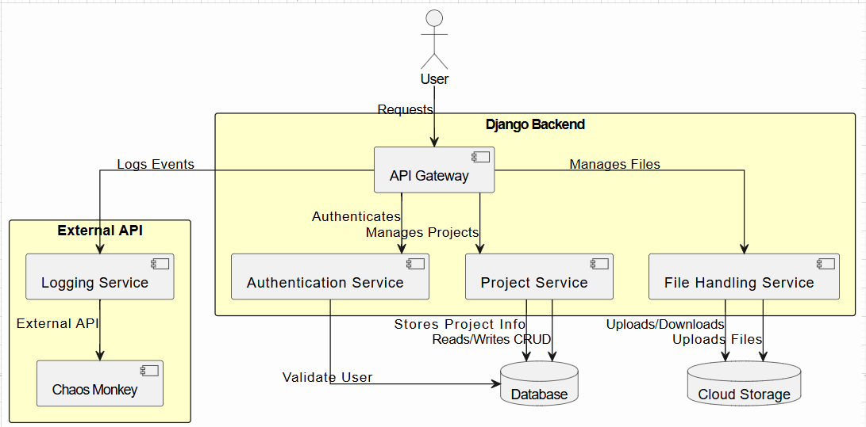
ARCHITECTURE DIAGRAM

Slide 10
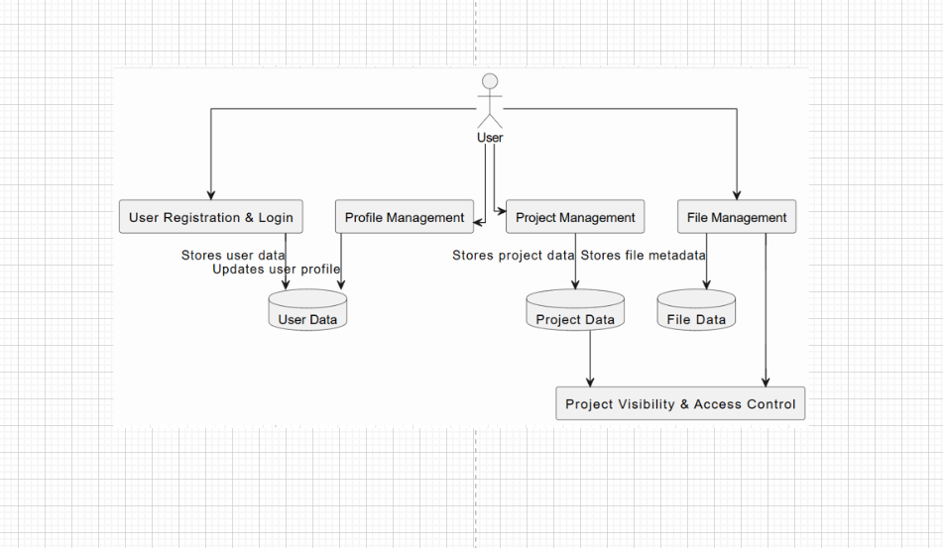
DATA FLOW DIAGRAM

Slide 11
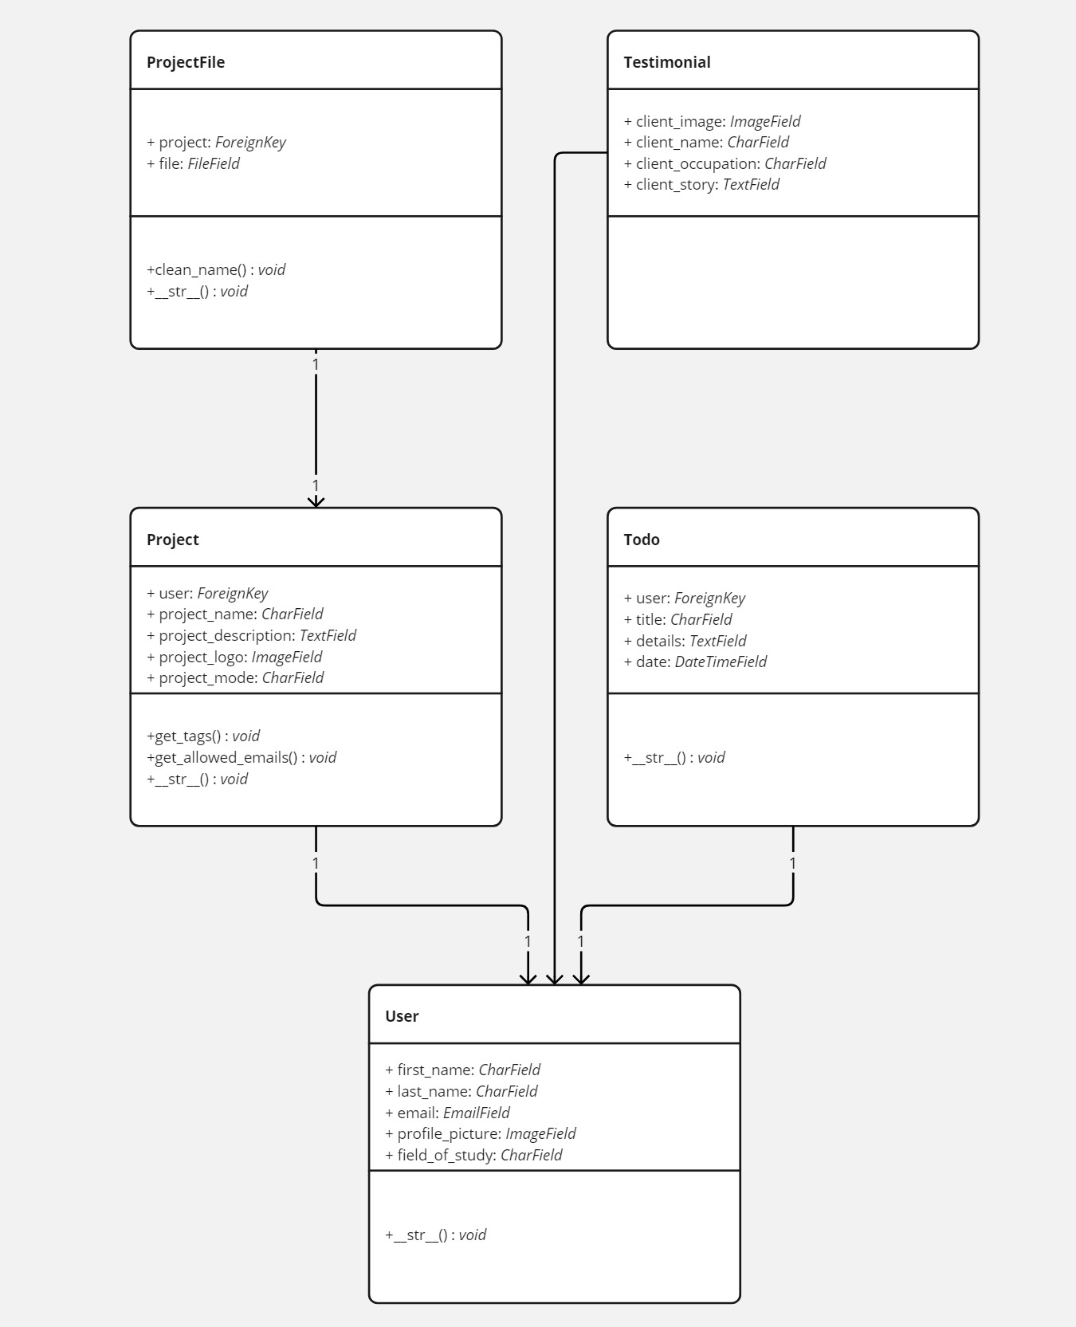
CLASS DIAGRAM

Slide 12
ACTIVITY DIAGRAM

Slide 13
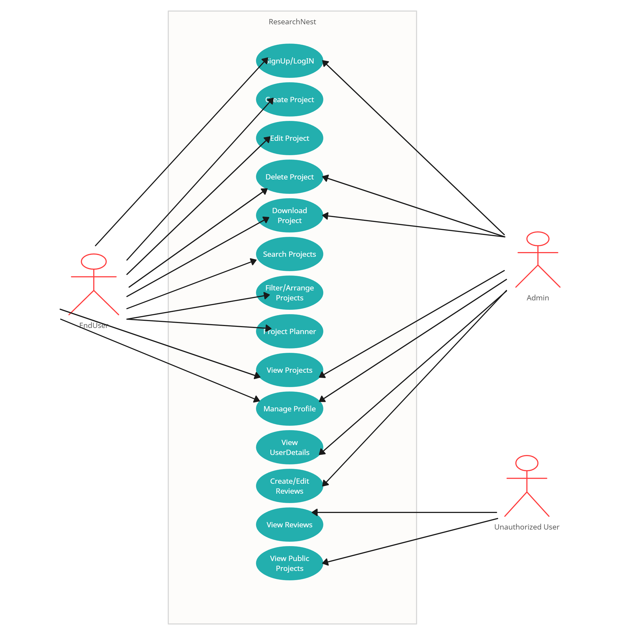
USECASE DIAGRAM

Slide 15
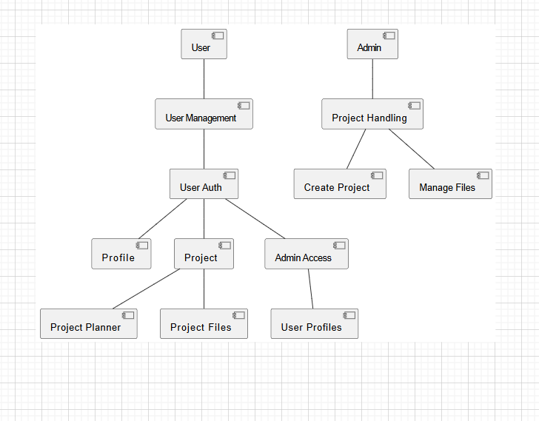
COMPONENT DIAGRAM

Slide 16
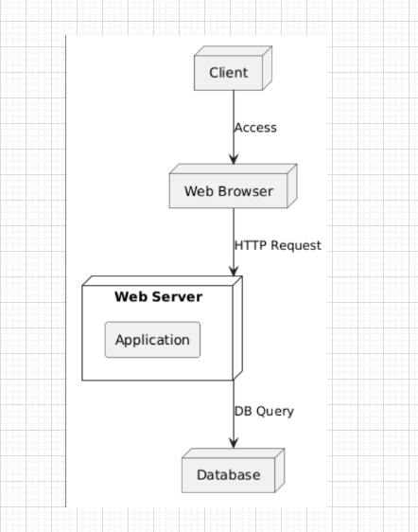
DEPLOYMEENT DIAGRAM

Slide 17
Code:
Settings.py :

Slide 18
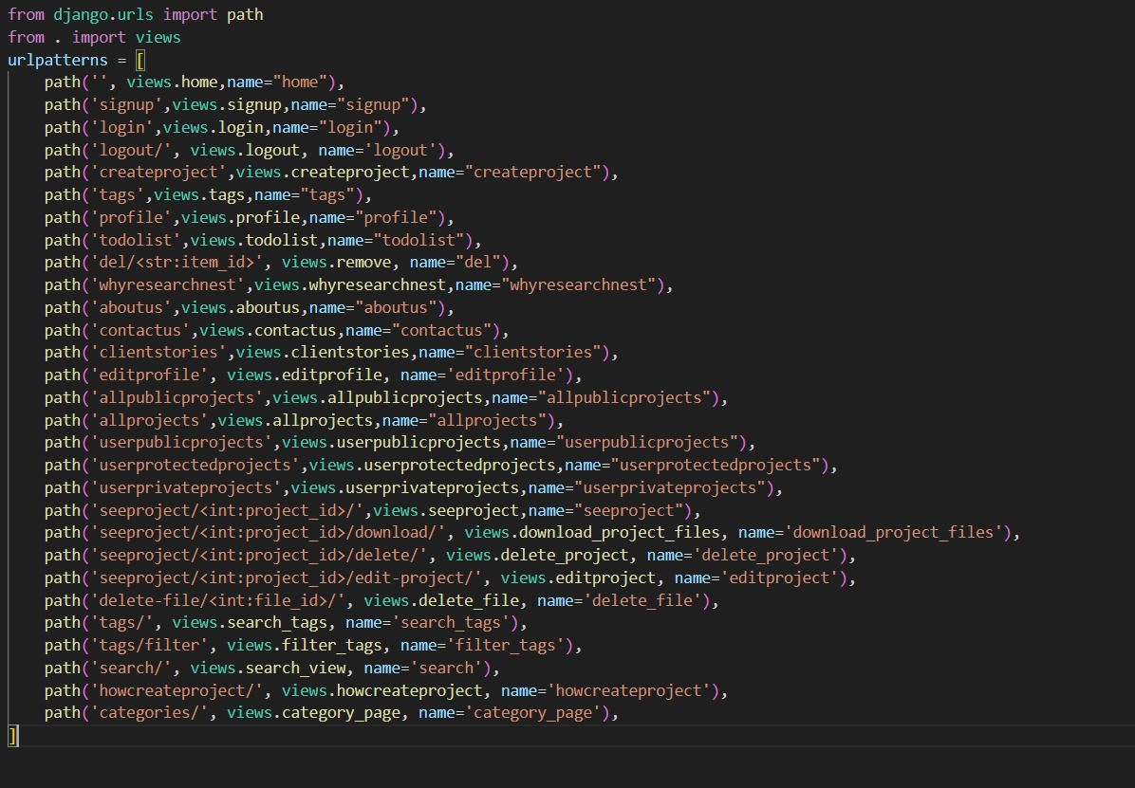
urls.py :

Slide 19
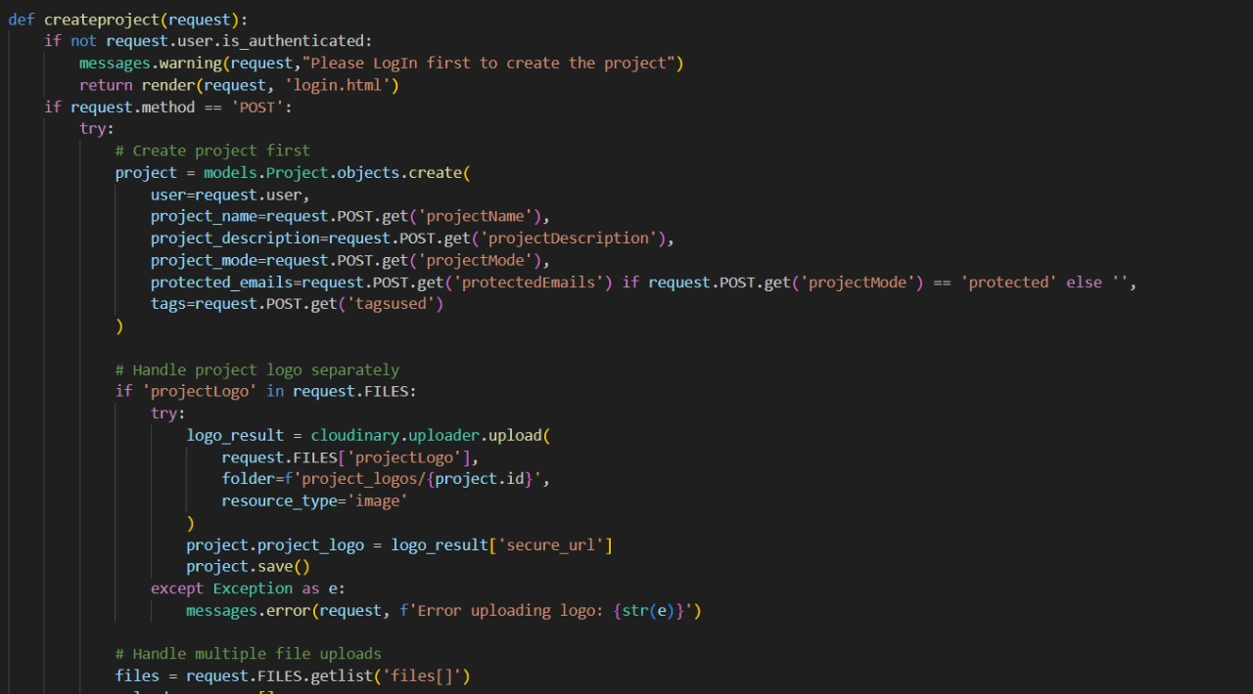
Project_creation.py :

Slide 20
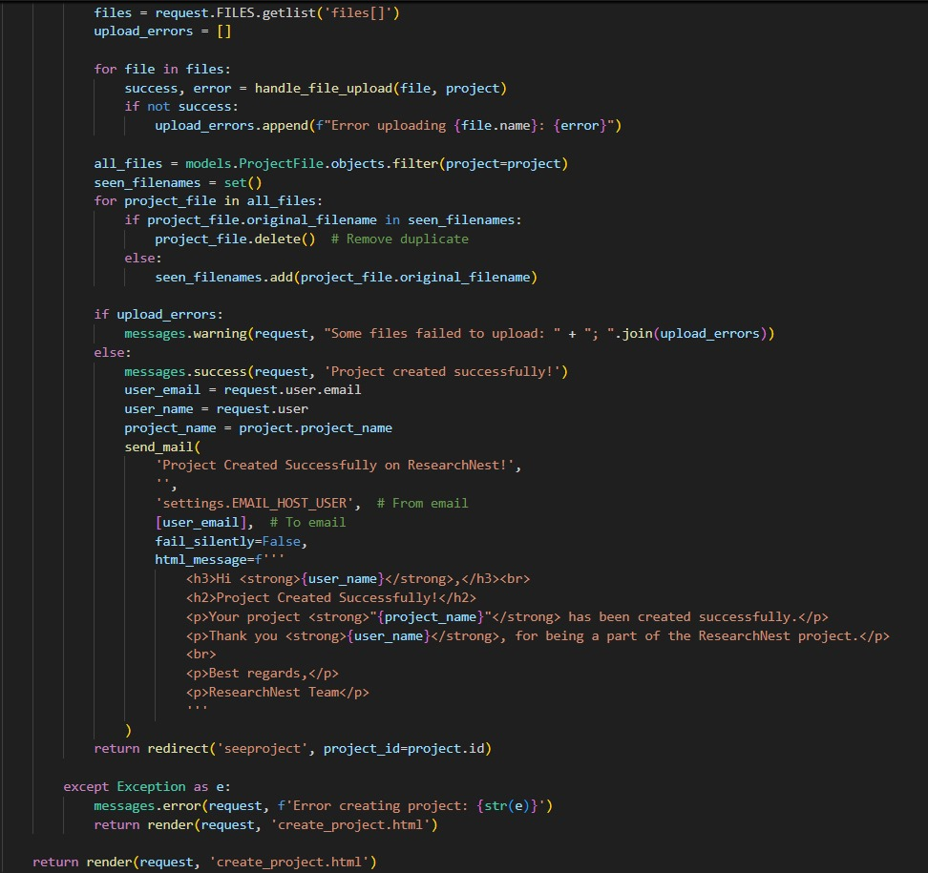
Project_creation.py (Part-2):

Slide 21
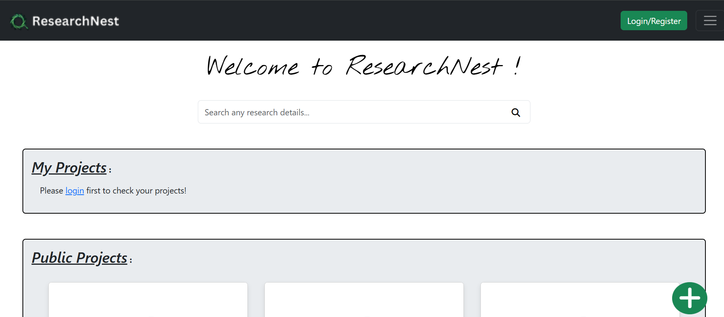
Output :
Landing Page :

Slide 22
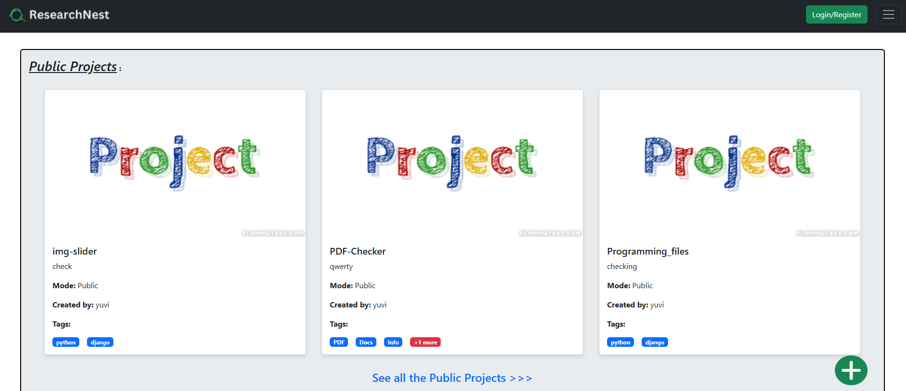
Public Projects Page :

Slide 23
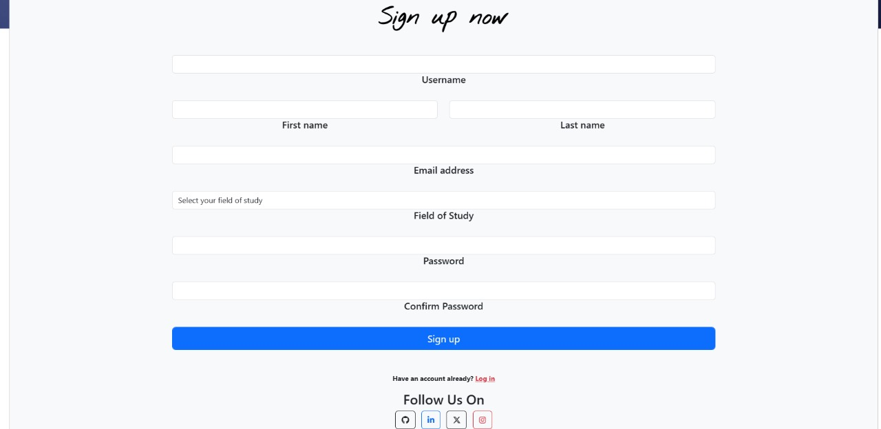
Sign Up page :

Slide 24
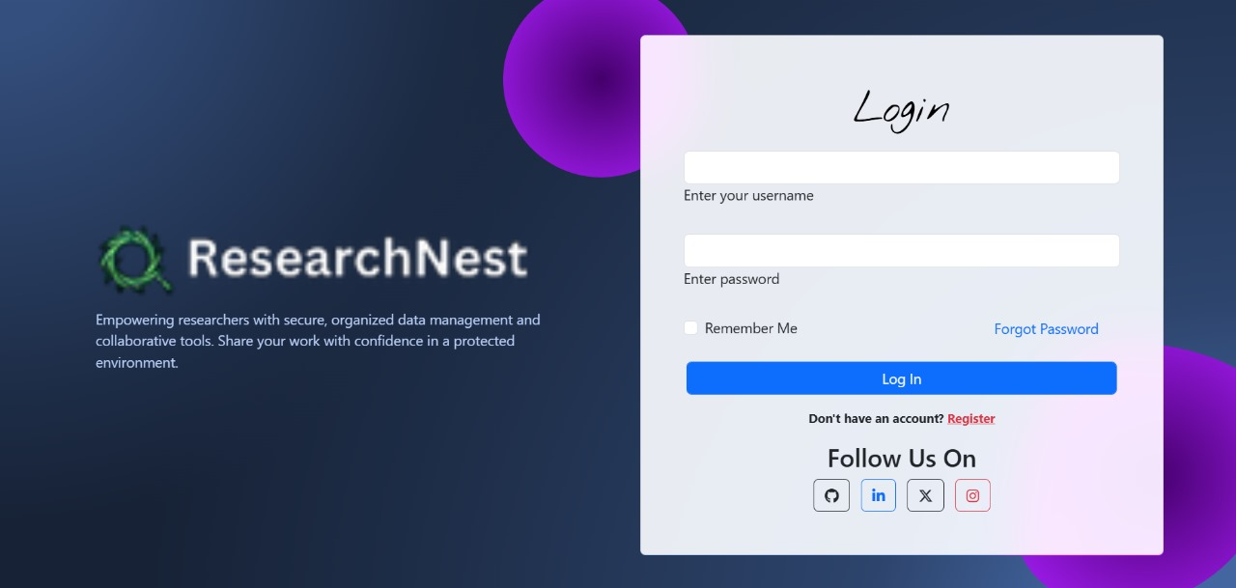
Login page :

Slide 25
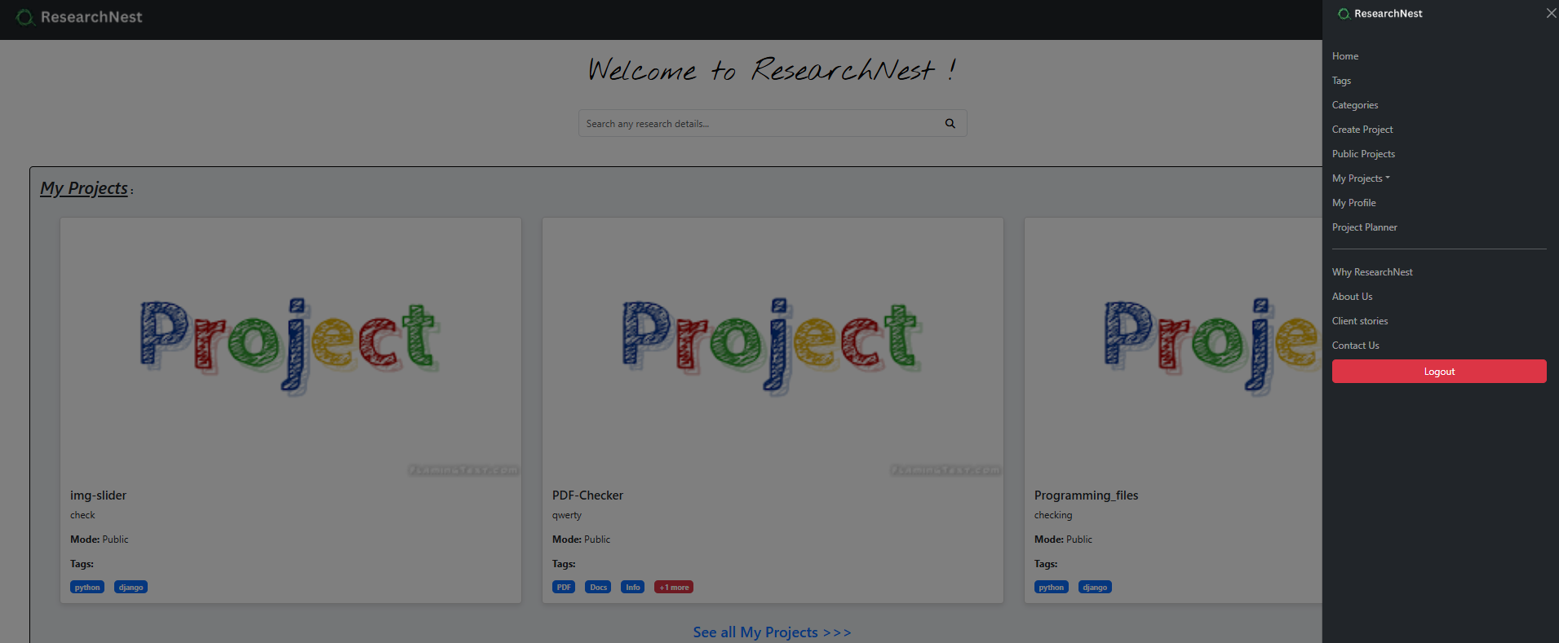
Landing page :

Slide 26
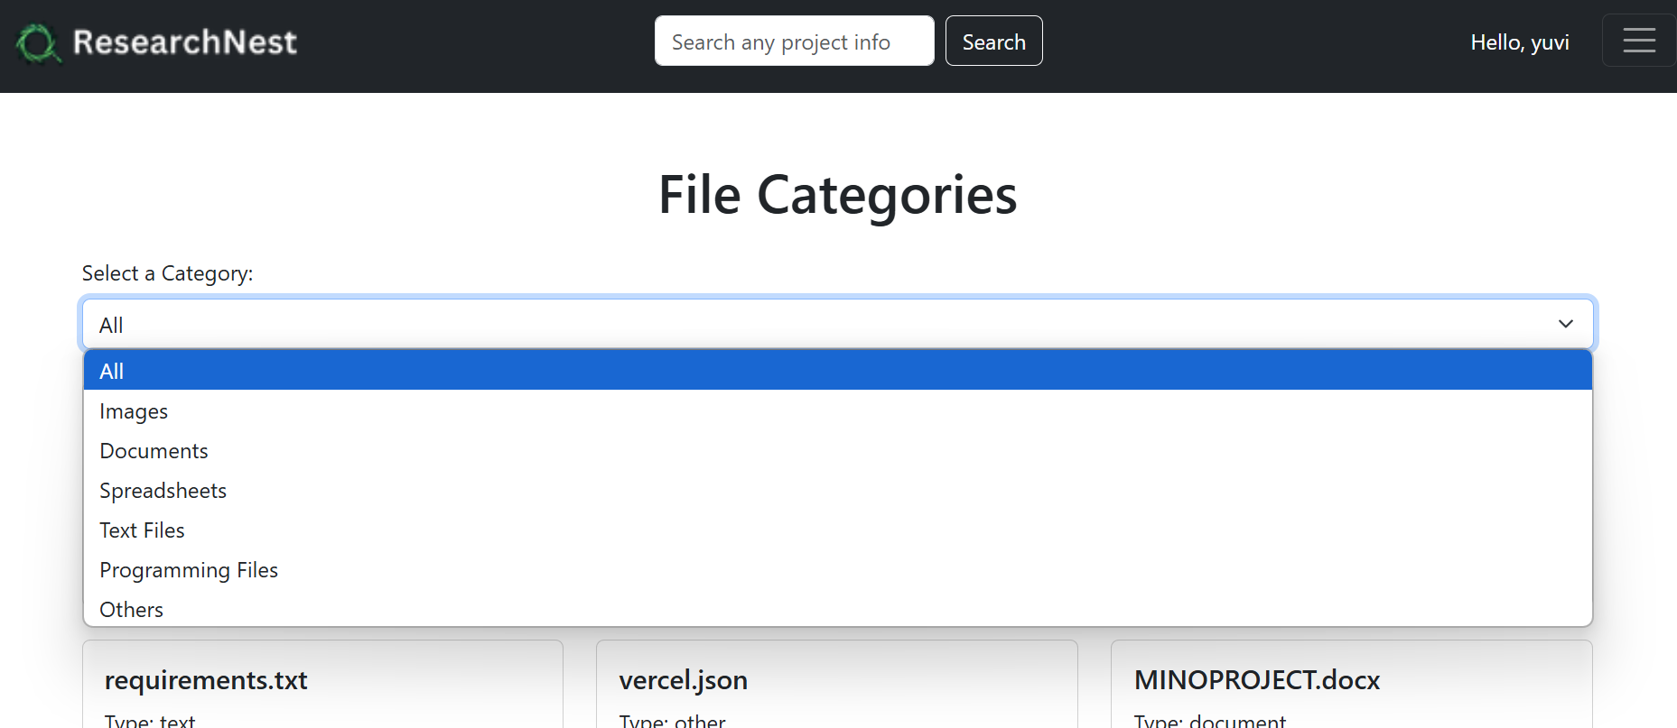
File Filtering page :

Slide 27
Project Upload page :

Slide 28
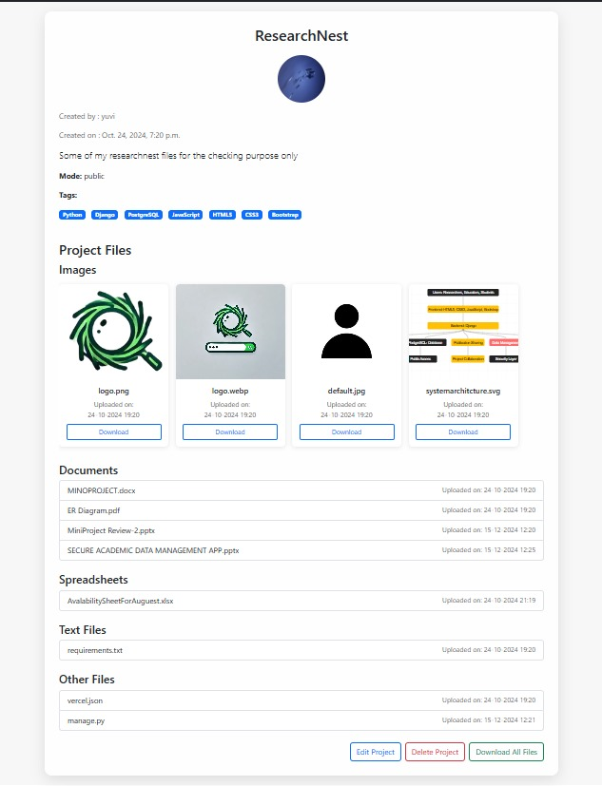
Sample Project Page :

Slide 29
Conclusion :
Efficient and secure research data management is a critical requirement in the academic and research community. Existing solutions, such as RIMS and general-purpose cloud storage platforms, have limitations in addressing the unique needs of this sector, particularly in areas such as security, accessibility, and compliance with data protection regulations. The Secure Research Data Management App offers a promising solution by combining advanced features tailored for academia, such as fine-grained access control, diverse file format support, and seamless collaboration tools. Additionally, the proposed future enhancements will ensure that the platform evolves with the changing demands of researchers, educators, and students, making it a sustainable and innovative solution for the academic community.

Slide 30
Future Enhancements :
The Secure Research Data Management App can be further developed and
enhanced in the following ways to meet evolving needs and challenges in academia:
Real-Time Collaboration: Introduce advanced collaboration features, such as live document
integrated video conferencing, and discussion threads, to facilitate teamwork in real time.
Data Versioning and Recovery: Implement robust version control systems to track changes
in data and enable users to recover previous versions or deleted files seamlessly.
Interdisciplinary Collaboration: Facilitate interdisciplinary research by introducing features
that recommend related projects or datasets across different fields of study.

