Slide 1
Financial Statement Analysis
Valuation ∙ Credit analysis ∙ Evaluating performance
The analytical income statement
and balance sheet
Chapter 4

Slide 2
How far have we come?

Slide 3
Learning objectives
After the lesson you should be able to:
Understand that operating activities are the primary driving force behind value creation
Separate operating income and expenses from financial income and expenses
Make a distinction between operating and financial assets and liabilities
Prepare an income statement and balance sheet for analytical purposes
Define and measure net operating profit after tax (NOPAT) and invested capital, respectively

Slide 4
Operating versus financing activities
A firm consists of operating, investing and financing activities
In calculating financial ratios, which intend to measure a firm’s profitability, it is beneficial to separate ‘operations’ and ‘investments in operations’ from financing activities
In financial statements, a distinction between operating items and financial items is not always easy due to several factors:
  The definition of operations is not clear-cut
  The specifications in the income statement and the balance sheet do not clearly distinguish between operating and financing activities
  The notes are not sufficiently informative
Which activities to include in operations depend on the business model and the characteristics of the firm. Items that are sometimes categorised as belonging to ‘operations’ may at other times be classified as belonging to ‘financing’

Slide 5
Income statement – example
Traditional
Net revenue
- Cost of sales
Gross profit
- Distribution costs
- Administrative expenses
-/+ Other expenses/-income
Operating profit (EBIT)
- Financial expenses, net
Earnings before taxes (EBT)
- Taxes
Net earnings (E)

Slide 6
Income statement – example
Analytical
Net revenue
- Cost of sales
Gross profit
- Distribution costs
- Administrative expenses
-/+ Other expenses/-income
Operating profit (EBIT)
- Operating tax
NOPAT (Net Operating Profit After Tax)
- Financial expenses, net
+ Tax savings from debt financing (also called tax shield)
Net earnings
Consider removing
non-recurring items (Ch 17)

Slide 7
Income statement – condensed
Income statement
Revenues | 200
Operating expenses | -90
Operating profit (EBIT) | 110
Financial income | 5
Financial expenses | -15
Earnings before tax (EBT) | 100
Corporation tax | -30
Net earnings € | 70

Slide 8
Analytical income statement
Operating versus financial income
Revenues | 200
Operating expenses | -90
Operating profit (EBIT) | 110
Taxes on EBIT | -33
NOPAT | 77
Net financial expenses | -10
Tax savings from debt financing | 3
Net financial expenses after tax | -7
Net earnings (operating earnings + net financial expenses) | 70

Slide 9
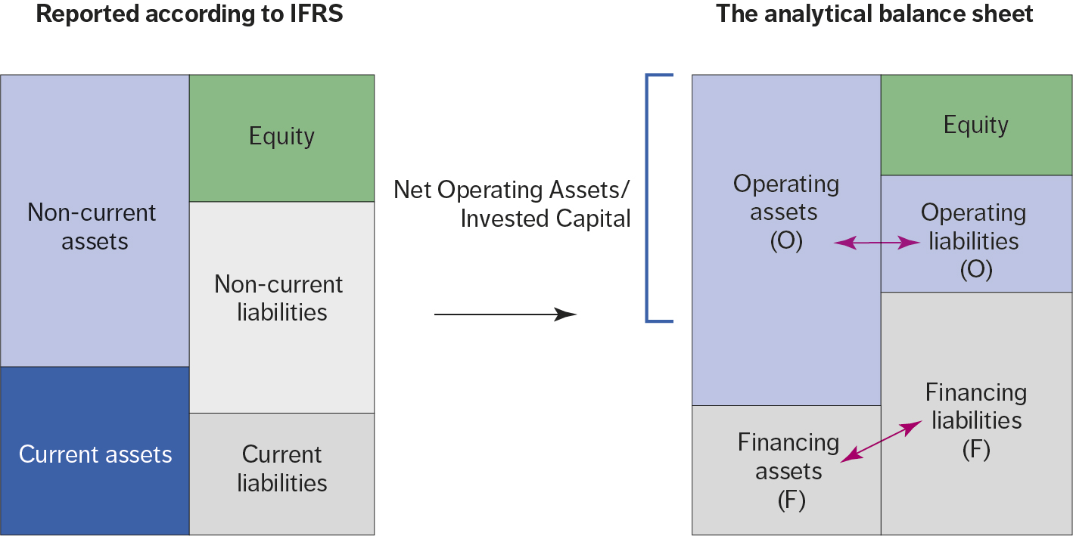
Balance sheet IFRS versus Analytical

Slide 10
Analytical balance sheet
Invested capital
Assets (investments)
Operating assets
+ Non-current assets
+ Inventories
+ Accounts receivables
+ Operating cash and cash equivalents
- Operating liabilities
= Invested capital (net operating assets)
Liabilities and equity (financing)
+ Equity
+ Minority interests
Interesting bearing liabilities (net)
+ Mortgage debt
+ Bank loan
- Excess cash
- Financing assets
- Other non operating assets
= Invested capital

Slide 11
Balance sheet: Assets – condensed
Assets (average figures)
Intangible and tangible assets | 268
Total non-current assets | 268
Inventories | 325
Accounts receivables | 57
Cash and cash equivalents | 50
Total current assets | 432
Total assets | 700

Slide 12
Balance sheet: Liabilities and equity – condensed
Equity and liabilities (average figures)
Equity | 400
Loans and borrowings | 100
Total non-current liabilities | 100
Loans and borrowings | 100
Tax payable | 15
Accounts payable | 85
Total current liabilities | 200
Total equity and liabilities | 700

Slide 13
Analytical Balance Sheet
Invested capital (net operating assets)
Total assets | 700
Cash and cash equivalents | -50
Accounts payables and tax payable | -100
Invested capital (net operating assets) | 550
Invested capital (financing)
Equity | 400
Loans and borrowings (non-current) | 100
Loans and borrowings (current) | 100
Cash and cash equivalents | -50
Interest bearing liabilities, net | 150
Invested capital (financing) | 550

Slide 14
Operating or financing items?
Special items
Taxes
Investment in associates and related income and expenses from associates
Receivables and payables to group enterprises and associated firms
Cash and cash equivalents
Exchange rate differences
Derivative financial instruments
Non-controlling interests (minority interests)
Retirement benefits
Rule of thumb: Financing item if interest bearing or requires a return!

Slide 15
Conclusions
Separating accounting items into operation and financing highlights the sources of value creation
The separation will make it easier for debt providers to measure the ‘debt capacity’ and for board of directors to measure value creation in the operation in order to determine performance related bonuses
The most important challenges when dividing accounting items into operation and financing include:
  The definition of core operations is not clear-cut
  The income statement and balance sheet do not distinguish clearly between operating and financing activities
  The notes are not sufficiently informative
The overall rules to guide the analysts are:
  Items must be classified the same way in the income statement and the balance sheet.
  Invested capital shall be defined consistently over time and across firms.

