Slide 1
Financial Statement Analysis
Valuation ∙ Credit analysis ∙ Evaluating performance
Accounting quality
Chapter 13

Slide 2
How far have we come?

Slide 3
Learning objectives
After the lesson you should be able to:
Understand the meaning of accounting quality
Understand that accounting regulation introduces flexibility
Identify some areas of inconsistencies between IFRS’ Conceptual Framework and the accounting standards
Identify key measurement bases and their impact on assets and liabilities.

Slide 4
Definition of accounting quality
Two fundamental questions:
Is the financial information relevant for users?
and
Is the financial reporting a faithful representation: complete, neutral and free from errors?
Conceptual Framework (2010)/Exposure Draft of the Conceptual Framework (2015):
“the financial statements should provide relevant financial information and should be faithful”
However: good accounting quality or “high quality” is not to be used as a qualitative characteristic in the Framework/not discussed in ED Framework
Gaynor et al. (2016):
“more complete, neutral and free from error and provides more useful predictive
or confirmatory information about the firm’s underlying economic position and
performance”.

Slide 5
Accounting regulation and flexibility
  Flexibility is inevitable.
  Examples include (the list is not exhaustive):
If a firm sells computer equipment with two years of “free” support and software updates, then how much should be recognised as revenue each year?
How much should be written off of technical obsolete inventory?
Should R&D be expensed as incurred or capitalised?
What is the expected lifetime of the firm’s property, plant and equipment?
How much of accounts receivable are uncollectable?
Is goodwill impaired and needs to be written down?
And so on.

Slide 6
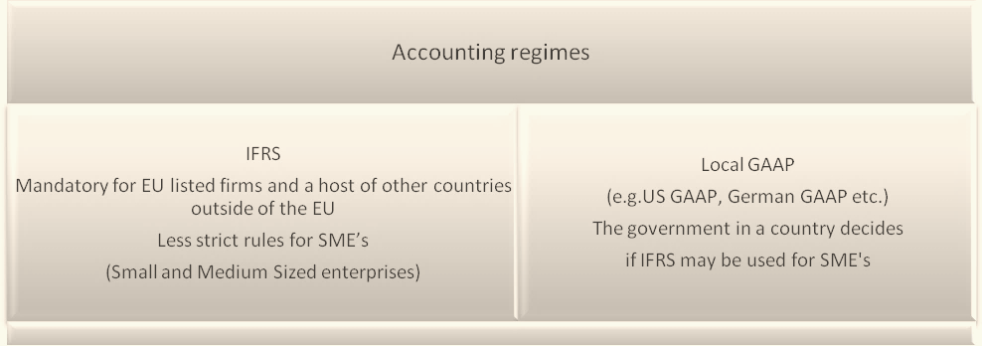
Accounting regulation
Different accounting regimes result in different accounting numbers:
Is a source of noise in cross-sectional analysis if firms belong to different accounting jurisdictions
Is a source of noise in time-series analysis if firms must change from one accounting regime to
another (e.g. mandatory use of IFRS for listed companies as of January 1, 2005)

Slide 7

Daimler-Benz 1993
Daimler-Benz was the first German company to list in
New York.
 | Profit/(loss) | Equity
German GAAP | DM + 0,6 billion | DM 17.6 billion
US GAAP | DM – 1,8 billion | DM 26.3 billion
Profit/(loss) | Equity
DM + 0,6 billion | DM 17.6 billion
  (Camfferman and Zeff, 2007; Radebaugh et al., 1995)

Slide 8
Different profits using local GAAP
Net profit (Є mill.)
Most likely
(accepted 27)

Slide 9
IFRS adopted in many countries
IFRS mandatory (blue) or adopted version (red/Japan: voluntarily) for listed firms
Out of the Global 500
(Forbes 2013)
IFRS 240 (48%)
US GAAP 175 (35%)
J GAAP 55 (11%)
Other 30 (6%)
More than 25,000 of the approximately 48,000 domestic listed companies on the 85 major securities exchanges in the world use IFRS Standards.
And of the companies that do not use IFRS Standards, over 80 per cent are listed in China, India, Japan, and the United States.

Slide 10
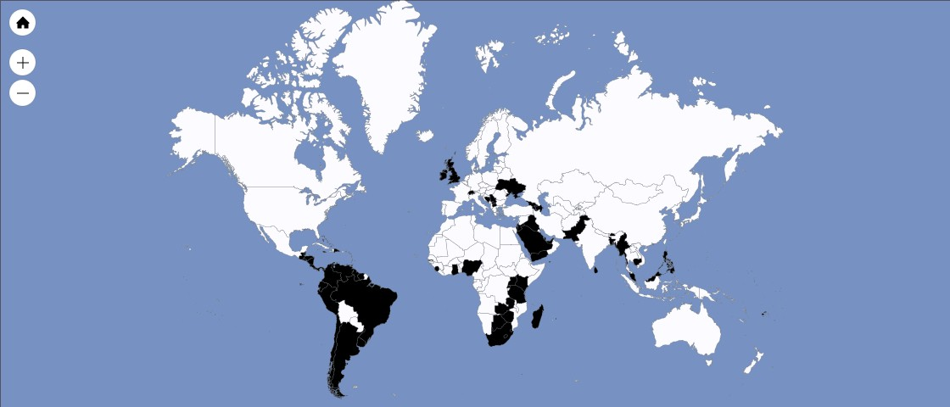
International harmonisation of accounting regulation
Globalisation of business has increased the demand for harmonisation of accounting regulation
  Facilitate cross-border transactions and investments
The IASB
  Aims to develop, in the public interest,
  a single set of high quality, understandable, enforceable and globally accepted financial reporting standards based upon clearly articulated principles (IFRS Foundation, 2013).
IFRS
  Used by more than 25,000 listed companies
IFRS for SMEs
  Issued in 2009
IASB = International Accounting Standards Board
IFRS = International Financial Reporting Standards
IAS= International Accounting Standards
(‘old’ to be replaced by IFRS’s)
SME = Small and Medium-sized Entities
Countries where IFRS for SME are adopted (black)

Slide 11
IASB Conceptual Framework
IASB Conceptual Framework is a guidance when developing the specific IFRS’s, with some general definitions and principles that ensure consistent concepts in the various detailed accounting standards
However: “Nothing in this Conceptual Framework overrides any specific IFRS.”
Standard structure of an IFRS:
  the scope of the standard
  definitions
  what the recognition criteria are and when an event should be recognized
  how accounting items should be measured
  how accounting items should be presented (classification)
  information that must be disclosed

Slide 12
IASB Conceptual Framework definitions
An asset
’a present economic resource controlled by the entity as a result of past events’
A liability
‘a present obligation of the entity to transfer an economic resource as a result of past events’
Equity
Assets minus liabilities- a residual
Income
‘increases in assets or decreases in liabilities that result in increases in equity’
Expenses
‘decreases in assets or increases in liabilities that result in decreases in equity’

Slide 13
IASB Conceptual Framework
Definitions
An asset
’a present economic resource controlled by the entity as a result of past events’
What about human capital?
Human capital is the most valuable resource for many firms.
A law firm may own an office building, office furniture, cars and information technology. All such assets are recognized as assets in the balance sheet, but are easily replaceable and hardly explain the profit of a law firm.
However, the most important resources – the employees and partners of the law firm – are not recognised as assets.
They do not meet the definition of an asset: employees are not under the firm’s control, but are generally free to leave with fairly short notice.

Slide 14
IASB Conceptual Framework
Recognition
Recognition of assets and liabilities (when): not stated in the Framework
Specified in the different IFRS’s, not always intuitive:
Marketing expenses:
If a firm launches a huge marketing campaign, it is likely to increase future sales
Hence, marketing should be expected to fulfil the asset definition of “economic resource controlled by the firm as a result of past events”
However, marketing costs cannot be capitalized as an asset under IFRS, since the “economic resources” (i.e. the increased future sale) are viewed by IFRS to be too uncertain
R&D expenses:
In some industries like the biotech industry, firms are highly dependent upon successful R&D projects
IAS 38 on intangible assets states all research costs should be expensed, whereas development costs shall only be capitalised if the firm intends, is able to complete the intangible asset and is able to demonstrate how the asset will generate future economic benefits
It has therefore a significant effect on reported numbers whether costs related to R&D activities are considered as development costs, and if these costs are expensed as incurred or capitalised

Slide 15
Conceptual framework
Measurement - assets
Should assets be measured at:
Historical costs less depreciation, amortisation and impairment losses
Amortised costs
Replaceable value
Liquidation value
Fair value
Value in use
Insured value
Tax based value???
The Conceptual Framework has no preferred measurement bases; just lists:
• Past cost, which is the historical cost at the transaction
• Current value, which includes:
  ° Fair value, the market price in an orderly transaction
  ° Value in use for assets and fulfilment value for liabilities, firm-specific present values of cash flows of
  the use of assets or fulfilment of a liability.

Slide 16
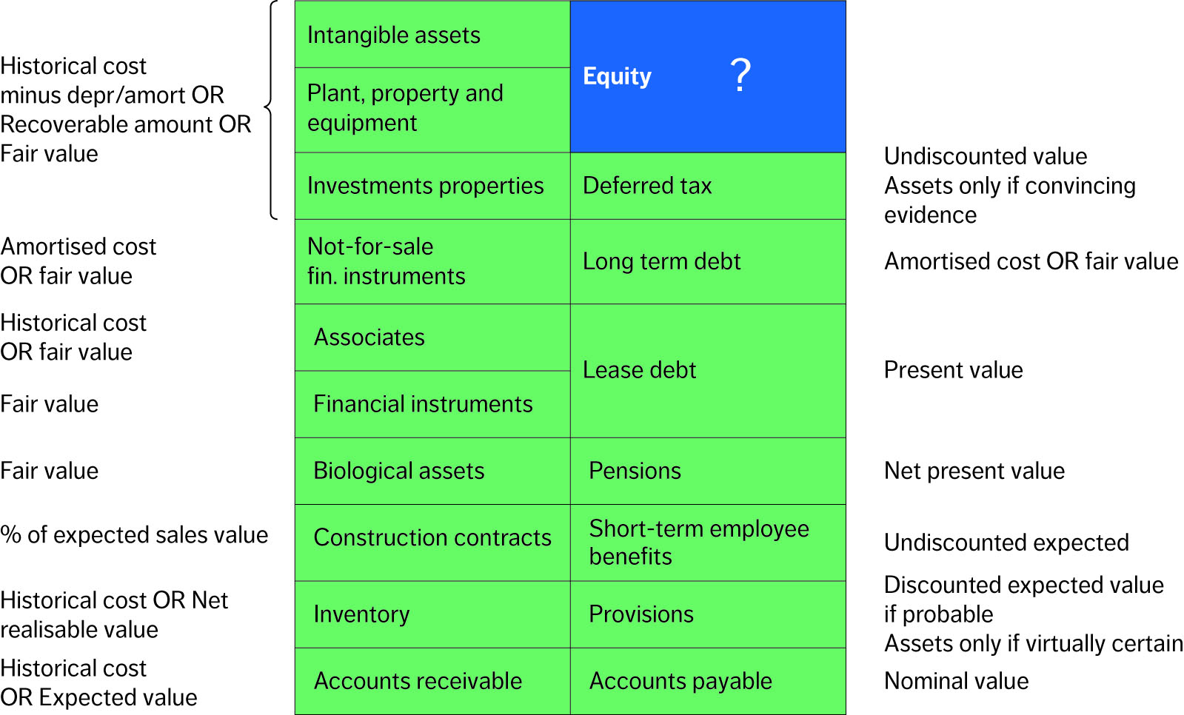
Mixed measurement basis under IFRS

Slide 17
Conceptual framework
Classification
Accounting items may be classified in different ways. For instance, restructuring costs may be included in production costs (and, thus, part of a firm’s core operations, i.e. included in EBIT), while other firms choose to highlight restructuring and similar costs in a separate line item by labelling them ‘special items’, ‘abnormal items’, ‘unusual items’, ‘extraordinary items or the like.
Analysts need to be able to single out non-recurring items. For instance, in forecasting future earnings (and cash flows) non-recurring items should be disregarded. Analysts therefore prefer that restructuring and similar costs are classified as a separate line item in the income statement.
IFRS does not permit classification of items in the income statement as ’extraordinary items’. Nonetheless, firms may wish to classify transactions in a separate line item, if the firms believe those transactions require special attention; for instance if they are non-recurring events.

Slide 18
Conceptual framework
Disclosure
The financial statements also contain notes, supplementary data and other information that
Explain items in the balance sheet and income statement,
Disclose the risks and uncertainties affecting the firm, and
Explain any resources and obligations not recognised in the balance sheet.
Notes and other supplemental information should explain or disclose accounting items and risk
factors affecting a firm. Expressions such as ‘explain’ and ‘disclose’ are somewhat vague leaving
much discretion to management.
Analyst often need to separate out unusual items. Such information historically may or may not
be found on the face of the income statement as items marked for example ‘special items’.
If unusual items are not be shown as separate line analysts need to be looking elsewhere;
i.e. in the notes and supplementary information.

Slide 19
Examples of inconsistencies under IFRS
Asset definition
In order to be defined as an asset, the resource must be under the control of the firm
Goodwill, trademarks, research, marketing etc. cannot be recognized as assets if they are generated internally; cannot be measured reliably.
Takes control over such assets through an acquisition, IFRS 3 says that those assets should be recognized.
Asymmetrical recognition of uncertain assets and liabilities
Financial statements should be ‘neutral without bias’,
Construction contracts: expected loss on a contract as a whole should be expensed (recognise a liability) immediately
an expected profit should be recognised over the contract period.
Provisions should be recognized as a liability if it is ‘probable’ (> 50% probability)
The recognition of an uncertain asset must be ‘virtually certain’ (> 90% probability).
Deferred income taxes are recognized as liabilities without any threshold levels of probability
Deferred tax assets are only recognized if there is ‘convincing other evidence’ of future income
Inventories are required not to be stated higher than cost, i.e. gold barrels or oil not allowed to be stated at fair value if fair value is higher than cost.
Inventory as biological assets such as living fish or growing trees shall be measured at fair value

Slide 20
Examples of inconsistencies under IFRS
Recognition of liabilities
Provisions are recognized if there is more than 50% probability that they result in a cash outflow.
No claim is recognized when there is an estimated 40% chance of losing the case.
If part of an acquisition, the claim should be recognized at fair value. With a 40% chance of a cash outflow of 10, the firm must recognise a liability of 4.
Measurement of loans
A loan of 100 USD at an exchange rate of 7 DKK per USD is recognised at 700 when borrowed., later 800 if USD rate increase to 8 DKK per USD
The same principle is not applied for fixed interest loans.
E.g: a 10-year fixed-rate loan of 100 at 10% interest rate. Later floating interest decreases to 7%, whereas the firm still has to pay 10%.
If the firm was to settle the loan, it would have to pay 130. Still, the loan would be recognised at a value of 100 in the balance sheet.

Slide 21
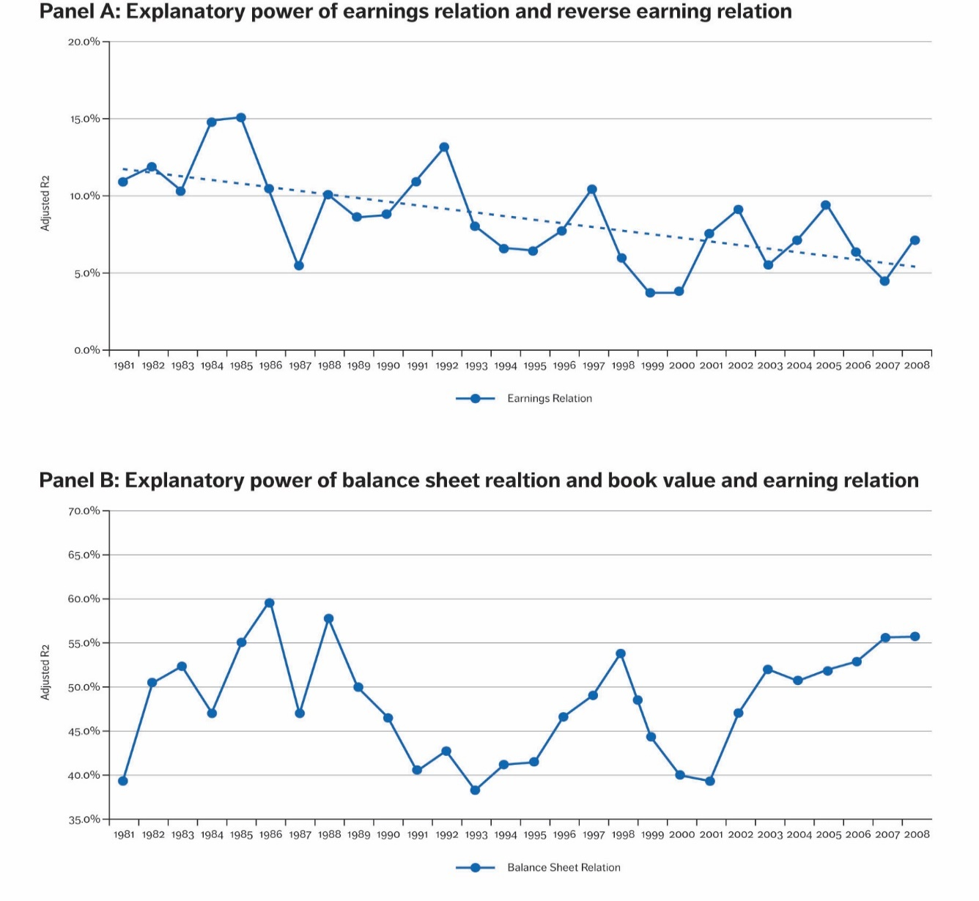
Relevance of financial statements
Correlation between changes in earnings and equity versus the changes in market values

