Slide 1
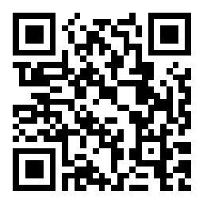
USI implementation
Log in to Slido:
Scan QR code or go to
slido.com and use code
#hosausi
HoSA webinar
22 March 2022
Moderators:
Annika Danielsson, Flinders University
Edwina Grose, University of Sydney

Slide 2
Acknowledgement of country
We begin today’s webinar by acknowledging the traditional custodians of the various lands on which we are meeting today, and pay respects to their leaders – past, present and emerging. We offer our respect to any First Nations colleagues who are joining us today.

Slide 3
How today’s session will be run
We have muted participants on entry to the webinar
Please Unmute only if you are about to speak
To ask a question, please use Slido
The webinar is being recorded today, and a link will be emailed to members after the event

Slide 4
What we will cover today
Update
Brief update from Janette Dines, Student Identifiers Registrar
Survey results
What HoSA members told us are the current issues with USI implementation
Response to issues raised in survey
  NZ and offshore students – USI team to respond
  Continuing students, communications & website – USI team to respond
  Validation & name-matching – USI team & TCSI team to respond
Questions & discussion – use Slido to record your question

Slide 5
Log on to slido
Scan QR code
or go to
slido.com
and use code
#hosausi
Record your questions at any time during the session

Slide 6
Update from Student Identifiers Registrar, Janette Dines

Slide 7


Slide 8
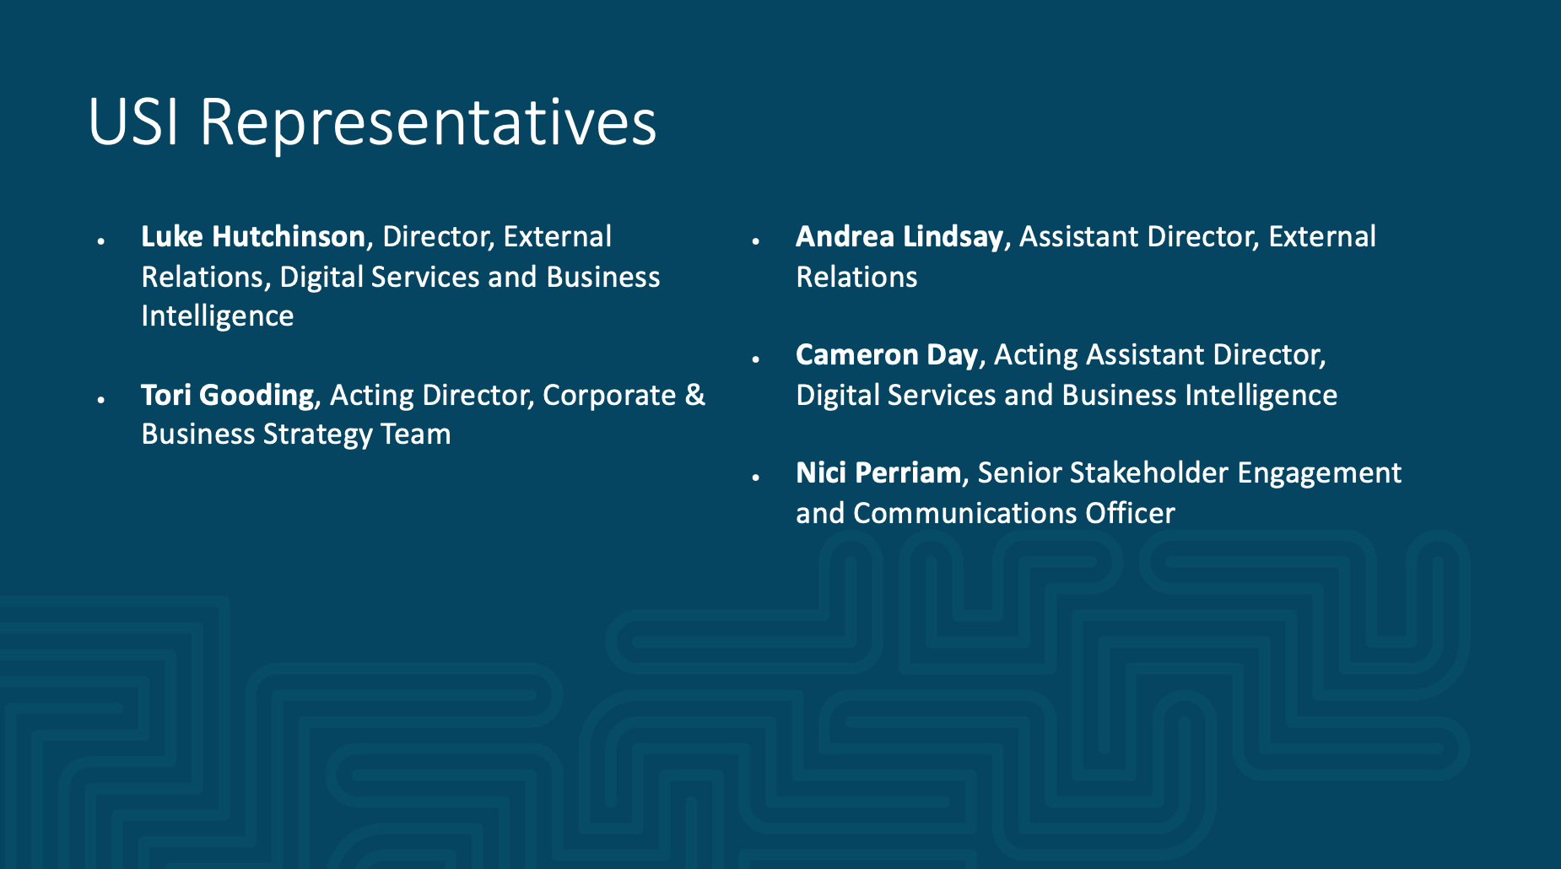
Janette Dines
Student Identifiers Registrar

Slide 9
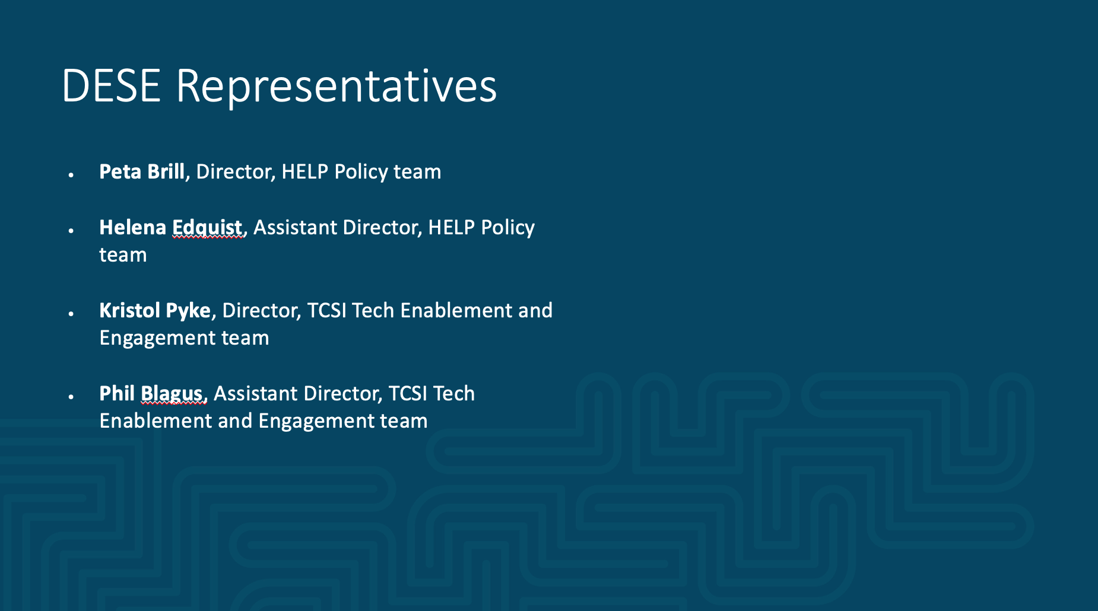
USI Representatives
Luke Hutchinson, Director, External Relations, Digital Services and Business Intelligence
Tori Gooding, Acting Director, Corporate & Business Strategy Team
Andrea Lindsay, Assistant Director, External Relations
Cameron Day, Acting Assistant Director, Digital Services and Business Intelligence
Nici Perriam, Senior Stakeholder Engagement and Communications Officer

Slide 10
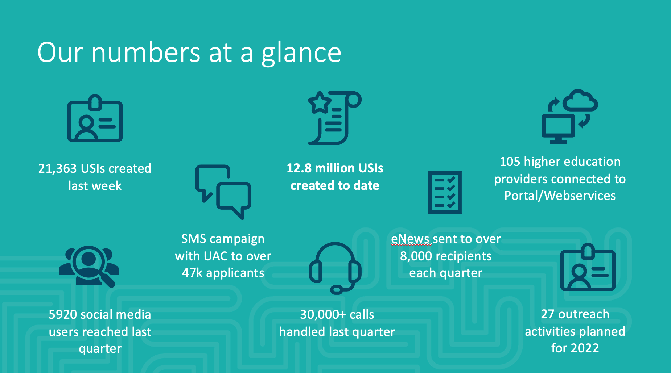

Slide 11
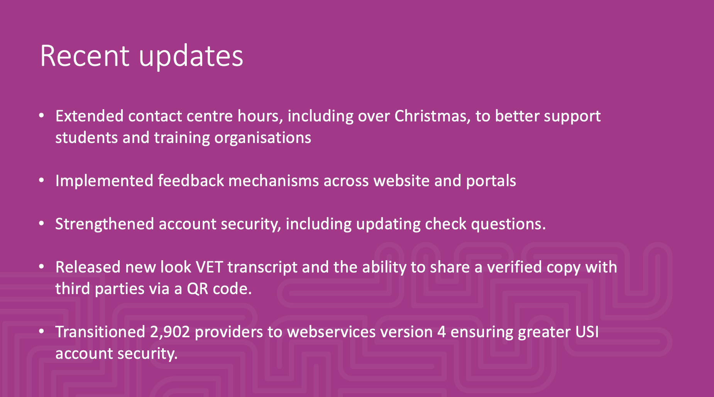

Slide 12
Survey results
Conducted February 2022
25 universities responded

Slide 13
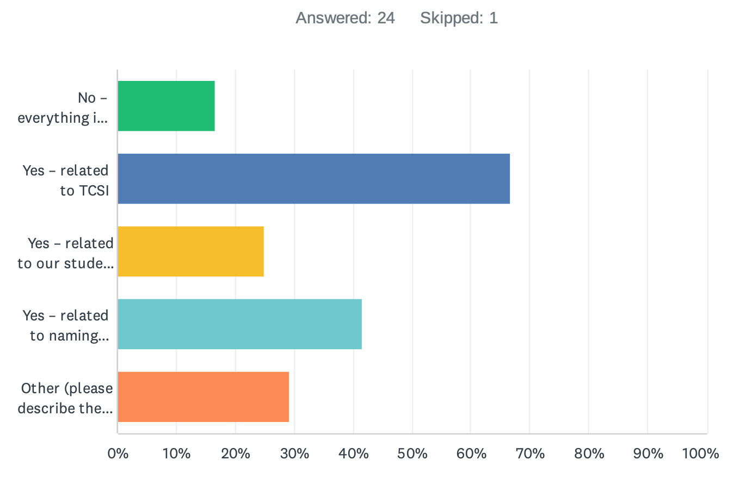
Are you having any validation problems with the USI?

Slide 14
Other implementation problems
Students with a numerical character in their name
Mismatch of names between TCSI and USI
High volumes of TCSI errors
42 day validation timeline is causing significant problems
StudentOne will only transmit data once it passes USI registry
Students without access to required identification documents e.g. in remote Indigenous communities
Reluctance from some students to provide USI because of lack of perceived benefit
Students who are offshore, NZ citizens, and PRs without current resident return visa

Slide 15
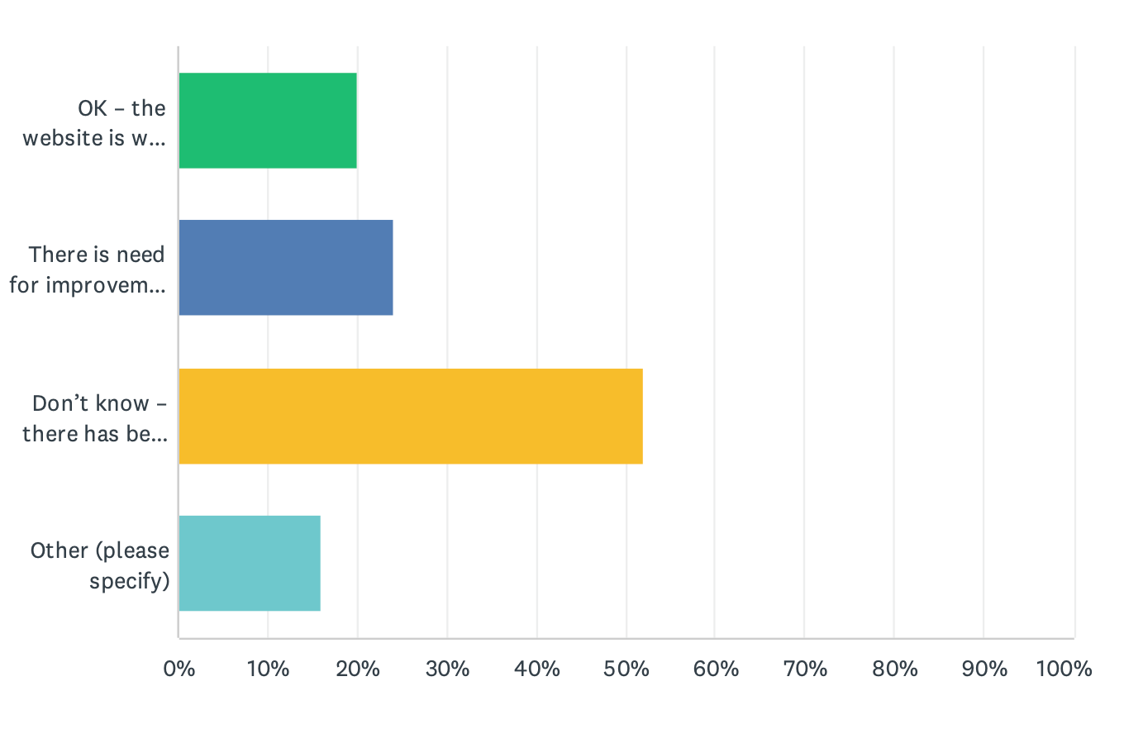
Experience of using USI website

Slide 16
Suggested improvements/wish-list
Bulk verification via USI portal would be useful
Access to historical data (change of name, change of address etc)
Ability for an institution to request a USI on behalf of students (as for CHESSN)
Access to SLE entitlements via the USI
Improved FAQs e.g. student responsibilities including emphasis on consistent use of names, implications of missing data and impact on Commonwealth assistance, NZ students
Improved name matching to allow for different system field lengths (e.g. first 20 characters)
Interface with ATO to match records?

Slide 17
- New Zealand & offshore students
- Continuing students, communications & website
- Validation & name-matching

Slide 18
Q & A
Scan QR code
or go to
slido.com
and use code
#hosausi

