Slide 1

Contract Bridge and Senior Citizens: from Entertainment to Competition
International Scientific Conference
RECREATION AND JOY OF LIFE IN SENIORS
Torun, 20-21.4.2017.
Tihana Brkljačić ♦ Ines Sučić ♦ Barbara Brdovčak

Slide 2
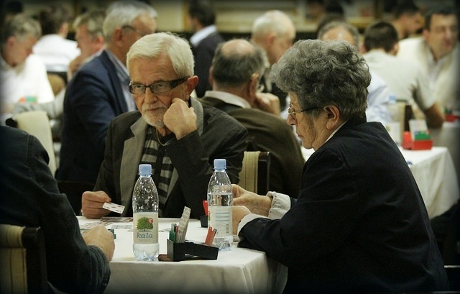
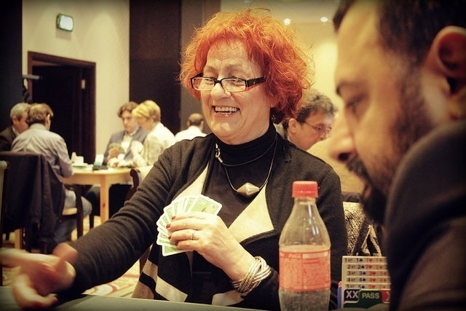
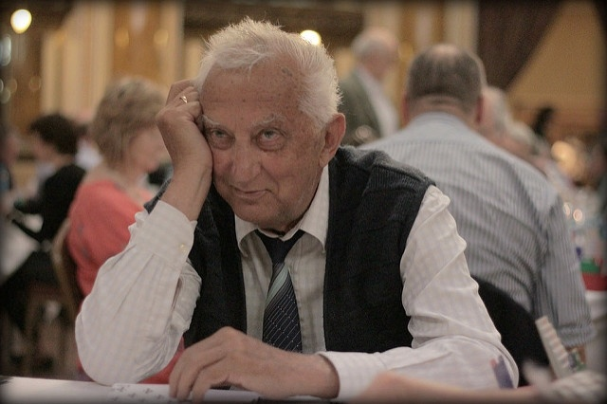
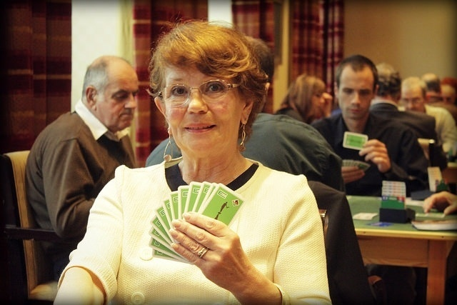
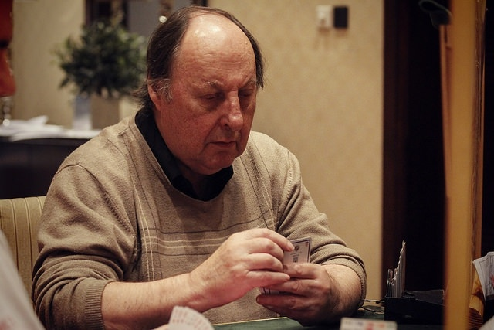

Slide 3
Aims of the Study:
to explore motivation of senior citizens to engage in contract bridge
to analyze self-reported benefits of the game regarding Major’s classification

Slide 4
Serious Leisure (Major, 2001):
benefits:
  social affiliation
  sense of accomplishment (i.e., self-confidence, power, and control)
  health and fitness (i.e., physical benefits and stress relief)

Slide 5
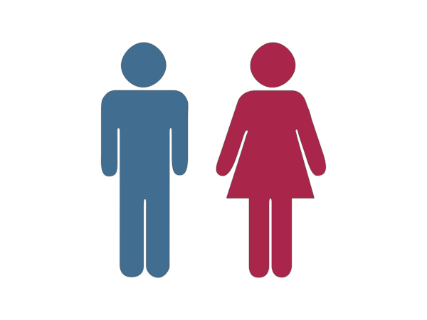

Method: Sample
3
5
age: 68-80
players who play at least once per week for last 8 years
all approached agreed

Slide 6
Method: Instruments
In depth semi-structured interview:
general:
* age
* health
* social life including family
* work and other hobbies
bridge:
* experiences
* motivation
* benefits from bridge

Slide 7
Method: Procedure
in depth semi structured interviews
about 30 minutes
voluntarily and anonimously
agreed to share their comments for scientific purposes

Slide 8
Results: Demographics
General:
6 married/in a relationship, 2 widowed
7 university degree
all retired, 1 with disability
6 still worked part-time jobs
Free time activities: mostly intellectual and passive (reading, watching TV, cross-words/puzzles)
Bridge:
average club players or better
5 started to play when they were over 60, 3 started to play earlier and had long bridge experience.
All played for at least 5 years.

Slide 9
Social affiliation: Communication/Fun
“There are lot of people in a bridge club. I like chatting to different people. I can’t go around and talk to people on the streets, or approach someone in the coffee-shop. That would be weird. I like the fact that everyone knows me here.”
“ I like to chat with opponents. I don’t like serious tournaments. It is all fun to me. I don’t understand why people get upset.”
“ You have to talk. It is very social. Some pretend to be serious, but it is a game, isn’t it?”
“On Wendsdays me and (name) go to different clubs. As soon as we come home we talk on phone for at least half an hour. About bridge hands if we remember. And gossip (laugh).
“I never go to bars, but at the club I have a drink or two, it is like going out.”

Slide 10
Social affiliation: Going out, Plans, Life Routine
“That’s what I do on Thursdays. I look forward to it the whole week.”
“ I have to get out of the house. I will never quit bridge and smoking. I can’t walk, I come by taxi. But I don’t mind to spend on what I like.”
“Bridge is stable thing in my life for over 30 years.”

Slide 11
Social affiliation: Understanding, supporting
“Last year we were playing some tournaments to collect money for the juniors. Later, one of them, during the club game said me (after I made unsufficient bid): it is not problem, just bid what you wish. I don’t know, but I think we are kind of closer now. We help each other.”
“Most of the kids at bridge behave very nice. They respect me.”
“Oh, no, I don’t mind when they (youth) call me by my first name. I feel younger.”

Slide 12
Social affiliation: Status & Recognition
“I agreed with junior player that he would help me something with my computer. When he arrived my friend was at my home, and she was astonished (how young guys come to help me). Usually she is the one with adventures.(laugh)”
“ You know, it is nice to say... I can’t (go somewhere) because I have to go to bridge. It is nice that you have any plans, and even better if they sound so good. I feel important. (giggles)”
“Yes, I think people think you are smarter when you say that you play bridge.”

Slide 13
Sense of acomplishment: Competing, Improving
“Did you see how good I am. I check ranking list every day. I am even better then (name), and he thinks he is an expert.”
“ Winning is very important to me. I am proud of myself when I do well. But, my play is much more important to me, than what partner does.”
“When I make mistake I want to kill myself. How could I be so stupid. Oh, yes, I am proud of myself when I make a contract that others didn’t.”

Slide 14
Sense of acomplishment: Learning, Solving problems
“Allways in my life I was active. Because of bridge I can still be active and learn new things.”
“After I got retired I had to do something, friend told me about bridge. I never regreted. I put a lot of effort into it, and I know I learned a lot. I feel good about it”
“You can study bridge forever, you will never know it all. That is why I love it.”

Slide 15
Health: Staying mentally fit
“I never watched Spanish or Turkish soap-operas. I like thrillers. Bridge is similar to that. It is good for my brain. (laugh)”
“You will see once you get old, there are not many challenges. Oh yes, you cook, and help with grandchildren. They say grandchildren keep you young. They don’t. Y ou feel old when you have to run after them (laugh). But, when you play bridge it doesn’t ask for anything you can’t do. You are as good as you were before. Or, at least I feel like that. (laugh)”
“Bridge keeps me moving. I excercise my brain. All my life I liked puzzels. Bridge is the best game of all.”

Slide 16
Qulity of life
“Of course I would leave him if he wouldn’t support my bridge. In this age, you have to be practical. But, he knows bridge means a lot to me. ”
“ Bridge significantly improves quality of my life. And I think it is the same for all of us. We feel good and accepted here.”
“I have other hobbies, but I can’t imagine my life without bridge. Because it is people and play, and tournaments. It is interesting in so many ways. If there was no bridge, I would play something else, as similar to bridge as possible.”

Slide 17
Limitations
small convinient sample
Croatia: cross-cultural differences
familiar interviewer

Slide 18
Main Findings
Bridge contributed to well-being of elderly by:
advancing social affiliation
communicating with people of all ages, finding new friends, getting social support, recognition and status and going out of home)
enchasing sense of accomplishment
learning, solving problems, competing, advancing and winning
mental fitness
staying intellectually fit, learning new things, logical reasoning
While it seems that senior player often come to bridge because of social reasons, it is competitive element that keeps them there.

Slide 19
Practical Advices
Social inclusion: dividing youngsters from seniors may not be the best idea
* Special games for specific generation should not be standard approach
* Cross-generation understanding and support should be encouraged

Slide 20
Would you rather be
40 years old
or 80 years young?

Slide 21
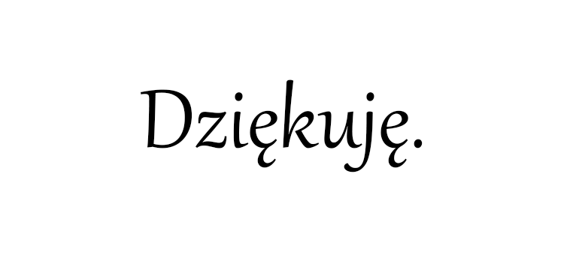
Thank you!

