Slide 1
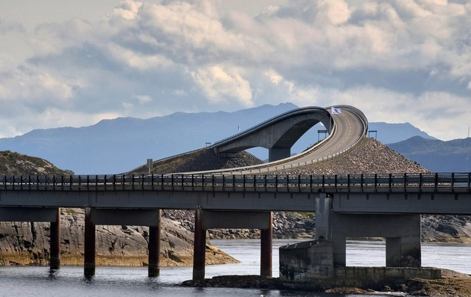

NEW TERMS FOR SETTLEMENT THROUGH THE NATURAL PERILS POOL
From 1 January 2016

Slide 2

New Terms for Settlement through the Natural Perils Pool from 1 January 2016
The board of the Norwegian Natural Perils Pool has approved new Terms for Settlement through the Natural Perils Pool to apply from 1 January 2016
The new Terms for Settlement through the Natural Perils Pool supersede the Common Terms and Conditions for All Insurance Contracts Covering Damage Caused by Natural Events of 1 January 2012 (hereinafter referred to as the Common Terms and Conditions)
The Common Terms and Conditions will cease to apply as an independent set of insurance terms from 1 January 2016
The new Terms for Settlement through the Natural Perils Pool regulate only what companies can settle through the Pool and will no longer serve as minimum terms
The settlement of natural perils claims must conform to the company’s terms for fire insurance for the damaged object

Slide 3
New Terms for Settlement through the Natural Perils Pool from 1 January 2016
The new Terms for Settlement set out the maximum a company may settle through the Pool
The new Terms for Settlement set out the terms for settlement between companies and the Pool, and do not apply between the company and the policyholder
Settlement through the Pool is nevertheless limited to the company's own terms for fire insurance for the damaged object
Where the Natural Perils Insurance Act specifies a different extent of cover or a different calculation of indemnity to the company’s terms, the Act has precedence over those terms
Departures from the Act to the policyholder’s detriment are not permitted
See Circulars 1/15, 7/15 and 12/15

Slide 4
New Terms for Settlement through the Natural Perils Pool from 1 January 2016
The following applies in the transition from the old to the new terms:
The Terms for Settlement through the Natural Perils Pool apply to the settlement of claims for losses occurring from 1 January 2016 onwards
Claims for losses occurring before 1 January 2016 are to be settled in accordance with the Common Terms and Conditions of 1 January 2012
Example:
Customer renews on 1 October 2015 and is issued a certificate of insurance expiring on 1 October 2016
Claims under this policy are to be settled in line with the Common Terms and Conditions of 1 January 2012 for losses occurring before 1 January 2016
Claims for losses occurring on or after 1 January 2016 are to be settled in line with the new Terms for Settlement through the Natural Perils Pool

Slide 5
New Terms for Settlement through the Natural Perils Pool from 1 January 2016
Some key points
Section 3 of the new Terms for Settlement set out what the company can settle through the Pool
Settlement through the Pool presupposes that the company did actually provide the cover in question
Example:
If the company claims for a permanent wooden wharf, the certificate of insurance must state that permanent wooden wharves are covered
Additional buildings under 10 square metres are covered only if the company has this cover in its own terms
The definition of "building" is as set out in the company’s terms, cf. Section 3.1. The company may also settle under Section 3.1.1 first bullet if the company included these additions in its own terms

Slide 6
New Terms for Settlement through the Natural Perils Pool from 1 January 2016
Cover for gardens is as set out in Section 1 of the Natural Perils Insurance Act
Terms that are less favourable than set out in the Act are not permitted
Should a company nevertheless have terms that are less favourable than set out in the Act, the Act has precedence over those terms
Note that forest, standing crops, pasture, home fields and outlying fields do not count as garden

Slide 7
New Terms for Settlement through the Natural Perils Pool from 1 January 2016
Note the new financial limits of indemnity
Even though this is not expressly stated in the Terms for Settlement, it is possible to claim for additional expenses due to price rises if the company has this cover in its own terms
If you have any questions about the changes to settlement through the Pool, please contact:
pool@fno.no

