Slide 1
GO1 | Content Marketplace Partner
Partner with GO1
Access the world’s largest corporate training library

Slide 2
The Content Marketplace partner program
GO1 | Content Marketplace Partner
Give your users access to the world’s largest marketplace.
GO1 helps to...
Provide your users with
certified or accredited skills.
Manage re-certification of
your community base.
Provide value-add to your job seekers or community members.
Become a GO1 Content Marketplace Partner today!

Slide 3
Are you a…
GO1 | Content Marketplace Partner
Member community of experts?
Regulatory Governance body? Candidate Job board?
Provided their job seekers
with the certificates
and cards needed be eligible for placements in construction.
Find out why organisations like yours have become GO1’s Content Marketplace Partners...
Workana provided their community of freelancers with certified courses to help increase their chances of winning
contracts and projects.
JT Academy provide training to their community members entering the workplace for the first time. It has better preparef them by increasing their skills and confidence.

Slide 4
Partner with GO1
GO1 | Content Marketplace Partner
GO1 Learning Platform
GO1 offers a Cloud based online training platform, with LMS capability including the ability for users to build their own courses. Accessible 24/7 on any mobile or tablet device.
With the world’s largest network of online training providers,
GO1 simplifies your corporate training.
GO1 PRODUCT SUITE
GO1 Content Marketplace
The marketplace contains more than 400,000 learning items. Ranging from free to pay-per-use courses covering compliance, soft skills and personal development content.
GO1 Premium Library
GO1 offers a premium library made up of the most in-demand courses available from GO1’s network of global content creators.
Each year GO1 trains more than 500,000 people!

Slide 5
Open new doors
Leverage the fast growth of the online learning industry; to attract new clients.
GO1 | Content Marketplace Partner
Development tools
You will have access to our proven partner integration patterns.
Flexible integration options
We can work with you to develop the appropriate solution to suit your needs.
Generate additional value
Expand your product portfolio with GO1’s platform and content offerings.
Why partner
with GO1?
Quick time to market
Expect short time from signing up to launch of our partner solution.
Get rewarded
Create new revenue streams for your organisation.
Enjoy extensive support
Access to marketing collateral, technical implementation documentation and sales enablement.
Partner Manager
They will be available to support you through the partner process and answer your questions.

Slide 6
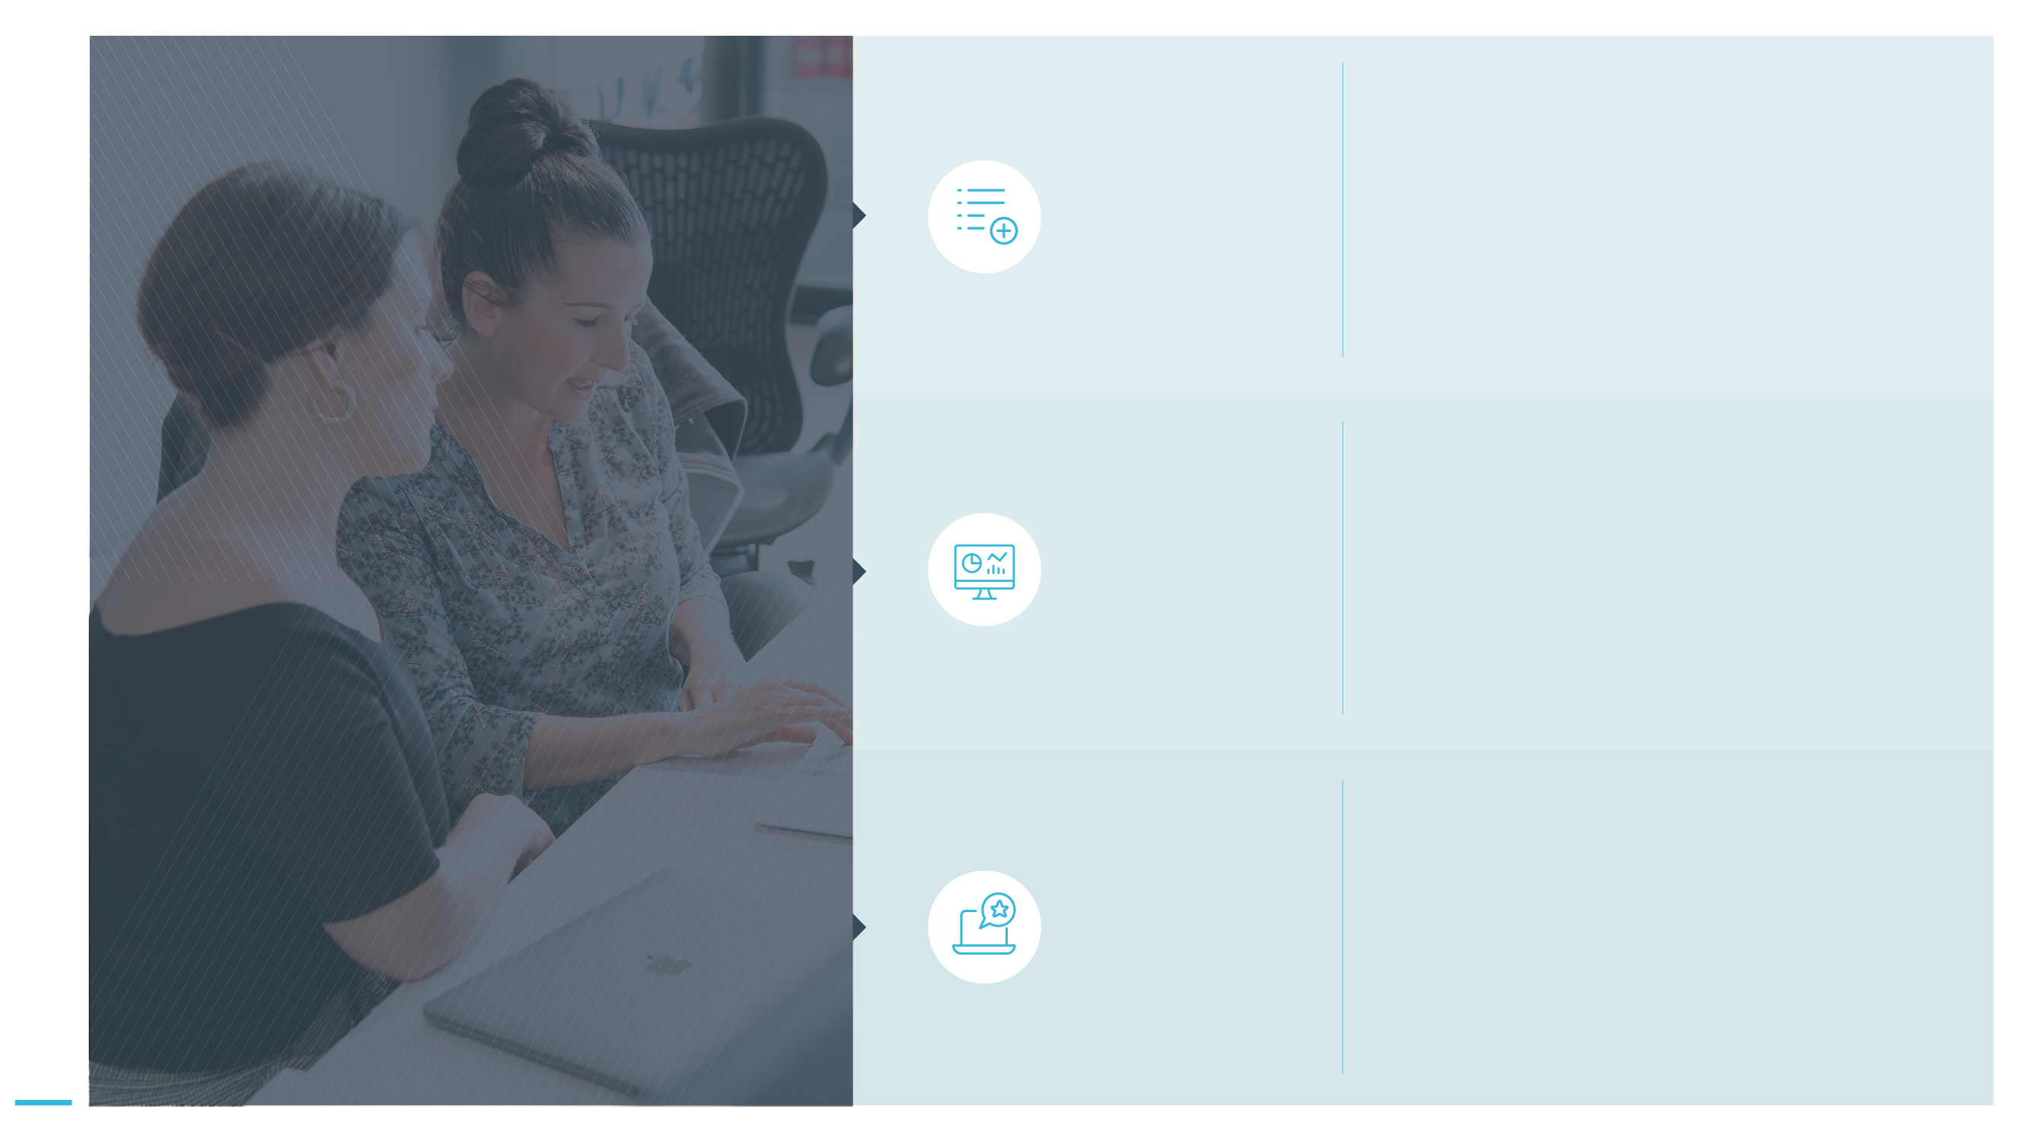
Volumes of quality GO1 content
GO1 | Content Marketplace Partner
GO1 is internationally recognised for having the highest quality eLearning content, curated by industry leading providers.
The comprehensive content library offers courses relevant to all businesses; compliance, personal and professional development, soft skills and much more!
The content is in a SCORM video format
GO1’s partner solution will make the content
library directly searchable from your platform.
This means:
Only 1 site for your customers to navigate to, where they can find, view and pay for GO1 content.
Only 1 platform for you to manage content purchases and taxation.
Why choose
GO1 content?
Available within your product
Adding value to your offering
Your platform retains its core value proposition, but now with the inclusion of an enriched content offering available for your consumers.

Slide 7
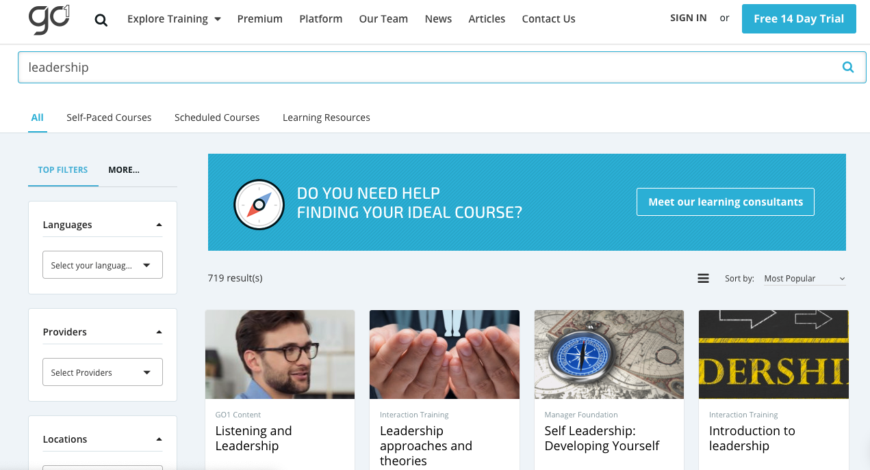
Example Content Marketplace application
GO1 | Content Marketplace Partner
GO1 will supply your organisation with a single GO1 portal instance where you can browse the pay per use courses from the marketplace or the premium subscription content and choose what you want available to your users.

Slide 8
Finding content
GO1 | Content Marketplace Partner
Using an API endpoint, the content will then be built into a marketplace storefront displayed within your website. From within your website, users can then search using the filters and search bar, to browse for courses. They can then select what interests them and see an overview of that course.
An example of a content marketplace we have developed.

Slide 9
Easy payment process
GO1 | Content Marketplace Partner
Once you user selects the content, a payment gateway will be triggered. Payment for each course can be
via GO1 pay or alternatively through a payment form. When paying, users will have create a personal GO1 account linked to your organisations portal instance. When the user completes the content your organisation will be updated with course status.

Slide 10
GO1 | Content Marketplace Partner
Sign your Partner Agreement
Work with your GO1 Partner team to decide on your success plan
Design and develop the integration;
you will need to decide on payment means and portal configuration. GO1 will provide you with API support documentation and developer portal access. The GO1 Product Team will be hand to answer any technical integration questions you may have.
Becoming a Content Marketplace Partner
Launch
and operate
Work with GO1 to launch your marketplace and leverage materials to drive engagement

Slide 11
Ready to join the GO1 Partner Program?
GO1 | Content Marketplace Partner
Contact your Partner Manager:
dfish@go1.com

