Slide 1
GO1 | Referral Partner
Partner with GO1
Access the world’s largest corporate training library

Slide 2
GO1 helps to...
GO1 | Referral Partner
Create a new recurring revenue stream
Be seen as a thought leader and an end-to-end solution provider for your customers (help your customers to maintain workplace code compliance)
GO1 referral partner program
Begin earning today!
Join the GO1 Referral Partner Program today!

Slide 3
Are you a…
GO1 | Referral Partner
Business Advisor?
B2B Saas Platform looking to provide extra value to your customer through your addon ecosystem?
Check out some of GO1’s Referral Partners...
Flare and Roubler have enabled their customers to create rich onboarding courses to get staff trained on their internal systems and processes faster and ensure they remain compliant with workplace code and practices.

Slide 4
Partner with GO1
GO1 Learning Platform
GO1 offers a Cloud based online training platform, with LMS capability including the ability for users to build their own courses. Accessible 24/7 on any mobile or tablet device.
With the world’s largest network of online training providers,
GO1 simplifies your corporate training.
GO1 PRODUCT SUITE
GO1 Content Marketplace
The marketplace contains more than 400,000 learning items. Ranging from free to pay-per-use courses covering compliance, soft skills and personal development content.
GO1 Premium Library
GO1 offers a premium library made up of the most in-demand courses available from GO1’s network of global content creators.
Each year GO1 trains more than 500,000 people!

Slide 5
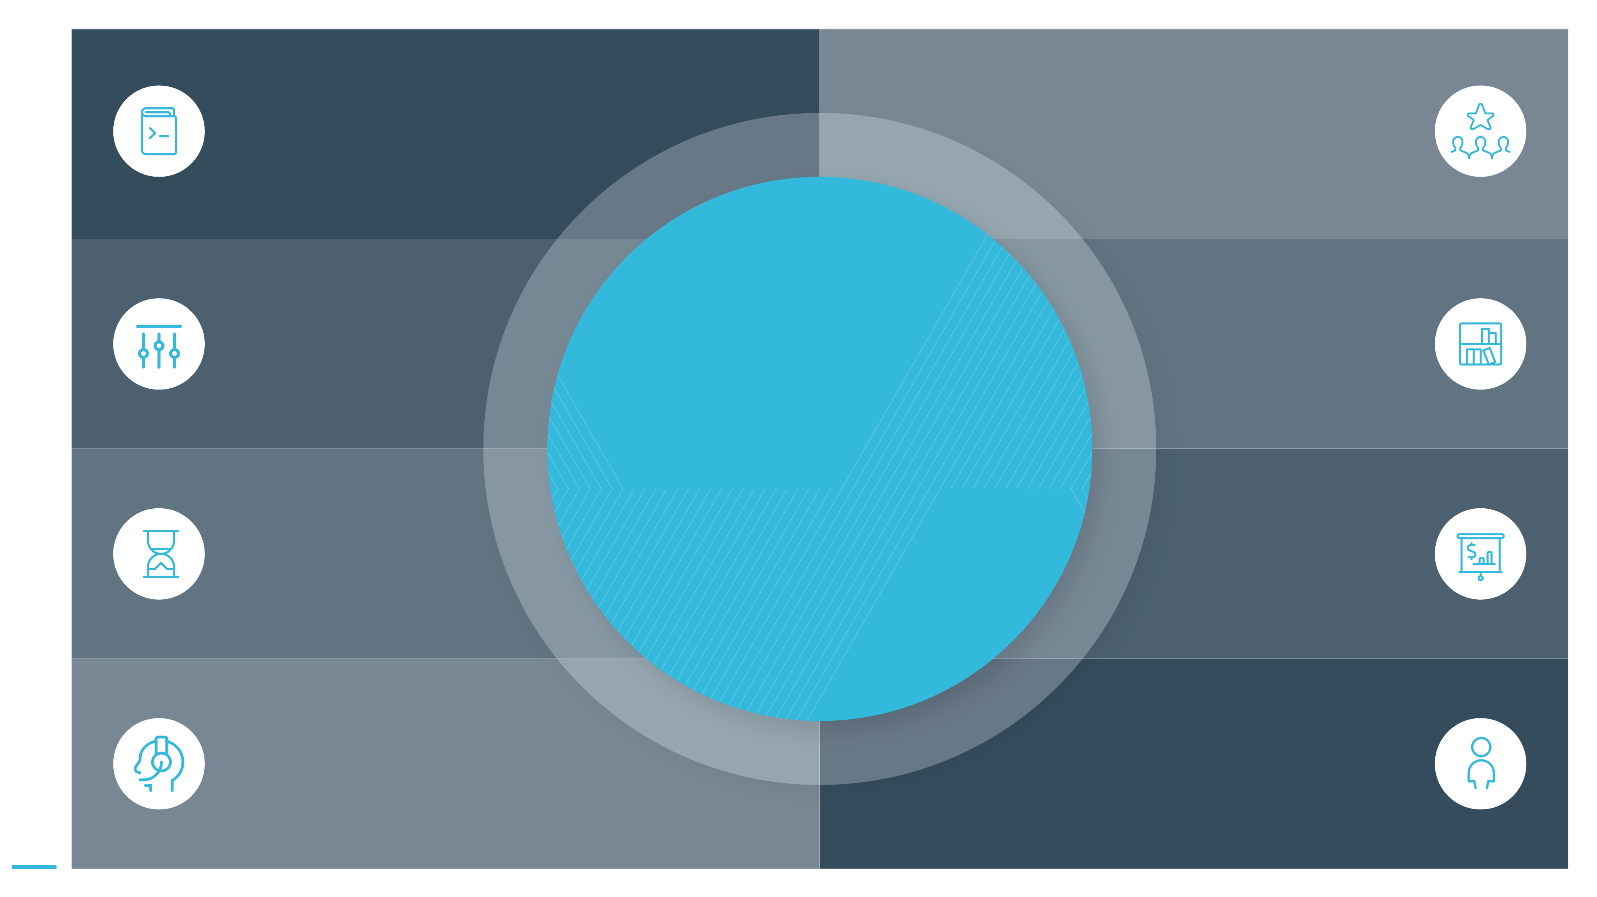
Open new doors
Leverage the fast growth of the online learning industry; to attract new clients.
GO1 | Referral Partner
Development tools
You will have access to our proven partner integration patterns.
Flexible integration options
We can work with you to develop the appropriate solution to suit your needs.
Generate additional value
Expand your product portfolio with GO1’s platform and content offerings.
Why partner with GO1?
Quick time to market
Expect short time from signing up to launch of our partner solution.
Get rewarded
Create new revenue streams for your organisation.
Enjoy extensive support
Access to marketing collateral, technical implementation documentation and sales enablement.
Partner Manager
They will be available to support you through the partner process and answer your questions.

Slide 6
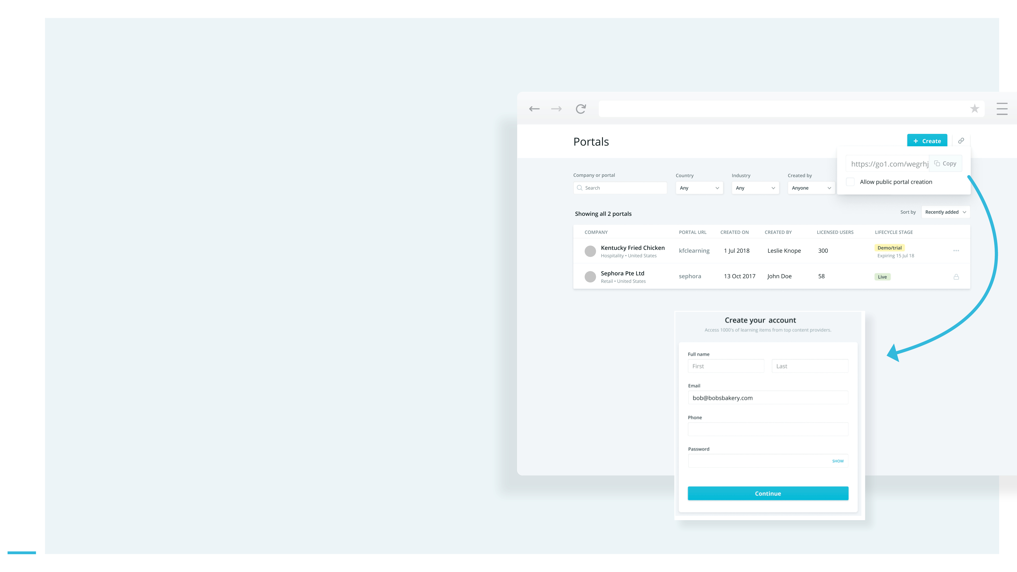
GO1 direct referral Partner Program
GO1 | Referral Partner
Let your customers know about GO1
As a GO1 referral partner, we let you self-manage your interested clients. You will have access to the GO1 Referral Partner Hub, which will serve as your referral tool. You will also be provided with a web- link which can be embedded into your website,
or emailed to your clients. When clicked this will generate an instance of GO1 automatically (linked to your partner account).
Use your outbound communication channels to engage your customers. If you have an interested customer, generate a GO1 trial portal straight from your partner hub.

Slide 7
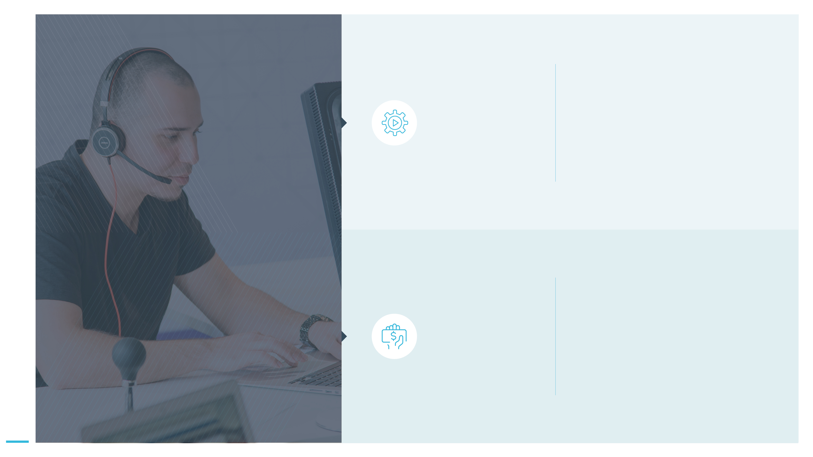
GO1 will take care of the rest
GO1 | Referral Partner
Once you create your customers GO1 portal we will take care of the sales enablement activities to convert your referrals, using both direct outreach and automated email communications. Once converted: GO1 will manage new clients during on- boarding and with ongoing support.
Why become GO1 referral partner?
Receive 50% net revenue for each client you refer to GO1, once they purchase GO1. Every quarter you will receive your revenue share from GO1 for your active, paying referrals.
Receive your commission
There’s no limit to what you can earn!

Slide 8
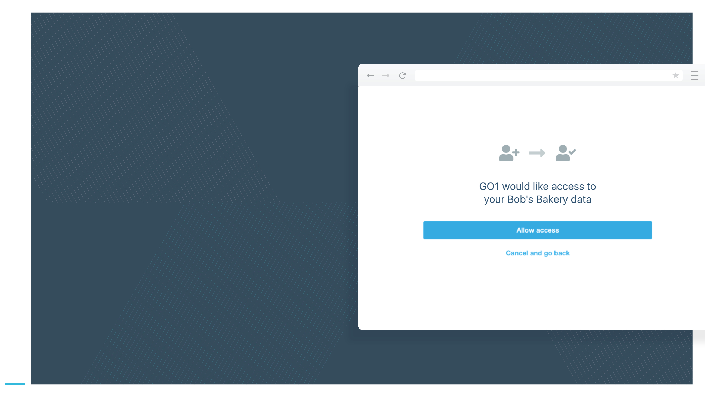
GO1 | Referral Partner
Integrated user experience
You can additionally build workflow based integrations into your existing platform, so that user data can be pushed between both
platforms, creating a seamless login experience.
*Optional development

Slide 9
Getting started
GO1 | Referral Partner
Sign the Partner agreement.
Receive your login for your unique Partner Hub
Connect with your GO1 Partner Manager
Use marketing tools and support from GO1 to communicate with new and existing clients
Sales support
What to expect next
GO1 will take care of converting leads to paying customers, using our tried and tested sales processes.
We’ll also take care of all billing and support.
Share your unique referral weblink on your website, social media and in email campaigns
How you can help?
Stay in regular contact with your partner manager
Consent to your brand being used in promotional material
Create a GO1 landing page on your website

Slide 10
Ready to join the GO1 Partner Program?
GO1 | Referral Partner
Contact your Partner Manager:
dfish@go1.com

