Slide 1
GO1 | Platform partnership
Partner with GO1
Access the world’s largest corporate training library

Slide 2
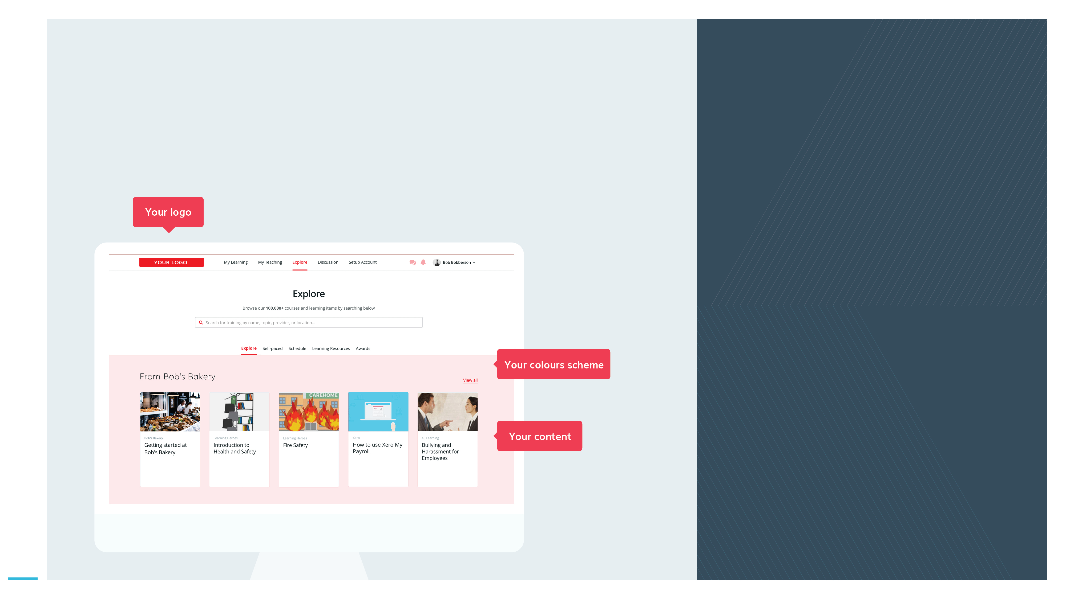
A GO1 platform partnership
GO1 | Platform partnership
GO1 helps to...
Extend your value chain by providing your customers an integrated learning management solution.
Distribute your own content or enable your customers to create their own sophisticated and interactive training.
Offer personal development and compliance training to your customers – without the need for a complex LMS or content provider integration.
Let GO1’s LMS power your product.
Become a platform partner today!

Slide 3
Are you a…
GO1 | Platform partnership
B2B SaaS platform looking to enhance its offering through the provision of LMS capability?
Enabling their customers recruiters to assign valuable training and in-house onboarding courses on or before the candidates start date.
Find out why organizations like yours have powered their product with the GO1 platform.
Complispace powered by GO1’s platform has enabled them to rapidly distribute their compliance based online training to a user base in more than 1000 schools across Australia.

Slide 4
Partner with GO1
GO1 | Platform partnership
GO1 Learning Platform
GO1 offers a Cloud based online training platform, with LMS capability including the ability for users to build their own courses. Accessible 24/7 on any mobile or tablet device.
With the world’s largest network of online training providers,
GO1 simplifies your corporate training.
GO1 PRODUCT SUITE
GO1 Content Marketplace
The marketplace contains more than 400,000 learning items. Ranging from free to pay-per-use courses covering compliance, soft skills and personal development content.
GO1 Premium Library
GO1 offers a premium library made up of the most in-demand courses available from GO1’s network of global content creators.
Each year GO1 trains more than 500,000 people!

Slide 5
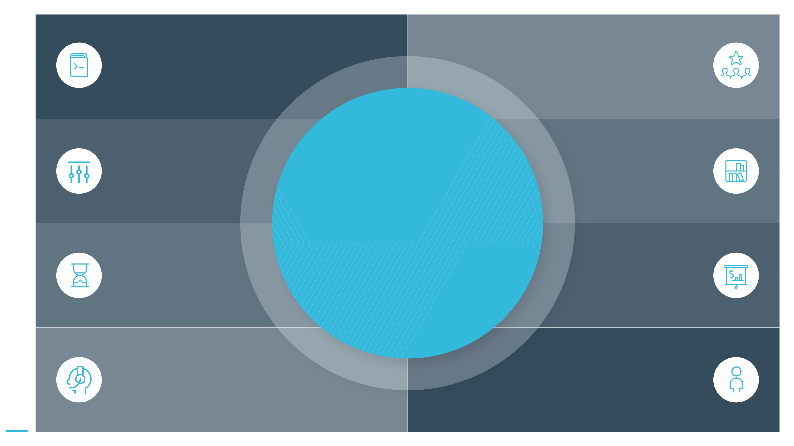
Open new doors
Leverage the fast growth of the online learning industry; to attract new clients.
GO1 | Platform partnership
Development tools
You will have access to our proven partner integration patterns.
Flexible integration options
We can work with you to develop the appropriate solution to suit your needs.
Generate additional value
Expand your product portfolio with GO1’s platform and content offerings.
Why partner with GO1?
Quick time to market
Expect short time from signing up to launch of our partner solution.
Get rewarded
Create new revenue streams for your organisation.
Enjoy extensive support
Access to marketing collateral, technical implementation documentation and sales enablement.
Partner Manager
They will be available to support you through the partner process and answer your questions.

Slide 6
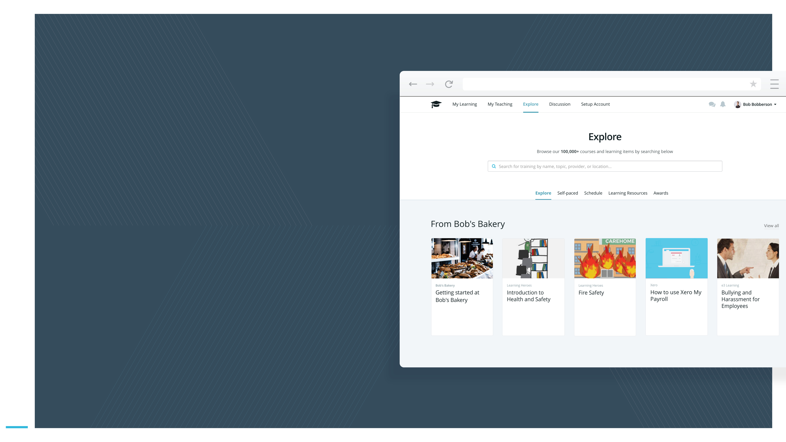
Let the GO1 platform power your product suite
GO1 | Platform partnership
Brand the GO1 LMS as your own
We can work to theme and configure the GO1 LMS to suit to your organisations look and feel, so it seamlessly integrates into you current existing product suite.
Decide on your content
The platform supports various content formats. You can decide if the platform will distribute your content and/or GO1 content.

Slide 7
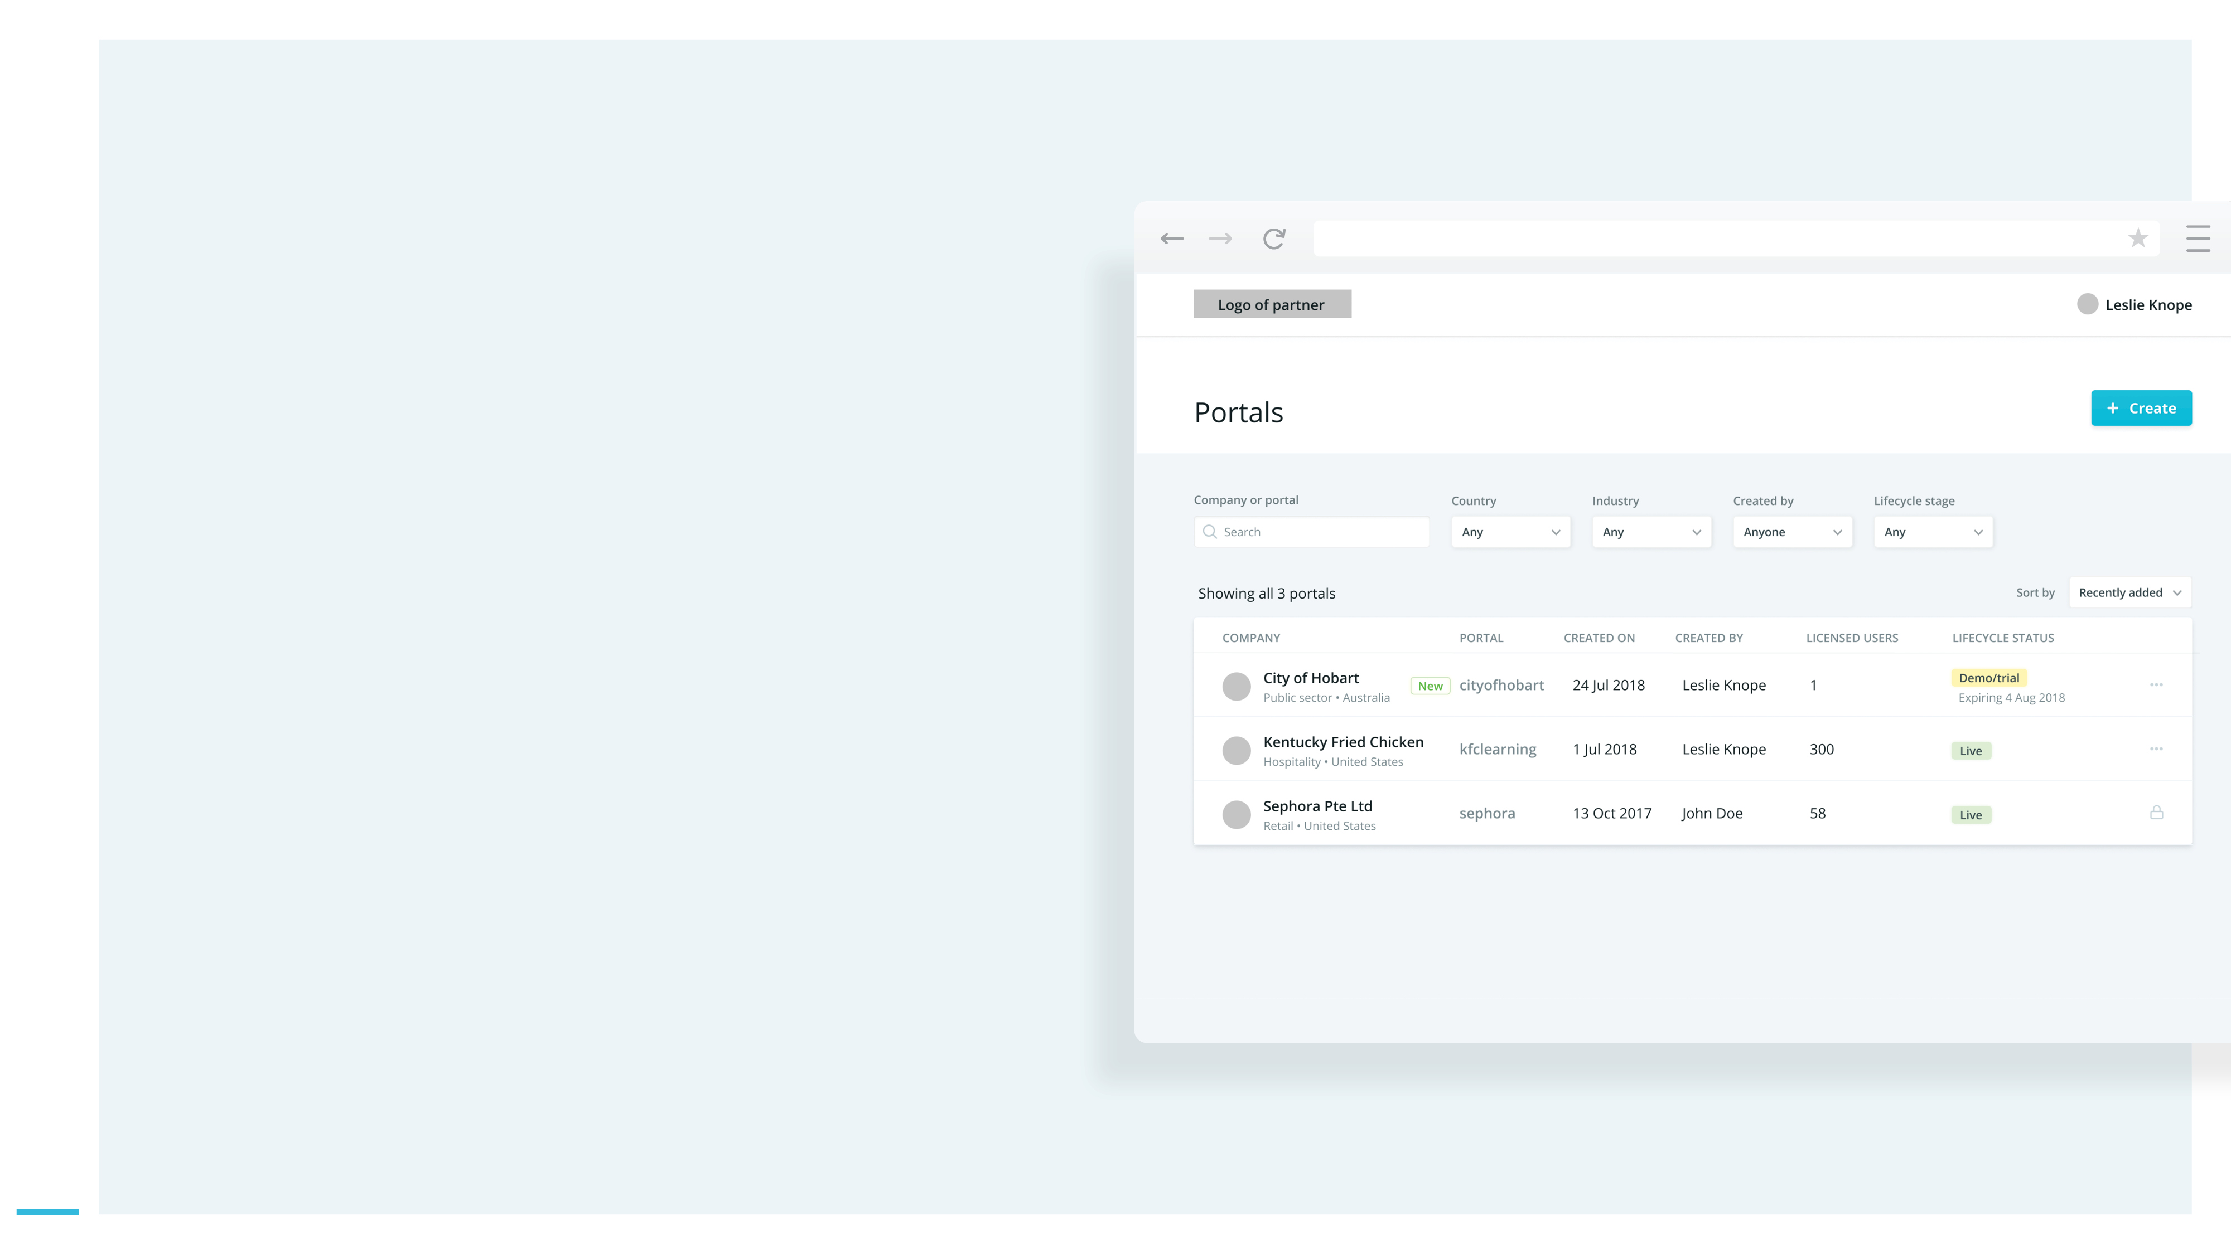
GO1 | Platform partnership
Become a reseller
Use the self-service GO1 Portal Launcher tool to generate your branded portals (with your chosen content package) for potential customers. The Partner Hub will also allow you monitor your customers conversion status and view high level reports.

Slide 8
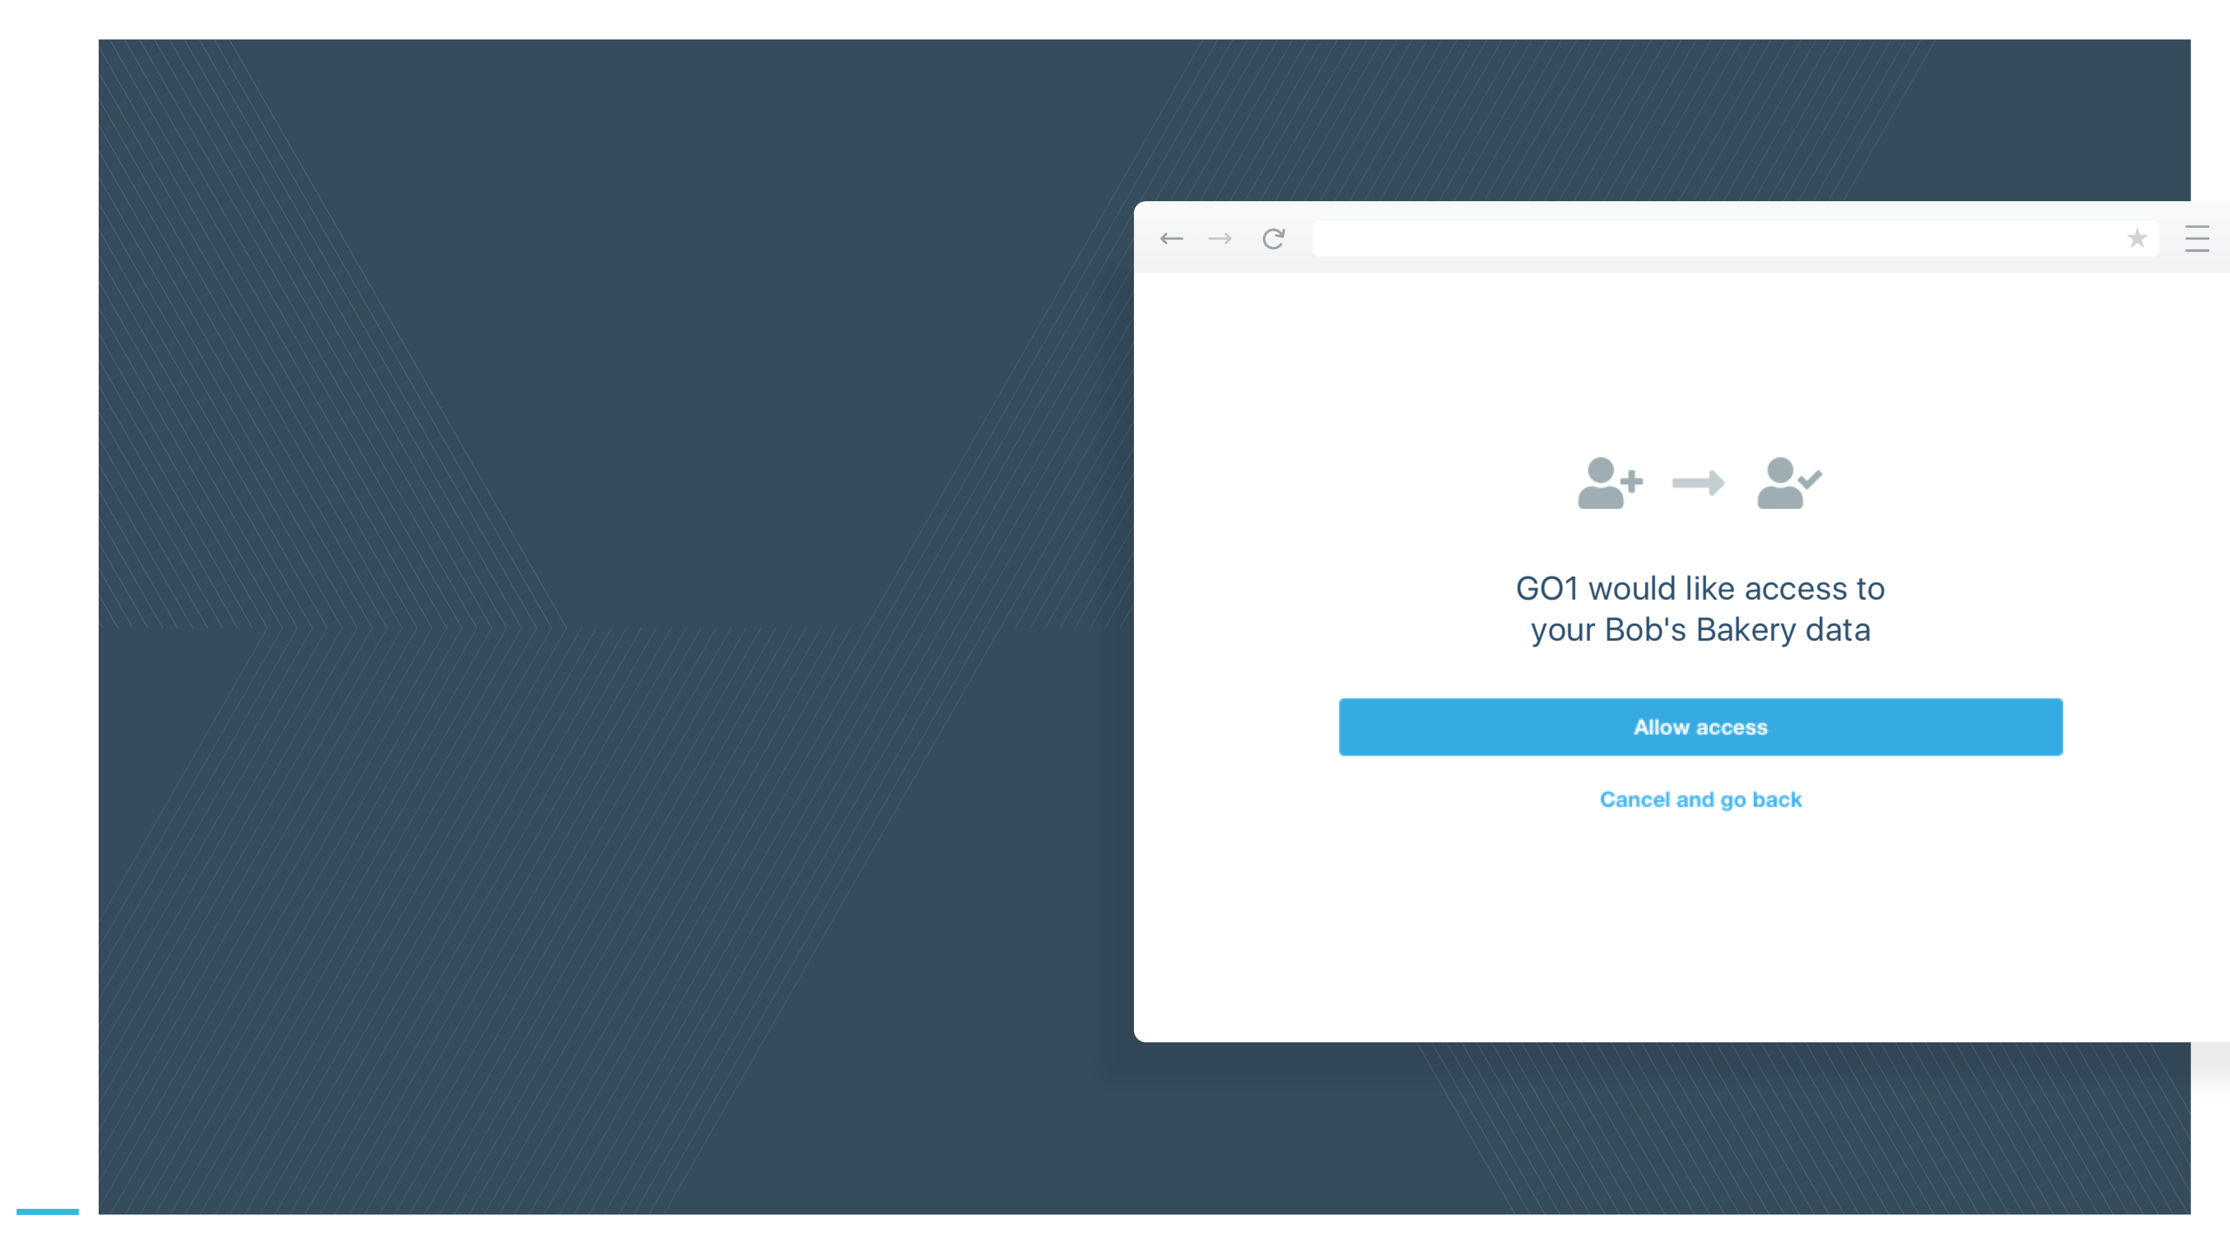
GO1 | Platform partnership
Integrated user experience
You can additionally build workflow based integrations into your existing platform, so that user data can be pushed between both
platforms, creating a seamless login experience.
*Optional development

Slide 9
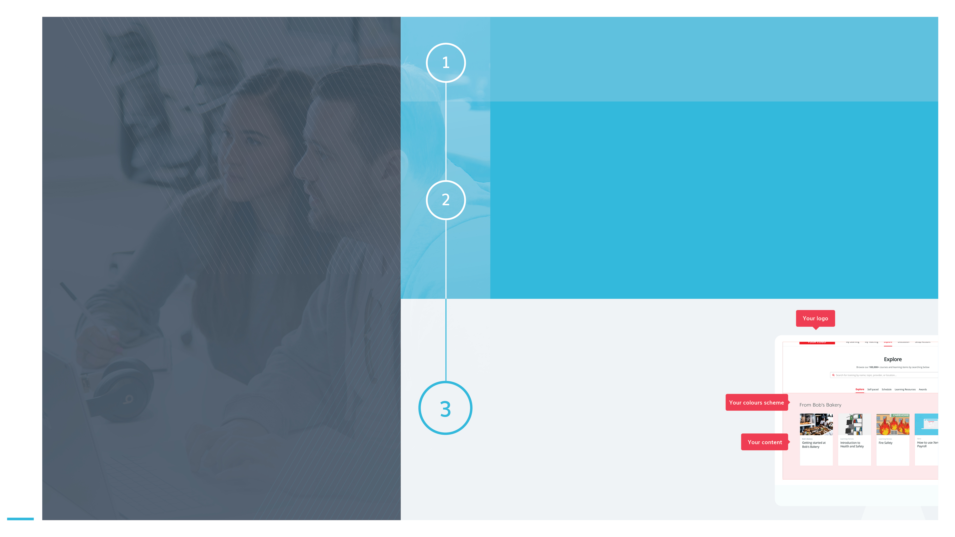
Sign your Partner Agreement
GO1 | Platform partnership
Design and Delivery
Work with the GO1 Product and Partner teams, to plan and then develop the integration.
We will provide you API support documentation and developer portal access.
If you are a reseller - Partner Hub access will be provided.
What to expect next
Launch and operate
Work with the GO1 Partner team to plan your Go-to-market strategy.
Use marketing materials and support documents provided by GO1 to deliver on the strategy.
We will work together to decide on an appropriate launch process, such as staged release; market test and/or EAP

Slide 10
Ready to join the GO1 Partner Program?
GO1 | Platform partnership
Contact your Partner Manager:
dfish@go1.com

