Slide 1
GO1 | Partner powered by content
Partner with GO1
Access the world’s largest corporate training library

Slide 2
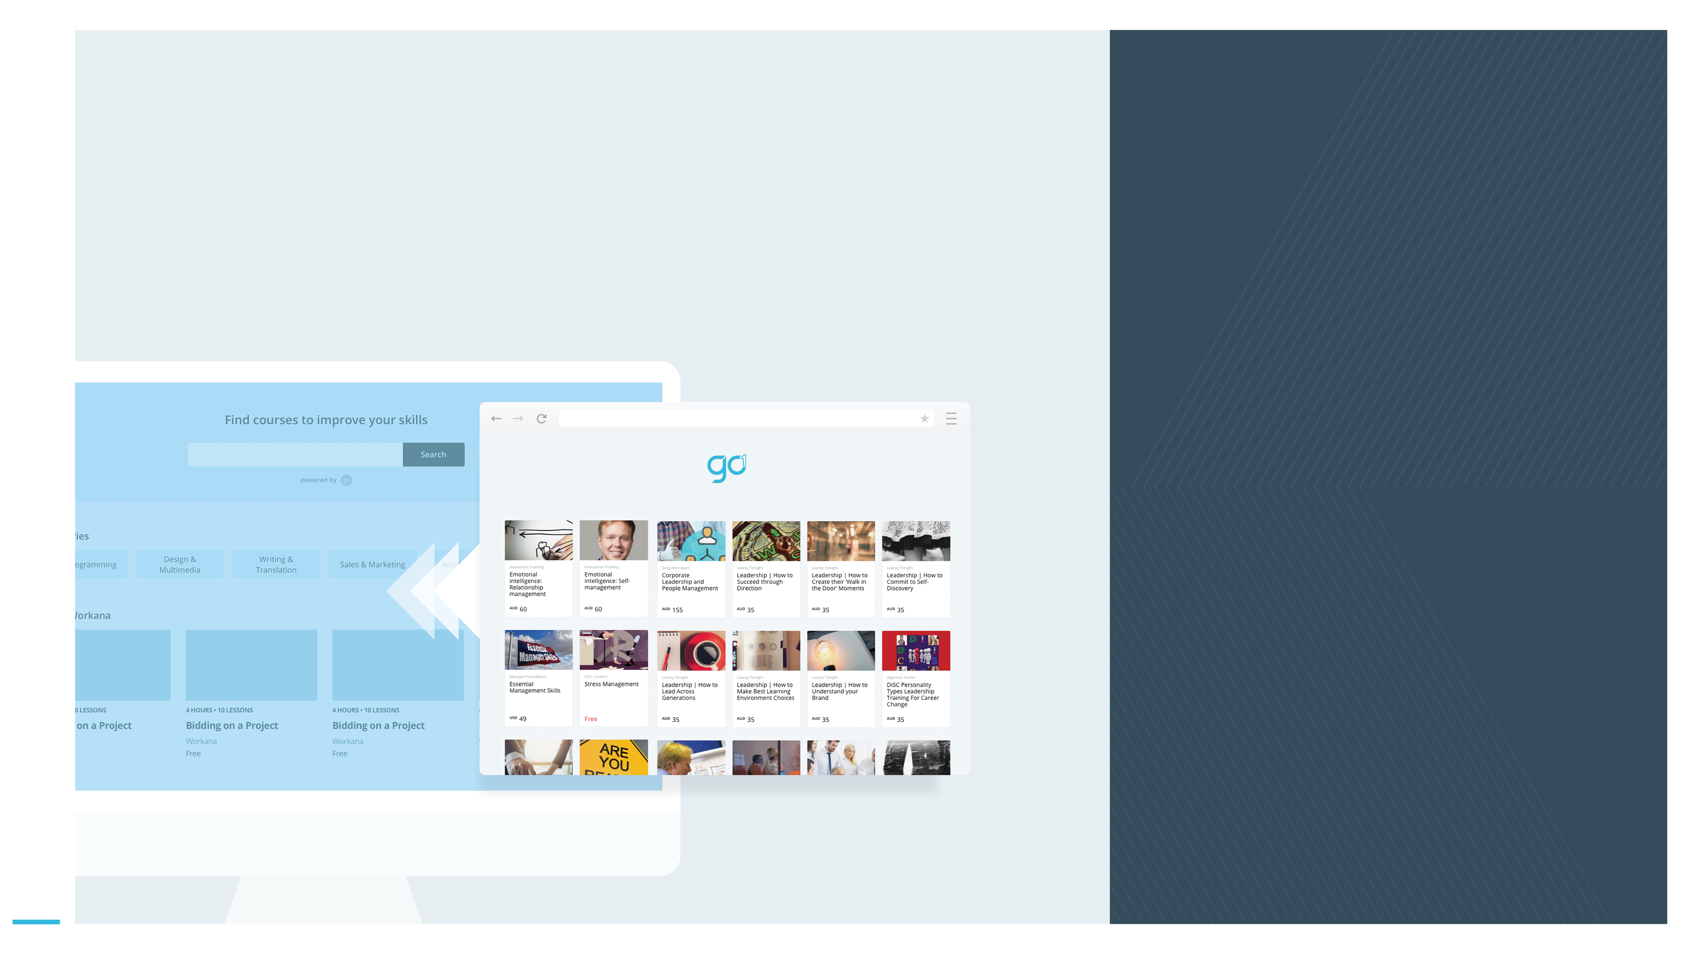
Join the GO1 partner program today and let GO1 content power your product
GO1 | Partner powered by content
GO1 helps to...
Provide your customers with learning content they don’t currently have.
Provide your customers with access to a single expansive source of external learning content integrated into your offering.
Generate new streams of recurring revenue.
Power your product with GO1 content today!

Slide 3
Are you a…
GO1 | Partner powered by content
LMS system integrator or ecosystem partner?
SaaS platform with built in Learning or Content Management capability?
“Totara: an Enterprise LMS with more than 150 partners globally who all needed a single content solution and to provide an end to end full service solution”
Find out why organisations like yours have powered their product with GO1 content…
For PageUp, utilizing the GO1 content loader app they will enrich their core LMS offering for their enterprise customer base.

Slide 4
Partner with GO1
GO1 | Partner powered by content
GO1 Learning Platform
GO1 offers a Cloud based online training platform, with LMS capability including the ability for users to build their own courses. Accessible 24/7 on any mobile or tablet device.
With the world’s largest network of online training providers,
GO1 simplifies your corporate training.
GO1 PRODUCT SUITE
GO1 Content Marketplace
The marketplace contains more than 400,000 learning items. Ranging from free to pay-per-use courses covering compliance, soft skills and personal development content.
GO1 Premium Library
GO1 offers a premium library made up of the most in-demand courses available from GO1’s network of global content creators.
Each year GO1 trains more than 500,000 people!

Slide 5
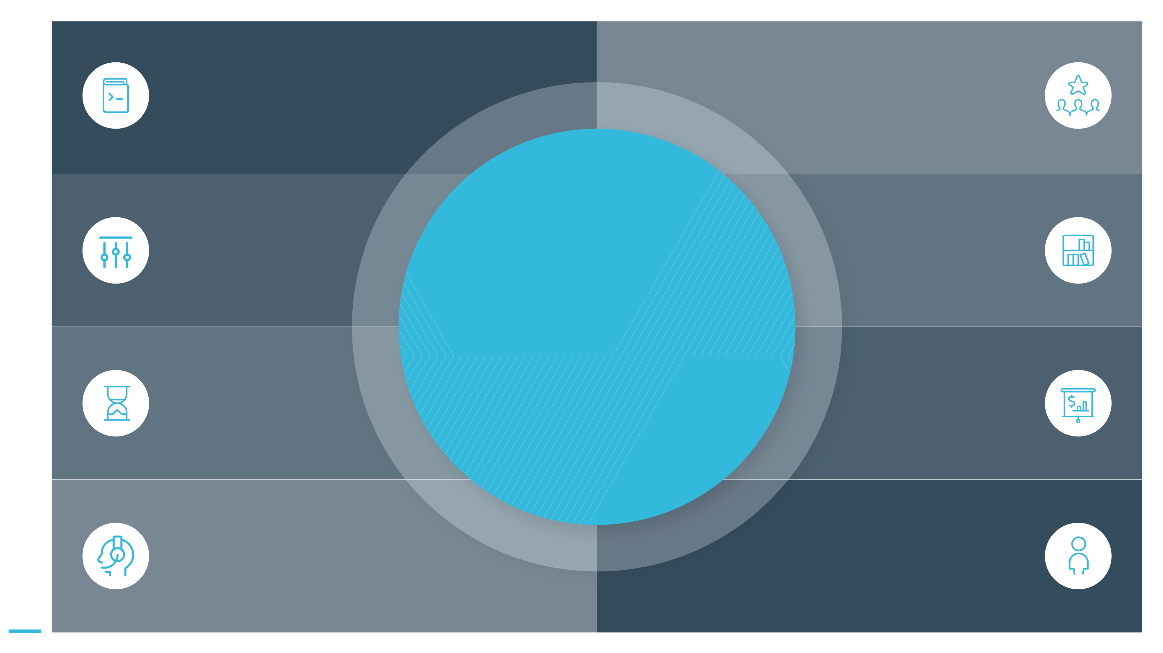
Open new doors
Leverage the fast growth of the online learning industry; to attract new clients.
GO1 | Partner powered by content
Development tools
You will have access to our proven partner integration patterns.
Flexible integration options
We can work with you to develop the appropriate solution to suit your needs.
Generate additional value
Expand your product portfolio with GO1’s platform and content offerings.
Why partner with GO1?
Quick time to market
Expect short time from signing up to launch of our partner solution.
Get rewarded
Create new revenue streams for your organisation.
Enjoy extensive support
Access to marketing collateral, technical implementation documentation and sales enablement.
Partner Manager
They will be available to support you through the partner process and answer your questions.

Slide 6
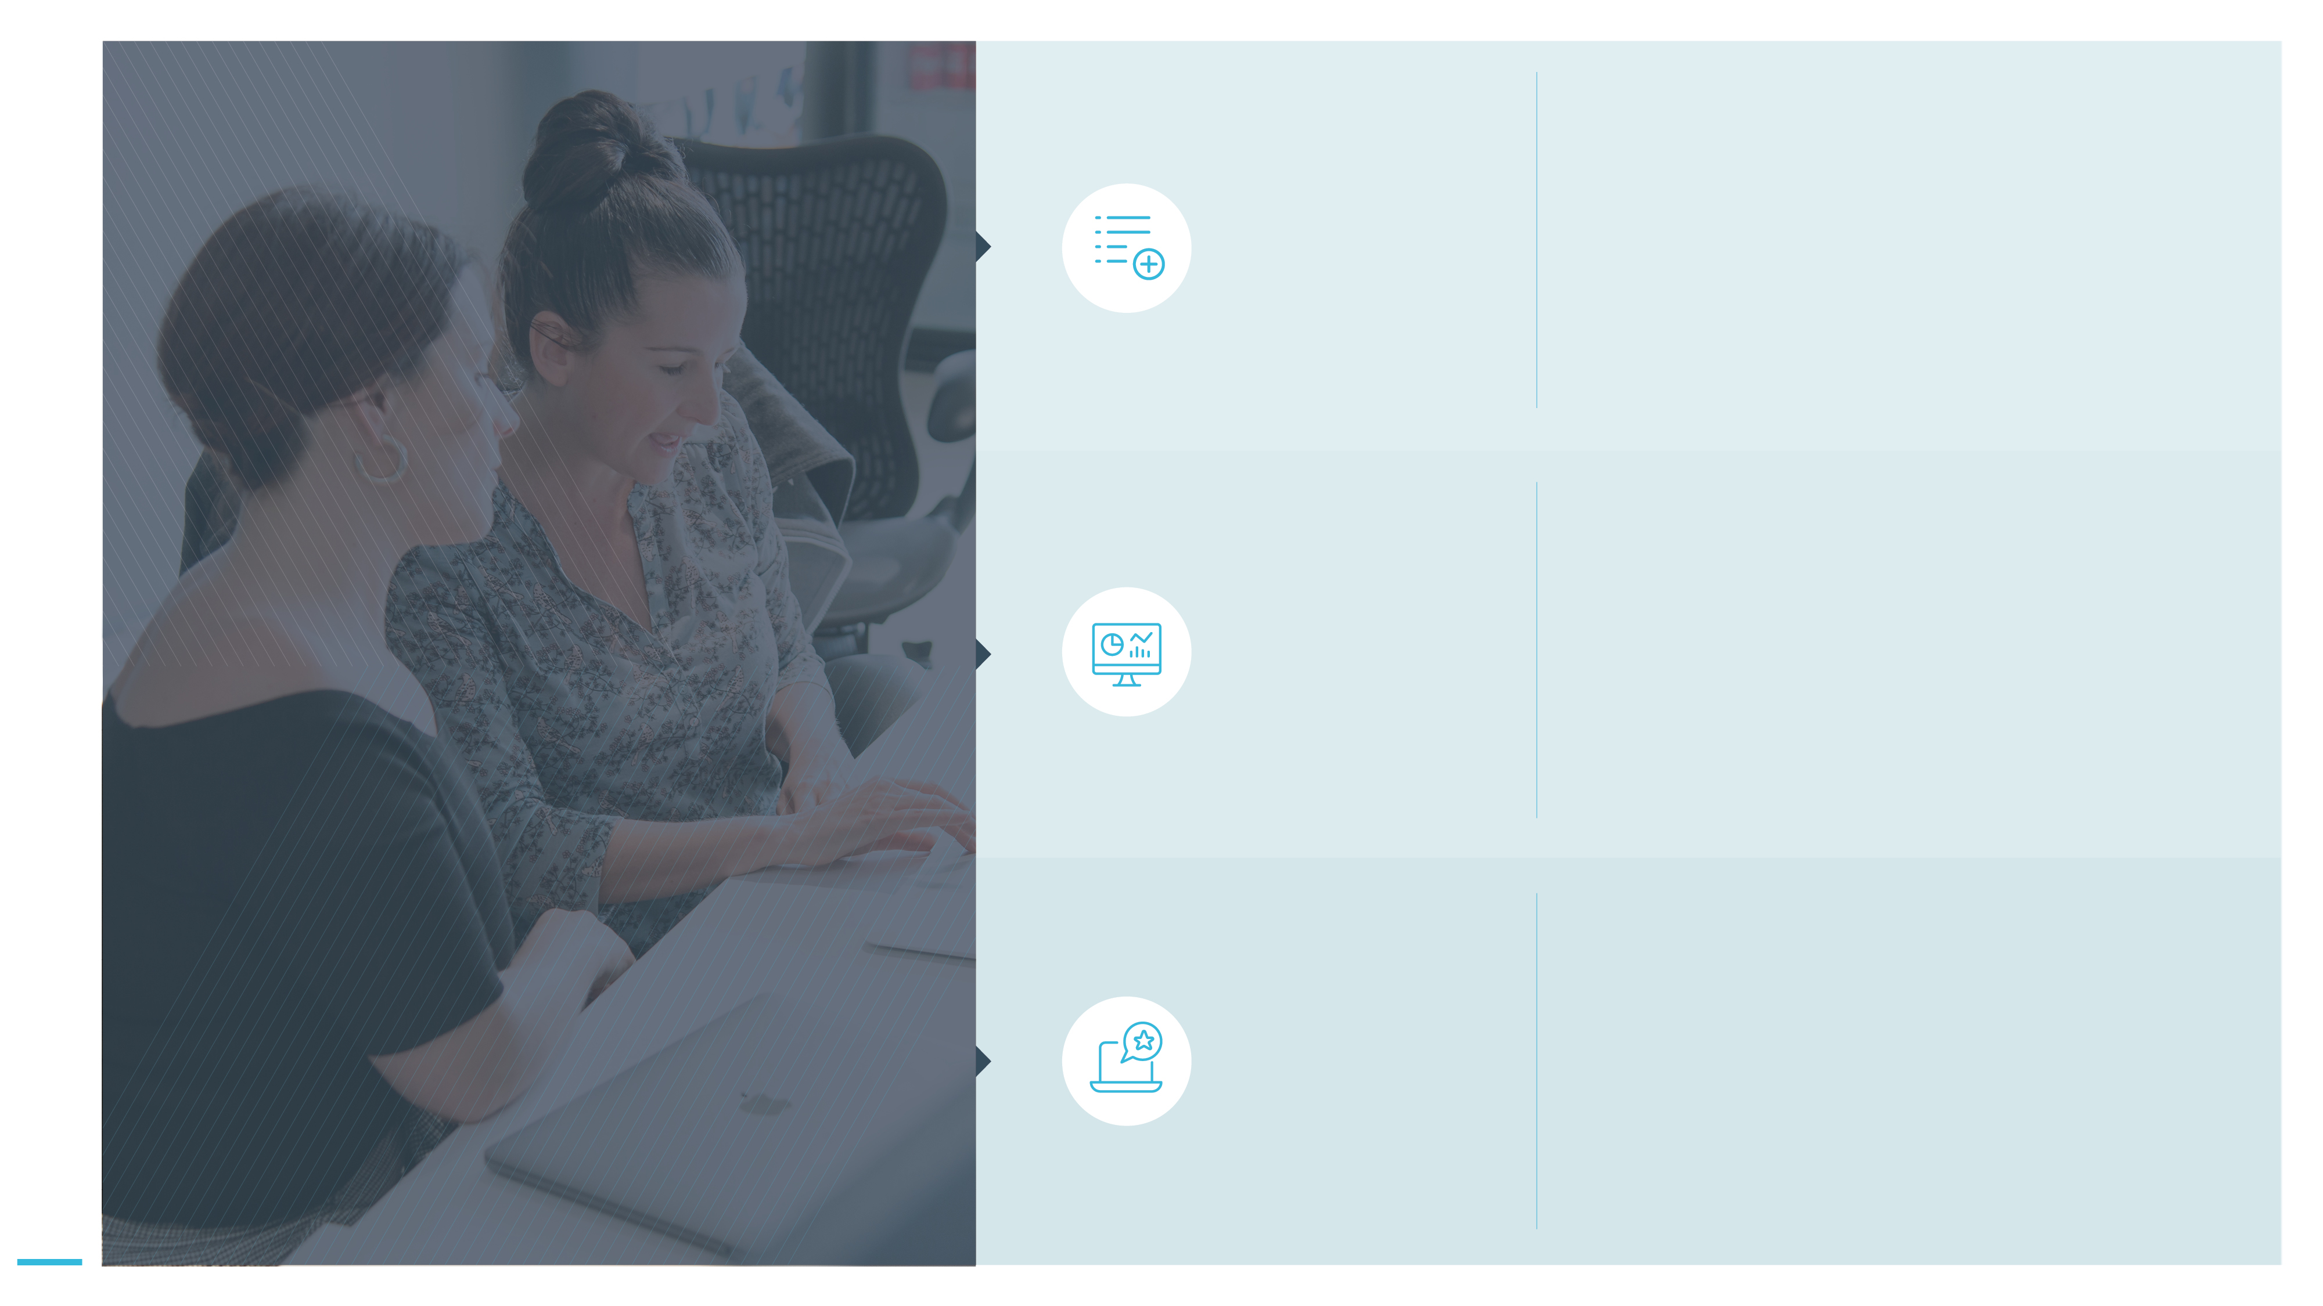
Volumes of quality GO1 content
GO1 | Partner powered by content
GO1 is internationally recognised for having the highest quality elearning content, curated by industry leading providers.
The comprehensive content library offers courses relevant to all businesses; compliance, personal and professional development, soft skills and much more!
The content is in a SCORM or AICC format, compatible with most LMS.
GO1’s technical solution will mean the comprehensive content library is directly accessible within your platform.
This means 1 platform for your customers to navigate to, where they can view and select GO1 content.
1 place for their learners to view and enrol in content.
Why choose a GO1 content partnership?
Available within your product
Adding value to your product
Your platform retains its core value proposition, but now with the inclusion of an enriched content offering available for your consumers.

Slide 7
Content Loader App
GO1 | Partner powered by content
Use the content import application: to search, select and import GO1 content into your platform.
Powering your platform with GO1 content:
Technical solution
Work with us to custom develop a fully integrated user experience to access content, that is embedded in your application. A custom developed integration and will require a longer design and development timeframe than the pre-configured loader app.
Native built integration

Slide 8
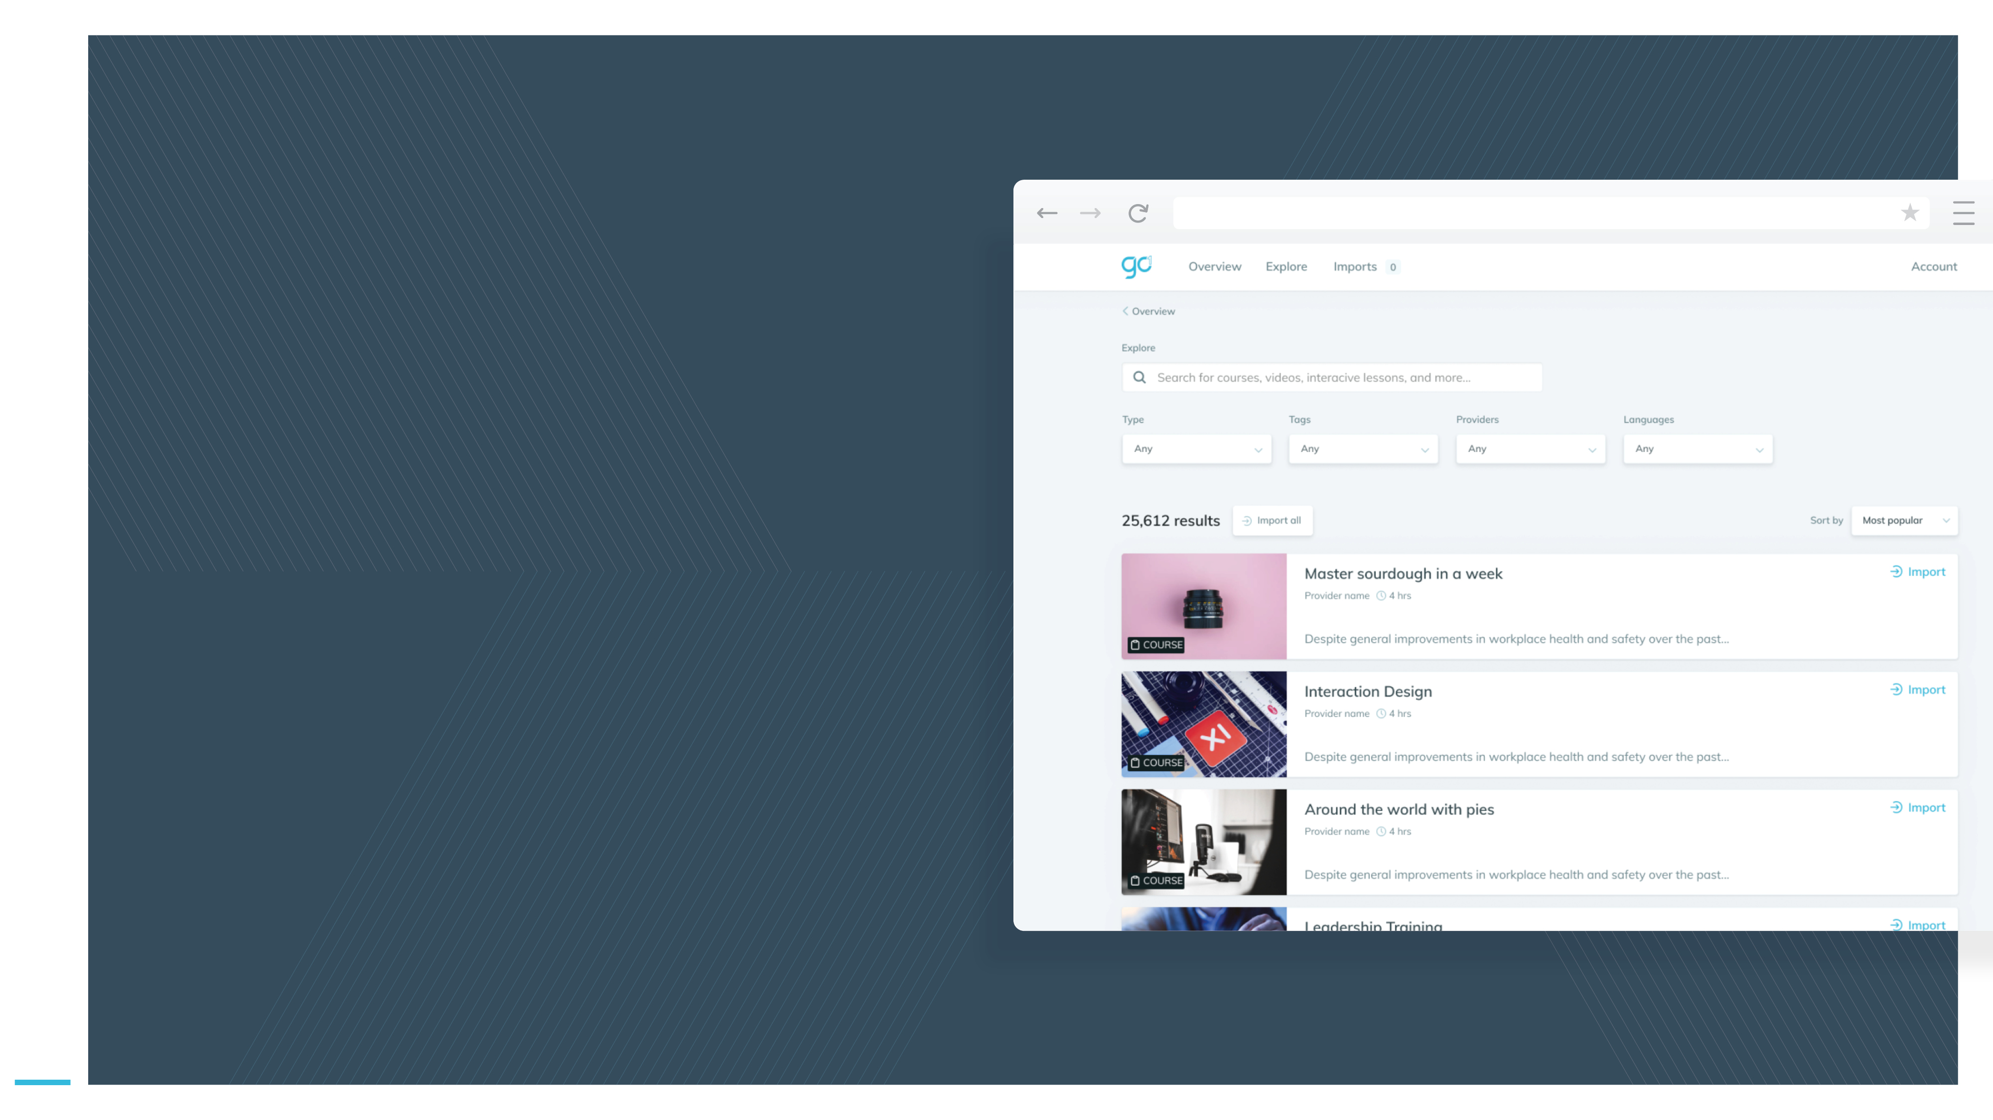
Content loader application
GO1 | Partner powered by content
Search GO1 content from the app
Using the GO1 content loader web application your customers can effortlessly search and find the content they require from the GO1 library. The Content loader will open in a new window, where you will see a modified version of the GO1 explore page with search bar and filtering options.

Slide 9
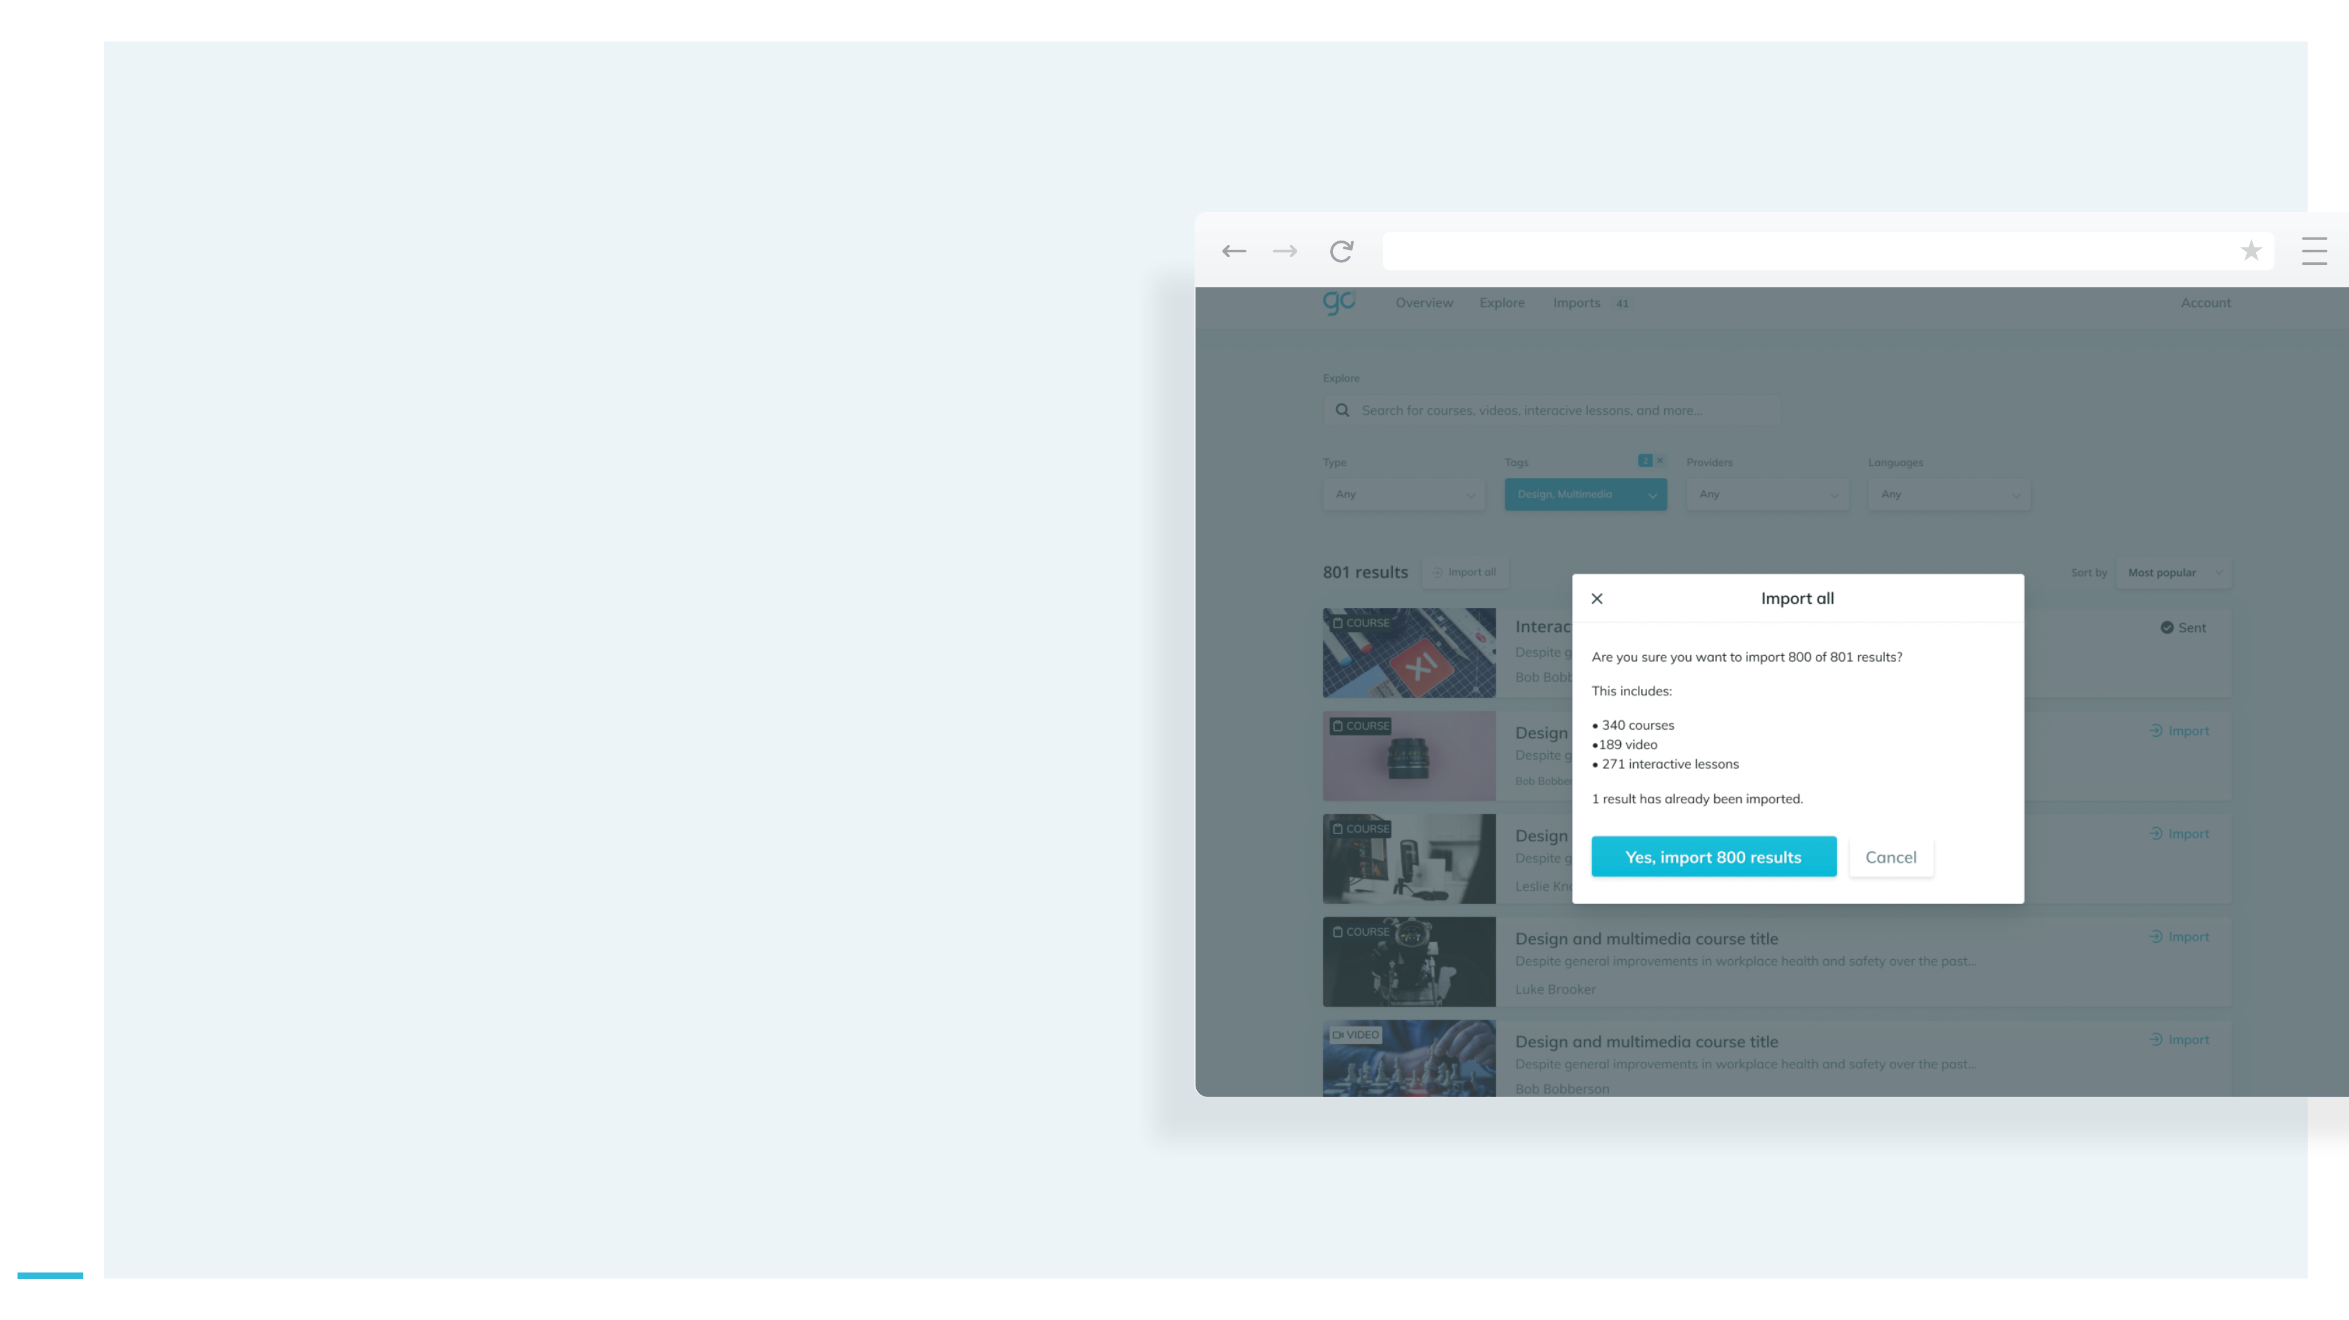
Content loader application
GO1 | Partner powered by content
Import content into your platform
Use GO1’s API endpoints to pull GO1 content into your platform. A simple API integration behind the scenes enables your platform to then pull this content in a SCORM or AICC compatible format and surface it into your LMS or TMS. The GO1 API can also be used to provision instances of GO1 for your customers, ahead of selecting the content they require.

Slide 10
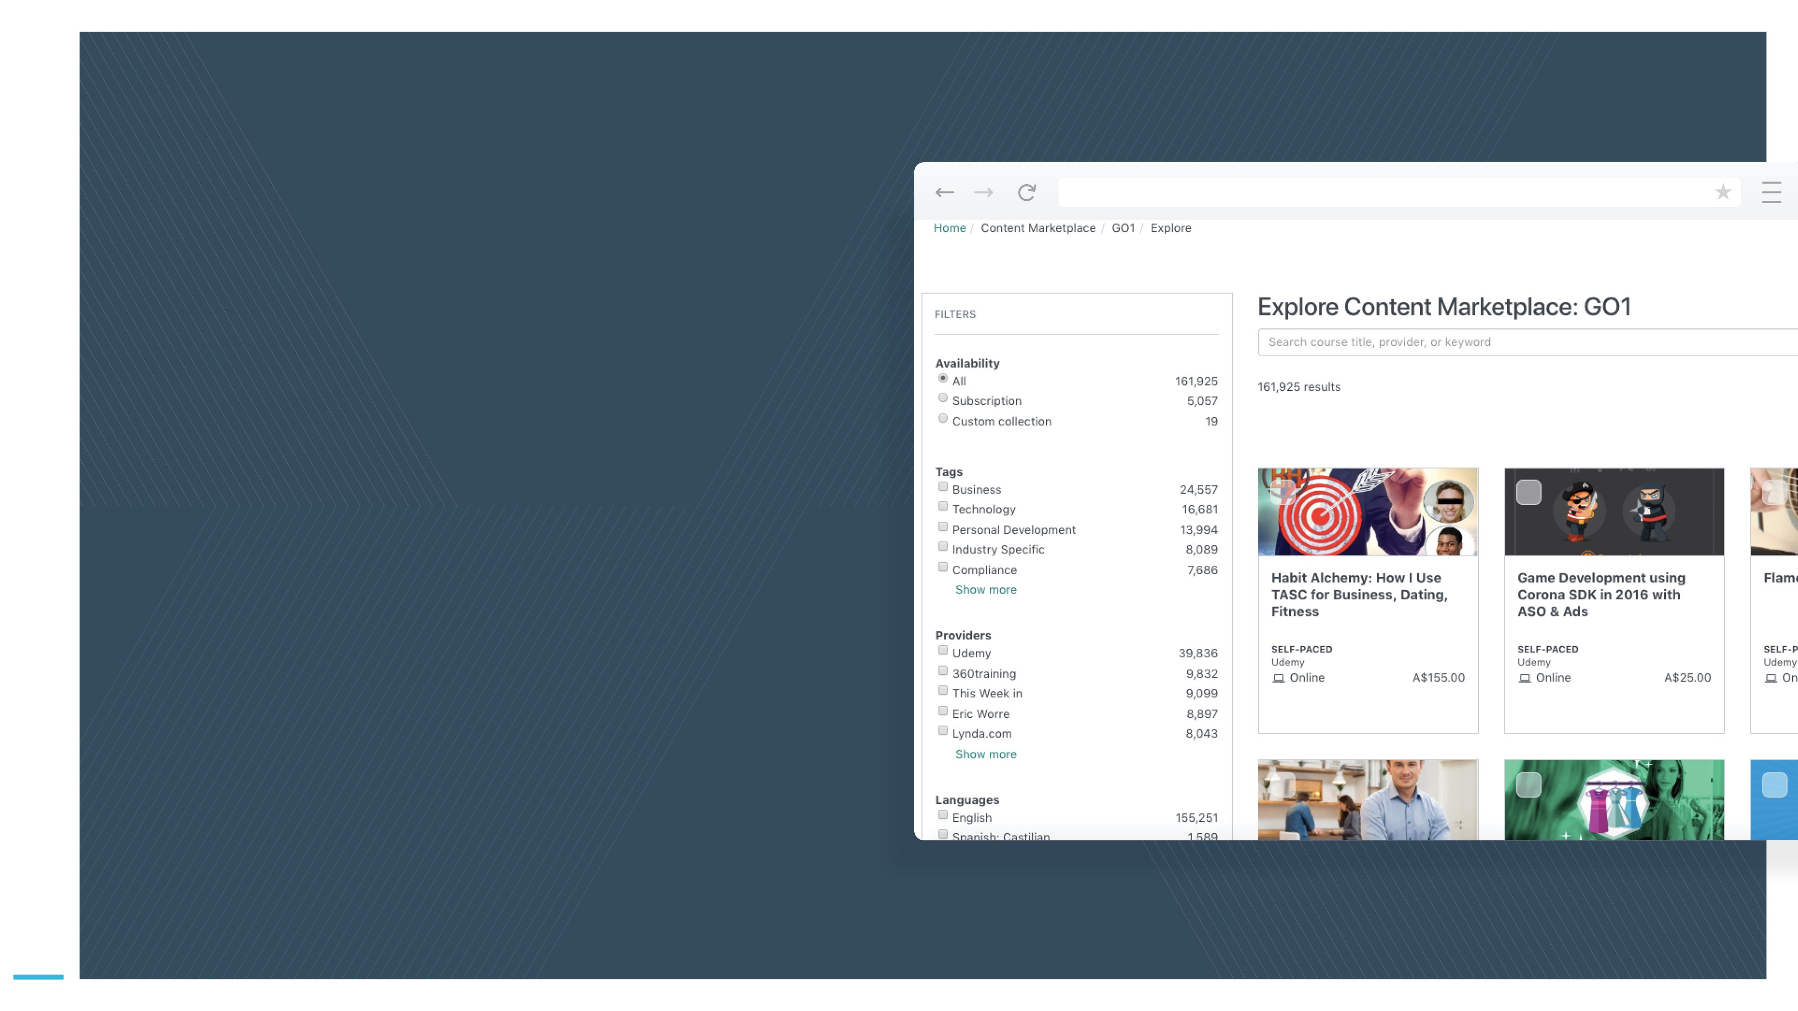
Native built integration
GO1 | Partner powered by content
We will work with you to implement API endpoints as
a deeply integrated offering into your platform. This means your customers will not need to access a separate application to pull in content.
From within your platform your customers can Activate a GO1 new subscription or connect to their existing GO1 account.
Users can explore the GO1 content they want to offer their learners. Course authors can Use the selected content - either integrated into a greater learning plan or nominate the learning to be completed as single items.
Learners will have the ability to undertake courses without leaving the platform or logging into another service.
Users will have insight into course completions by their learners.
Examples of previous native built integration
A user would explore the GO1 content library within their partner instance. With one click on a course card, the SCORM compliant package would be downloaded into their platform ready to be played.
11

Slide 11
GO1 | Partner powered by content
GO1 offers 24/7 technical support for your
customers
GO1 Sales team will support your customers through their defined trial period (to be confirmed in GTM plans)
GO1 will bill you customers directly for their content subscriptions
Every quarter you will receive your revenue share from GO1 for your active, paying customers
Operating the integration

Slide 12
GO1 | Partner powered by content
Sign your Partner Agreement
Work with the GO1 Product team, to decide on your integration solution
Design and Delivery
GO1 will provide you with API support documentation and developer portal access. We will work together to decide on an appropriate launch process, such as staged release; market test and/or EAP. Use marketing materials and support documents provided by GO1 to deliver on the strategy.
Next steps
Launch

Slide 13
Ready to join the GO1 Partner Program?
GO1 | Partner powered by content
Contact your Partner Manager:
dfish@go1.com

