Slide 1
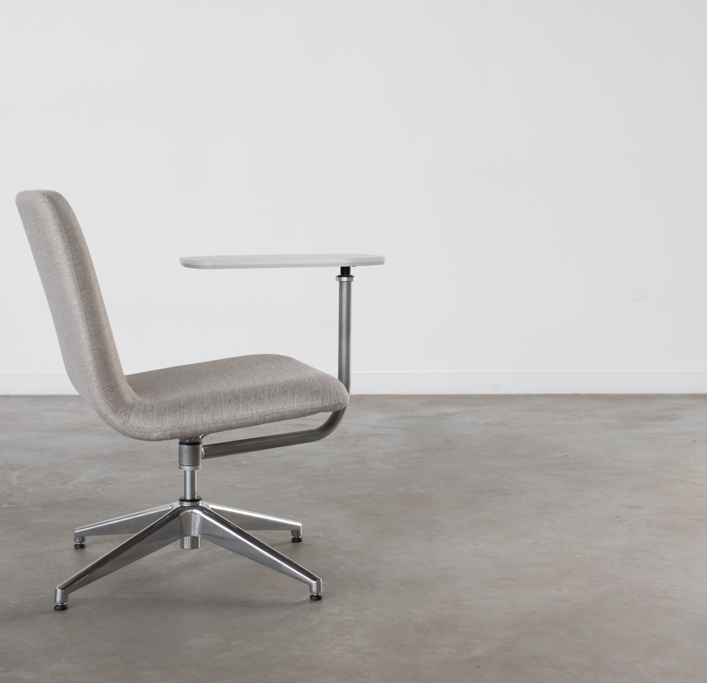
CO|HO
Market Launch : November 1, 2018
PRODUCT MANAGER: RAIKKOL CHENG
Notes:
Thanks for joining us today for our online module for Co|Ho.

Slide 2
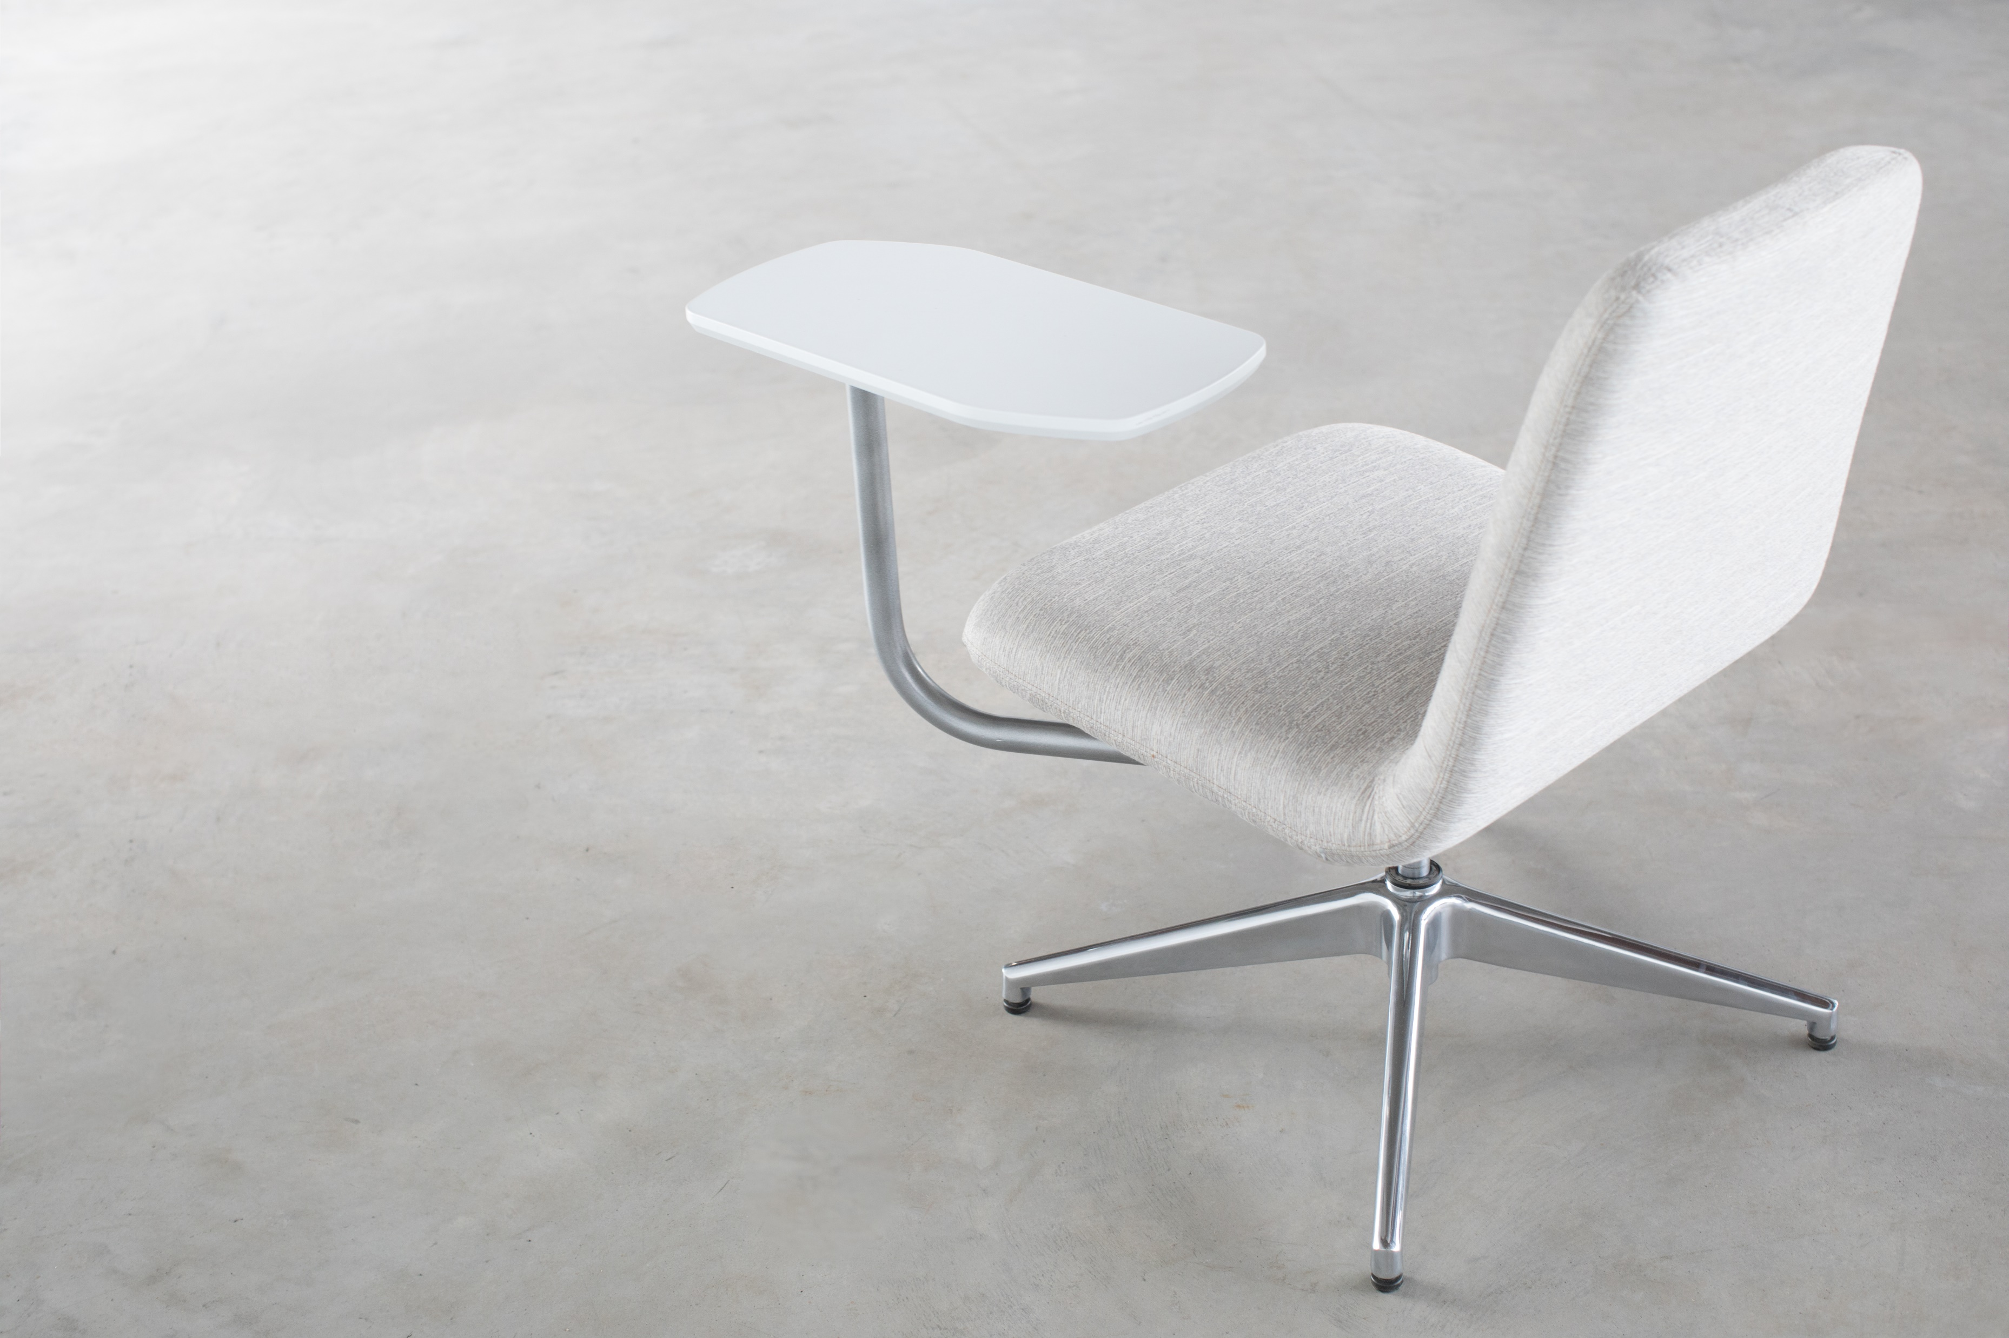
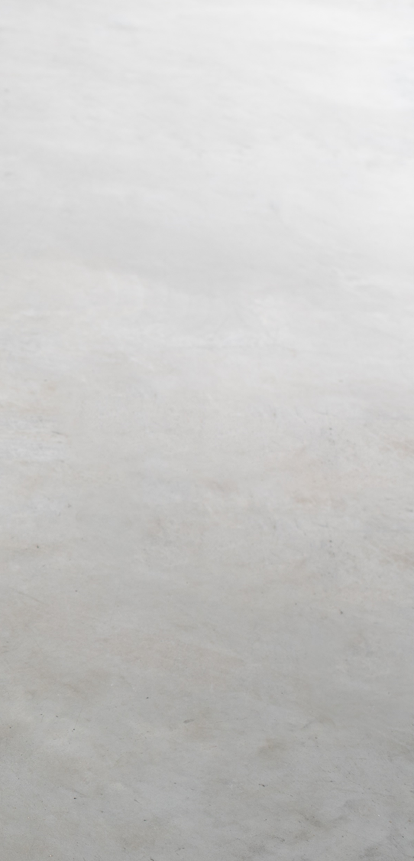
What is the Need?
Standalone seat perfect for an individual or group setting.
Working lounge chair with an optional work surface
Light-scale mobility makes relocating more manageable
Placement anywhere from an underutilized corner to a reception area, traditional office space, or a collaborative meeting room
Notes:
Co|Ho is a versatile, lounge chair that supports both individual and collaborative work across a wide variety of settings.
The product is inspired from the environment and vibes from a coffee house while adding posture and a proper work surface.
An easy way to remember the name is it's a shortened version of Coffee House.

Slide 3

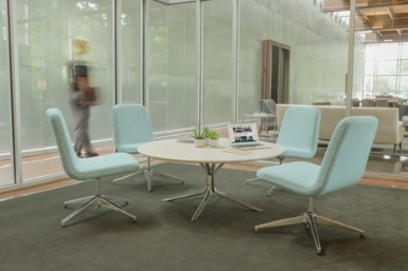
What If We Could…
Create "Coffee House" comfort with work place posture
Have a versatile, lounge chair that supports both individual and collaborative work across a wide variety of settings?
Offer a light-scale solution that works almost anywhere?
Notes:
Co|Ho strings together coffee-house comfort with workplace posture to create a personal piece of furniture that works almost anywhere. The two photos above show the combined light scale and flexibility offers users the choice to concentrate or collaborate comfortably, bringing the sentiment of a coffee house into the setting of the workplace.
Bruce Fifield is a familiar Allsteel family face, he most recently designed Mimeo task chair.

Slide 4
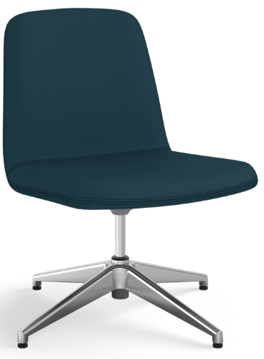
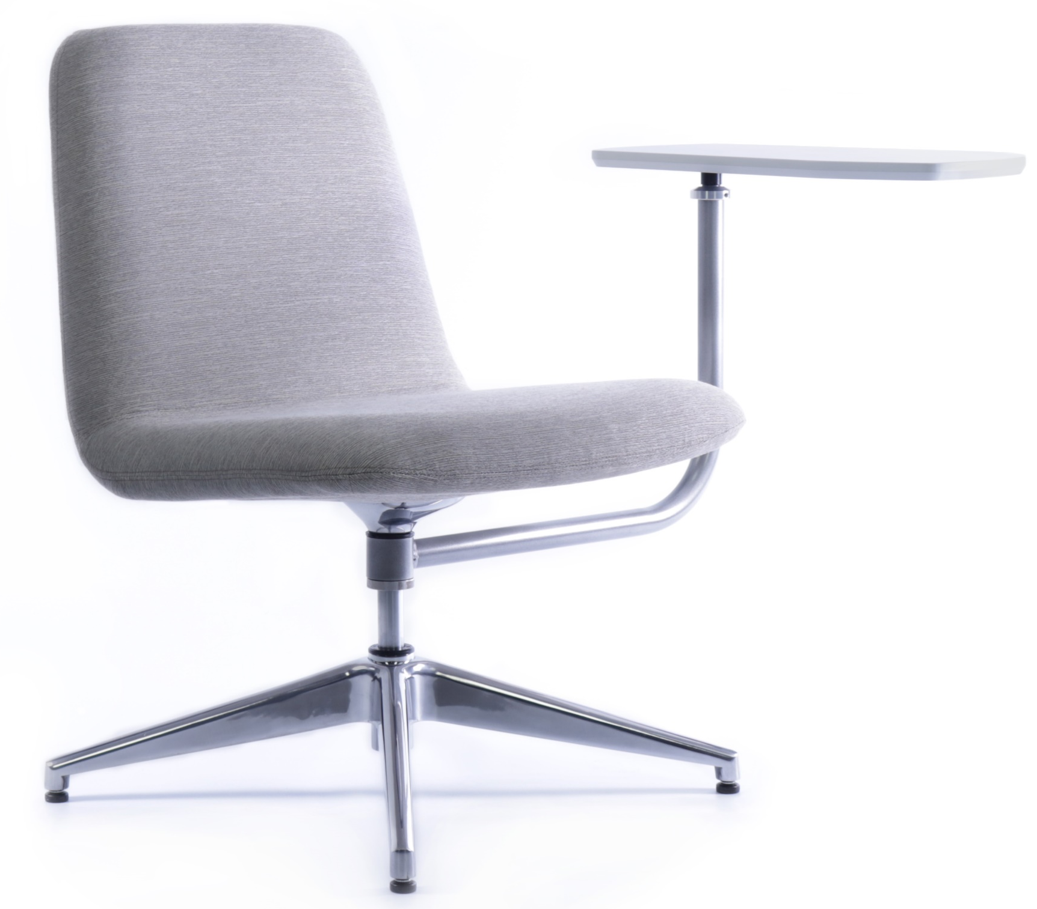
CO|HO
STATEMENT OF LINE
Work Lounge without Tablet Arm
Work Lounge with Tablet Arm
Notes:
Shown is Co|Ho’s statement of line: simple, easy and fits in any space. Add a tablet arm to create a agile worksurface.

Slide 5
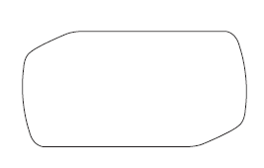
Tablet Arm
Polished Aluminum, Rotating Adjustable Arm available in Designer White or Loft.
Arm Width Range
Width Range : 360 degrees
Tablet :
Max weight 75lbs
19”
9.75”
Notes:
The beauty of the tablet arm is its full mobility – there’s no need to fret about whether the user is left or right handed as it rotates 360 degrees. It’s a perfect work surface, fidget piece, or can be tucked behind the chair when not necessary.
This tablet arm is very unique in the way it is easily added or removed in order to accommodate floor plan configurations. If a customer is unsure if they need the arm, why not get a couple tablet arms and order more at a later date?

Slide 6

Active Support
A working person is perpetually in motion. Co|Ho supports the perpetual side sit spin, proper posture toe tap, and relaxed sway.
Notes:
CoHo provides great comfort either when you are sitting upright in a work mode or side sitting in a casual posture. This working lounge has an auto return to center which leaves a clean look to the office without effort.

Slide 7
Sales & Dealer Training
INTERNAL USE ONLY

Slide 8
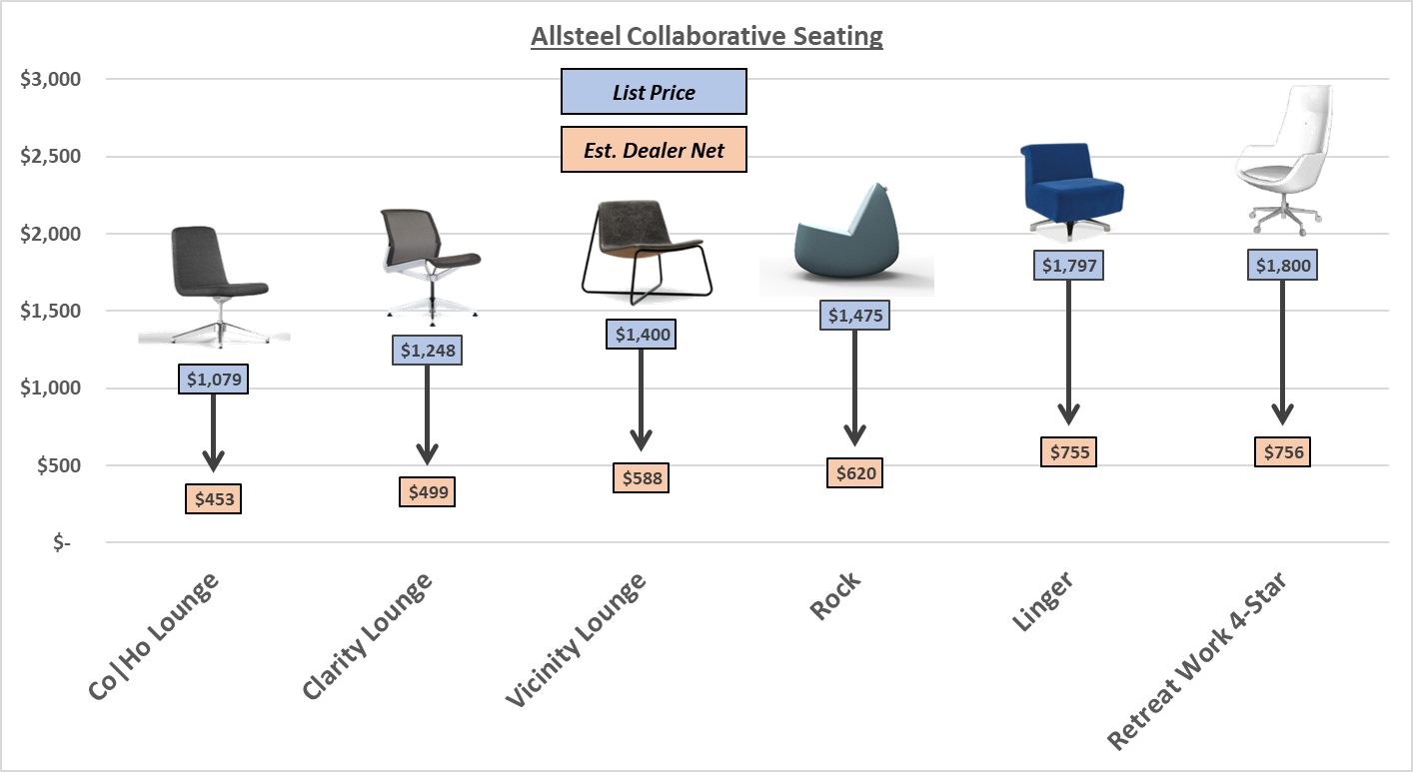
Co|Ho Lounge Internal Positioning
Notes:
Lets talk about where CoHo falls within the Allsteel line. Please note these are based on July of 2018 prices.​
CoHo plays well over to the left, filling a previous gap in the Allsteel line up.

Slide 9
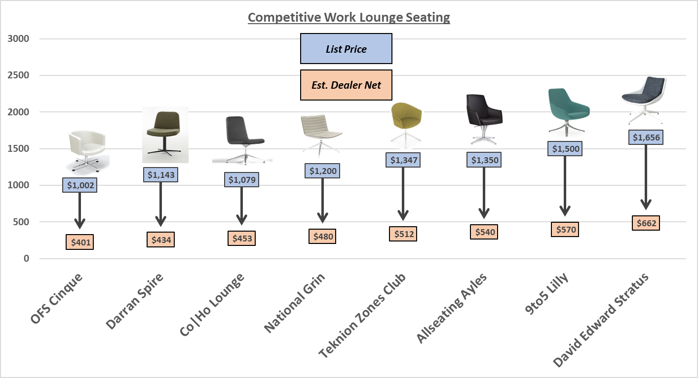
CO|HO vs. Key Competitors
*Pricing noted above is provided as reference only. Stated GSA discounting is applied to non-Allsteel product.
Notes:
When compared to the competition CoHo is competitively aligned with other major brands.​ Please note this is based on July 2018 pricing.
CoHo allows Allsteel and its dealer network to compete against open line manufacturers leading to a competitive advantage.​

Slide 10
Price Changes
Notable Updates:
Less discount as it falls into Lounge-Soft category
Grade 1 fabrics available – Paoli started from Grade 2
Valued feature updated - tablet arms

Slide 11

Customers to Target with CO|HO
We are missing a stand alone chair that take minimal amount of space and offers purposeful work
I need to create multiple short term work stations that are portable
Small group interactions without a barrier of a table
I’m looking for a product that has quality and simplicity with a variety of fabric options
Bring comfort into the work place with soft edges and comfortable work posture
Utilize small spaces with an innovative design
Notes:
Thought starters for CoHo when speaking to a customer and uncovering their needs. These customers are looking for a chair to fill underutilized spaces in perimeter planning or customers who needs a chair that transitions from individual to collaborative work.

Slide 12

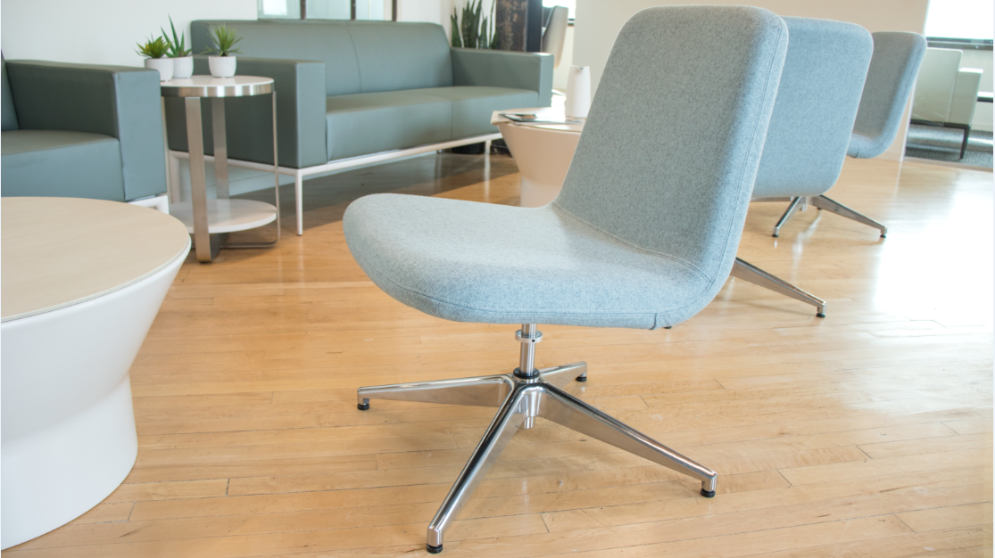
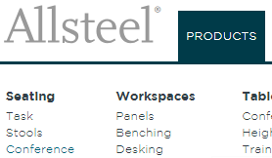
FIND MORE INFORMATION
1
2
https://www.allsteelsynergy.com/Pages/Home.aspx
Synergy/Products/Seating/Co|Ho
http://www.allsteeloffice.com/
Allsteeloffice.com/products/conference
3
2
1
3
Notes:
AllsteelSynergy.com houses all your sales tool needs. Please visit allsteelsynergy.com for a complete asset library of sales tools for CoHo including a go-to-market brief, imagery, symbols, list pricing, and FAQs. Thank you for joining me today to learn more about CoHo.

Slide 13
How to Order
First Order Entry: November 1, 2018
Lead Time: 4-6 weeks
Pricing:
  A&D Program- Standard 65%
  Showroom- Standard 75%
  Edge Eligible- Base program eligible
  Staples Allsteel Edge- Base program eligible
  Mockup- Standard Discount

Slide 14
Pre-Sell Launch Timing
LAUNCH
Q&A call for RMs who have pre-emptive questions on Sep. 18th and 20th of 2018
  Note: COM is normal procedure and available 90 days after launch
  AO & Synergy Website
  Configurators, Brochures, and Spec Sheets (Online)
  Symbols Available Online

Slide 15
Launch Timing
OPEN FOR ORDERS November 1, 2018
  Price List & Spec Guide (Online) October 2018
  20/20 & Symbols Publication November 2018
  Allsteel Communications October 2018
  First Shipment November 2018
  Brochure October 2018
  Showroom Integration November 2018
Questions?
Raikkol Cheng: chengr@allsteeloffice.com

Slide 16
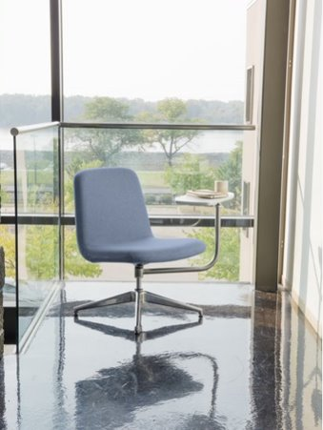
Pre-Sell Tools
CO|HO
Imagery is located here
GTM Co|Ho Brief is located here
List Co|Ho pricing is located here
Symbols Co|Ho are located here
Specification sheet is located here
FAQ Co|Ho located here

Slide 17
FAQ
CO|HO
Q: Why is Co|Ho a top choice to become an Allsteel product?
A: It fills the gap in the active work lounge category and complements our Lounge-Soft portfolio with a versatile solution.
Q: What is changing on product and pricing?
A: Improved quality standards including straighter line of stitching and specific packaging to decrease damage to tablet during transit. Refreshed with Allsteel standard fabrics with plentiful options for customers to find the right match. The list price for the base model without tablet arm has been reduced to $1,079 to capture an even more competitive position in the market. Slight increase on tablet arm upcharge is largely due to tax impact on metal components.
Q: Is the tablet arm removable and/or added after purchase?
A: Yes, customers can reconfigure this chair by simply removing and/or adding the tablet arm. To order separate tablet arm kits, please contact Allsteel TPG.
Q: Where is Co|Ho manufactured and how does it ship?
A: Manufactured at the Gunlocke facility in Wayland, NY and ships assembled with tablet surface separate.
Q: How do I get a new chair to match my current Co|Ho Lounge Chair sold by Paoli?
A: COM options are available as always 90 days after launch, if the fabric was previously used the process is simpler.
Q: How do I process warranty claims since now it's marketed under Allsteel?
A: All chairs with a Paoli tag are to proceed with warranty claims with HON and chairs with Allsteel tags are to contact Allsteel customer support.

