Slide 1
Sales & Dealer Training
INTERNAL USE ONLY

Slide 2
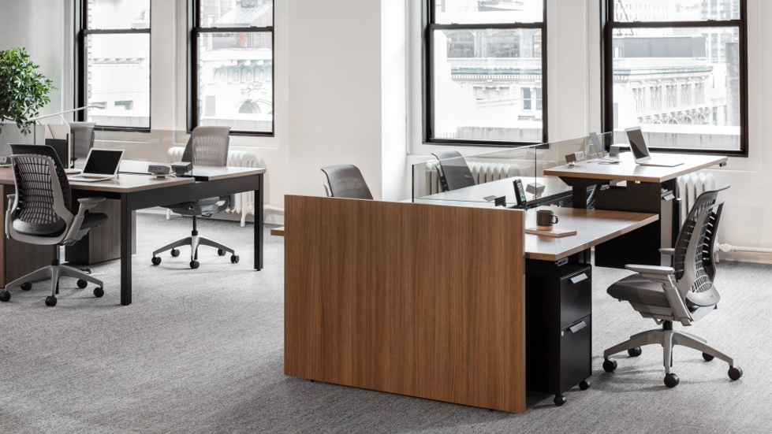
Customers and designers are looking for ways to soften and modernize the workspace to cater to new-generation workers.

Slide 3
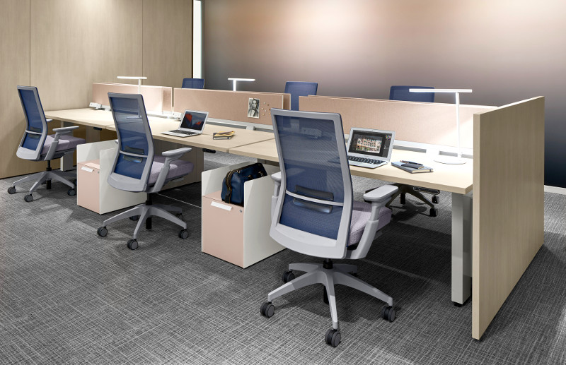

What is the Need?
Panels that divide space while softening the aesthetic
An alternative solution to traditional panel walls when the functionality isn’t needed
Full enclosure above and below the worksurface
The ability to integrate a mix of materials, including natural wood and glass

Slide 4
“… Customers are tired of looking at old school cubicles… need something more fresh, different, modern aesthetic.”
-- Quote from Allsteel Trade Partner. --
Notes:
Desire for panels that divide space for softer.. Light scale... more modern.. Less corporate aesthetic…
Drivers: corporate image… attracting new generation of workers… OR simply because customers want a more “modern” look and feel to the workstation.

Slide 5
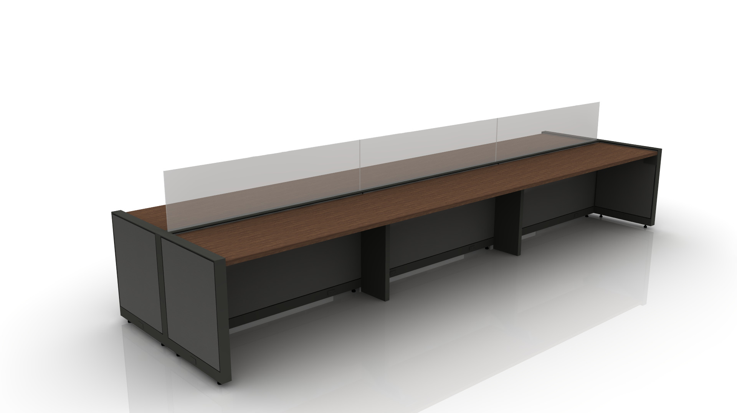
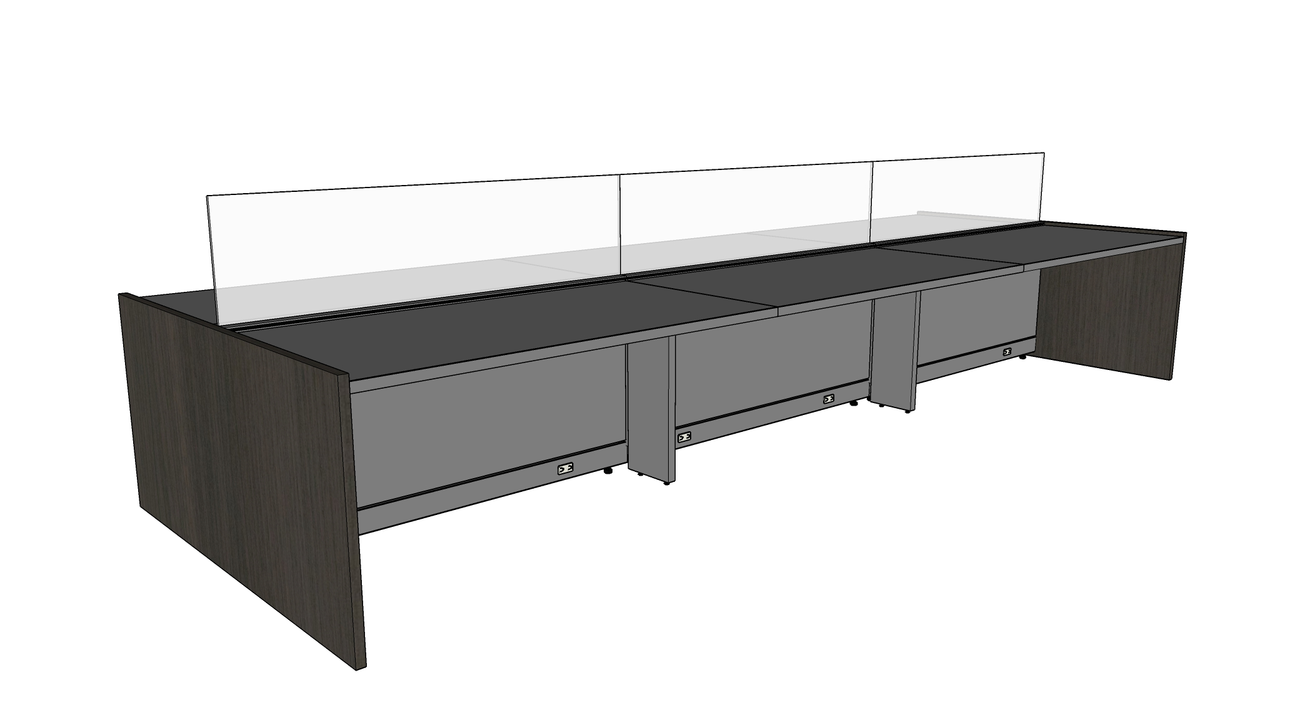
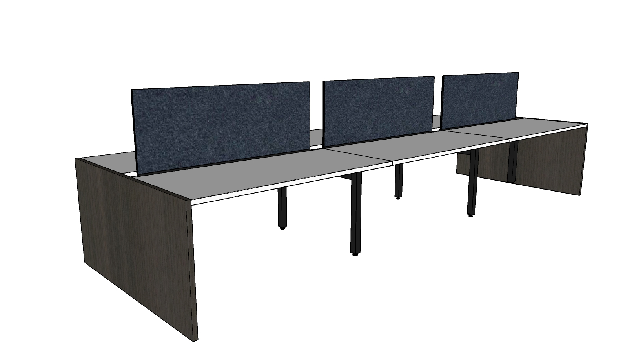
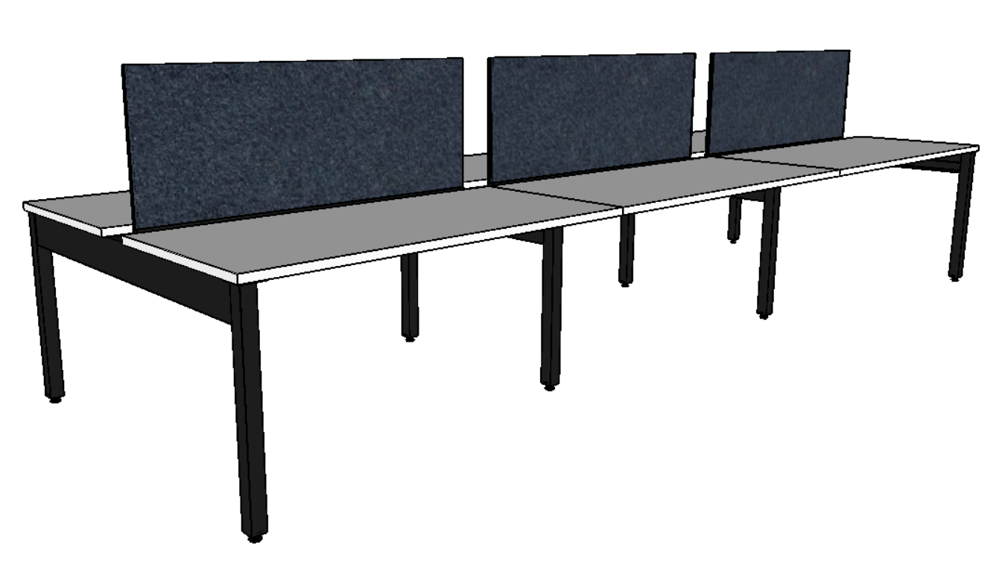
Aesthetic
Traditional vs. Updated
Notes:
Compare before and after, traditional vs. updated, scale up or down

Slide 6
How did we solve for Gallery Panels today?
Allsteel used to offer limited options for Gallery Panels
Further Adaptive / Further Fixed
  Limited to solid laminate
  Limited sizes
  Limited applications
TPG
  Specials that integrate with Stride/Terrace panel systems
  Specials for woodgrain laminates
  Specials for broader range of sizes
PROBLEM (the risk) with that was…
  Lead time…
  Price…
  Complexity…
AND… we continue to see the demand from customers through RFP…. more modern aesthetic vs. price.

Slide 7
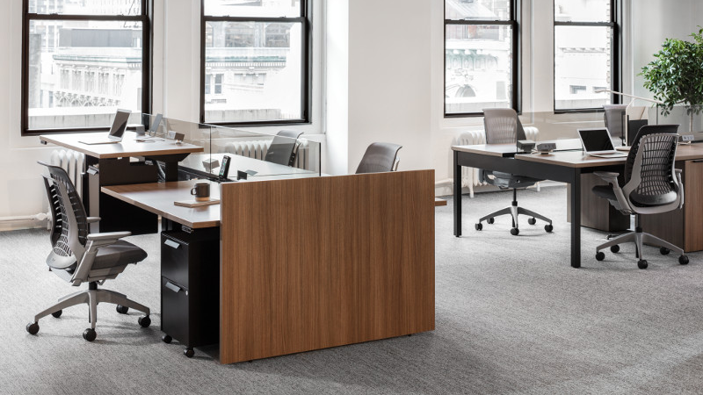
Notes:
So here is the new solution

Slide 8
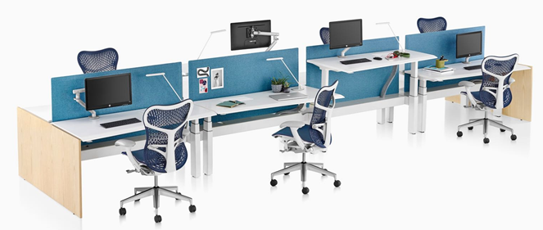
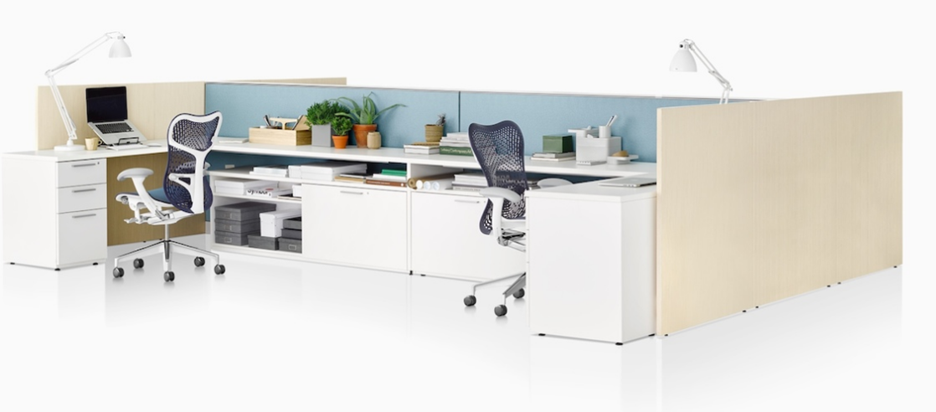
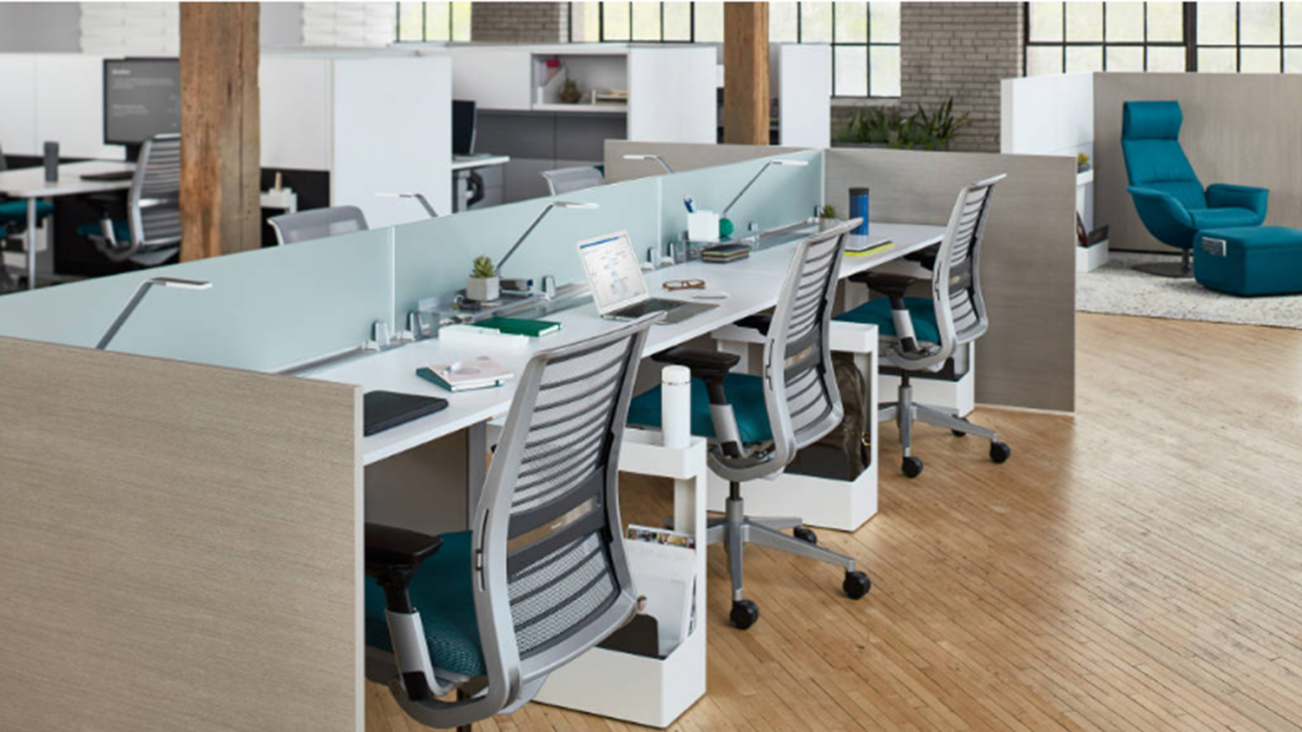
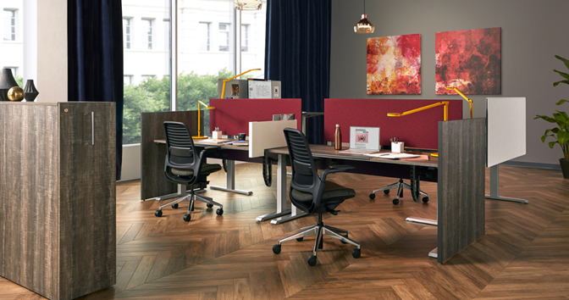
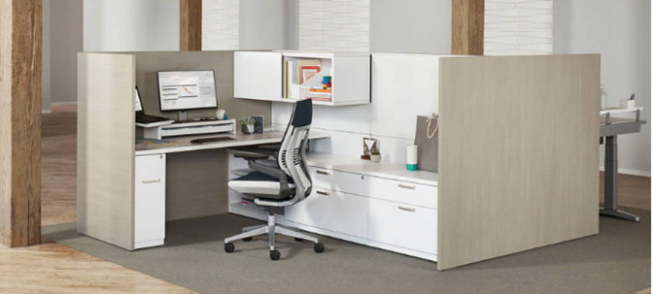
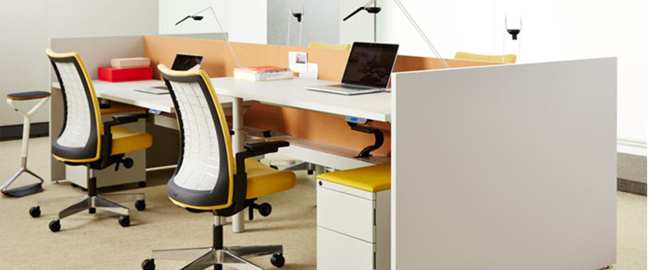
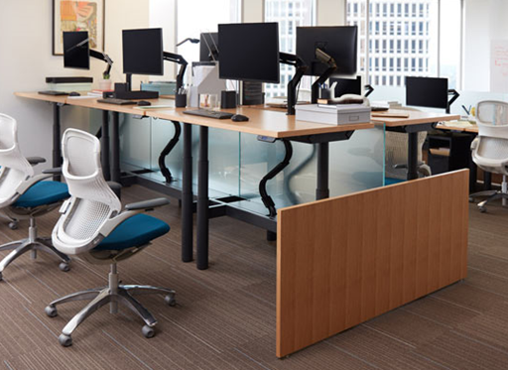
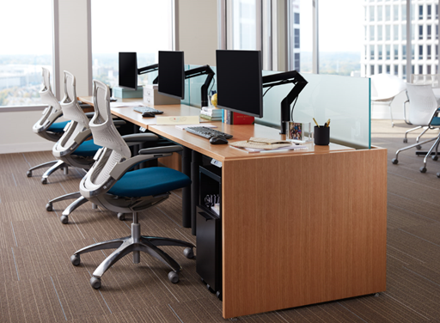
Customers also have other options…
Herman Miller
Steelcase
Knoll
Notes:
Everybody looks the same… what’s different?

Slide 9
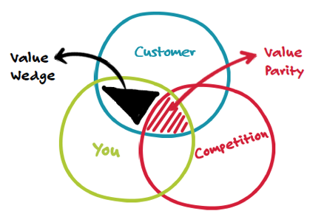

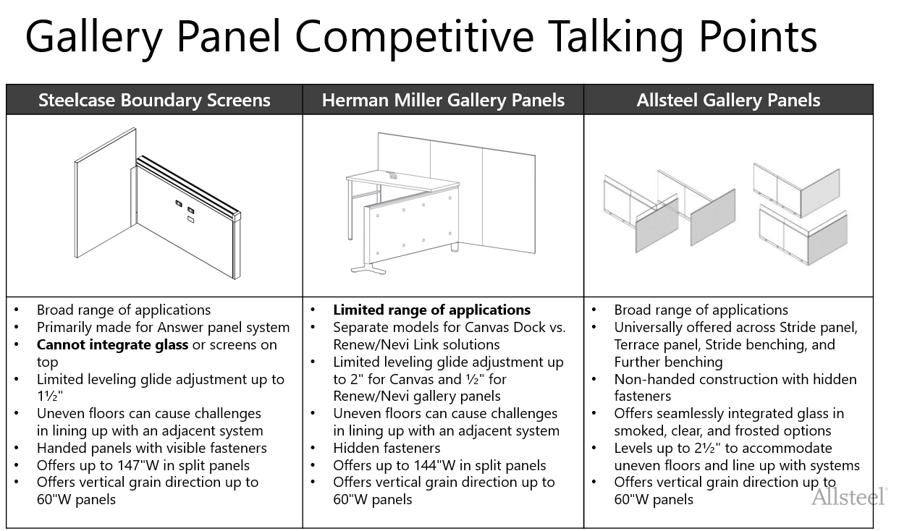
Differentiators
Important to customers, Unique to us, Defensible
Integrated glass with Gallery Panels
Clever design that works across panel & benching platforms
Highest leveling range to accommodate uneven floors and lining up with adjacent systems
Other features that are important to customers but NOT truly unique to us:
Broad range of applications
Smart design with non-handed construction and hidden fasteners/brackets (Example: Allsteel, Herman Miller)
Notes:
How are we different? If you recall “Value Wedge”… which is something that is important to customers, unique to us and most importantly defensible.
So we have identified key differentiating features.
1. Integrate glass… This is very important as we see from requests coming to TPG, RFP… this is what customers want… only Allsteel offers this.
2. Unlike others’ Gallery Panels, our solution can work across 4 key platforms (Terrace, Stride, Further and Stride Benching). This means fewer kit of parts, easy specification and
3. This may seem a little out of place, but we all know how important leveling capability is. You can confidently overcome any uneven floors without delaying the installation or compromising the aesthetic of the product.
MORE details on competitive comparison, or side by side.. GO TO “GO TO MARKET BRIEF”….

Slide 10
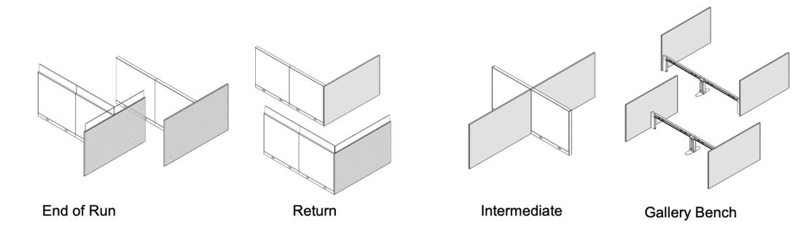
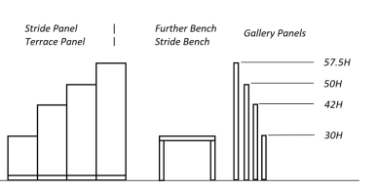
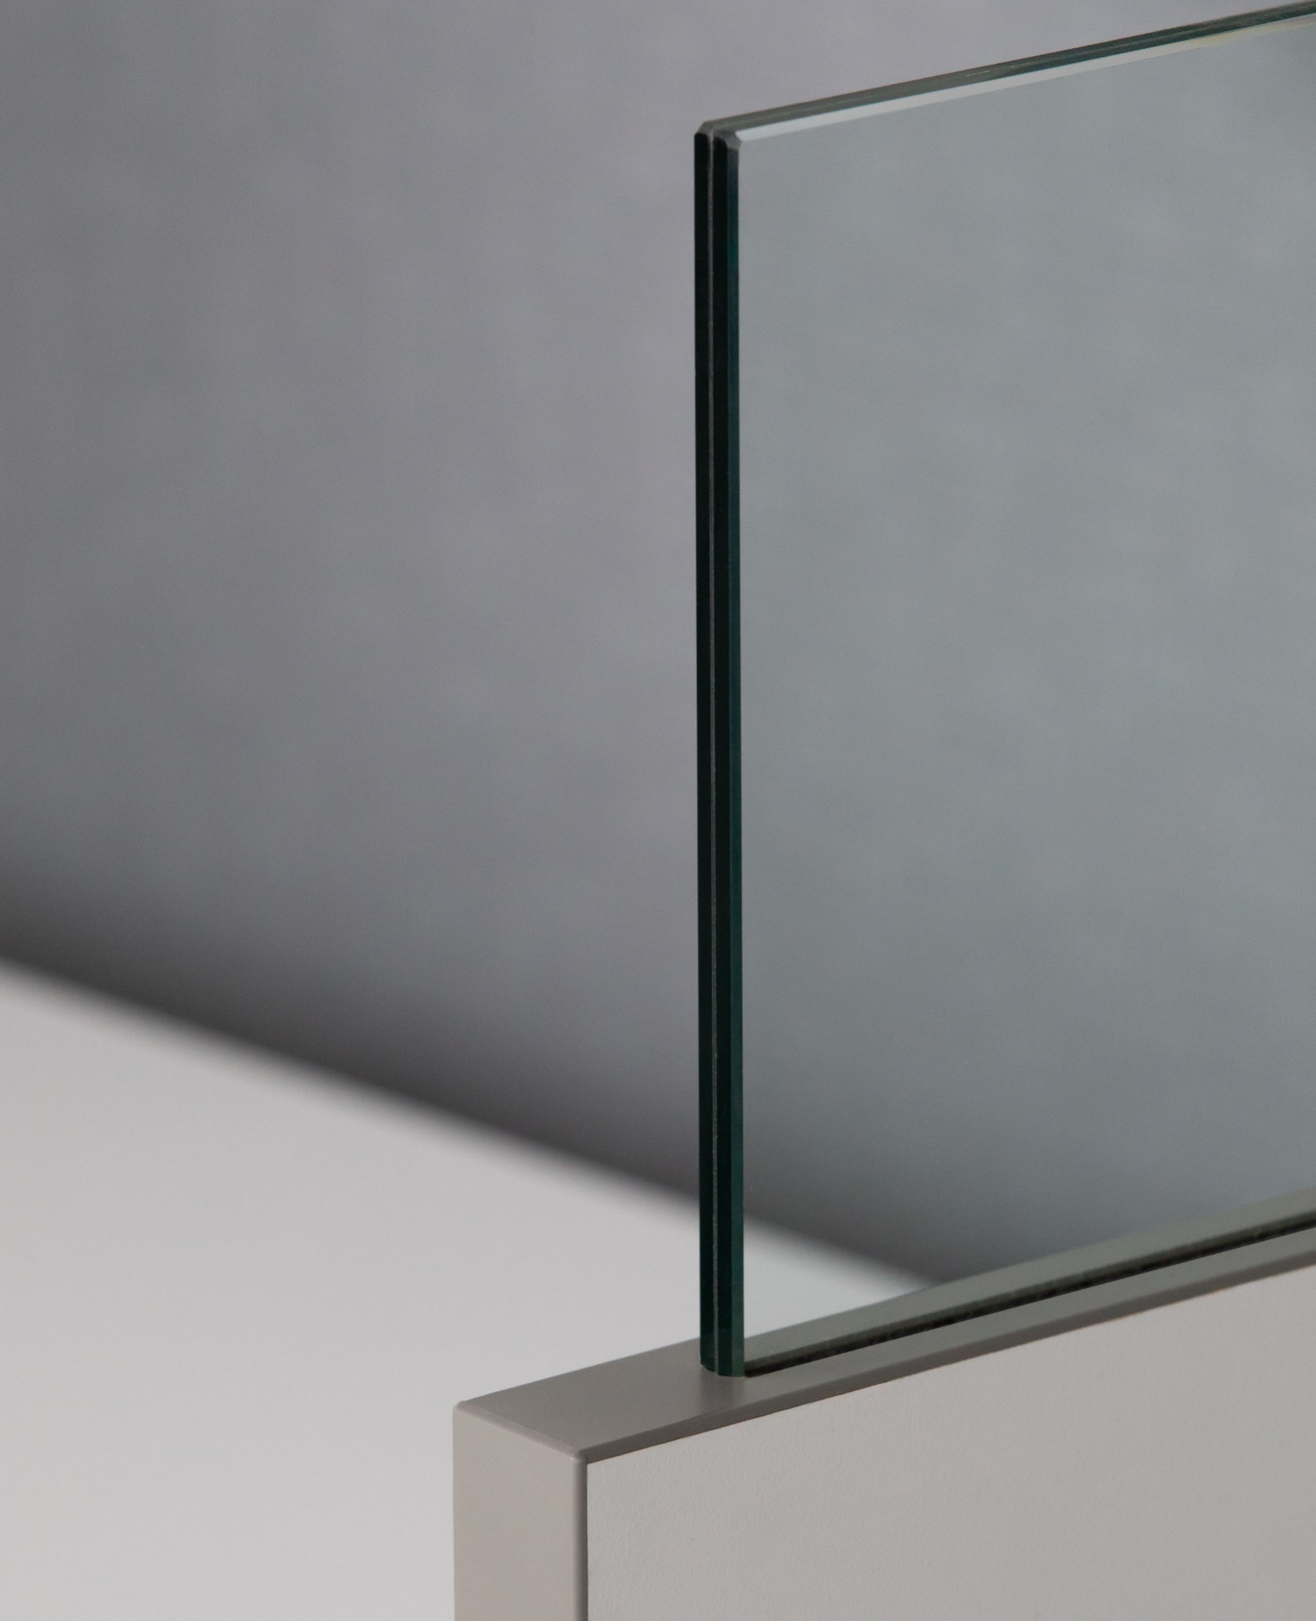
Statement of Line
Horizontal woodgrain is standard.
Vertical woodgrain is an option for panels up to 60"W.
Integrated Glass

Slide 11
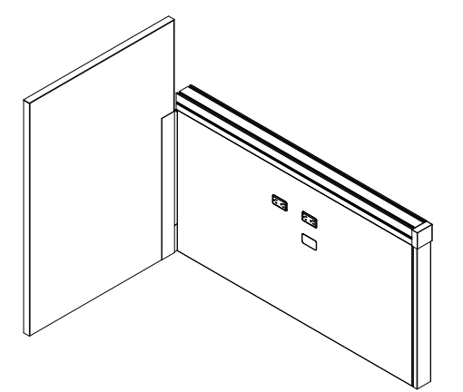
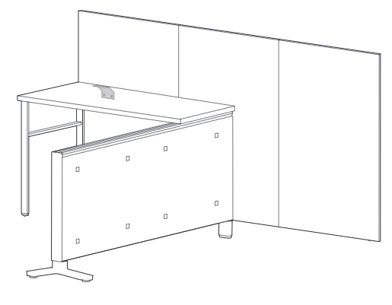
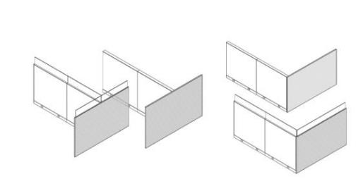
Gallery Panel Competitive Talking Points
Steelcase Boundary Screens | Herman Miller Gallery Panels
Broad range of applications Primarily made for Answer panel system Cannot integrate glass or screens on top Limited leveling glide adjustment up to 1½" Uneven floors can cause challenges in lining up with an adjacent system Handed panels with visible fasteners Offers up to 147"W in split panels Offers vertical grain direction up to 60"W panels | Limited range of applications Separate models for Canvas Dock vs. Renew/Nevi Link solutions Limited leveling glide adjustment up to 2" for Canvas and ½" for Renew/Nevi gallery panels Uneven floors can cause challenges in lining up with an adjacent system Hidden fasteners Offers up to 144"W in split panels Offers vertical grain direction up to 60"W panels
Allsteel Gallery Panels
Broad range of applications Universally offered across Stride panel, Terrace panel, Stride benching, and Further benching Non-handed construction with hidden fasteners Offers seamlessly integrated glass in smoked, clear, and frosted options Levels up to 2½" to accommodate uneven floors and line up with systems Offers vertical grain direction up to 60"W panels
INTERNAL TRAINING

Slide 12
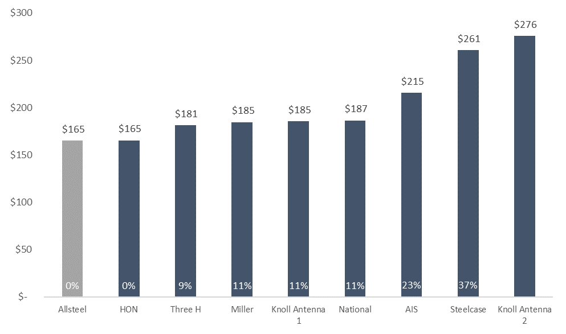
Competitive Offering

Slide 13
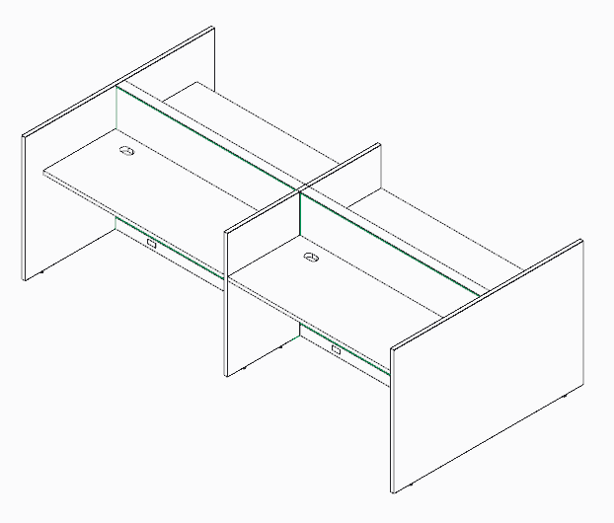
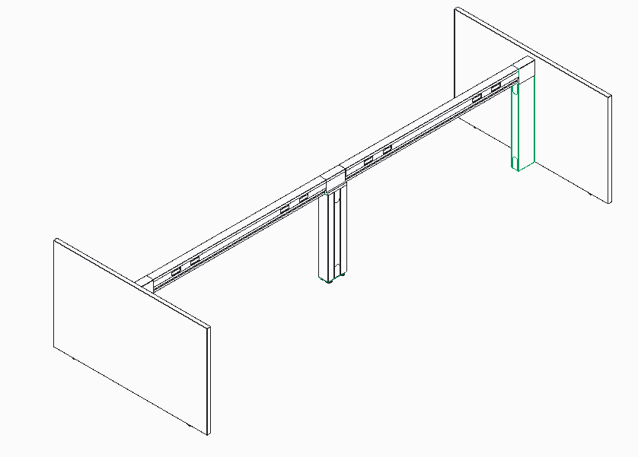
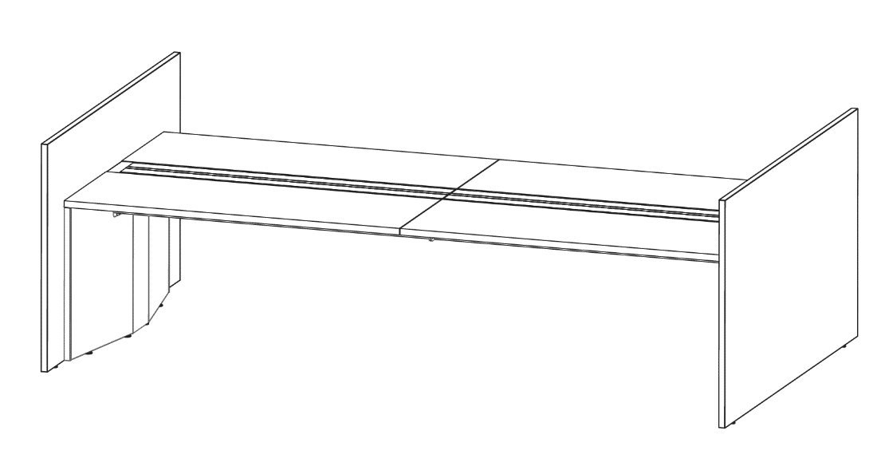
Gallery Panel Configurations
Panel System
Further
Stride Benching
INTERNAL TRAINING

Slide 14
Further Bench
Frame-and-Tile Bench
Without Gallery Panel
+5%
-10%
Further Gallery Bench
Gallery Panel Bench
With Gallery Panel
More premium look
Added natural wood elements
Fewer parts and easy installation
Below surface privacy
*Value Option up to 10% lower in price
than frame-and-tile bench

Slide 15
Launch Timing
OPEN FOR ORDERS August 2019
  Allsteel Communications August 2019
  Brochure N/A
  Allsteel University Integration In Progress
  Showroom Integration Complete
  Price List & Spec Guide (Online) August 2019
  20/20 & Symbols Publication Complete/August for CET
Questions?
Product related, Zhas Amirov: amirovz@allsteeloffice.com
Marketing related, Brian Parrott: parrottb@allsteeloffice.com
INTERNAL TRAINING

Slide 16
How to Order
First Order Entry: August 2019
Lead Time: 4-5 weeks
Pricing:
  Standard Terms 60% off
  Showroom Discount 80% off
  A&D Own Use Program 75% off
  Everyday Advantage 72% off
  BIFMA Certified
  GSA Schedule Pending
  Sustainability Level 3, Indoor Advantage Gold
INTERNAL TRAINING

Slide 17
Surface Materials
Surface Materials Available Through Allsteel Advantage
Laminate samples
Smoked, clear, and frosted glass samples
Laminates
Select from Allsteel standard laminates
Square laminate edge
Available with matching or contracting edge detail
Horizontal woodgrain is standard; vertical woodgrain is available for gallery panels up to 60" wide
INTERNAL TRAINING

Slide 18
Gallery Panel Range
INTERNAL TRAINING
Horizontal woodgrain is standard.
Vertical woodgrain is an option for panels up to 60"W.

Slide 19
Frequently Asked Questions
Q: What are the available gallery panel heights and widths?
A: Available heights are 30", 42", 50", and 57". Widths range from 18"-84". 35" high is a special height through TPG.
Q: What connection options are available for gallery panels?
A: Gallery panels can be attached to Stride and Terrace panels, Stride benching, and Further in end-of-run (“T”), return, and intermediate positions. Stride benching and Further can only accommodate end-of-run applications.
Q: Can gallery panels be used with Concensys and Optimize?
A: No. Gallery panels are designed to be used with Stride and Terrace panels, Stride benching, and Further.
Q: What are the size limitations for gallery panels?
A: For end-of-run (“T”) applications, a single gallery panel can be specified up to 84" wide. Over 84" wide requires two panels, with a maximum overall width of 147". For return and intermediate connections, the maximum gallery panel width is 84".
INTERNAL TRAINING

Slide 20
Frequently Asked Questions
Q: Are all Allsteel standard laminates and edge bands available on gallery panels?
A: All system standard laminates and edge bands are available on gallery panels. Velvet laminates are not an option on gallery panels.
Q: What is the direction of the woodgrain for woodgrain laminates?
A: Both horizontal and vertical woodgrain laminate are options. Horizontal woodgrain direction is available on all gallery panel sizes. Vertical woodgrain direction is available on gallery panels up to 60" wide. Some restrictions may apply for certain woodgrain laminates. Please see price lists for complete information.
Q: Does the woodgrain match on "T" applications where two gallery panels come together at end-of-run?
A: No. We cannot ensure woodgrain matching for either horizontal or vertical woodgrain in this application.
Q: Can you specify one laminate on one side of the gallery panel and another laminate on the other side?
A: No. The same laminate must be applied on both sides of the gallery panel.
Q. Do Gallery Panels connect to all generation of Terrace Tiles?
A. Gallery Panels work with all generation of Terrace Tiles except for Terrace 2.6.
INTERNAL TRAINING

Slide 21
Frequently Asked Questions
Q: Is veneer an available option for gallery panels?
A: Veneer currently is not a standard option but is available as a special through TPG.
Q: Can you wrap a workstation with gallery panels on three sides?
A: No. Gallery panels must always attach to a panel system for stability.
Q: Can gallery panels be used freestanding?
A: No. Gallery panels must always attach to a panel system for stability. Contact TPG for a possible freestanding solution.
Q: What glass finishes and heights are available for the integrated glass option?
A: Standard glass options include smoked, clear, and frosted. Glass height is 7½".
Q: Can gallery panels be leveled?
A: Yes. Gallery panels come standard with two leveling glides per panel, with a maximum adjustment range of 2½" per leveling glide.
INTERNAL TRAINING

Slide 22
Frequently Asked Questions
Q: Are there any limitations on where gallery panels can be used?
A: There are certain situations where gallery panels are not approved for use. They include:
  Gallery panels along the spine of a Further singled-sided, fixed-height bench (a Further single- sided Adaptive bench can accept gallery panels along the spine when attached to the beam)
  Applications where neither end of the gallery panel attaches to a regular panel. For example, using a gallery panel instead of a desk-mounted screen when there is no structural spine, or using a gallery panel as a return panel off another gallery panel
  Gallery panels at end-of-run on a perpendicular Further Adaptive bench
  Applications other than end-of-run on Stride benching and Further
Q. What are the anticipated concerns?
A. Because of natural wood construction, gallery panels tend to react to humidity and climate changes and therefore may bow over time. This is normal behavior for wood components.
INTERNAL TRAINING

Slide 23
Appendix

Slide 24
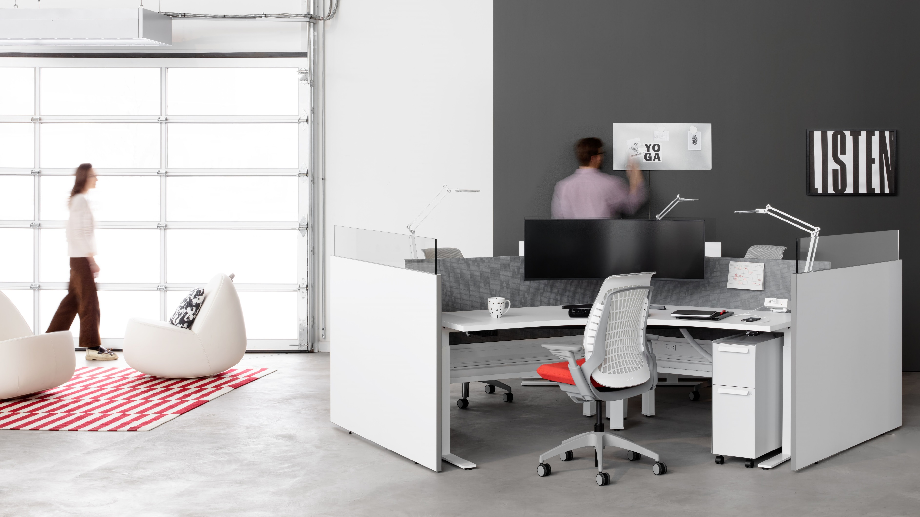

Slide 25
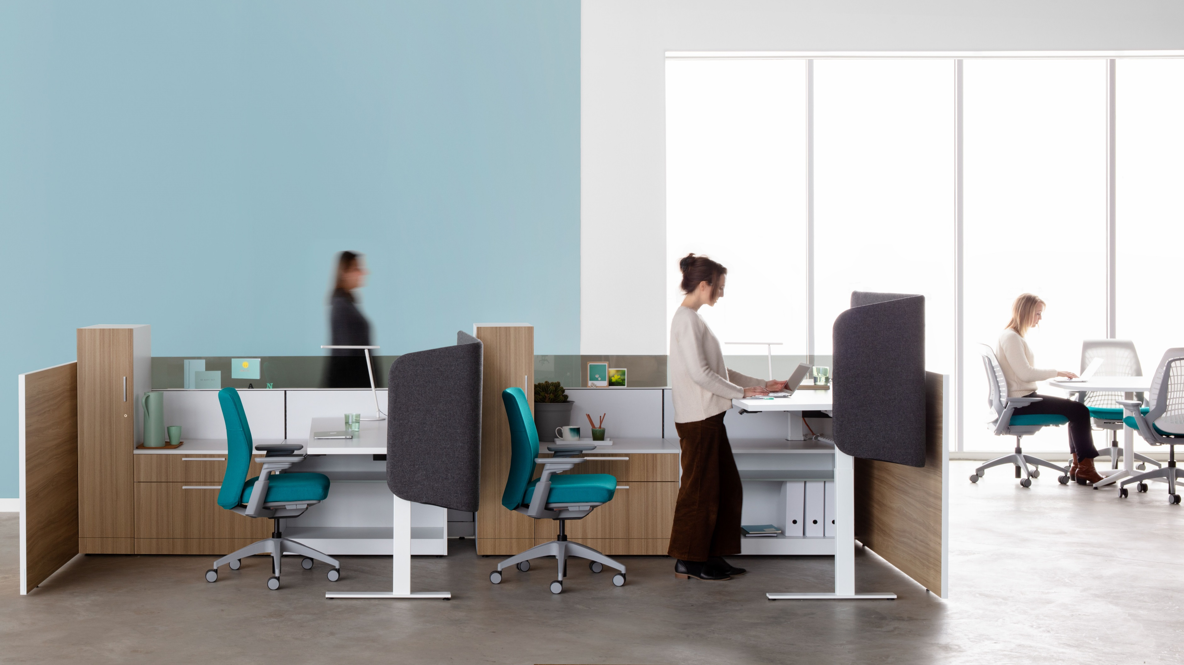

Slide 26
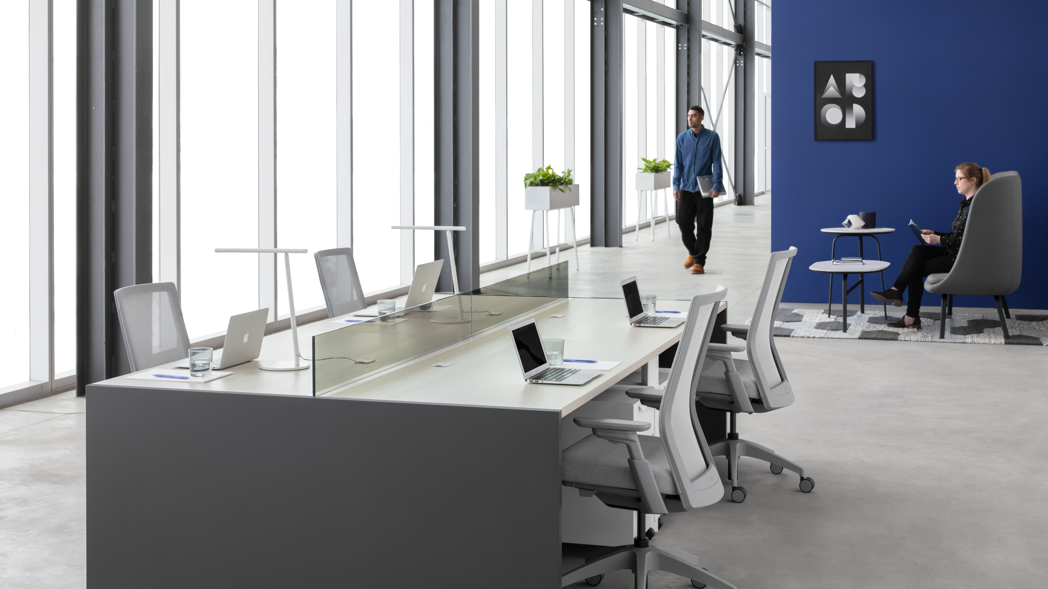

Slide 29
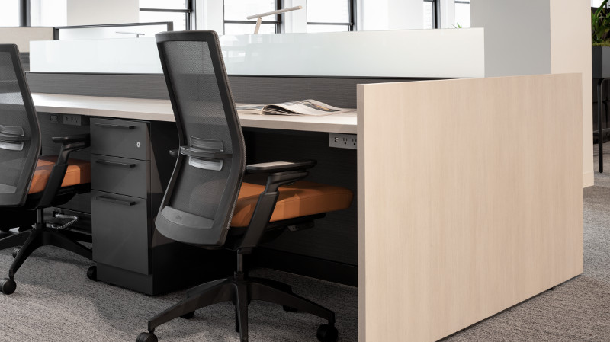

Slide 30
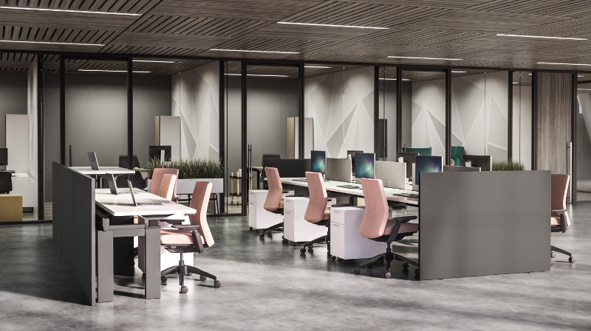

Slide 31
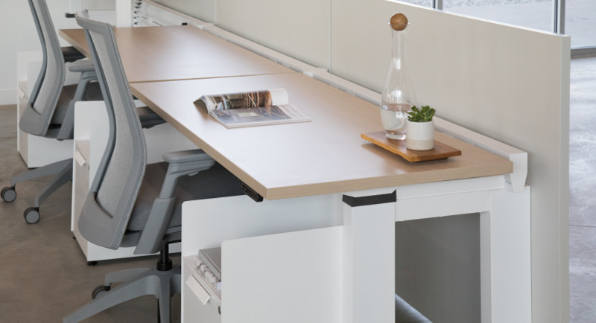

Slide 32
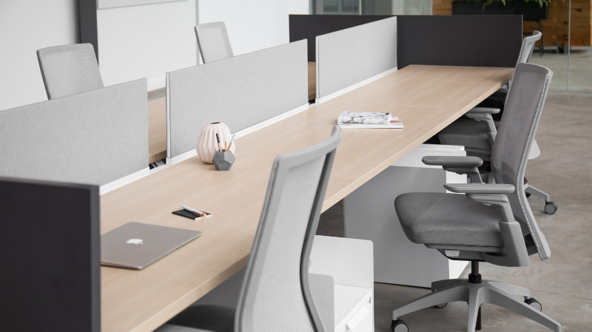

Slide 33


Slide 34
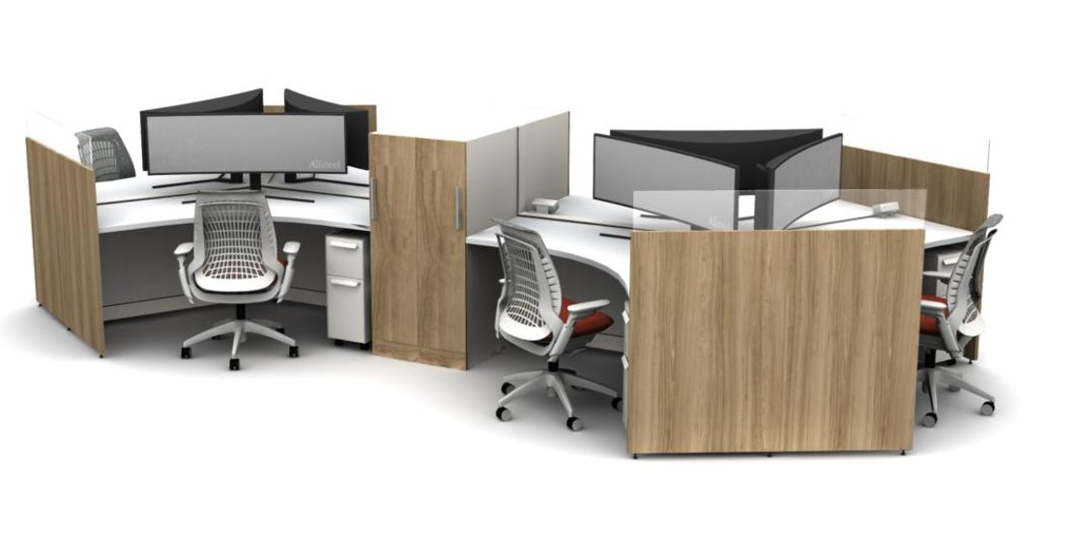

Slide 35
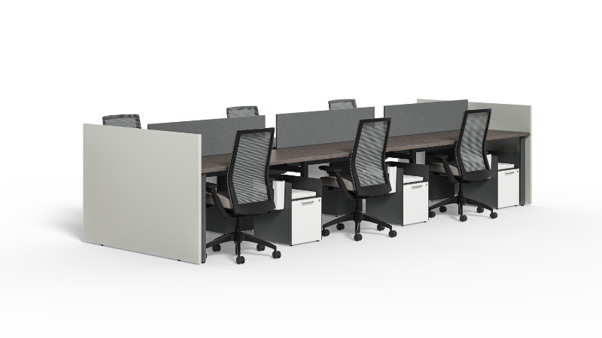

Slide 36
