Slide 1
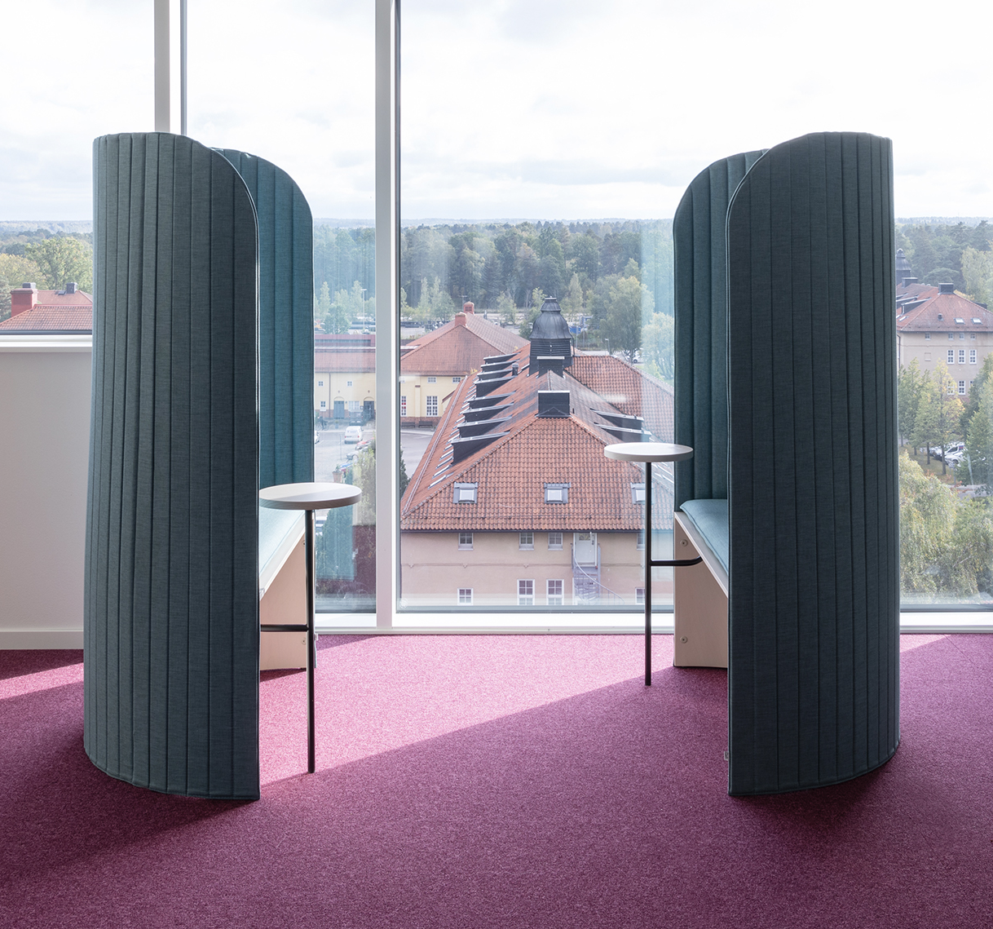
Sales & Dealer Information
INTERNAL USE ONLY

Slide 2
A Note on Exclusivity
Zilenzio
Allsteel has exclusive* distribution for North America
Registration opportunity for Global Accounts with locations inside and outside of N. America. Registration process is a simple email or other written communication between Zilenzio, Allsteel and a dealer
* with the exception of a couple grand-fathered in retailers
INTERNAL TRAINING
Notes:
Exclusive distribution rights to strategic global accounts with locations inside and outside of North America in pre-registered and specific projects (registration process is a simple email or other written communication between Zilenzio, Allsteel and a dealer).

Slide 3
Terms
Zilenzio
Discount: 45% off List
Project Discount: For project discounting greater than $50,000 net, contact marie.lindqvist@zilenzio.se.
Showroom Discount: 75% off List
Shipping:
$0-6,000 Net = 15% ($150 min)
$6,000-$12,000 Net = 12.5%
above $12,000 Net = 10%
INTERNAL TRAINING

Slide 4
Warranty & Lead Time
Zilenzio
Warranted to be free of workmanship defects for 2 years.
Set expectations. These are high quality, but not tested to BIFMA
Manufacturing lead time is 4-5 business weeks; Tone, Tune and Kyoto are 6-8 business weeks.
Shipment is made via boat to a Harbour; 4-5 weeks. Add 1-week delivery to NY and 2-week delivery to Western US.
Air freight is available at additional charge, delivery time ~1 week
INTERNAL TRAINING

Slide 5
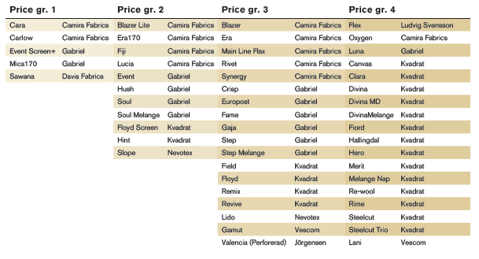
Surface Materials
Zilenzio
Curated offering
Standard powder paint + RAL match for upcharge
Textile specific to unit including Camira, Davis, Gabriel, and Kvadrat in Price Grades 1-4
COM is available
INTERNAL TRAINING
Fabrics for Table screen, floor screen, wall absorbent and ceiling absorbent

Slide 6
FAQs (internal use only)
Zilenzio
Q: Who is my point of contact at Zilenzio?
A: Orders- order@zilenzio.com
Customer Support- support@zilenzio.com Sales Opportunity- sales@zilenzio.com
Q: What is the warranty?
A: 2 Year. Normal wear and tear to the Goods are not covered by the warranty.
Q: How do you clean and disinfect the product?
A: Standard fabrics may be cleaned by soap and water. COM fabrics can also be specified to meet specific cleaning requirements.
INTERNAL TRAINING

Slide 7
FAQs (internal use only)
Zilenzio
Q: I need a mockup fast, how do I get it?
A: Email: sales@zilenzio.com
Q: Is additional discounting available for large project volumes?
A: Yes. Discount schedule is: +5% discount for orders > $50K Net, +10% for projects > $100K Net, +15% for projects > $200K Net
Q: What is the dealer showroom discount?
A: 75% for a period of 6 months
INTERNAL TRAINING

Slide 8
FAQs (internal use only)
Zilenzio
Q: What are typical lead times?
A: Manufacturing lead time is ~4-5 weeks; Tone, Tune and Kyoto are 6-8 business weeks. Shipment via boat in 4-5 weeks. Add 1-wk delivery to NY and 2-wk delivery to Western US.
Q: What are payment terms? A: 30-day payment terms at Delivery
Q: How does Zilenzio focus on sustainability?
A: Zilenzio is focused on promoting sustainability and transparency throughout their supply chain, supporting responsible consumption and production, and encouraging sustainable forestry through the purchase of sustainably sourced wood. Zilenzio follows a Swedish sustainability and quality standard, similar to BIFMA for the furniture industry (looks at product quality, durability, sustainability) called Möbelfakta.
INTERNAL TRAINING

Slide 9
FAQs (internal use only)
Zilenzio
Q: What specification tools are available?
A: CET and Revit are in process. 2D/3D .dwg CAD currently available. https://zilenzio.com/support/downloads/
Q: Can I get COM’s?
A: Yes. Zilenzio will communicate pass/fail and yardage requirement. Most furniture fabric can be applied if it is not too thick. As a quick test, try to blow through the fabric; if the air goes thru the fabric, then it will work. Email requests to support@zilenzio.com.
Q: How can we find information about sound?
A: https://zilenzio.com/sound/
INTERNAL TRAINING

Slide 10
FAQs (internal use only)
Zilenzio
Q: What samples are available?
A: Once setup as a dealer, a sample set of fabrics and finishes will be sent to your dealer location(s). If additional sample sets are required email support@zilenzio.com.
Q: How does my dealer become a Zilenzio dealer?
A: Fill out Dealer Agreement (on Brand Connect) and provide resale license. Email forms to support@zilenzio.com. After this Zilenzio will set up acoustic and product trainings for the dealer team.
Q: Where are the products manufactured?
A: In Sweden and Europe.
INTERNAL TRAINING

Slide 11
FAQs (internal use only)
Zilenzio
Q: What are your installation to ceiling and wall guidelines?
A: The product does not ship with attachments for mounting to the existing ceiling or wall. When mounting to the ceiling, be aware of the weight of each product. Ask a professional for ceiling mounts. Zilenzio does not take any responsibility for the construction of the ceiling or the installation to the ceiling.
Q: How do I get a quick recommendation for the amount of Stone wool for a room or space?
A: Email 3 images of the room incl the measurements of the walls and the height of the ceiling to support@zilenzio.com. Respond with guidance on square footage usage.
Q: What kind of sales help can I get of the Zilenzio support?
A: We do the calculation of Stone wool, 3D drawing and quotation incl. all the mountings fitting.
INTERNAL TRAINING

Slide 12
FAQs (internal use only)
Zilenzio
Q: How can I track my order?
A: Email to delivery@zilenzio.com
Q: Can we get the Zilenzio products custom made?
A: Yes. support@zilenzio.com
Q: How can I try or feel how the sound absorption works in a Zilenzio product?
A: Put you ear against it, or talk into it, then you will experience how the sound absorbs= disappears.
Q: How do I do to get an online education about the Zilenzio products?
A: Email to sales@zilenzio.com and book a time. Or listen to one of the many options available on Brainshark.
INTERNAL TRAINING

Slide 13
How do I get my dealer setup to sell?
Zilenzio
Fill out 2 Dealer agreement forms found on Brand Connect
Email forms to sales@zilenzio.com
Zilenzio will create a customer number in their system for order management.
Offer training to dealer sellers and designers!
INTERNAL TRAINING

Slide 14
Available Training
Zilenzio
There is lots of great information to learn more about Acoustics and Zilenzio!
Available Brainsharks on Zilenzio
Zilenzio Partnership: who they are and how they fit
Zilenzio Product Line: nuggets about Zilenzio products
Zilenzio Integration With Allsteel: storytelling with Allsteel product
Zilenzio Sales Details: covers the key details of the partnership terms
Zilenzio Sound
Press Event
Zilenzio’s Story
Information on Acoustics
Brainshark- Intro to Acoustics
Learning Lab- Acoustics: A Human Centric Focus
Insta Live 2/10
INTERNAL TRAINING

