Slide 1
Sales & Dealer Training
INTERNAL USE ONLY

Slide 2
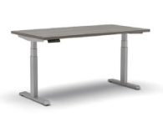
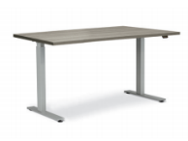
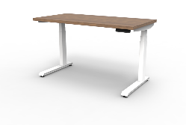
Offering Comparison
Feature | Altitude A3 (Disco 12/31/2020) | Altitude A5 (Disco 12/31/2020) | Altitude A6
Anti-Collision | • |  | •
T-Leg | • |  | •
C-Leg |  | • | •
Standard Range | • | • | •
Extended Range | • |  | •
# of Controllers | 1 | 2 | 5
Standard Lift Capacity | • | • | •
Maximum Lift Capacity |  |  | •
Rectangle Columns | • | • | •
Warranty | 7 years electronics, 10 years metal base | 7 Years | 7 years electronics, 10 years metal base
Notes:
The Altitude A6 combines the Altitude A3 and Altitude A5 features. When comparing the features of the A3 and the A5, neither product offers a complete set of solutions for every customer. In fact, the only differentiator between A5 compared to A3 is that A5 offers 50lbs more lifting capacity and a C-Leg. The Altitude A6 features now allows Allsteel to offer all available features under one product line.
We will see A3 and A5 be discontinued and fully merged into Altitude A6.

Slide 3
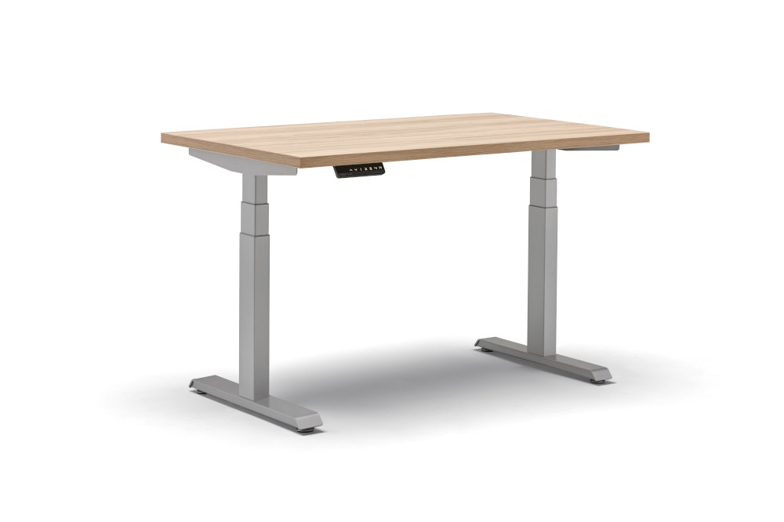
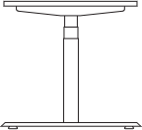
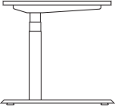
Specification Options
Laminate Options
Available in full Allsteel standard laminate offering
Control Options
Up/Down
Paddle
Memory
Rotating
Base Finish Options
Black
Silver
White
INTERNAL TRAINING
Leg Configuration
T-Leg
C-Leg
Height Range
2-Stage: 27.75" - 47.38"
3-Stage: 22.75" - 48.5"

Slide 4
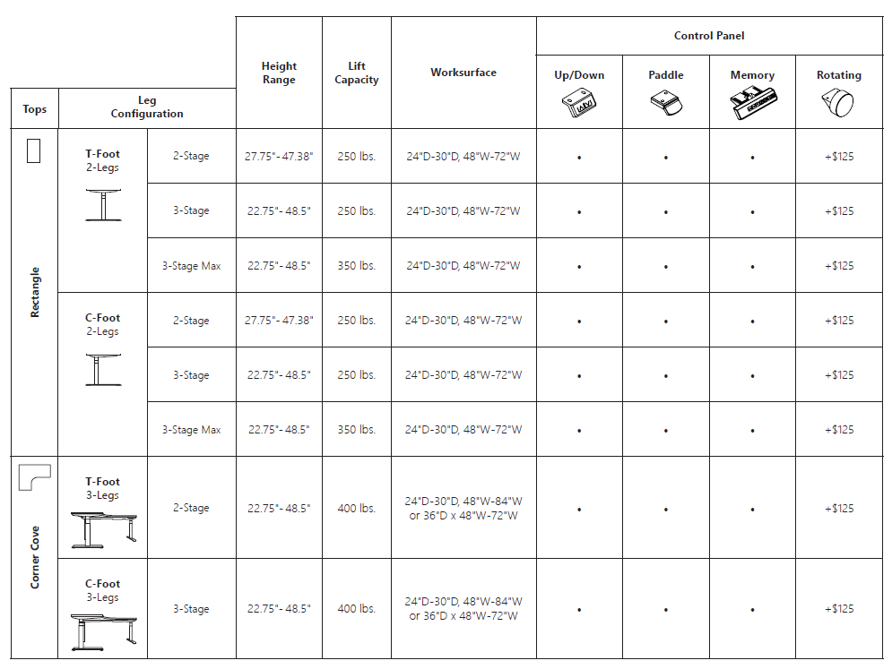
Matrix
INTERNAL TRAINING

Slide 5
Altitude A6
PRICING SNAPSHOT
 | Description | Model | List
T-Foot | 2-Stage, 2-Leg, Rectangle, T-Foot | ^{A6REC2S2LTF} | ^{$1,535}
 | 3-Stage, 2-Leg, Rectangle, T-Foot | ^{A6REC3S2LTF} | ^{$1,721}
 | 3-Stage, 3-Leg, Rectangle, T-Foot | ^{A6REC3S3LTF} | ^{$2,705}
 | ^{Max, 3-Stage, 2-Leg, T-Foot} | ^{A6MREC3S2LTF} | ^{$2,389}
INTERNAL TRAINING
C-Foot | 2-Stage, 2-Leg, Rectangle, C-Foot | ^{A6REC2S2LCF} | ^{$1,535}
 | 3-Stage, 2-Leg, Rectangle, C-Foot | ^{A6REC3S2LCF} | ^{$1,721}
 | 3-Stage, 3-Leg, Rectangle, C-Foot | ^{A6REC3S3LCF} | ^{$2,705}
 | ^{Max, 3-Stage, 2-Leg, C-Foot} | ^{A6MREC3S2LCF} | ^{$2,389}

Slide 6
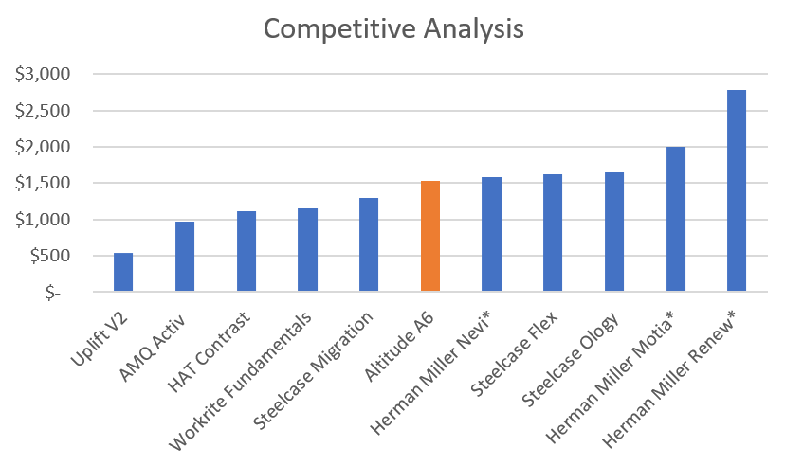
Height-adjustable Tables
INTERNAL TRAINING

Slide 7
Customers to Target
We want a consistent design aesthetic that can be incorporated into various team settings.
We want to promote wellness with height-adjustable tables.
We want a height-adjustable table that has a full offering of features and benefits.
We want our employees to have the ability to create and adjust their work areas to fit their needs.
We want features and options that are trending in the market.

Slide 8
FAQ
^{Q: What is being discontinued?}
A: The Altitude A3 and A5 table offerings will discontinue 12/31/2020. The Altitude A6 combines new features in addition to all of the best features of the Altitude A3 and Altitude A5, creating an all-inclusive and easy to specify offering.
Q: How does this change benefit Altitude Height-Adjustable Tables in the market?
A: Altitude A6 enhances the current Altitude Family of Height-Adjustable tables by offering more scalable options, a wide breadth of finishes, and an easier specifying experience. We have simplified the buying experience by creating a product matrix to show compatibility and available options.
^{Q: Are model numbers changing?}
A: Yes – with the launch of A6, A3 and A5 models will roll up into the offering and receive new model numbers. Part of the Altitude A6 project was to improve the height-adjustable table model logic. Now when you specify A6, paint, glides, and controls are on the option level, allowing us to react to market changes faster than ever.
^{Q: What is the warranty on A6?}
A: The Altitude A6 warranty and Altitude A3 warranty both offer an improved 10 years of coverage on the metal base and 7 years of coverage on electronic components.

Slide 9
FAQ
Q: Can I put a A8 Screen onto an A6 Table?
A: Yes – A8 Screens can be used on many different work surfaces including all the Altitude Height-Adjustable tables.
Q: Are A3 and A5 going away? Will the naming “A3” and “A5” go away?
A: Altitude A3 and Altitude A5 Height-Adjustable tables will be consolidated into the Altitude A6 launch and discontinue 12/31/2020. The purpose of this is to create an easier buying experience where there are no barriers or need to go ^{through TPG.}
Q: Is there an up-charge for the 4-memory control panel?
A: No, there is only an up-charge for the rotating keypad control and foot control.
Q: Are there non-controllable keypad options available?
A: Yes - the basic up/down keypad control, the paddle keypad control, and foot control are non-programmable.
Q: Can I get any of the control panels with a T-foot configuration?
A: Yes – you can now get any control panel with any configuration! Altitude A6 will simplify specifying and expand options like controls, finishes, etc.

Slide 10
Launch Timing
OPEN FOR ORDERS Fall 2018
Pre-Sell May 18th, 2020
Allsteel Communications The month of July
Brochure July 1st
Showroom Integration
Price List & Spec Guide (Online) July 1st
20/20 & Symbols Publication July 1st
Questions?
Product related : Lydia Neeley neeleyl@allsteeloffice.com and Madeleine Tigges tiggesm@allsteeloffice.com
Marketing related: Chelsie Kammeyer kammeyerc@allsteeloffice.com and Mary Palmer palmerm@allsteeloffice.com

Slide 11
Pre-Sell Tools
Sales Presentation is located here
GTM Brief is located here
Imagery is located here
List pricing is located here
FAQs are located here
Symbols are located here

