Slide 1
Sales & Dealer Training
INTERNAL USE ONLY

Slide 2
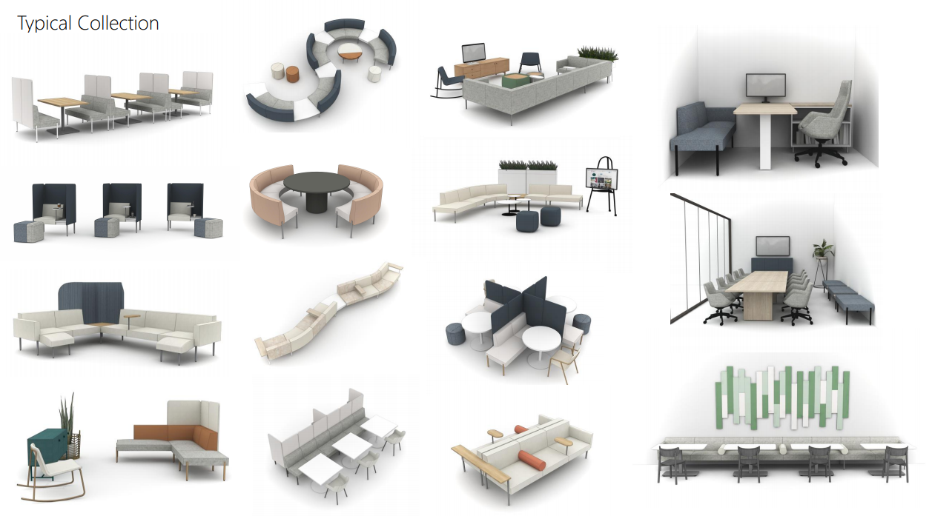

Slide 3
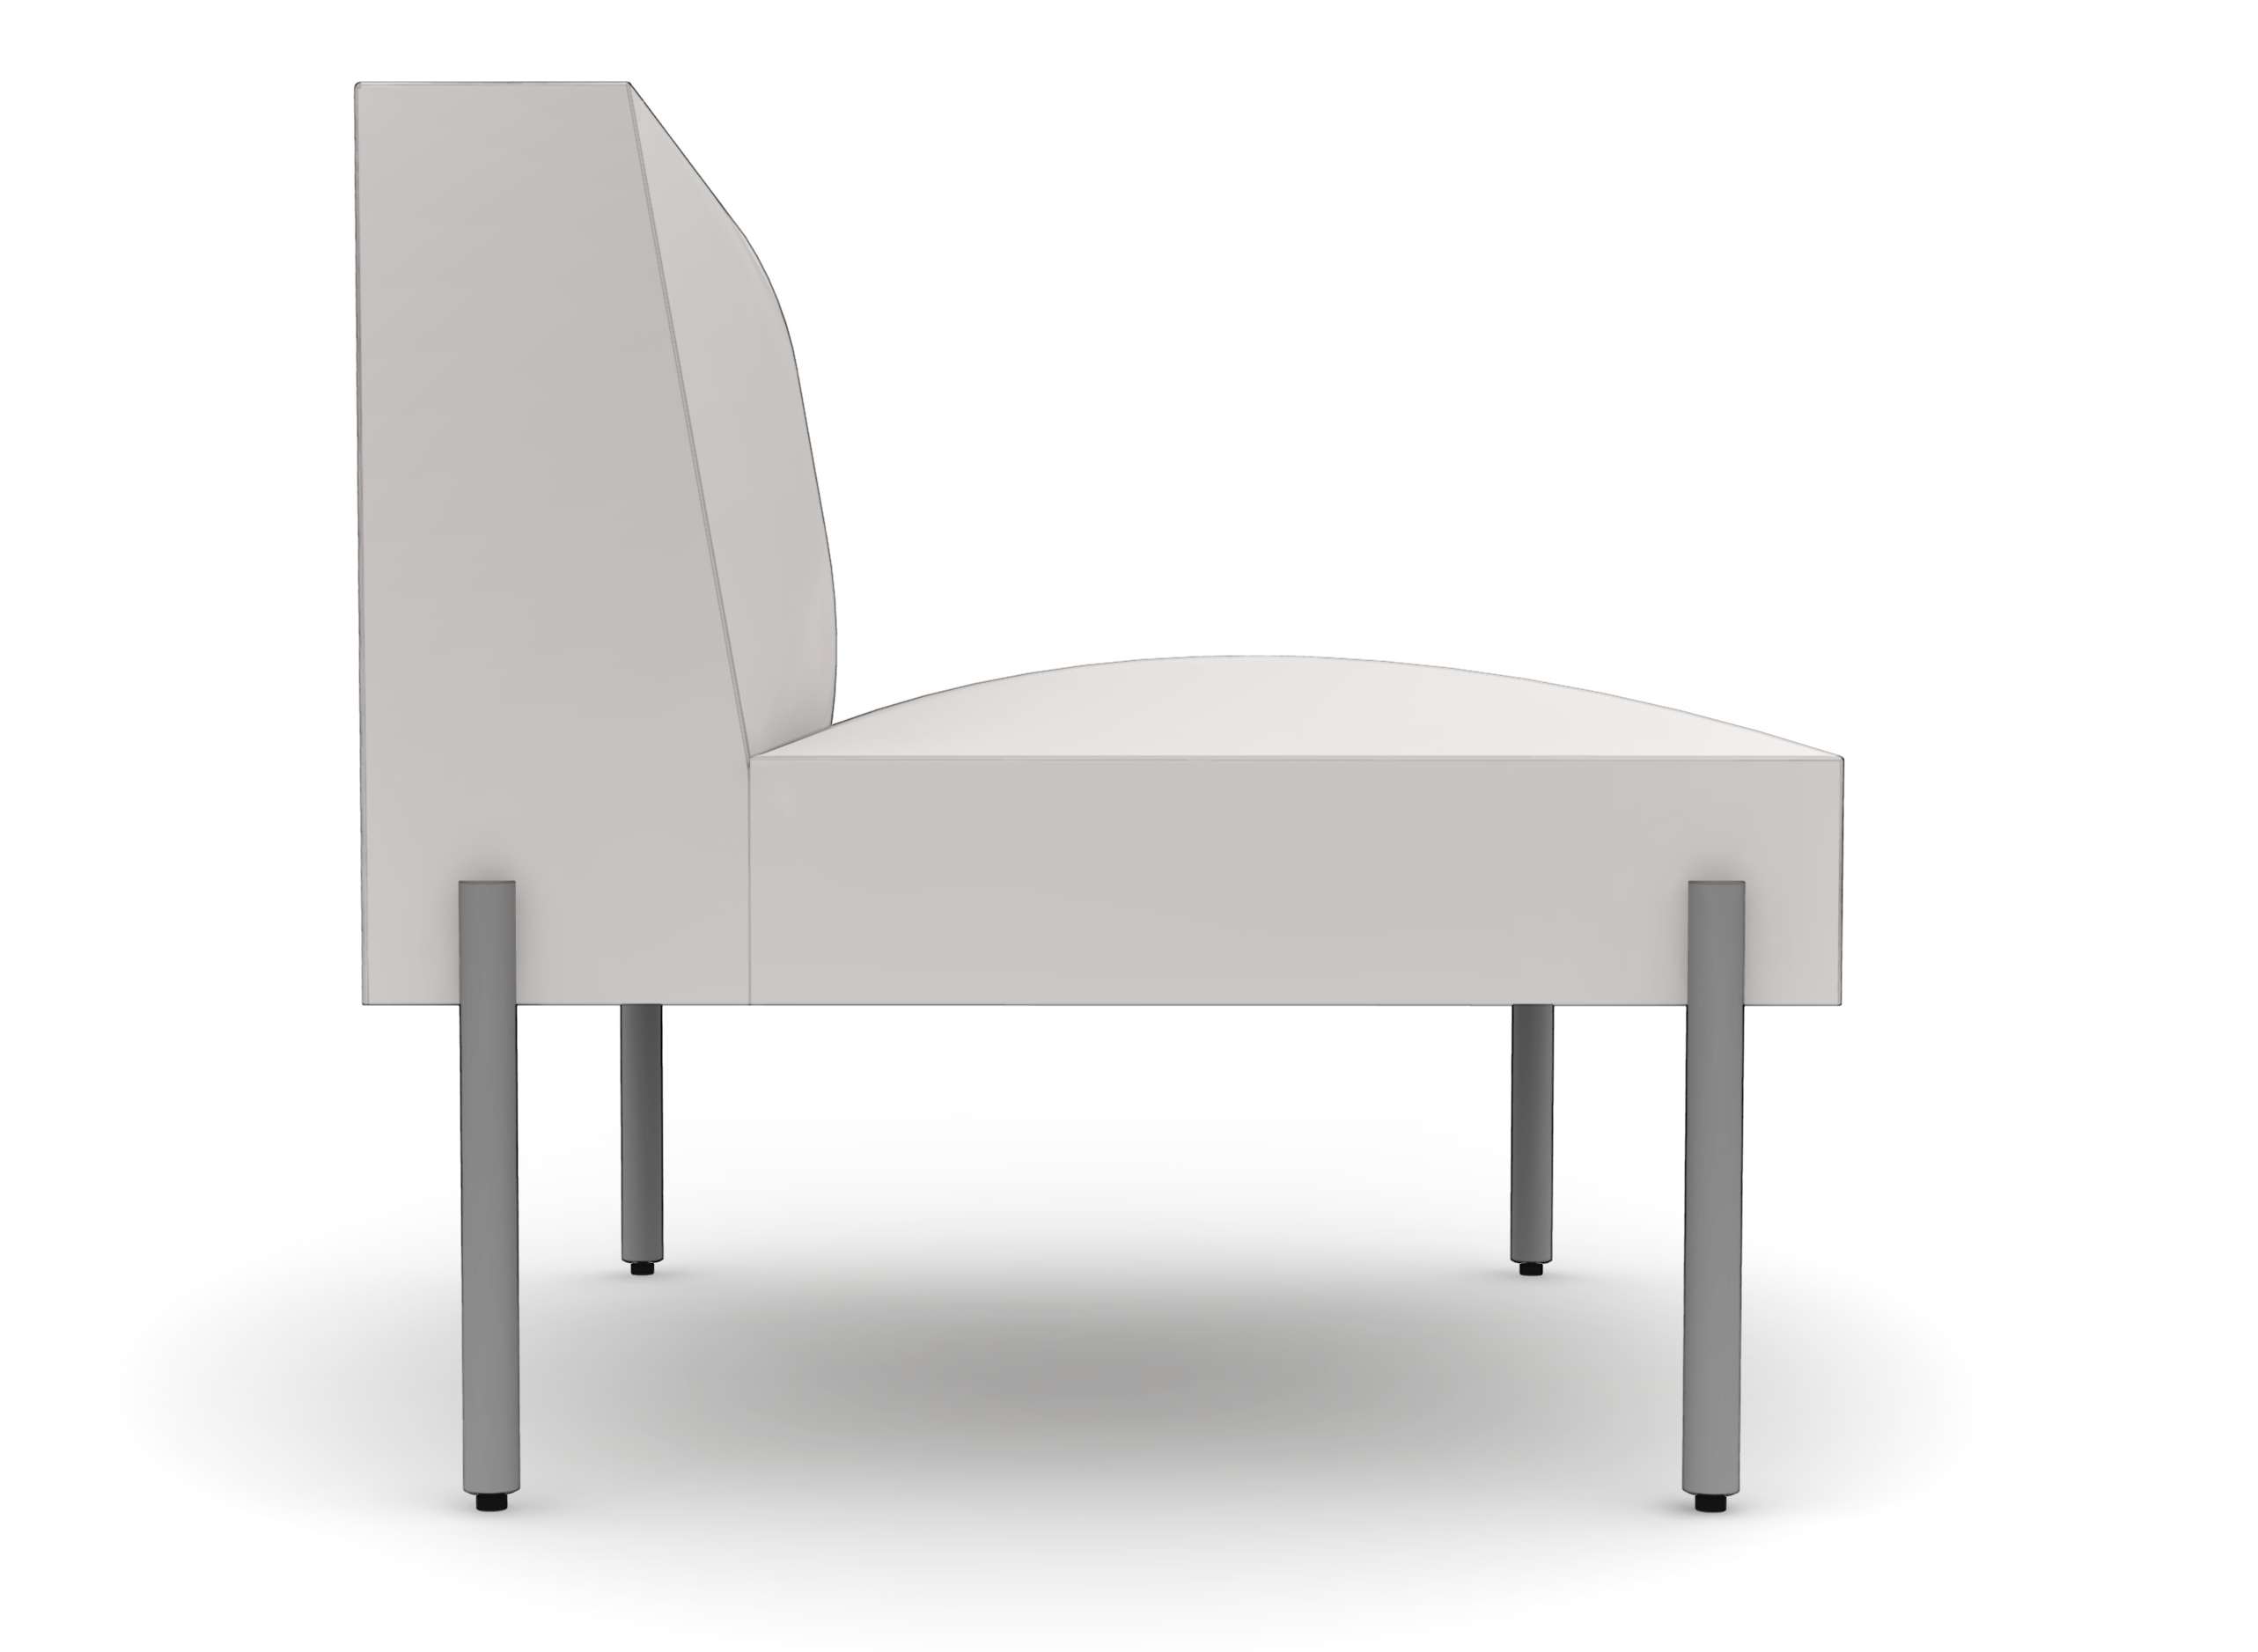
Planning Dimensions
Lounge Posture
Overall Height: 28 3/8"
Overall Width: 30"
Overall Depth: 30"
Seat Height: 18"
Seat Depth: 21 1/2"
INTERNAL TRAINING

Slide 4
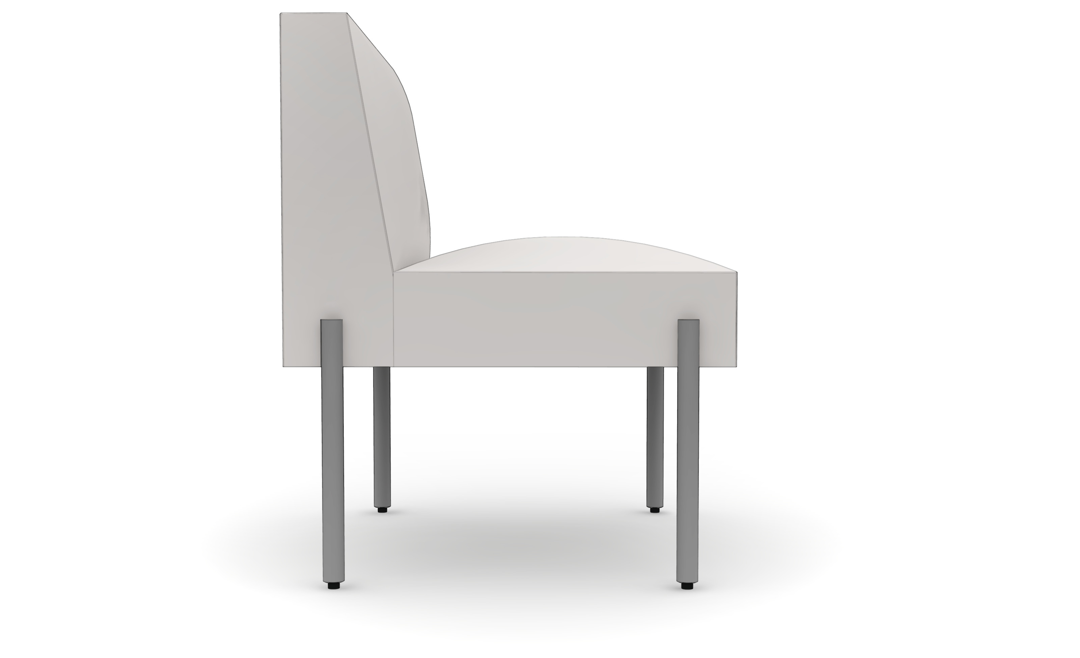
Planning Dimensions
Work Posture
Overall Height: 29 7/8"
Overall Width: 24"
Overall Depth: 24"
Seat Height: 19 1/2"
Seat Depth: 17 1/2"
INTERNAL TRAINING

Slide 5
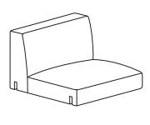
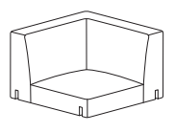
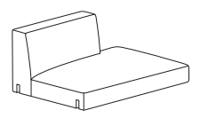
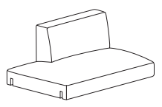
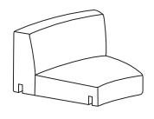
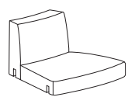
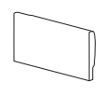
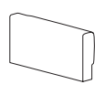
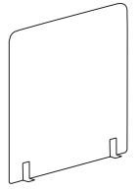
Statement of Line & List Price
Lounge Seats & Backs
Single Seat & Back
BPLSS - $1,533
BPLSM - $1,642
Corner
BPLCS - $1,861
BPLCM - $2,080
Ottoman
BPLO - $1,204
Right Half Back
BPLRS - $1,971
BPLRM - $2,107
Left Half Back
BPLLS - $1,971
BPLLM - $2,107
Serpentine
Wide at Back
BPLSWS - $1,752
BPLSWM - $1,888
Serpentine
Narrow at Back
BPLSNS - $1,752
BPLSNM - $1,888
Serpentine
Ottoman
BPLO - $1,368
INTERNAL TRAINING
Arms
Accessories
Legs & Connectors
Tailored Arm
BPLTL - $657
BPLTR - $657
Box Arm
BPLBL - $766
BPLBR - $766
Bolster Arm
BPLB - $602
Calf Rest
BPLCR - $876
30" Privacy Screen
BPBSCR30 - $958
45" Privacy Screen
BPBSCR45 - $1,067
See the Price & Specification Guide for pricing and more details.

Slide 6
Statement of Line & List Price
Work Seats & Backs
Single Seat & Back
BPWSS - $1,368
BPWSM - $1,478
Corner
BPWCS - $1,752
BPWCM - $1,971
Ottoman
BPWO - $1,095
Right Half Back
BPWRS - $1,752
BPWRM - $1,888
Left Half Back
BPWLS - $1,752
BPWLM - $1,888
Serpentine
Wide at Back
BPWSWS - $1,587
BPWSWM - $1,724
Serpentine
Narrow at Back
BPWSNS - $1,587
BPWSNM - $1,724
Serpentine
Ottoman
BPWO - $1,204
INTERNAL TRAINING
Arms
Accessories
Legs & Connectors
Tailored Arm
BPWTL - $602
BPWTR - $602
Box Arm
BPWBL - $711
BPWBR - $711
Bolster Arm
BPWB - $547
24" Privacy Screen
BPBSCR24 - $903
36" Privacy Screen
BPBSCR36 - $1,012
See the Price & Specification Guide for pricing and more details.

Slide 7
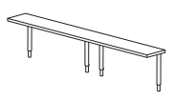
Statement of Line & List Price
Connecting Tables & End Caps
Lounge Connector
Table 30" x 30"
BPCT30 - $1,040
Lounge Half Connector Table 15" x 30"
BPCT15 - $821
Lounge Serpentine Connector Table
BPCTO30 - $1,149
Lounge Corner Connector
Table 30" x 30"
BPCCT30 - $1,040
Lounge Notched Table 30" x30"
BPNT30 - $1,095
Lounge Half- Notched Table 15" x 30"
BPNT15 - $876
Lounge End Cap 30"
BPTE30 - $629
Lounge End Cap 60"
BPTE30 - $739
Lounge
Shared Table
BPTS30 - $629
INTERNAL TRAINING
Work Connector
Table 24" x 24"
BPCT24 - $930
Work Half Connector Table 12" x 24"
BPCT12 - $711
Work Serpentine Connector Table
BPCTO24 - $1,040
Work Corner Connector
Table 24" x 24"
BPCCT24 - $930
Work Notched Table 24" x 24"
BPNT24 - $985
Work Half- Notched Table 12" x 24"
BPNT12 - $766
Work End Cap 24"
BPTE24 - $574
Work End Cap 48"
BPTE48 - $684
Work
Shared Table
BPTS24 - $574
Accessories
Swivel Tablet Arm
BPTT - $465
Coffee Table 24" x 45"
BPCT2445 - $1,314
Coat Hanger
BPCH - $273

Slide 8
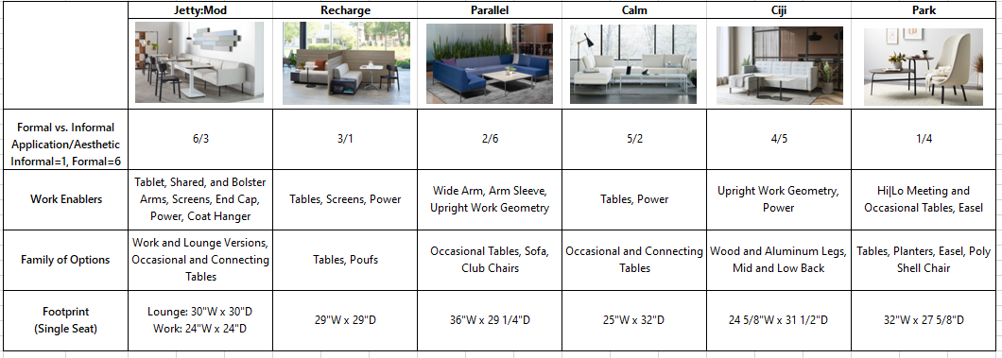
Internal Positioning
INTERNAL TRAINING

Slide 9
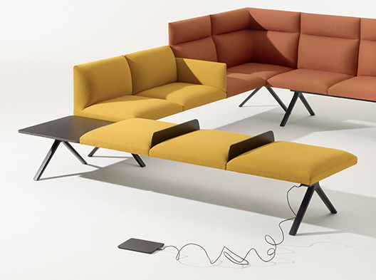
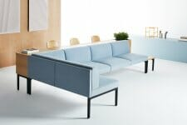
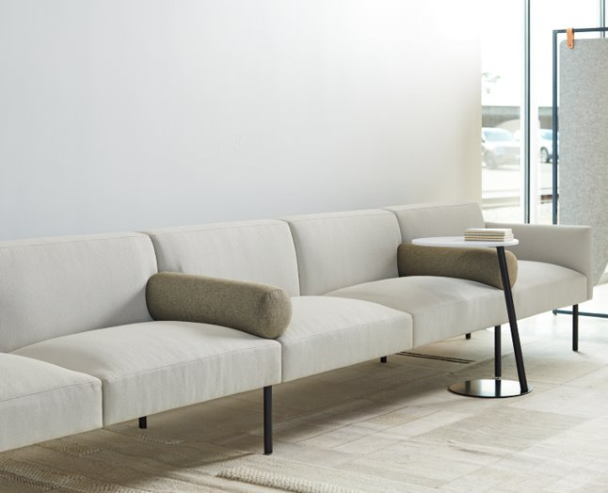
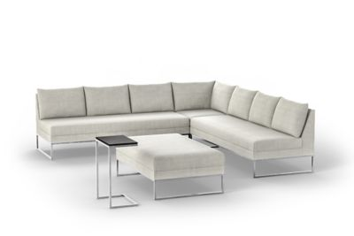
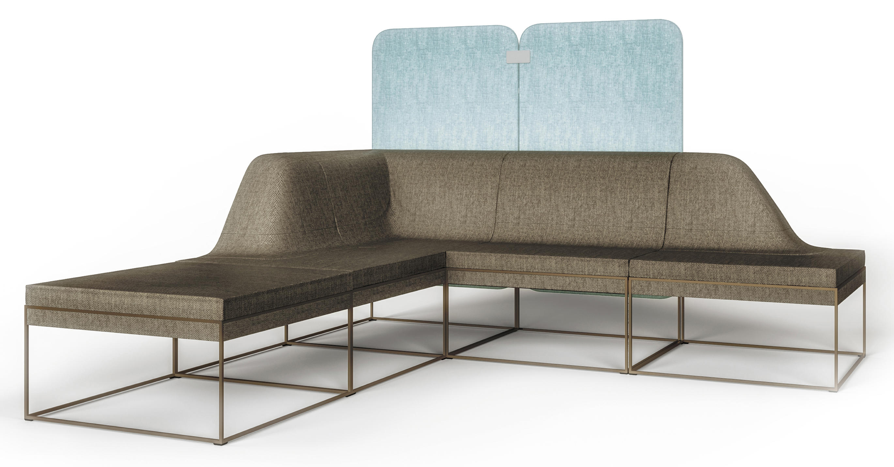
Price Positioning
Two Seat & Back w/ Arms and Connecting Table in the Middle
55% Discount
INTERNAL TRAINING

Slide 10
Launch Timing
OPEN FOR ORDERS November 2021
Press Release & Media Announcement October 2021
Allsteel Sales Team Training Call February 2021
AO & Brand Connect Website Live June 2021
Showroom Integration Q4 2021/Q1 2022
Price List & Spec Guide (Online) June 2021
20/20 & Symbols Publication June 2021
CET June 2021
INTERNAL TRAINING
Questions?
Product related, Caitlin Sullivan: sullivanc@allsteeloffice.com
Marketing Related, Brian Parrott: parrottb@allsteeloffice.com

Slide 11
How to Order
First Order Entry: November 2021
Lead Time: Variable due to the seating foam situation; goal is 6 weeks once things stabilize
Pricing:
Standard Terms 55% off
Showroom Discount 75% off
Everyday Advantage N/A
Eligible for Edge points and counts toward standard sales incentive programs
BIFMA Certified
Indoor Advantage™ Gold and Level 2
GSA in progress
INTERNAL TRAINING

Slide 12
Frequently Asked Questions
Q: What is the Jetty:Mod collection?
A: Jetty:Mod is a modular sofa collection that includes cushions, arms, tables, legs, connectors, screens, and accessories and provides solutions for specific activity modes, including work and lounge. Legs and arms can be changed or added over time to create new looks and configurations. Components can be integrated to support the specific work being accomplished.
INTERNAL TRAINING
Q: Where will this collection be used within the workspace?
A: Jetty:Mod can create a variety of applications across the floorplan, including private offices, collaboration hubs, banquettes, booths, and individual workspaces.
Q: What is the planning footprint for Jetty:Mod?
A: Jetty:Mod utilizes height and depth combinations to support appropriate postures for various work needs. For the work version, the footprint is built on a 24" per seat dimension that supports a posture to get work done. The lounge version has a footprint of 30" per seat that supports a posture for relaxing and lounging.

Slide 13
Frequently Asked Questions
Q: What are the available upholsteries?
A: Available fabrics can be found in the Jetty:Mod section of the Seating, Social Collaborative & Tables Price & Specification Guide available online.
Q: Are dual upholsteries an option?
A: Yes. Dual upholsteries can be specified on seat and back, corner, half backs, and serpentine pieces. See the Jetty:Mod section of the Seating, Social Collaborative & Tables Price & Specification Guide available online.
INTERNAL TRAINING
Q: Are COMs an option on upholstered pieces?
A: COMs are avaiallbe at launch.
Q: What laminates can be specified on tables?
A: Available laminates can be found in the Jetty:Mod section of the Seating, Social Collaborative & Tables Price & Specification Guide available online.

Slide 14
Frequently Asked Questions
Q: What paint colors can be specified on the legs and connectors?
A: Connectors are automatically painted Black. Legs are available in Textured Salt, Textured Titanium, and Solar Black.
Q: What electrical is being used for Jetty:Mod?
A: With Jetty:Mod, we are introducing a new electrical product called Triplex. It includes jumper and infeed kits that are undermounted to the upholstered and table pieces. Miki units are then plugged into the Triplex units to provide electrical wherever needed. More information on electrical can be found in the Jetty:Mod section of the Seating, Social Collaborative & Tables Price & Specification Guide available online.
INTERNAL TRAINING

Slide 15
Frequently Asked Questions
Q: What is the weight rating for Jetty:Mod?
A: The weight rating for all social collaborative products offered by Allsteel is 300 pounds per seat.
Q: Where can the screens can be used?
A: Screens can be used on the back and sides of seating units that have a seat and back. Screens can also be used on the back of connecting tables, but not on the sides.
INTERNAL TRAINING

