Slide 1
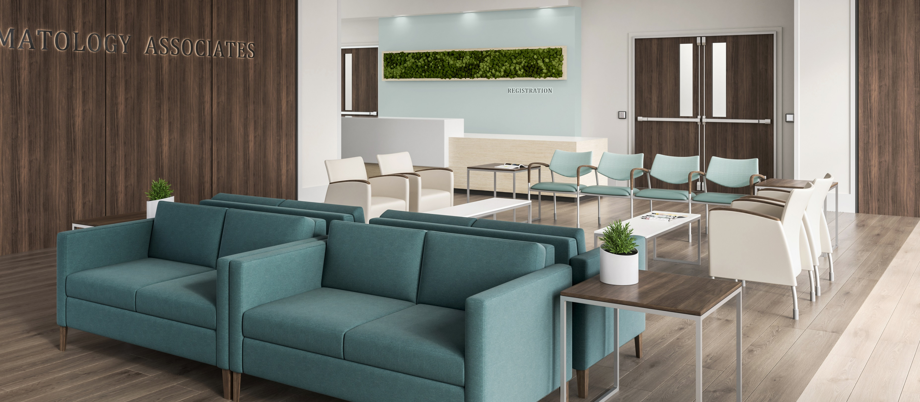
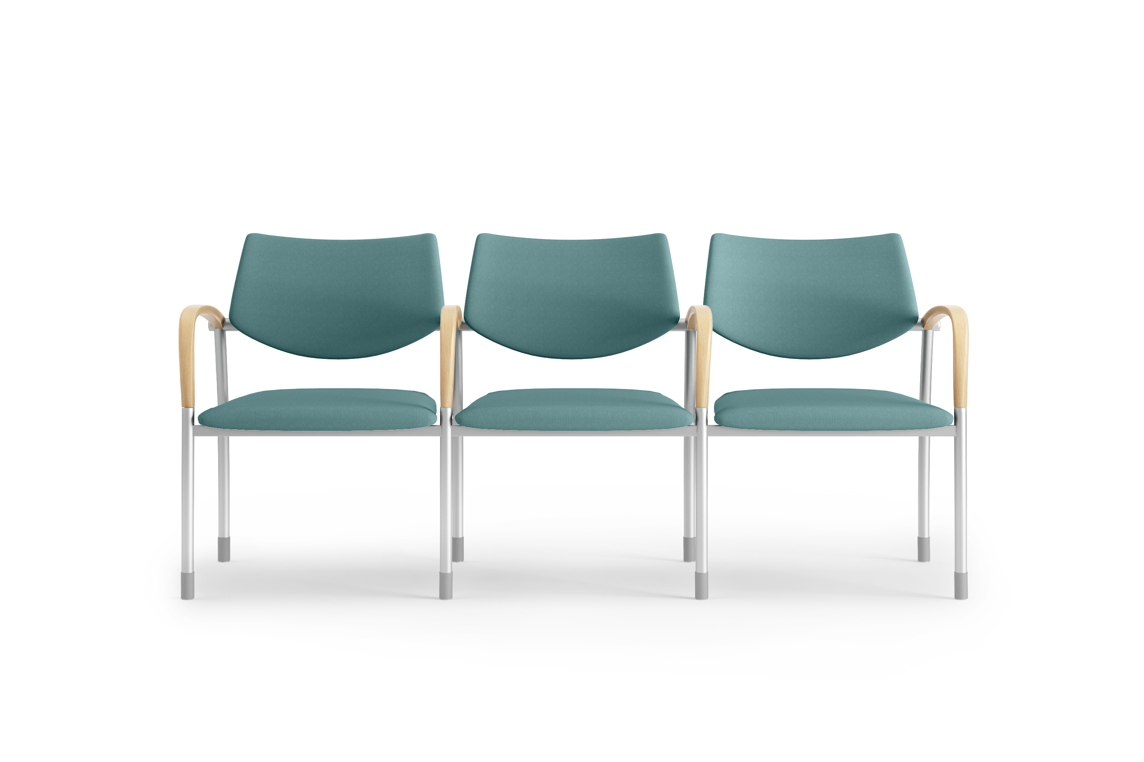
CONTRACTS
PREMIER CONTRACT
BENEFITS TO YOU
Offering Pre-Negotiated Pricing on our Portfolio
Together with our dealer partners, we can also provide a host of value-added services that save time and money.
WHY USE THIS PROGRAM?
Simplified Buying Process
Authorized manufacturer meeting all of Premier’s requirements
Access to our Workplace Advisory Team, Ergonomist and Sustainability Experts.
Local sales and support experts to deliver a seamless experience

Slide 2
SOLUTION SUPPORT
DESIGN
DEALER SERVICES
Workplace Strategy
Wellness and Ergonomic Support
RFP Optimization
Continuing Education Units (CEUs)
Post-Occupancy Evaluation
Conceptual Design Consultation
Collaborative Design on Demand (Live Design)
Visualization Services (Renderings, VR, AR)
Solution development across the entire Allsteel | Gunlocke product portfolio to meet specific budget, aesthetic, and cultural preferences
Project Management
Solution consultation
Installation support
Local support and ongoing connectivity
Day two engagement for updates and growth
Allsteel | Gunlocke are members of HNI Corporation
Meghan Bildner
Business Development Manager Cell: 617.571.6617
bildnerm@allsteeloffice.com
Headquartered in Muscatine, Iowa, HNI is one of the largest furniture manufacturers in the world. Allsteel | Gunlocke anchors the HNI brands providing key furniture solutions for relevant workplace challenges.
With deeply held values, our employees, who we call members, are united by a dedication to integrity, quality, innovation, service, continuous improvement and value creation for our customers. Our unwavering commitments to sustainability and customer service unite the brands, with those shared values driving product design and delivery.
These qualities allow us to achieve something special, something that creates value for our shareholders, our customers, our members, and our communities.
Meghan Bildner
Business Development Manager Cell: 617.571.6617
bildnerm@allsteeloffice.com

