Slide 1
Sales & Dealer Training
INTERNAL USE ONLY

Slide 2
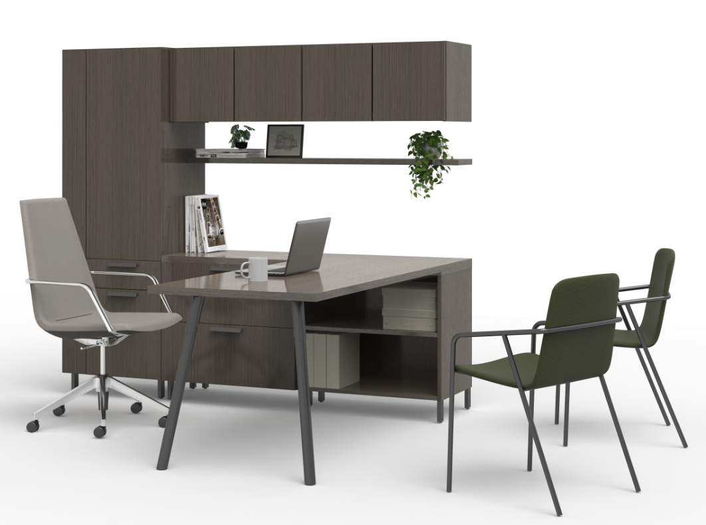
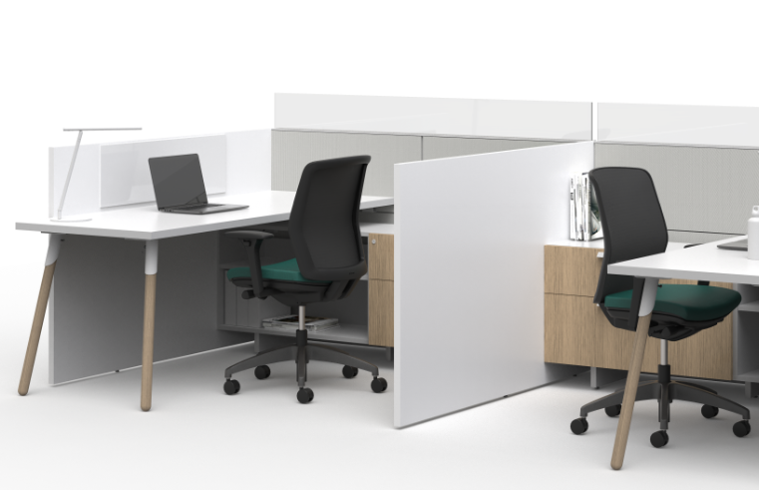
A New Direction for Approach
Approach was originally introduced to optimize the functionality of the private-office space. We’ve expanded the capability of Approach with requested private-office enhancements and new models that also make Approach a go-to workstation desking and storage solution.
INTERNAL TRAINING
Notes:
Approach has been a successful private-office solution since its introduction in 2016. With this reintroduction, on-trend products for workstations make Approach a solution that can be specified throughout the workspace. Approach is a full-facility solution offering application scalability and a diverse footprint.

Slide 3
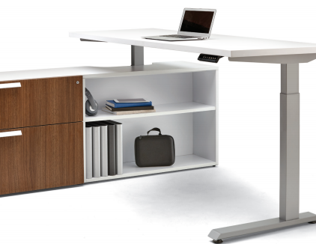
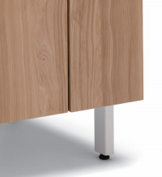
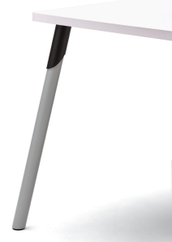
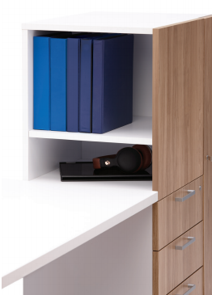
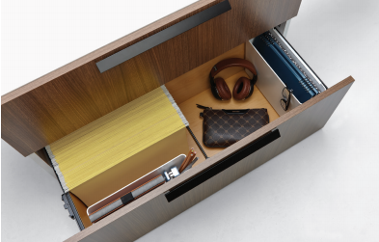
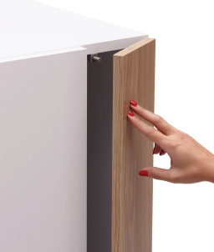
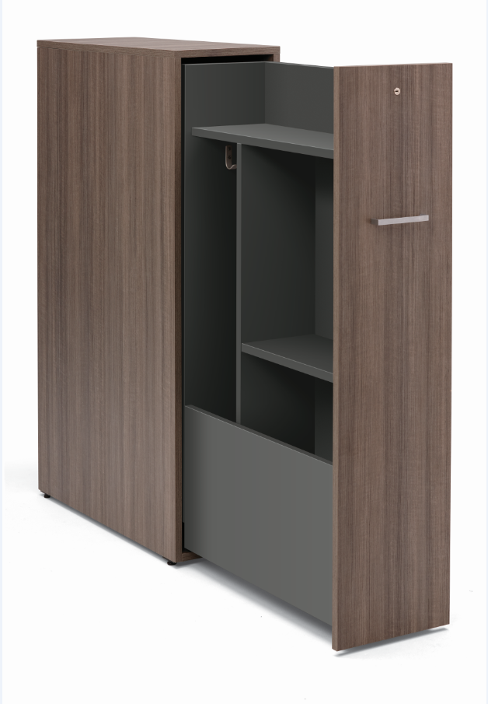
A Portfolio of Options
INTERNAL TRAINING
Notes:
Top row (left to right): credenza for integrated height-adjustable table, storage post foot, floating shelf, metal splay leg
Bottom row (left to right): side-access tower, lateral file storage, touch-latch wardrobe door, pull-out tower

Slide 4
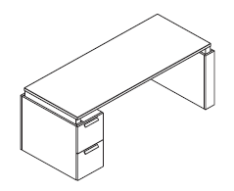
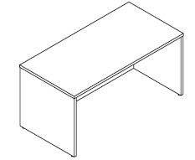
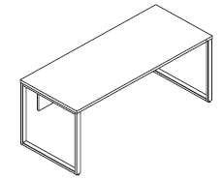
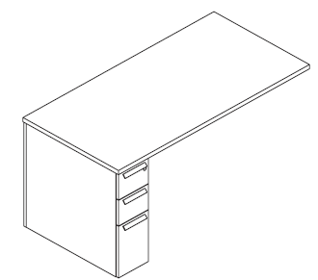
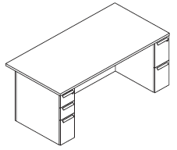
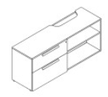
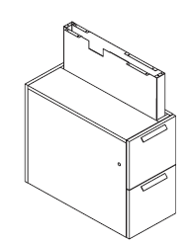
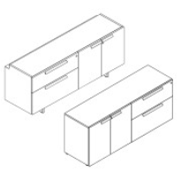
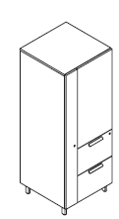
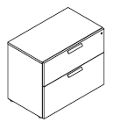
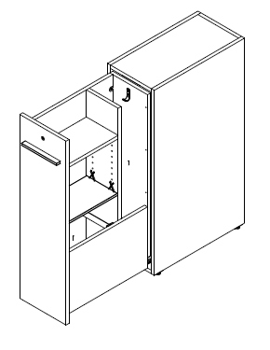
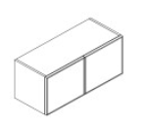
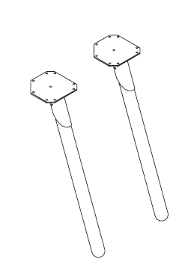
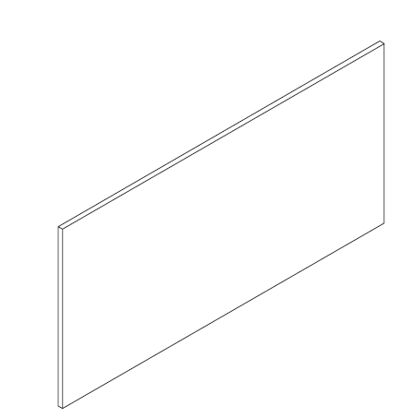
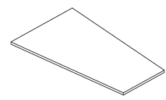
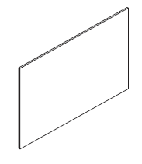
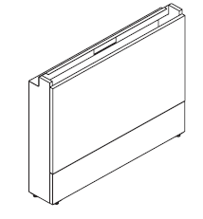
Approach Statement of Line
Desking
Height- Adjustable
Shell
Freestanding
Runoff
Pedestal
Credenza for Integrated Leg
Shroud for Integrated Leg
Storage
INTERNAL TRAINING
Pedestal
Modular Credenza
Unitized Credenza
Wardrobe
Side-Access Combination
Pull-out Tower
Lateral File
Hutch & Stack-on
Bookcase
Overhead
Additional Items
Worksurfaces
Support Options
Wall Access
Modesty Panels
Floating Shelf
Tackable & Writable Boards
Notes:
This is only a small representation of the Approach products available. See the Approach price list for the full statement of line and details on storage products that can be used with Allsteel panel systems in the open plan.

Slide 5
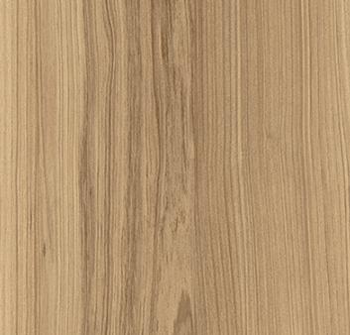
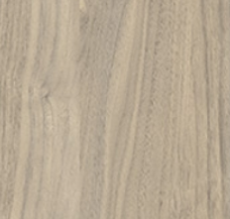
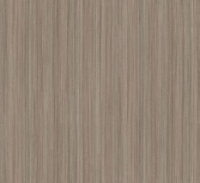
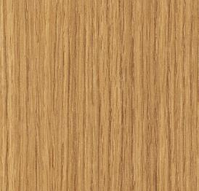
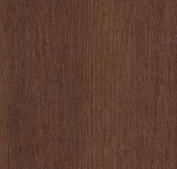
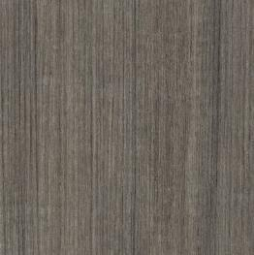
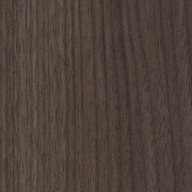
Approach Laminate Offering
Designer White
Loft
Phantom Ecru
Fawn Cypress
Kingswood Walnut
INTERNAL TRAINING
Veranda Teak
Natural Recon
NeoWalnut
Lowell Ash
Florence Walnut
Portico Teak
Skyline Walnut
Flint
Notes:
Matching edges are available for all laminate finishes. Approach features thermally fused (low-pressure) laminate which offers the same functionality and scratch resistance as high-pressure laminate.

Slide 6
Approach Pull Paint Colors
Bar Pull
Square Pull (Q4 2020)
Halo & Beam Pulls (Q1 2021)
Arch Pull
Designer White
Designer White
Loft
Designer White
Silver
Silver
INTERNAL TRAINING
Silver
Silver
Pyrite
Pyrite
Matte Black
Black
Flint
Matte Black
Notes:
The square pull colors have expanded (adding Loft, Pyrite, and Flint) and will be available Q4 2020. New halo and beam pulls will be available early 2021.

Slide 7
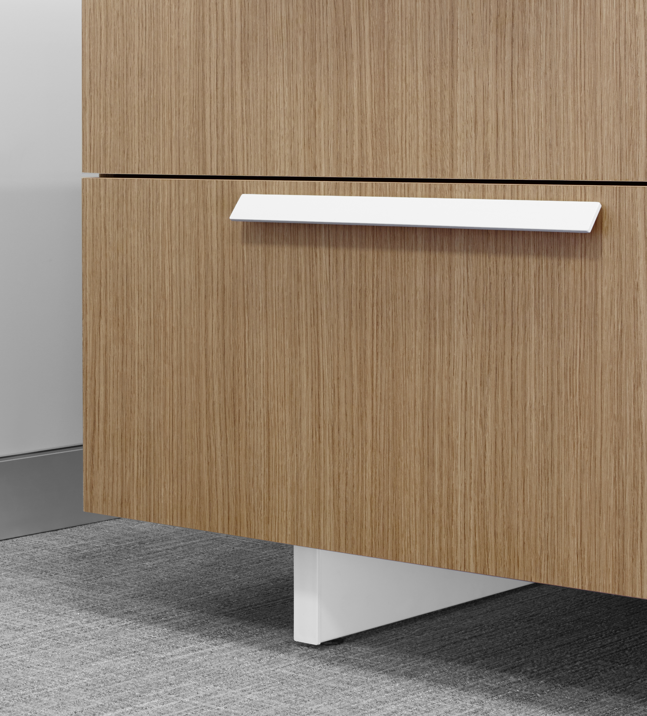
Approach Storage Feet Paint Colors
Current Blade Foot
New Post Foot
Designer White
Silver
Designer White
Loft
Silver
Pyrite
INTERNAL TRAINING
Black
Flint
Matte Black
Notes:
Post foot provides a lighter-scale look for off-the-floor storage.

Slide 8
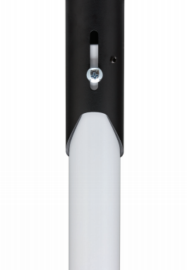
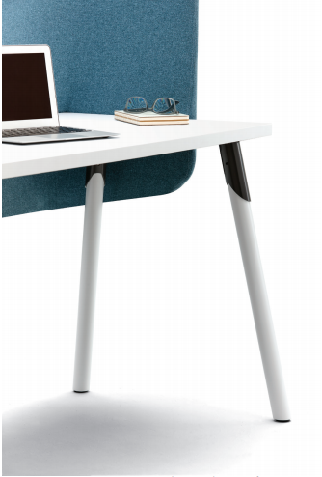
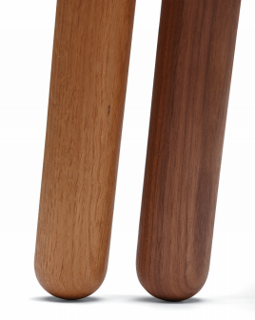
Splay Legs
Two new leg styles offer design options
Metal
Shroud and leg available in all standard Allsteel paint colors
Floor-protection glide on bottom of leg
Screw adjustment in shroud
Wood (Q4 2020)
Available in Natural Oak and Walnut
Rounded leg bottom
Screw adjustment in shroud
INTERNAL TRAINING
Notes:
The height adjustment within the shroud makes it easy to adjust legs to floor conditions. The glide on metal legs is meant to protect the leg and floor and is not meant for leveling the worksurface or table.
Splay legs can also be used to create freestanding tables that can be positioned within the workstation or in a collaborative area.

Slide 9
Customers to Target with Approach
I want to know the furniture investment I’m making is smart and that I’m getting the most for my money.
I want furniture with clean, simple lines that won’t date itself.
I know I want laminate furniture because of durability.
INTERNAL TRAINING
I want a furniture solution that works in the private office and open plan for a consistent aesthetic and so I can easily manage moves, adds, and changes.
I’m pressed on my timeline, and I need furniture fast.
I know I want to go with this layout design, but I want to be certain it can change over time with business needs.
I want choices in applications to fit our workstyles.
Notes:
One of the most compelling advantages for Approach is the ability for the customer to use the same product in the private office and open plan:
By working with one brand and utilizing one product platform, specification and ordering is easier
Long-term inventory management is simplified
The furniture aesthetic is consistent across the floorplan

Slide 10
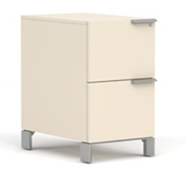
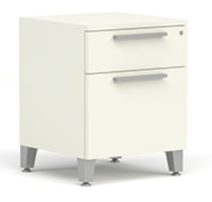
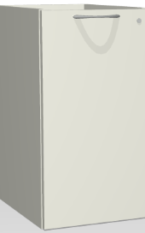
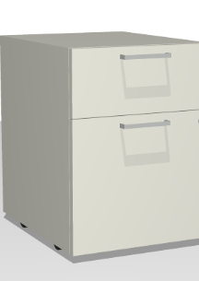
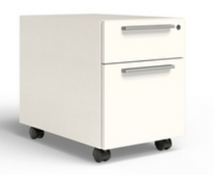
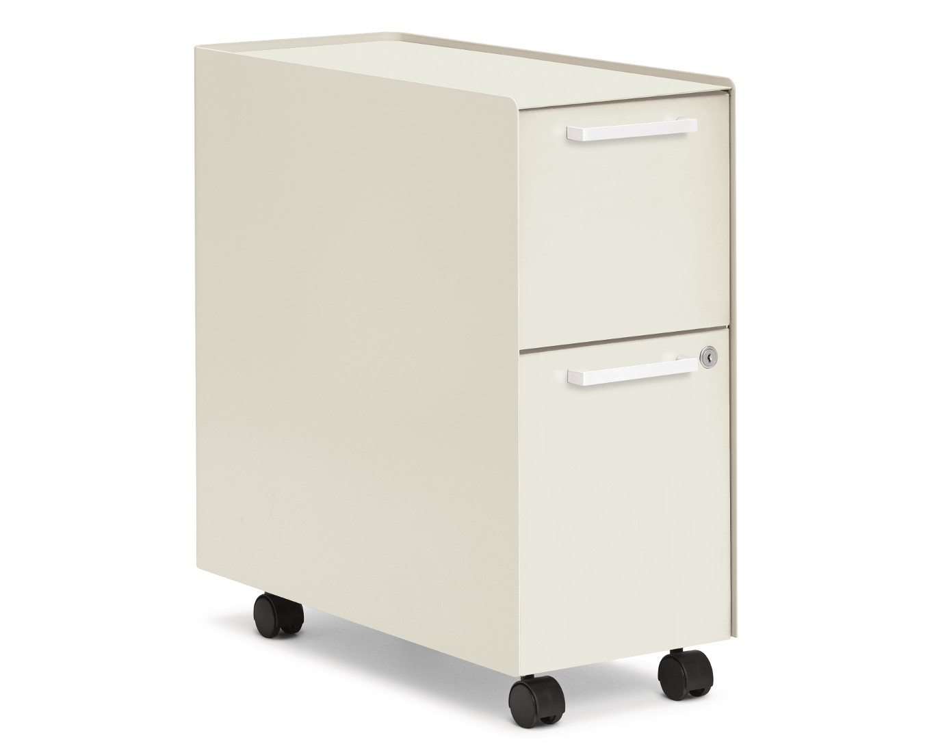
Allsteel Storage Positioning
Everyday Advantage Discount
HIGHEST Available Net
LOWEST Available Net
INTERNAL TRAINING
Pricing based on 2019 data
Notes:
Note: Imagery is for illustrative purposes only and is not representative of the pedestals being compared. This information is provided to show where Approach falls in price within the full Allsteel storage offering.

Slide 11
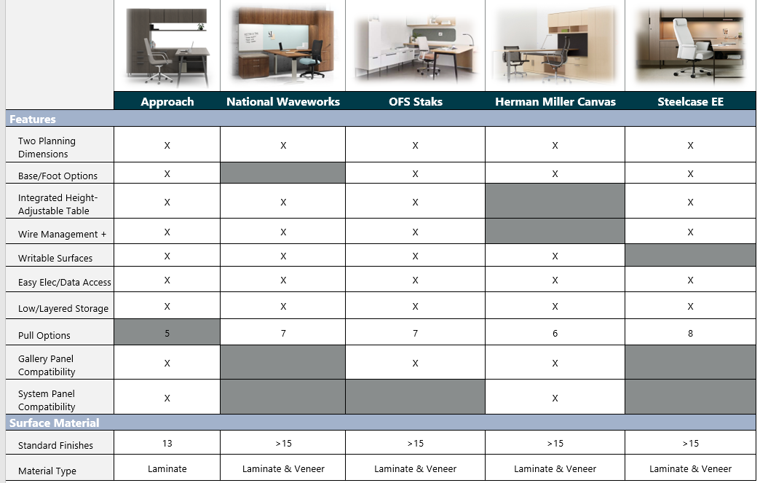
Competitive Talking Points
INTERNAL TRAINING
Notes:
There are several competitive products within this category, and all are high-quality platforms that perform well. Note the number of competitors, however, whose products will not work in the open plan.

Slide 12
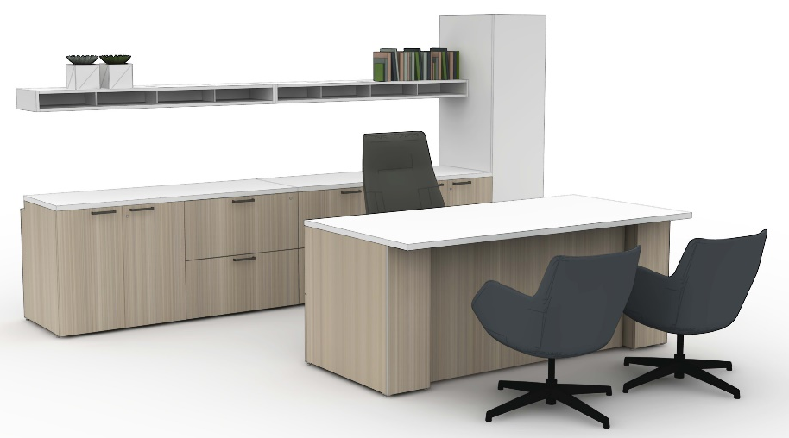
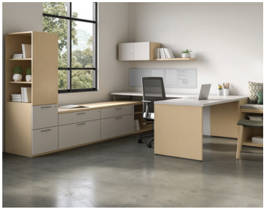
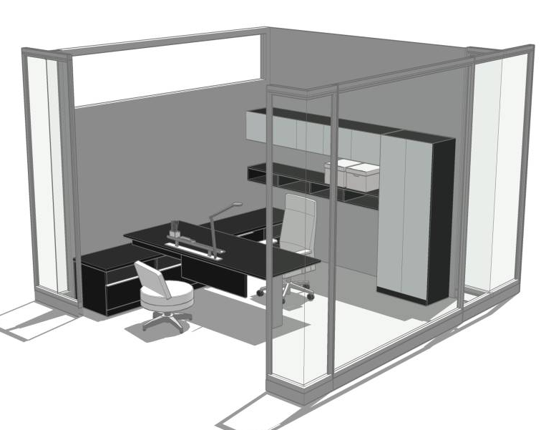
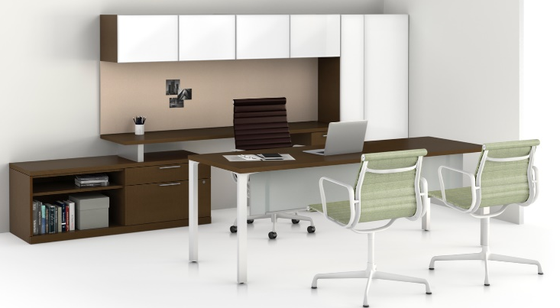
GSA Discount
Approach | 74.00%
HM Canvas | 74.80%
National Waveworks | 61.00%
OFS Staks | 60.00%
SC Elective Elements | 69.27%
Approach vs. Key Competitors
Pricing based on 2020 data
INTERNAL TRAINING
Notes:
Note: Imagery is for illustrative purposes only and is not representative of the typical being compared across multiple brands. Height-adjustable tables and seating/non-casegoods products are not included in the prices shown.

Slide 13
GSA Discount
Approach | 74.00%
HM Canvas | 74.80%
National Waveworks | 61.00%
OFS Staks | 60.00%
SC Elective Elements | 69.27%
Approach vs. Key Competitors
Pricing based on 2020 data
INTERNAL TRAINING
Pricing based on 2020 data
Notes:
Note: Imagery is for illustrative purposes only and is not representative of the typical being compared across multiple brands. Height-adjustable tables and seating/non-casegoods products are not included in the prices shown.
.

Slide 14
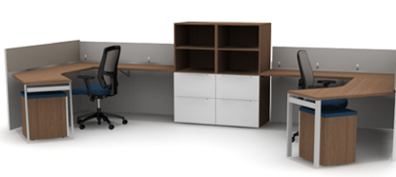
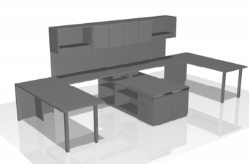
GSA Discount
Approach | 74.00%
HM Canvas | 74.80%
National Waveworks | 61.00%
OFS Staks | 60.00%
SC Elective Elements | 69.27%
Approach vs. Key Competitors
Pricing based on 2020 data
INTERNAL TRAINING
Notes:
Note: Imagery is for illustrative purposes only and is not representative of the typical being compared across multiple brands. Height-adjustable tables and seating/non-casegoods products are not included in the prices shown.

Slide 15
Launch Timing
OPEN FOR ORDERS July 2020
Allsteel Communications August 2020
Brochure August 2020
First Ship August 2020
Allsteel University Integration August 2020
Showroom Integration Q3 2020
Price List & Spec Guide (Online) August 2020
20/20 & Symbols Publication June 2020
Questions?
Product related, Heather Evans: evansh@allsteeloffice.com
Marketing related, Brian Parrott: parrottb@allsteeloffice.com
INTERNAL TRAINING
Notes:
All new Approach products are open for order early August except for the wood splay legs, which are available Q4 2020.

Slide 16
How to Order
First Order Entry: July 2020
Lead Time: 3-4 Weeks
Pricing:
Showroom Discount 80% off
Everyday Advantage 76% off
INTERNAL TRAINING

Slide 17
Frequently Asked Questions
Q: Why is Approach expanding?
A: Allsteel is expanding Approach beyond the private office based on market feedback. We are adding design features and moving the Approach platform into the open plan where it will provide surprising utility and value for any style, footprint, and floorplan.
Q: What are the new Approach enhancements?
A: Enhancements include:
• Unitized desks (shell and w/15"W pedestal)
• Support pedestals
• Wardrobes (L/R, footed and to-the-floor)
• Full line of front- and side-access towers (L/R, footed and to-the-floor)
• No-trough credenzas
• Credenza for integrated height-adjustable tables
• Pull-out towers
• Splay legs
• Storage post foot
• Floating shelf
• Full-height modesty panels
• Hutches and tackboards
• Shortened end cap
INTERNAL TRAINING

Slide 18
Frequently Asked Questions
Q: Are there visual differences between new Approach models and current Approach models?
A: There are a few visual differences:
• New no-trough credenzas have a top-over design and finished backs and current trough credenzas have inset tops and backs
• 30"W towers do not accept feet and have a top-inset design while other towers accept new post feet and have a top-over design
• New combination/side-access towers have touch-latch wardrobe doors
Q: Which Approach storage units have touch-latch doors? Am I able to specify touch-latch doors on all Approach models?
A: Approach towers with doors and drawers have touch latch on doors. Units with only doors or only drawers offer standard pull options.
Q: Which products are designed specifically for open-plan and workstation applications?
A: Credenzas for integrated height-adjustable tables, no-trough credenzas, towers/wardrobes, and pedestals are all applicable for this type of application. See the Approach price list for details on storage products that can be used with Allsteel panel systems.
Q: Will the Involve® panel-to-credenza bracket work with Approach credenzas?
A: Yes. The Involve bracket that allows storage units to support panels or gang credenzas will work with Approach. See the Approach price list for bracket models specific to Approach credenzas with finished backs and inset backs
INTERNAL TRAINING

Slide 19
Frequently Asked Questions
Q: What laminate finishes are available? Are they available on all Approach models?
A: Current standard Approach thermally fused laminates are available on all Approach products. This includes a total of 13 solid and woodgrain laminates with matching edges.
Q: What height-adjustable bases work with the Approach credenza for integrated height-adjustable tables?
A: Two-stage Altitude® A3, A5, and A6 bases (C or T legs) are compatible with this credenza.
Q: Does the Approach credenza for integrated height-adjustable tables have a unique worksurface?
A: Yes. The worksurface has a scalloped top to accept and hide one leg of the height-adjustable table. The configuration option for this application is an open credenza ganged with a file/file credenza to create a unitized credenza.
Q: What height-adjustable bases work with Approach shroud pedestals?
A: Currently, two-stage Altitude A5 C legs are compatible with the shroud. We are redesigning shroud pedestals to accommodate the new Altitude A6 base.
Q: Which Approach storage products require ganging?
A: All towers require additional support and come with ganging screws. The credenza for integrated height-adjustable tables has a bracket to gang the file/file unit to the open unit (open unit has cavity for the table leg) to create a unitized credenza. Standard modular credenzas can be specified with counterweights or ganged for support.
INTERNAL TRAINING

Slide 20
Frequently Asked Questions
Q: Do towers align with panel system and gallery panel heights?
A: Yes. Footed and to-the-floor towers align with both system panels and gallery panels.
Q: When will splay legs be available?
A: Metal splay legs are available at launch and wood splay legs are available Q4 2020. Wood splay legs come in natural walnut and oak and metal splay legs are offered in all Allsteel standard paint colors.
Q: Do splay legs leave enough room for an Altitude A8 screen?
A: Yes. A worksurface can accommodate both an Altitude screen and splay legs by positioning the legs deeper into the worksurface.
Q: Are full-height modesty panels intended for runoff applications?
A: No. Full-height modesty panels are designed to allow modular building of shell desks and must be placed between two end panels.
Q: I was awarded XYZ% discount on Approach for a project. Does that discount apply to new Approach models that might be added to the project?
A: Yes. New models are set up in the same product series, so all discounts apply.
INTERNAL TRAINING

Slide 21
Frequently Asked Questions
Q: Are there extended lead times for new Approach models?
A: No. Standard lead times apply to all Approach products.
Q: Can I request specials on the new Approach models?
A: Current Approach models are available as specials, but new models are not available as specials until late October 2020.
INTERNAL TRAINING

Slide 22
INTERNAL TRAINING
Notes:
A classic storage workwall with adjoining worksurface makes the most of the compact private office.

Slide 23
INTERNAL TRAINING
Notes:
A contemporary private office features a height-adjustable workwall and floating shelves.

Slide 24
INTERNAL TRAINING
Notes:
Towers and pedestals provide ample storage while defining individual workspace in a shared application.

Slide 25
INTERNAL TRAINING
Notes:
Sit-to-stand worksurfaces provide user adjustability while glass and screens offer protection and privacy.

Slide 26
INTERNAL TRAINING
Notes:
Worksurfaces supported by splay legs layer over credenzas that feature multiple storage options.

Slide 27
INTERNAL TRAINING
Notes:
Private workstations defined by gallery panels utilize versatile pull-out towers for efficient vertical storage.

