Slide 1
Sales & Dealer Training
INTERNAL USE ONLY

Slide 2
Gallery Panels Enhancements
Designed By IDA Design
Market Launch: September 2020

Slide 3
Agenda
Product Story
Review Current SOL
Coming Soon
Imagery

Slide 4
What is the Need?
Panels that divide space while softening the aesthetic
An alternative solution to traditional panel walls when integrated power isn’t needed​.
Full enclosure above and below the worksurface
The ability to integrate a mix of cleanable materials, including wood and glass

Slide 5
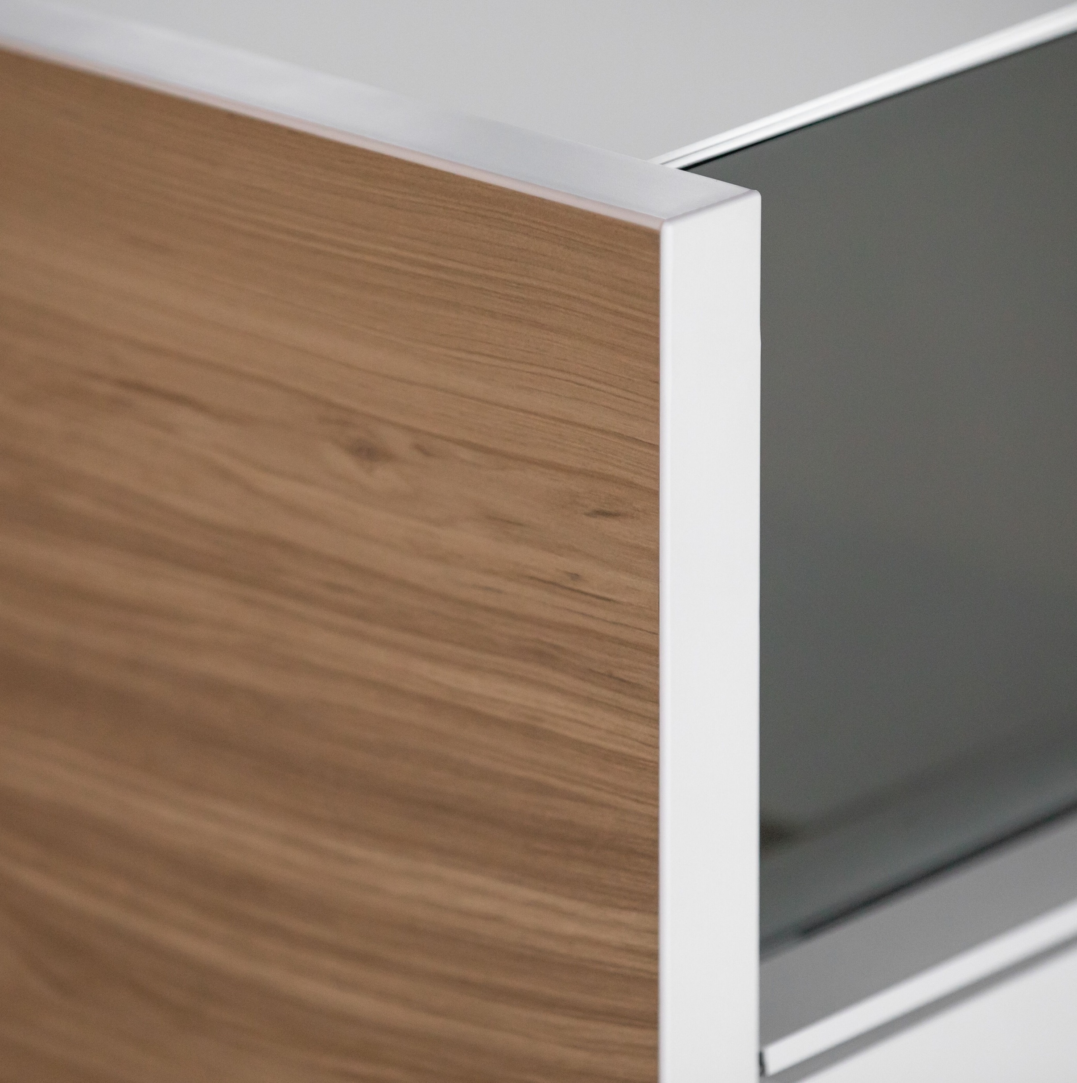
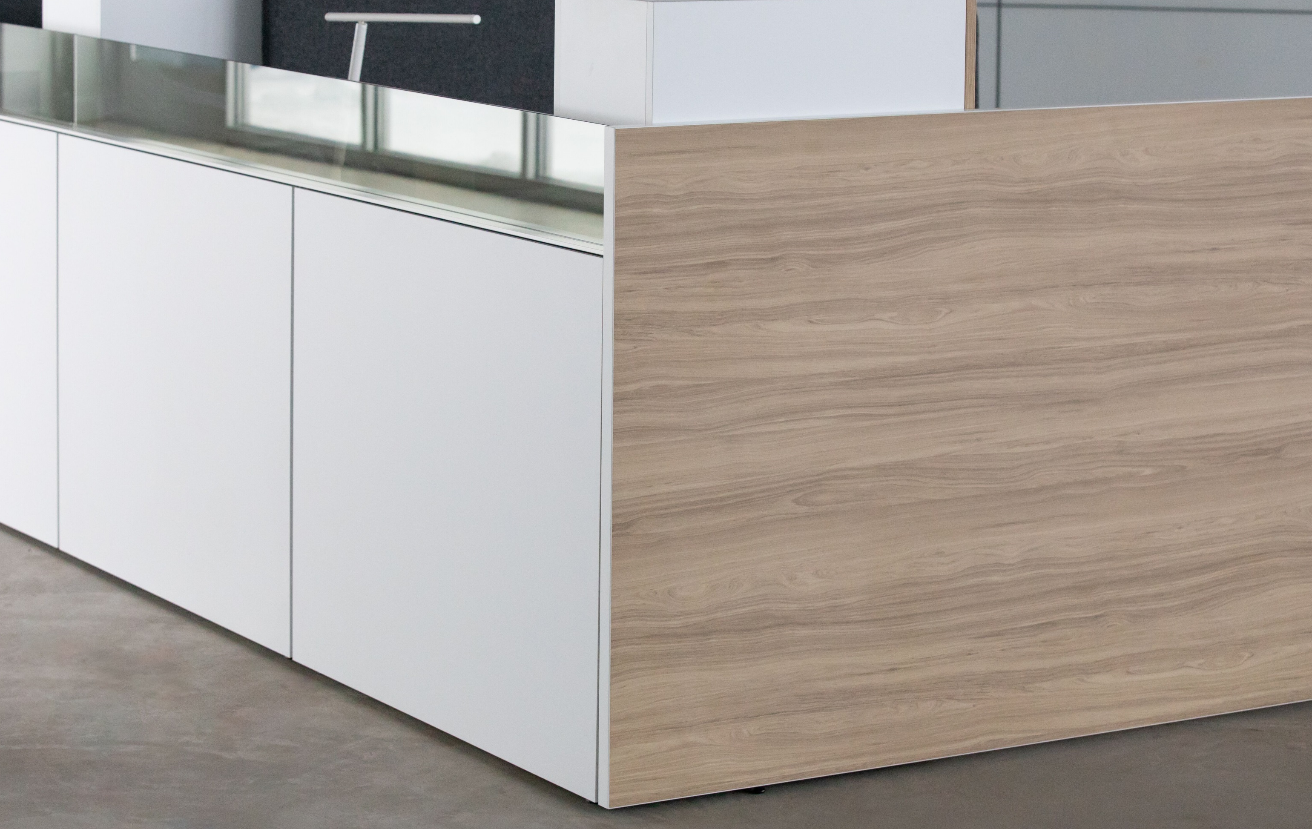
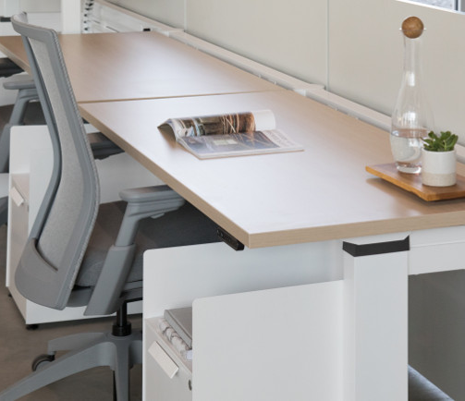
Gallery Panels
PRIVACY
AESTHETIC & MATERIALS
VERSATILITY
Standard 4-5 Week Lead Times

Slide 6
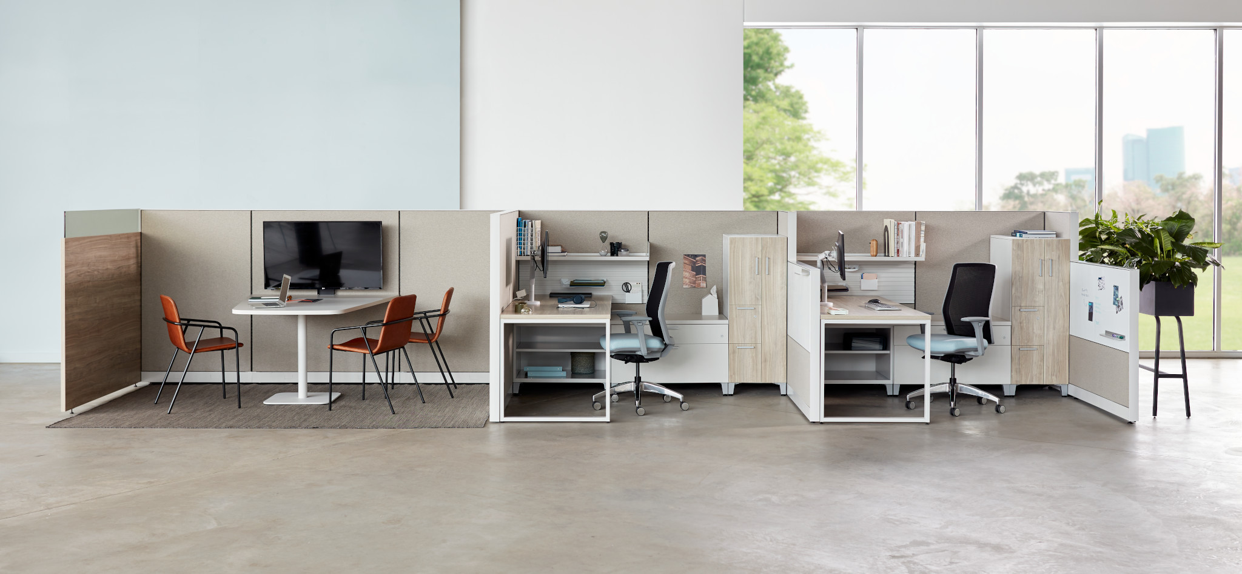
Cost-Effective Privacy Solution
10%-20%
*avg compared to panel w/fabric tiles
40%-55%
*avg compared to panel with laminate tiles
30%-40%
Increased savings when 1 gallery panel replaces 2 traditional fabric panels
Notes:
Increased savings when 1 gallery panel replaces 2 traditional panels – 30-40%
Value engineer option

Slide 7
Versatility
Gallery panels work with various Allsteel systems platforms and benching products.
Same gallery panels regardless of the base product makes it easy to add to or change in the future while maintaining visual consistency
Organic or linear layouts in panel-based or benching applications

Slide 8
Current Statement of Line

Slide 9
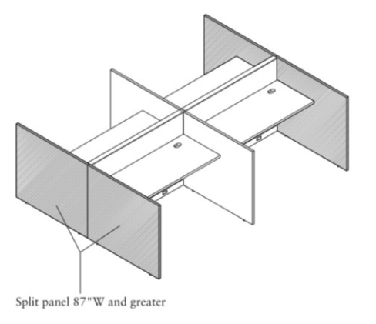
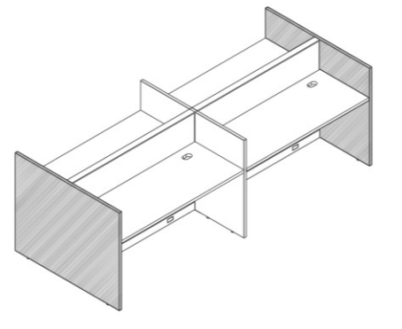
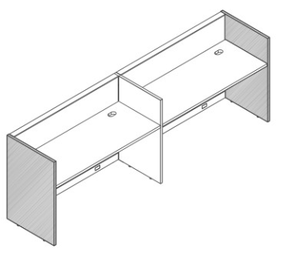
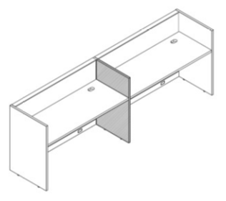
Statement of Line – Stride and Terrace
End Panel (Dual-Sided)
End Panel (Single-Sided)
Mid Panel
*Split End of Run
*Stride Only. Terrace coming in September 2020
Notes:
Same model numbers for the panels themselves, separate connection kits for each application
Each application has separate models that can incorporate glass

Slide 10
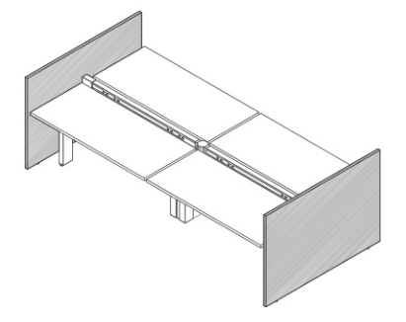
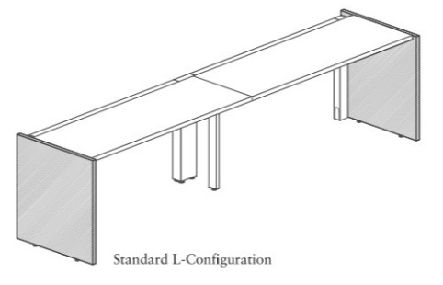
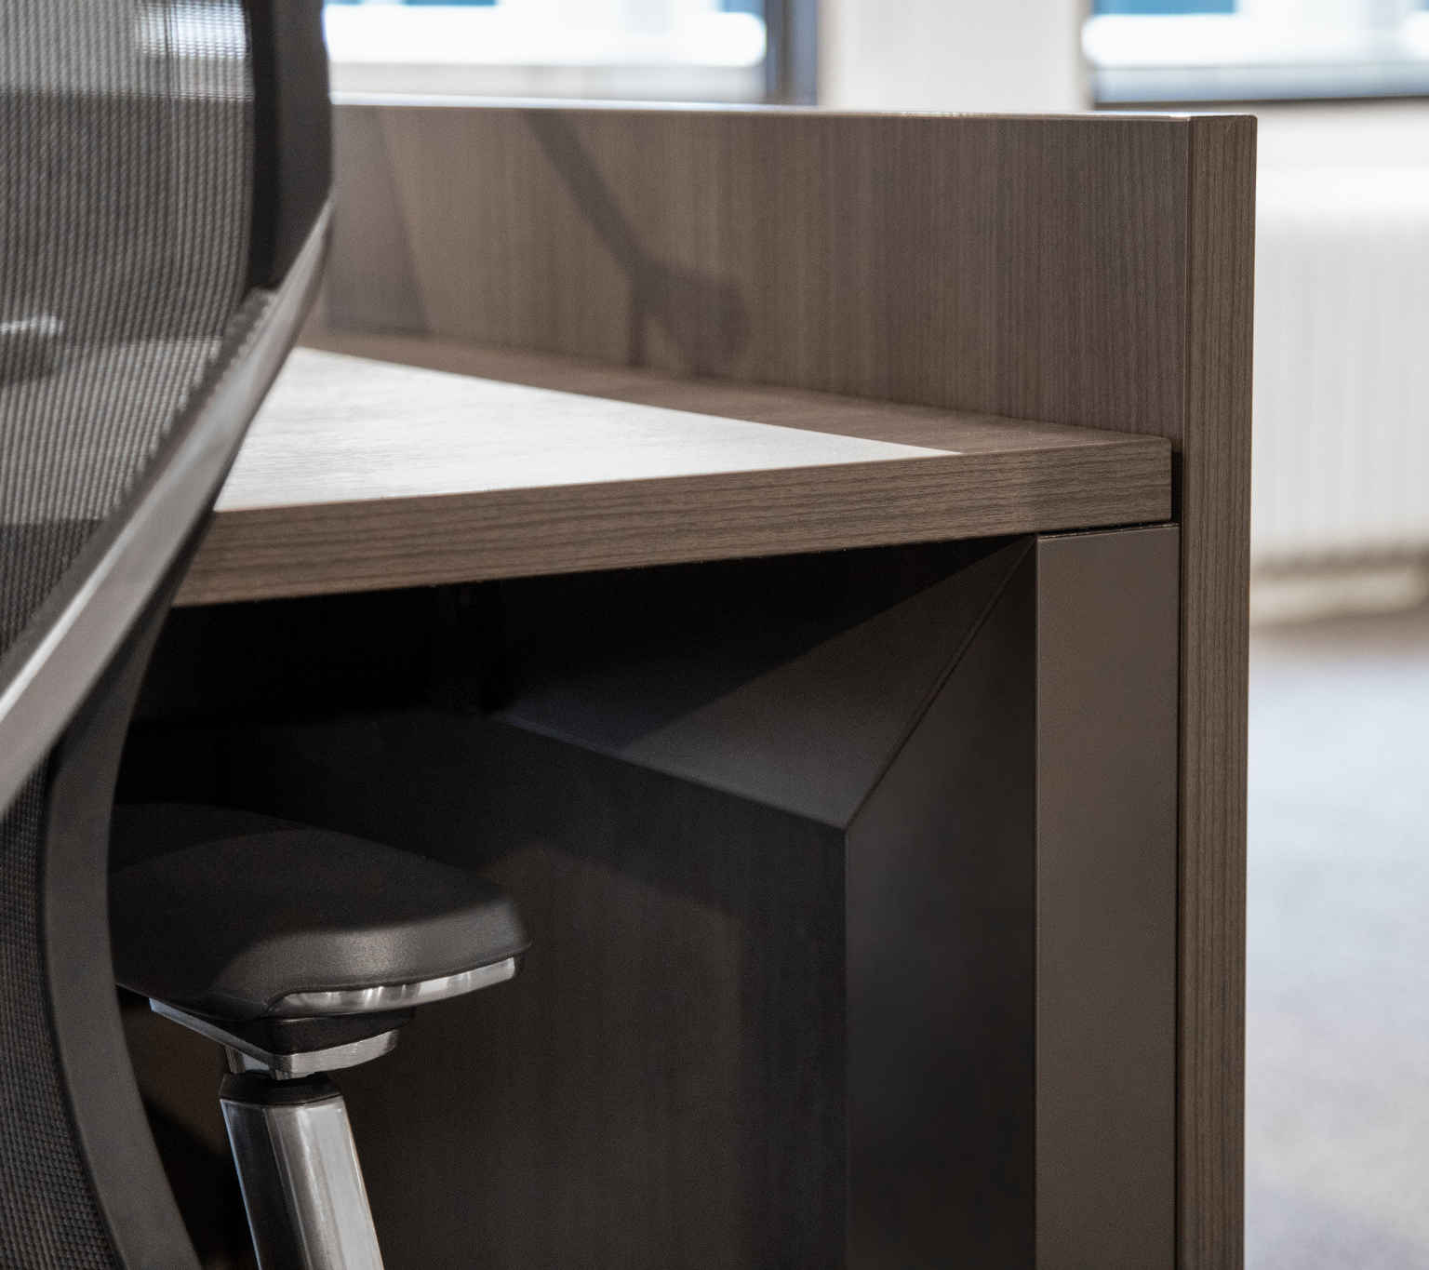
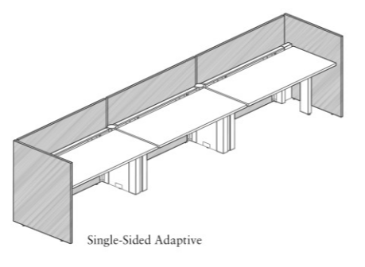
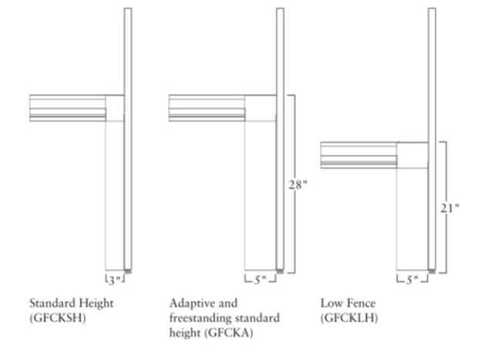
Statement of Line – Benching (Further & Stride)
End Panel (Dual-Sided)
End Panel (Single-Sided)
Further Single-Sided Adaptive ONLY
Further Standard, Adaptive, and Freestanding connectors
Notes:
Same model numbers for the panels themselves, separate connection kits for each application
Each application has separate models that can incorporate glass

Slide 11
Coming Soon!
September 2020

Slide 12
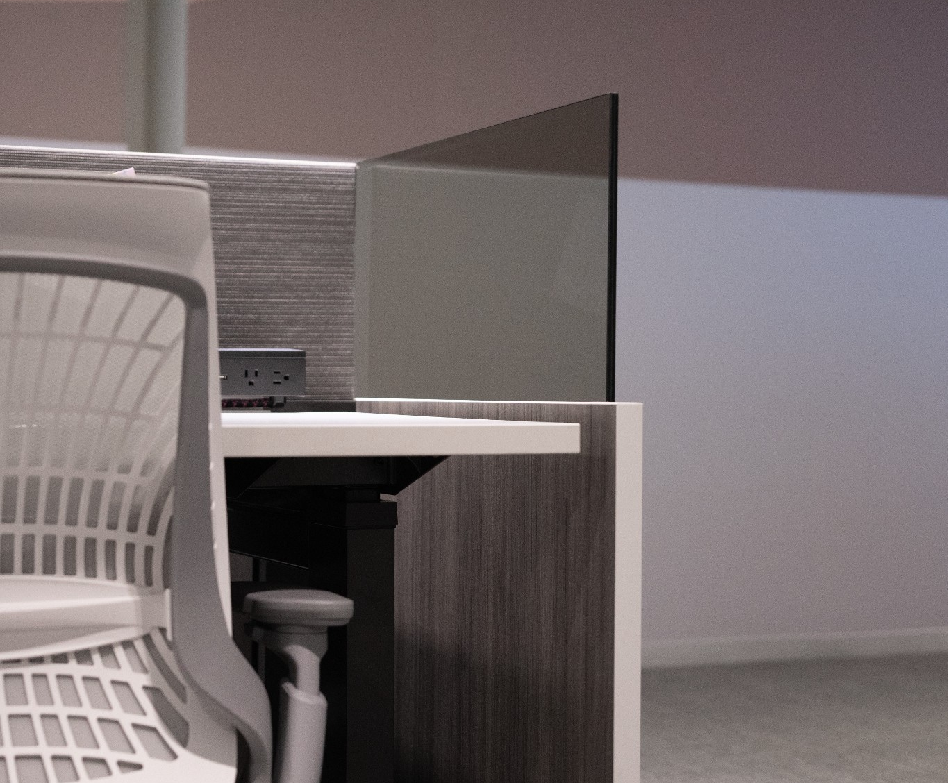
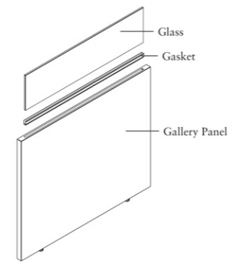
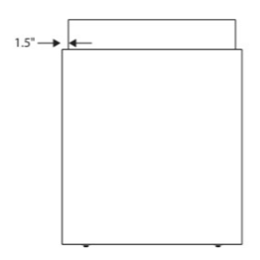
13”H & 15”H Integrated Glass
Height aligns with Allsteel Benching and Panel Systems glass
New glass models, same installation and finish as existing 7.5H glass

Slide 13
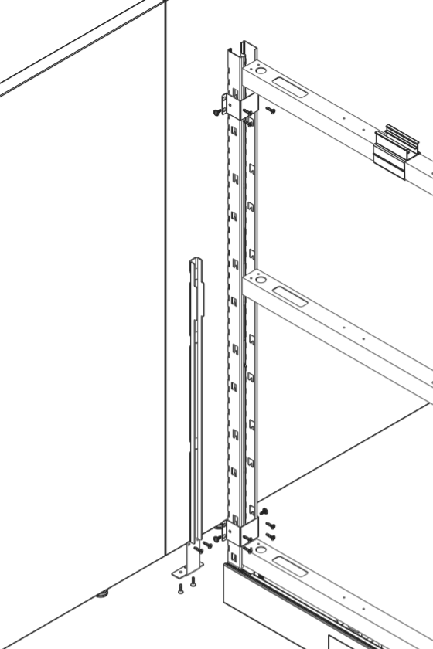
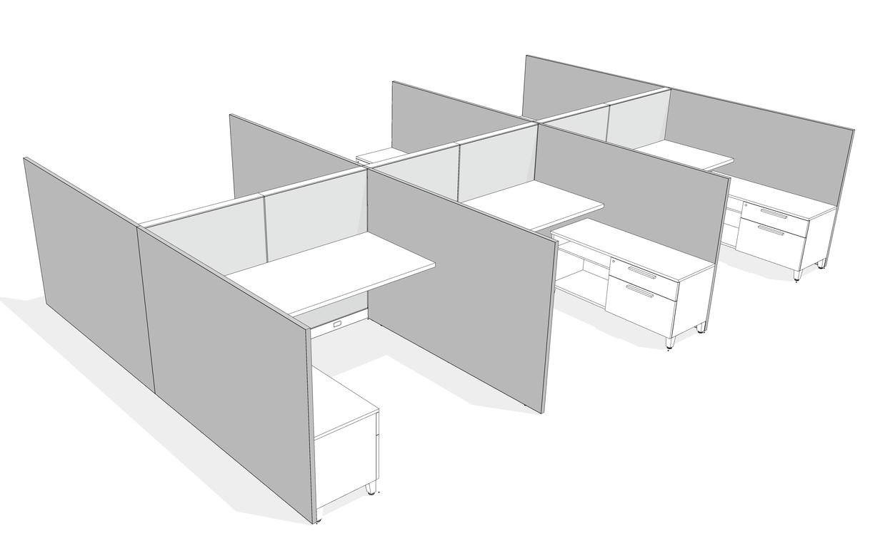
Terrace Split-T
Brackets mount over frame vertical.
Standard bracket leveraged on both single and split panels.
New connector kit to connect Split Panels to Terrace end of run
Order existing Split Panel models (available on Stride)
Notes:
Always black

Slide 14
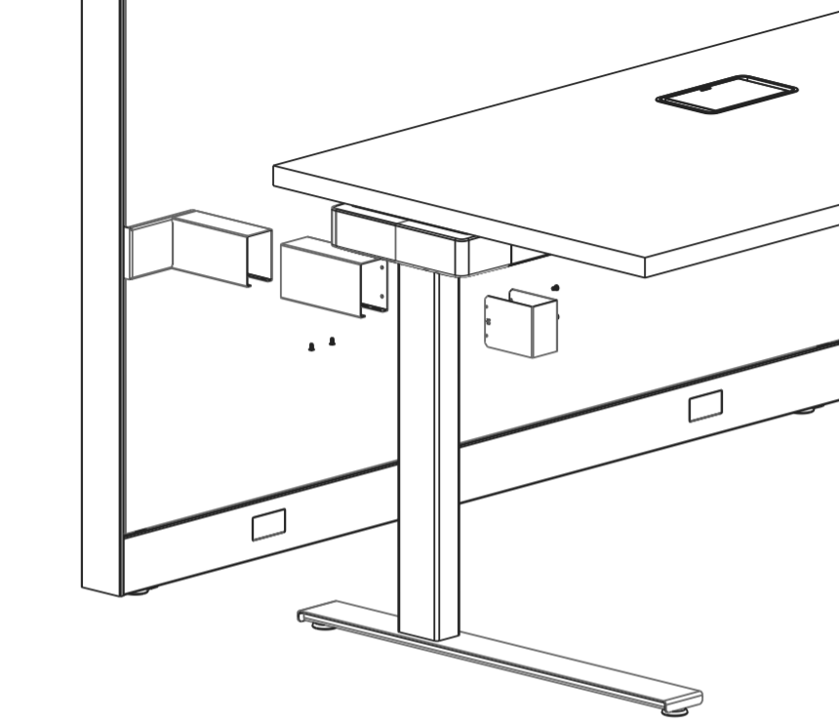
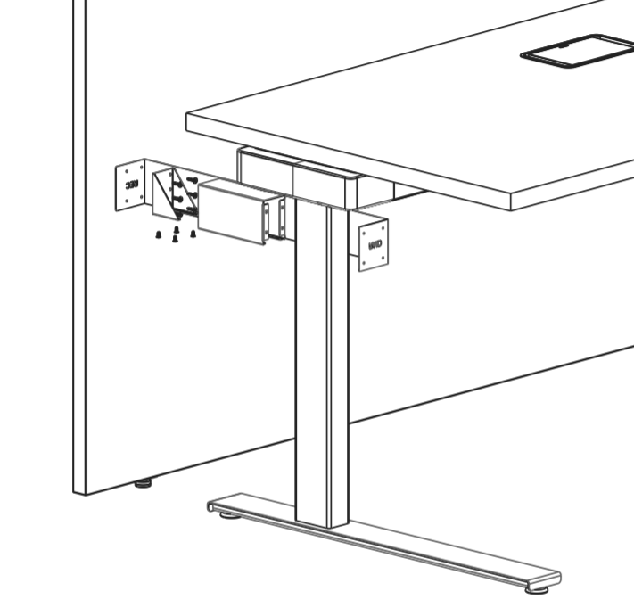
HAT to Panel Rigidity Brackets
HAT to Panel Bracket
Bracket mounts into slotted standard.
Inner and outer shroud telescope to accommodate screens/varying worksurface depths.
HAT to Gallery Panel Bracket
Template squares off against leg and gallery panel to set pilot hole locations.
Mounting bracket screws to gallery panel via pilot holes.
Provides rigidity for long, unsupported wing panels (Does NOT replace stability requirements)
Day 2 installation capability
Models dependent upon type of HAT leg, attachment to slotted standard or Gallery Panel
Handed per the user’s orientation (GP models not handed)
HAT to Gallery Panel template MUST be ordered

Slide 15
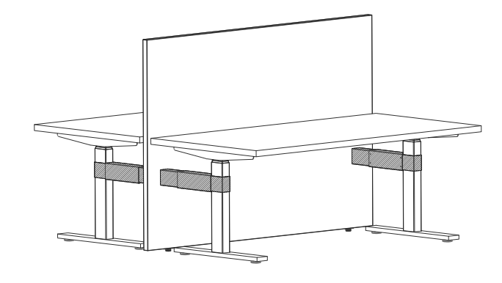
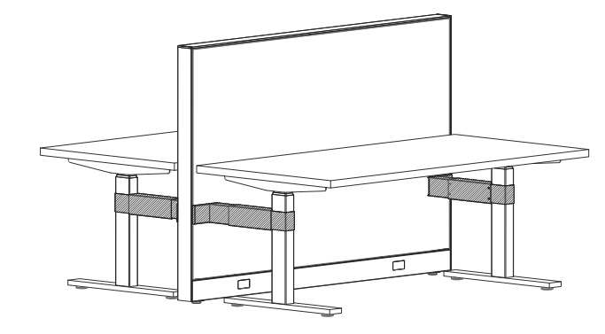
HAT to Panel Rigidity Brackets

Slide 16
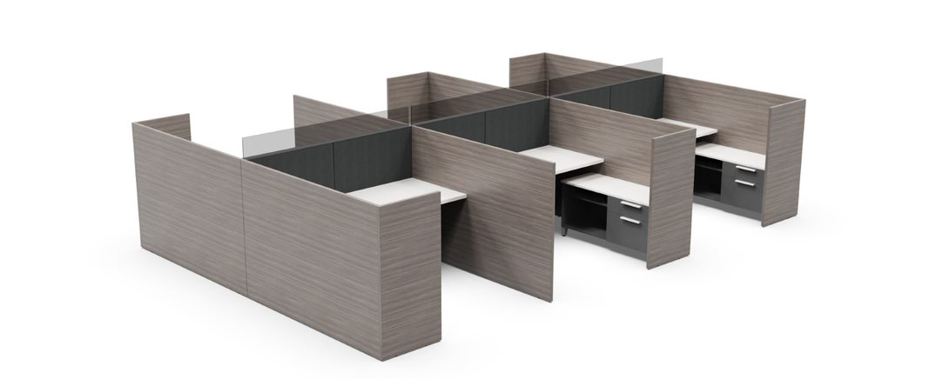
Gallery-to-Gallery Panels
L-, T-, and Non-Symmetrical T- options
Ability for Gallery-to-Gallery panels to be at lower or equal heights
Day 2 installation capability
New freestanding applications

Slide 17
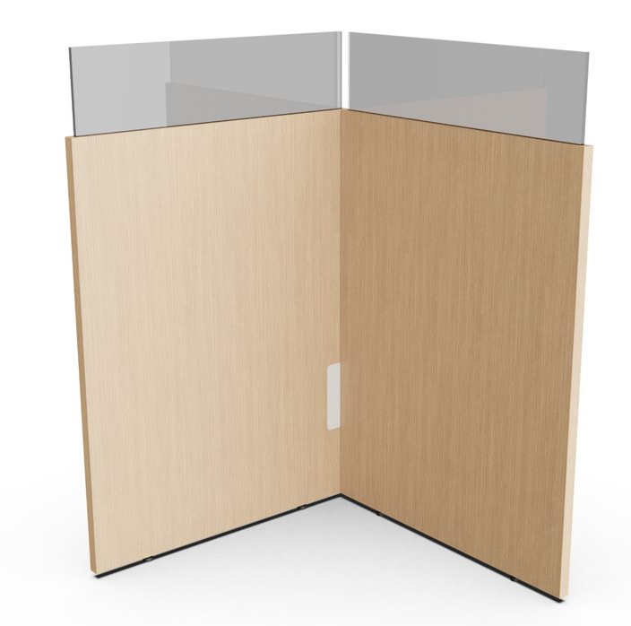
Gallery-to-Gallery Panels
NEW
Existing
Interior face has an inset flat bracket with painted metal cover
Exterior face is clean
Installation template MUST be ordered to connect gallery panels
New freestanding applications can be created with existing panels and new Gallery-to-Gallery panels
Stability guidelines must be met (see spec guide)

Slide 18
Gallery-to-Gallery Panels
Template Tool
Day 2 installation
Height Variability
Reduces Specification Complexity
Backwards Compatibility
Additional Details
Oversized by 1-1/8” to maintain interior modularity (caps over standard Gallery Panel)
Glass is specified at the same width as the panel, not 3” less like existing models
Glass is inset from the side edges by ½”
Must be of equal or lower height than the standard gallery panels
Gallery-to-Gallery panel widths are available in 3” increments from 18W to 30W and in 6” increments from 30W to 78W
Hardware Pocket
Hardware will ship within
a pocket in each panel to improve install experience.
Return Panel
Future L&T Panels include glass and nonsymmetric T variations.
Parent Panel
Return panels may attach to any standard Universal Gallery Panel or to outer end of Return Panels.
Installation template (GTEMP) MUST be ordered to connect gallery panels

Slide 19
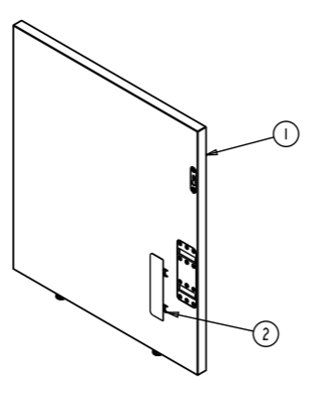
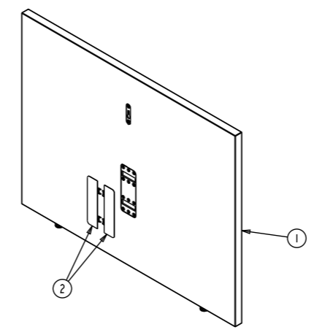
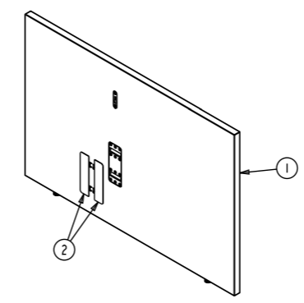
Statement of Line
L- Panel
Left and Right-handed
30”, 35”, 42”, 50”, 57.5” H
18”W-30”W every 3 inches
30”W-78”W every 6 inches
T- Panel
30”, 35”, 42”, 50”, 57.5” H
18”W-30”W every 3 inches
30”W-78”W every 6 inches
Nonsymmetric T- Panel
Left and Right-handed
30”, 35”, 42”, 50”, 57.5” H
42”, 48”, 54”W
(18”, 24”, and 30” on either side)

Slide 20
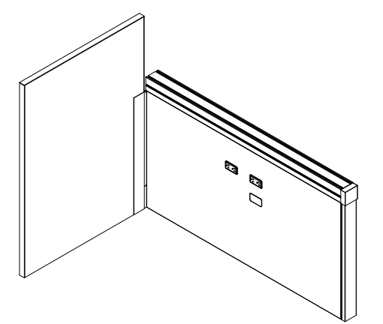
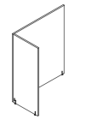
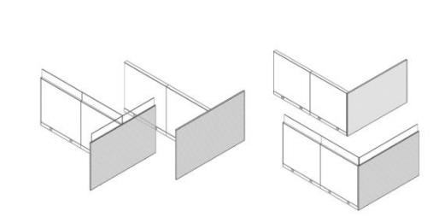
Gallery Panel Competitive Talking Points
Steelcase Boundary Screens | Knoll Antenna
Broad range of applications Primarily made for Answer panel system Cannot integrate glass or screens on top Limited leveling glide adjustment up to 1½" Uneven floors can cause challenges in lining up with an adjacent system Handed panels with visible fasteners | Limited range of applications Separate models for Canvas Dock vs. Renew/Nevi Link solutions Limited leveling glide adjustment up to 2" for Canvas and ½" for Renew/Nevi gallery panels Uneven floors can cause challenges in lining up with an adjacent system Hidden fasteners Offers up to 144"W in split panels
Allsteel Gallery Panels
Broad range of applications (L-, T-, and Nonsymmetrical T-) Can be installed Day 2 Offers seamlessly integrated glass in smoked, clear, and frosted options Levels up to 2½" to accommodate uneven floors and line up with systems Available in freestanding applications in a variety of shapes and sizing
INTERNAL TRAINING

Slide 21
Competitive Offering
INTERNAL TRAINING
-15%
-6%
-20%
-30%
-34%

Slide 22
Launch Timing
OPEN FOR ORDERS September 2020
Allsteel Communications August 2020
Brochure N/A
Allsteel University Integration In Progress
Showroom Integration In Progress
Price List & Spec Guide (Online) August 2020
20/20 & Symbols Publication Complete/August for CET
Questions?
Product related, Carly Hewitt: hewittc@allsteeloffice.com
Marketing related, Peter Barton: bartonp@allsteeloffice.com
INTERNAL TRAINING

Slide 23
How to Order
First Order Entry: September 2020
Lead Time: 4-5 weeks
Pricing:
Standard Terms 60% off
Showroom Discount 80% off
A&D Own Use Program 75% off
Everyday Advantage 72% off
BIFMA Certified
GSA Schedule Pending
Sustainability Level 3, Indoor Advantage Gold
INTERNAL TRAINING

Slide 24
Frequently Asked Questions
Q Can we use Split-T Gallery Panels at the end of a run on Terrace?
A Yes, we now have a connector kit that allows Split Gallery Panels to be used on Terrace end-of-run applications.
Q What heights of integrated glass are available on Gallery Panels?
A 7.5”, 13”, and 15”H glass models are now available.
Q What glass finishes are available for the integrated glass option?
A Standard glass options include clear, frosted, and smoked.
Q What is the difference between Standard Gallery panels and the new Gallery-to-Gallery panels?
A Standard Gallery panels attach to Frame & Tile or Benching systems as an Intermediate or End of Run application. Dimensions align with standard panel heights and widths, and integrated glass must be specified 3” narrower than the panel. Gallery-to-Gallery panels connect ONLY to Standard Gallery Panels in an L-, T-, or Nonsymmetrical T- condition. These panels cap over the Standard Gallery panel and are 1-1/8” wider than Standard Gallery panels to maintain true interior dimensions. Integrated glass must be specified at the same width as the panel.
INTERNAL TRAINING

Slide 25
Frequently Asked Questions
Q Can these new Gallery-to-Gallery panels be taller than the panels they attach to?
A No. Gallery-to-Gallery panels can be the same height or shorter than the panels they connect to. If taller panels are needed, contact TPG for a custom solution.
Q What are the new Gallery-to-Gallery panel heights and widths?
A Available heights are 30", 42", 50", and 57". Gallery-to-Gallery panel widths are available in 3” increments from 18W to 30W and in 6” increments from 30W to 78W. True widths are 1-1/8” longer than the stated width, to maintain modular interior dimensions.
Q What connection options are available for these new panels?
A Gallery-to-Gallery panels can ONLY be attached to Standard Gallery Panels.
Q Are the connectors visible?
A Standard Gallery panels attach to Frame & Tile and Benching platforms with hidden fasteners. Gallery-to-Gallery panels mount to Standard Gallery panels using an inset flat bracket that is hidden with a painted metal cover. This cover is only visible on the inside of the panel connection.
INTERNAL TRAINING

Slide 26
Frequently Asked Questions
Q Do separate connectors need to be ordered to connect Gallery-to-Gallery panels to Standard Gallery panels?
A No, the connection hardware is integrated into the Gallery-to-Gallery panel and ships with the panel model. However, the installation template GTEMP must be ordered and is required to install. These templates can be kept and reused.
Q Can Gallery Panels be used freestanding?
A Yes, connecting Standard Gallery Panels and Gallery-to-Gallery panels can create freestanding applications. See spec guide for stability requirements.
Q Are all Allsteel standard laminates and edge bands available on Gallery Panels?
A All system standard laminates and edge bands are available on Gallery Panels. Velvet laminates are not an option on Gallery Panels.
Q What is the direction of the woodgrain for woodgrain laminates?
A Both horizontal and vertical woodgrain laminate are options. Horizontal woodgrain direction is available on all Gallery Panel sizes. Vertical woodgrain direction is available on Gallery Panels up to 60" wide. Some restrictions may apply for certain woodgrain laminates. Please see price lists for complete information.
INTERNAL TRAINING

Slide 27
Frequently Asked Questions
Q Can you specify one laminate on one side of the gallery panel and another laminate on the other side?
A No. The same laminate must be applied on both sides of the gallery panel.
Q Is veneer an available option for gallery panels?
A Veneer currently is not a standard option but is available as a special through TPG.
Q Can gallery panels be leveled?
A Yes. Gallery panels come standard with two leveling glides per panel, with a maximum adjustment range of 2½" per leveling glide.
Q What are the anticipated concerns?
A With natural wood, the gallery panels have tendency to react to humidity and local climate therefore may bow over time. This is a normal process for wood components.
INTERNAL TRAINING

Slide 28
Application Images

Slide 32
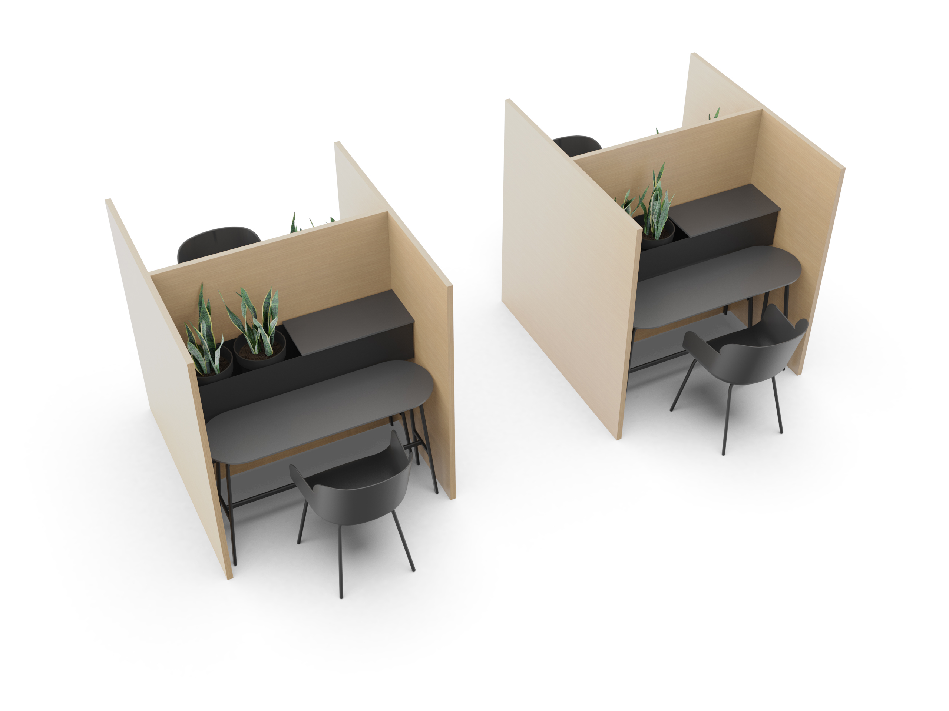

Slide 33
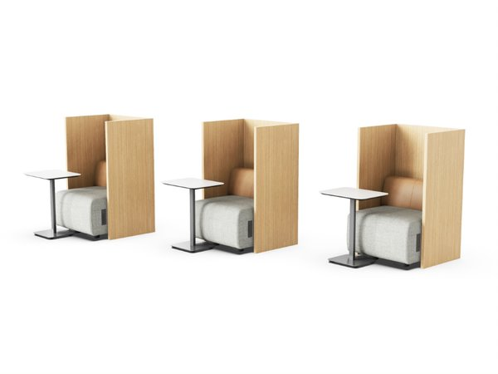
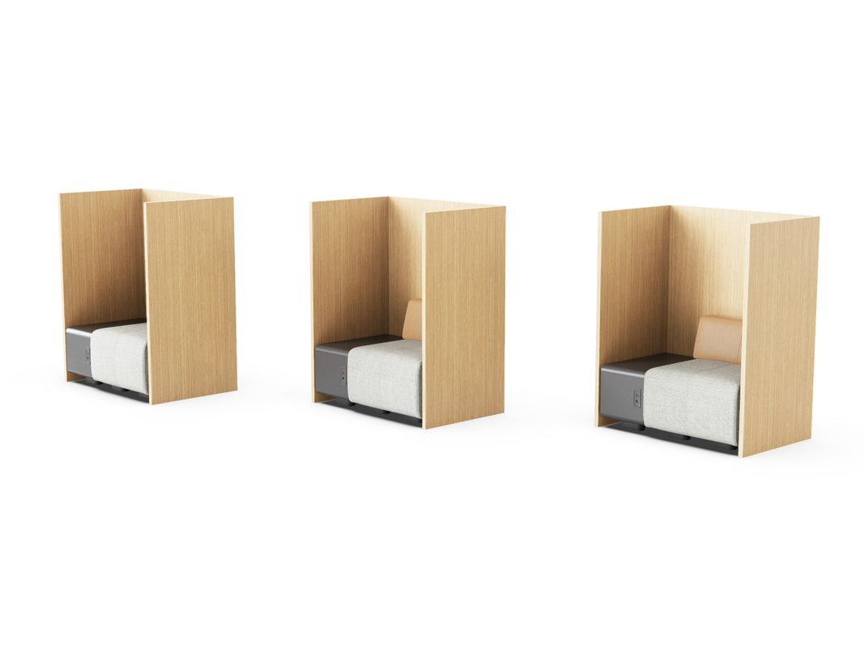

Slide 34
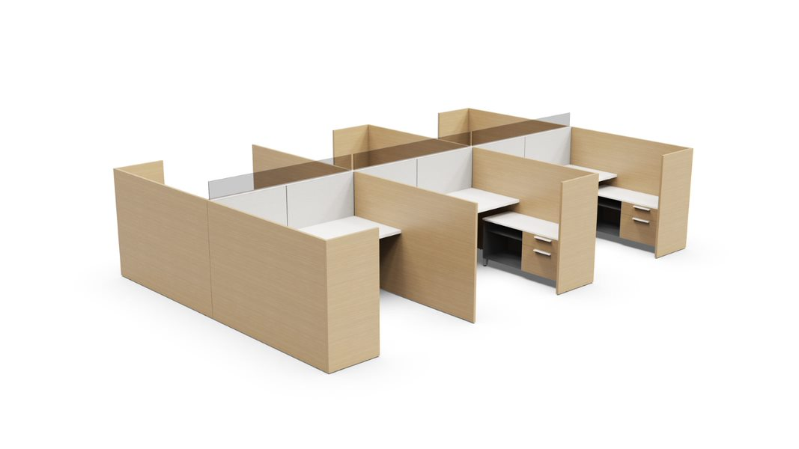

Slide 35
