Slide 1
Sales & Dealer Training
INTERNAL USE ONLY

Slide 2
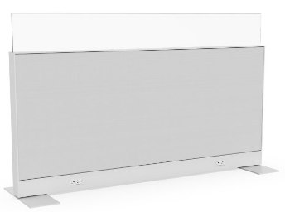
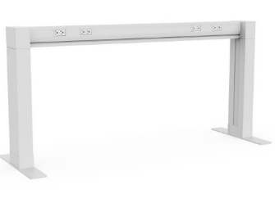
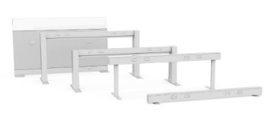
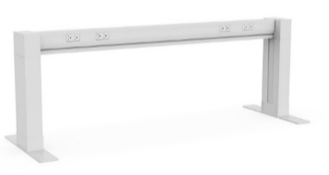
Allsteel Freestanding Power Offering
 | LOW RAIL | RAISED RAIL | FURTHER BEAM 20-1/2H | FURTHER BEAM 28H | PANEL FENCE
HEIGHTS | 5”H | 20-1/2”H | 20-1/2”H | 28”H | 30”H
WIDTHS | 48”W-72”W | 48”W-72”W | 36”W-96”W | 36”W-96”W | 24”W-60”W
CONFIGURATIONS | Linear, L-, T-, X- | Linear, L-, T-, X- | Linear, L-, T-, X-, 120 | Linear, L-, T-, X-, 120 | Linear, L-, T-, X-, 120
SCREENS | NO | YES | YES | YES | YES
POWER POLE | YES | YES | YES | YES | YES
SUPPORTS SURFACE | NO | NO | NO | YES | YES
PRICE SCALE
INTERNAL TRAINING
$
$$$
Notes:
This view illustrates the comprehensive power offerings for Allsteel.
The illustration is laid out, left to right, from the most cost-effective to the least cost-effective power options.

Slide 3
Customer: Convenient power access is key throughout your workday. A power rail should provide easy access power to support all your devices for your open-plan system.
Sales: We now offer more solutions at various price points and capabilities.
INTERNAL TRAINING
Notes:
Altitude Power Rail offers a simple yet convenient power access to all types of work environment. It now comes with more options to support agile spaces with a low rail or to create more boundary between workstations with a raised rail.

Slide 4
Altitude Power Rail
INTERNAL TRAINING
Raised Rail
Low Rail
Raised Rail with Hub
Notes:
The Altitude Power Rail, is an adaptable solution to power that allows low or raised legs to be used as needs change. Based on your data and power needs, choose a hub to conceal and accommodate heavy data user needs or put Elevated slim legs to lighten up the aesthetic.
The same rail can now be configured to lay on the floor with floor legs, be raised with elevated legs, or conceal data with a hub.

Slide 5
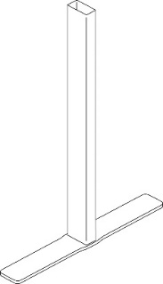
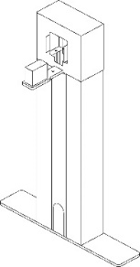
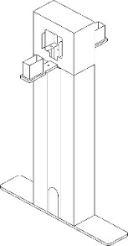
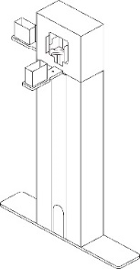
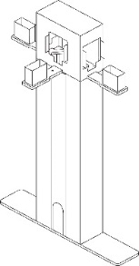
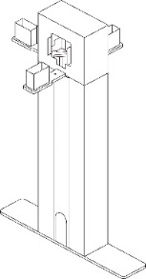
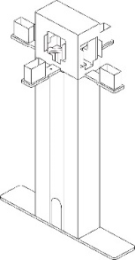
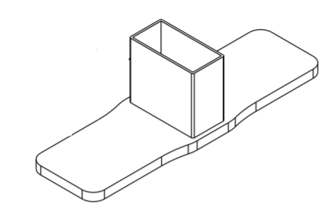
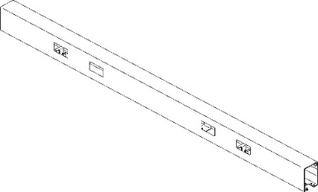
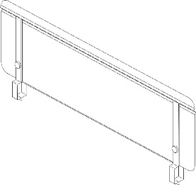
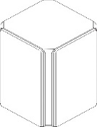
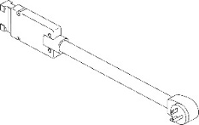
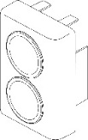
Altitude Power Rail Statement of Line
Legs
Hubs
Floor Leg
Elevated Power
Rail Legs
End of Run Hub
Inline Hub
End of run T Hub
Inline T hub
INTERNAL TRAINING
L Hub
X Hub
Power Rail
Connector
Electrical
Screens
Power rail
48” 54” 60” 66” 72”
Universal Connector
End Cap
Electrical
Power Pole
Screens
Notes:
Altitude Power Rail offers a comprehensive Statement of Line to accommodate various configurations and settings compared to its competitors in the market.
Power Rail comes with:
Floor vs. Elevated legs
Hubs to support higher capacity power/data/tech needs as well as to integrated Power Pole
Broader Power Rail lengths
Screens for Vertical Privacy
Electrical and Power Pole that seamlessly integrated to provide clean aesthetic

Slide 6
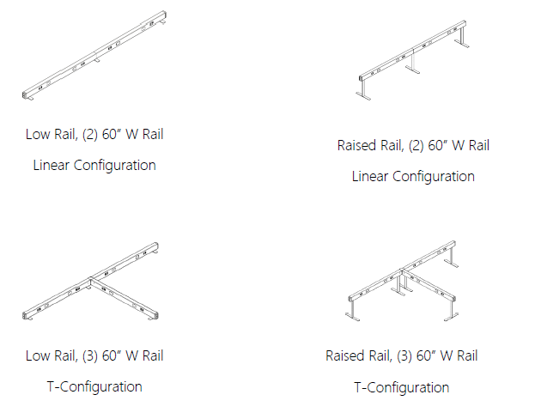
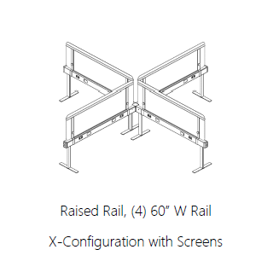
Altitude Power Rail Configurations
INTERNAL TRAINING
Notes:
Unlike some power rail competitors, which we discuss at a later slide, Altitude Power Rails can be configured with various shapes.

Slide 7
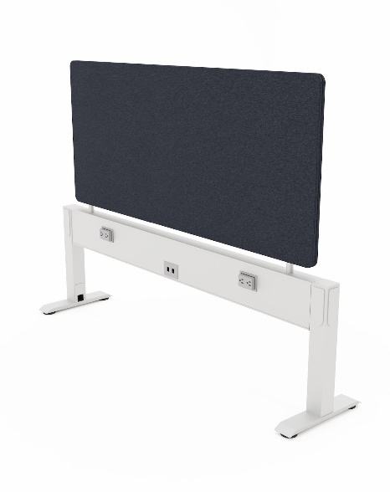
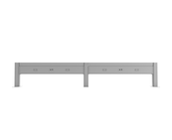
Altitude Power Rail vs Competitors
Altitude Power Rail
Available in 5 lengths
Low and elevated options
Integrated power pole
Variety of support options (floor leg, raised leg + hubs)
Available in 32 colors
Various configurations
ESI - Railway
Available in 4 lengths
4 outlets, 2 data inputs/per side of rail
48 hr. shipping on small offering
Linear application only
Workrite
Available in 3 lengths
Screen bracket integrated into rail for clean aesthetic
Various Configurations
Limited Sizes and Options
INTERNAL TRAINING
Notes:
Compared to its peers in the market, Altitude Power Rail comes in 5 lengths, low and elevated options, integrated power pole which cannot be done with ESI or Workrite solutions.

Slide 8
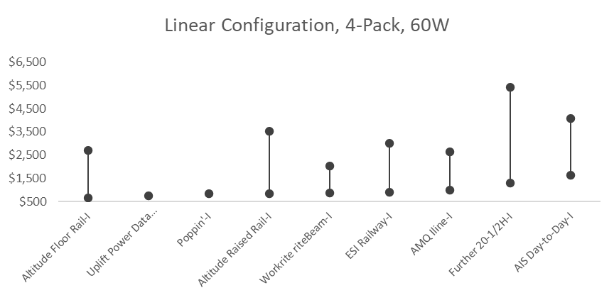
Competitive Pricing
INTERNAL TRAINING
Notes:
Altitude power rails compete against the open line competitors such as Uplift, Poppin, Workrite and ESI Ergo.
For more features and functions against the major competitors, we have Further power beam options.

Slide 9
NEW Altitude Power Rail Selling Tools
Available now on Synergy
Go to Market Brief
User Reference Guide
Spec Sheet
Pricing
CAP/CET – August update
Imagery
Launch Date: October 1, 2020
INTERNAL TRAINING

Slide 10
FAQ
Q: Are there models being discontinued?
A: The original Altitude A8 power rail models will be discontinued as of October 1, 2020 and replaced with new models at the same time.
Q: If I have an A8 Floor Rail, can I buy the Altitude Power Rail raised legs and have them installed in the field?
A: Existing FDRW** Rail Housing models can not be retrofitted with elevated legs.
Q: What are my options for routing power to my power rail?
A: Power can be routed through a hub, power pole, or wire manager.
Q: How is this different than the A8 Floor Rail?
A: The Altitude Power Rail allows the user to specify elevated or floor legs. The A8 Low Rail can still be specified with the foot. The overall list price will remain the same for the Low Rail.
INTERNAL TRAINING

Slide 11
FAQ
Q: What improvements have been made?
A: The new rail design can now share a leg at a linear configuration where the two rails intersect rather than the two feet, as previously required.
Q: Is the power pole in the offering new to the Allsteel portfolio?
A: No – the power pole utilized is the Further Power Pole and can be specified using the same model number.
Q: Can the Power Pole integrated with the Low Rail?
A: Yes – the new Low Rail design can integrate the square Power Pole.
INTERNAL TRAINING

Slide 12
FAQ
Q: Why did the floor foot change?
A: The floor foot was re-designed to better accommodate leveling capability and be shared between the two rails in a linear configuration.
Q: What are the cleaning instructions for the Altitude Power Rail?
A: For disinfecting hard surfaces against the COVID-19 virus the CDC recommends using diluted household bleach solutions (minimum 1/3 cup of bleach for every gallon of water, or a 2% bleach solution) or isopropyl alcohol solution (minimum 70% isopropyl. More details around cleaning can be found at https://www.allsteeloffice.com/design-resources/surface-materials/material-cleaning
INTERNAL TRAINING

Slide 13
Zhas Amirov
Product Manager
563.299.0691
AmirovZ@AllsteelOffice.com

