Slide 1
Sales & Dealer Training
INTERNAL USE ONLY

Slide 2
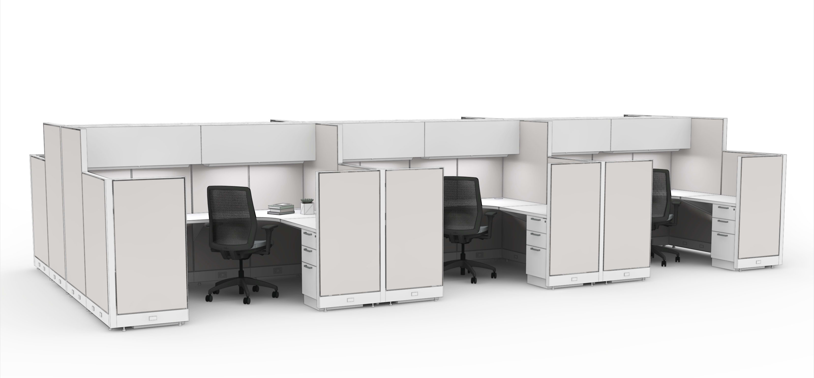
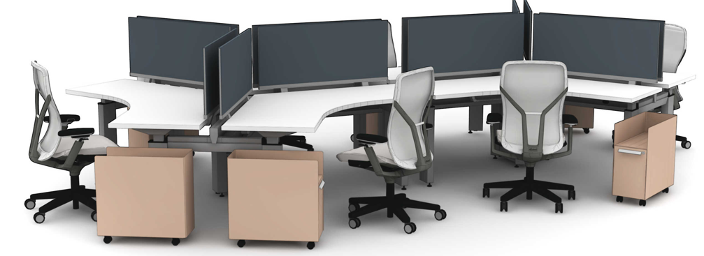
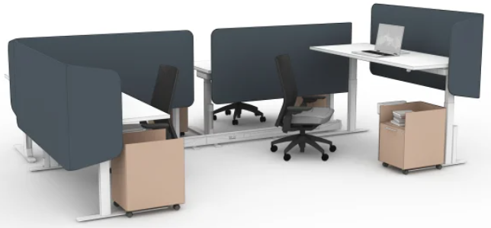
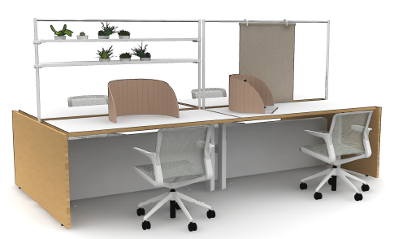
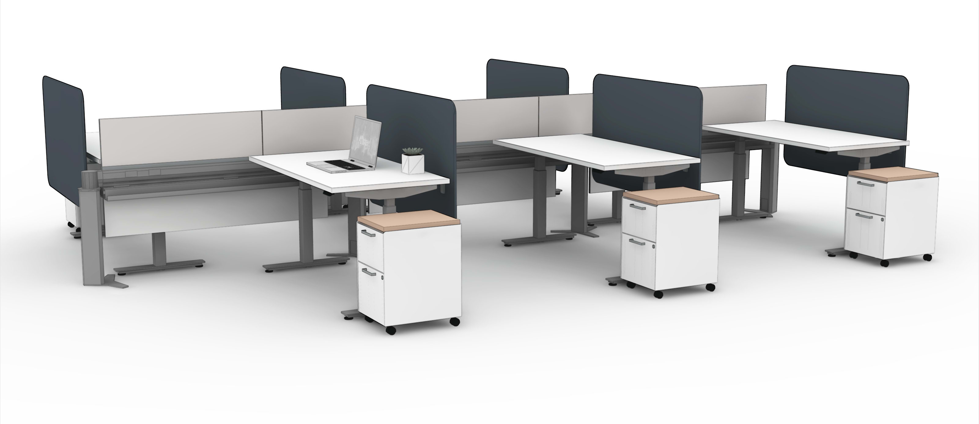
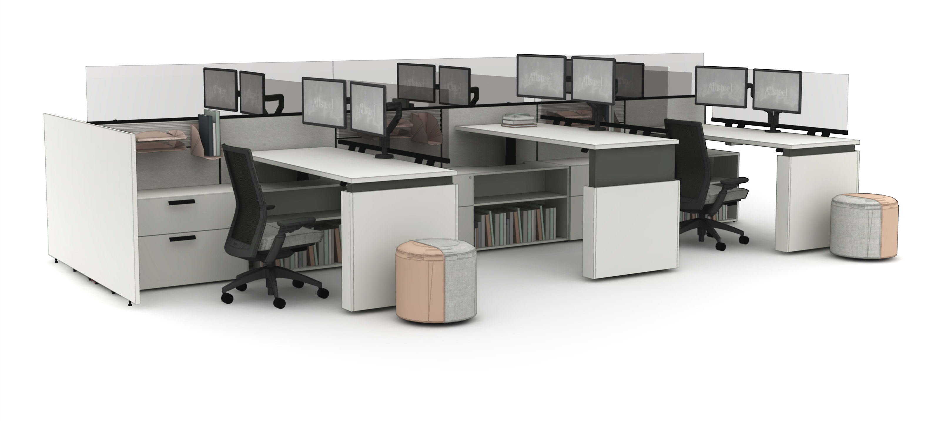
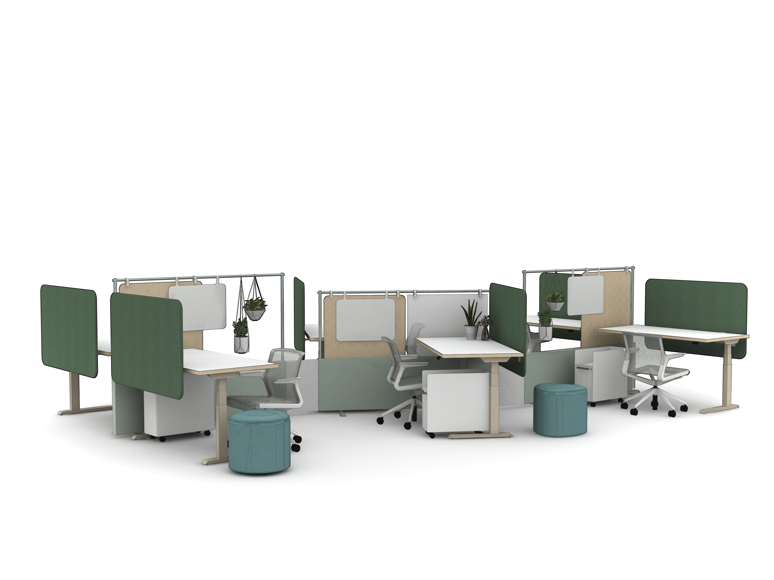
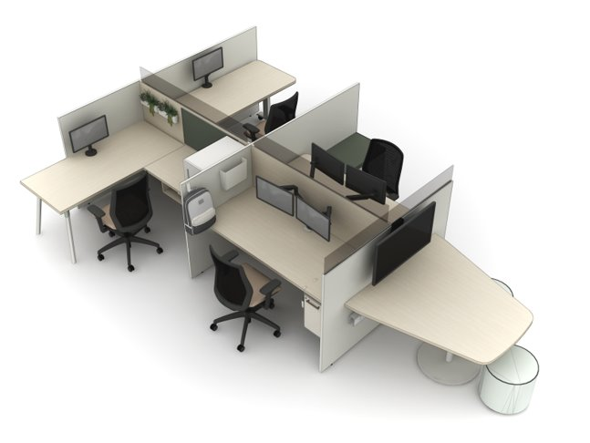
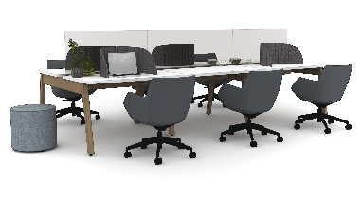
Market Segmentation
TRADITIONAL
TRANSITIONAL
PROGRESSIVE
High Panel
Above/Below Surface Privacy
Heavy Storage Elements
8' x 8' Space
Low Panel
Above/Below Surface Privacy
Moderate Storage Elements
6' x 6' Space
Open Plan/Agile
Adequate Privacy
Minimal/Shared Storage Elements
5' x 6' Space
Further Adaptive
Panel Systems
(Stride/Terrace/Optimize)
Altitude A6 + Power Rail
Mural (Linear)
INTERNAL TRAINING
Fence + Height-Adjustable Tables
(Further/Altitude)
Panel + Gallery
Mural (Organic)
Further A-Frame Benching
Fit
Notes:
Here is a segmented view of customer profiles and how each Allsteel solution can fit each customer type. This view helps us gather our thoughts in a more structured way and cater a specific solution that is more meaningful to a customer.
First, think about your potential customer. Is this customer more Traditional, Transitional or Progressive?
The Traditional customers are more straight forward. They value high level of privacy, storage components at each desk and large size stations. Typically these are Government sectors. However, in recent months, we installed fairly large desking and benching solutions for Government customers. This tells us they're "Transitioning" to more modern, open plan solutions but not yet willing to give up a high-level of user privacy, electrical/data etc.
Transitional customers are those that are currently living in a space with tall panels, large stations and a ton of storage pieces but renovating their space with more modern aesthetic and bringing panel heights down.
Then the next customer type is Progressive. They are everywhere. They range from startups to mega cap enterprises. They're usually easier to spot in West Cost; Facebook, LinkedIn, Amazon etc. Their primary need is agile workplace, innovative and differentiated solutions that attract new generation talent that fit their company's vision.

Slide 3
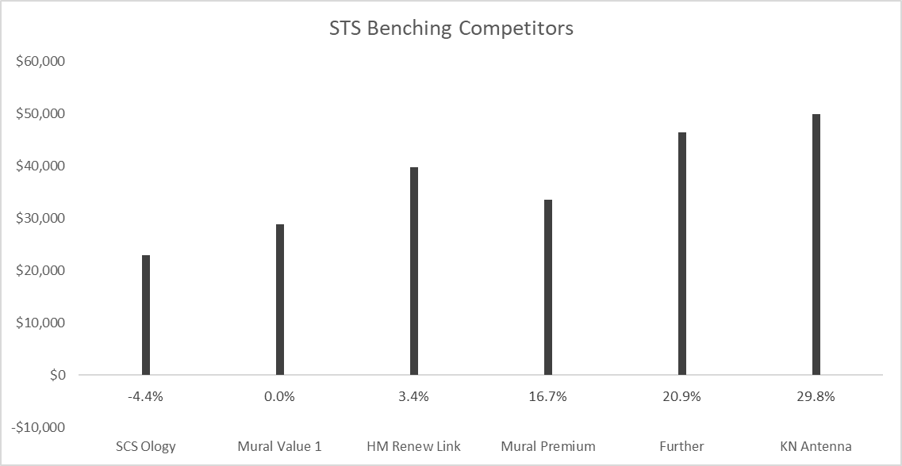
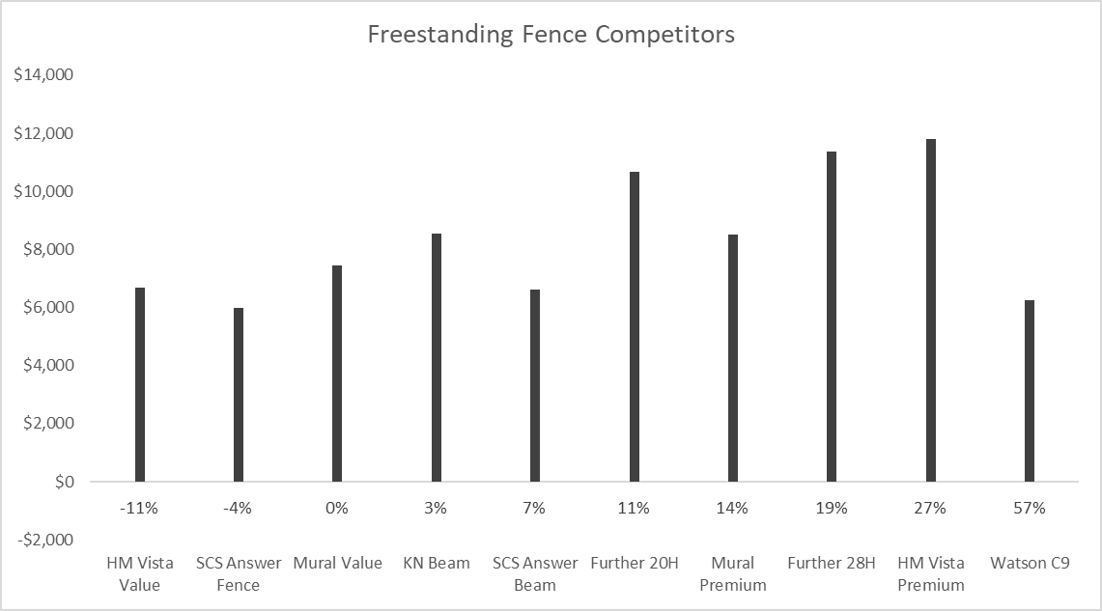
Competitive Pricing
INTERNAL TRAINING
*
**
*
**
Pricing is based on:
6-pack, 30"D x 60"W stations
Includes 42"H AFF screens/grade 1 fabric
Discount assumes avg. project size
*Standard connector
**Flexible patent-pending connector

Slide 4
Competitive Benchmark
INTERNAL TRAINING

Slide 5
Internal Product Differentiation
 | ATTRIBUTES | FURTHER | MURAL
APPLICATIONS | Traditional Benching | Y | N
 | Integrated Benching | Y | Y
 | Freestanding Fence | Y | Y
OPTIONS | Beam-Based | Y | N
 | Frame-Based | N | Y
 | Screens/Boundary | LIMITED | EXPANDED
 | STD/Extended Range Height-Adjustable | STD | STD/EXT
 | Power & Data | LITE | ROBUST
 | Heights | 42½", 50", 57½" | 50", 57", 65"
AESTHETIC | Transitional | Y | N
 | Progressive | N | Y
INTERNAL TRAINING

Slide 6
FAQ
Q: What heights are available with Mural?
A: The Mural fence is 22"H, but by adding screen frames the system can be 50", 57", or 65"H.
Q: When would I specify the “flex” connector?
A: The flex connector allows for unlimited 2-way configurations and can be moved by users depending on the configuration. We recommend the flex connector whenever an organic space is likely to flex as needs change.
Q: What is the power & data capacity?
A: Mural is a high-capacity power and data solution that leverages all the benefits of a traditional panel system, but with the personality of a desking and benching solution.
Q: How do I bring power into the fence?
A: Power can be routed through a power pole, enhanced connector, bottom of the fence, or through end trim when infeed trim is specified.
INTERNAL TRAINING

Slide 7
FAQ
Q: Are gallery panels compatible with Mural end of runs?
A: Yes, in fact, 22"H models were also launched to accommodate Mural Integrated Bench applications. See the gallery panels section in the Desking & Benching Preview on Brand Connect for full offering details.
Q: When will Mural be in specification software?
A: Mural will be available in specification software April 2022.
Q: When is Mural launching?
A: Training and specification materials will be available starting in April. Mural will be open for orders June 2022 and the official launch will be included in the June new product launch release.
Q: What is Mural’s discount?
A: Mural is on the Everyday Advantage program at 76% off, the showroom contract at 85% off, and the A&D contract at 80% off.
INTERNAL TRAINING

Slide 8
Mural Launch Timing
OPEN FOR ORDER June 2022 (NeoCon)
  Allsteel Communications April 2022
  Price List & Spec Guide (Online) April 2022
  CET, 20/20 & Symbols Publication April 2022
  First Shipment July 2022
  Brochure June 2022
  Showroom Integration Q3 2022
Questions?
Madeleine Tigges: tiggesm@hniworkplacefurnishings.com
Zhas Amirov: amirovz@hniworkplacefurnishings.com
INTERNAL TRAINING

Slide 9
Appendix

Slide 10
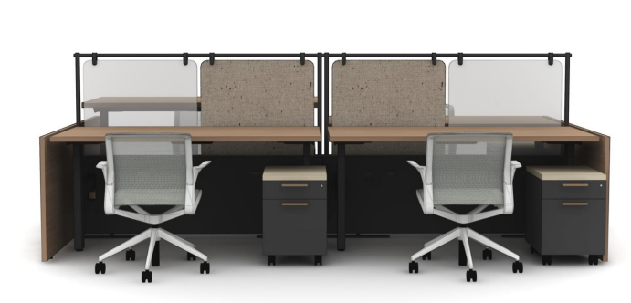
Shared Bench

Slide 11
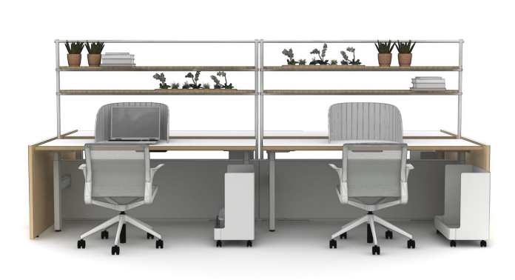
Shared Bench

Slide 12
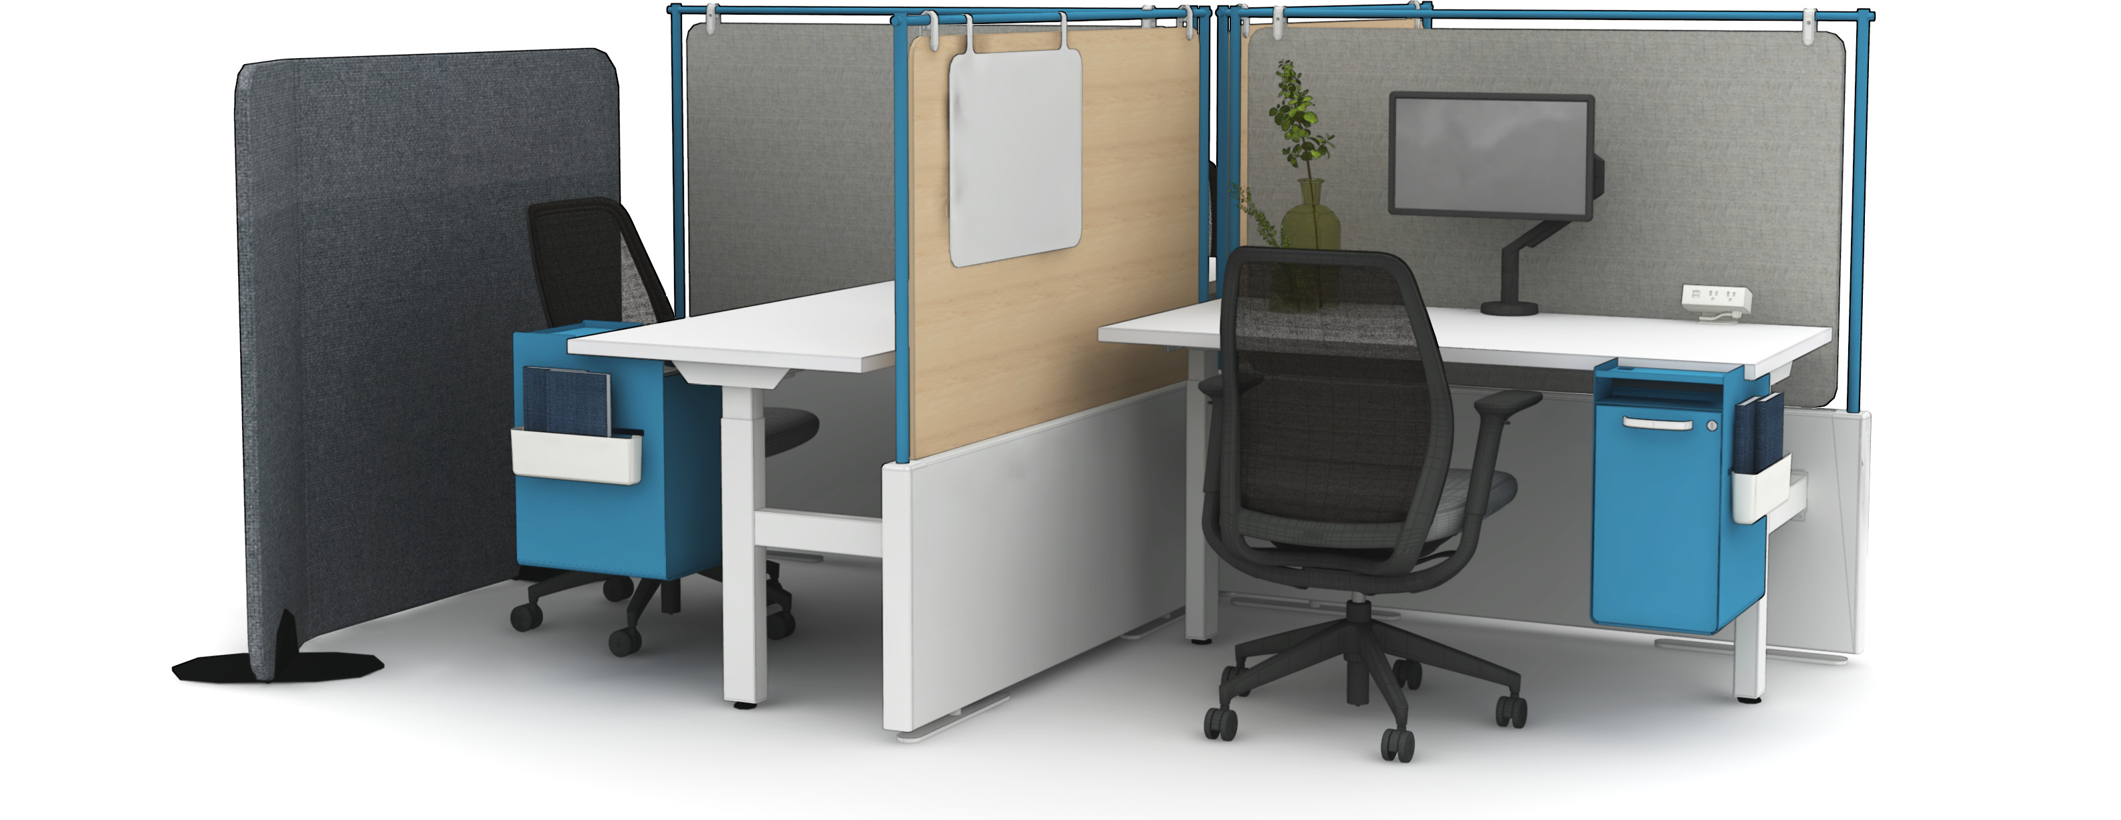
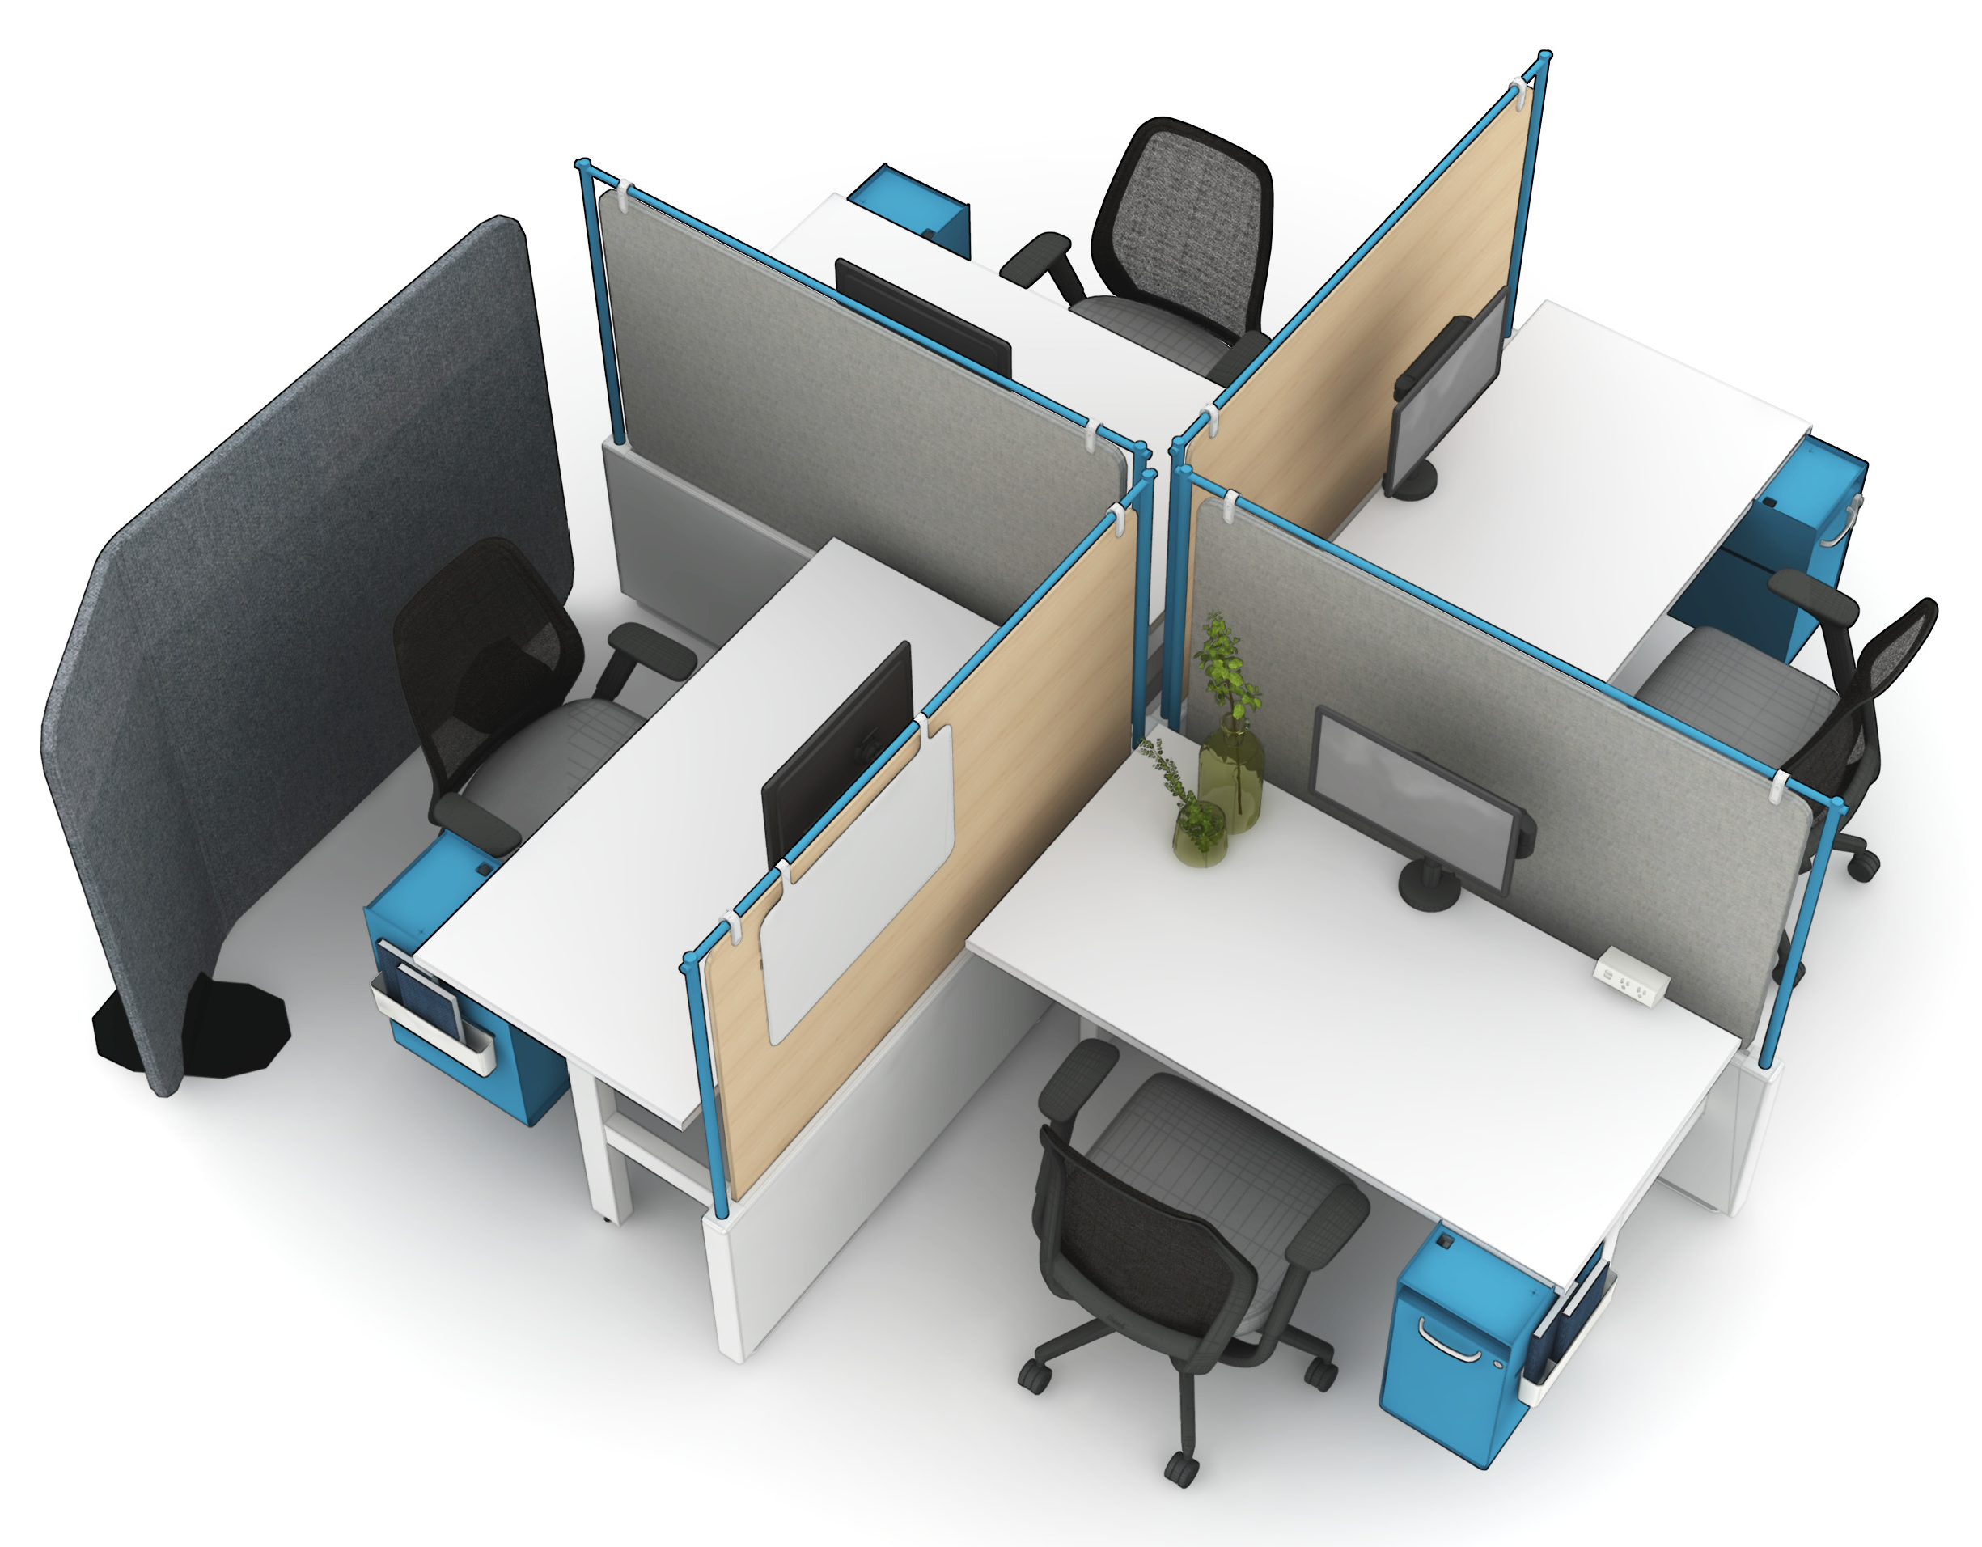
Solo Workstations

Slide 13
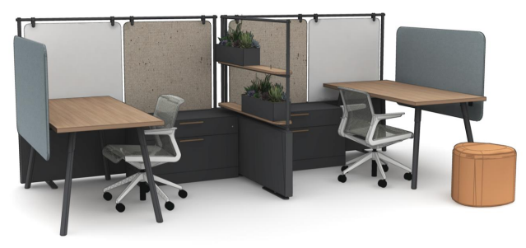
Solo Workstations

Slide 14
Solo Workstations

Slide 15
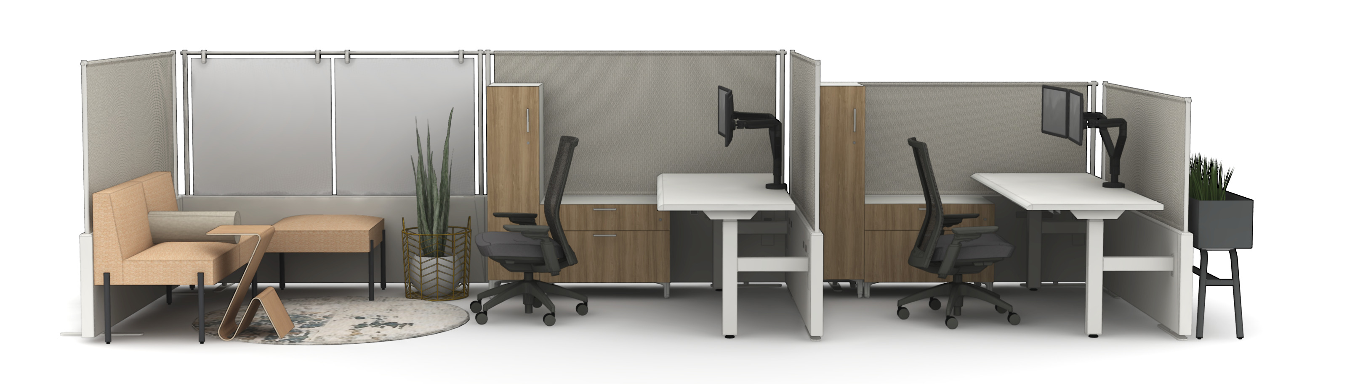
Solo Workstations + Collaborative
Notes:
Call out complimentary products:
- Park planter, JettyMod etc.

Slide 16
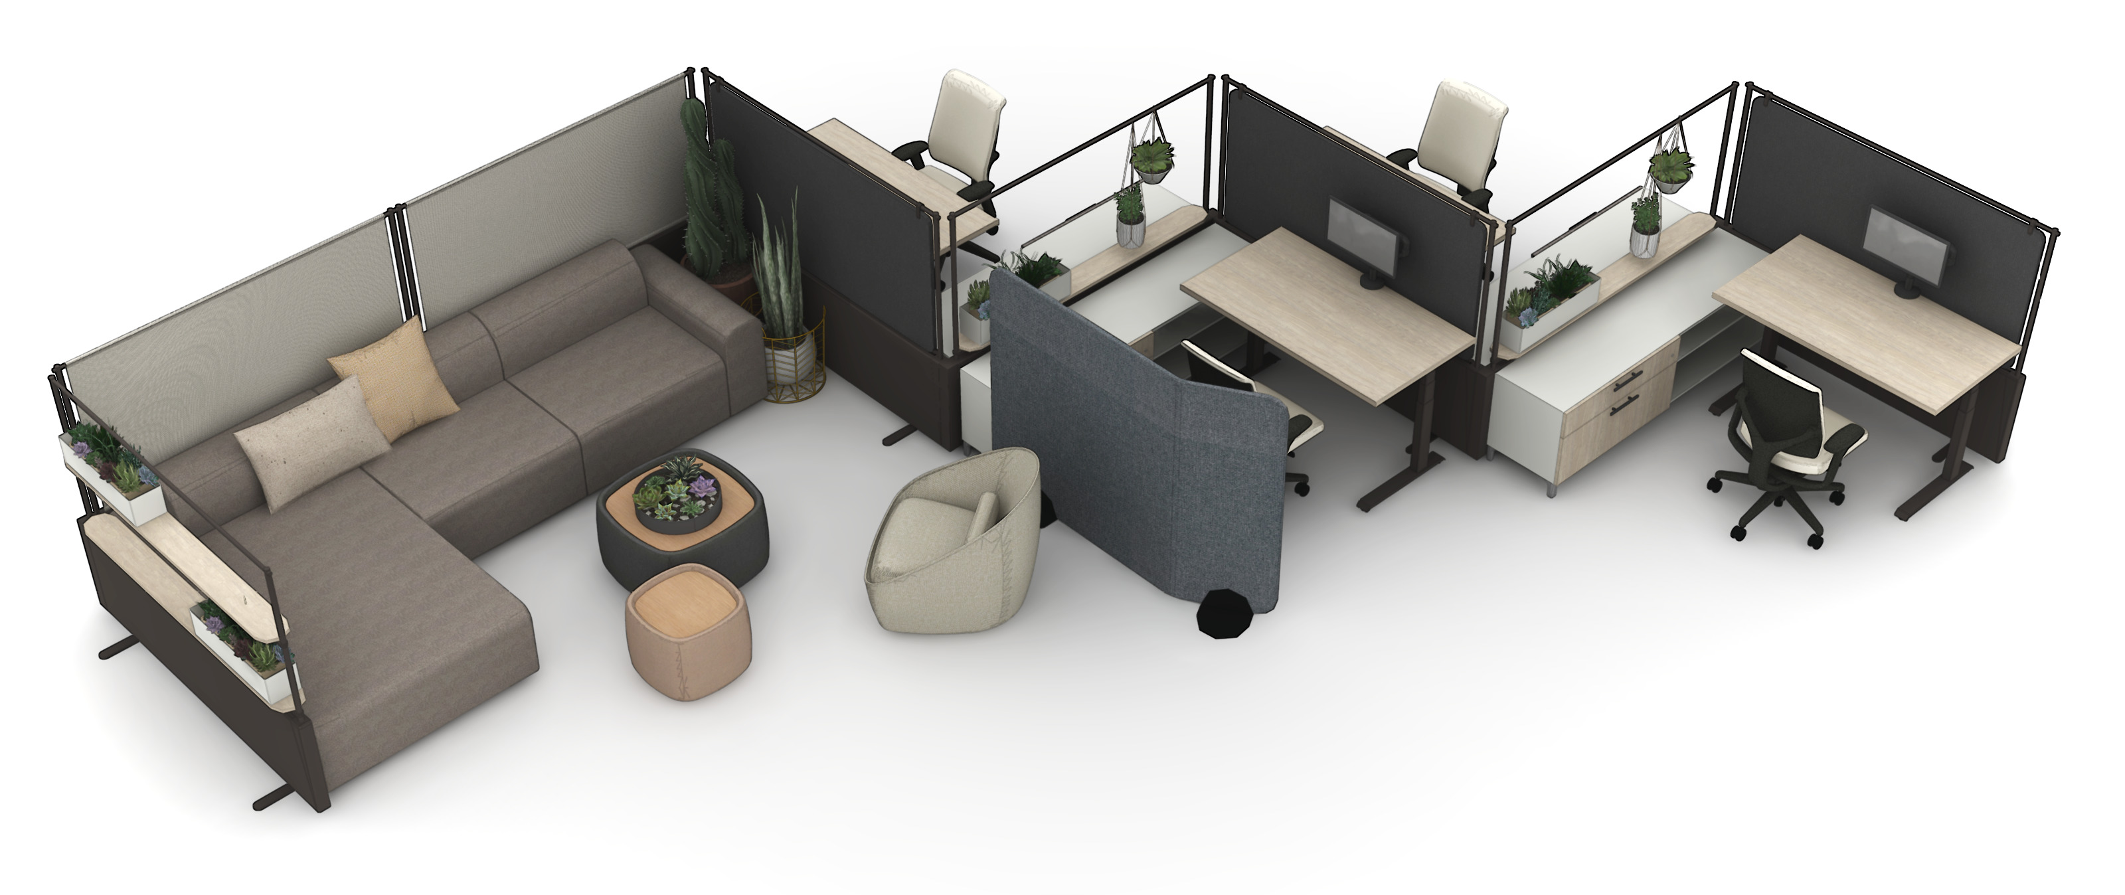
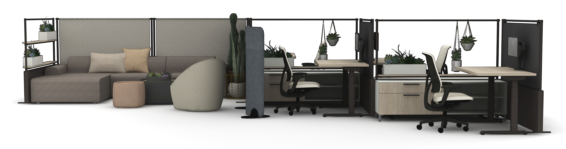
Solo Workstations + Collaborative
Notes:
Call out complimentary products:
- Park planter, JettyMod etc.

Slide 17
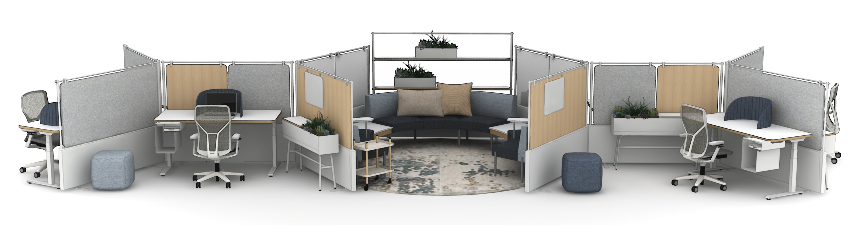
Solo Workstations + Collaborative

Slide 18
Thank You

