Slide 1
Sales & Dealer Training
INTERNAL USE ONLY

Slide 2
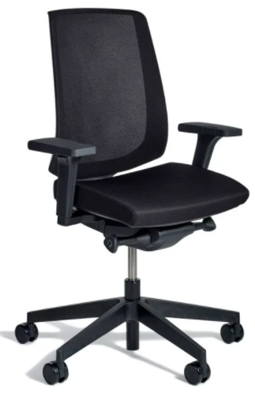
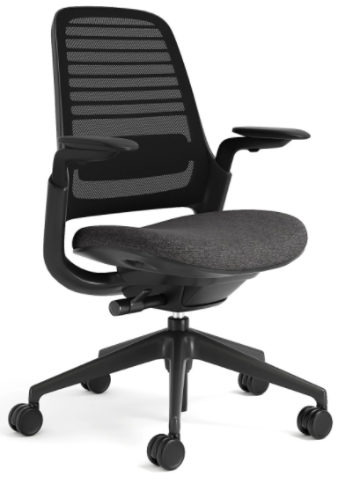
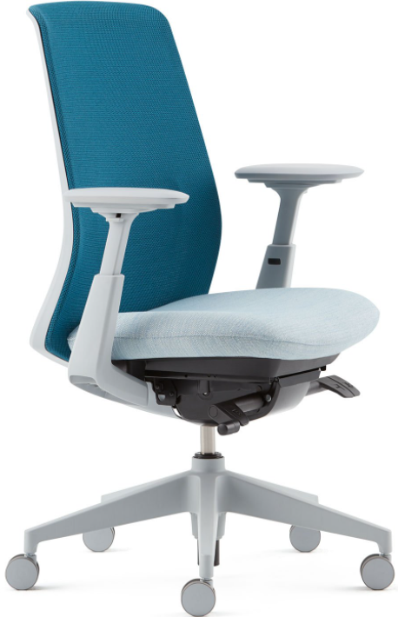
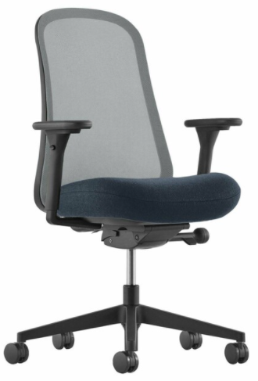
O6 Competitive Talking Points
Knoll k. Task | Steelcase Series 1 | Haworth Soji | Herman Miller Lino
Less premium design No stool model Limited surface material optionality – 2 mesh colors, 2 frame colors, limited seat fabric options | Smaller in scale – may not fit larger/taller individuals 11 mesh colors compared to 29 on O6 Limited number of frame colors: 2 | Expensive compared to others in competitive set No stool model 11 mesh colors compared to 29 on O6 Limited number of frame colors: 2 | Hard initial sit Limited number of frame colors: 2 Limited number of mesh colors: 6
INTERNAL TRAINING

Slide 3
Customers to Target with O6
My budget is tight, but we can’t sacrifice comfort or quality.
I want fresh design language in an Allsteel task chair.
INTERNAL TRAINING
I want all the ergonomic adjustments for individuals to properly adjust their task chair.
INTERNAL TRAINING
I’m looking for a seating solution that allows for and enables color and finish optionality.
I need options within a task seating family to scale down the price if needed.
I want a design that stands out but doesn’t dominate the workspace.

Slide 4
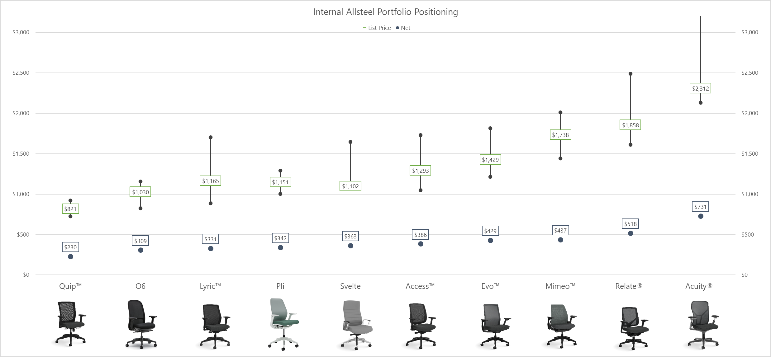
Internal Positioning
INTERNAL TRAINING

Slide 5
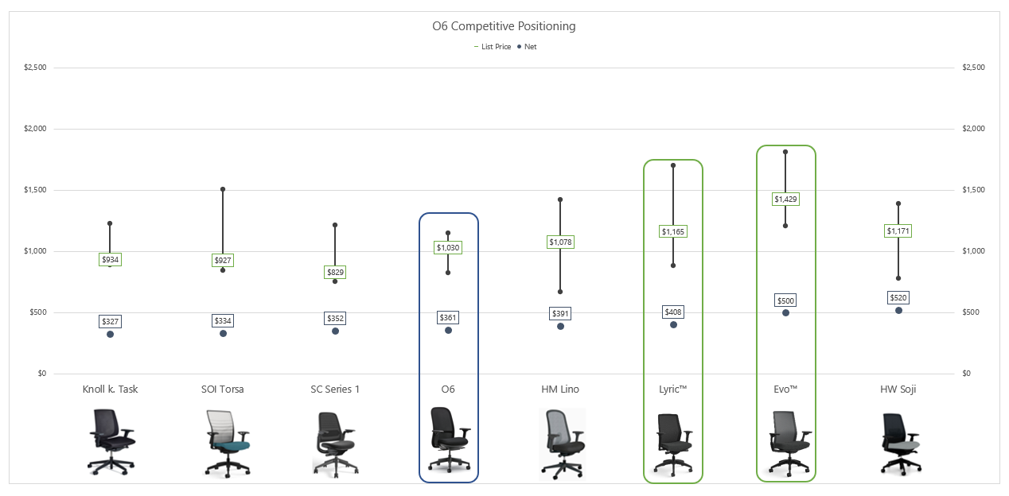
Competitive Positioning
INTERNAL TRAINING

Slide 6
O6 Launch Timing
OPEN FOR ORDERS April 4, 2022
Price List & Spec Guide (Online) March 2022
20/20 & Symbols Publication March 2022
Allsteel Communications February 2022
First Shipment May 2022
Brochure March 2022
Showroom Integration Q2 2022
Questions?
Derek Vickroy: vickroyd@allsteeloffice.com
INTERNAL TRAINING

Slide 7
FAQ
Q: Is O6 a family of seating?
A: Task chair and stool models with or without arms are available.
Q: What type of control mechanism is available on O6? What are its adjustment features?
A: O6 uses a weight-activated control mechanism that automatically responds to the weight of each user. It features two control levers with three simple, standard adjustments – pneumatic height, seat depth, and upright tilt lock.
Q: Is lumbar support available on O6?
A: A dedicated lumbar component with 4" in adjustment range can be specified on O6 task chair and stool models. A stand-alone lumbar support model is available for post-purchase and can be installed in the field.
INTERNAL TRAINING

Slide 8
FAQ
Q: What type of arm adjustability is available on O6?
A: There are three different arm options available on O6: 4D (height, width, depth, pivot), 2D (height, width), and armless.
Q: How many mesh and frame/base colors are offered on O6?
A: O6 has two separate mesh styles to choose from: Premium Spectrum™ mesh (back and seat) and lower-cost 4-Way Stretch mesh (back only). Between these two options, there are 29 total mesh colors available. O6 offers four frame/base colors: Salt, Titanium, Flint, and Black.
Q: Where does O6 position within Allsteel’s seating portfolio?
A: O6 fills the $850-$1,050 gap between Quip™ and Lyric™ models.
INTERNAL TRAINING

Slide 9
Appendix

Slide 10
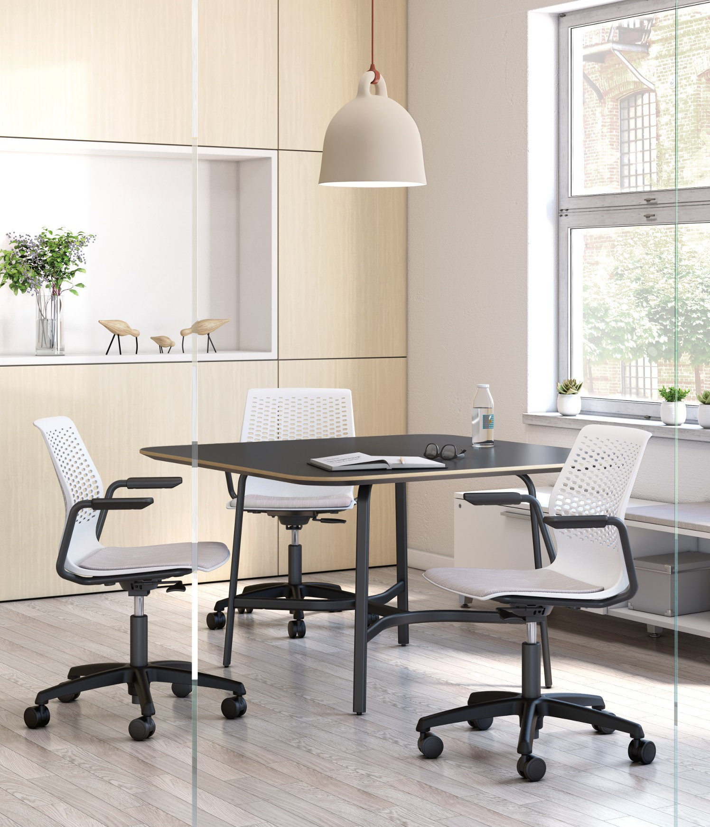
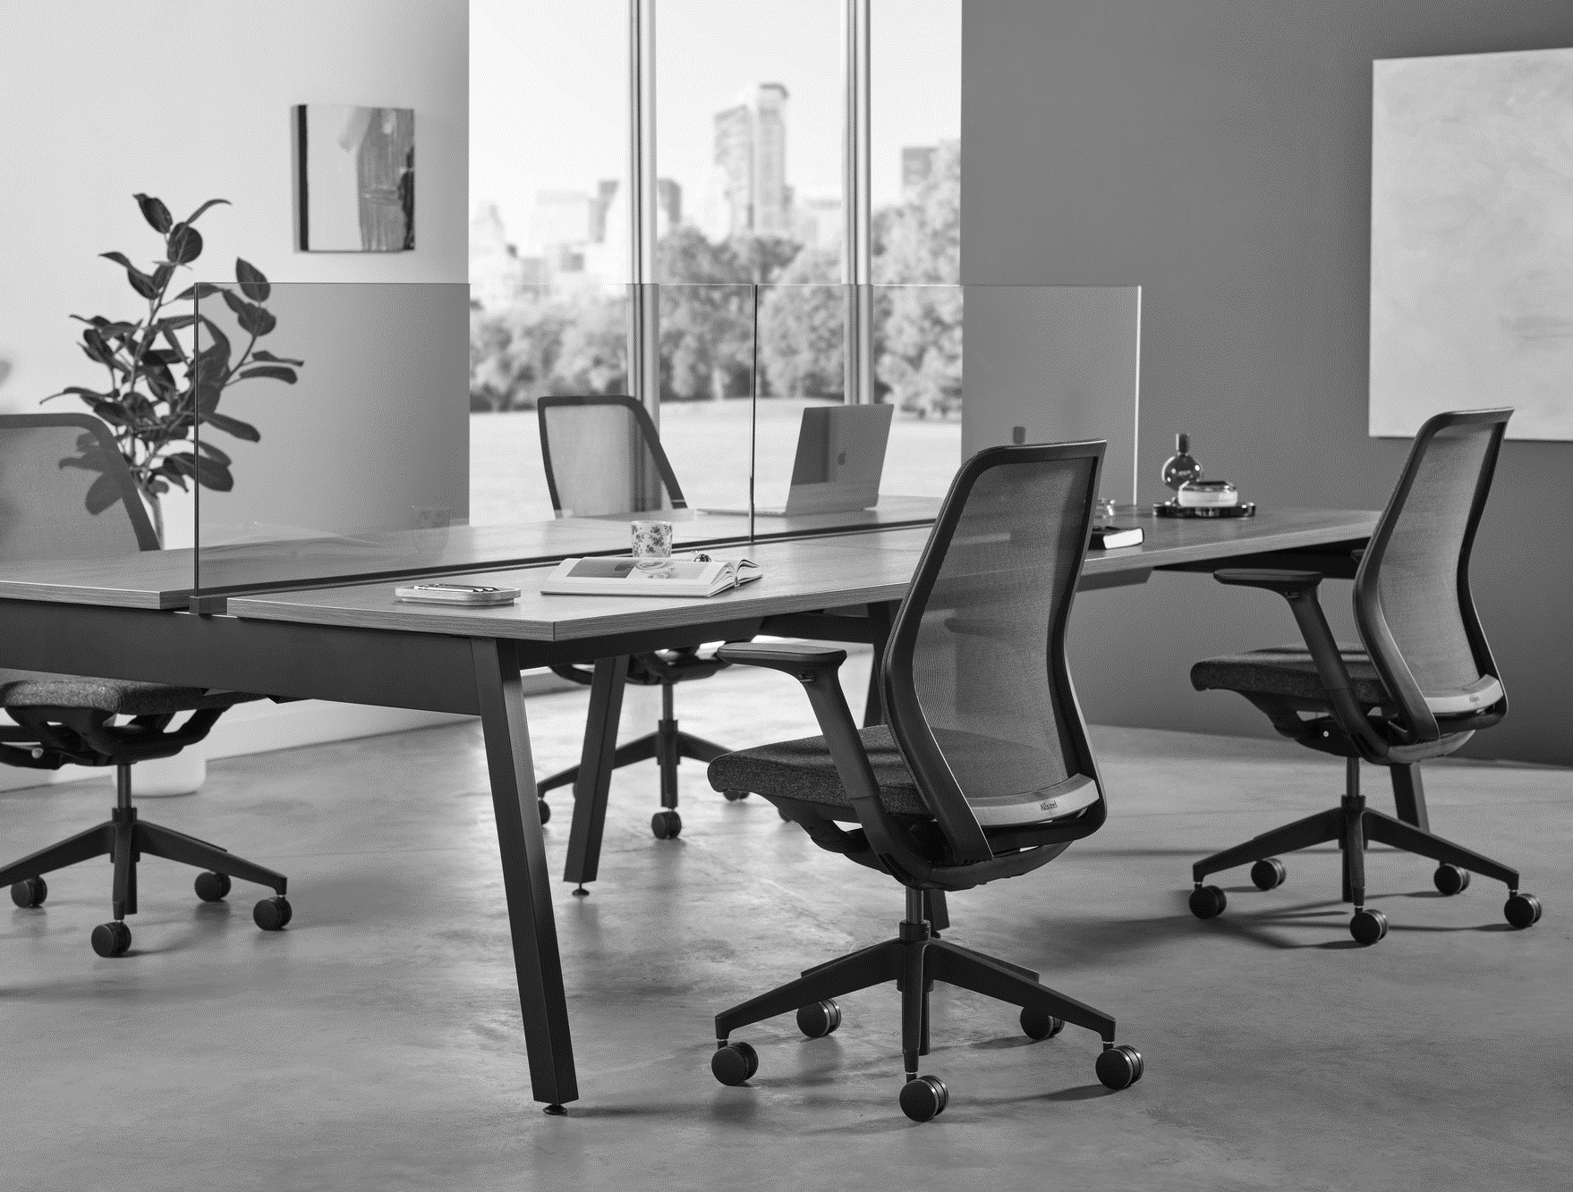
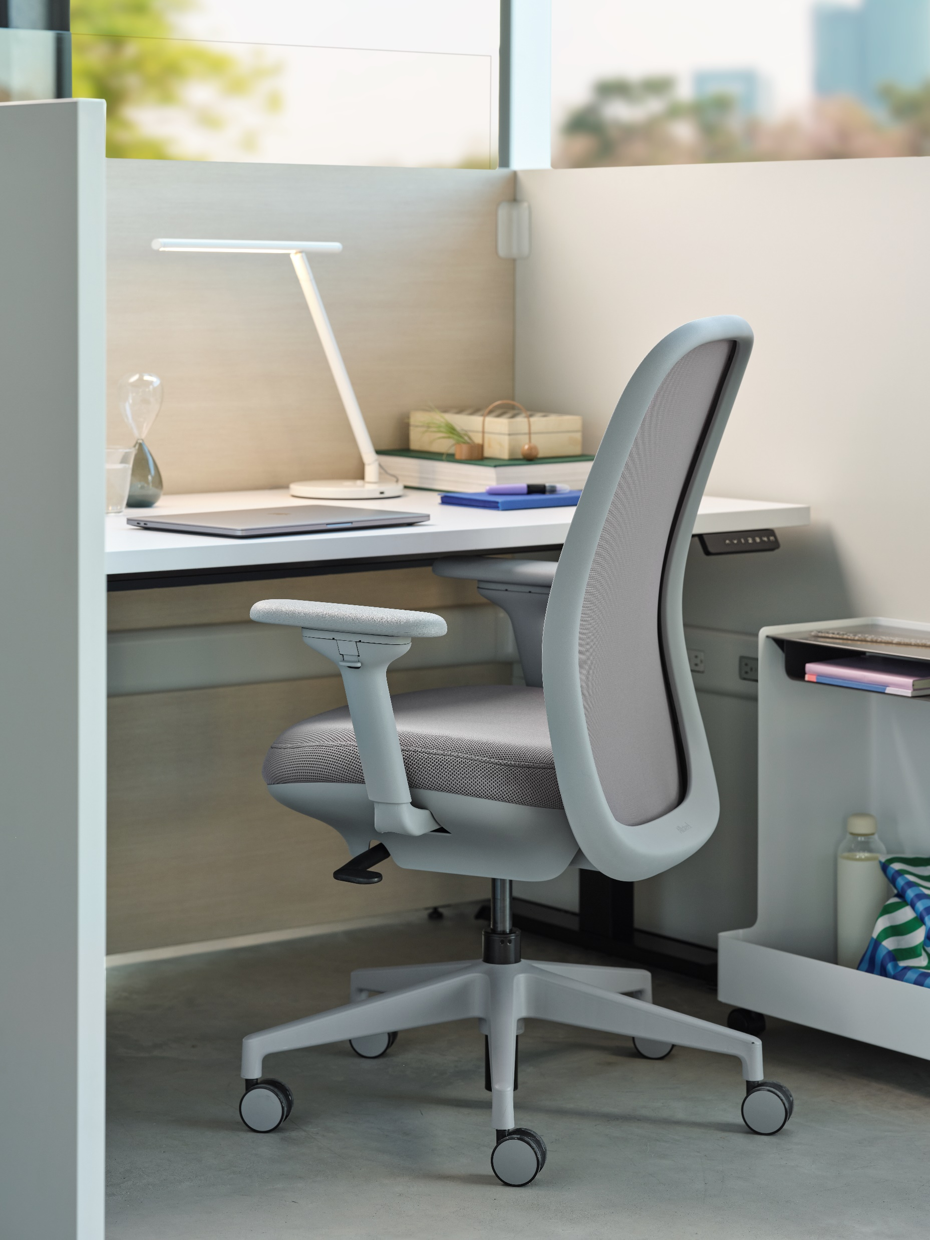
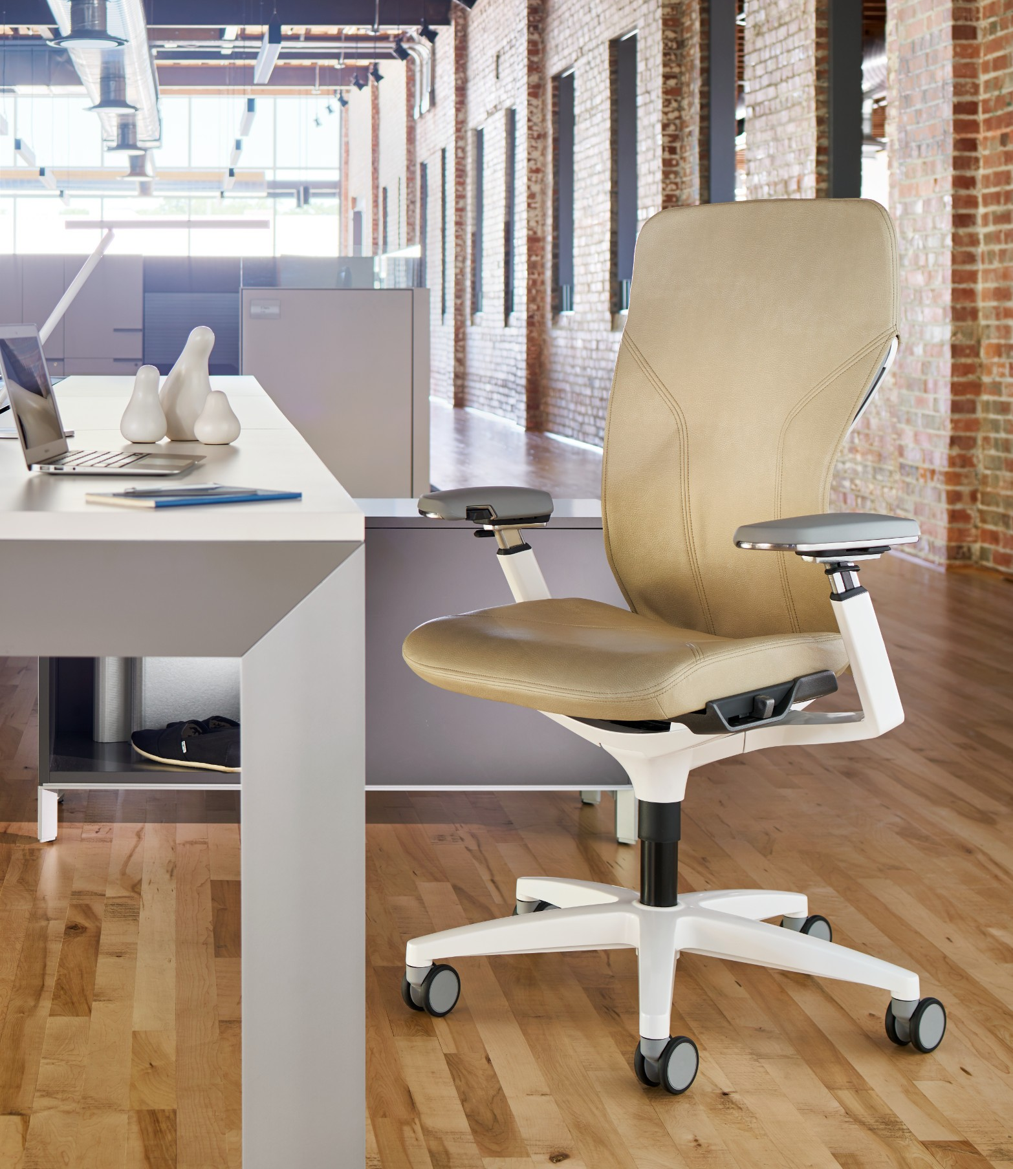
Task Seating
Informal “We”
Collaborative Task
Unassigned “I”
Alternative Task
Assigned “I”
Traditional Task
Formal “We”
Executive Task
Temporary Sit (1-3 hr.)
Short- or Mid-term (2-8 hr.)
Mid-Term or All Day (4-8+ hr.)
Small team use for planned and/or impromptu work.
Applications
Huddle rooms, small conf./meeting, and open-plan touchdown.
Specialized around the individual (assigned or unassigned).
Applications
HATs, desking, benching, open-plan workstations, and agile.
Dedicated to the individual w/ an ergo-centric feature set.
Applications
Open-plan/traditional workstations, HATs, and private offices.
Object furniture, rich design w/ premium use of materials.
Applications
Private offices, formal/lg. conference rooms + executive spaces.
O6
Notes:
The task seating category has and continues to split into multiple segments that address varying degrees of ergonomic adjustability, scale, price, and design. There is a segment that serves to address true-ergonomic needs, offering weight-activated control, seat depth adjustment, multi-point tilt lock, and more. This segment demands direct user engagement to find and dial in comfort. These solutions are also typically dedicated to and owned by the individual user. This is the category in which O6 falls.

Slide 11
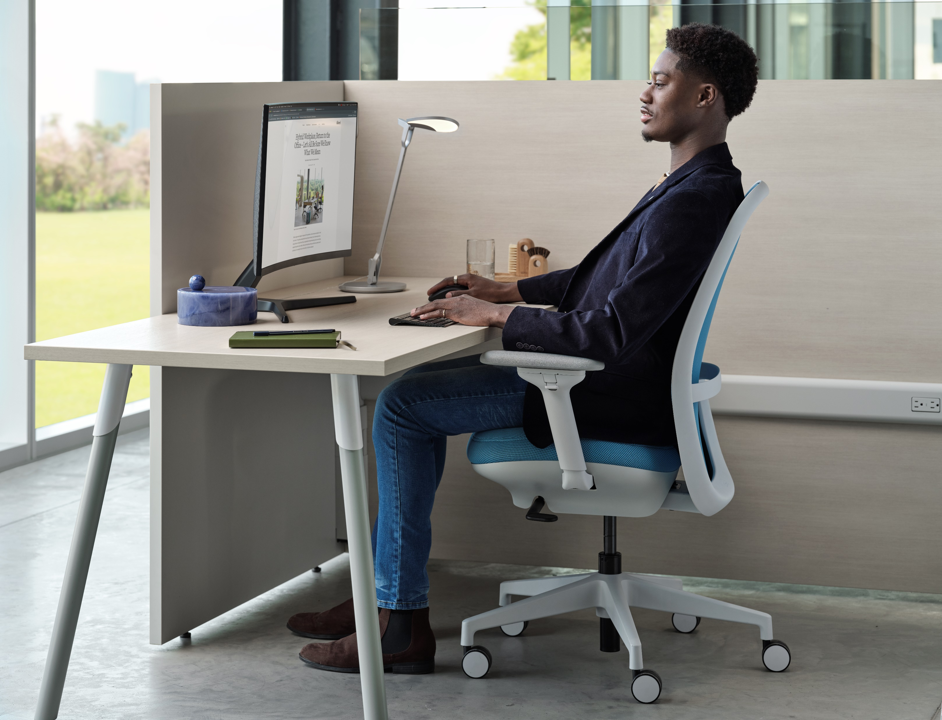
Longer-Term Sit
Open-Plan Workstations
Private Offices
Concentrated Work
Notes:
The O6 seat cradles the body in a cushion of comfort, while the chair back hugs the user’s back for maximum support. The optional lumbar adds another level of adjustment to customize support right where it’s needed.

Slide 12
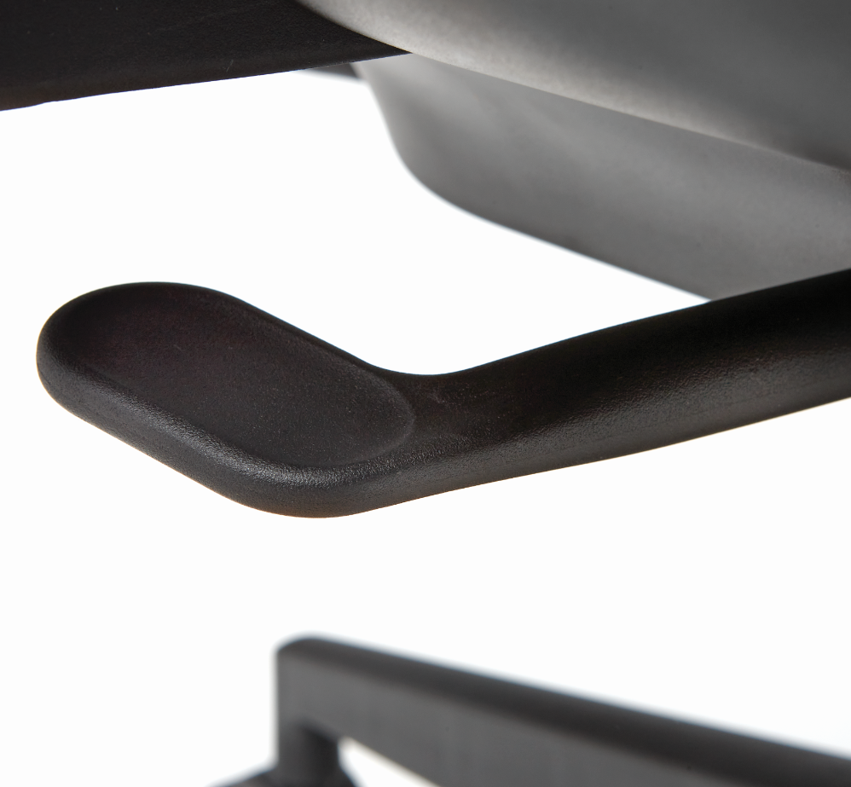
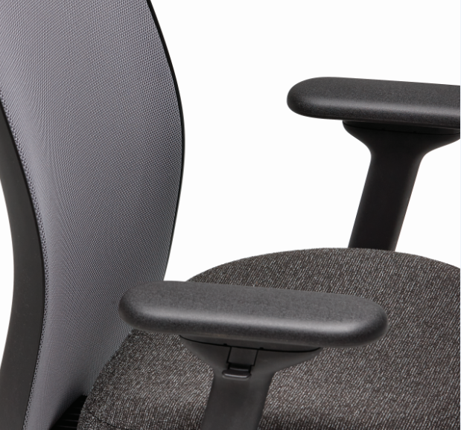
Intuitive Adjustments
Seat Height & Depth Upright Tilt Lock
Back Lumbar
Arm Height & Arm Pads
Notes:
The O6 controls are user intuitive in both their location and operation. One lever controls seat height and tilt lock and another lever controls seat depth. The back lumbar can be adjusted up and down while seated. The arms adjust in height with a simple button, and the arm pads move side to side and front to back while also pivoting.

Slide 13
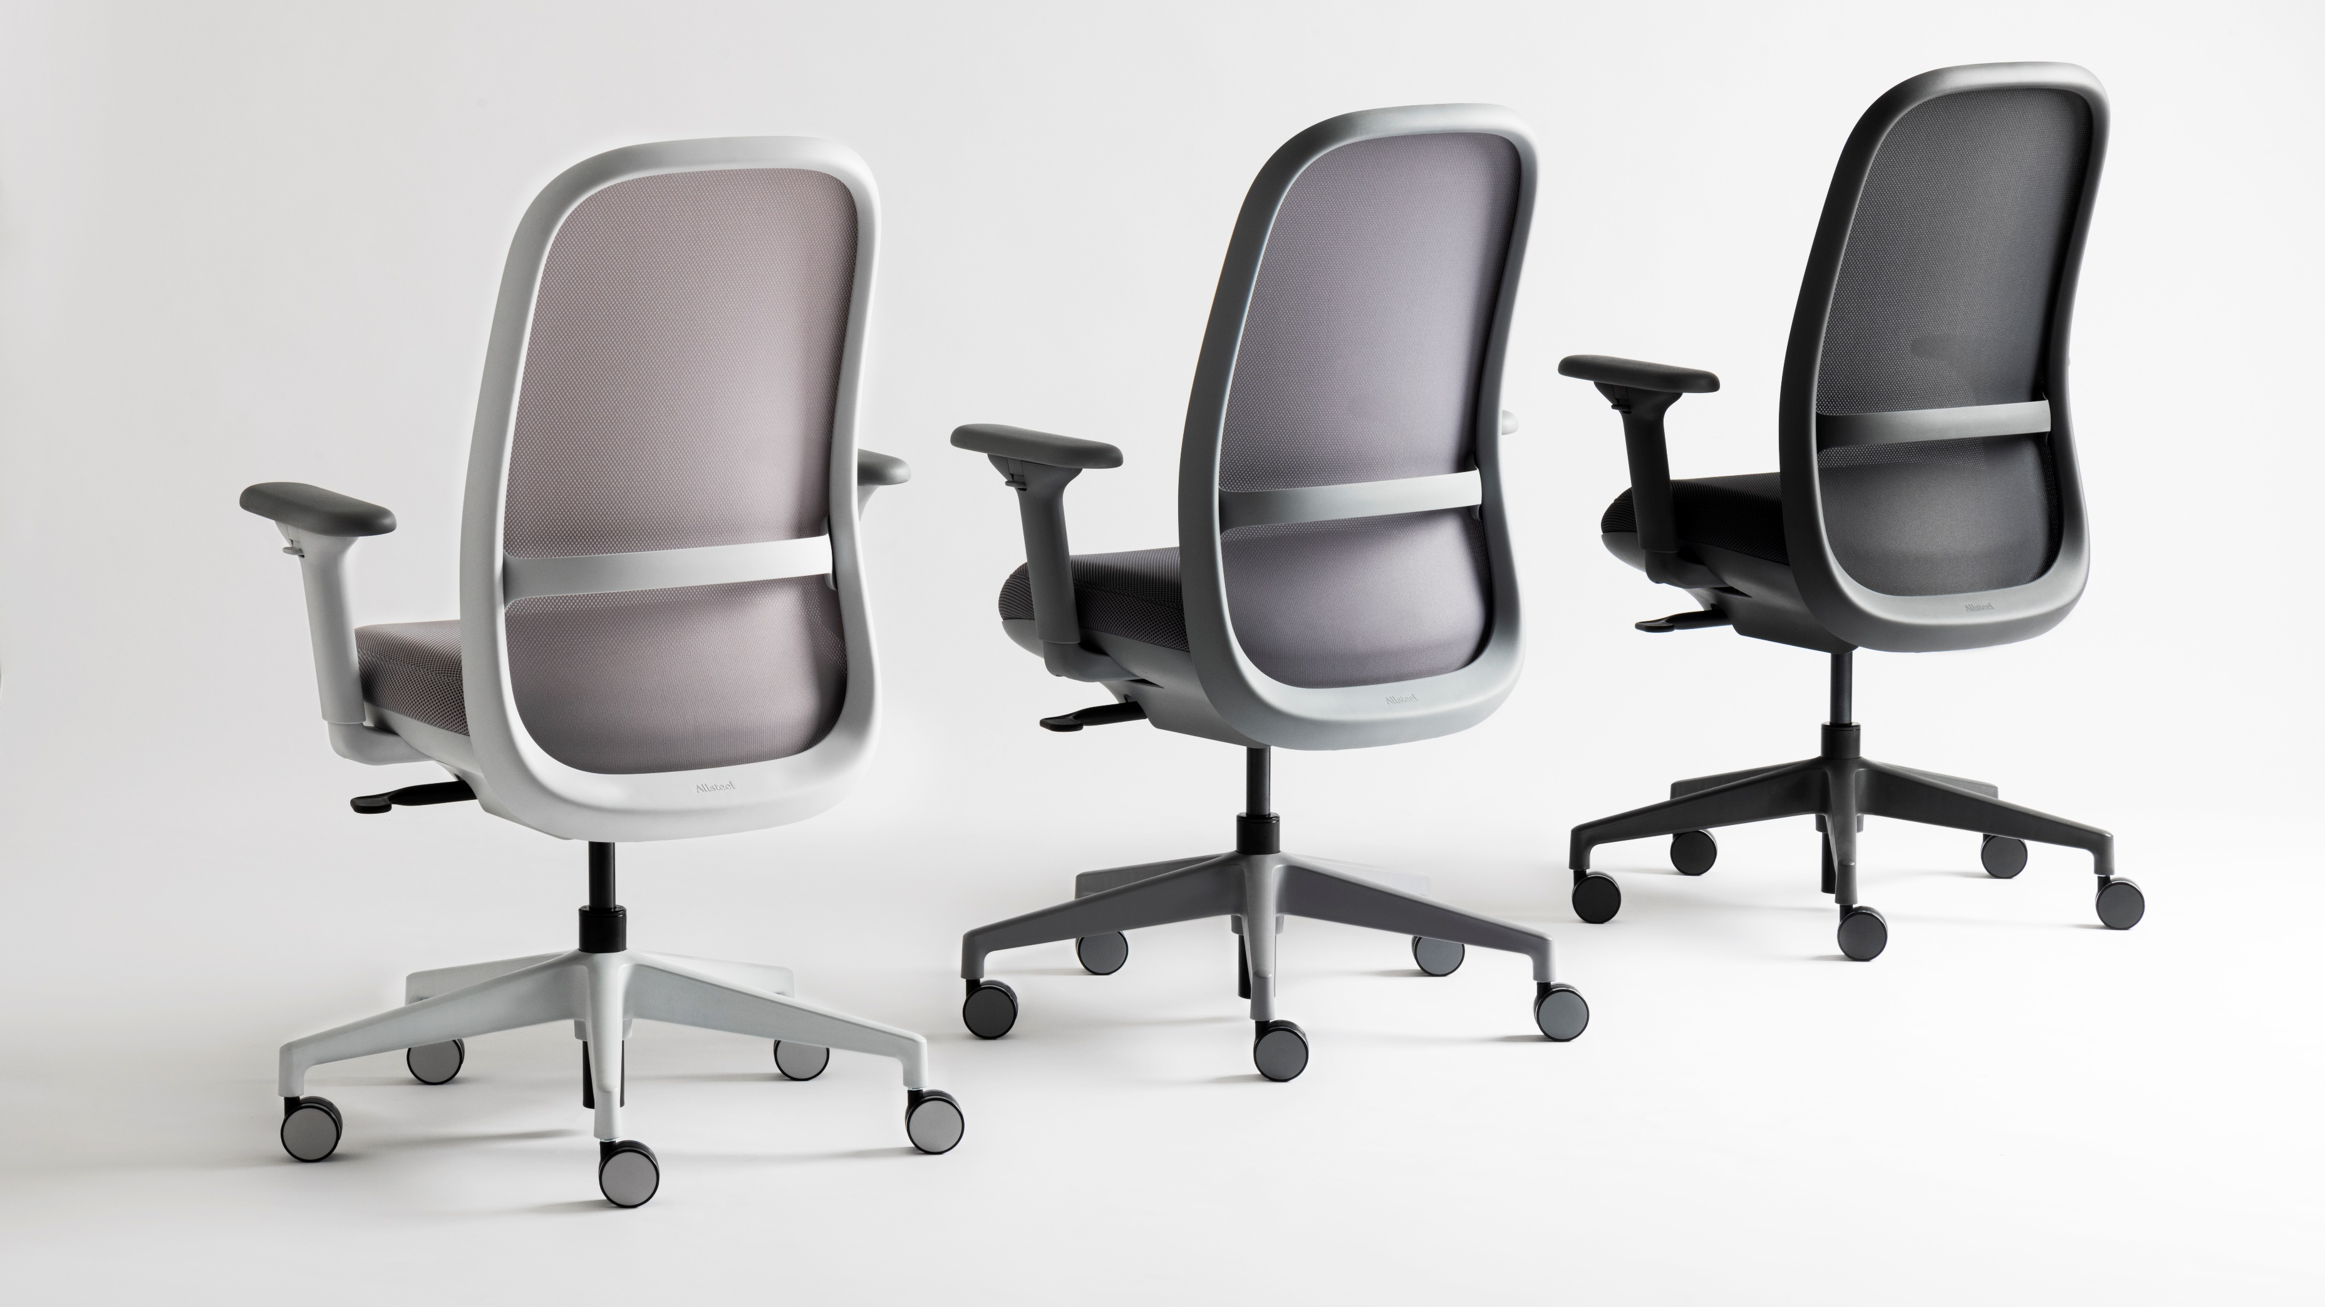

Slide 14
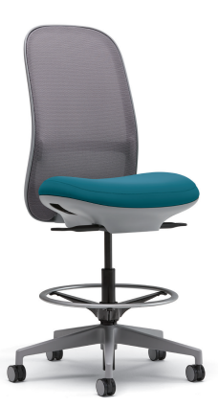
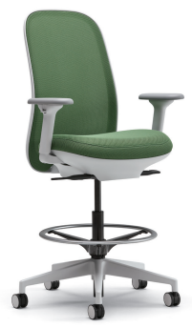
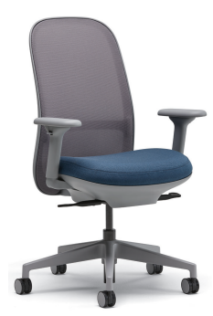
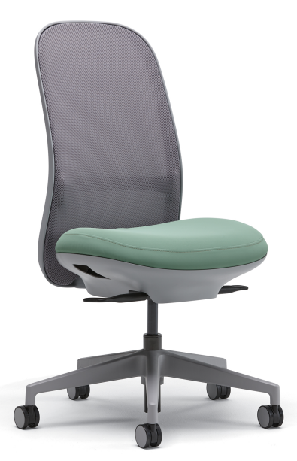
Statement of Line
Task Chair
Task Stool
4D Fully Adjustable Arms
2D Adjustable Arms
Armless
4D Fully Adjustable Arms
2D Adjustable Arms
Armless
Notes:
Both the task chair and stool are available with or without arms and lumbar support. Arm options include 4D fully adjustable arms (arm height and arm pad width, depth, and pivot) or 2D adjustable arms (arm height and arm pad width).

Slide 15
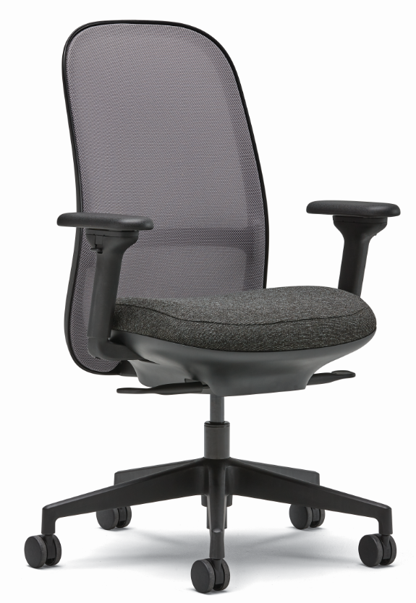
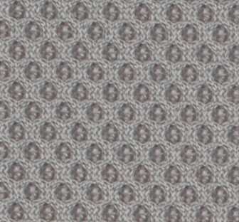
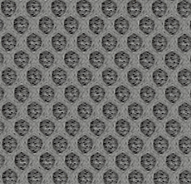
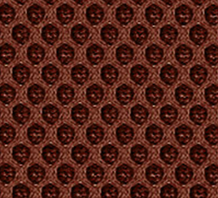
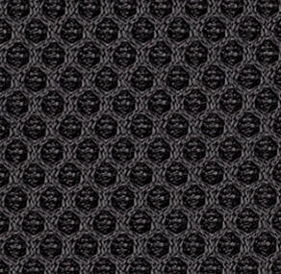
Design Options
Spectrum Mesh Colors
Loft
Sky
Bullseye
Kermit
Titanium
Steel
Leaf
Cobalt
Brick
Onyx
Espresso
Blueberry
Carbon
Arm Options
4D Fully Adjustable Arms
2D Adjustable Arms
Armless
Cylinder Options
Standard
Short
Extended (stool)
Base Colors
Salt
Titanium
Flint
Black
Frame & Lumbar Colors
Salt
Titanium
Flint
Black
Caster Options
Salt Multi-Surface
Titanium Multi-Surface
Flint Multi-Surface
Black Hard Tread
Black Multi-Surface
Configurator
Notes:
There are an additional 9 non-standard Spectrum mesh colors available (an additional 2-week lead time). 4-Way Stretch mesh in 7 colors can also be specified as a value option. Spectrum mesh can be applied to both the back and seat. 4-Way Stretch mesh can only be applied to the back. The frame and base colors can either be monochromatic or complementary (some customers want a light-colored frame and a dark-colored base for long-term wear).

