Slide 1
Sales & Dealer Training
INTERNAL USE ONLY

Slide 2
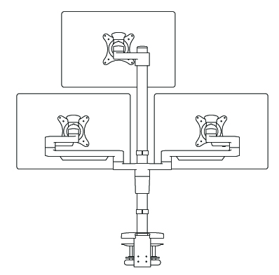
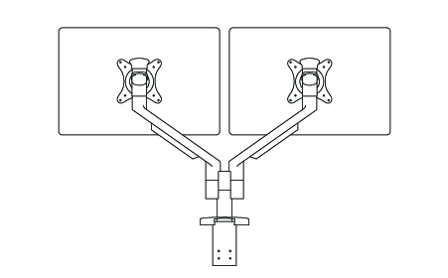
Statement of Line
INTERNAL TRAINING
Standard
Accommodates 1 monitor
Supports up to 17 lb. per monitor
19” reach
8.5” height adjustment
Standard Dual
Accommodates 2 monitors
Supports up to 17 lb. per monitor
20” reach
9.6” height adjustment
Heavy Duty
Accommodates 1 monitor
Supports up to 20 lb. per monitor
20” reach
8.5” height adjustment
Heavy Duty w/ Cross Bar
Accommodates 1-2 monitors
28” crossbar with horizontal adjustability
Fixed Post
Accommodates 1-6 monitors
Supports up to 20 lb. per monitor
27.5” fixed post mount with height adjustment

Slide 3
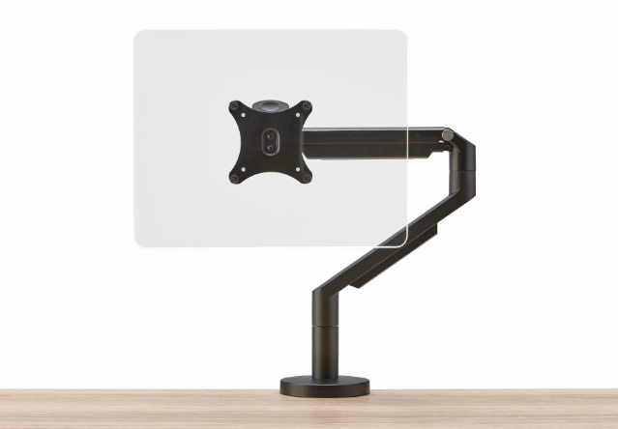
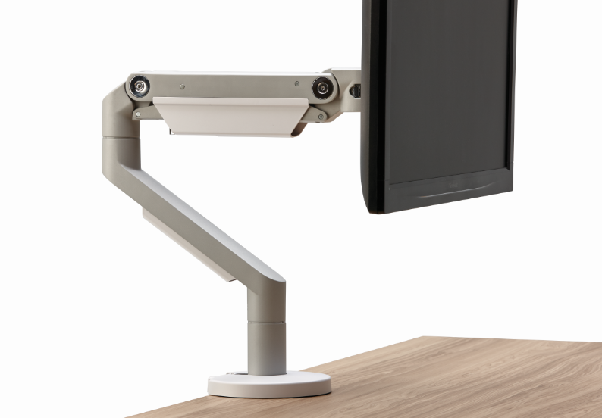
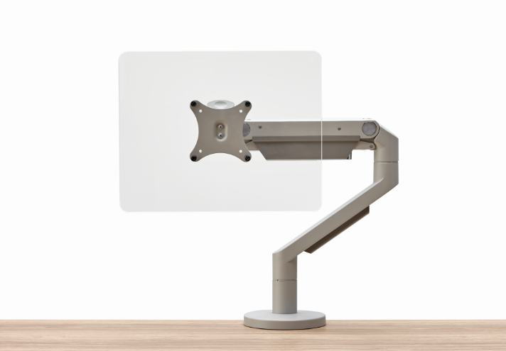
Finish Options
INTERNAL TRAINING
Black with black trim
Silver with white trim
Silver with gray trim
Notes:
Recharge is Allsteel’s response to new requirements within a changing workspace. Through in-depth research into corporate space and application settings, we developed a concise kit of parts that make it easy to plan and specify; as well as simple to reconfigure.
We considered the aspects to individuals that were important in an area meant to offer a workplace beyond the desk. The thorough power incorporation means workers are supported with choice and autonomy to find the space that most suits them.
The blend of soft and hard surfaces with a mixed material palette helps a company showcase their brand in a meaningful way. This effectively compounds to create a space that people want to be in, are able to be productive at and promotes an appealing aesthetic to attract and retain skilled workers.

Slide 4
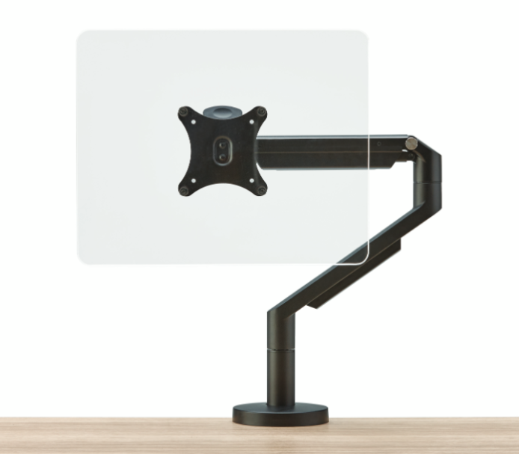
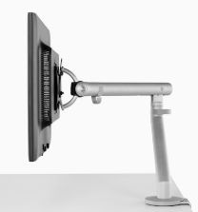
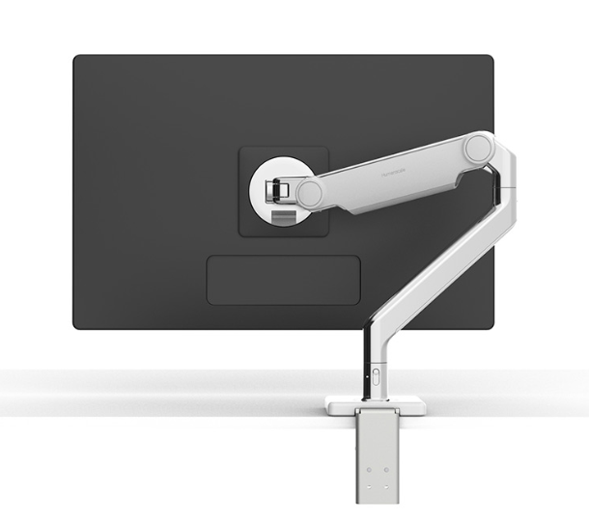
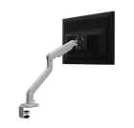
Competitive Talking Points
STANDARD WEIGHT SINGLE MONITOR ARMS
Allsteel Pivot – Standard | Herman Miller Flo | Humanscale M2.1 | ESI Kata
Max arm reach: 20” Max height adjustment: 9.6” Weight capacity: up to 17 lb per monitor Color options: silver with white trim, silver with gray trim, or black with black trim | Max arm reach: 13.3” Max height adjustment: 20” Weight capacity: up to 20 lb per monitor Color options: silver or white for standard model – silver for all other models | Max arm reach: 20” Max height adjustment: 12” Weight capacity: up to 15 lb per monitor Color options: polished aluminum with white trim, silver with gray trim, or black with black trim | Max arm reach: 21” Max height adjustment: 14” Weight capacity: up to 20 lb per monitor Color options: silver, black, or white
INTERNAL TRAINING

Slide 5
Customers to Target
I’m looking for a product that allows for user customization
I desire options to support technology as it evolves throughout my business
I want to promote healthy habits and ergonomics among individuals
INTERNAL TRAINING
I need computer monitor support that is not overly bulky or large when installed on workstations
I need integrated power, but I want to maintain flexibility and concealment
I want something that coordinates not only with other furniture, but with overall interior design as well
I want to be flexible and accommodating to future unknown needs

Slide 6
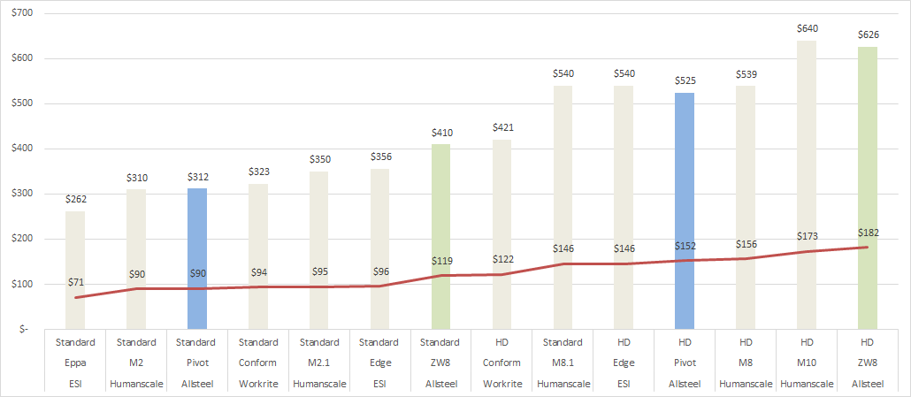
Competitive Price Positioning
SINGLE MONITOR ARMS
INTERNAL TRAINING
List and net pricing at project discounting

Slide 7
Competitive Price Positioning
DUAL MONITOR ARMS
INTERNAL TRAINING
List and net pricing at project discounting

Slide 8
Pre-Launch Timing
PRE-LAUNCH September 2019
Allsteel Communications September 2019
Press Release & Media Announcement December 2019
AO & Synergy Updates December 2019
INTERNAL TRAINING

Slide 9
Launch Timing
OPEN FOR ORDERS December 2019
Allsteel Communications December 2019
Brochure December 2019
First Ship December 2019
Allsteel University Integration December 2019
Showroom Integration December 2019
Price List & Spec Guide (Online) December 2019
20/20 & Symbols Publication December 2019
Questions?
Product related, Marcus Simpao: simpaom@allsteeloffice.com
Marketing related, Jessica Payne: payneje@allsteeloffice.com
INTERNAL TRAINING

Slide 10
Pre-Sell Tools
GTM Brief is located here
Imagery is located here
List pricing is located here
FAQs are located here
INTERNAL TRAINING

Slide 11
Frequently Asked Questions
Q: Are Pivot monitor arms part of Extensions?
A: No, this is a standalone product line.
Q: Will the SPIFF program be different from what is offered today?
A: YES – a competitive SPIFF program for Pivot will be available at launch. More details to come.
Q: What options are available in the statement of line?
A: Standard weight arms (single and dual dynamic), heavy duty weight arms (single and dual dynamic with crossbar), and post arms (single dynamic, dual dynamic, triple fixed - which can accommodate up to 6 monitors)
Q: What finishes are available?
A: Black and silver. Silver monitor arms ship with two sets of plastic pieces - one is silver and one is black - which can be installed and alternated as needed.
Q: What is the maximum number of monitors that Pivot can support?
A: Pivot can support up to six computer monitors using the post arm models.
Q: When will existing monitor arms be discontinued?
A: The existing monitor arm models will be discontinued in July 2020.
A: Yes, there will be all new model numbers which will be reflected in the specification guide at the time of launch.
Q: Will pricing be different for Pivot monitor arms compared to existing monitor arms?
A: Yes, there will be a price difference. Please reference the Pricing Snapshot flyer leading up to launch for more information about list pricing. The specification guide will be updated at the time of launch.
INTERNAL TRAINING
Notes:
Configurator access

Slide 12
Frequently Asked Questions
Q: What are standard lead times for Pivot monitor arms?
A: Pivot will offer a 2-3 week lead time.
Q. What are the weight limits of the monitor arms?
A: The standard weight arms will support monitors up to 17 pounds and the heavy duty weight arms will support monitors up to 40 pounds.
Q: Can I use a curved monitor on the Pivot Monitor Arms?
A: Yes, the Pivot platform will support curved monitors as long as the weight limit does not exceed per the given arm.
Q: Are the Pivot arms TAA compliant to be sold on GSA contracts?
A: There will be separate models for GSA contracts that will be TAA compliant.
INTERNAL TRAINING
Notes:
Configurator access

