Slide 1
Sales & Dealer Training
INTERNAL USE ONLY

Slide 2
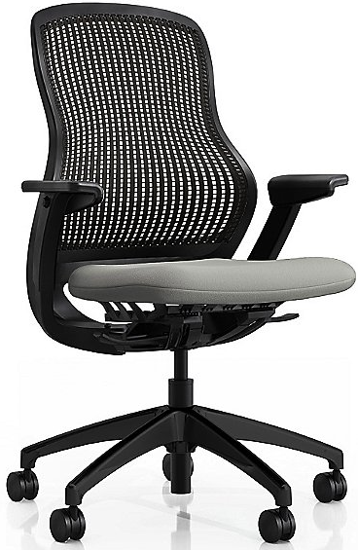
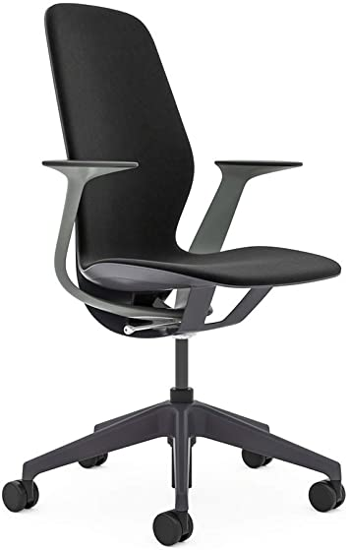
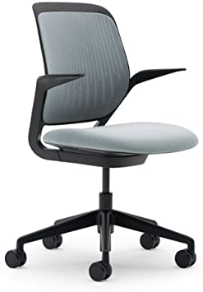
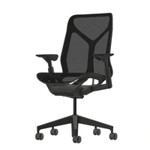
Pli Competitive Talking Points
Knoll ReGeneration | Steelcase Silq | Steelcase Cobi | Herman Miller Cosm
Overly-complicated controls for this application segment. No mesh back option. Limited CMF optionality (two frame colors) | Control mechanism doesn’t feature side-to-side movement. Control adjustment levers can be difficult to discern. Only offers fixed arms Hard initial sit. | Control mechanism doesn’t feature side-to-side movement. Only fixed-armed and armless models offered. No mesh back option. | Control mechanism doesn’t feature side-to-side movement. Expensive relative to competition. Polarizing leaf arms. All mesh can limit applications.
INTERNAL TRAINING

Slide 3
Customers to Target with Pli
We want to promote employee wellbeing.
I want a clean and minimal design language.
INTERNAL TRAINING
We want innovative features and options.
I’m looking for a product that allows for and enables premium design specification.
I need a core collection of seating that will fit open desking/benching, agile and open-plan workstations
I’m always on the move. I want a chair that fits me and requires minimal adjustment.

Slide 4
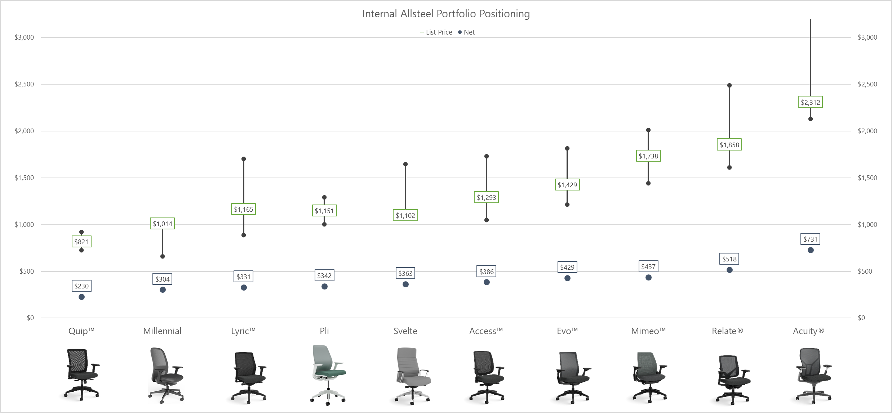
Internal Positioning
INTERNAL TRAINING

Slide 5
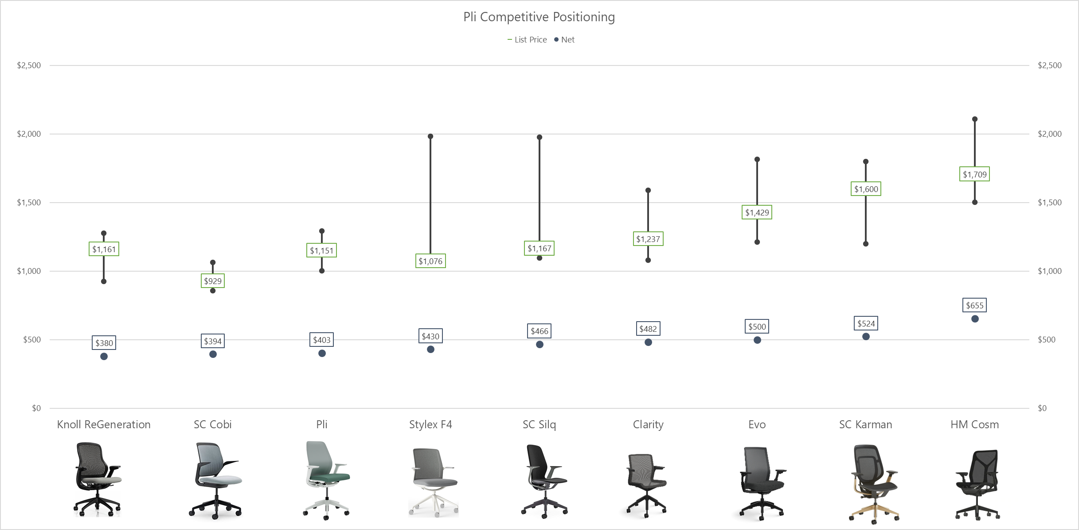
Competitive Positioning
INTERNAL TRAINING

Slide 6
Pli Launch Timing
OPEN FOR ORDERS March 15, 2022
Price List & Spec Guide (Online) March 2022
20/20 & Symbols Publication March 2022
Allsteel Communications February 2022
First Shipment March 2022
Brochure March 2022
Showroom Integration March 2022
Questions?
Derek Vickroy: vickroyd@allsteeloffice.com
INTERNAL TRAINING

Slide 7
FAQ
Q: What is the key differentiator between Pli task and Allsteel’s other task chairs?
A: Pli is a task chair that provides an auto-fitting comfort that is attained through two innovative design features. The first is a four-point seat suspension system that naturally responds to a user’s shifting movements. The second is a backrest that’s been purposely engineered to reduce the perception of a rigid perimeter like that found on most traditional mesh back designs.
Q: What type of control mechanism is available on Pli? What are its adjustment features?
A: Pli uses a weight-activated control mechanism along with a four-point suspension that automatically responds to the weight of each user. As a scaled-down, simpler chair, it has two standard adjustments – pneumatic height adjustment and upright tilt lock.
INTERNAL TRAINING

Slide 8
FAQ
Q: Where does Pli position itself within Allsteel’s seating portfolio?
A: Pli fills the $1,000 - $1,250 gap between Lyric ™ and Access ™ models.
Q: How many mesh and frame colors are offered on Pli?
A: Pli uses the same mesh as Evo, utilizing five mesh colors within the offering. Along with this, there are four frame colors offered on Pli – Black, Flint, Titanium, & Salt.
INTERNAL TRAINING

Slide 9
FAQ
Q: Is there a lumbar available on Pli?
A: No. The mesh back is designed to mirror the spine of a user, providing ergonomic support in the lumbar continuously.
Q: What are the main applications that Pli fits?
A: Pli is designed for an all-day sit and is specialized around the individual, though can be used for assigned or unassigned ownership. Open desking/benching and agile environments are becoming more inherent in the workforce. Pli is intended to capitalize on this emerging application segment.
INTERNAL TRAINING

Slide 10
Appendix

Slide 11
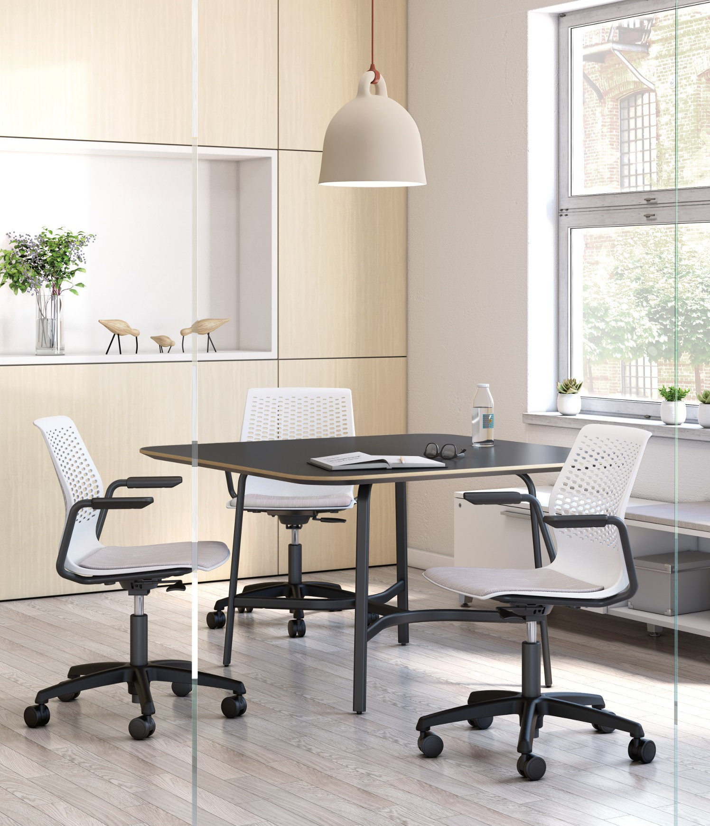
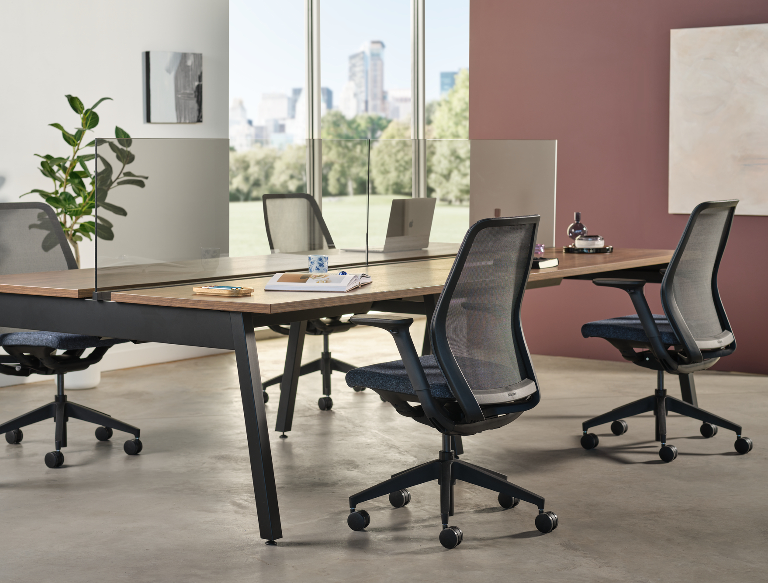
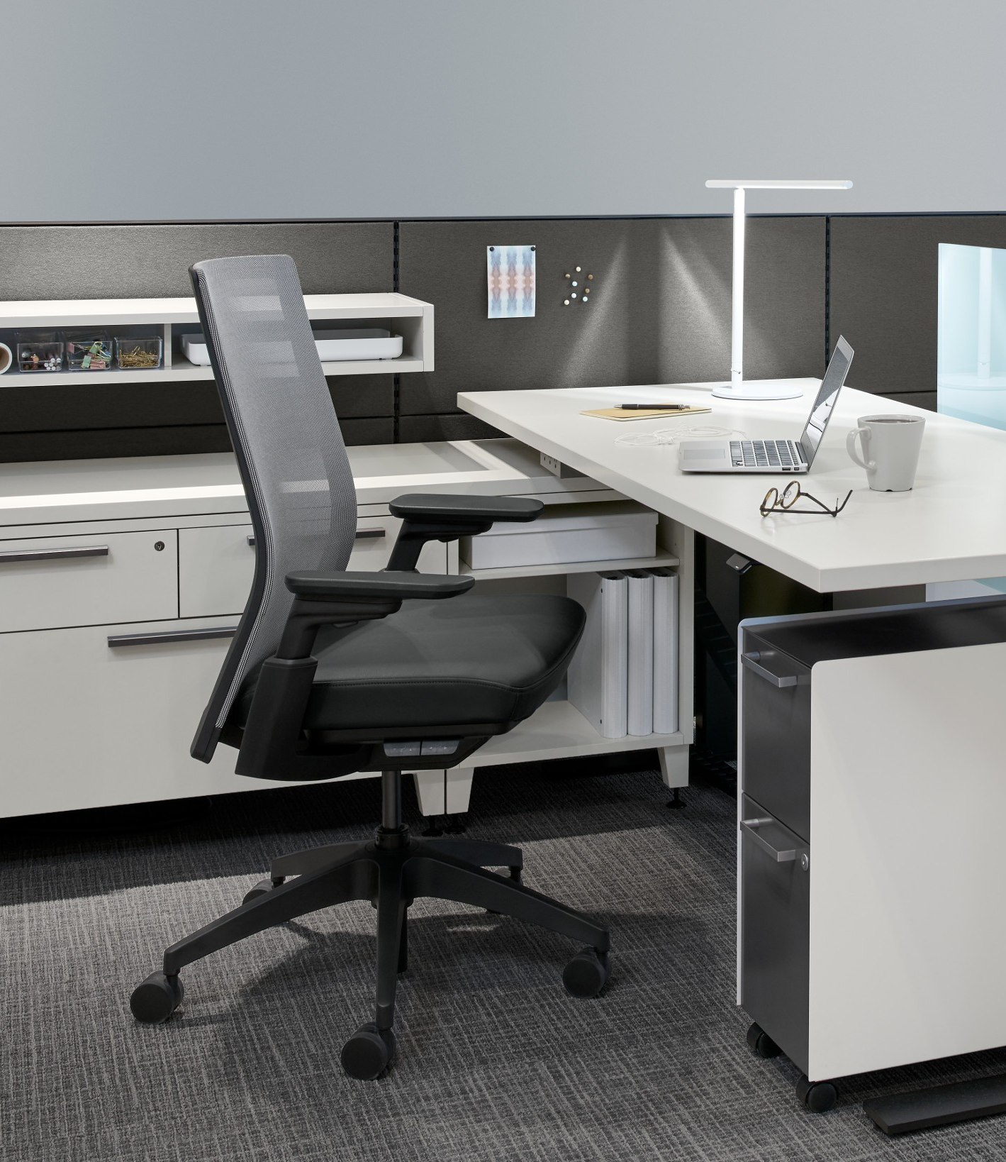
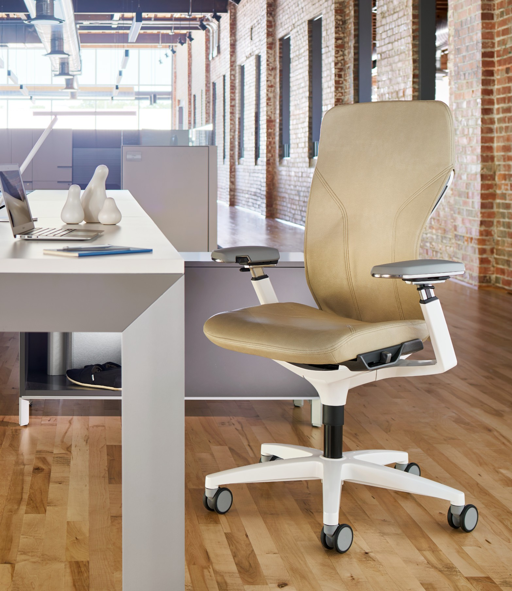
Task Seating
Informal “We”
Collaborative Task
Unassigned “I”
Alternative Task
Assigned “I”
Traditional Task
Formal “We”
Executive Task
Temporary Sit (1-3 hr.)
Short- or Mid-term (2-8 hr.)
Mid-Term or All Day (4-8+ hr.)
Small team use for planned and/or impromptu work.
Applications
Huddle rooms, small conf./meeting and open-plan touchdown.
Specialized around the individual (assigned or unassigned).
Applications
HATs, desking, benching, open-plan workstations and agile.
Dedicated to the individual w/ an ergo-centric feature-set.
Applications
Open-plan/traditional workstations, HATs and private office.
Object furniture, rich design w/ premium use of materials.
Applications
Private offices, formal/lg. conference rooms + executive spaces.
Pli
Notes:
The category of task seating has and continues to split into multiple segments that address varying degrees of ergonomic adjustability, scale, price and design. On one side, there is a segment that serves to address true-ergonomic needs: offering weight-activated control, seat slide adjustment, multi-point tilt lock and more. This segment demands direct user-engagement to find, and dial in comfort. These solutions are also typically dedicated to and owned by the individual.
A new and emerging segment within task seating however realizes that most users want a comfortable sit without being required to fine-tune their support. Naturally, product solutions on this side of the spectrum are specialized around the individual, though can be assigned or unassigned in terms of their actual ownership. This is due to their inherent application focused around desking, benching, open plan workstations and agile environments. As this segment continues to grow, Allsteel’s introduction of Pli, not only intends to provide the market with a solution that’s designed to ergonomically support its user, but one that has been scaled to reach the continued reduction in real estate, and a workstation footprints.

Slide 12
Short to Mid-term Sit
Hoteling & Shared Spaces
Open Benching
Touchdown Workstations
Hybrid Work
Notes:
Short- or Mid-term Sit (half day, 4-5 hours)
Work environments have been adjusting more and shared space seating is needed. With Hybrid work, workers are traveling into the office a portion of the week and working from home the other days. There is a shift in designated individual workstations and hoteling, where the individual using the space is different sometimes day-to-day, and sometimes morning to afternoon. With Pli’s easily adaptable ergonomic support and comfort, it is painless for multiple individuals to use Pli throughout the day.
Hybrid Work: Community spaces rather than designated individual space to accommodate for the constant transitions
Paired with Further A-Frame benching
Touchdown workstations for shared working space or traveling individuals (sales team, remote workers, etc.)
Hybrid work schedules are becoming more prevalent, some companies are providing shared spaces for when workers come into the office.

Slide 13
Temporary to Short-term Sit
Multi-functional Use
Hosting Visitors
Project Room
Community Room
Training Room
Notes:
Temporary Sit (1-4 hours)
With the evolving workplace, business environments have drastically changed, and the demands of a task chair have shifted. No longer do individuals exclusively work from their desk or workstation throughout the entirety of a given day. Instead, the use of conference/collaborative rooms have been heavily employed, this means a variety of different individuals can be using the same chair in a given day, for an extended sit. Furthermore, the evolving workplace demands a chair that offers comfort to a wide variety of "sits"/individuals, a shift from private work-spaces to collaborative work settings.
Ability to host visitors and provide comfortable designated workspaces for them
Moving towards more community spaces rather than designated individual space to accommodate for the constant transitions
Great for project rooms, community room, training room

Slide 14
All Day Sit
Solo Spaces
Individual Workstation
Paired with Height-Adjustable Tables
Notes:
Long-term Sit (Full day, 4-10 hours)
With its ergonomic and comfort capabilities, there is the opportunity for Pli being a chair used for a full day-to-day sit.
Pairing Pli with HAT workstations enhances the idea of a healthy balance between standing and an active sit throughout the work day.

Slide 15
Refined Aesthetics
Notes:
The ability to spec monochromatic, in four frame color options. Black, Flint, Titanium, and salt.
A clean edgeless back with approachable design

Slide 16
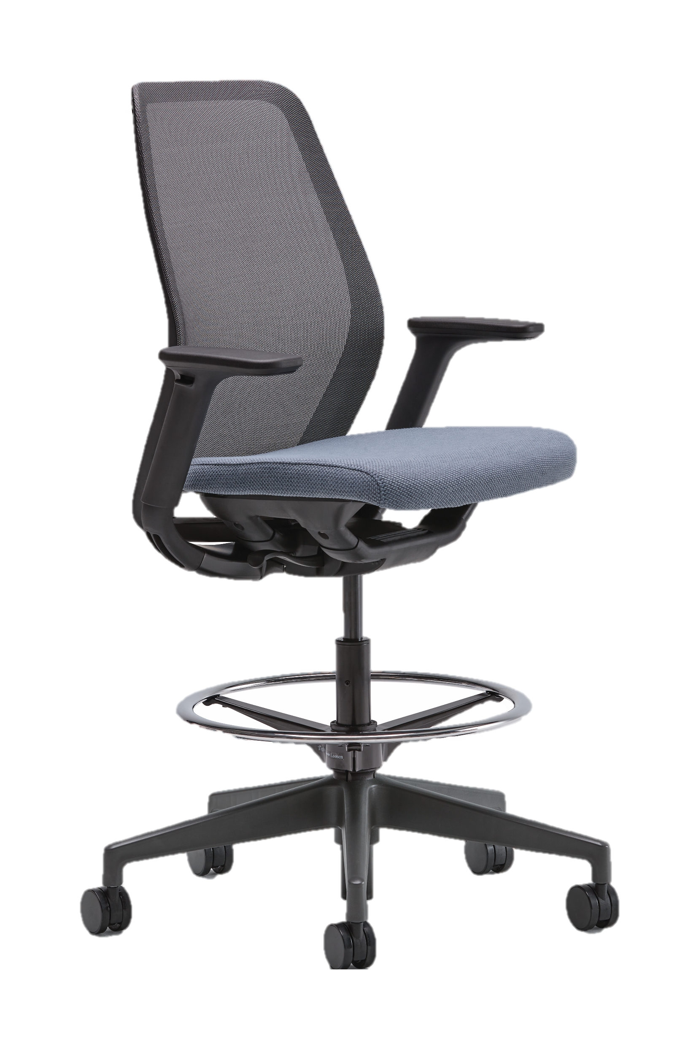
Statement of Line
Task Chair
Task Stool
Height-adjustable Arms
Fixed Arms
Armless
Height-adjustable Arms
Fixed Arms
Armless
Notes:
With an array of Finishes and Mesh options, designers can create consistency across the floorplate and have a variety of task chair options.

Slide 17
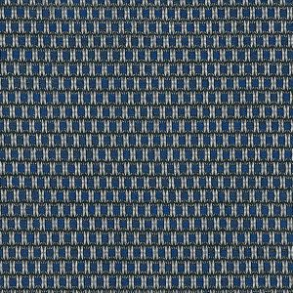
Design Options
Arm Options
Height-Adjustable
Fixed
Armless
Mesh Colors
Dusk
Mist
Lustre
Clay
Navy
Cylinder Options
Standard
Short
Extended (stool)
Frame Colors
Black
Flint
Titanium
Salt
Base Colors
Black
Flint
Titanium
Salt
Caster Options
Black Hard Tread
Black Multi-Surface
Titanium Multi-Surface
Flint Multi-Surface
Salt Multi-Surface
Configurator

