Slide 1
Sales & Dealer Training
INTERNAL USE ONLY

Slide 2
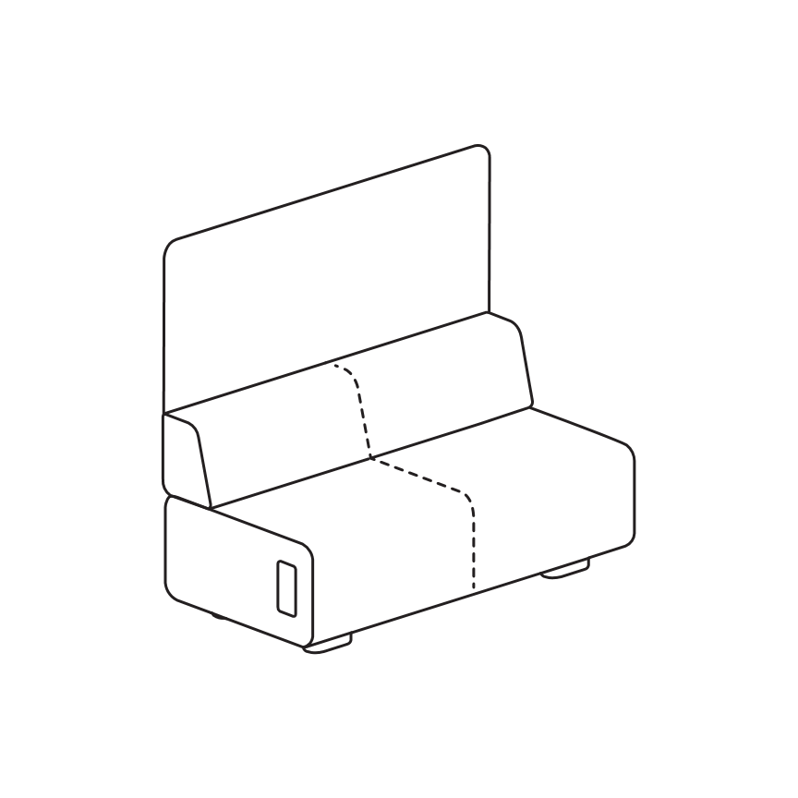
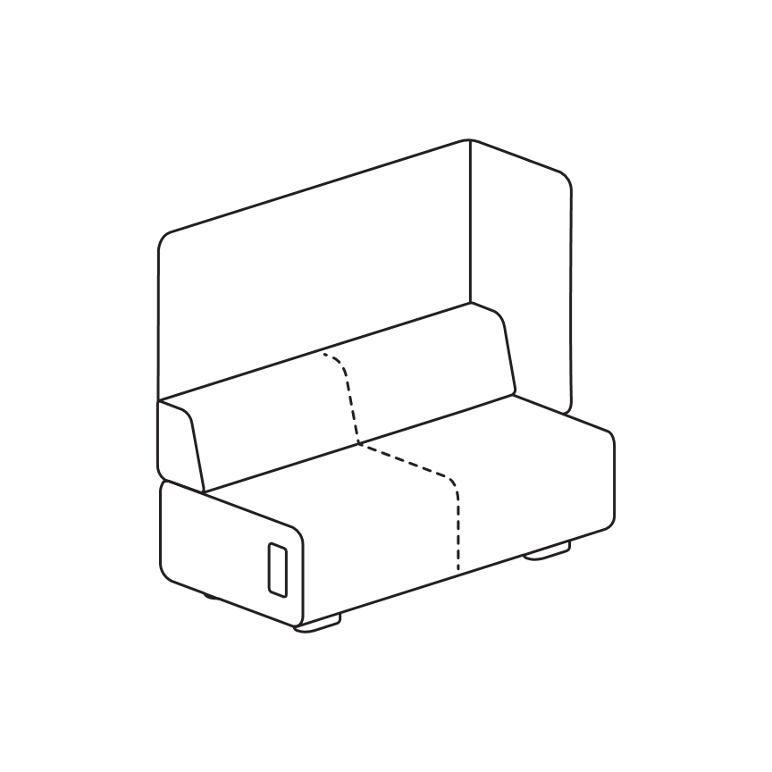
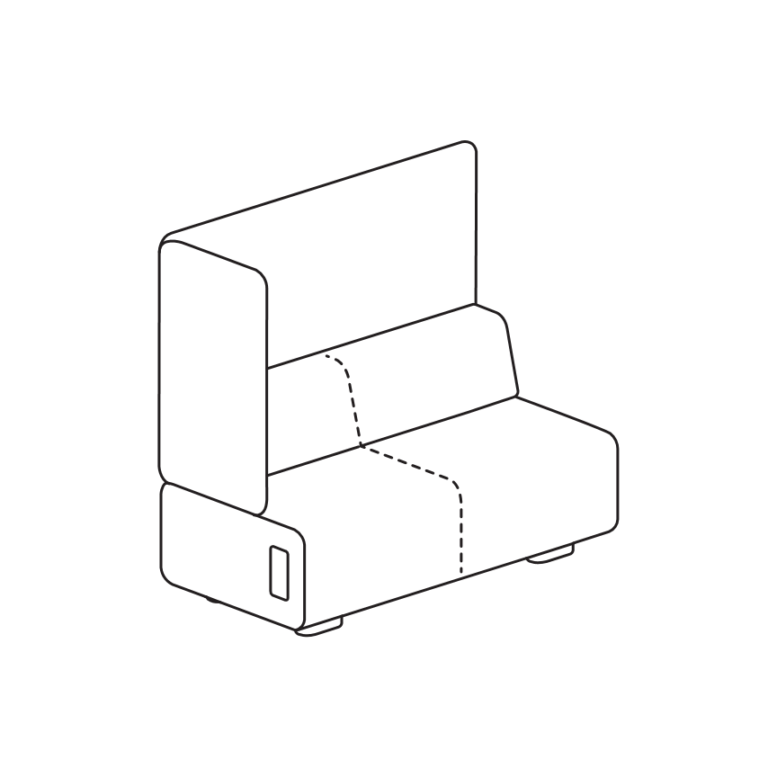
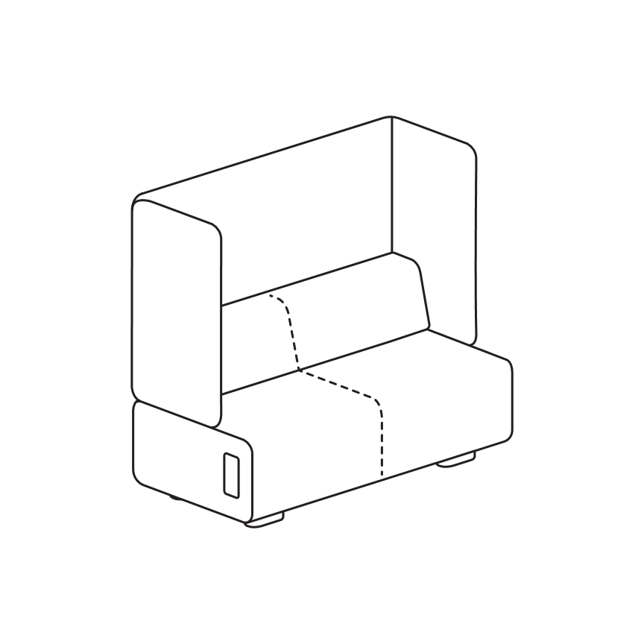
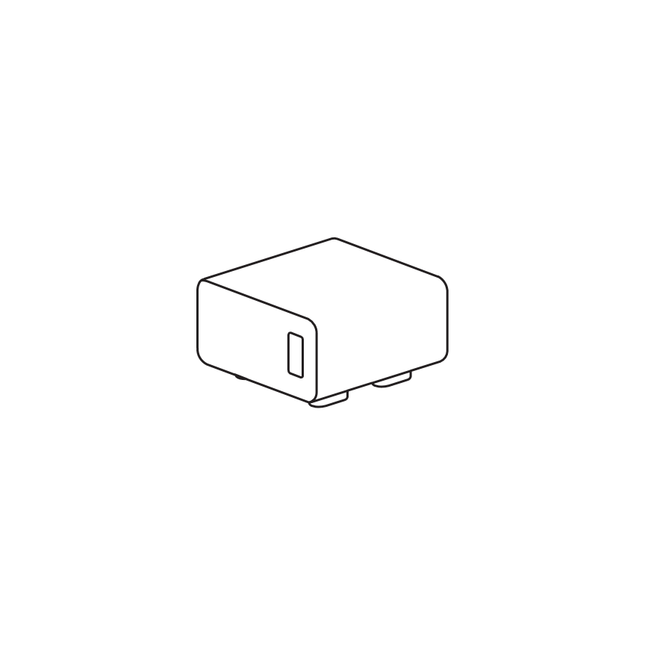
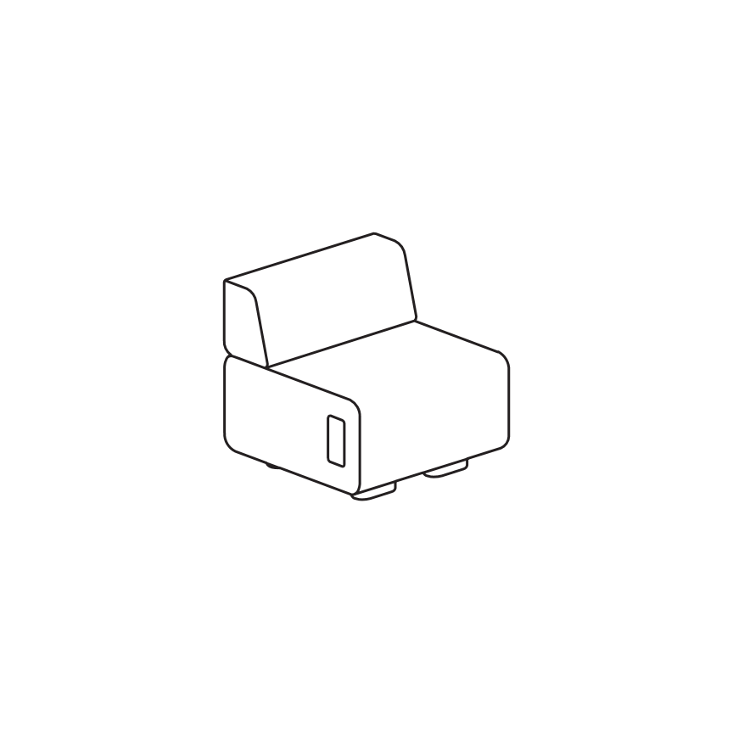
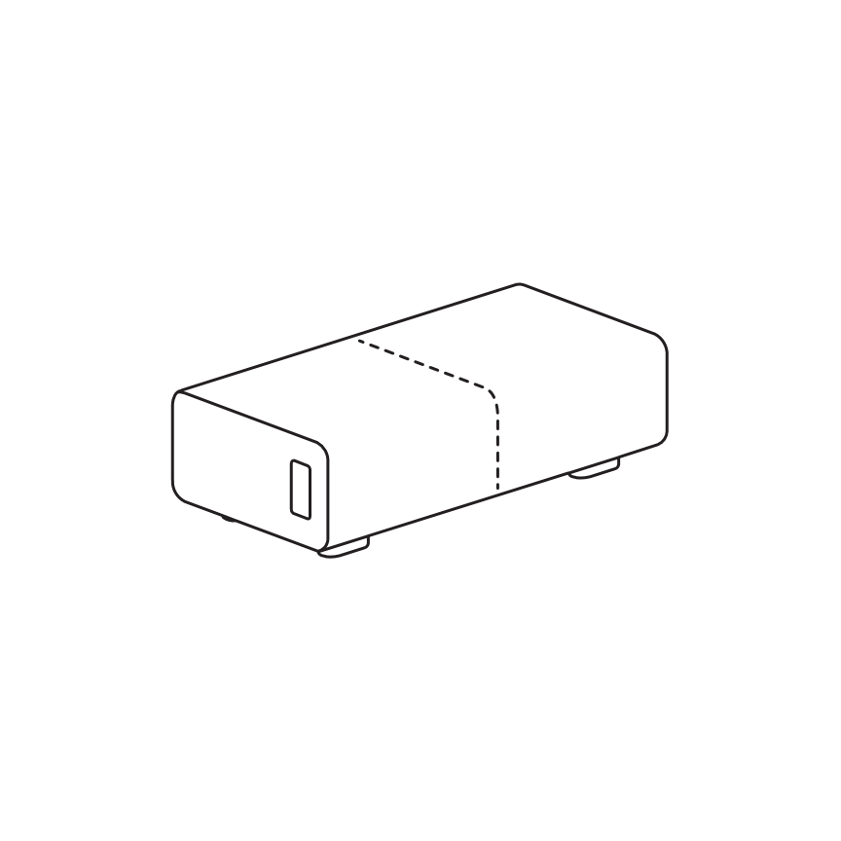
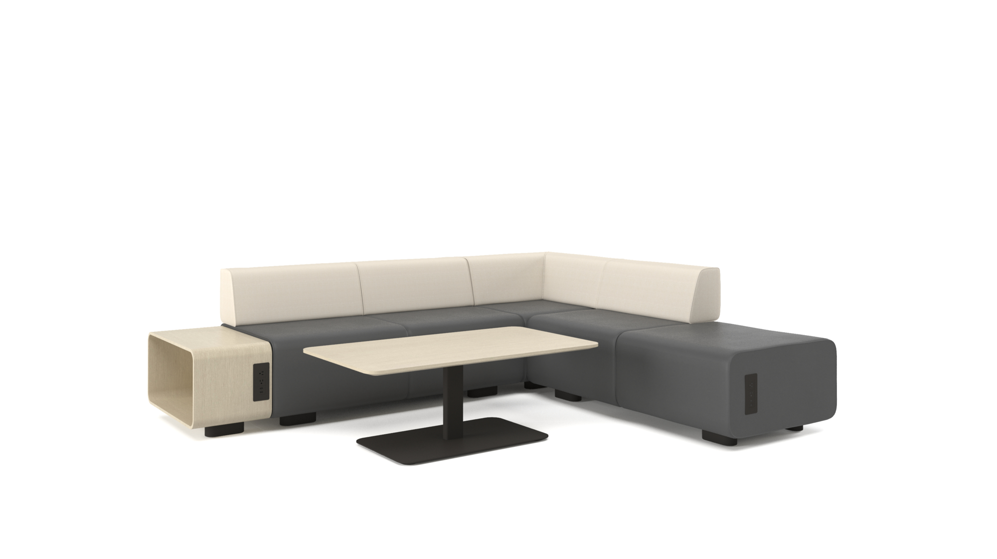
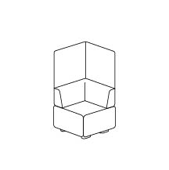
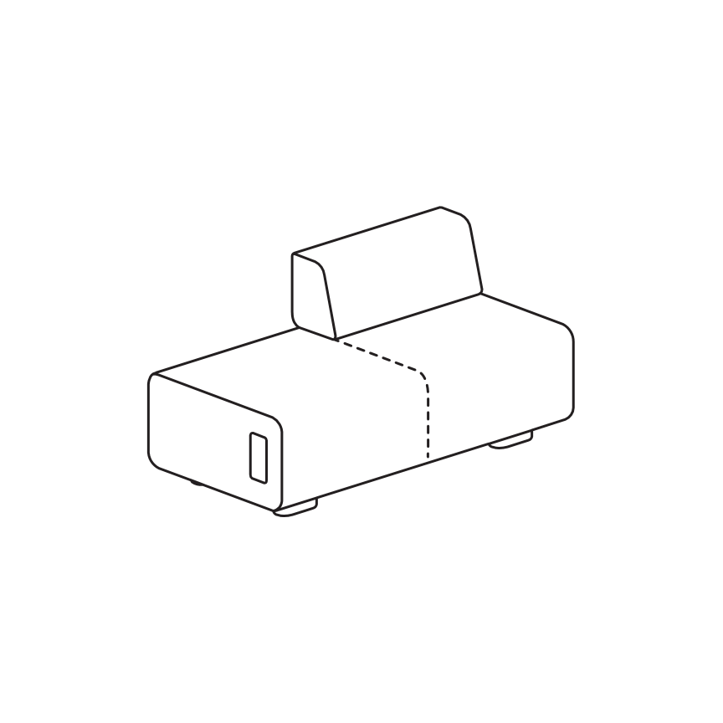
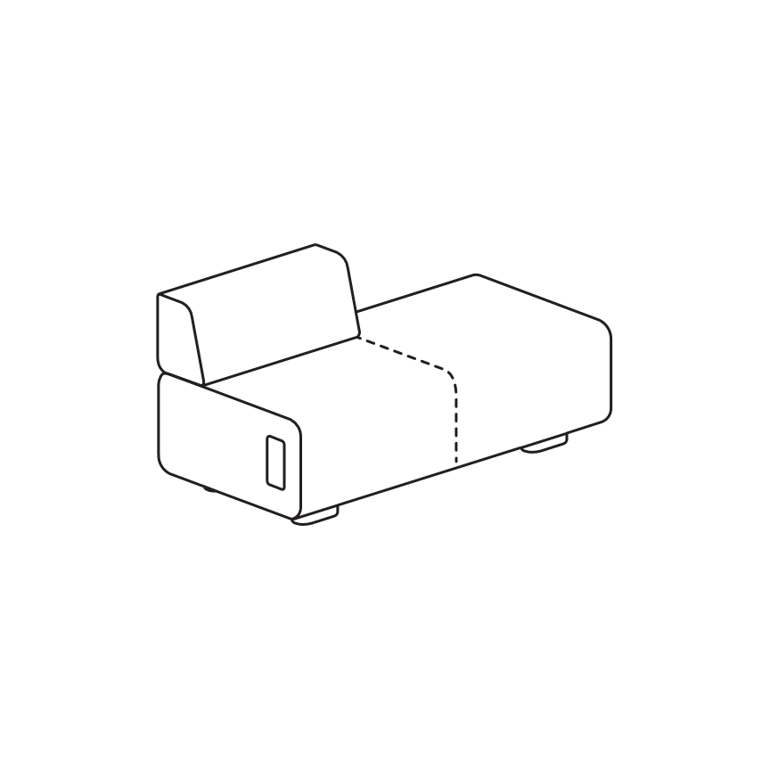
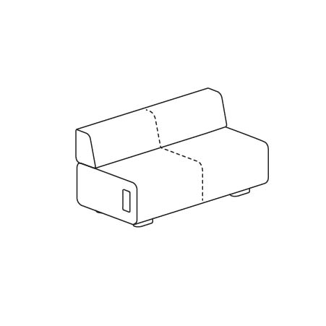
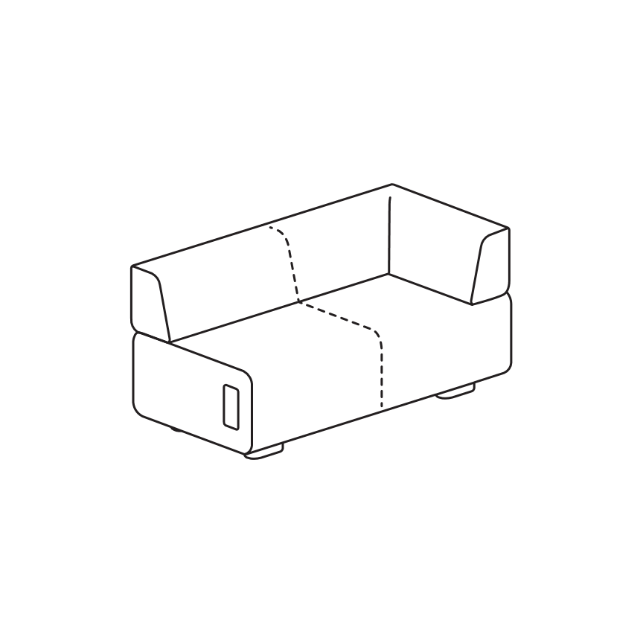
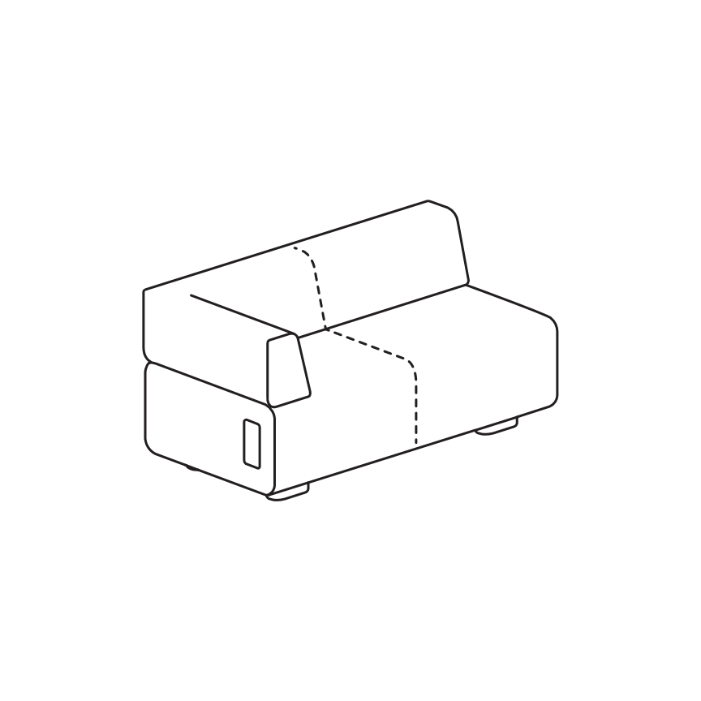
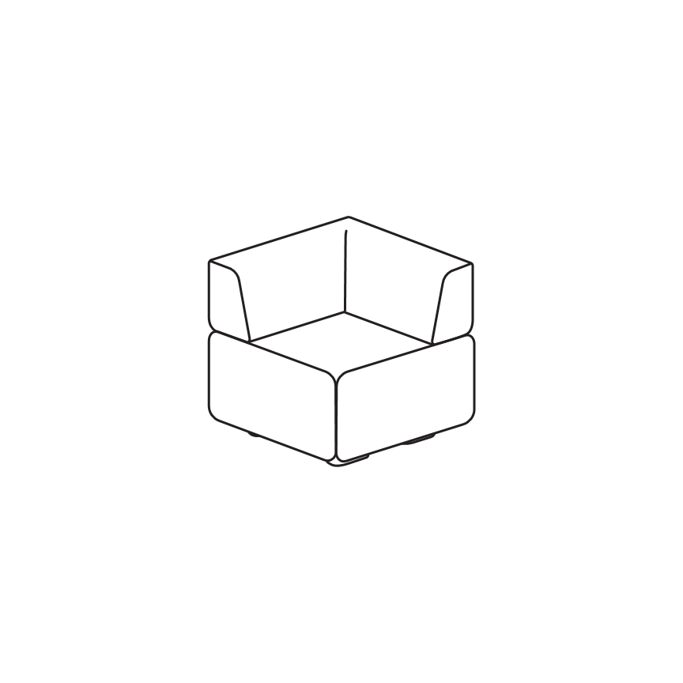
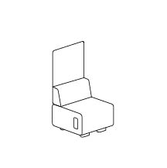
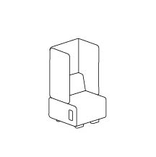
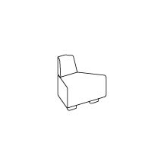
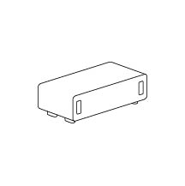
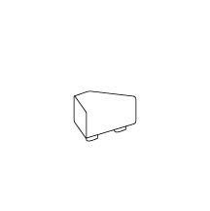
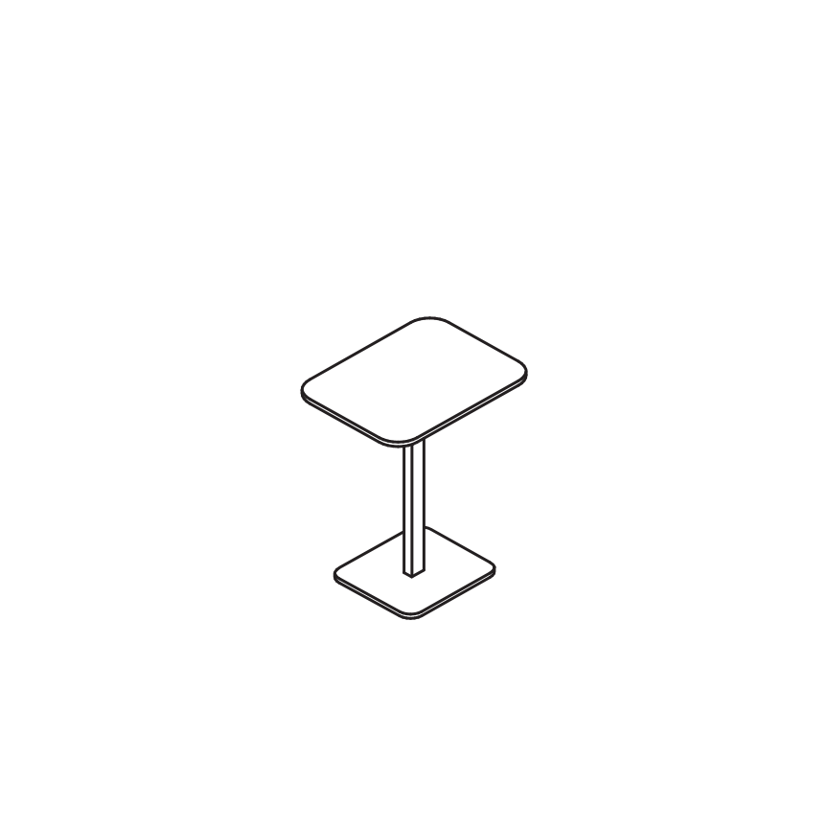
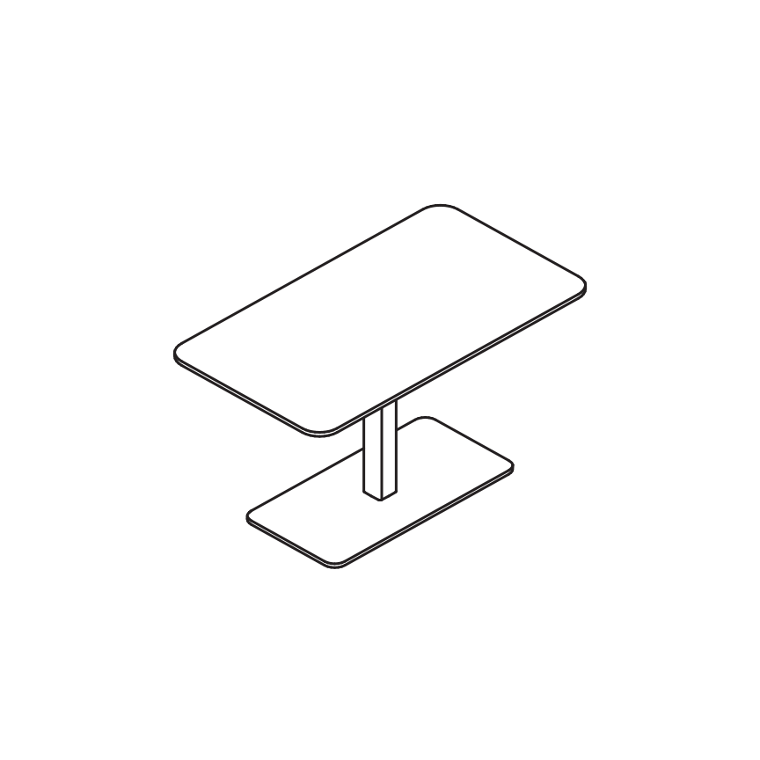
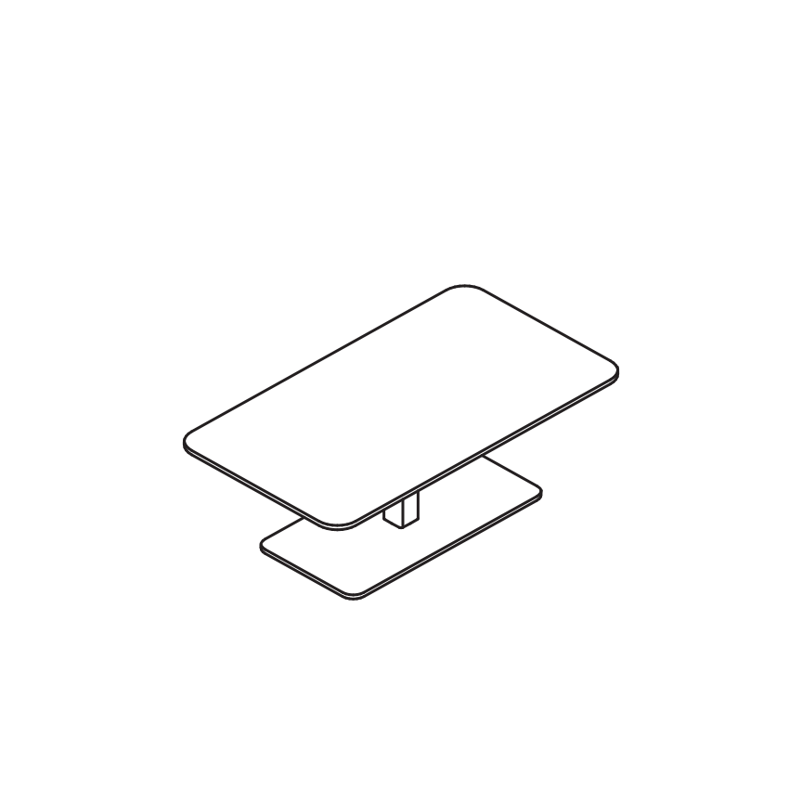
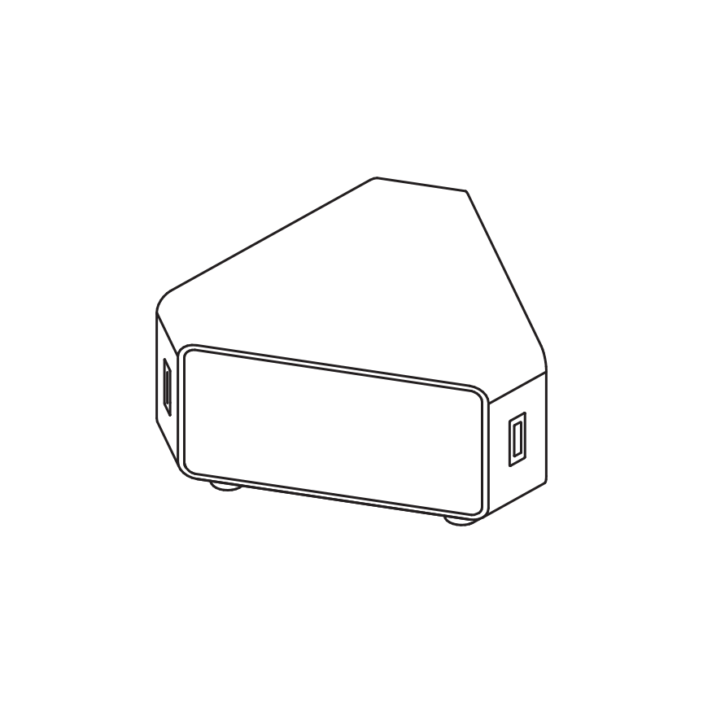
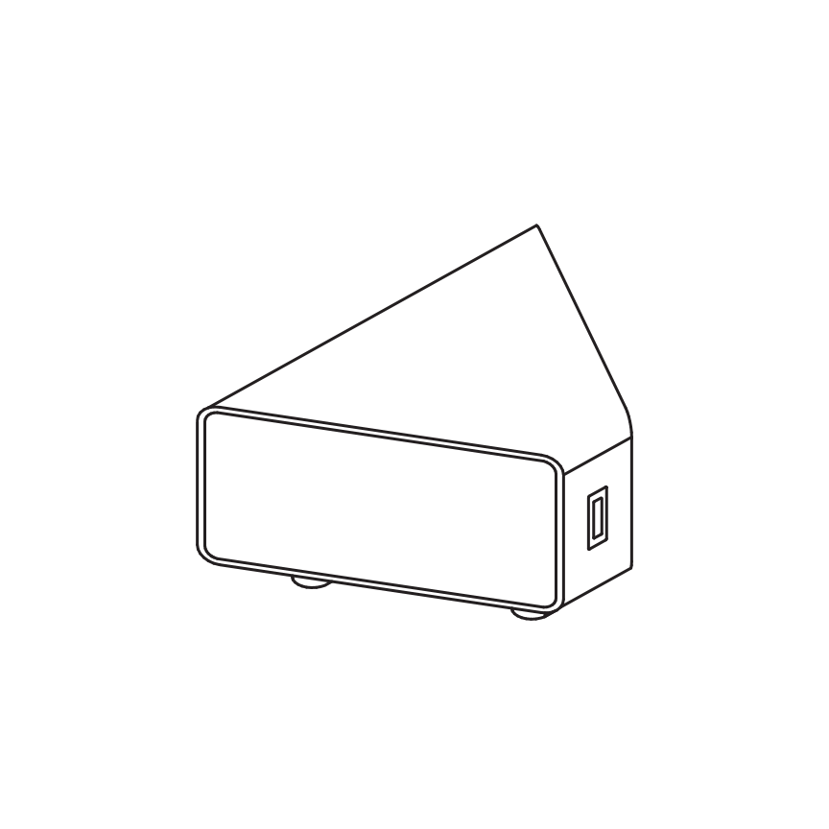
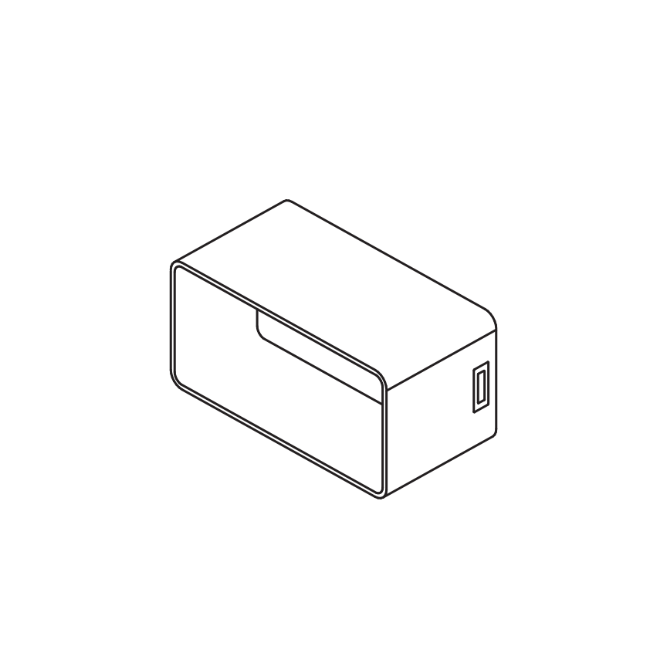
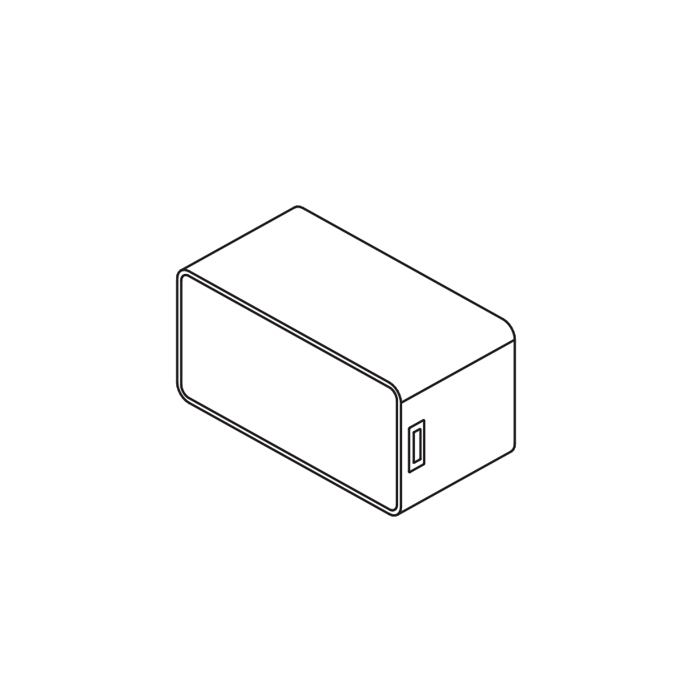
Building Blocks
Statement of Line:
Double Seat with Straight Screen
Double Seat with
Left L Screen
Double Seat with
Right L Screen
Double Seat with
U Screen
Single Seat
Single Seat With Bolster
Double-Seat Bench
Double-Seat with
Left Half Bolster
Double-Seat with Right Half Bolster
Double-Seat with Double Bolster
Double Seat with
Left L Bolster
Double Seat with
Right L Bolster
Square Corner
Square Corner L Screen
with Bolster
INTERNAL TRAINING
Single Seat Straight
Screen with Bolster
Single Seat U Screen
with Bolster
End Cap
60 degree Inside Corner
with Bolster
60 degree Outside
Corner with Bolster
60 degree outside
Corner
90 degree Inside Corner
with Bolster
90 Degree Corner
Laptop Table
Work Table
Coffee Table
Corner Side Table
Square Pouf ​
Round Pouf ​​
120 x 3 Connector Table
120 x 2 Connector Table
Single Connector
Single Connector

Slide 3
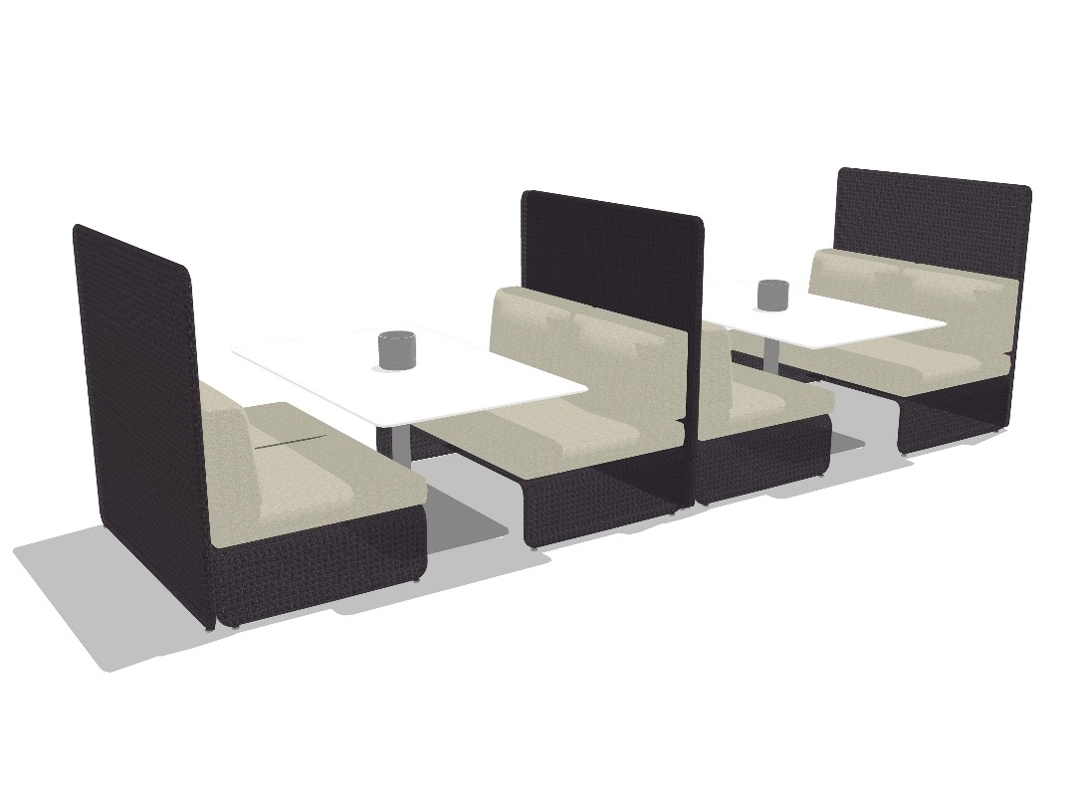
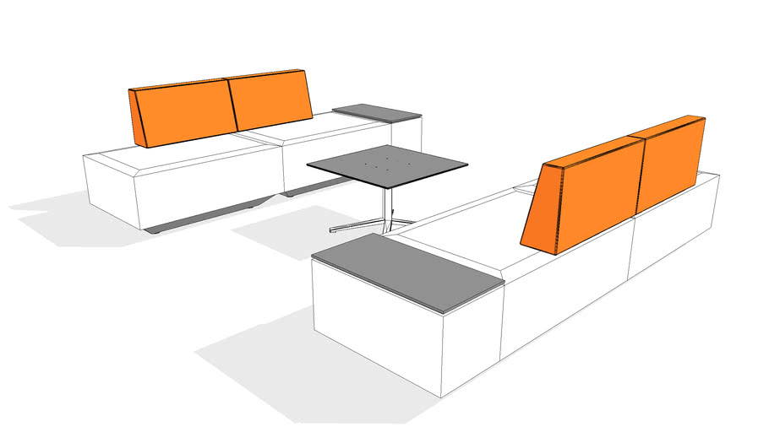
Recharge Competitive Talking Points
Coalesse Lagunitas
Recharge has a softer, more comfortable sit
Aftermarket power port is mounted under the seat; wiring is not concealed
Does not have planning flexibility supported by concise kit-of-parts like Recharge
Teknion DNA
Recharge has a softer, more comfortable sit with a bolster that has a softened angle and more cushion
Both maintain a fixed planning module, but DNA cannot create continuous runs of seating with uninterrupted back support like Recharge can
Power can only be integrated using additional tables
INTERNAL TRAINING

Slide 4
Customers to Target with Recharge
I'm looking for a furniture solution to provide privacy instead of architecture
I am a designer looking for a calm, understated design for soft seating products
I want a singular collection that can accommodate solo spaces, team spaces, and community settings
INTERNAL TRAINING
I want integrated power, but I want to maintain flexibility and concealment
I’m looking for a collection of components that allow me to apply creativity to meet my specific needs
I don't need to move my products on a daily basis, but want to address future unknown needs

Slide 5
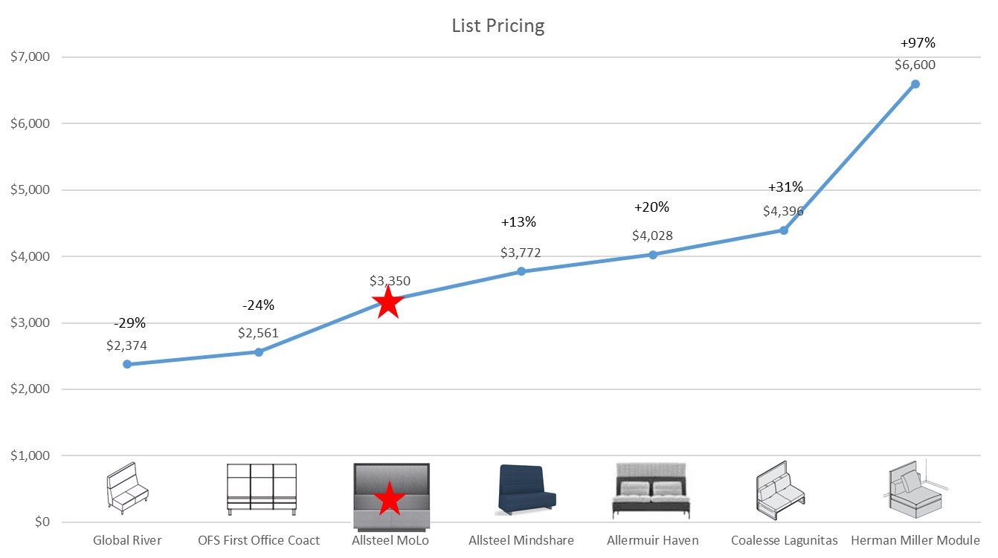
Recharge vs. Key Competitors
Private Work Space
Double seat w/ straight double bolster w/ back screen
No power included in units
INTERNAL TRAINING
Allsteel Recharge

Slide 6
Surface Materials
Materials Timing
Order via standard literature process post-Market Launch
Sample kits of mesh material will be available to the resource centers at launch
Dual fabrics
Dual fabrics standard (option 1 seat, option 2 back bolster (if applicable))
Contrast welt cord option available (on seat and back)
Large subset of Allsteel standard and partnership fabrics available at launch
COM’s available after 90 days post launch
Laminates
Merge knife edge detail for all table tops (work and coffee)
Laminate availability for table tops similar to Vicinity tables
Laminate connectors available in 2 standard finishes; designer white and flint
In stock; no lead-time obstacles
Non-standard finishes must go through TPG and pricing is subject to quantity ordered (less than 5 will incur a significant upcharge)
Woodgrain is not recommended for 3x120 connectors as woodgrain will not be able to match between top and bottom sections.
INTERNAL TRAINING

Slide 7
Frequently Asked Questions
Q: What is the BIFMA rating?
A: 300lbs per seat, including bolster tops
Q: Can I get COMs?
A: There will be a 90-day hold for COMs on this product to facilitate initial production and ramp. Post 90-days the standard COM procedure will be available.
Q: Can I get connectors in finishes other than white or flint?
A: White and flint are the only finishes available with standard lead-times and listed pricing. Additional finishes can be requested through TPG but pricing is tied to MOQ of 5 units or more. Significant cost increases can incur for orders less than 5.
Q: What about woodgrain on connectors?
A: Same standards apply. Grain will match on single and 120x2 connectors, but the 120x3 will have 2 sides as an imperfect match. Images do exist on Synergy to show detail.
INTERNAL TRAINING

Slide 8
Frequently Asked Questions
Q: Are the units flush when put back to back?
A: Yes, both models with and without screens will be flush when put back to back.
Q: Are dual fabrics available?
A: Yes, they are a standard option with no upcharge. The duality is the seat and the bolster, which differs from Rise or Linger.
Q: What’s the deal with welt cords?
A: In an effort to soften the visual look and make it a more familiar soft form there are welt cords. They are available as a standard .option and can be contrasted for a unique look.
Q: What’s the planning footprint?
A: All soft seating is built on a 29” platform per seat. Single seats are 29” square, double seats are 29”Dx58”W
INTERNAL TRAINING

Slide 9
Frequently Asked Questions
Q: What kind of material is the screen?
A: Knit, similar to a sweater or some performance footwear. It has passed multiple iterations of durability testing and a video to address snags will be available on Synergy.
Q: Do I detect a pattern on the screen?
A: Yes, there is an opacity gradient and a subtle pattern to promote more light through the top and signal a form when the unit is in use.
INTERNAL TRAINING

Slide 10
Appendix

Slide 11
A compact setting for individual or two-person work can be created with one Recharge bench, bolster, and small work table.

Slide 12
Poufs add extra seating and connector tables add a work surface and a place to stow a bag while still providing power.

Slide 13
Large Recharge tables provide support surface for four people
and are offered in lounge or active work heights.

Slide 14
90° bolsters are useful in creating compact lounge spaces
which are inviting alternative work areas.

Slide 15
Benches can be ganged end-on-end to create touch down seating in underutilized hallways or to divide space on an open ﬂoor plate.

Slide 16
Distinct work zones can be created by adding bolsters, connector tables, and work tables.

Slide 17
Privacy screens create areas for focused work in open spaces.

Slide 18
Privacy screens stay within the bench footprint allowing back-to-back and end-on-end ganging without taking extra ﬂoor space.

Slide 19
Left and right privacy screens can come together to form larger spatial divisions.

Slide 20
Larger unscheduled settings can be used by several individuals working separately or one large group working together.

Slide 21
Presentation areas can be made with benches and 120° connector tables.

Slide 22
Branching forms can grow into sculptural seating environments for large atriums and public spaces.

Slide 23
Clusters of ottomans with 90° bolsters provide distinct seating options for individuals in large common-use or public spaces.

