Slide 1
Rise™
Sales & Dealer Training
INTERNAL USE ONLY

Slide 2
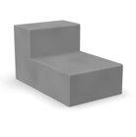
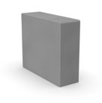
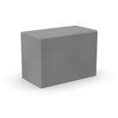
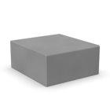
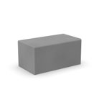
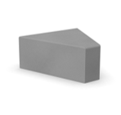
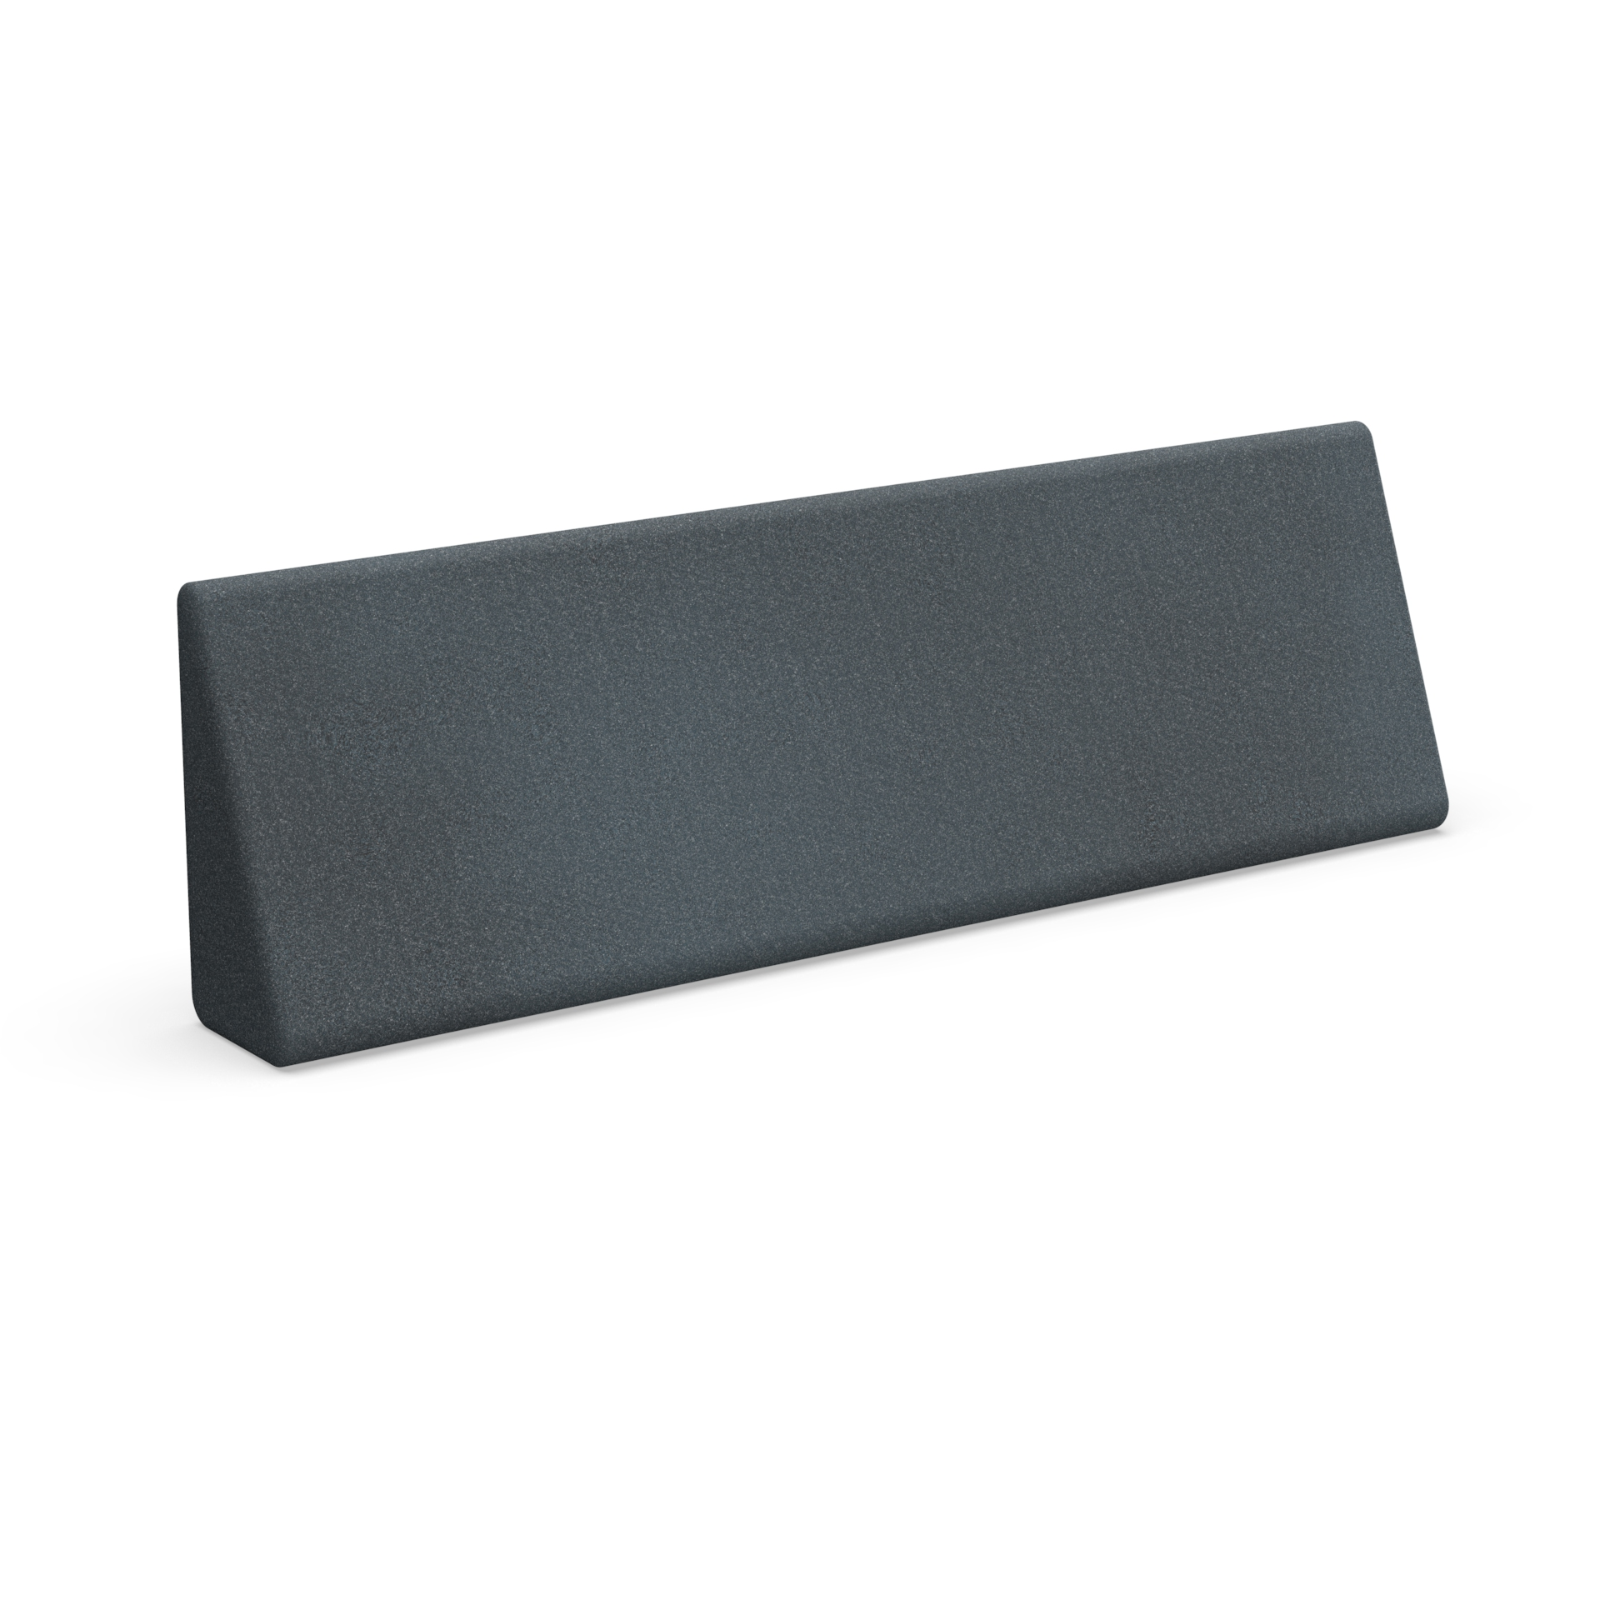
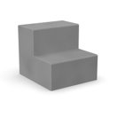
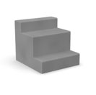
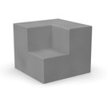
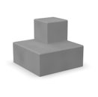
Internal Training
Statement of Line & List Price
New Seating Models
Chaise*
Non-Power - $2,450
Power-Ready - $2,513
2-Tone Non-Power - $2,637
2-Tone Power-Ready - $2,700
Triangle*
Non-Power - $1,800
Power-Ready - $1,863
Arm Perch
Non-Power - $1,800
2-Tone Non-Power - $1,987
Soft Wall
Non-Power - $1,800
2-Tone Non-Power - $1,987
Full Ottoman*
Non-Power - $1,775
Power-Ready - $1,838
2-Tone Non-Power - $1,962
2-Tone Power-Ready - $2,025
Half Ottoman
Non-Power - $1,500
2-Tone Non-Power - $1,687
Lumbar Pillow
$200
Existing Seating Models
2-Tier*
Non-Power - $2,268
Power-Ready - $2,333
2-Tone Non-Power - $2,458
2-Tone Power-Ready - $2,521
3-Tier*
Non-Power - $2,521
Power-Ready - $2,586
2-Tone Non-Power - $2,710
2-Tone Power-Ready - $2,774
Inside Corner
Non-Power - $3,097
2-Tone Non-Power - $3,275
Outside Corner
Non-Power - $3,097
2-Tone Non-Power - $3,275
*Available with or without power.
Pricing is based on Grade 1 textile.

Slide 3
Internal Training
Dimensions
New Seating Models
Chaise*
34"H overall 17"H tiers
36"W
60"D overall 40"/20"D tiers
Triangle*
17"H
10"W front 37"W back
40"D
Arm Perch
17"H x 36"W x 40"D
Soft Wall
34"H x 13"W x 40"D
Full Ottoman*
17"H x 36"W x 40"D
Half Ottoman
17"H x 36"W x 20"D
Lumbar Pillow
10"H x 36"W x 5"D
Existing Seating Models
2-Tier*
34"H overall 17"H tiers
36"W
40"D overall 20"D tiers
3-Tier*
34"H overall 9½"/16"/8½"H tiers
36"W
40"D overall 12"/20"/8"D tiers
Inside Corner
34"H overall 17"H tiers
40"W overall 20"W tiers
40"D overall 20"D tiers
Outside Corner
34"H overall 17"H tiers
40"W overall 20"W tiers
40"D overall 20"D tiers
*Available with or without power.

Slide 4
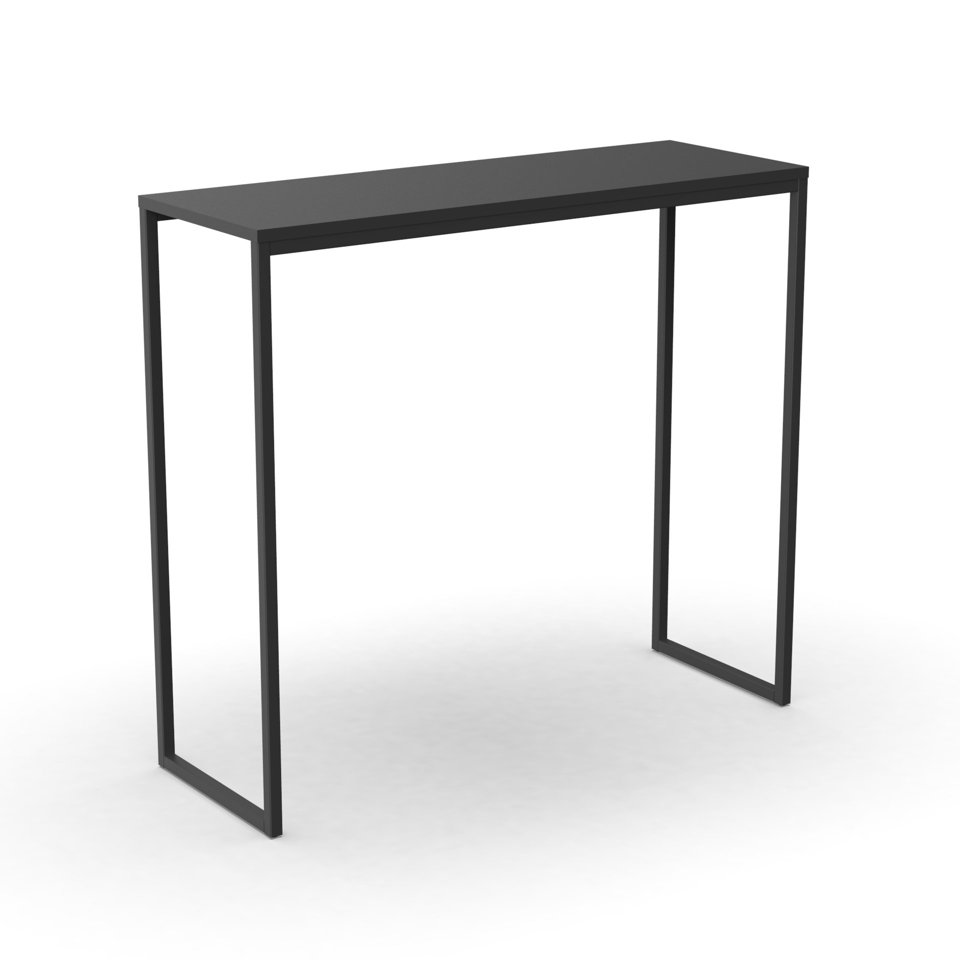
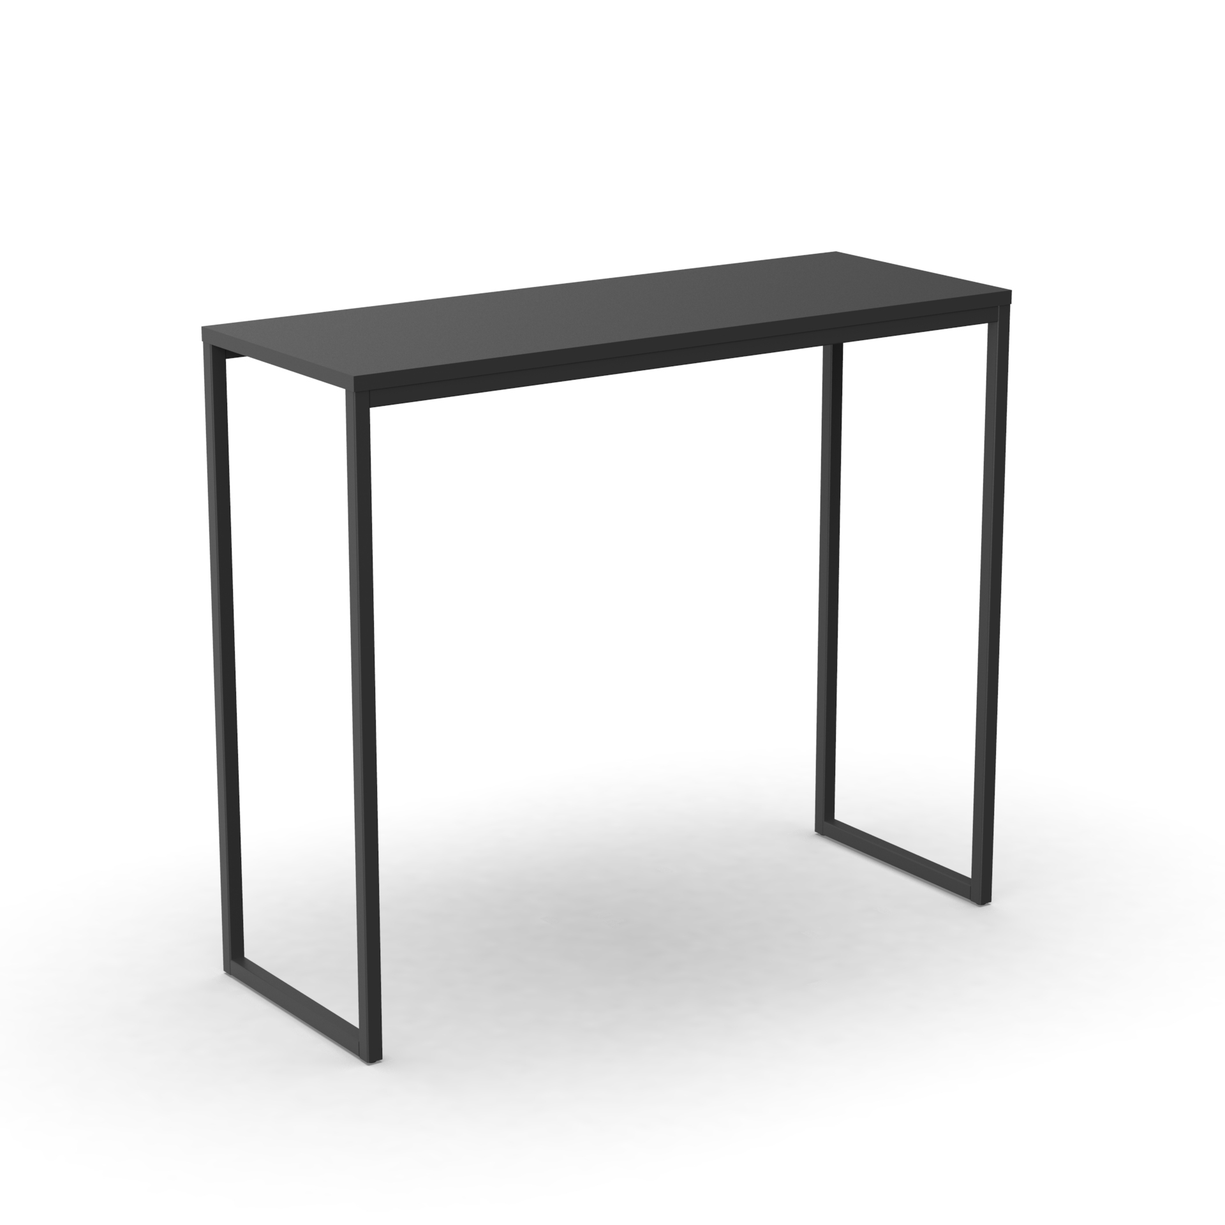
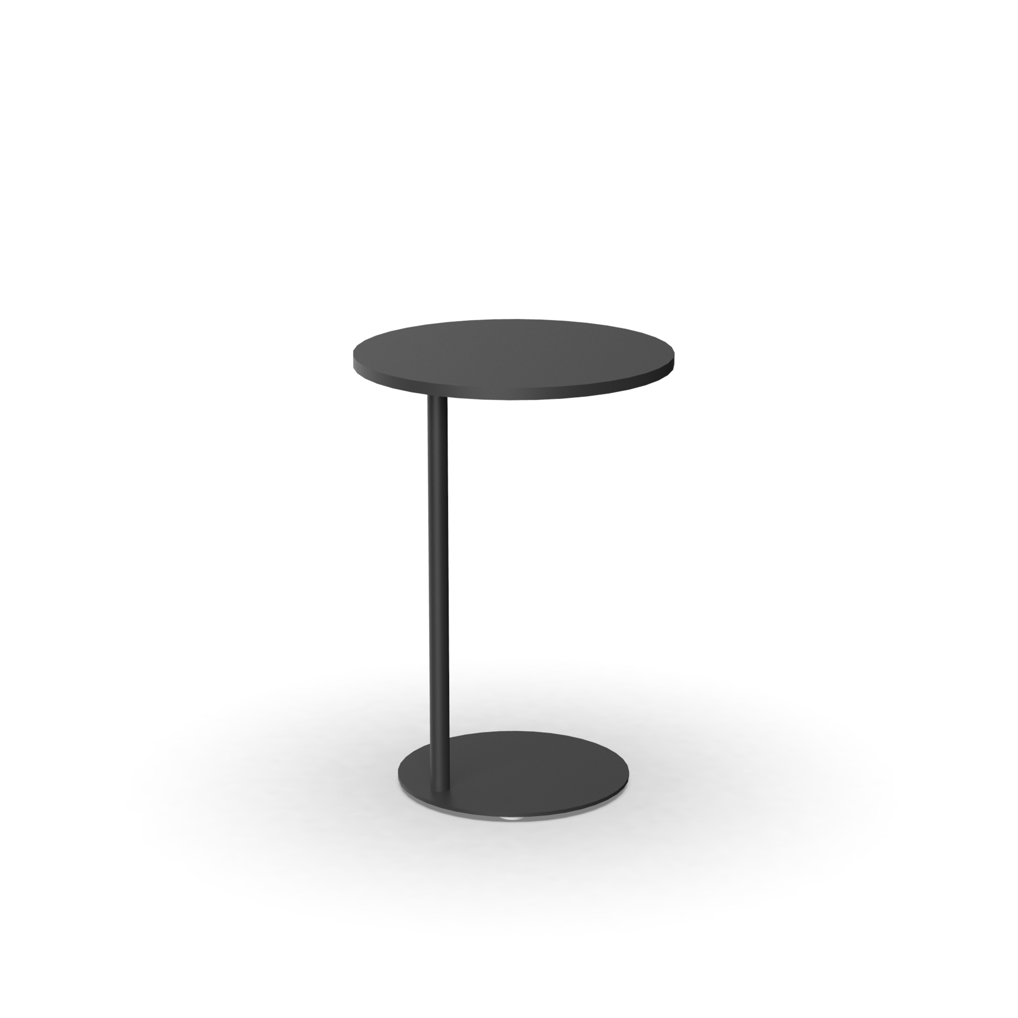
Internal Training
Statement of Line & List Price
Work Tables
High Rectangle Table
Pricing coming soon/Q4 2019 launch
38"H x 42"W x 15"D
Low Rectangle Table
Pricing coming soon/Q4 2019 launch
28"H x 36"W x 15"D
Laptop Table
$700
28"H x 20" Round Top
Pricing is based on L1 laminate and P1 paint.

Slide 5
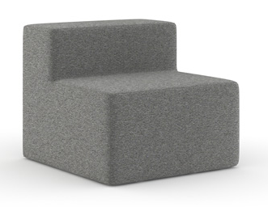
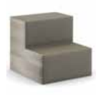
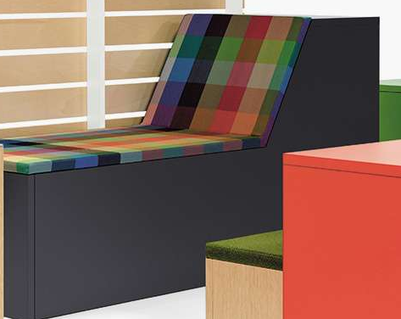
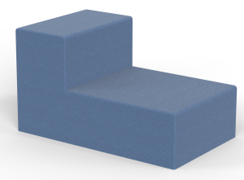
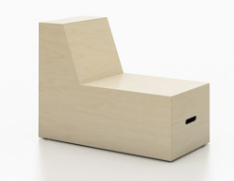
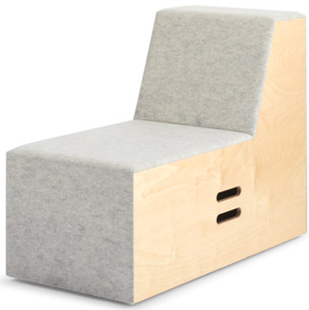
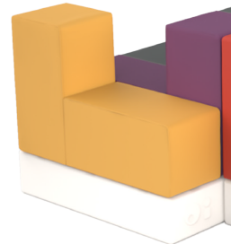
Internal Training
Rise Price Positioning – Chaise

Slide 6
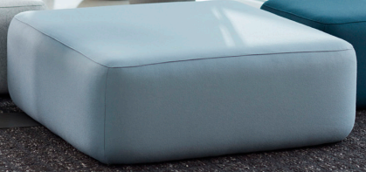
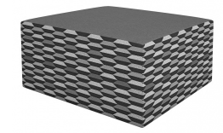
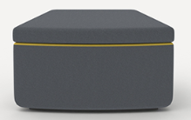
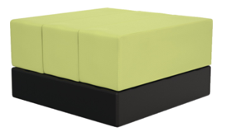
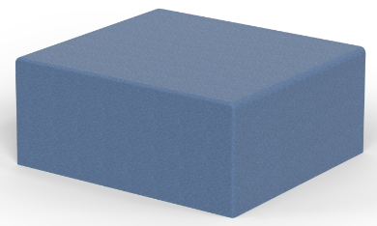
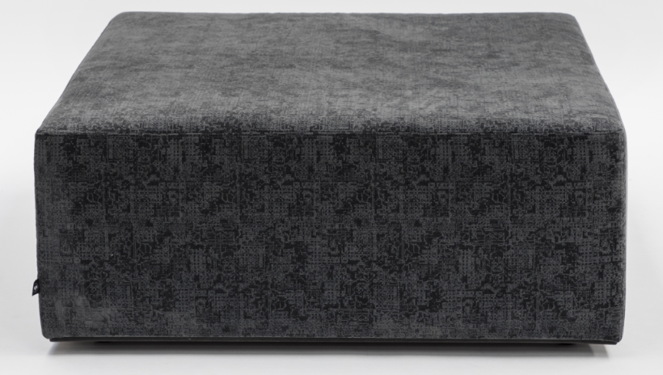
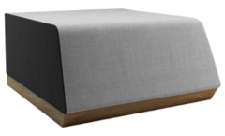
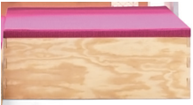
Internal Training
Rise Price Positioning – Full Ottoman
Notes:
Price current to Rise now

Slide 7
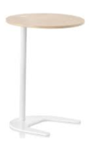
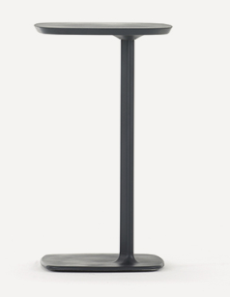
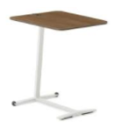
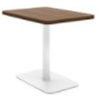
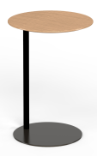
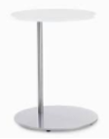
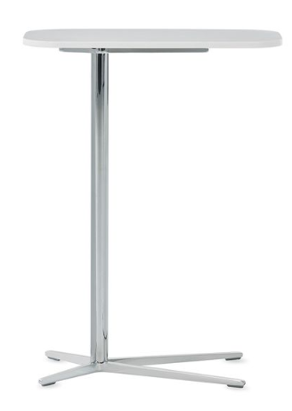
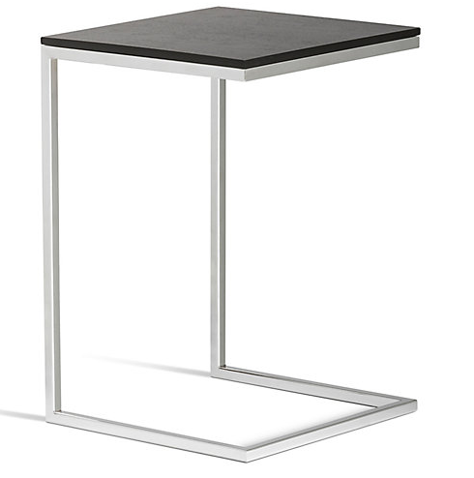
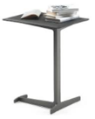
Internal Training
Rise Price Positioning – Laptop Table

Slide 8
Internal Training
Customers to Target with Rise
I want teams to be able to easily change their furniture surroundings.
I want something kind of fun for the space, but it must support collaborative work.
I want team members to feel comfortable in casual team settings.
I’m looking for soft seating that provides support for different postures and sitting positions.
I like furniture flexibility and movability, but I don’t want the mess.
I want furniture that can continuously adapt and evolve to our current and future space needs.
Collaborative furniture is great for group meetings, but there aren’t worksurfaces to support work.

Slide 9
Internal Training
Pre-Sell Launch Timing
PRE-LAUNCH
Press Release & Media Announcement NeoCon
Sample Availability Very limited until launch
Allsteel Sales Team Training Call October 2019
Pre-Sell Package August 2019
AO & Synergy Website Live At Launch
Brochure (Online) At Launch
Pre-Sell Symbols Available Online August 2019

Slide 10
Internal Training
Launch Timing
OPEN FOR ORDERS October 2019 (excluding rectangle work tables)
Allsteel Communications October 2019
Brochure At launch
First Ship November 2019
Allsteel University Integration Fall 2019
Showroom Integration Fall 2019
Spec Guide & Price List (Online) At launch
20/20 & Symbols Publication At launch
Questions?
Product related, Raikkol Cheng: chengr@allsteeloffice.com
Marketing related, Brian Parrott: parrottb@allsteeloffice.com

Slide 11
Internal Training
How to Order
First Order Entry: October 2019
Lead Time: 5-6 Weeks
Pricing:
Standard Terms 55% off
Showroom Discount 75% off
A&D Own Use Program 65% off
Everyday Advantage NA
Eligible for Edge points and counts towards standard sales incentive programs
BIFMA Certified (certificates available in fall)
GSA and Sustainability in progress – not yet available

Slide 12
Frequently Asked Questions
Q: What new pieces are being added?
A: Full and half ottomans, chaise, soft wall, arm perch, triangle, lumbar pillow, and laptop table are available in October. High and low work tables will be available Q4 2019.
Q: What new configurations can be accomplished with the new pieces?
A: Expanded applications, such as island, zig-zag, wave, and serpentine layouts that accommodate more activities and support more postures.
Q: Is Rise movable?
A: Yes. Slide glides are an option for all new shapes. Current Rise shapes (2-tier, 3-tier, inside corner, outside corner) require a separate part order (part # 3130100100; qty. of 4). The plan is to set up new model numbers for current shapes with the slide-glide option built into the specification string.
Q: Will the slide glides work on all surfaces?
A: Slide glides will work on all surfaces, from concrete to carpet. Be cautious with hardwood flooring as scratches may occur, depending on the weight of the unit.
Q: Can you level Rise units? What is the leveling range?
A: Rise units with regular glides or slide glides can be leveled, with an adjustment range of 1½ inches.
INTERNAL TRAINING

Slide 13
Frequently Asked Questions
Q: Are ganging brackets available to make sure Rise can’t move?
A: Ganging brackets are included in the hardware pack. If a soft wall is placed at the end of the configuration, a special ganging bracket (model # S922GB) is recommended to prevent tipping.
Q: Can power be specified on the new units?
A: Power is available on the chaise, triangle, full ottoman, and current 2-tier and 3-tier models.
Q: Is there any change with the electrical?
A: With the launch of new Rise shapes, we are transitioning all Rise electrical kits to Recharge electrical kits. This applies to the current Rise shapes (2-tier, 3-tier) as well. Refer to the updated Specification Guide & Price List online, which is always updated.
Q: What are the available fabrics?
A: Refer to the Specification Guide & Price List online, which is always updated.
Q: Are COMs an option?
A: With similar upholstery requirements as current Rise models, COMs are available at launch.
INTERNAL TRAINING

Slide 14
Frequently Asked Questions
Q: Are dual upholsteries an option?
A: Dual upholsteries are available on the chaise, ottomans, arm perch, soft wall, and current models.
Q: Is leather an option?
A: Leather available on current Rise units is also available on new Rise units.
Q: What is the weight rating and warranty on the new Rise units?
A: The weight rating for all social collaborative products offered by Allsteel is 300 lbs. per seat. The warranty matches current Rise products.
Q: Will worksurfaces be added in the future? Will all laminates and edge bands be available?
A: A laptop table will be available with the new shapes. Rectangle work tables will be available Q4 2019 with additional information to be shared at launch. Laminate and paint color offerings vary. Refer to the Specification Guide & Price List online, which is always updated.
Q: Will Rise continue to be part of the Gather collection?
A: Allsteel is moving away from categorizing products under the Gather name. Rise will stand on its own within the social collaborative category, which includes current Gather products as well as products like Park by Norm Architects and Townhall.
INTERNAL TRAINING

