Slide 1
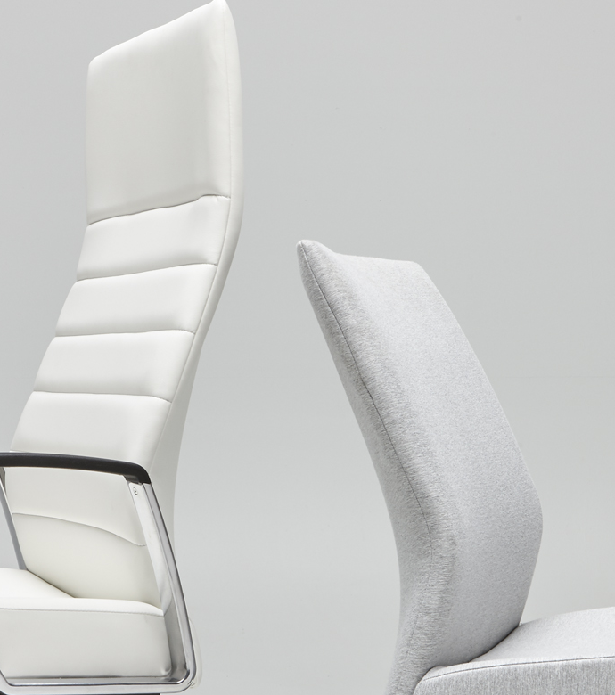
Svelte
Market Launch : November 1, 2018
PRODUCT MANAGER: RAIKKOL CHENG
Notes:
Svelte, a term defined in the dictionary is slender and elegant.

Slide 2
What is the Need?
Slim, modern aesthetics with great comfort
A variety of choices in fabrics and colors
to help you tailor the look of your
private offices and conference rooms
Competitive price point that eases the struggle
with limited budget for quality products
Notes:
What is important to companies? Aesthetics, variety of choices, and price are what we are focused on for this addition. This is a great choice for start up companies looking for a way to design on a dime.

Slide 3

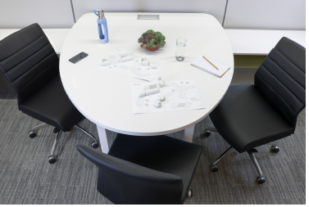
What If We Could…
Design a chair that is slim, lighter, leaner than average?
Offer a premium look at an affordable price?
Give designers a wide array of customizable options?
Svelte
Notes:
Sophistication shouldn’t have to be expensive, and quality can be affordable. Svelte gracefully alleviates the disparity between low-cost and luxury in an elegant design that possesses an aesthetic as slender as the stack of cash to afford it. Combine that with its ability to elevate the identity of any brand by consistently performing across almost any office setting, and it only adds to its value.
Designer Bill Raftery: Owner of Raftery Design in Canon, OH and has most recently designed Executive, Manager and Ergonomic Task Seating and much more.

Slide 4
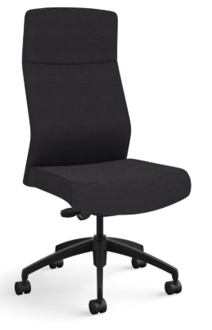
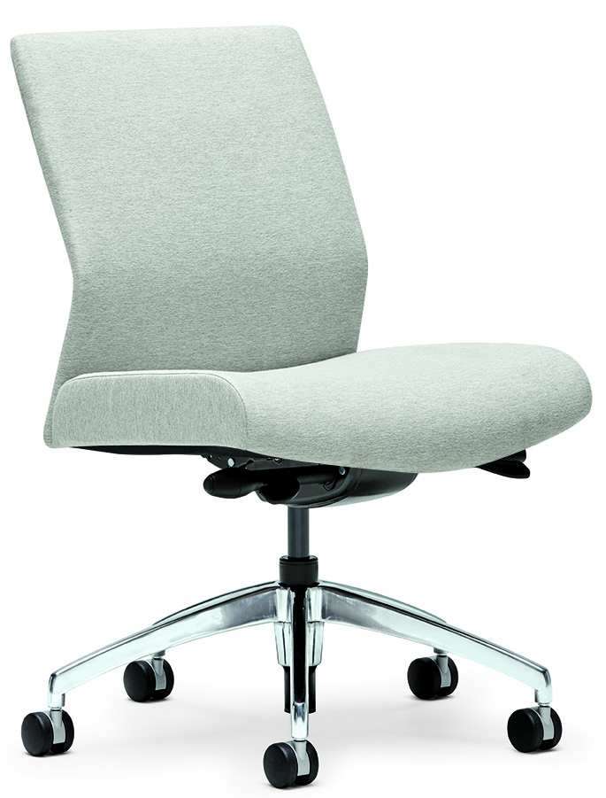
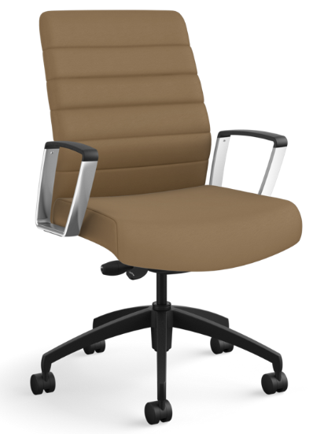
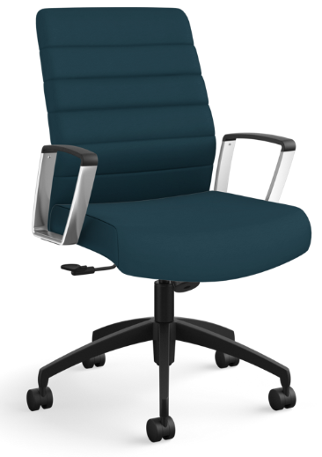
Svelte
STATEMENT OF LINE
High Back Channel Stitch
High Back Plain
Mid Back Plain
Mid Back Channel Stitch
Notes:
Mix, mingle, and own which options you prefer lets keep rolling and discuss the plethora of options
They are: High or mid back height, channel or not channel stitching, polished aluminum loop arm or no arm, lastly a polished aluminum base or black nylon

Slide 5


Svelte
OPTIONS
Upholstery Options
Standard Allsteel fabrics and more
Back Options
Channel Stitch
Plain Back
Arm Options
Armless
Polished Aluminum Arms
INTERNAL TRAINING
Control Options
Synchro Seat Slider
Base Finish Options
Black Nylon
Polished Aluminum

Slide 6
Sales & Dealer Training
INTERNAL USE ONLY

Slide 7
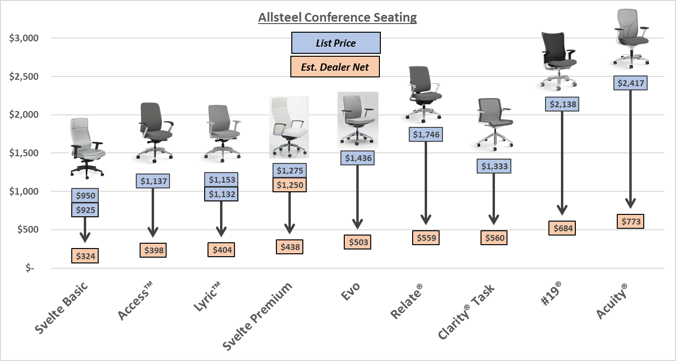
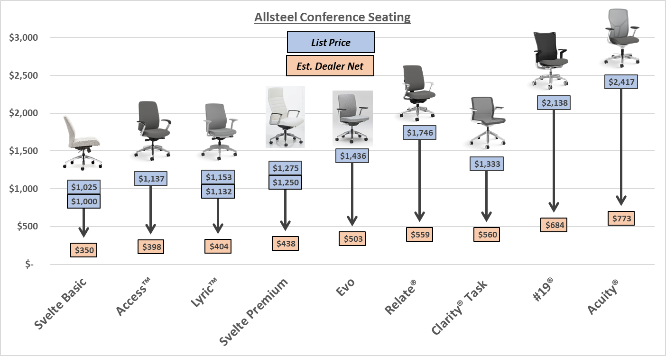
Internal Positioning
* Svelte Basic is specified with armless, black nylon base, synchro seat slider control and plain back
* Svelte Premium is specified with polished arms, polished base, synchro seat slider and plain back
Notes:
Lets talk about where Svelte falls within the Allsteel line, please note these are based on July of 2018 prices
Svelte plays well over to the left and has the ability to become more premium options in the center, this gives the ability to play in a wide range of customer budgets
We have chosen options as close to polished bases and polished arm options for price lineup and applied everyday advantage 65% off

Slide 8
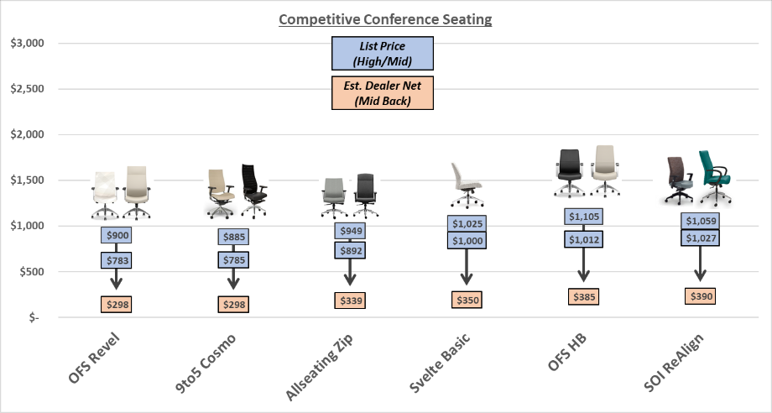
Competitive Positioning – Basic Version
* Armless, Plastic Base, Synchro Seat Slider Control, Fully Assembled
* Pricing noted above is provided as reference only. Stated GSA discounting is applied to non-Allsteel product.
Notes:
Based on July 2018 pricing, (note: SOI is SitOnIt)
To help give you a flavor where Svelte shown in it’s basic option falls near competitors you might expect to see
Svelte allows Allsteel and dealer network to compete against open line manufacturers leading to a competitive advantage as we are not an open line manufacturer

Slide 9
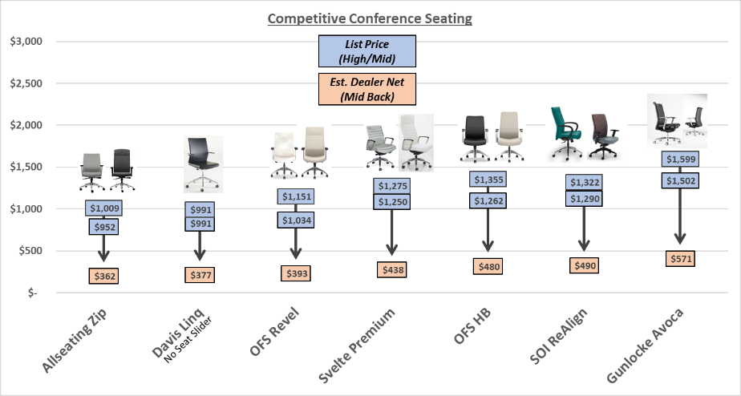
Competitive Positioning – Premium Version
* Synchro Seat Slider, Polished Arms, Polished Base, Fully Assembled
* Pricing noted above is provided as reference only. Stated GSA discounting is applied to non-Allsteel product.
Notes:
Based on July 2018 pricing, To help give you a flavor where Svelte shown in it’s premium falls around competitors with similar options

Slide 10
Price Changes
Notable updates
Synchro control with seat slider included vs. only basic control on previous Paoli basic model ($150 upcharge to SSS)
Higher quality standards
Deeper discount following Everyday Advantage Program
Valued features such as channel stitch updated
New arms and controls at an even lower price point will become available from Jul 2019
Notes:
One of the first questions from DSRs and Customers will be what is the price point change.
Given the different Discount approach and materiality options, comparing at List prices can be misleading. We will provided this detailed comparison.
What you need to know is that we are nominally the same price +/- 5%.
For Svelte
Deeper discount following Everyday Advantage Program
Valued features such as channel stitch updated
For Co|Ho
Less discount as it falls into Lounge-Soft category
Grade 1 fabric available - Paoli started at Grade 2
Valued feature updated - tablet arms

Slide 11

Customers to Target with Svelte
I have limited furniture experience and I do not need many bells & whistles
Modern and can double as Executive and Conference
Wanting a stylized conference chair fit for a modern setting
I’m looking for a product that has quality and simplicity
I’m looking for a product that allows for and enables premium design specification.
Slim and light chair that has customized looks
Notes:
Triggers to think about Svelte for a customer when you are uncovering their needs. We believe start up companies are going to gravitate to this chair

Slide 12
How to Order
First Order Entry: November 1, 2018
Lead Time: 4-5 weeks Standard
Pricing:
  A&D Program- Standard 70%
  Showroom- Standard 80%
  Everyday Advantage/COP- Add at 65% Seating Discount
  Mockup- Standard Discount
  Edge Eligible- Base program eligible
  Staples Allsteel Edge- Base program eligible

Slide 13
Pre-Sell Launch Timing
LAUNCH
  Allsteel Sales Call 9/28
  Q&A call for RMs who have pre-emptive questions
  Note: COM will be available 90 days after launch
  AO & Synergy Website
  Configurators, Brochures, and Spec Sheets (Online)
  Symbols Available Online
2019
Component updates for Svelte and compacity update to dealers
Re-assess discounts and bulk sale locations (who is purchasing these chairs)
Slight updates on controls and cylinders, based on market feedback
Replace Svelte samples

Slide 14
Launch Timing
OPEN FOR ORDERS November 1, 2018
  Price List & Spec Guide (Online) October 2018
  20/20 & Symbols Publication November 2018
  Allsteel Communications October 2018
  First Shipment November2018
  Brochure October 2018
  Showroom Integration November2018
Questions?
Raikkol Cheng: chengr@allsteeloffice.com

Slide 15
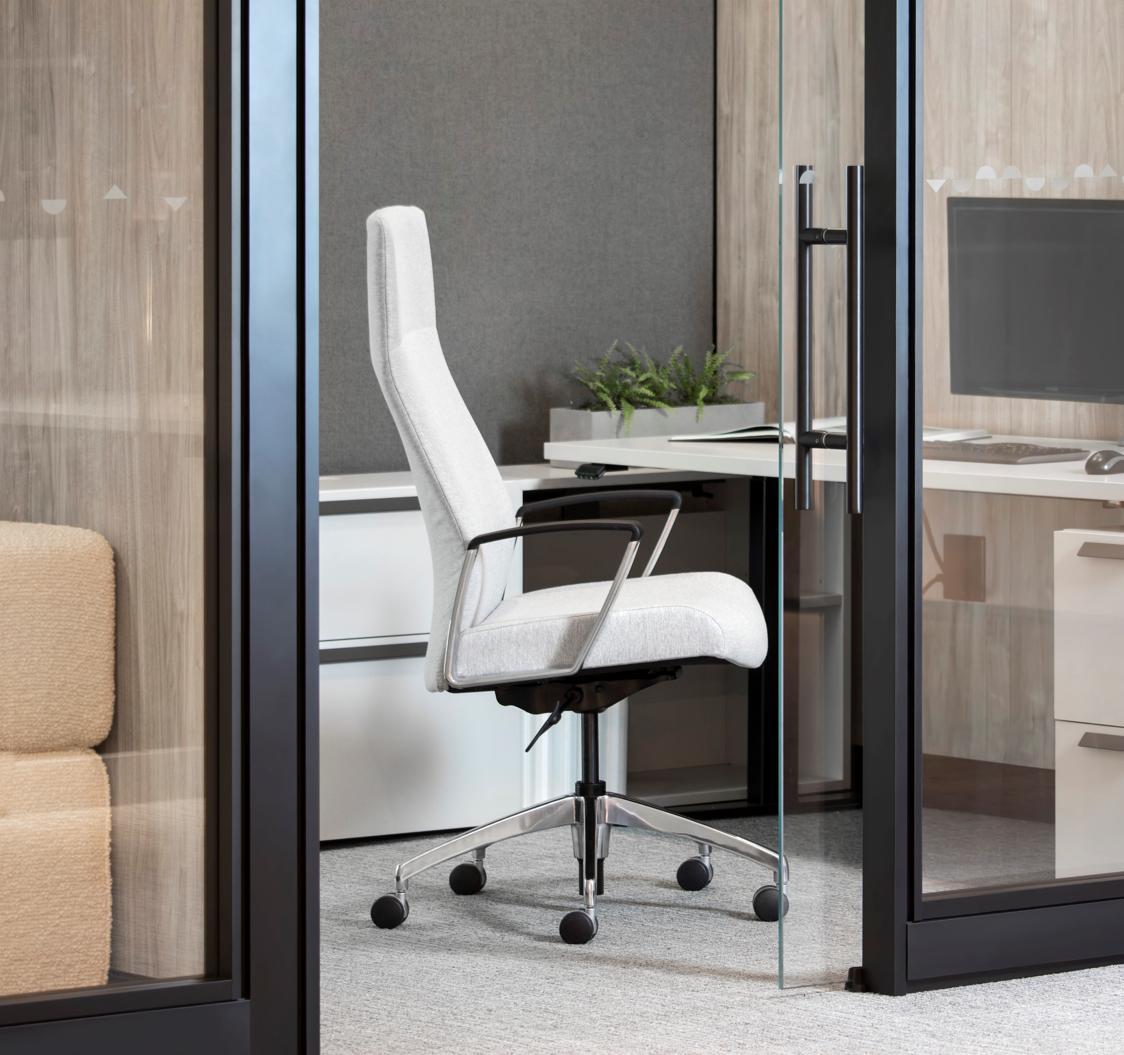
Pre-Sell Tools
Imagery is located here
GTM Svelte Brief is located here
List Svelte pricing is located here
Symbols Svelte are located here
Specification Sheet is located here
FAQ Svelte located here

Slide 16
FAQ
Svelte
Q: Why is Svelte a top choice to become an Allsteel product?
A: Many reasons such as dealers specifically requesting Svelte, expanding our offerings in the Executive/Conference seating category, and having a budget-friendly, fully upholstered chair to meet market demand.
Q: What is changing on product and pricing?
A: Armless is now a standard offering. There are slight price adjustments due to inflation, tariff impact and higher quality requirements.
Q: How do I get a new chair to match my existing Paoli Svelte chairs?
A: COM options are available as always 90 days after launch. If the fabric was previously used the process is simpler.
Q: Where does Svelte position itself within Allsteel’s current Executive/Conference seating portfolio?
A: Svelte basic is below the $1,137 Access™ price and Svelte premium fills the $1,200 to $1436 list price gap between Lyric™ and Evo models.
Q: How do customers process warranty claims since now it's refreshed and marketed under Allsteel?
A: All chairs with a Paoli tag are to proceed with warranty claims with HON and chairs with an Allsteel tag are to contact Allsteel customer support.
Q: Where is Svelte manufactured and how does it ship?
A: Svelte is manufactured at the Gunlocke facility in Wayland, NY and ships fully assembled.

