Slide 1
Sales & Dealer Training
INTERNAL USE ONLY

Slide 2
Internal Training
Statement of Line & List Price
18½" Round Pouf Single Upholstery
(17 1/8" H, 8 lbs.)
$550
18½" Round Pouf Multi Upholstery
(17 1/8" H, 8 lbs.)
$625
18½" Round Wobble Pouf Single Upholstery
(17 1/8" H + Wobble Base Height, 11 lbs.)
$600
18½" Round Wobble Pouf Multi Upholstery
(17 1/8" H + Wobble Base Height, 11 lbs.)
$675
17" x 22" Pebble Pouf Single Upholstery
(17 1/8" H, 21 lbs.)
$700
17" x 22" Pebble Pouf Multi Upholstery (17 1/8" H, 21 lbs.)
$775
18" x 20" Pebble Pouf Single Upholstery (18 5/8" H, 25 lbs.)
$750
18" x 20" Pebble Pouf Multi Upholstery (18 5/8" H, 25 lbs.)
$825
21" x 28" Pebble Pouf Single Upholstery
(15 5/8" H, 28 lbs.)
$800
21" x 28" Pebble Pouf Multi Upholstery
(15 5/8" H, 28 lbs.)
$875
Prices based on Grade 1 upholstery.

Slide 3
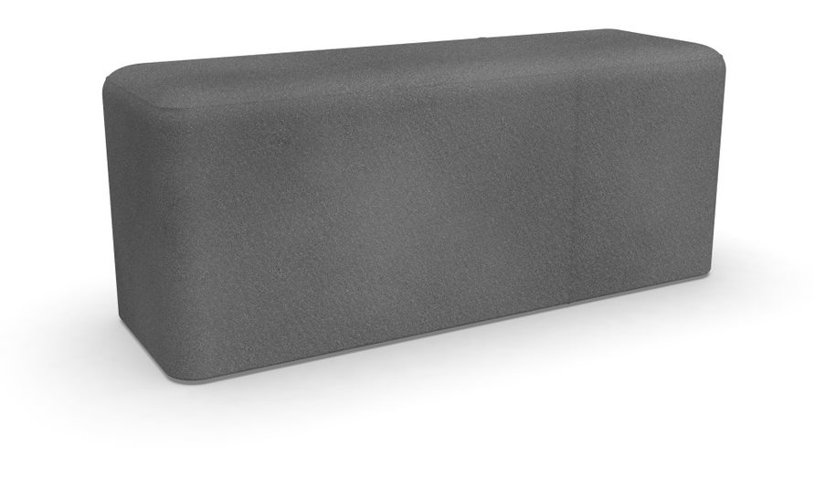
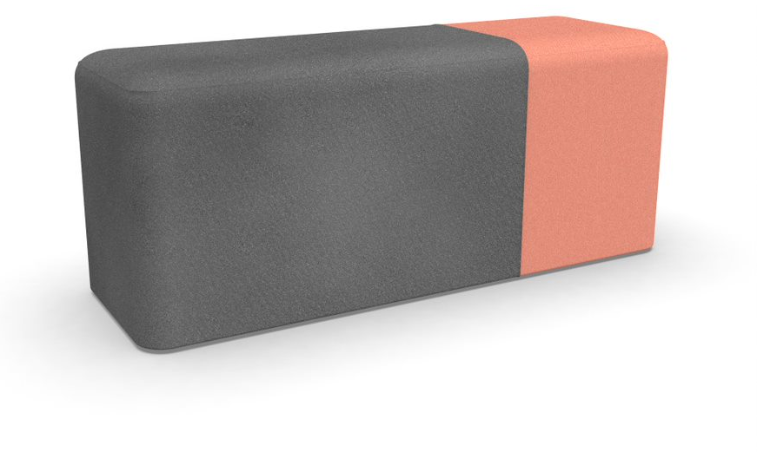
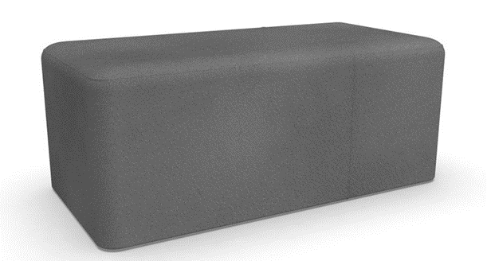
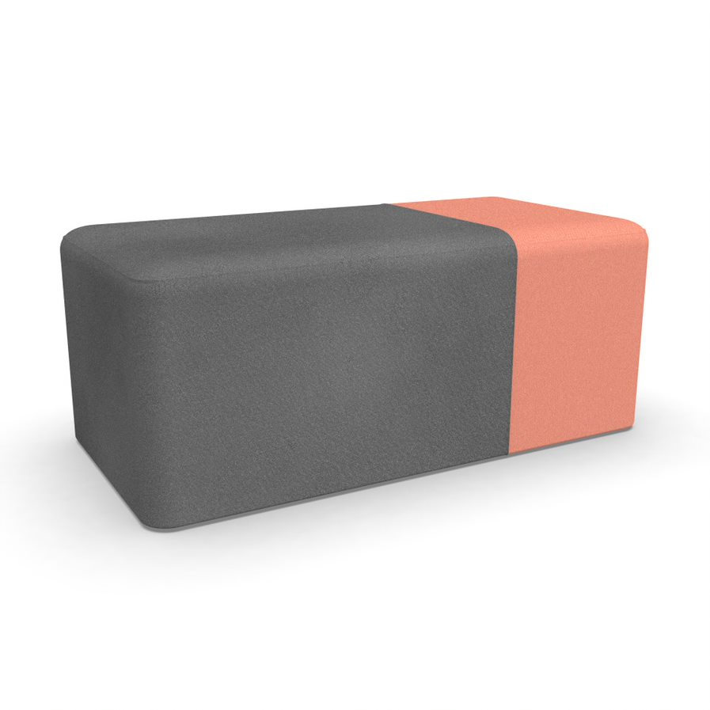
Internal Training
Statement of Line & List Price
14" x 21" Block Pouf Single Upholstery (17 1/8" H, 20 lbs.)
$600
14" x 21" Block Pouf Multi Upholstery (17 1/8" H, 20 lbs.)
$675
21" x 21" Block Pouf Single Upholstery
(17 1/8" H, 31 lbs.)
$650
21" x 21" Block Pouf Multi Upholstery
(17 1/8" H, 31 lbs.)
$725
21" x 28" Block Pouf Single Upholstery
(17 1/8" H, 31 lbs.)
$700
21" x 28" Block Pouf Multi Upholstery
(17 1/8" H, 31 lbs.)
$775
14" x 42" Block Pouf Single Upholstery
(17 1/8" H, 31 lbs.)
$875
14" x 42" Block Pouf Multi Upholstery
(17 1/8" H, 31 lbs.)
$950
21" x 42" Block Pouf Single Upholstery
(17 1/8" H, 35 lbs.)
$950
21" x 42" Block Pouf Multi Upholstery
(17 1/8" H, 35 lbs.)
$1,025
Prices based on Grade 1 upholstery.

Slide 4
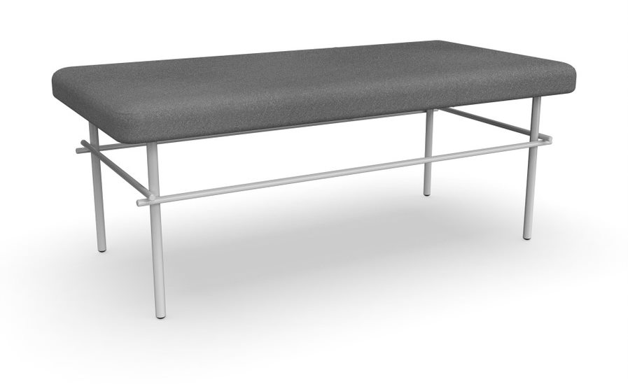
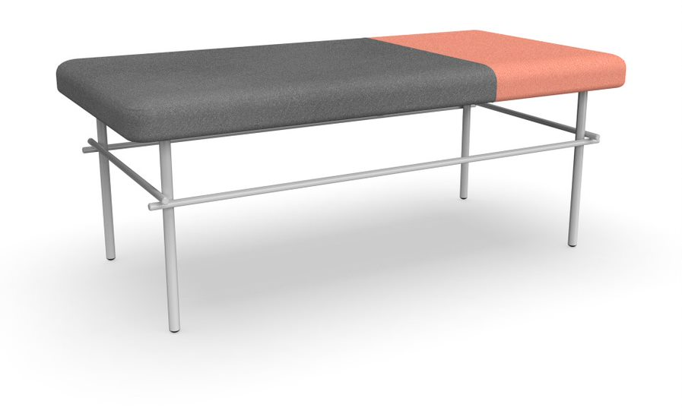
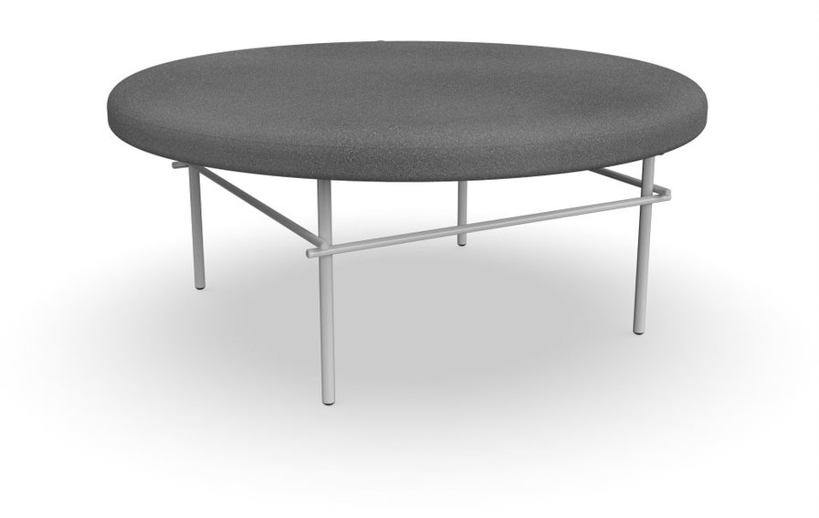
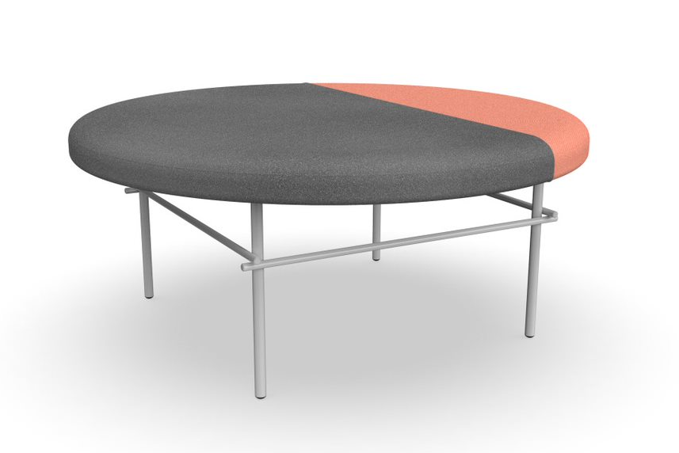
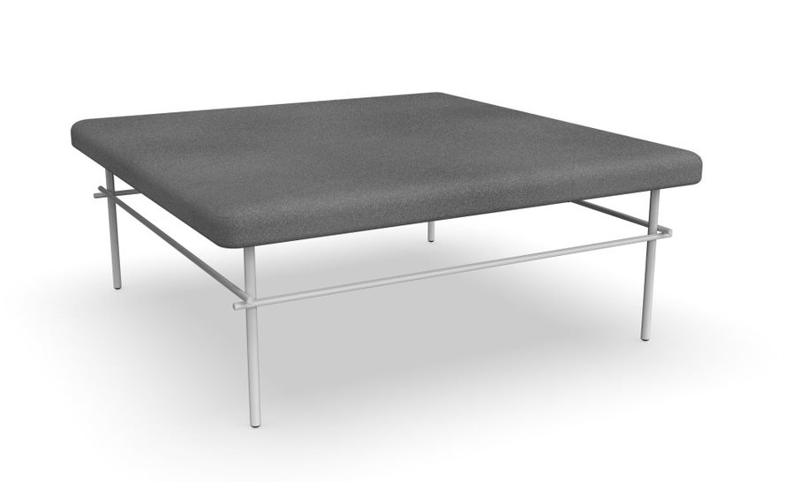
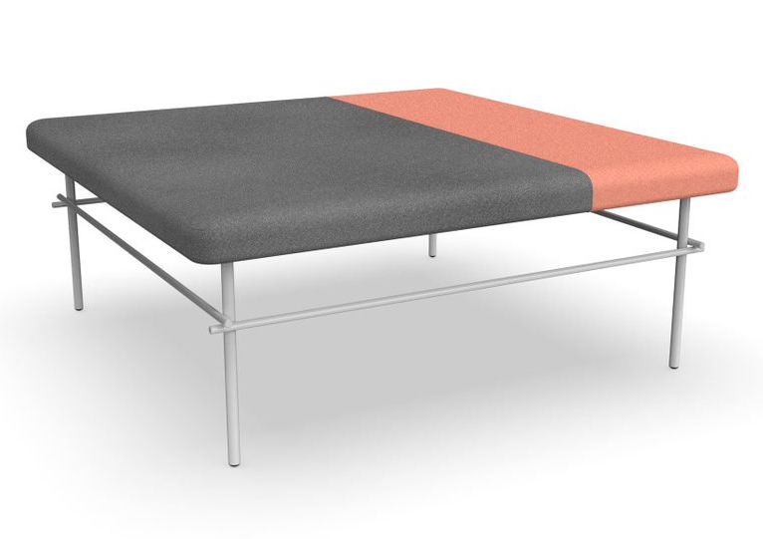
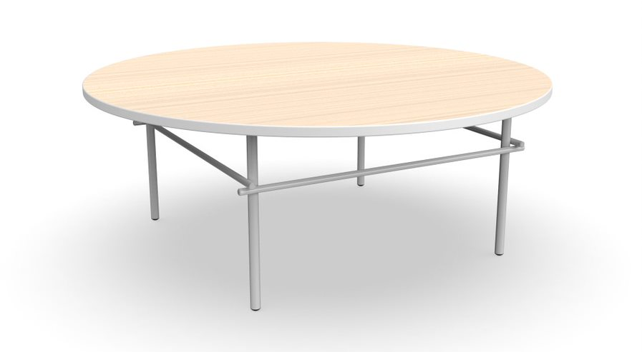
Internal Training
Statement of Line & List Price
21" x 42" Bench Single Upholstery
(17 1/8" H)
$550
21" x 42" Bench Multi Upholstery
(17 1/8" H)
$650
39" Round Bench Single Upholstery
(17 1/8" H)
$1,500
39" Round Bench Multi Upholstery
(17 1/8" H)
$1,600
42" x 42" Bench Single Upholstery
(17 1/8" H)
$1,500
42" x 42" Bench Multi Upholstery
(17 1/8" H)
$1,600
21" x 42" Table
(14 7/8" H)
$1,150
39" Round Table
(14 7/8" H)
$1,350
42" x 42" Table
(14 7/8" H)
$1,400
20" Round Side Table
(17 1/8" H)
$600
14" x 21" Side Table
(17 1/8" H)
$850
Prices based on Grade 1 upholstery, Grade P1 paint, and Grade L1 laminate.

Slide 5
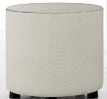
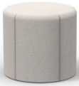
Internal Training
Two-Thirds Poufs Price Positioning – GSA Discount
*BluDot and Poppin based on retail price.

Slide 6
Internal Training
Two-Thirds Ottoman Price Positioning – GSA Discount
*Poppin based on retail price.

Slide 7
Internal Training
Two-Thirds Round Bench Price Positioning – GSA Discount

Slide 8
Internal Training
Customers to Target with Poufs & Tables
I want pieces that can add pops of color around the office without disrupting existing designs.
My teams must take time to find seating for conference room overflow.
I need movable seating for quick catch-ups with teammates.
I already have a modular soft-seating solution but want a few pieces to add for more interest.
I am looking for a lower-cost alternative for casual seating in the workplace.
I want items that can continuously adapt and evolve to our current and future space needs.
I need something I can plop in bare areas around the office without investing in a costly soft-seating solution.

Slide 9
Internal Training
Pre-Sell Launch Timing
PRE-LAUNCH
Press Release & Media Announcement NeoCon 2019
Sample Availability Shipping January/February 2020
Allsteel Sales Team Training Call February 2020
Pre-Sell Package December
AO & Synergy Website Live February 2020
Spec Sheet (Online) At Launch
Pre-Sell Symbols Available Online December

Slide 10
Internal Training
Launch Timing
OPEN FOR ORDERS February 2020
Allsteel Communications February 2020
Brochure February 2020
First Ship Q1 2020
Allsteel University Integration Q1 2020
Showroom Integration Q1 2020
Price List & Spec Guide (Online) February 2020
20/20 & Symbols Publication February 2020
Questions?
Product related, Raikkol Cheng: chengr@allsteeloffice.com
Marketing related, Brian Parrott: parrottb@allsteeloffice.com

Slide 11
Internal Training
How to Order
First Order Entry: February 2020
Lead Time: 6 Weeks
Pricing:
Standard Terms 55% off
Showroom Discount 75% off
A&D Own Use Program 65% off
A&D Own Use Promotion 75% March – May 2020
Everyday Advantage NA
Eligible for Edge points and counts towards standard sales incentive programs
BIFMA Certified (certificates available spring 2020)
GSA and Sustainability in progress – not yet available

Slide 12
Internal Training
Pre-Sell Tools
GTM Brief
Imagery
List Pricing
Symbols
FAQs
All information is located on Synergy.

Slide 13
Frequently Asked Questions
Q: What new pieces are available within the Two-Thirds offering?
A: The Two-Thirds collection includes fully upholstered poufs and benches with metal bases in various shapes and heights. Rectangle, square, and round tables with laminate or veneer tops and metal bases will also be available.
Q: Where will these new poufs, benches, and tables be used within the workspace?
A: These products fit a wide variety of spaces, including solo/enclave and team/lounge areas, huddle spaces, conference/meeting rooms, libraries, reception/lobby areas, and common/café areas.
Q: Why does Allsteel need more poufs?
A: Allsteel has a few pouf options but lacks the variety to address all the needs customers are experiencing.
Two-Thirds offers multiple pouf and bench shapes and sizes within one offering, with complementary tables to complete the collection.
Q: Will these new poufs discontinue Scooch?
A: Scooch offers a different aesthetic, and currently there are no plans to discontinue Scooch.
Q. What are the available upholsteries?
A: Available fabrics can be found in the Two-Thirds price list available online.
INTERNAL TRAINING

Slide 14
Frequently Asked Questions
Q: Are dual upholsteries an option?
A: Yes. Dual upholsteries (one-third/two-thirds) can be specified on poufs and benches. See the Two-Thirds price list online for available upholstery options.
Q: Is contrast stitching an option for poufs and benches?
A: No. The color-coordinated thread on the one-third side will determine thread color on the rest of the unit.
Q: Are COMs an option on poufs and benches?
A: COM requests will be considered at launch.
Q: What laminates, veneers, and paint colors can be specified on the tables?
A: Available laminates, veneers, and paint colors can be found in the Two-Thirds price list available online.
Q: Can the tables be used with other products?
A: The tables feature a simple, neutral design to fit many different applications while complementing a wide range of products.
Q: Is there a quick-ship option?
A: No. There is not a quick-ship option currently.
INTERNAL TRAINING

Slide 15
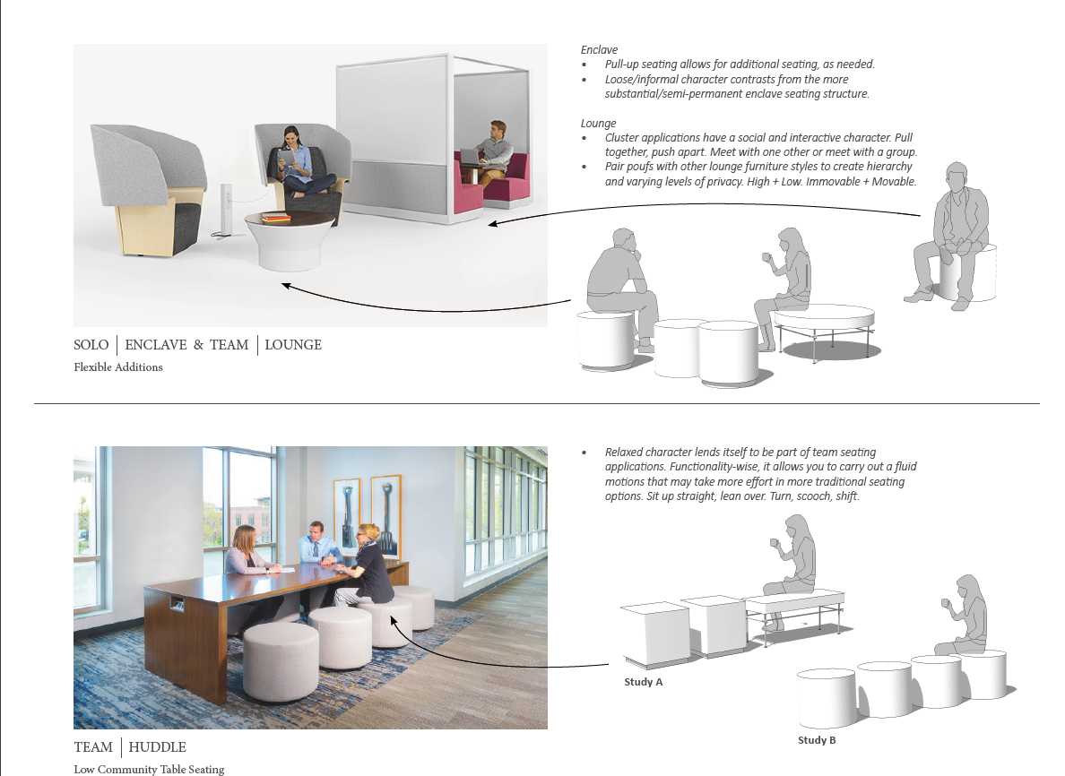
Internal Training

Slide 16
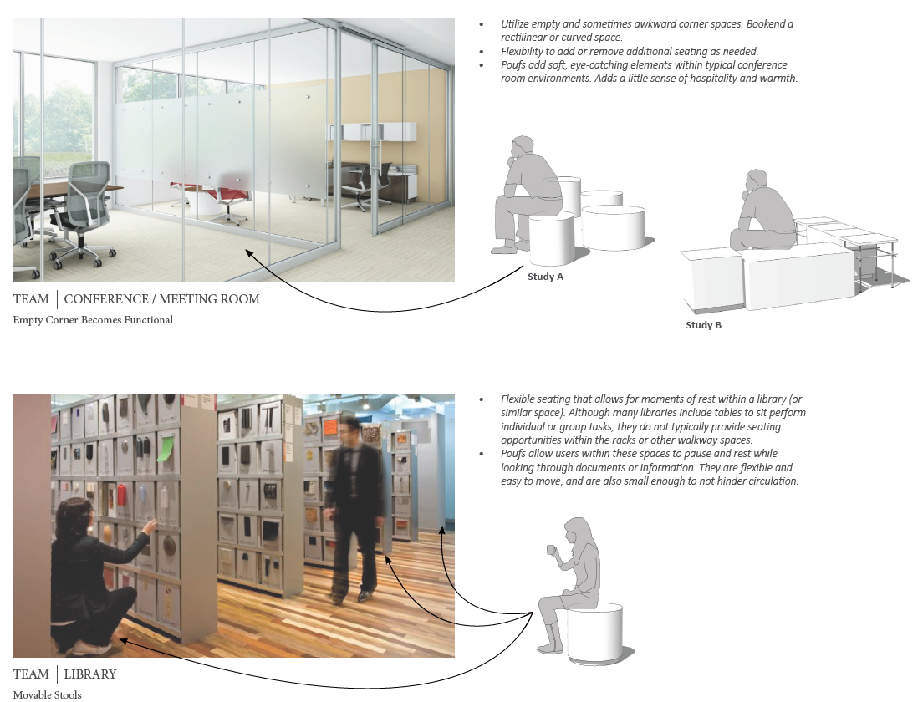
Internal Training

Slide 17
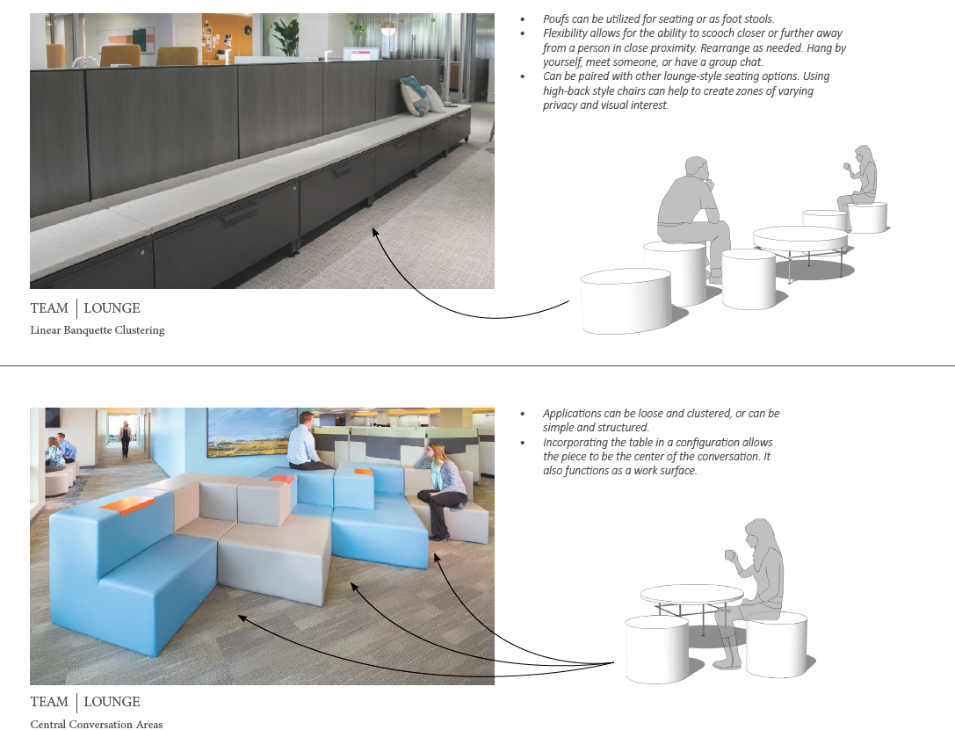
Internal Training

Slide 18
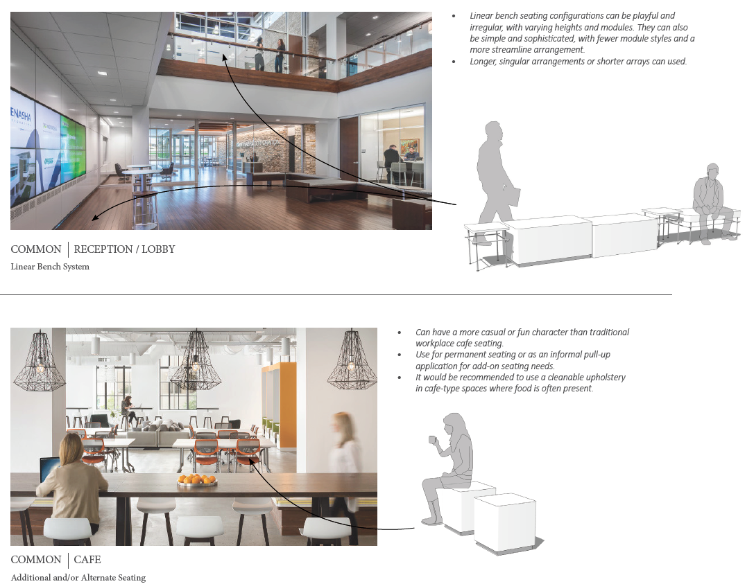
Internal Training

