Slide 1


Partner Review
Notes:
At Allsteel, we believe in solving problems with our clients.
Sometimes, we know what the client wants but HNI brands don’t yet offer it.
Because furniture trends are so varied, it makes sense to partner and cover the varied, and quickly evolving, floorplan.

Slide 2

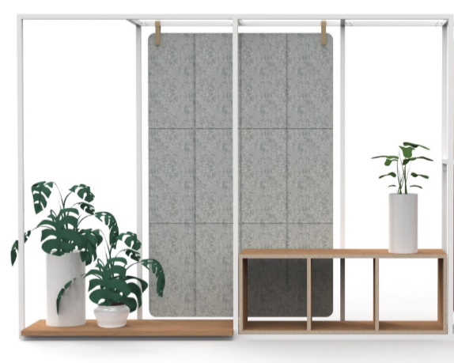
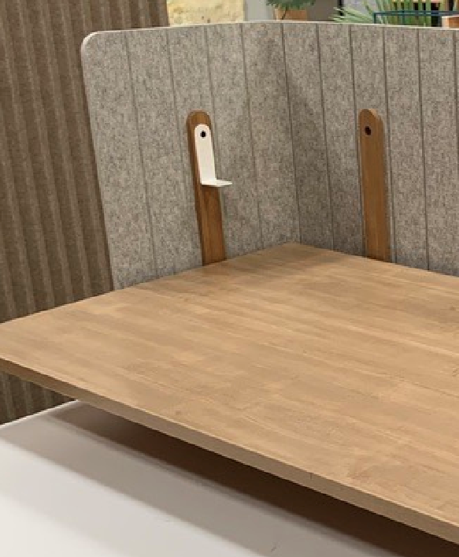


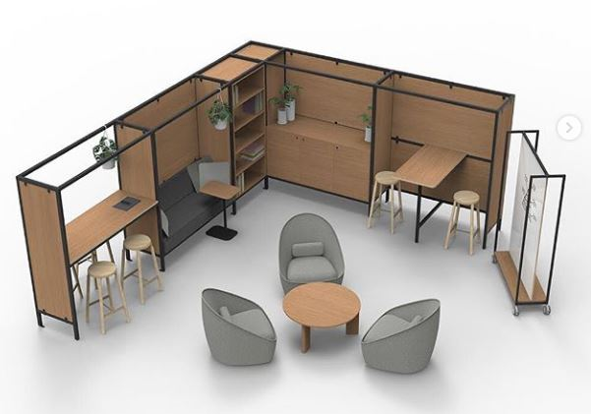
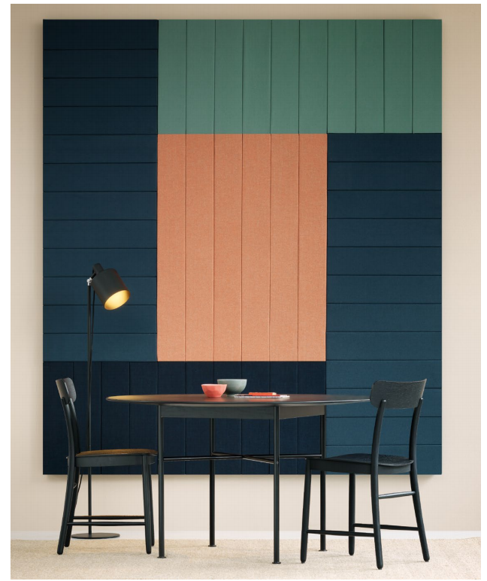
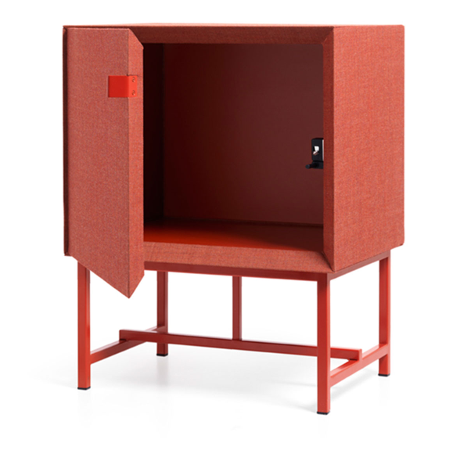
Client Driven
Customers seek full floorplate of product that is varied and quickly evolving
Eclectic blend of furniture requires multiple manufacturers
Curated
Experience
Notes:
Clients look for a broad range of products, materials, aesthetics and perspectives.
This desire for curated spaces requires huge resources and incredible response speeds
We believe that more creative minds and more in-market touchpoints will increase, not only our speed, but our effectiveness in responding to our clients

Slide 3
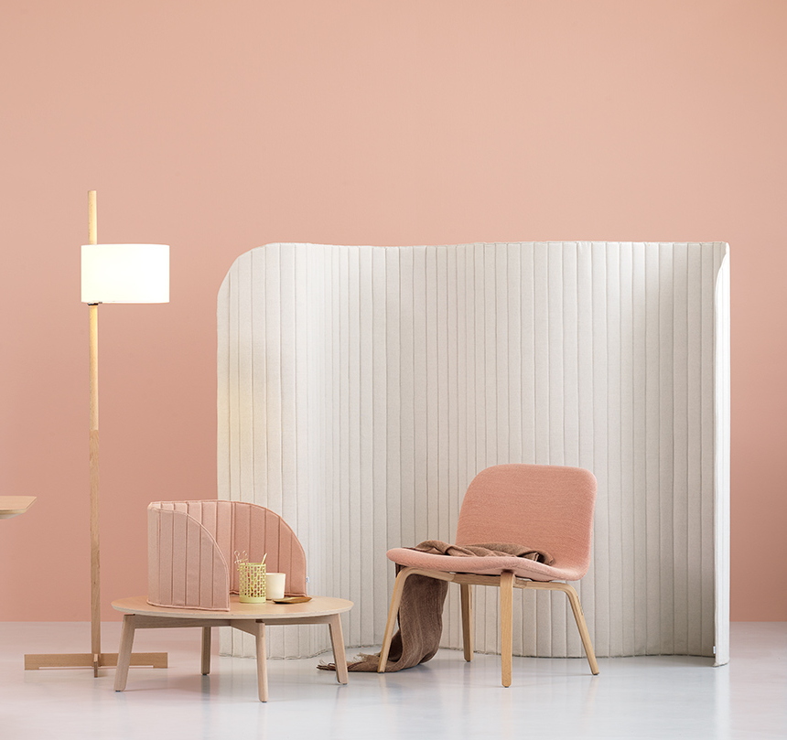
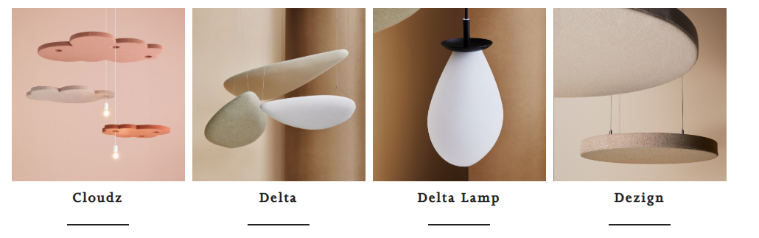
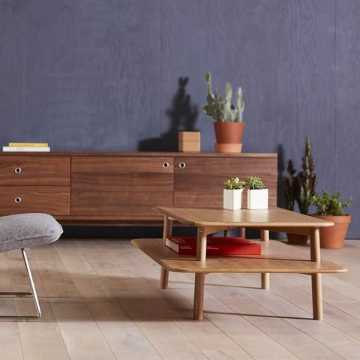
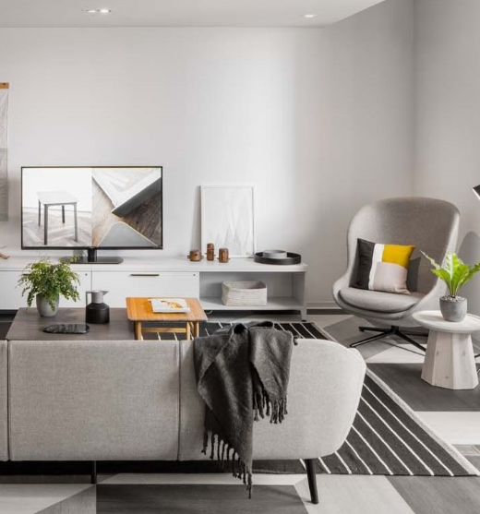
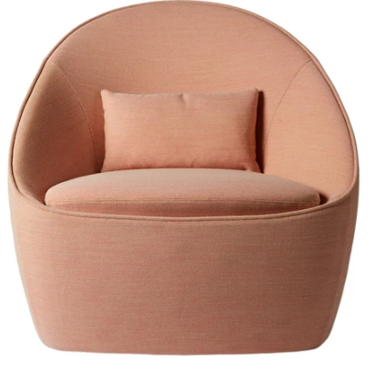
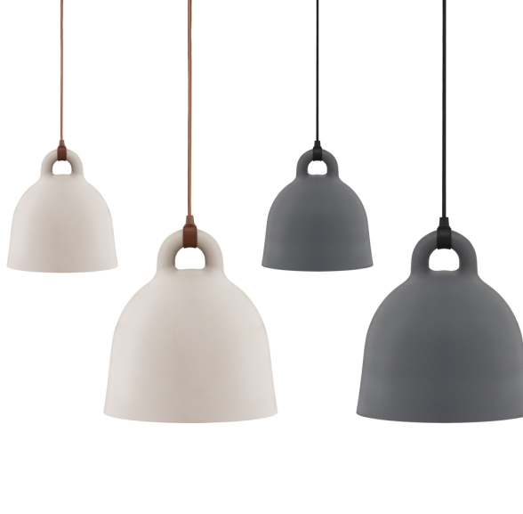
Complement and Elevate
Allsteel looks for partners with unique competencies and complementary offerings that provide added brand interest
Corral
Beauty, Utility
and Craft
Normann
Copenhagen Residential furniture & lighting
Zilenzio
Sound
and Space
Notes:
So as we seek out other manufacturers to partner with, we’re looking for brands that are complementary to HNI products, not cannibalistic.
And more important, we are looking for competencies, knowledge and know-how, that is additive to Allsteel & HNI expertise
And, we’re looking for brands that are on-trend, creative problem solvers.

Slide 4
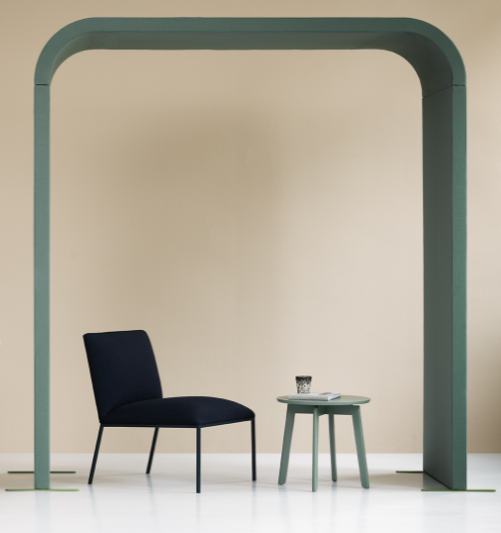
Why Partner?
Create Mindshare
Commissioned Allsteel Sellers
Exclusive North American Distribution
Brand Alignment (showrooms, web, social, print)
Notes:
There are so many options out there. We know that our dealer partners only have so much brainspace for furniture manufacturers!
Our goal is to partner and create mindshare – so that we can grow and be successful together.
We’re incenting our sellers to help support the sale while negotiating preferred discounting and greater brand emphasis through partnership alignment
Today, who isn’t looking for more creative and inspiring things to talk about!

Slide 5

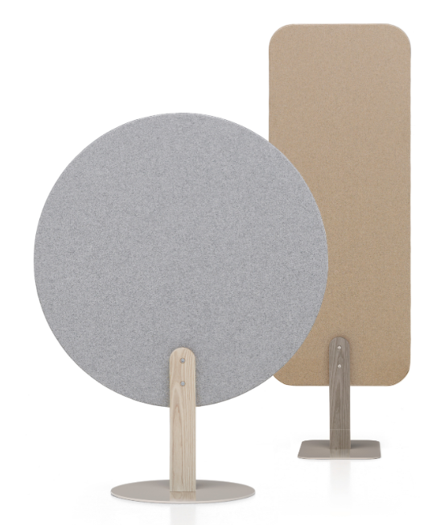
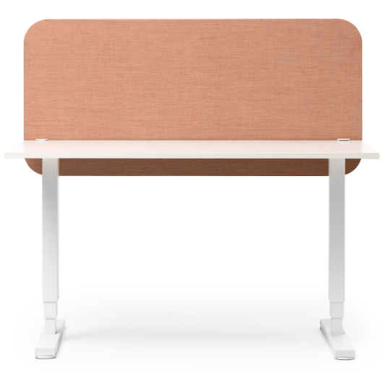
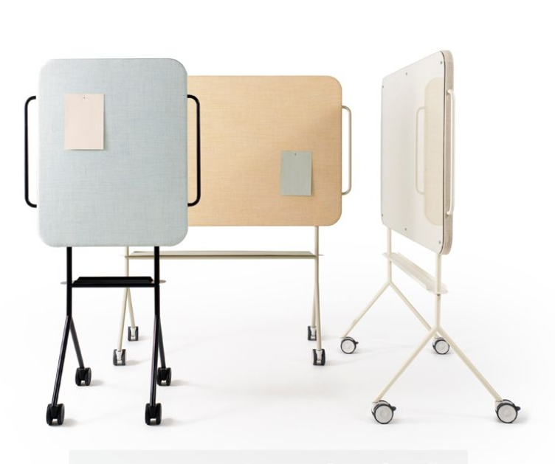
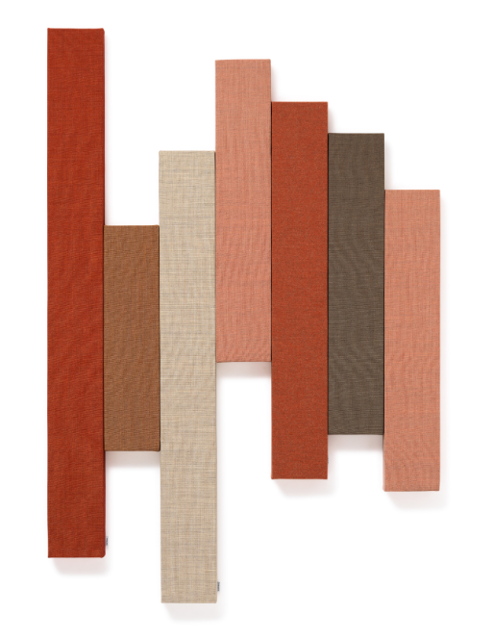
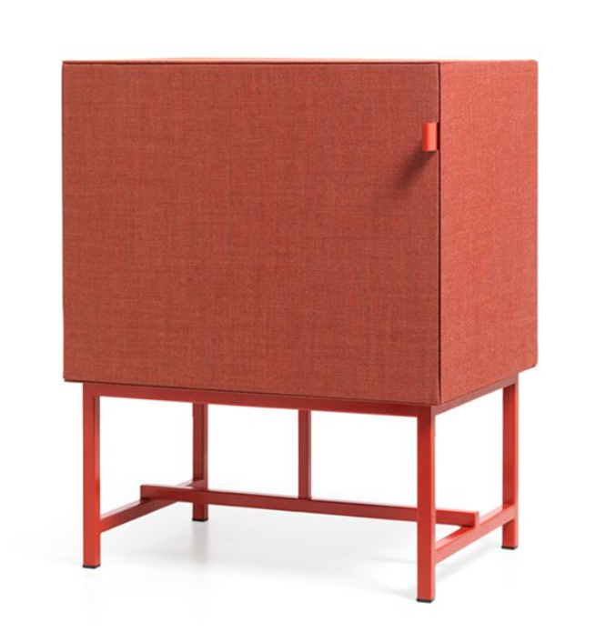
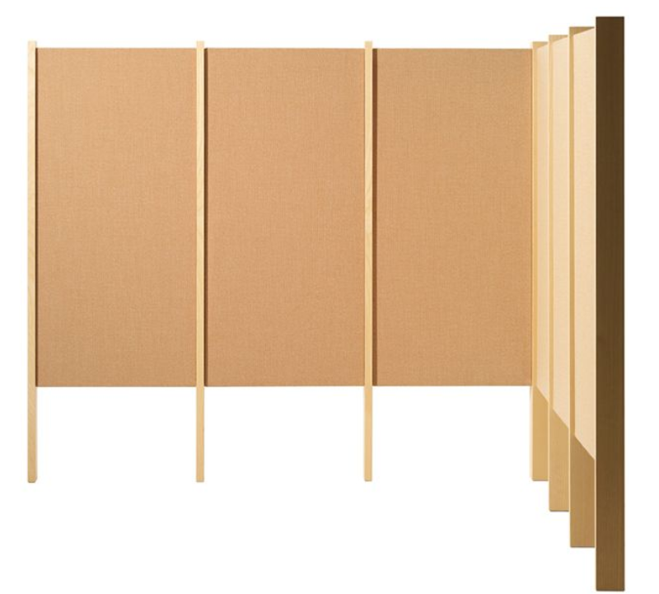
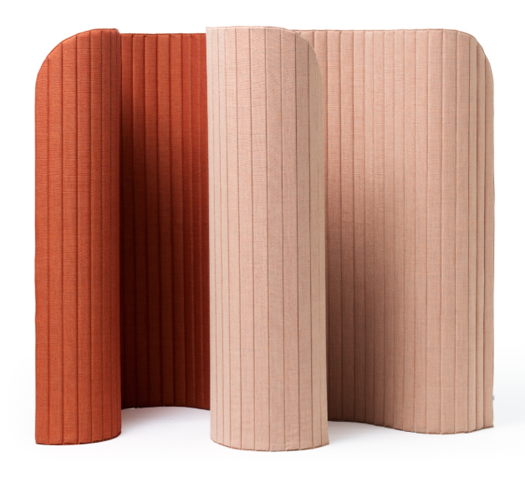
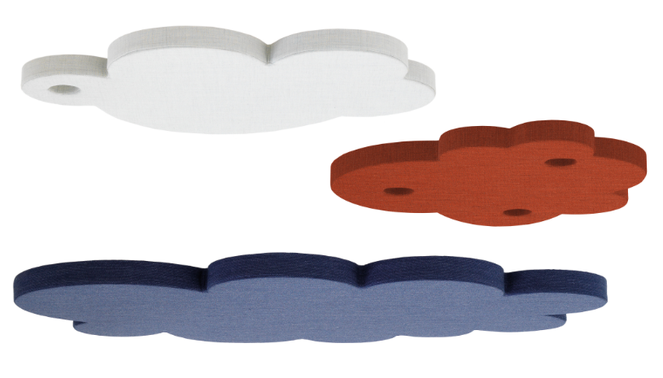
Zilenzio
+
Partnering to improve sound in the built environment.
Notes:
Zilenzio develops and delivers high-quality sound absorption using well considered and designed solutions.
Their products are the result of their experience and research in sound design, analysis of offices, and tests carried out according to international standards.
They have created healthy acoustic surroundings in many space types and workplaces

Slide 6

Who is Zilenzio
Sound-Absorbing Design
Based in Sweden
Founded by Marie Lindqvist-Pahlstad and Jenny Hellden
Notes:
Marie Lindqvist-Pahlstad and Jenny Helldén decided to listen to the needs of their customers.
In 2003, they partnered with an acoustic expert,Pontus Thorsson from Chalmers University, co-develop a screen and showcase it at the Stockholm Furniture Fair.
the two have remained determined to undertake this journey in their own way, ensuring their employees are treated like family and a sustainable business is about the planet and the people.
Now, more than 16 years later, Zilenzio continues to sell a unique feature which they know customers want – and it is easy to sell.

Slide 7

Vision:
A quieter work environment.
Notes:
Not sure where you are in geography but imagine that it is mid-winter. Life is busy. Time is flying by.
Then one morning you awake to… a fresh, thick carpet of snow.
You stand on your porch for a few moments listening to… well, silence. The blanketed earth of so quiet. So still. So peaceful.
We can all relate to the refreshing nature of peace and quiet.
That is Zilenzio’ s mission. To create quieter work environments.

Slide 8
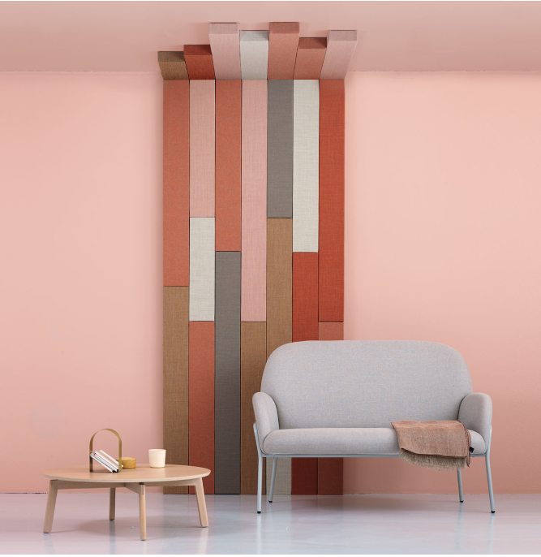
A quieter work environment.
Sound.
Space.
Sustainability.
Notes:
All of Zilenzio’s elements are thoughtfully designed and built with applications that help to define space through various partitions and screens.
As mentioned, Zilenzio’s primary initiative is improving acoustics in the built environment. We’ll spend more time later talking about products and acoustics but let’s dive a little more into what Zilenzio is about.

Slide 9

Sound.
The right product
The appropriate amount
The correct placement
Notes:
We can’t see it but it affects our physical well-being more than we realize.
Distractions from the human voice contribute to lost time and mental strain. It is an often-forgotten element of space design. Zilenzio intends for sound to be thoughtfully considered and designed for appropriately.
The right product means having substrates that absorb sound and then designed into a variety of shapes that provide choice in application and style.
The right amount of sound absorbing material is vital. Zilenzio does calculations to get the right amount of sound absorbers into specific settings with specific goals. They consider the application and as well as the material selections and barriers within the built environment.
The correct placement comes with a recommendation for the highest effect. The recommendation is proposed with clear 3D images normally within 24h.
We have much more to say about acoustics and its various components. These will be covered in a CEU course that is in the works.

Slide 10
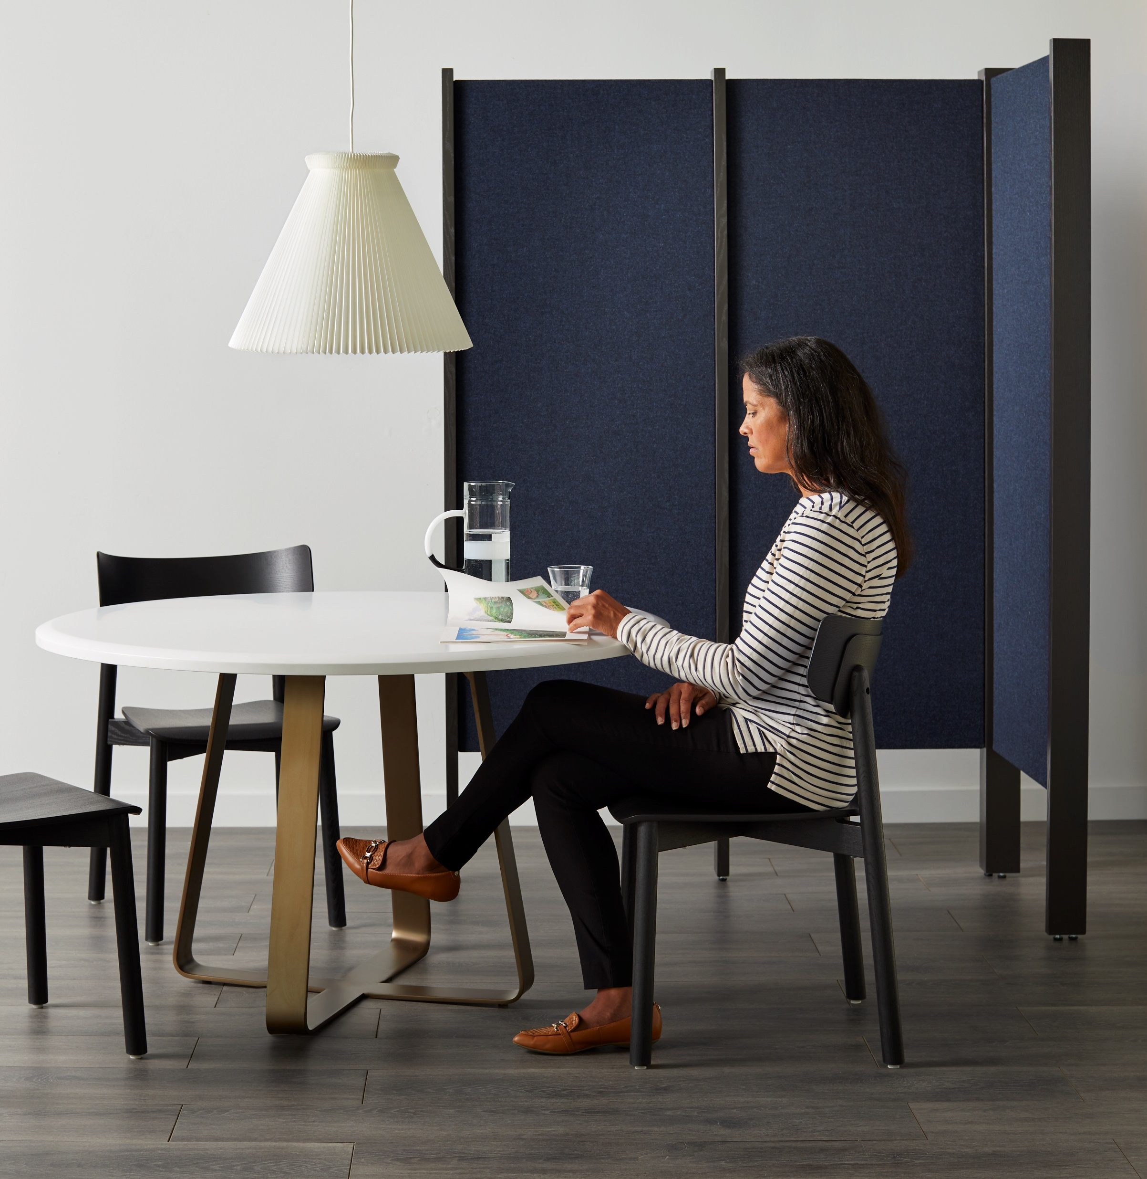
Space.
Define it.
Warm it.
Utilize it.
Notes:
Define it:
In addition to absorbing sound, Zilenzio’s screening and furniture elements define spaces to either create circulation patterns or give a measure of privacy.
Warm it:
All of their products are influenced by Nordic Design principles and include designs from Norm Architects and Note Design Studio
The use of upholstered mineral wool and wood warm up the settings in which they’re placed
Utilize It:
Some Zilenzio products are meant to be fixed while others portable, allowing for increased utilization of the spaces Zilenzio products are defining
And if you’re concerned about cleanability, because the product is upholstered, a fabric that meets specific cleaning goals can be specified.

Slide 11
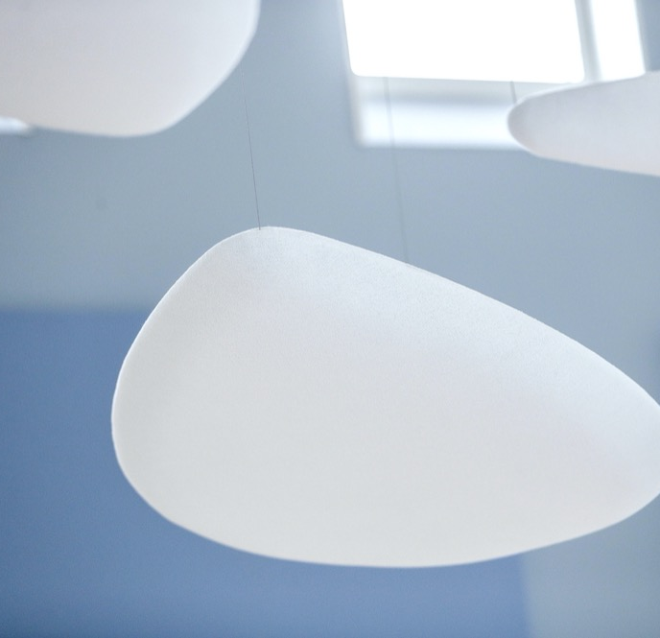
Sustainability.
Material Restraint
Social Responsibility
Well Being
Notes:
Using a natural stone as the core element, material restraint is the key component that contributes to the final design.
Combined with strict quality and safety standards plus chemical input considerations, Zilenzio prides itself in offering sustainable solutions.
Zilenzio uses a Swedish set of guidelines called, Mobelfakta. A piece of furniture that lives up to Möbelfakta's three parts meets the market's requirements for the environment, is manufactured in accordance with ethical guidelines and complies with current requirements specifications in terms of quality.
We all have personal stories of the frustrations of noise distractions while attempting to concentrate. Harvard Business Review recently noted that “Workers lose as much as 86 minutes per day due to noise distractions”
Acoustics is gaining traction in importance in the built environment. LEED v4.1, the International Green Construction Code (IgCC) and WELL Building Standard all have acoustic standards lending credence to the notion that we should pay attention to sound and create goals to strive towards.

Slide 12

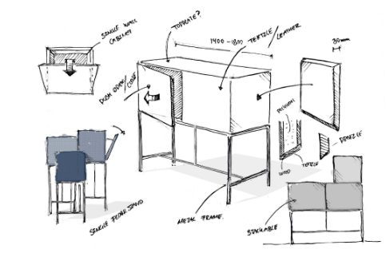
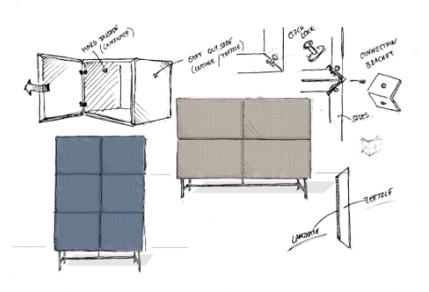
The
Collection
Notes:
Interestingly, Zilenzio’ s very first screen was great for the ears… but maybe not great on the eyes.
At their very first product fair, Marie and Jenny were approached by Note Design who offered to join their efforts in creating great design with acoustics at the core.
I think you’ll agree, the packaging is indeed beautiful.

Slide 13
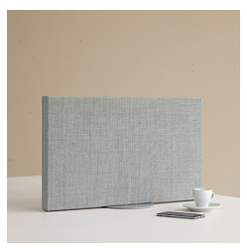
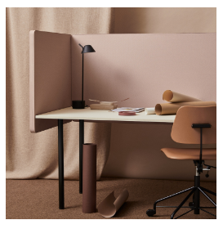
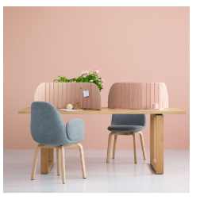
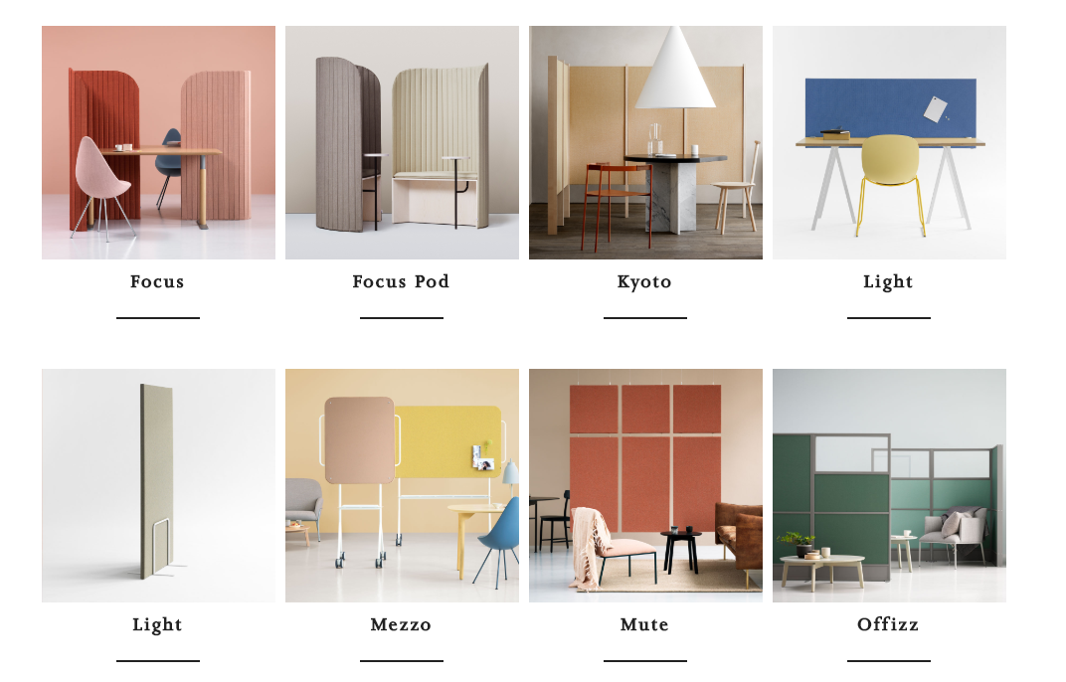
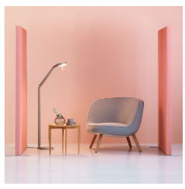
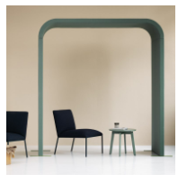
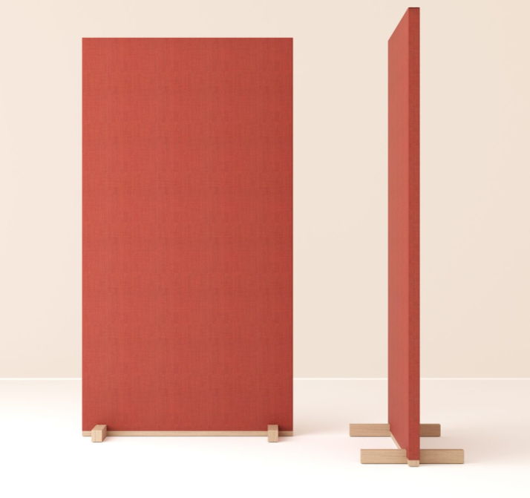
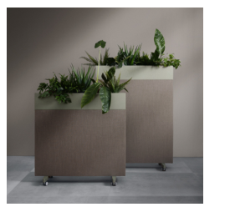
Space Defining
DEZIBEL FLEXIBLE
DEZIBEL TABLE
FOCUS
MEZZO
CLASSIC
ARC
KYOTO
DEZIBEL FLOOR
ZORLA
Notes:
Zilenzio’s sound absorbers can be placed in 3 major buckets: The products shown here sit on a table or the floor.
They also have wall and ceiling mounted products as well as a few furniture pieces.
Here you can see the broad range of products that define space as they add privacy.
We’ll show you a few more in detail.

Slide 14
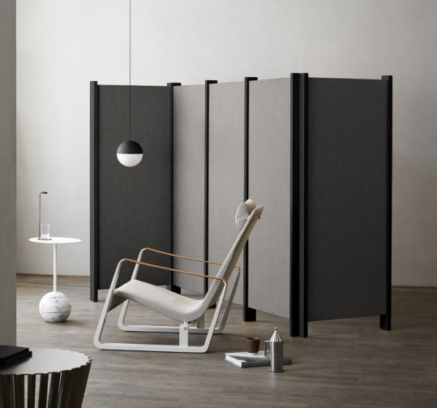
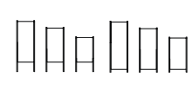
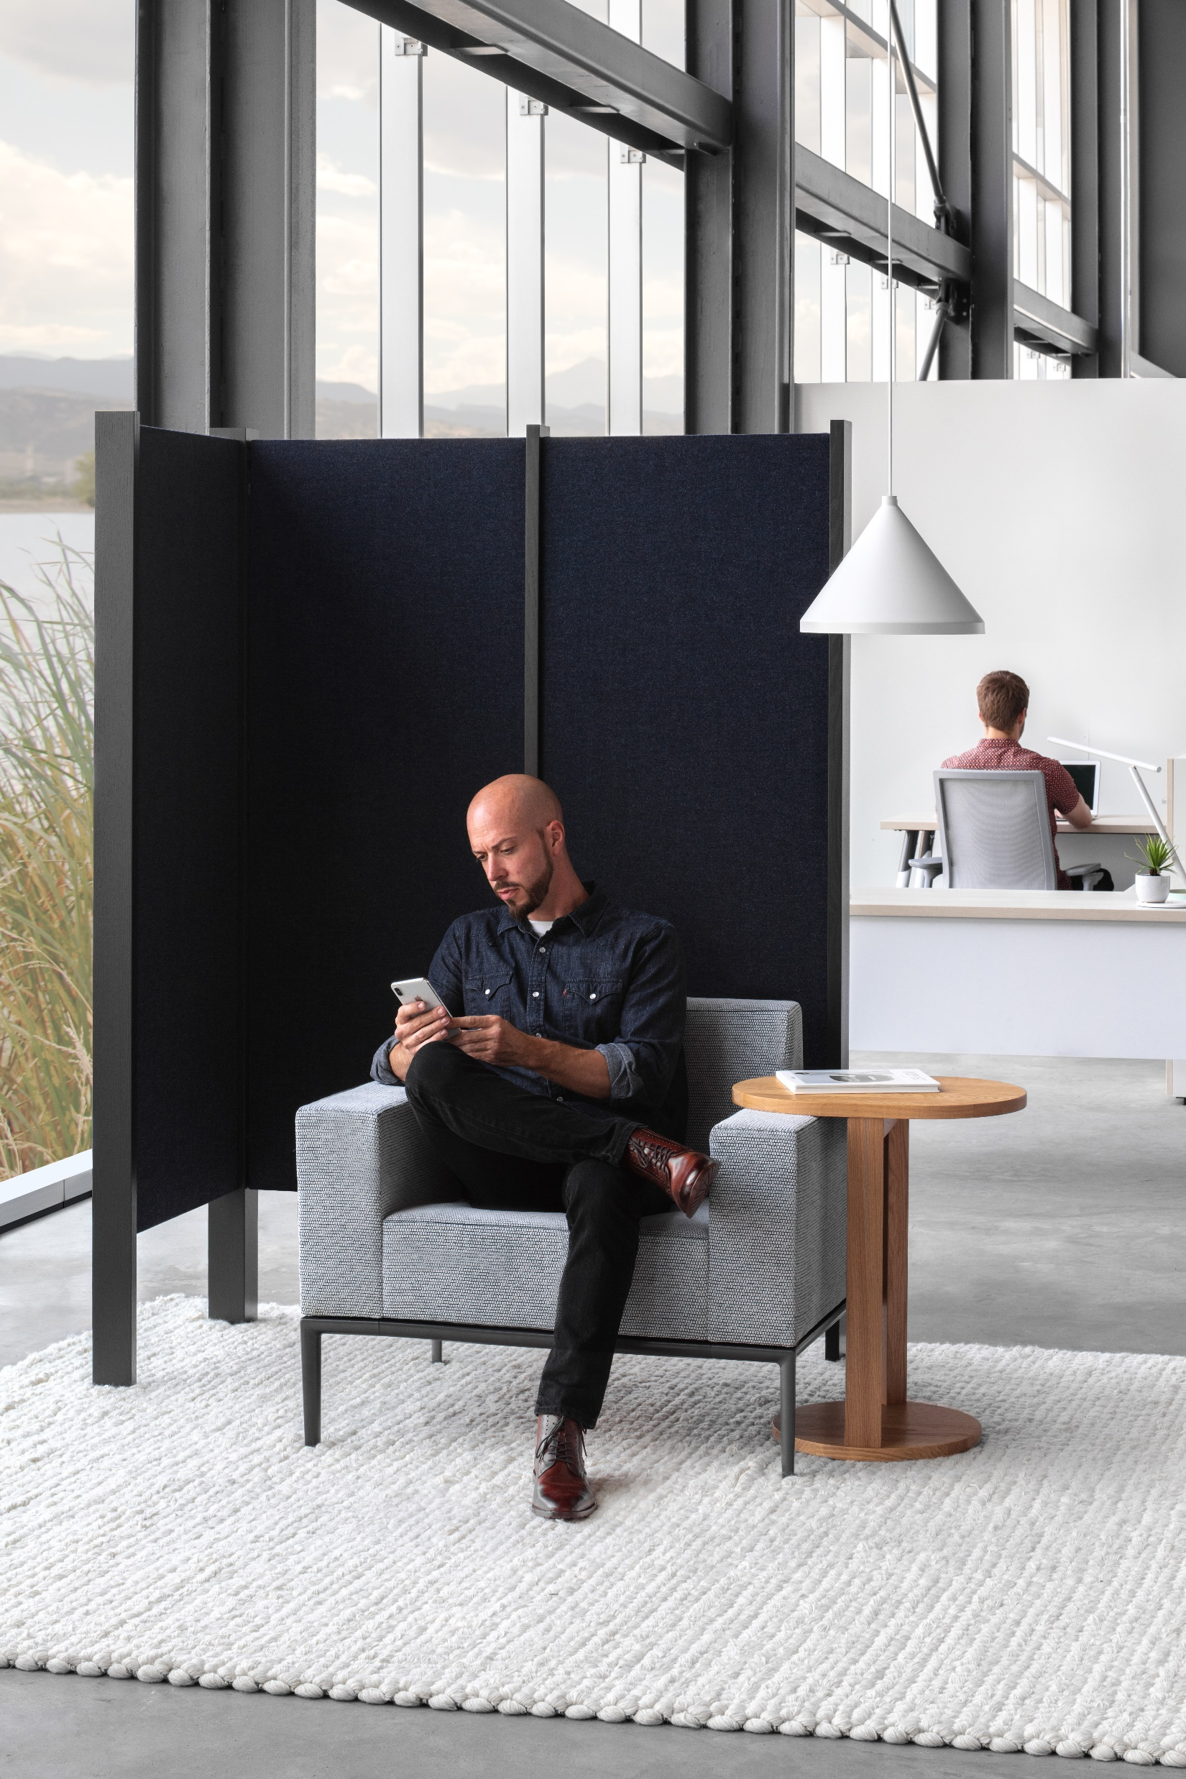
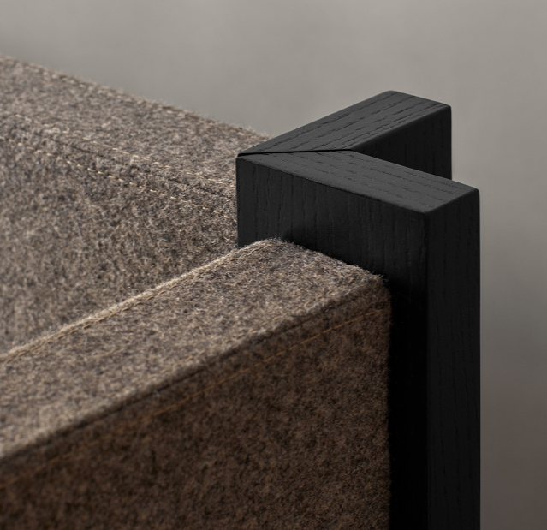
Kyoto
Notes:
As its name suggests, Kyoto’s inspiration comes from the land of quiet contemplation, particularly the beauty of its tearooms.
Kyoto is available in three frame sizes, plus 2 screen-to-floor drop heights.
The panels have a MDF core with mineral wool filling and external cover of fabric.
23.6”W x 51, 65 or 74.8”H
The wood posts are available in natural ash, stained white and stained black

Slide 15
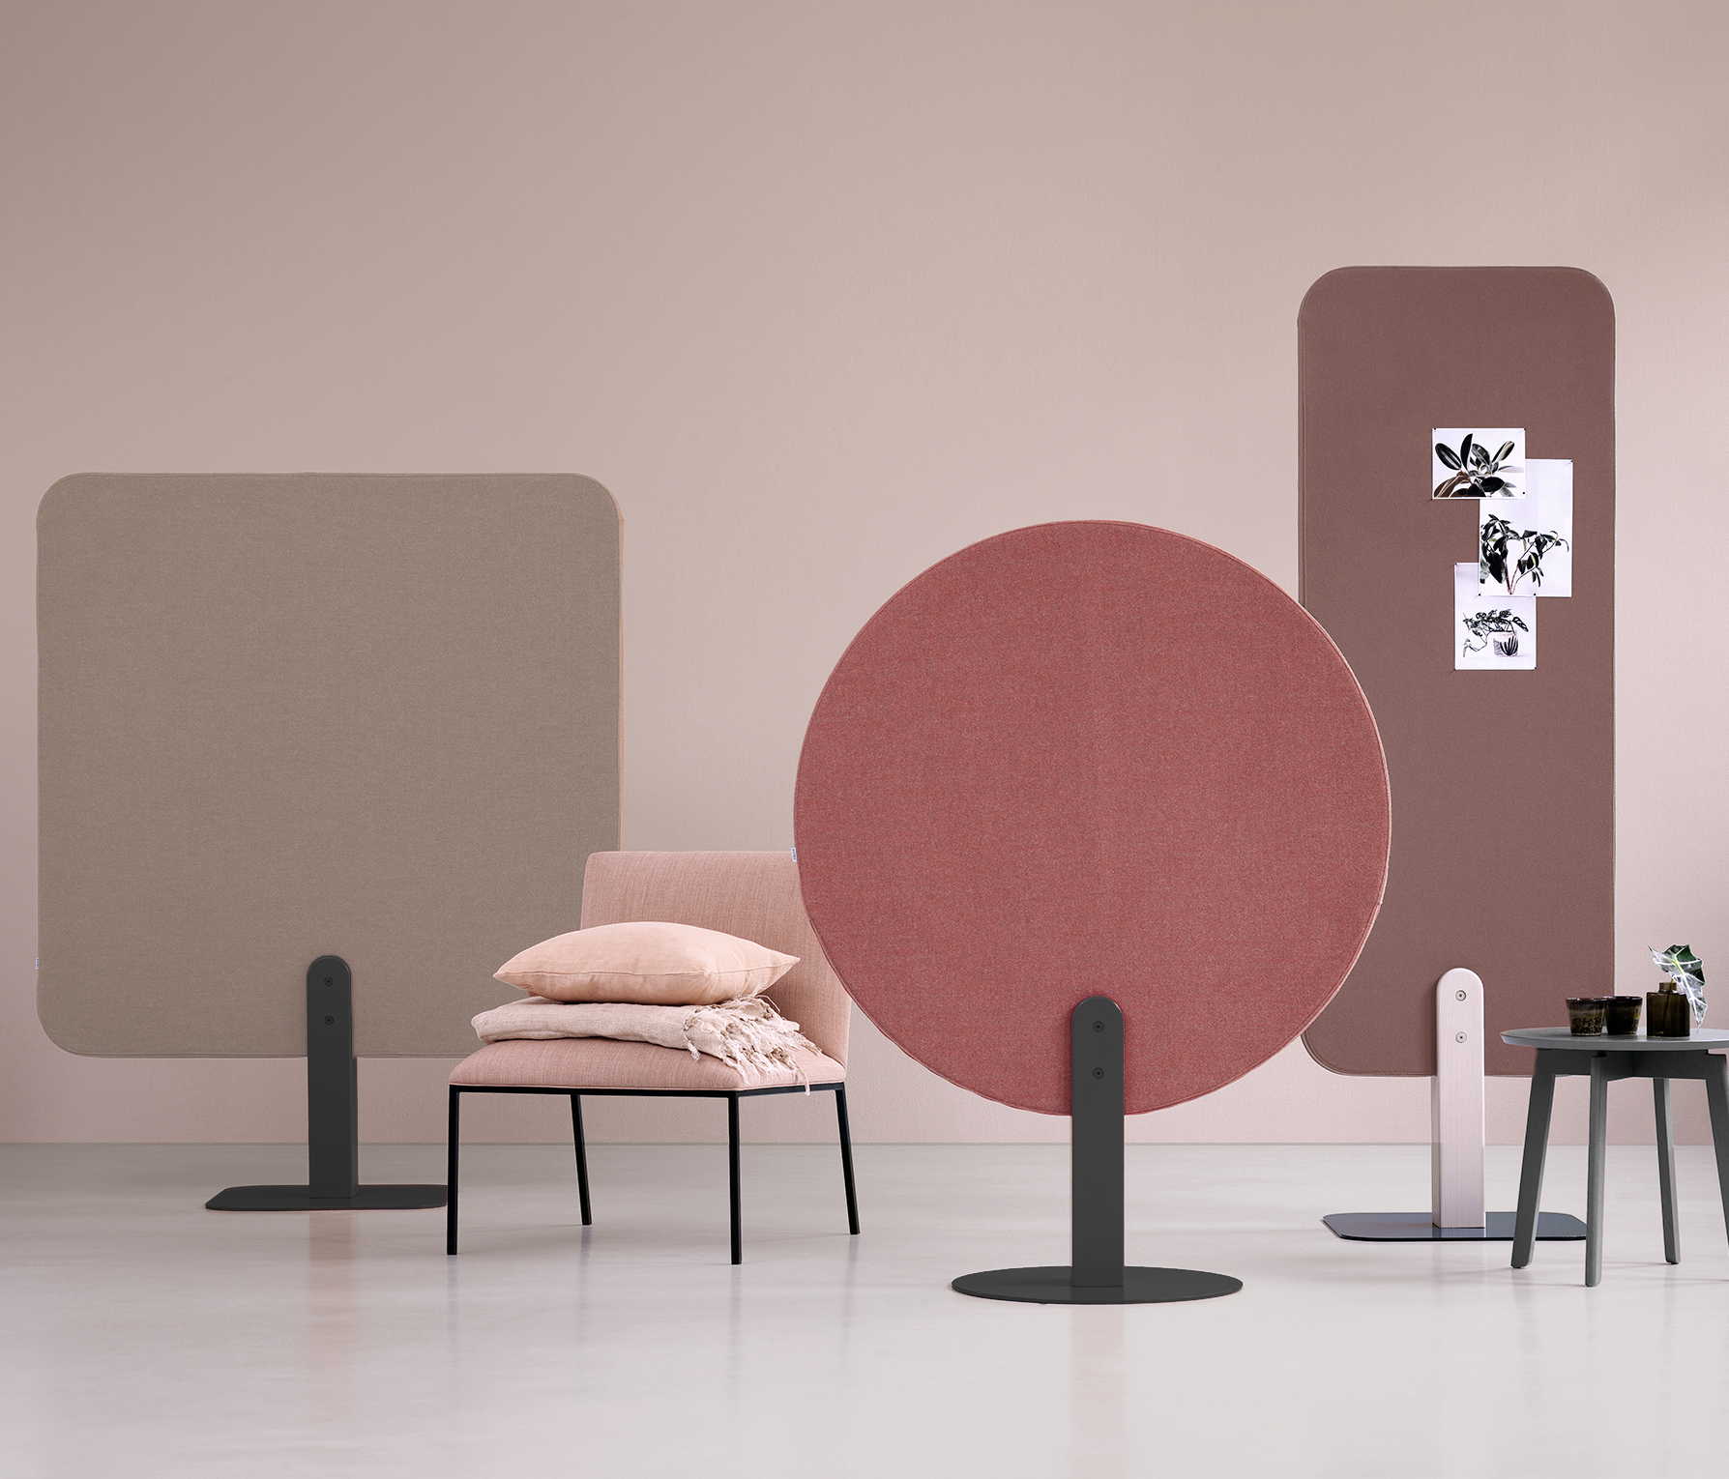
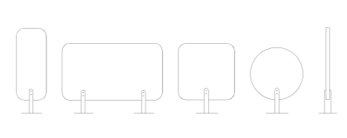
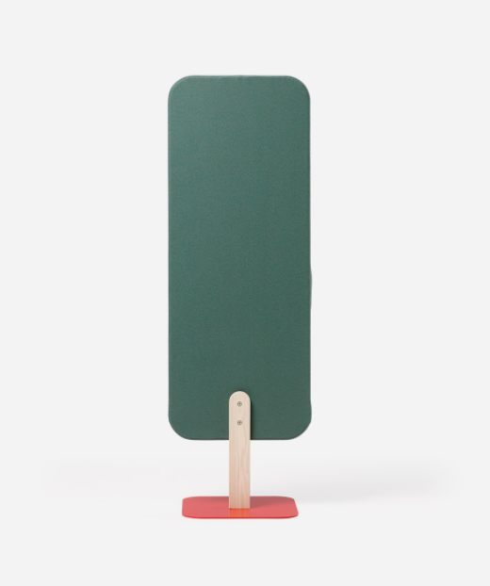
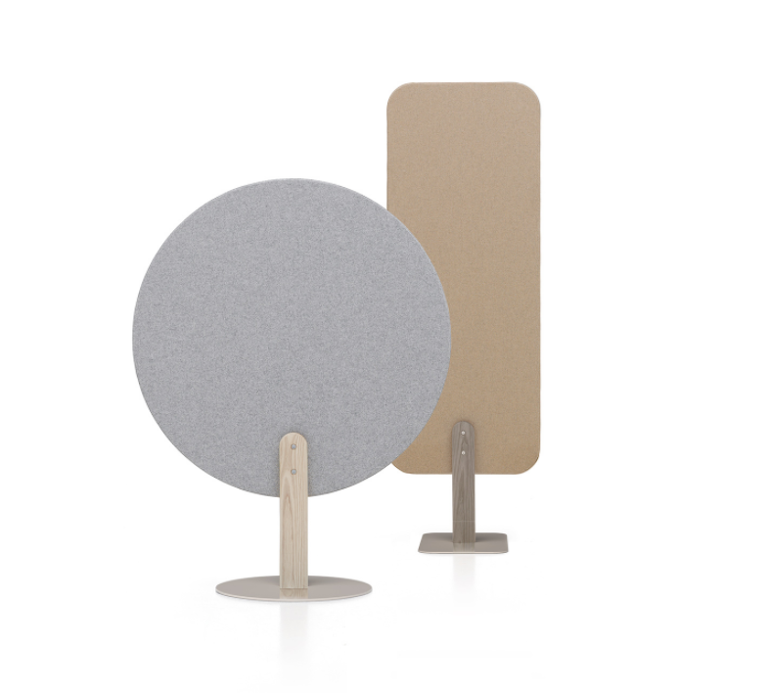
Skog
Notes:
Skog floor screen has high quality with respect to both design and noise reduction, and it can be used not only as decoration in the interior design of public environments but also as a screen in office surroundings.
24-78”W and 52-73”H
Available in white stained ash post with grey base; custom RAL color available

Slide 16
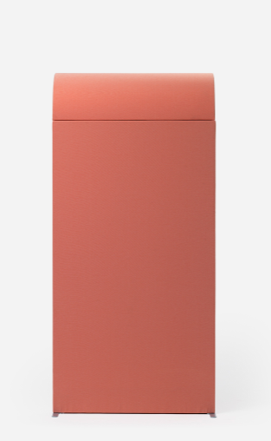

Arc
Notes:
Arc is a sound absorbing roof to create a feeling of enclosure. Walls and roof together create a defined space within a bigger space.
It can be placed freestanding or against a wall, to easily shield off and create a quiet atmosphere.
Available 24-47”W uprights with 59-118” between uprights.
STANDARD FABRICS
Blazer Lite from Camira Fabrics, price class 2
Blazer, Synergy from Camira, price class 3

Slide 17

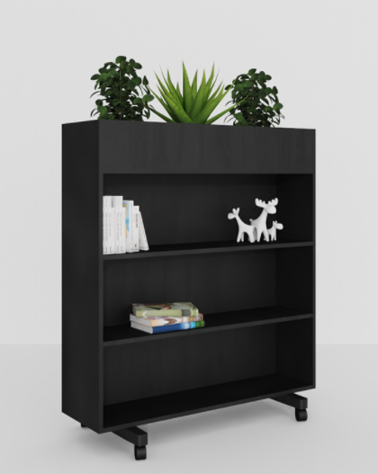

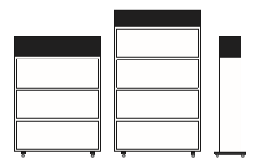
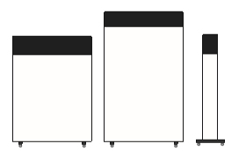
Zorla
Notes:
Zorla is a mobile floor screen with sound absorbing effects, perfect for reducing noise in open room constellations.
The top wooden box can be filled with natural or fake plants to make it a decorative piece of furniture, making it especially useful in schools and offices.
One side can be outfitted as a bookcase for displaying or storing items
Base with locking wheels.
47.2”W x 54 or 67.7”H
Plant box is available in natural ash, white-washed ash or black washed veneer. Or customize using RAL finishes.

Slide 18
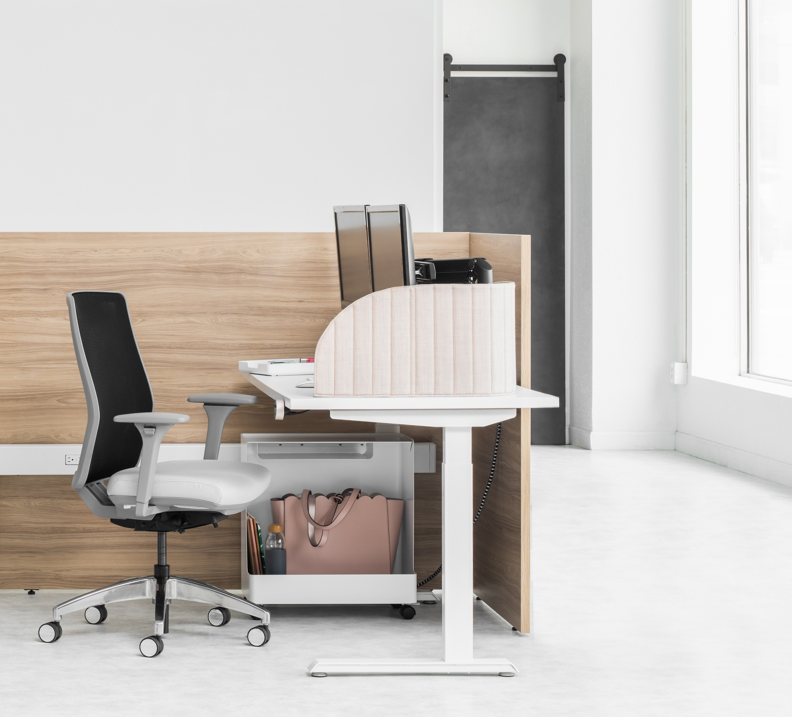
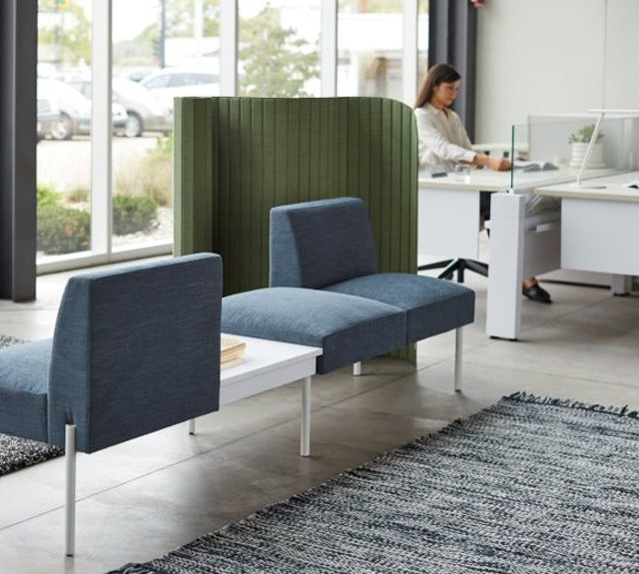
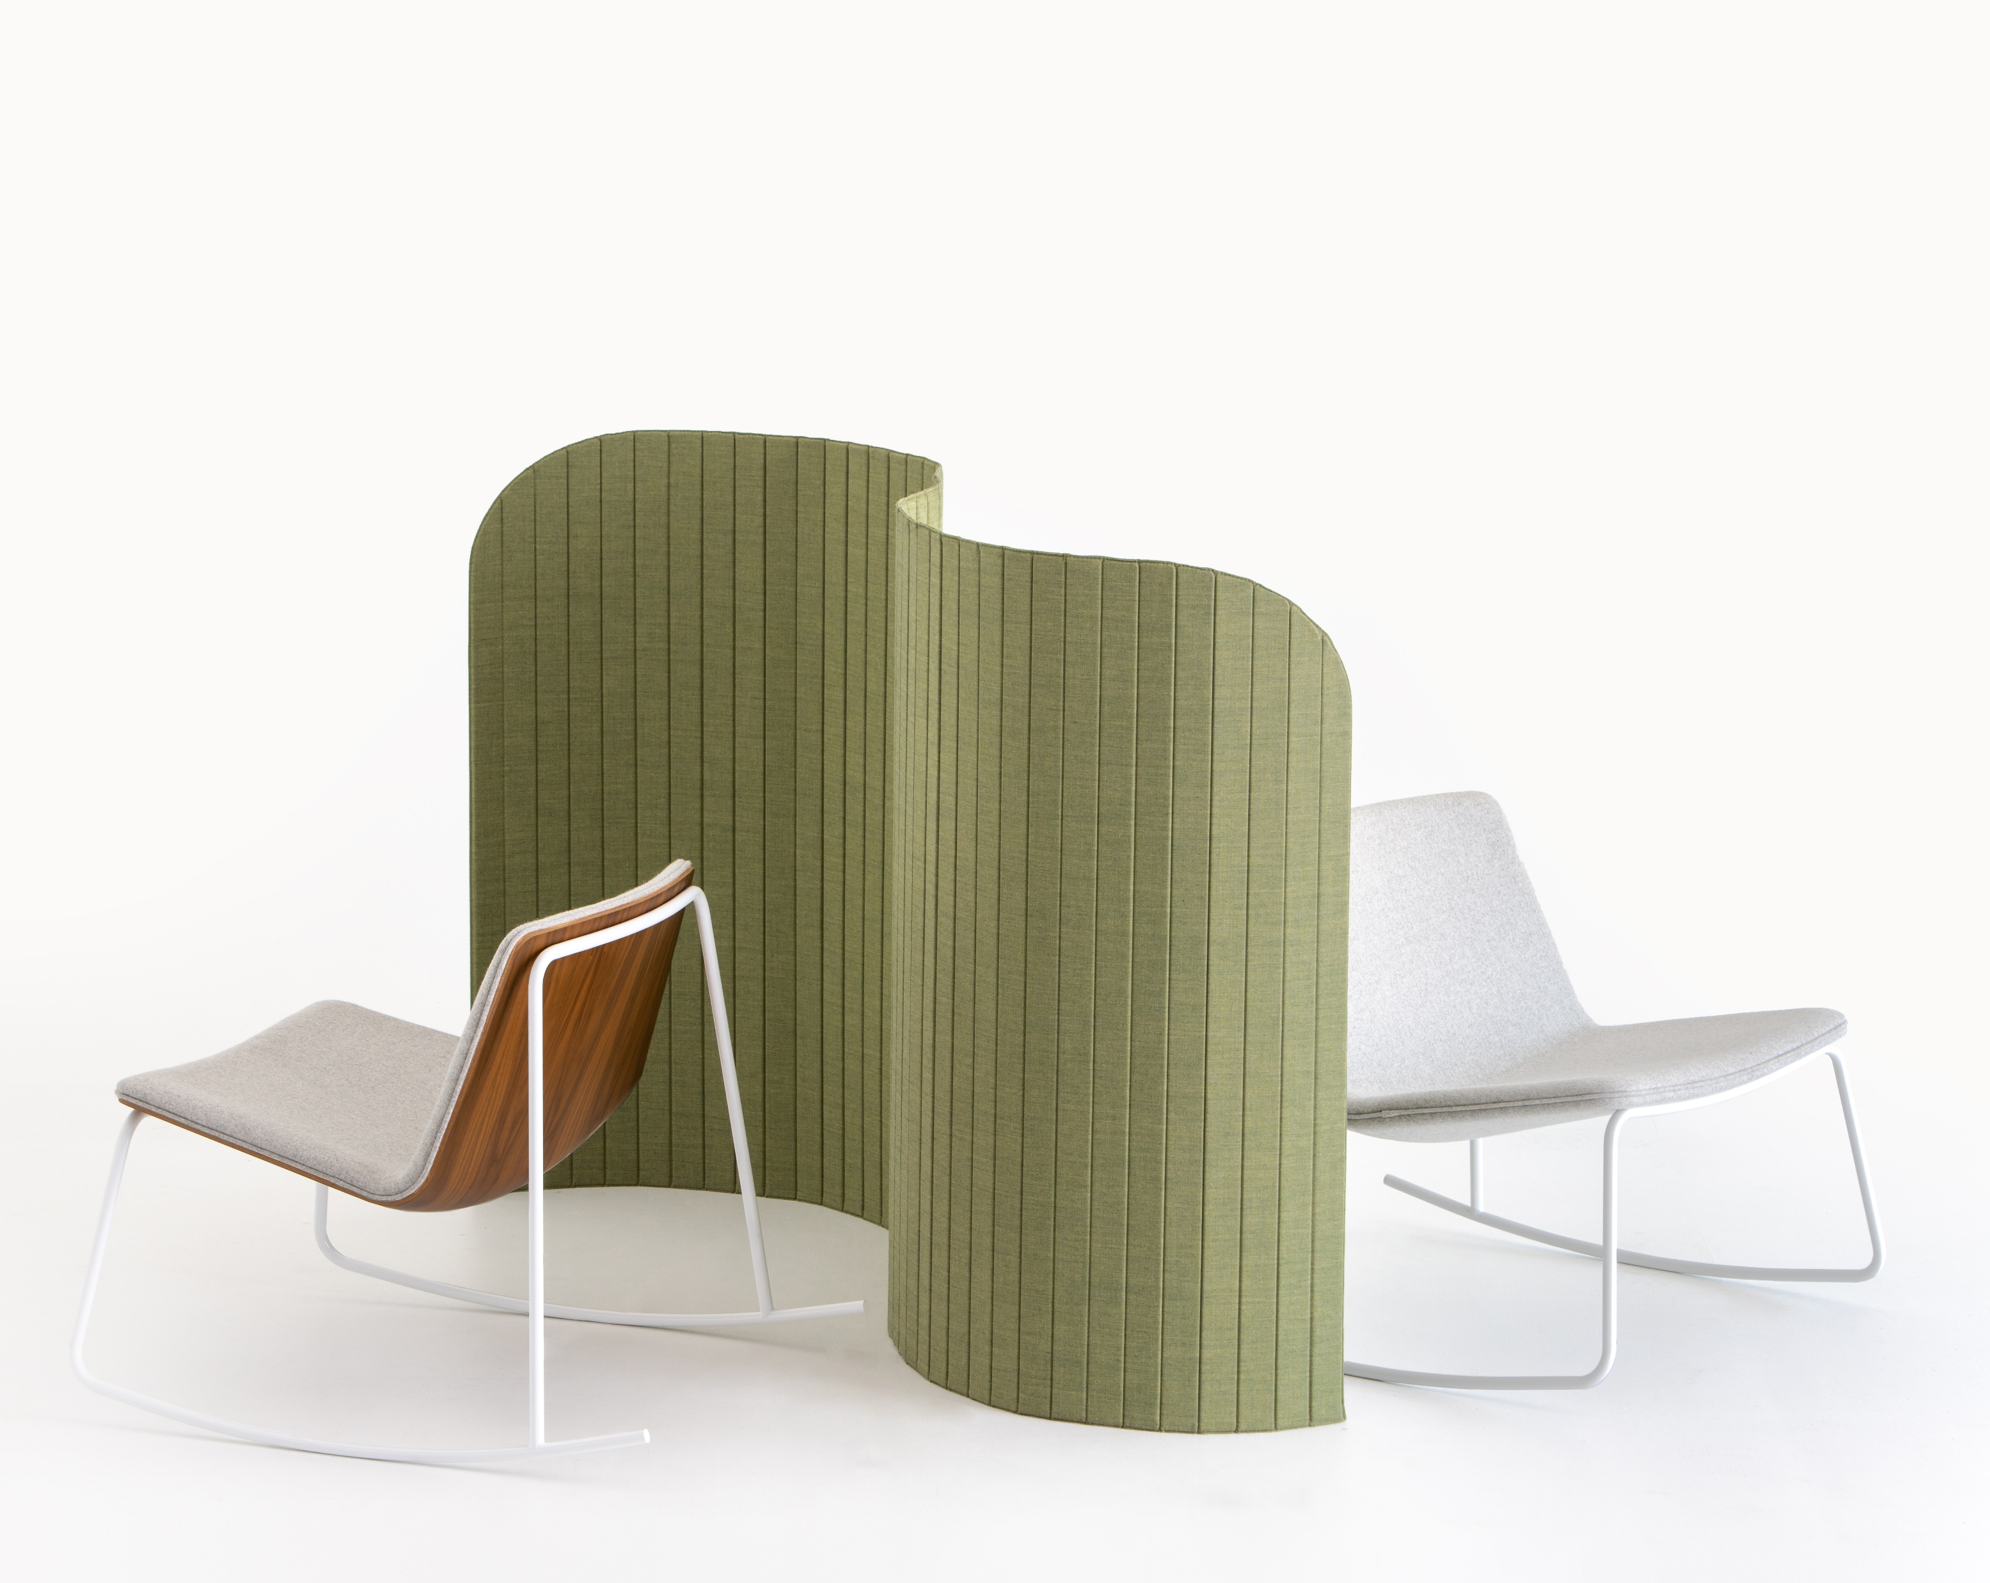
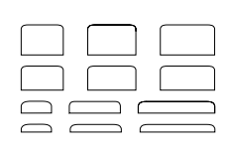
Focus
Floor Screen & Table Screen
Notes:
The Focus screen is about portable privacy. Its feather-light design makes it easy to move when you need to create a new configuration in a flexible office.
Designed for a creative work environment with a focus on flexibility, where you can shape the table screen according to your preferences.
The light and foldable construction can be applied to floor or table top.
Floor screen: 59 or 47”H
Table screen: 17.7” or 12.6”H

Slide 19
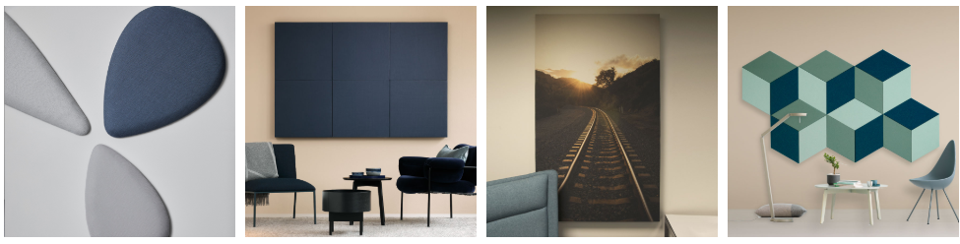



Wall and Ceiling Hung
DELTA
DEZIBEL WALL
DEZIBEL PRINT
FAZETT
TIMBER
CLOUDZ
DELTA
DEZIBEL CEILING
DEZIBEL DIVIDER
Notes:
These elements attach to the wall or hang from the ceiling
You will notice that some are playful while others are more absorptive

Slide 20


Timber
Notes:
Timber is a minimalist sound-absorbing module that can be combined in many different ways.
They work well as classic wall panels, but also as herringbone or other graphic wall displays.
Thru fabric choice, it can be a great moment for branding
Each piece s 5.9”W x 24, 31.5, 39.4, or 47”H

Slide 21




Delta
Notes:
Delta is a sound-absorbing system floating in the air, like a soft and generous flight of kites. Delta protects the user from noise while delimiting a space of quietude
Can also be applied to the wall
Available in 52.4, 39 and 32.7” long
Delta Lamp currently not available for US market

Slide 22





Dezibel Ceiling, Wall & Print
Notes:
Dezibel wall and ceiling hung panels are available in several sizes and shapes and can be combined endlessly to create the visual and acoustic effect you need.
The panels also work well as message or bulletin boards. They are an efficient way to reduce echoes and reverberation in public spaces.
Dezibel print offers an easy way to give your absorber a unique character by printing a design on fabric. Perhaps a brand logo or historical company photo? The canvas is yours, and the possibilities endless.
Dezibel Wall is available in two separate thicknesses depending on the sound absorption goal

Slide 23




Dezibel Divider
Notes:
Dezibel Divider is a sound-absorbing module that can be combined in many ways. The absorbers are suspended at 2” intervals.
Suspend it from the ceiling to create space separators and effective sound barriers. Mute makes it possible to create separate areas and a very pleasant sound environment while preserving the room’s openness.
Ranging from 14x22 to 22x47, Dezibel can be hung in a variety of patterns to accommodate bold and muted spaces.

Slide 24

Furniture
DEZK
FOCUS POD
TONE
TUNE
Notes:
Every element has the potential to absorb sound. Zilenzio has added furniture to their offering to take advantage of furniture that gets applied to a space.
Dezk, Tone and Tune – provide hard working sound absorption
Focus- is more about visual privacy and less about sound absorption

Slide 25




Tone
Notes:
Tone cabinets, designed by Norm Architects, are sound dampening design pieces made to help build a balanced acoustic environment in the workplace or at home, ultimately making it easier to focus and concentrate.
Designed to absorb certain frequencies of sound and placed discretely, where it is needed the most.
Zilenzio’s collection of acoustic furniture is designed to improve sound in the spaces that matters to you the most.
Paint standard in Jet Black and Dusty Grey or an RAL color
Fabric is Kvadrat Remix

Slide 26




Focus Pod
Notes:
Designed by Note Studio, the Focus Pod an easily placed and functional Screen with included seat and table.
A designed and comfortable seat that provides a calm and snug feeling.
Frame and table are available in white stained ash.
The table can mount on the left and right side
Available in 20 different fabric patterns

Slide 27




Tune
Notes:
Tune is a sound absorbing seating collections designed by Norm architects for Zilenzio.
The Sofa has a clad sound absorbing shell that’s combined with soft cushions that follows the smooth and clean lines of the sofa.
Legs available in black

Slide 28

Sticky Stories
and Integration

Slide 29


Stone Wool
Zilenzio’s key ingredient
Processed to be a specific density and thickness to optimally absorb the speech sound.
Notes:
-Absorbs sound in relevant frequency ranges
-Made of natural stone that is crushed, melted and then spun (like cotton candy) into a wool like material. That woold material is pressed to specific density for ideal absorption
- Contains no plastic
-No harmful substances.
-Stone wool does not burn. Fire rating class A1.

Slide 30

Brand Messaging
Notes:
Zilenzio products are meant to do the work – behind-the-scenes. This client printed marine images on Dezibel screen. Its beautiful and absorptive (to the setting and the sound!)
Clients could use this technology to print logos or images of products and services to support brand messaging.

Slide 31

Day Care
Notes:
Zilenzio had a client who owned a daycare. They had a limited amount of funds to use so at Zilenzio’s recommendation, they decided to outfit one space “right” (and by right, they meant the appropriate amount of material to do the job effectively)
The daycare had 2 primary rooms. Each with toys and activities for the children. Interestingly, it wasn’t long before all of the children CHOSE to be in the room with the “right” acoustics.
They were drawn to the space that allowed them to be children and play but where they could hear their own thoughts.

Slide 32


Slide 33


Slide 34


Slide 36


Slide 37

Allsteel & Zilenzio image

Slide 38
Sales & Dealer Training
INTERNAL USE ONLY
Notes:
white, black and natural oak. Custom color is an option with an MOQ of 50 or more

Slide 39
A Note on Exclusivity
Zilenzio
Allsteel has exclusive* distribution for North America
Registration opportunity for Global Accounts with locations inside and outside of N. America
* with the exception of a couple grand-fathered in retailers
INTERNAL TRAINING
Notes:
Exclusive distribution rights to strategic global accounts with locations inside and outside of North America in pre-registered and specific projects (registration process is a simple email or other written communication between Zilenzio, Allsteel and a dealer).

Slide 40
Terms
Zilenzio
Discount: 45% off List
Project Discount: Contact marie.lindqvist@zilenzio.se for discounting for projects greater than $50,000 net.
Showroom Discount: 75% off List
Shipping:
  $0-6,000 Net = 15% ($150 min)
  $6,000-$12,000 Net = 12.5%
  above $12,000 Net = 10%
INTERNAL TRAINING

Slide 41
Warranty & Lead Time
Zilenzio
Warranted to be free of workmanship defects for 2 years.
Set expectations. These are high quality, but not tested to BIFMA
Manufacturing lead time is 4-5 business weeks; Tone, Tune and Kyoto are 6-8 business weeks.
Shipment is made via boat to a Harbor; 4-5 weeks. Add 1-week delivery to NY and 2-week delivery to Western US.
Air freight is available at additional charge, delivery time ~1 week
INTERNAL TRAINING

Slide 42

Surface Materials
Zilenzio
Curated offering
Standard powder paint + RAL match for upcharge
Textile specific to unit including Camira, Davis, Gabriel, and Kvadrat in Price Grades 1-4
COM is available
INTERNAL TRAINING
Fabrics for Table screen, floor screen, wall absorbent and ceiling absorbent

