Slide 1
Fit™
Sales & Dealer Training
INTERNAL USE ONLY

Slide 2
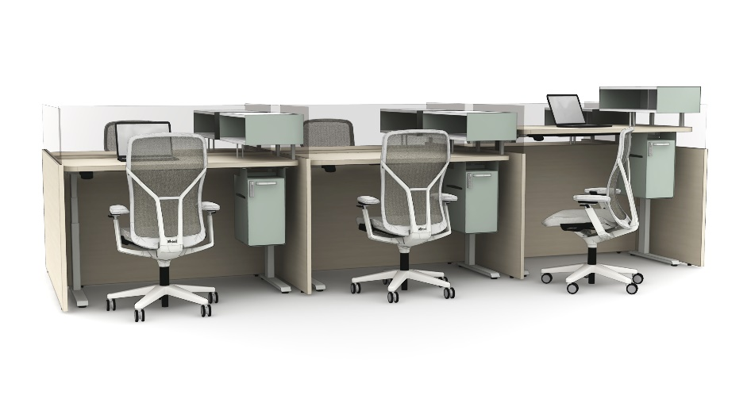
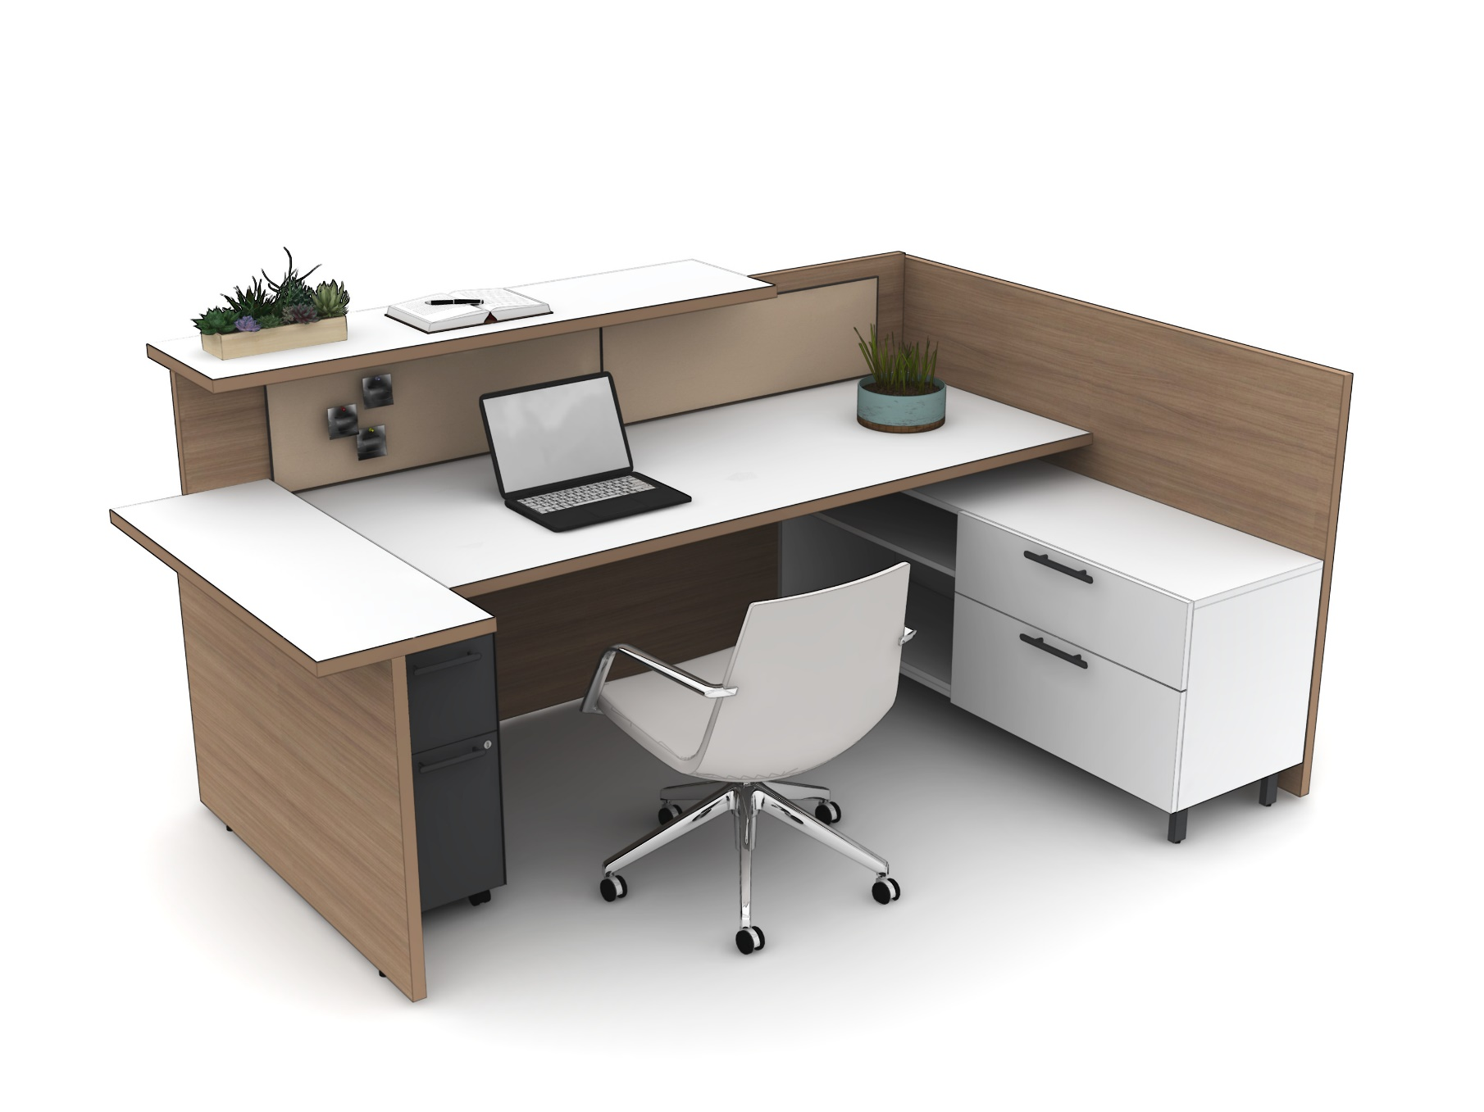
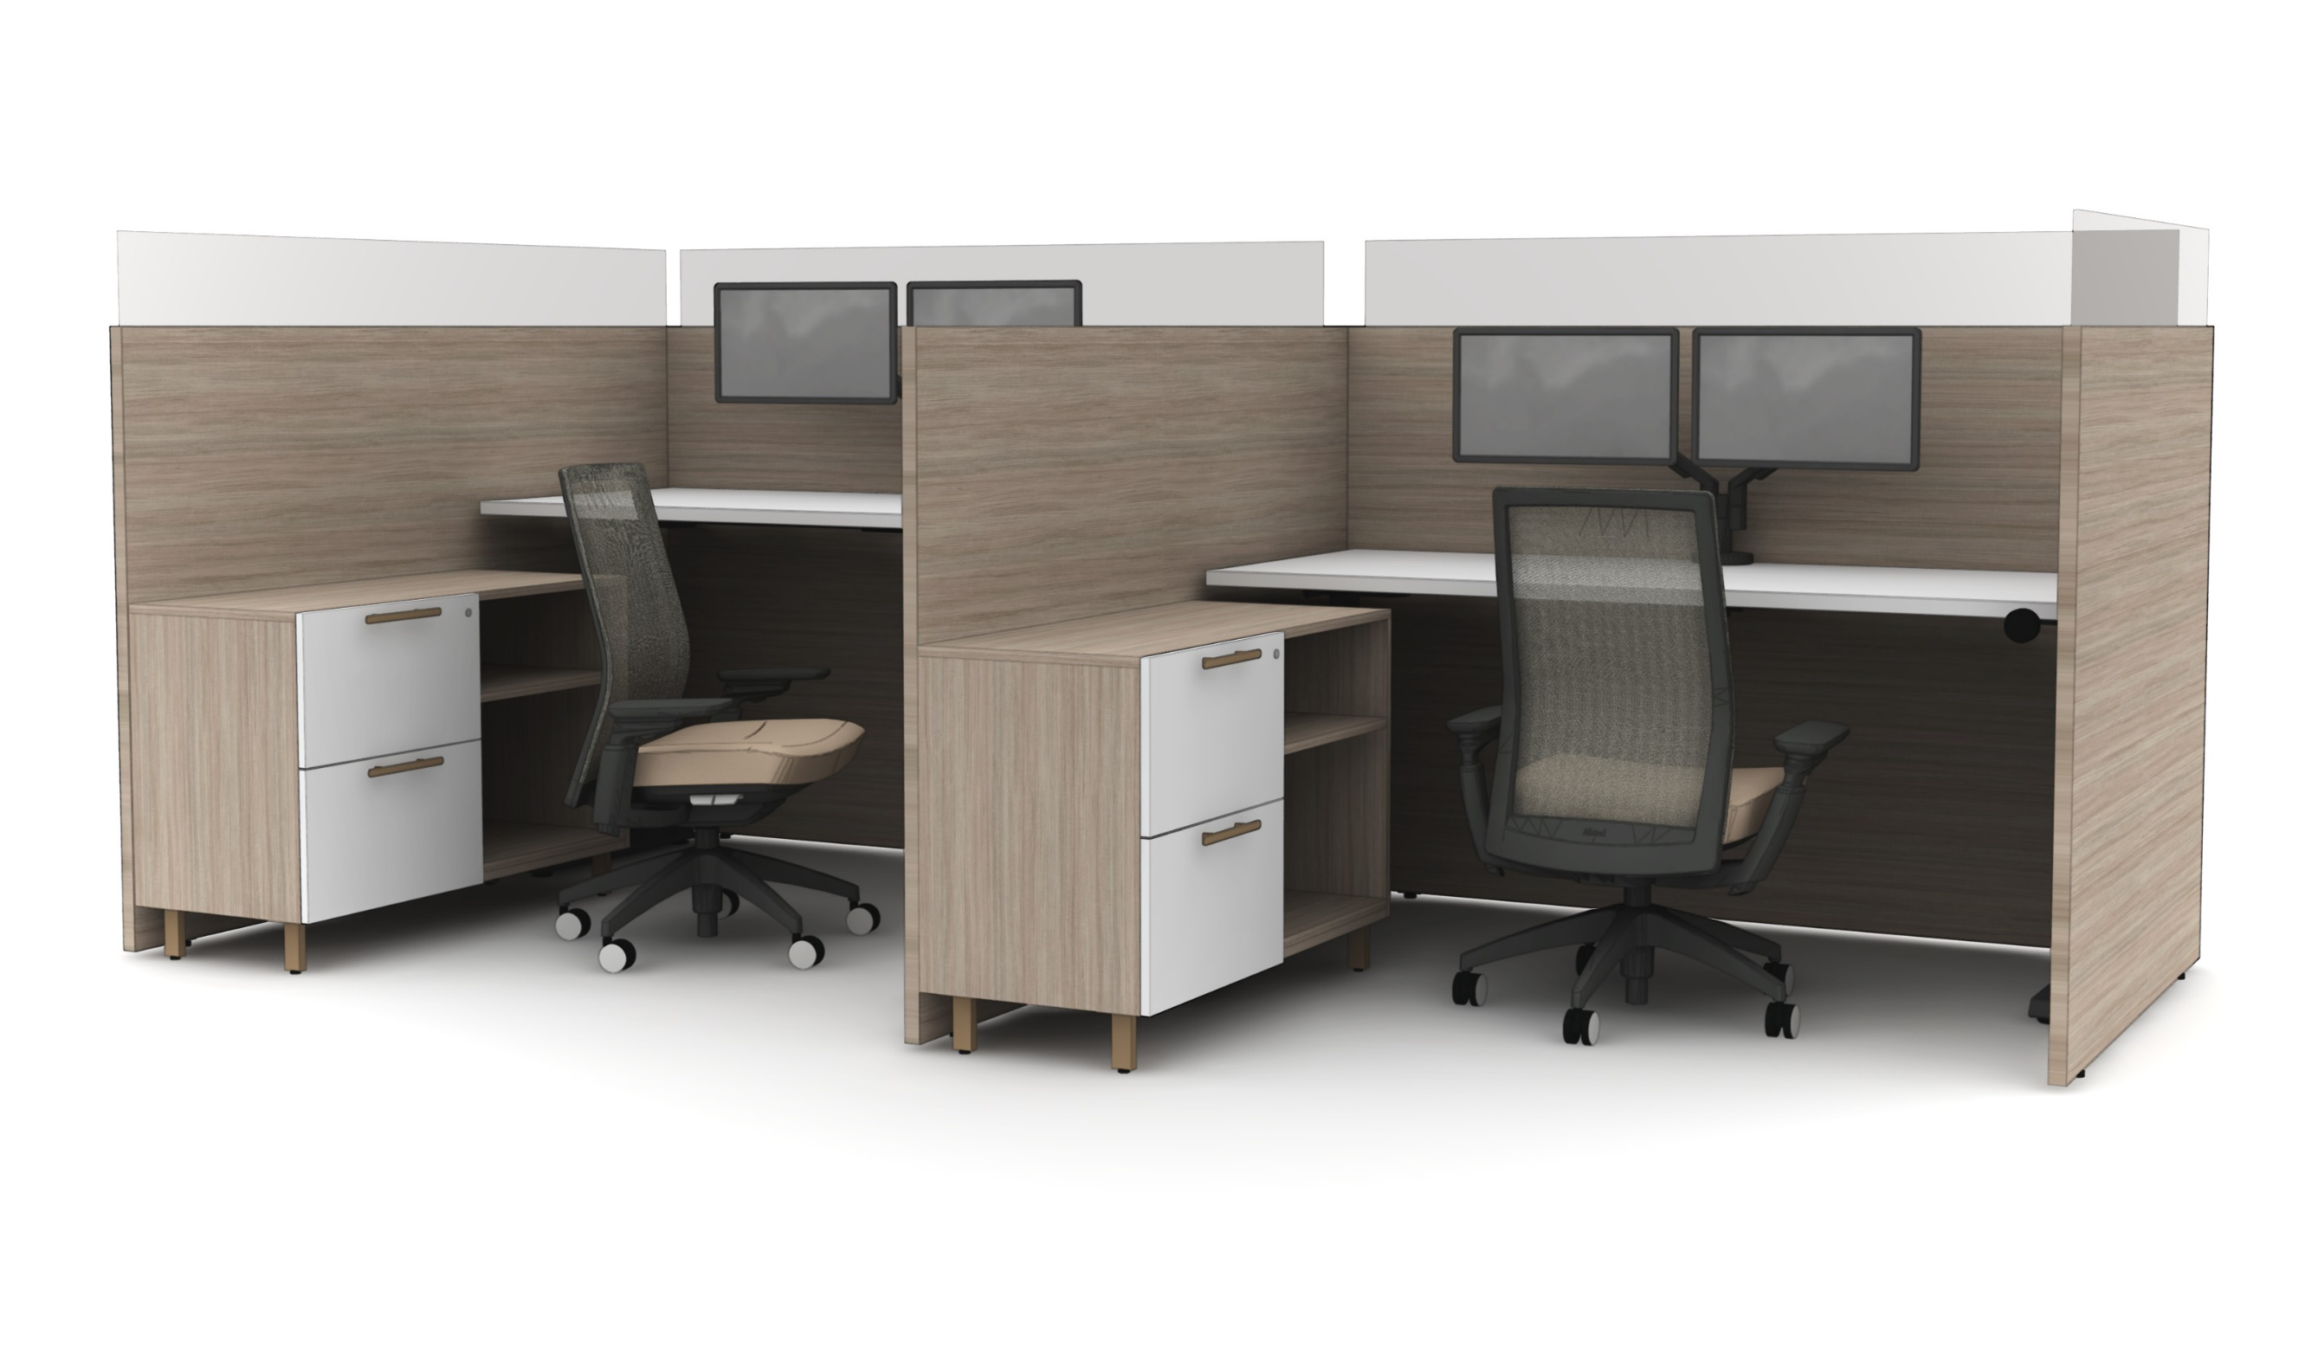
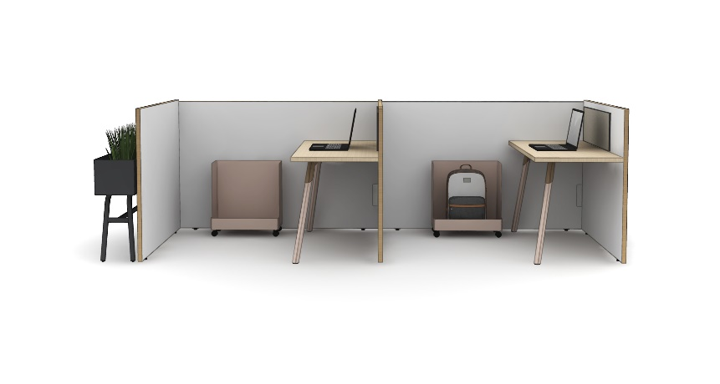
INTERNAL TRAINING

Slide 3
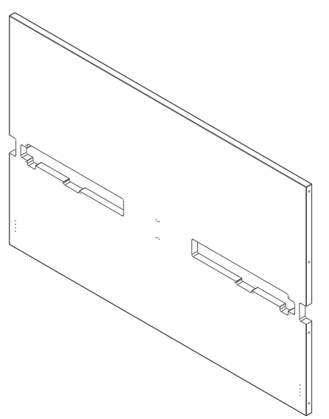
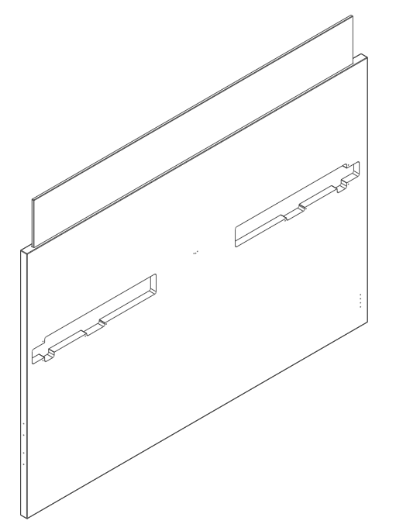
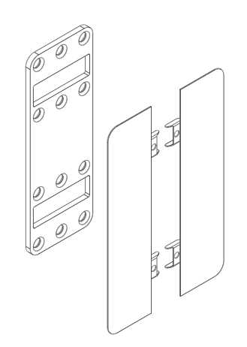
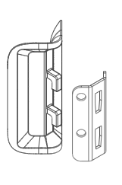
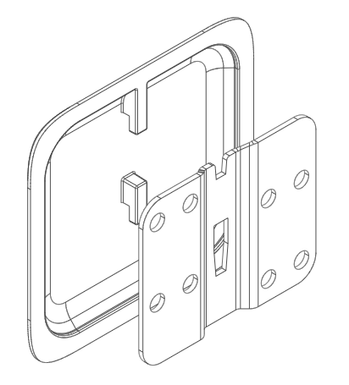
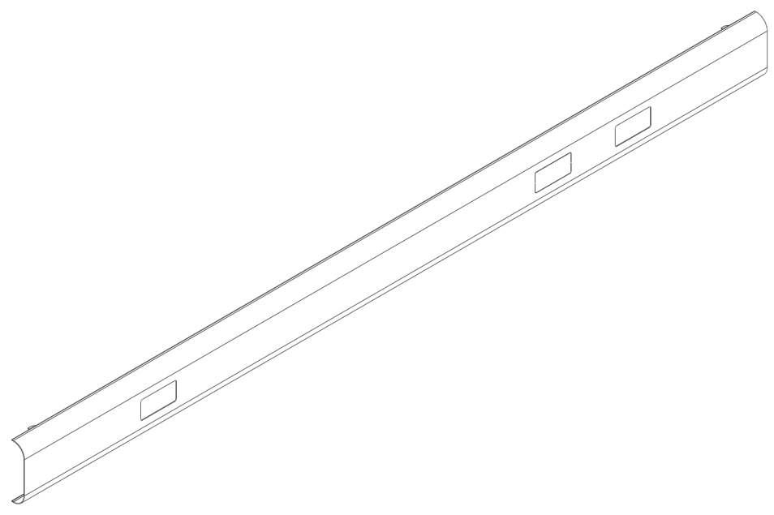
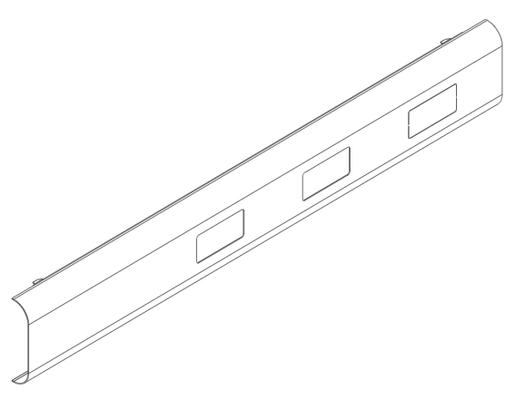
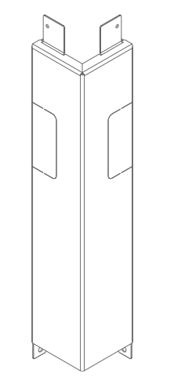
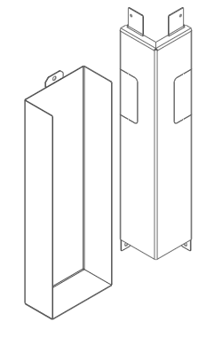
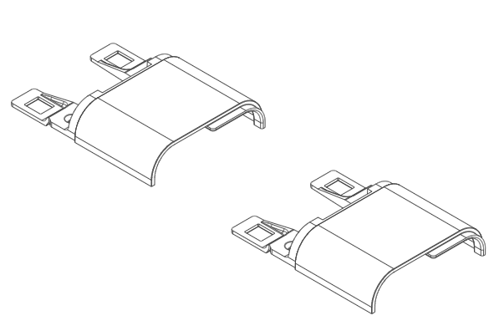
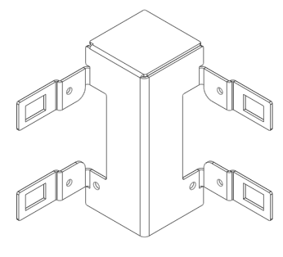
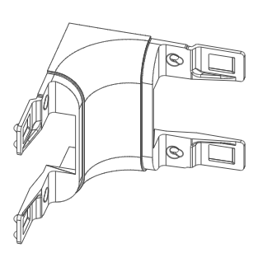
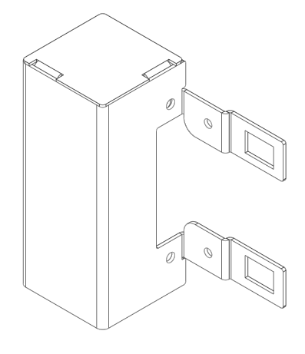
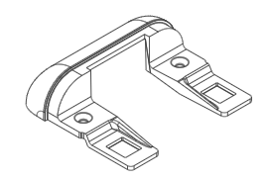
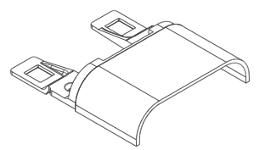
Statement of Line
Panels
Panel Connectors
Rails
INTERNAL TRAINING
Standard Panel
With Integrated Glass
L- Connector
In-Line Connector
Split End Connector
Spine Rail
Return Rail (Mid/End)
Rail Connectors & Infeed Shrouds
End Cap
L- Transition
Straight Corner
Straight In-Line
Infeed L- Transition
Infeed Straight Corner
Infeed Shroud
Hardwire Infeed

Slide 4
Planning Dimensions
INTERNAL TRAINING

Slide 5
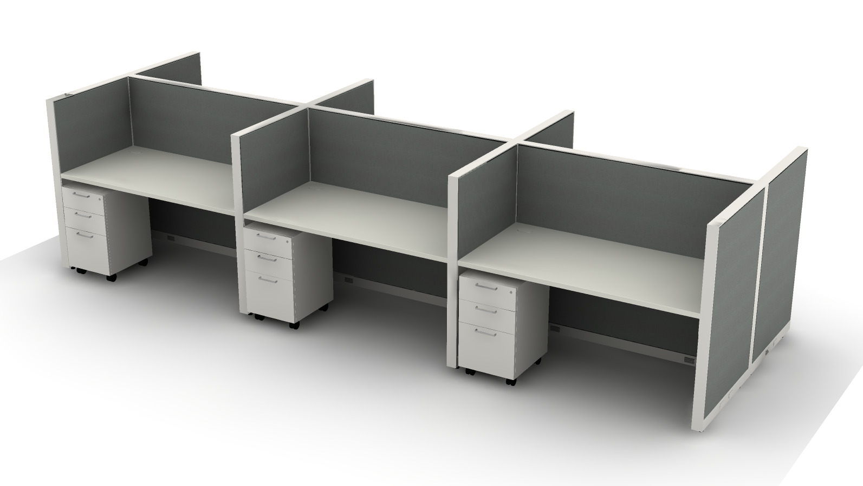
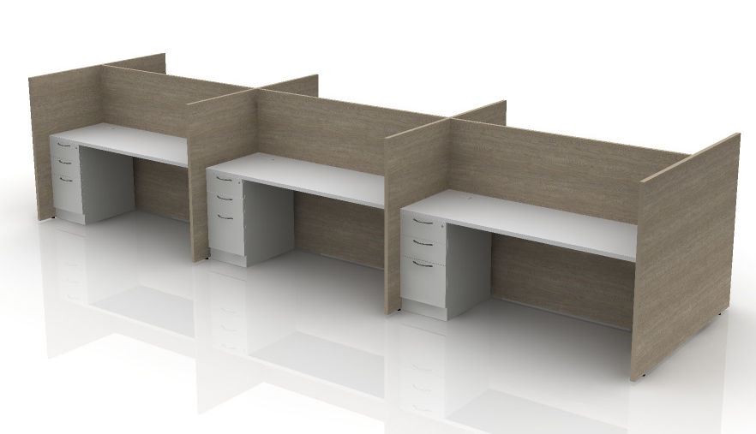
Planning Dimensions – 72”x30” 6-pack
Total Length: 228”
Total Length: 226.5”
Total Length: 220.5”
INTERNAL TRAINING
STRIDE
TERRACE
FIT

Slide 6
Internal Positioning
INTERNAL TRAINING
*Optimize, Terrace, and Stride pricing for fabric panels

Slide 7
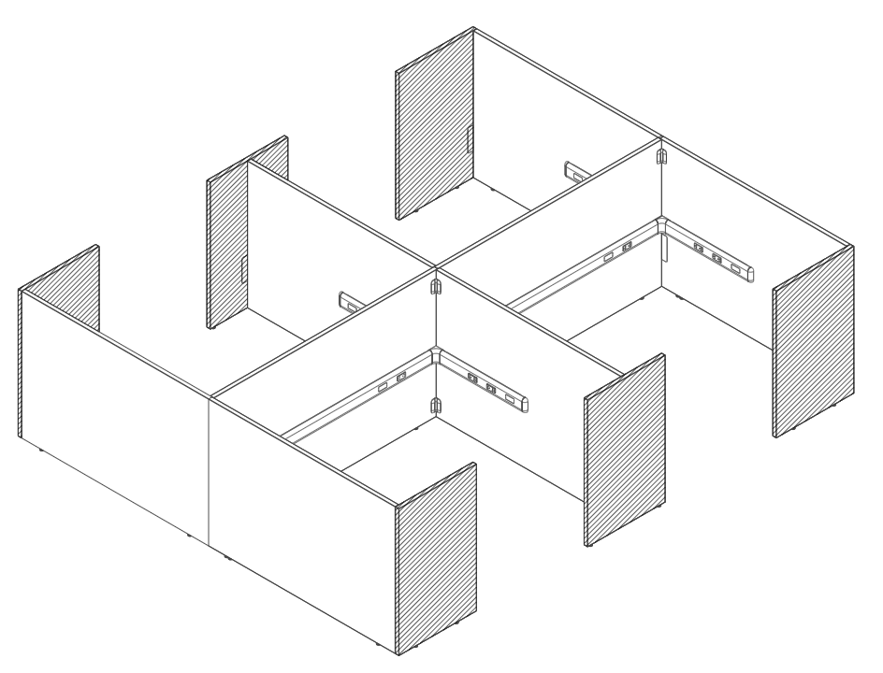
Specification Rules –
Stability
INTERNAL TRAINING

Slide 8
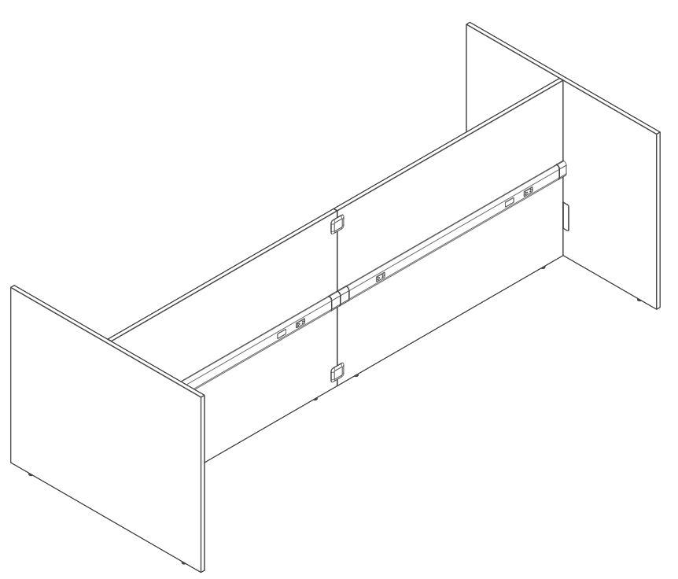
Specification – Stability Requirements
Dual-Sided Typicals (Opposing Returns)
A parent run must be a minimum of 60” and a maximum of 144” between return panels. The parent run must have a minimum of two return panels running in opposite directions on each end of run.
Dual-Sided returns must be a minimum of 60” combined width.
Return panels must not be any more than 30” lower than the maximum height of the parent panel run.
Return panels cannot be taller than the parent panel.
Panel height measurement includes integrated glass.
INTERNAL TRAINING
B
Min 60”
Max 144”
A + B >= 60”
A
30” + 30”
24” + 36”
18” + 42”

Slide 9
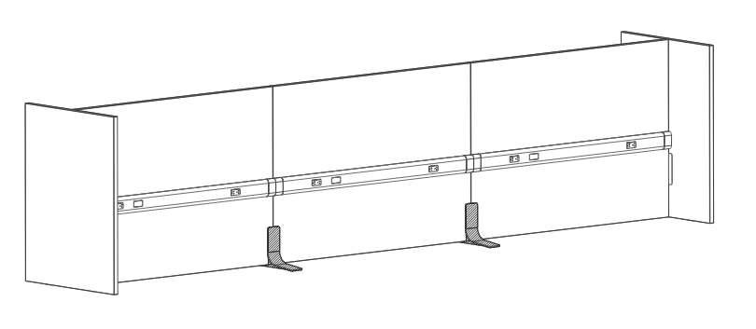
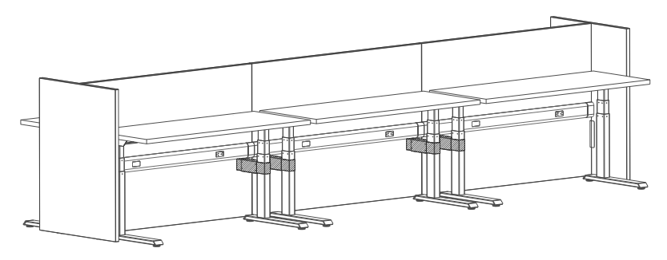
Specification – Dual-Sided Panel Bench
A freestanding bench can be created using either HAT brackets OR Freestanding Feet. Dual-sided ONLY.
There MUST be an end panel on each end of the run for all applications.
When using a 30”H spine with a below worksurface height rail, a worksurface or storage must be mounted at any panel-to-panel connection.
Support (HAT Bracket or Foot) needed every 96” on both sides. HAT brackets must be placed at same height; Foot is automatically back-to-back.
Max height, with glass = 65”H. No Max length.
INTERNAL TRAINING
HAT Bracket Bench
Footed Bench

Slide 10
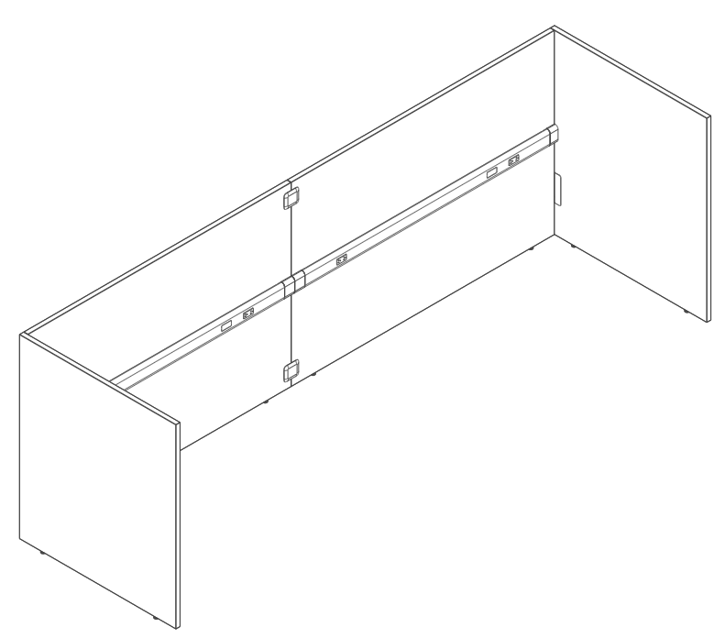
Specification – Stability Requirements
Single-Sided Typicals
A parent run must be a minimum of 60” and a maximum of 144” between return panels. The parent run must have a minimum of two return panels on each end of run.
A parent run <=84” must have a minimum of two return panels totaling 60” in combined width. For every 7.5” drop in return panel height, 6” must be added to the minimum combined return length.
A parent run >84” must have a minimum of two return panels totaling 84” in combined width.
INTERNAL TRAINING
Return panels must not be any more than 30” lower than the maximum height of the parent panel run.
Return panels cannot be taller than the parent panel.
Panel height measurement includes integrated glass.
B
Min 60”
Max 144”
If Spine <=84”
A + B >= 60”
If Spine >84”
A + B >= *84”
*Minimum single
panel return length of 24”
*Minimum single
panel return length of 24”
A

Slide 11
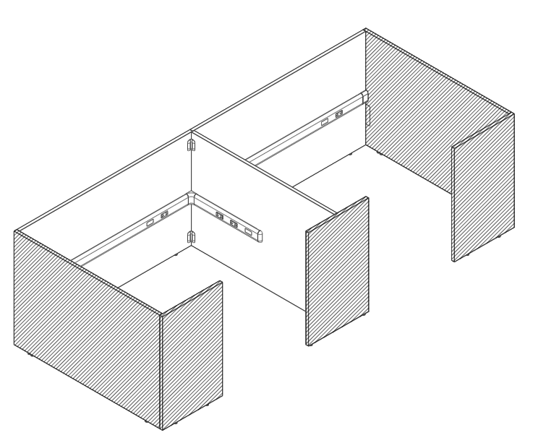
Specification Rules –
Model Logic
INTERNAL TRAINING

Slide 12
Specification – Panel Type
When specifying Fit™ Panels, the base model indicates the height and modular width needed. Model logic is ‘GSYS’ then ‘height’ then ‘width.’ (e.g., a 50”H by 72”W panel would be GSYS5072).
Due to the lack of connectors spacing out the panels, the true width of Fit™ panels must accommodate panel overlap, which is done by specifying ‘panel type’ explained on the next slide.
The first dot option indicates the panel type (where the panel is located within the typical) and power options.
Specify L- or T- Gallery-to-Gallery Panels when power is not needed in a single-piece end panel. Details on future slide.
Each Split End panel is specified separately and may be specified with or without power.
End Panels can only be specified at the same height or shorter than the spine panel.
INTERNAL TRAINING

Slide 13
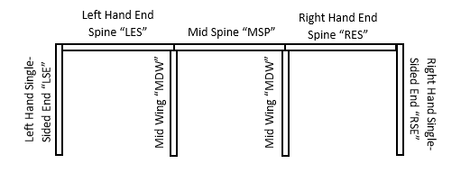
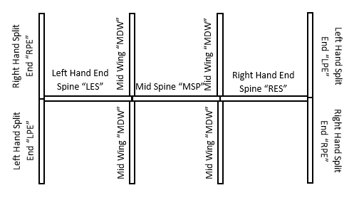
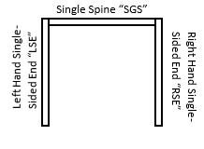
Specification – Panel Type
Panel type options are below:
Mid Wing = “MDW”
Left Hand Split End = “LPE”
Right Hand Split End “RPE”
Left Hand Single-Sided End = “LSE”
Right Hand Single-Sided End = “RSE”
Right Hand End Spine = “RES”
Left Hand End Spine = “LES”
Mid Spine = “MSP”
Single Spine = “SGS”
INTERNAL TRAINING

Slide 14
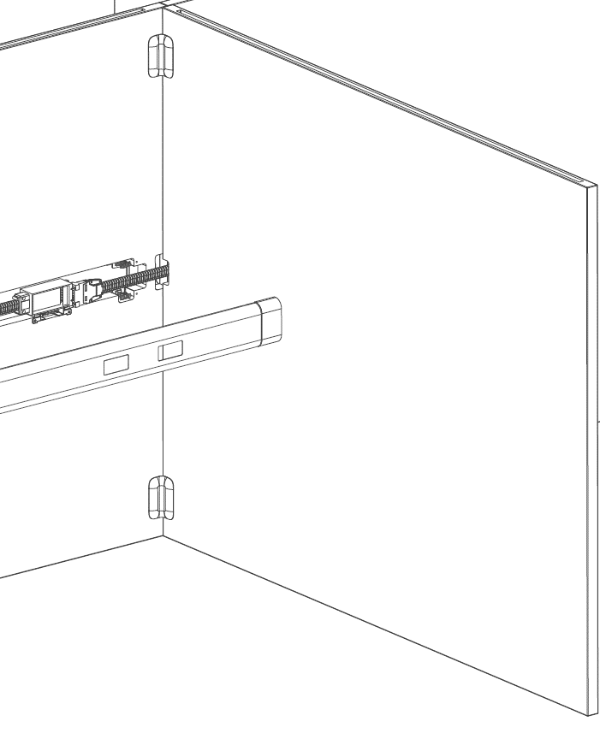
Specification – Panel Power
Following the ‘Panel Type’, the option code includes a power specification.
Panels under 60”W are not available with power. Panels 60”W and greater are available with single- or dual-sided power.
Spine panels are only available 60”W or greater and must be specified with power.
When power is not needed in Mid Wing Panels, they must be specified with No Power AND the spine power height in order to allow electrical components to pass through the panel. (See Image right)
Power can be specified at the Below Worksurface or Below HAT heights, see dimensions in FAQ. Only one height can be used per typical. Cannot mix and match rail height within the same stations.
INTERNAL TRAINING
Non-powered Mid Wings have a cutout to allow power harness to pass through.

Slide 15
Specification – Panel Power
Power options for Spine Panels are below:
Single-Sided Power Below Worksurface = “SW”
Single-Sided Power Below HAT = “SH”
Dual-Sided Power Below Worksurface = “DW”
Dual-Sided Power Below HAT = “DH”
Power options for End Panels are below:
No Power = “PN”
Single-Sided Power Below Worksurface = “SW”
Single-Sided Power Below HAT = “SH”
Power options for Mid-Wing Panels are below:
No Power Below Worksurface = “PW”
No Power Below HAT = “PH”
Left-Handed Single-Sided Power Below Worksurface = “LW”
Left-Handed Single-Sided Power Below HAT = “LH”
Right-Handed Single-Sided Power Below Worksurface = “RW”
Right-Handed Single-Sided Power Below HAT = “RH”
Dual-Sided Power Below Worksurface = “DW”
Dual-Sided Power Below HAT = “DH”
End
Spine
End
Mid
Spine
Mid
INTERNAL TRAINING
End
End
Shaded panels are Gallery-to-Gallery Panels, Details on future slide

Slide 16
Specification – Panel Model Logic
Select the Model Number | 1st Option: Panel and Power Type | 2nd Option: FSC: F – FSC Wood X – Non-FSC Wood | 3rd Option: Laminate | 4th Option: Edge | 5th Option: Grain: VLG - Horizontal grain or solid only VST - Vertical Grain (available only for single panels 54”W or less) | 6th Option: Glide:
GSYS__ __ | .___ __ | . | . | . | . | .G
Height
30”
35”
42”
50”
57”
Width
18”
24”
30”
36”
42”
48”
54”
60”
66”
72”
78”
84”
Panel type options:
Mid Wing = “MDW”
Left Hand Split End = “LPE”
Right Hand Split End “RPE”
Left Hand Single-Sided End = “LSE”
Right Hand Single-Sided End = “RSE”
Right Hand End Spine = “RES”
Left Hand End Spine = “LES”
Mid Spine = “MSP”
Single Spine = “SGS”
Power options for Spine Panels:
Single-Sided Power Below Worksurface = “SW”
Single-Sided Power Below HAT = “SH”
Dual-Sided Power Below Worksurface = “DW”
Dual-Sided Power Below HAT = “DH”
Power options for End Panels:
No Power = “PN”
Single-Sided Power Below Worksurface = “SW”
Single-Sided Power Below HAT = “SH”
Power options for Mid-Wing Panels:
No Power Below Worksurface = “PW”
No Power Below HAT = “PH”
Left-Handed Single-Sided Power Below Worksurface = “LW”
Left-Handed Single-Sided Power Below HAT = “LH”
Right-Handed Single-Sided Power Below Worksurface = “RW”
Right-Handed Single-Sided Power Below HAT = “RH”
Dual-Sided Power Below Worksurface = “DW”
Dual-Sided Power Below HAT = “DH”
INTERNAL TRAINING

Slide 17
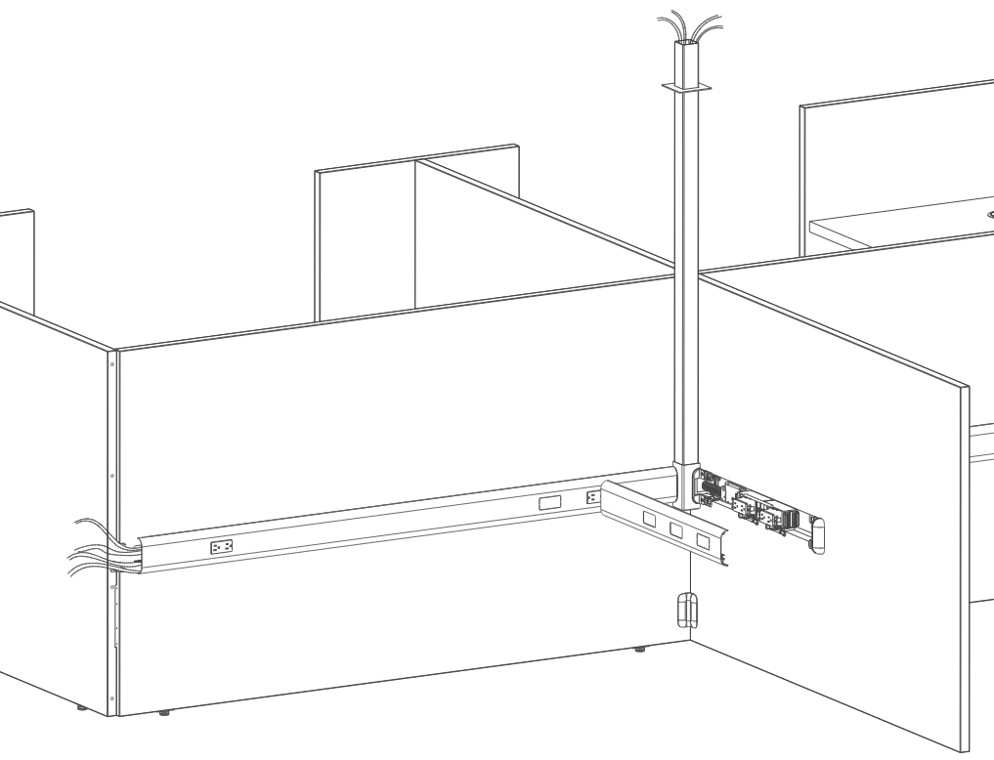
Specification Rules –
Other Components/Models
INTERNAL TRAINING

Slide 18
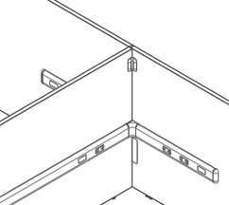
Specification – Panel Connectors
Panel connectors must be used at each panel connection.
INTERNAL TRAINING
GSYSCONS
Straight In-Line Connection (No Mid Panel between Spine Panels)
No In-line panel connector is needed if 1 or more wing panels are connected to the spine at the panel intersection
GSYSCONL
L-Connection (Between Spine and Mid Wing Each Mid Panel requires 2 kits – unless storage is ganged at the base, then 1 kit is needed
GSYSCONSE
Split Panel connection at the End of the Run
(Split panels also require 1 L-Bracket kit GSYSCONL to be specified)

Slide 19
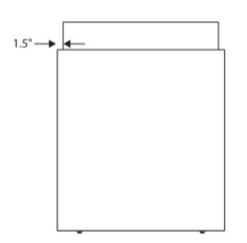
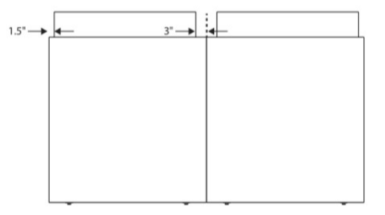
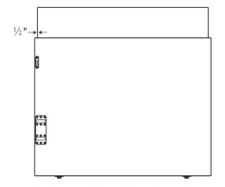
Specification – Panels for Use with Glass
Glass specified separately from panels.
Panels for use with glass have separate model numbers.
Spine, Mid, and Split End Panels for Use with Glass accept glass 3” NARROWER in width than the panel.
Single-Sided End Panels accept glass the SAME width as the panel (like Gallery-to-Gallery).
Glass is available in 3 finishes (Clear, Frosted, and Smoked) and 3 heights (7.5”, 13”, and 15”)
INTERNAL TRAINING
Spine & Mid
Panels
Split End Panels (each panel specified separately)
Single-Sided End Panels

Slide 20
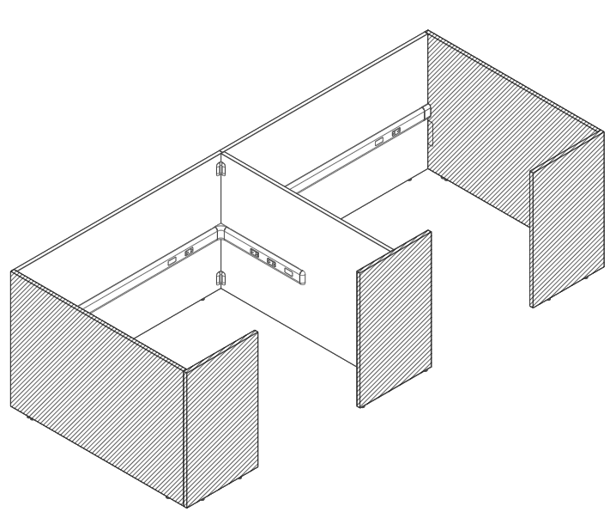
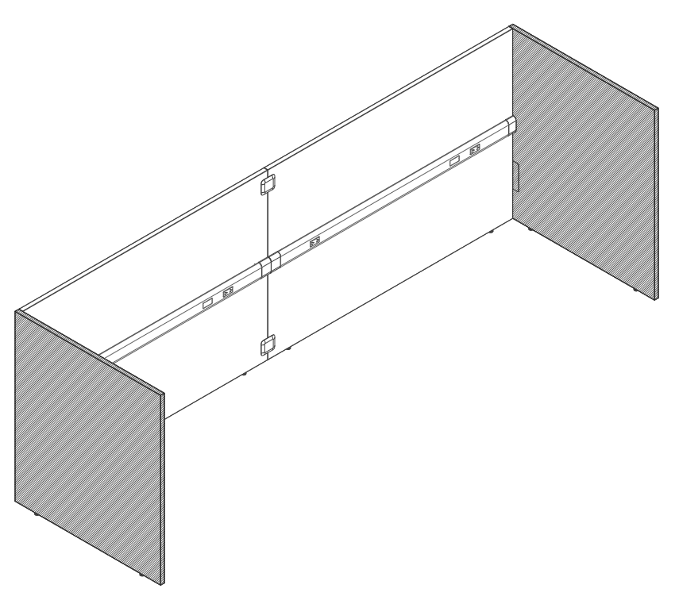
Specification – Gallery-to-Gallery Panels
Gallery-to-Gallery Panels are to be used in the applications below:
Non-Powered Single-Sided End Panels (Gallery-to-Gallery L-)
Single-Piece Dual-Sided End Panels (Gallery-to-Gallery T-)
All Return Panels attached to Wings and Ends (See Shaded Panels Below)
Shaded panels are Gallery-to-Gallery Panels.
INTERNAL TRAINING
1
2
3

Slide 21
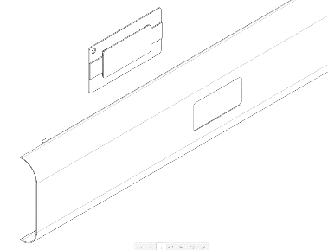
Specification - Rails
Single- or Dual-Sided rails are available to conceal power.
Spine Panels must be specified with a rail to match the full length, either single- or dual- sided if panel has single- or dual-sided power, respectively.
Return panels specified with power must have a matching Return Rail, which is a standard length regardless of panel length. Return rails are 36” in length.
Both Spine and Return Rails have 2 holes per rail for duplex receptacles plus one knockout for data.
Port covers may be ordered separately to conceal the cutouts where receptacles are not used.
INTERNAL TRAINING
Spine Rail:
8.75”
8.75”
Matches panel width
Return Rail:
9.5”
8.5”
Always 36”

Slide 22
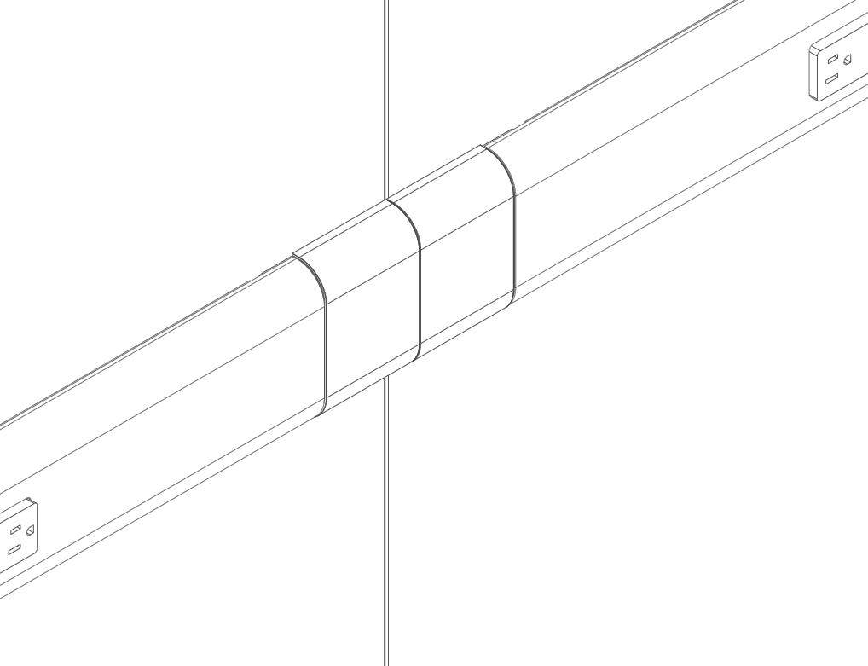
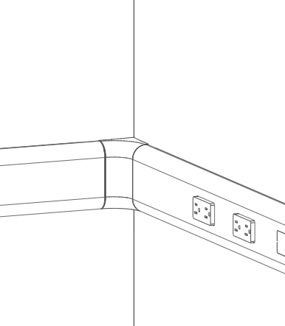
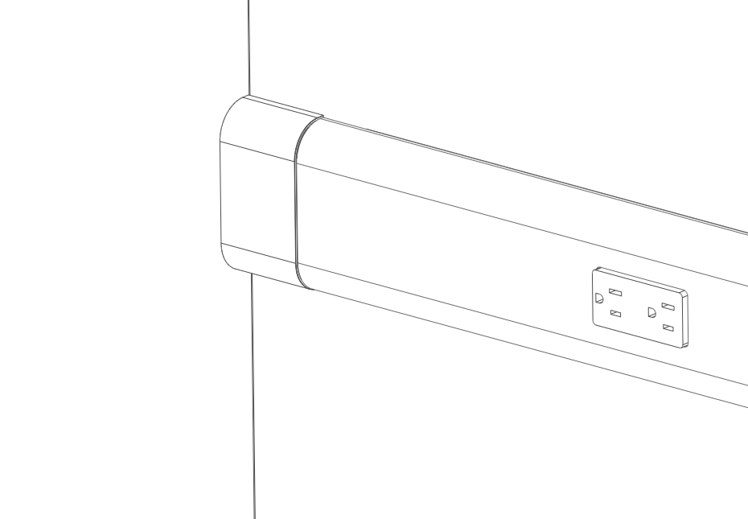
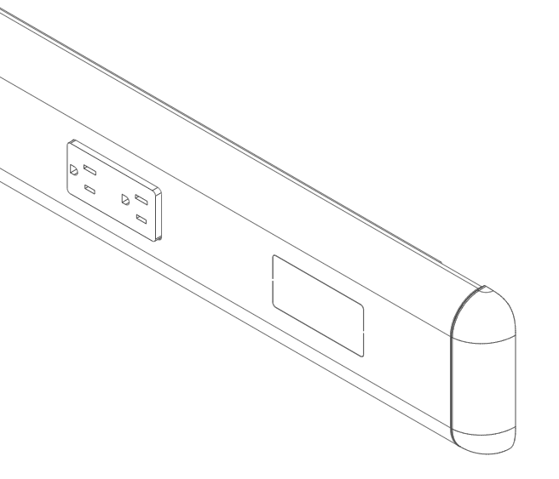
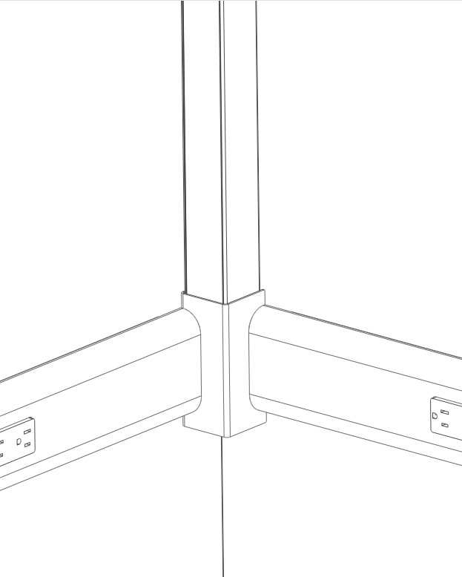
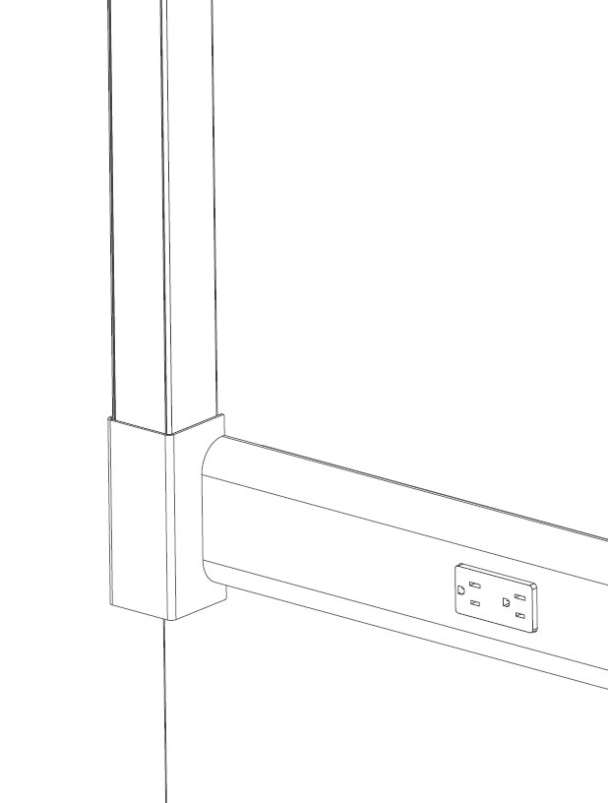
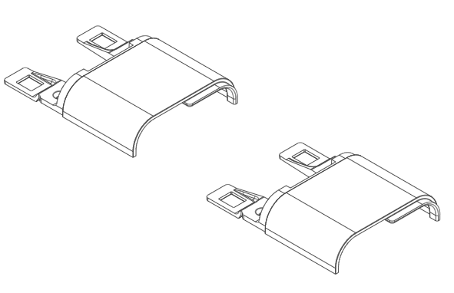
Specification – Rail Connectors
Rail connectors must be used at BOTH ends of each rail to create the proper transition.
INTERNAL TRAINING
GSYSRL
L-Connection (Between Powered Spine and Powered Wing)
GSYSRPL
L- Infeed Connection (Base infeed between Powered Spine and Powered Wing)
GSYSRPS
Straight Corner Infeed (Base infeed between Powered Spine and Non-Powered Wing)
GSYSRSL
Straight In-Line Connection (No Mid Panel between Spine Panels)
GSYSRSC
Straight Corner Connection (Between Powered Spine and Non-Powered Wing)
GSYSREC
End Cap (At the end of any Return Rail)

Slide 23
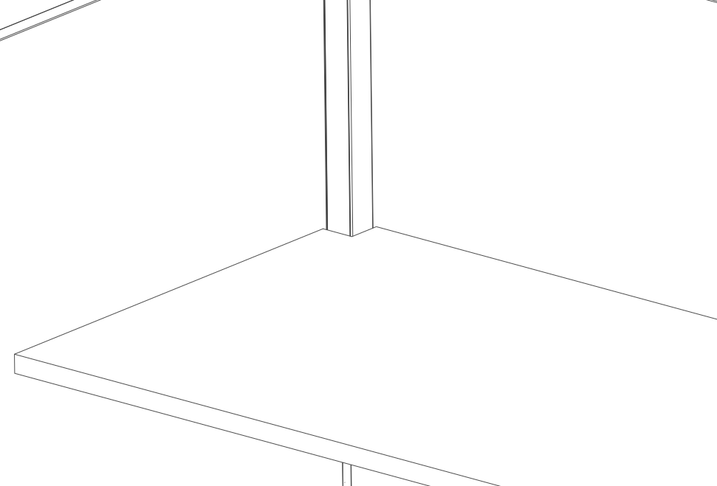
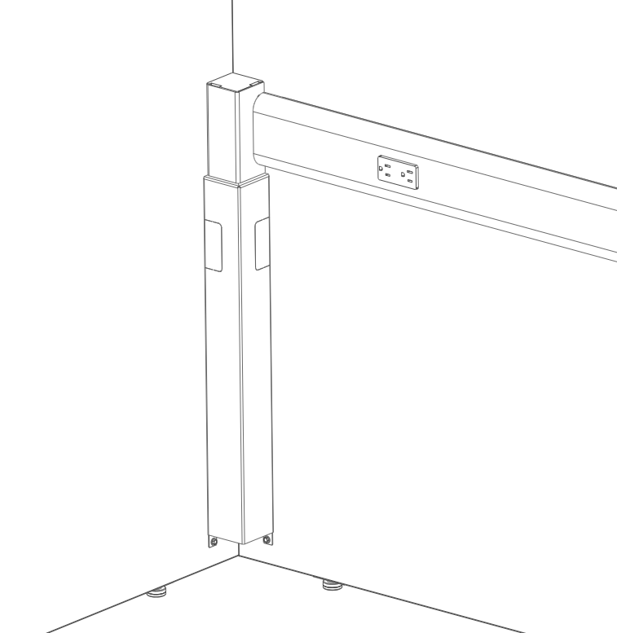
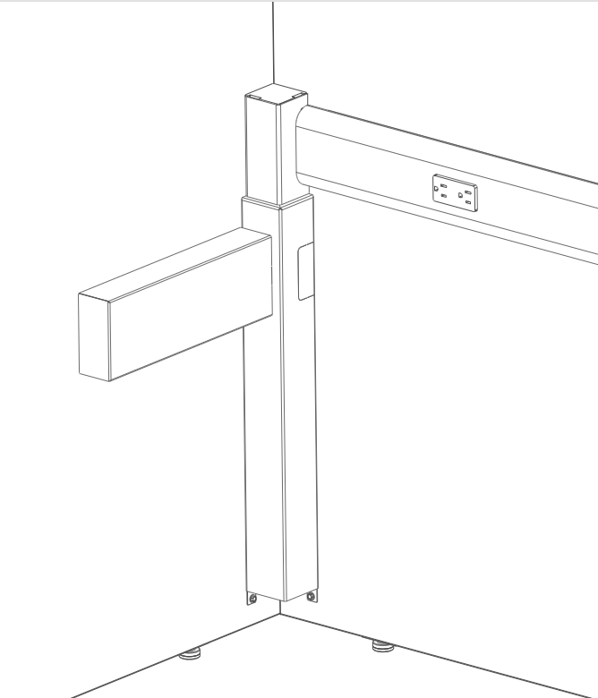
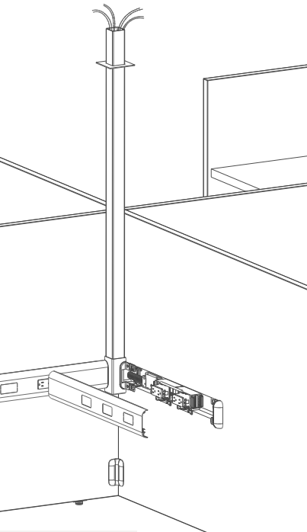
Specification – Electrical
An infeed must be brought into the spine at a 90° panel junction:
NOTE: When a ceiling power pole is used in a corner with a worksurface, the surface will need to be field-cut or undersized to accommodate.
INTERNAL TRAINING
Standard electrical harnesses or pass thrus are used within the rail.
NOTE: different receptacle models are needed for single- or dual-sided power due to the receptacle thickness required.
GSYSPBW
Floor Infeed to WS Rail
GSYSPBH
Floor Infeed to HAT Rail
GSYSHWBW
Hardwire Floor Infeed to WS Rail
GSYSHWBH
Hardwire Floor Infeed to HAT Rail
GSYSHWBW
Power Pole

Slide 24
Specification – Worksurface Mounting
A fixed worksurface can be mounted to the panels using mounting bracket kit GWSBK.
Bracket kit comes with 2 L-brackets, as shown right
Bracket is sized to touch off on Below Worksurface rail to set height.
33” max
INTERNAL TRAINING
33” max
33” max
Support
Storage
Floor Support
(Post Leg)

Slide 25
Specification – Other Models
Metal or Laminate storage can be attached to the panels using models GSGKM and GSGKL, respectively.
Gallery Panel Stiffeners are required for panels 75”W or greater that do not connect to a perpendicular worksurface or credenza. Metal stiffeners or laminate floating shelf stiffeners are available.
A Fit™ Panels installation template is required to help align the panels in 90° angles.
Wall starts are available and must match the height of the panel, not including glass.
Wall starts add 1” creep to the panel run.
Countertop brackets are used to mount a countertop across the top of a Fit panel.
Two brackets are needed for Straight Countertops
Three brackets are needed for Corner Countertops
INTERNAL TRAINING

Slide 26
Key Spec Rules to Remember
Spine Panels must have power and only 60”W panels or larger can have power.
End Panels are required in all applications. An End Spine or Single Spine panel MUST be capped by a panel at the end of the run.
Gallery-to-Gallery Panels are used for all non-powered single-piece End Panels. Split End Panels and powered End Panels are Fit™ models.
All Fit™ Panel models require glass that is 3” narrower than the panel EXCEPT powered single-sided End Panels, which require same-size glass.
Split End Panels are specified separately and are handed, see “Panel Type” within first dot option.
End Panels can only be specified at the same height or shorter than the spine panel (not including glass).
INTERNAL TRAINING

Slide 27
Fit™ & Gallery Panel Accessories
INTERNAL TRAINING

Slide 28
Freestanding Foot
Available in single or two-pack.
Single foot offers a rigidity solution to a large wing panel. Can fulfill a tie-in requirement. (Replace HAT bracket, storage/worksurface tie-in, or return panel.)
When using two feet, a Gallery Panel can become freestanding, see images right.
Feet can be located using the standard glide placement OR can be field-located to accommodate storage or HAT integration.
Can be painted in any textured Allsteel paint color.
INTERNAL TRAINING

Slide 29
Tackboards & Magnet/Markerboards
Tackboards have a metal frame that mechanically attaches to the panel and a fabric insert is placed within the frame. Tackboard pan depth is 1/3”.
Mounted magnet/markerboards have a similar construction to tackboards but the surface is painted metal.
For mounted and hanging magnet/markerboards: When painted in markerboard paint, this accessory functions as a magnetic & writeable surface. If another Allsteel paint color is selected, it will ONLY provide a magnetic surface. For writability, markerboard paint must be specified.
Hanging markerboards can also be placed on top of a worksurface to be used as a blotter, when specified in markerboard paint.
Mounted tackboards and magnet/markerboards are available in the following sizes:
Heights: 15”, 22.5”
*Widths: 24”, 30”, 36”, 42”, 48”, 54”, 60”
*True widths are undersized by ½”
Hanging magnet/markerboards are available in the following sizes:
Heights: 20”, 26”
Width: 30”
INTERNAL TRAINING

Slide 30
Tool Rail & Paper Management
Tool rails can be mounted at any location on the face of a Fit™ or Gallery Panel. Rails come in lengths every 6” from 12”-36” and can be combined to span across a full panel width.
New paper management accessories were designed to hang on the rail and can also be used on standard panel tool tiles. Current Extensions accessories CANNOT be used on the Gallery Panel rail.
Paper Management Accessories:
Angle file (Single, Dual, and Triple) – 12”W x “H x “D
Paper Tray (Single, Dual, and Triple) -12”W x “H x “D
Binder Bin – 12”W x “H x “D
Personal Shelf – “W x “H x “D
Coat Hook (Rail-Based or Mounted) = “W x “H x “D
Mounted version attaches directly to the panel.
INTERNAL TRAINING

Slide 31
Floating Laminate Shelf
Floating shelves come in widths every 6” from 12”-78”W and are made of ¾” HPL laminate with a matching or contrasting edge.
Shelves are 6” deep and can accommodate Xlbs per foot.
Shelves 54” and larger can function as a stiffener requirement when attached in the center of a large panel. For stiffener applications, the shelf must be at most 6” narrower than the panel it is attaching to.
INTERNAL TRAINING

Slide 32
Launch Details & FAQ
INTERNAL TRAINING

Slide 33
Launch Timing
OPEN FOR ORDERS December 2021
Press Release & Media Announcement NeoCon 2021
Allsteel Sales Team Training Call December 2021
AO & Brand Connect Website Live December 2021
Showroom Integration - Chicago September 2021
Price List & Spec Guide (Online) December 2021
20/20 & Symbols Publication November 2021
CET November 2021
INTERNAL TRAINING
Questions?
Product related, Carly Sibert: sibertc@allsteeloffice.com
Marketing Related, Peter Barton: bartonp@allsteeloffice.com

Slide 34
How to Order
First Order Entry: February 2022
Lead Time: TBD
BIFMA Certified
Indoor Advantage™ Gold
GSA in progress
INTERNAL TRAINING

Slide 35
Frequently Asked Questions
Q: What is Fit™?
A: Fit™ is a panel system constructed of solid wood panels with patent-pending electrical integration below the worksurface.
INTERNAL TRAINING
Q: Where will this collection be used within the workspace?
A: Fit™ can create a variety of applications across the floorplan, including reception, benching, traditional workstations, and collaborative spaces.
Q: What is the planning footprint for Fit™?
A: Fit™ panels are 1-1/8” thick and are sized in width to create standard modular interior station dimensions (e.g. 60”, 72”, 84”).

Slide 36
Frequently Asked Questions
Q: What is the power/data capacity?
A: The rail is sized to house standard single- or dual-sided 8-trac electrical components along with 12 total data wires. See right.
Q: Where is the rail located on the panel?
A: The power rail can be located at two standard locations: Below Worksurface and Below HAT (Height-Adjustable Table). Only one height can be used per typical. Measurements are shown below:
INTERNAL TRAINING
Below WS
Below HAT
Top of rail to floor = 27”
Bottom of rail to floor = 23”
Top of rail to floor = 20.5”
Bottom of rail to floor = 16.5”

Slide 37
Frequently Asked Questions
Q: What finishes are available?
A: All standard laminate and paint colors are available for Fit™ and components. The one exception is the Freestanding Foot, which only accepts textured paint.
Q: Can I submit specials for Fit™ panels and components?
A: Specials can be accommodated only for large-scale opportunities due to the complexity of these panels. When submitting a request to TPG, the full dot option logic must be provided.
INTERNAL TRAINING

