Slide 1
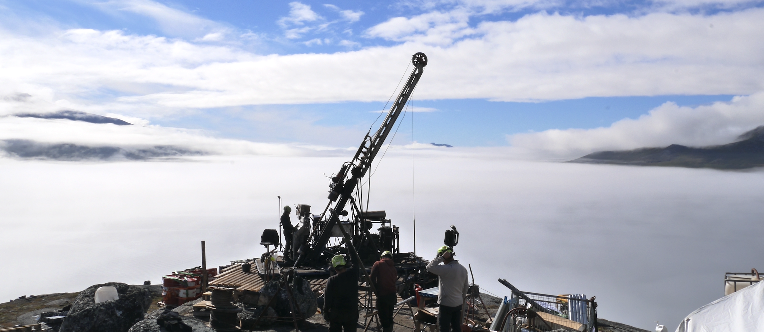

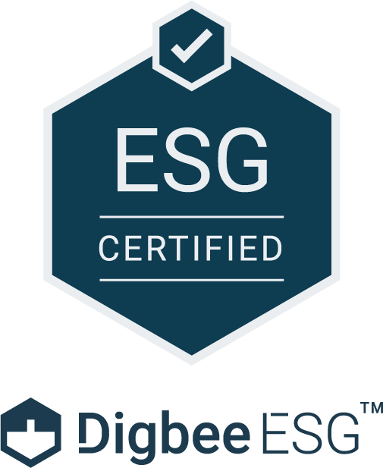

European Union
Strategic Project
Amitsoq: Graphite Supply for Europe
October 2025

Slide 2

Disclaimer
This Presentation is made on behalf of GreenRoc Strategic Materials Plc (“the Company”). This Presentation does not constitute an admission document relating to the Company nor does it constitute or form part of any offer or invitation or recommendation to purchase or subscribe for, or any solicitation of any such offer to purchase or subscribe for, any securities in the Company nor shall this Presentation or any part of it, or the fact of its distribution, form the basis of or be relied on in connection with, any contract therefor. No reliance may be placed by any person for any purpose whatsoever on the information or opinions contained in this Presentation or on the completeness, accuracy or fairness thereof. No representation or warranty, express or implied, is given by or on behalf of the Company, its shareholders, directors, officers and employees or any other person as to the accuracy or completeness of the information or opinions contained in this Presentation, and no liability is accepted for any such information or opinions (including in the case of negligence but excluding any liability for fraud).
If any person is in doubt as to the contents of this Presentation or wishes to obtain advice as to the investment merits of the Company’s securities, they should seek independent advice from a person who is an authorised financial services provider.
All statements (other than statements of historical fact) included within this presentation, including without limitation, the strategies, plans, expectations and objectives of the Company, and the markets and economies in which it operates, are forward-looking statements. A variety of factors could cause the actual results and expectation to differ materially from the anticipated results or other expectations expressed in the forward-looking statements. These statements are illustrative only and do not amount to any representation that they will be achieved as they involved risks and uncertainties and relate to events and depend upon circumstances which may or may not occur in the future. There can be no guarantee of future performance. No representations or warranties of any kind are made by any person as to the accuracy of such statements, estimates or projections, or that any of the events expressed or implied in any such statements, estimates or projections will actually occur. The Company is not under any obligation, and expressly disclaims any intention, to update or revise any such statements, estimates or projections.
The content of this Presentation has not been approved by an authorised person within the meaning of the Financial Services and Markets Act 2000 ("FSMA"). The Presentation is for background purposes only and is not intended to be relied upon as advice to investors or potential investors and does not contain all information relevant or necessary for an investment decision. Reliance on this Presentation for the purpose of engaging in any investment activity may expose an individual to a significant risk of losing all of the property or other assets invested.
This Presentation does not constitute or form part of any offer for sale or solicitation of any offer to buy or subscribe for any securities (including, without limitation, to any person or in any jurisdiction to whom or in which such offer or solicitation is unlawful) nor shall it or any part of it form the basis of or be relied on in connection with, or act as any inducement to enter into, any contract or commitment whatsoever or constitute an invitation or inducement to engage in investment activity under section 21 of FSMA.
Without prejudice to the generality of the above, this Presentation is being distributed to, and is directed only at, persons in the United Kingdom who are qualified investors within the meaning of Article 2 of the UK Prospectus Regulation: (i) who have professional experience in matters relating to investments falling within Article 19(5) of the FPO; and/or (ii) high net worth entities, unincorporated associations and other bodies falling within Article 49 of the FPO; and (iii) other persons to whom it may otherwise be lawfully distributed without an obligation to issue a prospectus or other offering document approved by a regulatory authority (each a “relevant person”). Persons who are not relevant persons should not rely on or act upon this document.
The distribution of this Presentation may, in certain jurisdictions, be restricted by law. Persons in possession of this Presentation are required to inform themselves about and to observe any such restrictions. Neither this Presentation nor any copy of it may be taken or transmitted into or distributed in the United States, Canada, Australia, Japan or South Africa or any other jurisdiction which prohibits the same except in compliance with applicable securities laws and it is not for distribution directly or indirectly to any US Person. Any failure to comply with these restrictions may constitute a violation of those applicable securities law.
The Presentation is provided for general information only and does not purport to contain all the information that may be required to evaluate the Company. The information in the Presentation is provided as at the date of the Presentation (unless stated otherwise) and is subject to updating, completion, revision and further verification. In furnishing the Presentation, the Company does not undertake or agree to any obligation to provide the recipient with access to any additional information or to update the Presentation or to correct any inaccuracies in, or omissions from the Presentation which may become apparent. No reliance may be placed for any purpose whatsoever on the information or opinions contained or expressed in the Presentation or on the accuracy, completeness, correctness or fairness of such information and opinions.
2

Slide 3
Presentation overview
Financing from EIFO
Why is Graphite a Critical Mineral?
Project Status and forward work programme
Exploitation Licence application
Timeline and news flow
3

Slide 4
EIFO Financing: €5.2M Convertible Loan Facility
Loan on ‘Market Standard’
Two years draw-down
10% interest rate (not compound) – EU-standard
Repayable in cash or convertible on Maturity
Maturity: 5 years from first drawdown or 6 months after commissioning of a Commercial Plant.
Trigger Event: repayment of the Loan and interest can take place either in cash or partly or wholly in Ordinary Shares, at EIFO’s discretion. Trigger Event is Maturity date, a Qualified Financing or an Exit
Qualified Financing: capital raised by GreenRoc, in aggregate amount >£15m over 18-months
Exit: change of ownership; disposal or transfer of assets; delisting; dissolution of the Company
EIFO has expressed interest to contribute with further finansing
Export and Investment Fund of Denmark
– Undilutive Funding for GreenRoc
4

Slide 5
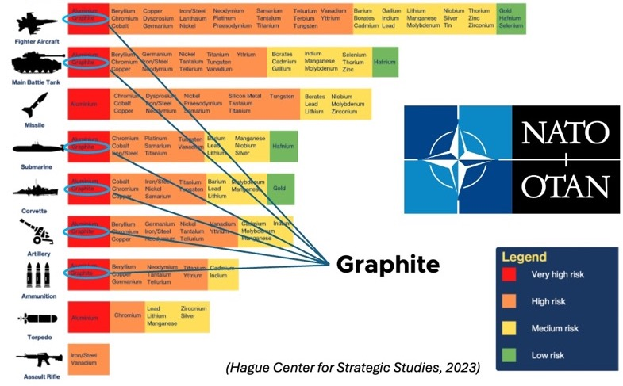
Graphite – Indispensable for the Energy Transition and Defence
Graphite active anode material
Flexible Graphite
Graphite in the form of coated purified spherical graphite makes up the active anode material (AAM) of Li batteries
25% of battery weight is graphite. Each standard electric vehicle carries 50-80kg of graphite AAM
Unlike other components in Li-based batteries, graphite anode material cannot be recycled
LFP
NMC 111
NMC 532
NMC 811
NCA
Lithium 17%
Lithium 15%
Lithium 16%
Lithium 16%
Lithium 11%
Other 83%
Nickel 29%
Nickel 43%
Nickel 68%
Nickel 73%
Cathode (+)
Manganese 29%
Manganese 24%
Cobalt 27%
Cobalt 17%
Manganese 8%
Cobalt 14%
Cobalt 8%
Silicon / other <5%
Silicon / other <5%
Silicon / other <5%
Silicon / other <5%
Silicon / other <5%
Supply risk for critical raw materials in military applications
Graphite >95%
Graphite >95%
Graphite >95%
Graphite >95%
Graphite >95%
Anode (-)
Source: Hague Center for Strategic Studies, 2023
Source: Pallinghurst - Traxys battery analysys. %s represent the proportions of cathode
and anode in each battery respectively/ NCA batteries contain 2% aluminium (not shown)
https://ecga.net/wp-content/uploads/2023/02/Graphite-in-batteries_Infosheet_final.pdf
5

Slide 6
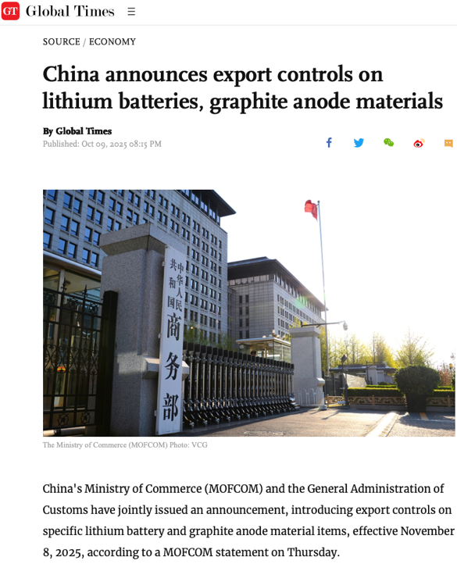
Graphite – Chinese dominance along entire value chain
China controls the global graphite anode supply chain, including*:
80% mined graphite
99% spherical graphite (precursor)
97% natural graphite anode (AAM)
    (2024)
Similar numbers apply to flexible graphite. The market is small, but strategically important.
Graphite from Amitsoq performs well as feedstock for processing into active anode material as well as into flexible graphite
China Oct8, 2025: export controls on graphite anode materials and technologies to manufacture anode material
Source: BMI (https://source.benchmarkminerals.com/article/infographic-china-controls-three-quarters-of-graphite-anode-supply-chain) and Fastmarket Battery Raw Materials conference, Sept 2024
6

Slide 7





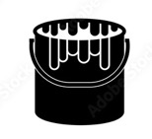
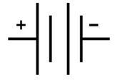
GreenRoc’s Upstream and Midstream business: Graphite Concentrate to AAM
Production of
graphite
Concentrate at
Amitsoq, Greenland
Processing Amitsoq Graphite into
AAM at plant in Northern Europe
Mining
Spheronisation
Coating
Battery
Concentration
Purification
Anode
Annual Production of circa 80,000t >95% concentrate
Annual production:
35-40,000t AAM
= Supply for ca 1M EVs
Amitsoq Deposit deep water fjord, mild climate,
no winter ice
7
7

Slide 8
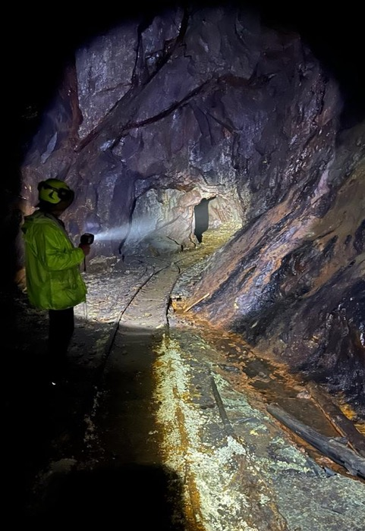
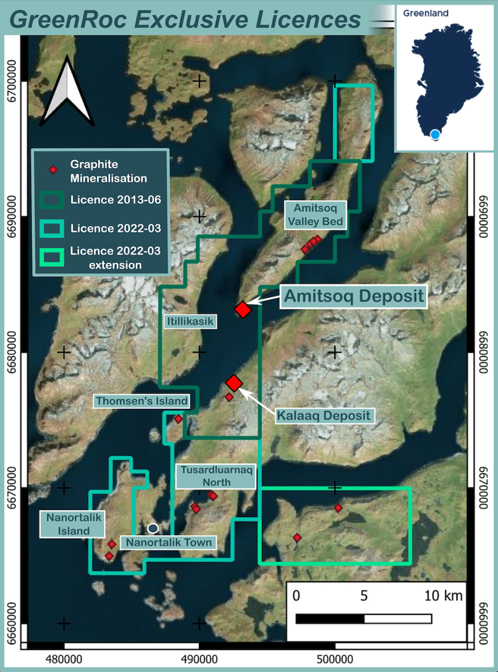
Amitsoq – Multi-decade graphite supply potential
Amitsoq: a previous producing bownfield site
Two main orebodies: Upper Graphite Layer (UGL) and Lower Graphite Layer (LGL)
Consistent mineable widths of 3-8m in UGL and 5-15m in LGL– and in places up to 20m widths
Deposit remains open in three directions – potential for further significant resource upgrades
Part of a large graphite district, all under GreenRoc licence
Underground mining
Underground
Amitsoq Mine
Nanortalik
8

Slide 9
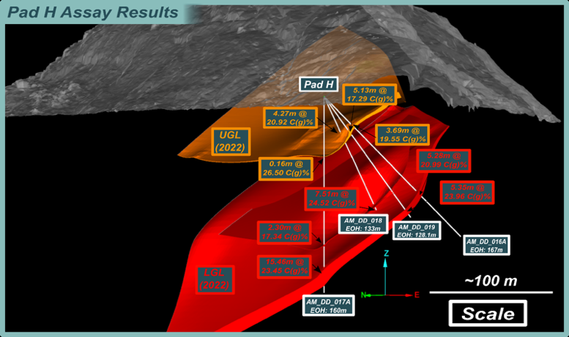
Amitsoq – Large and exceptionally high-grade resource
JORC Resource estimate, 2023 | Mt ore | %C(g) | Mt graphite
Measured | 1.26 | 22.05 | 0.28
Indicated | 6.12 | 21.04 | 1.29
Total Measured + Indicated | 7.38 | 21.21 | 1.57
Inferred | 15.67 | 20.04 | 3.14
Total Resources | 23.05 | 20.41 | 4.71
Amitsoq – world-class grades
Natural Flake Graphite Deposits under development
Source: Public information as at 13 May 2025
9

Slide 10
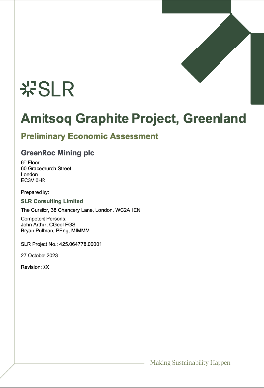
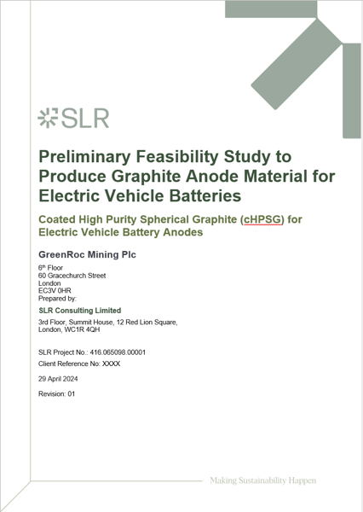


Strong Project Economics, Mine / AAM plant
Amitsoq Graphite Mine PEA (SLR Consulting, Oct 2023)
Initial capital cost (Capex): US$ 131 M inclusive of 25% contingency
Av. operating costs (Opex): US$ 121/t of milled ore, including shipping
4-year payback period after production start
Life of mine (LOM) is 22 years and av. 80,000t graphite concentrate/y
AAM Processing Plant PFS (SLR Consulting, June 2024)
Initial capital cost (Capex): US$ 340 M inclusive of 25% contingency
Av. operating costs (Opex): US$ 1,872/t CSPG (AAM)
4-year payback period on capital from start of production
Based on 22 years of operation and av. 40,000t graphite AAM/y
Feasibility Study
supported by:
Amitsoq Graphite Mine
After-Tax IRR 26.7% US$ Mil.
After-tax NPV at 8% discounting 179.35
AAM Processing Plant
After-Tax IRR 26.51% US$ Mil.
After-tax NPV at 8% discounting 621.46
10

Slide 11
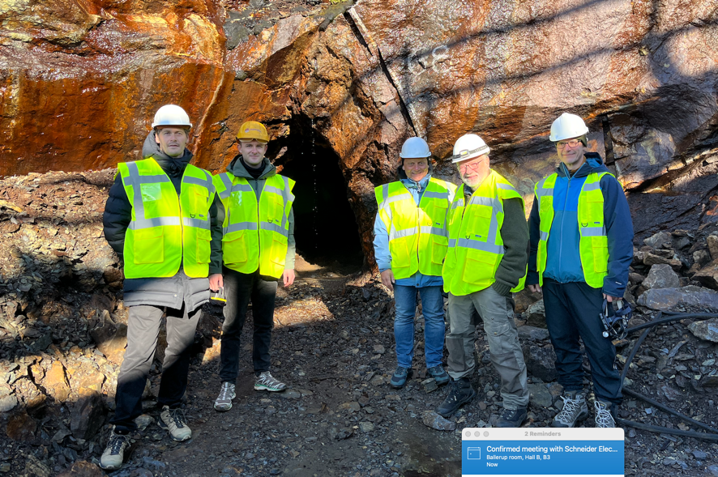
EIFO Financing: €5.2M Loan Facility
Development work at Amitsoq:
bulk sampling
processing of bulk sample
Phase III drilling
Geotechnical survey
EIA
SIA
Build pilot plant for processing to anode material and flexible graphite:
rental of warehouse in Denmark
puchase of mills from Zhongke Powder Co
design of purification plant
construction of plant
operating expenses of pilot
further purification testwork
early design of pilot for flexible graphite
11

Slide 12
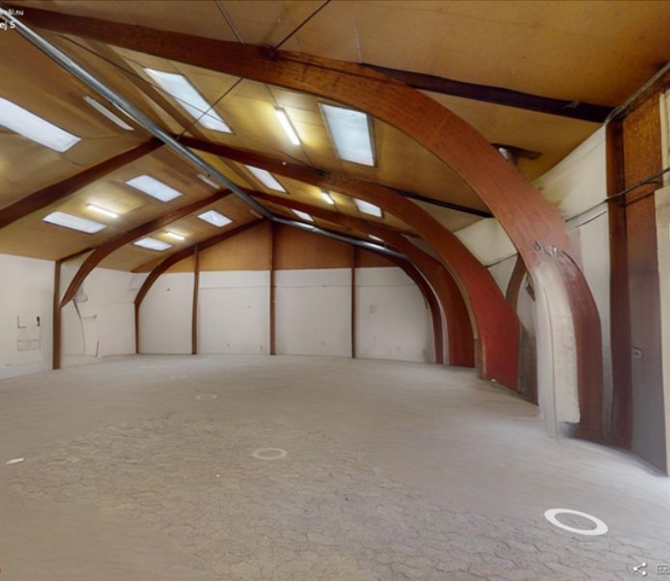
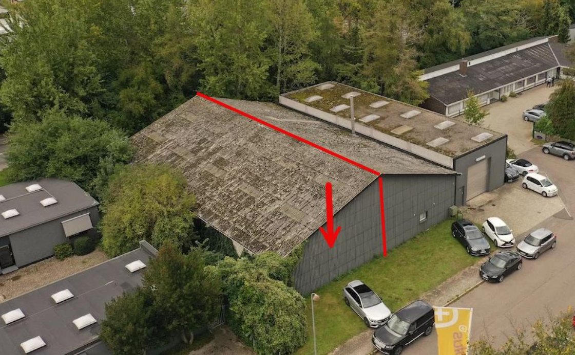
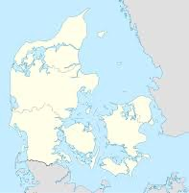
AAM Pilot Plant. Possible location in Hørsholm, Denmark
12

Slide 13
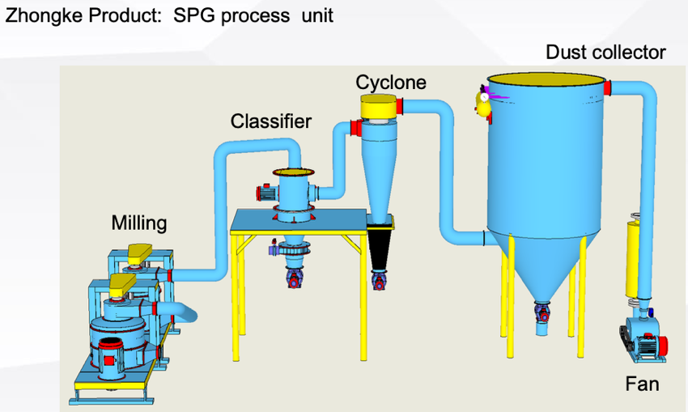

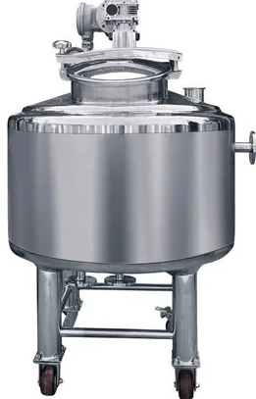
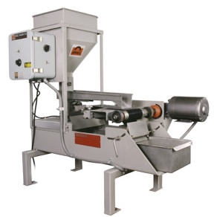
AAM Pilot Plant
Mills from Zhongke Powder, China to be ordered Oct 2025 – delivery Jan, 2026.
Purification plant presently being designed by Sepor Inc, USA, using standard equipment– delivery March, 2026
Construction starts January 2026
Plant operational in April 2026 (mills) and June 2026 (purification)
First spherical graphite ready for testing by Nov 2026
13

Slide 14
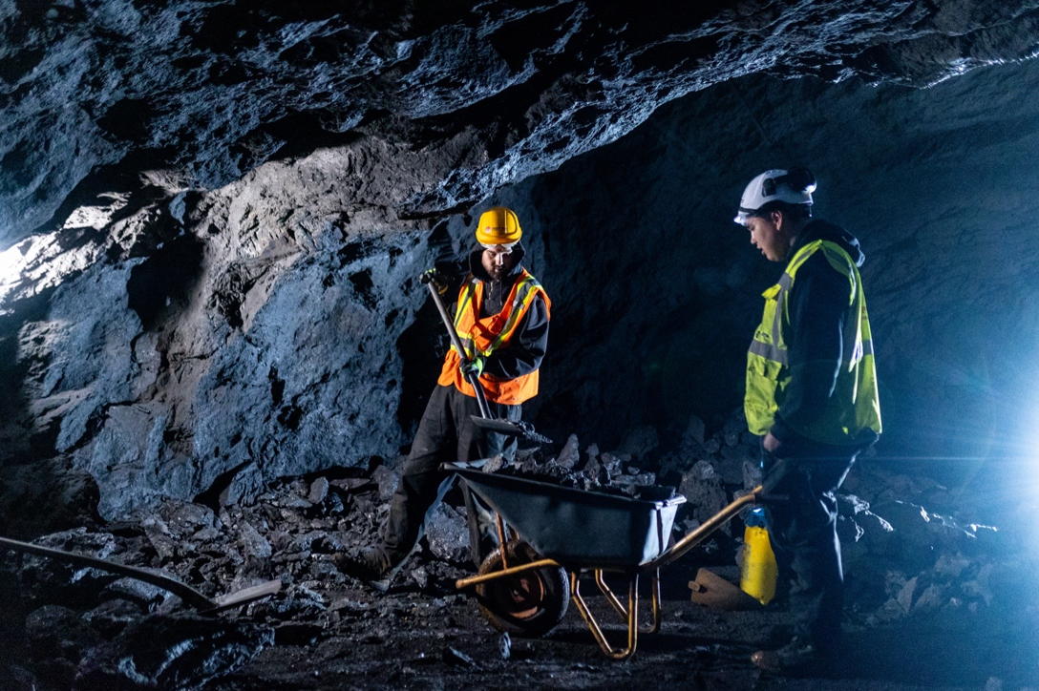
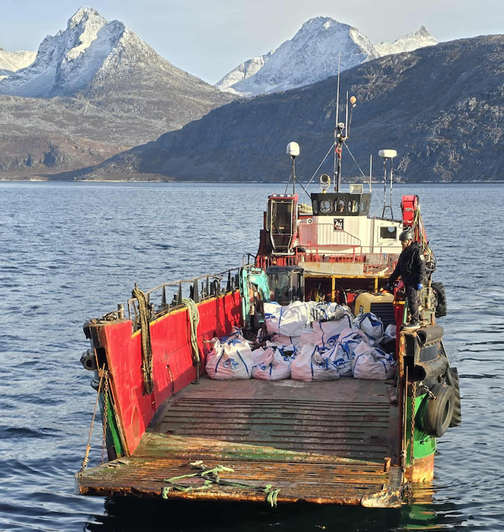
Amitsoq: Bulk Sampling completed, Oct, 2025
Total of 18.3 tons. Working with several companies for quotes to process bulk sample
14

Slide 15
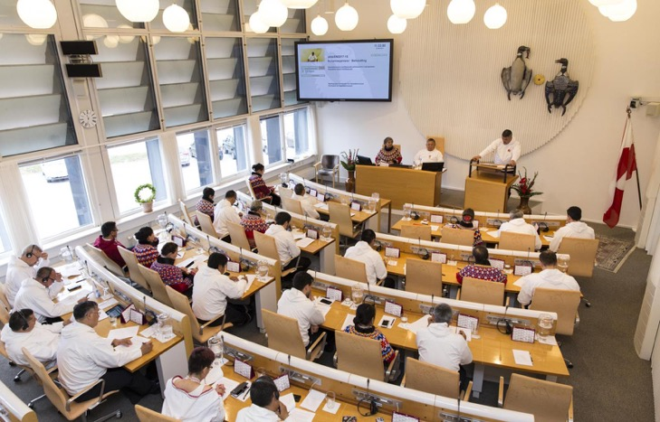
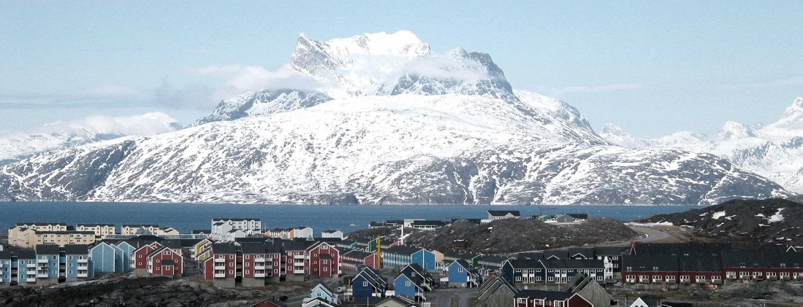
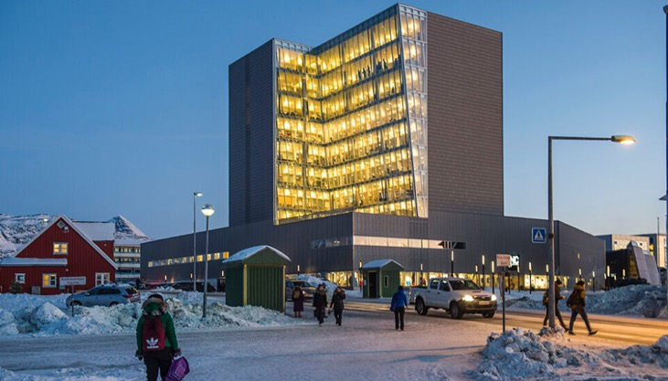
Amitsoq – Exploitation Licence Application
Sept 2024 Application submitted.
June 2025 Public consultation.
August 2025 White Book prepared and translated into Greenlandic.
Nov 2025 (expected) Recommendation presented to the Greenland Parliament
Regular local
information meetings
15

Slide 16
Roadmap to Primary Concentrate and AAM Production
Graphite concentrate production from Amitsoq mine, Greenland
2021+2022
Phase I and II drilling
Maiden Resource
Definition
2023
Resource definition,
PEA, Bulk Sampling,
Test process
2024
Exploitation Licence application
2025/2026 E
EIA+SIA completion
Drilling, bulk sample
Exploit. Licence
2027 E
PFS-DFS, Mining
Permit
2028-2029 E
Construction
2029 E
Start production
AAM production Plant in Norway/N Europe
2023
Feasibility Study
Electro-chemical tests
Purification tests
2024
Feasibility Study
Identify site
2025/2026
Running pilot plant,
Qualification tests
2027/2028 E
DFS
Construction
2029 E
Start production
News flow over the coming 12 months:
Site for Pilot plant secured
Exploitation Licence granted
Pilot plant commense construction
Pilot plant operational
First spheronized graphite
Drill contractor announced
Phase III drilling
Bulk sample processing commensed
Optimised purification technology achieved
DigBee revised ESG rating
First purified spheronized graphite
Revised Resource Estimate
Contractor for Amitsoq PFS announced
16

Slide 17


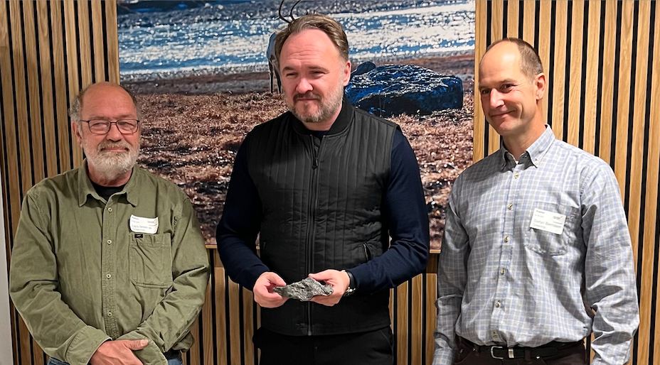

EU Strategic Project
GreenRoc’s Amitsoq awarded Strategic Project status under the EU Critical Raw Materials Act, June 2025
Invite to speak at special sessions on partner countries
EU-Commissioner for Energy Dan Jørgensen, Nuuk, Sept 2025
17

Slide 18
EIFO Financing: €5.2M Convertible Loan Facility
Conversion:
EIFO can convert into a maximum of 10% of the issued share capital of GreenRoc, with any remaining balance being settled in cash, unless GreenRoc is unable to settle in cash, in which case the excess shall be converted into shares in one or more of GreenRoc’s Amitsoq subsidiaries at a price determined by an independent valuation of the fair market value of the relevant subsidiaries
If EIFO elects to convert the loan into Ordinary Shares, the Company has the right to repay the loan plus accrued interest in cash and to issue share options to EIFO, with a two year duration and a nominal exercise price, in an aggregate value corresponding to 20% of the amount repaid in cash.
– Undilutive Funding for GreenRoc

Slide 19
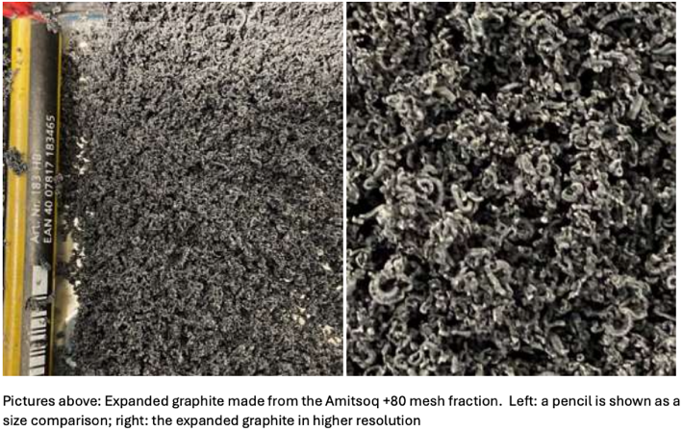
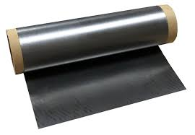

Flexible Graphite – Amitsoq graphite well suited as feedstock
Initial testwork shows Amitsoq graphite concentrate well suited for production of expandable graphite, the precursor to Flexible Graphite extensively used in the defence industry
Expandable graphite shows a 150-200 times volume increase during heating. When compressed it makes for an extremely resistant yet flexible material ‘Flexible Graphite’. Chemically inert, extemely conductive and can withstand temperatures to 3,000°C.
No production in the West today
Metallurgical test work by ProGraphite GmbH
19

Slide 20

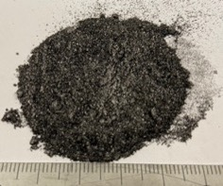
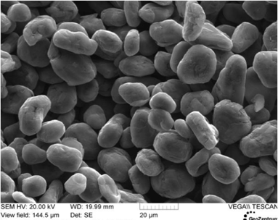

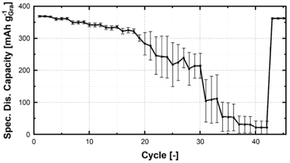
AAM – Amitsoq graphite highly suitable for processing into AAM
Concentration
Micronization Classification
Spheronization
Purification
Coating
Graphite Concentrate
95% C(g)
Spheronized graphite
SPG >99.95%C
Coated High Purity Spherical Graphite
X
Spheronized Amitsoq graphite
Hydrofluoric acid (HF)
Advanced discussions with Japanese company regarding
coating technology transfer
Sodium Hydroxide (NaOH)
Successful
electrochemical tests
Metallurgical/processing test work by ProGraphite GmbH
20

Slide 21
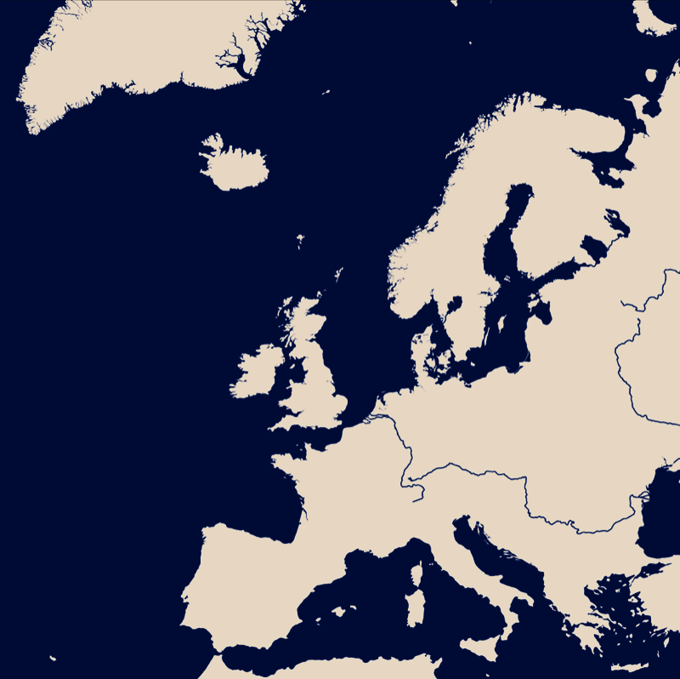
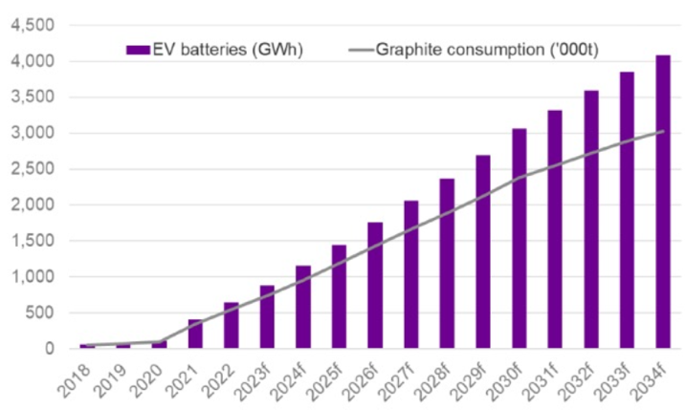

Looming graphite supply deficit and scarce European supplies
By 2030, >40 gigafactories with a total capacity of nearly 1.5 TWh* will be in production in Europe and North America
*Data from CIC Energigune
Skaland
Global graphite demand for batteries to increase 400% by 2035
Amitsoq
Vittangi
4-5 days Shipping from Greenland to Northern Europe
Woxna
Aitolampi
Fastmarket; MSP Conference March, 2024
2025 Three EU Strategic Projects:
Salrom, Ro
GreenRoc - MCap 7.1M GBP
Amitsoq 80kt/a - 4.71Mt graphite resource, coarse flakes
Talga - MCap 220M AUD
Vittangi 100kt/a - 3.04Mt graphite resource, microcrystalline
Societatea Nationaltá a Sárii - unlisted
Salrom: -?- mined in the 1940-70’s, microcrystalline
21

