Slide 1
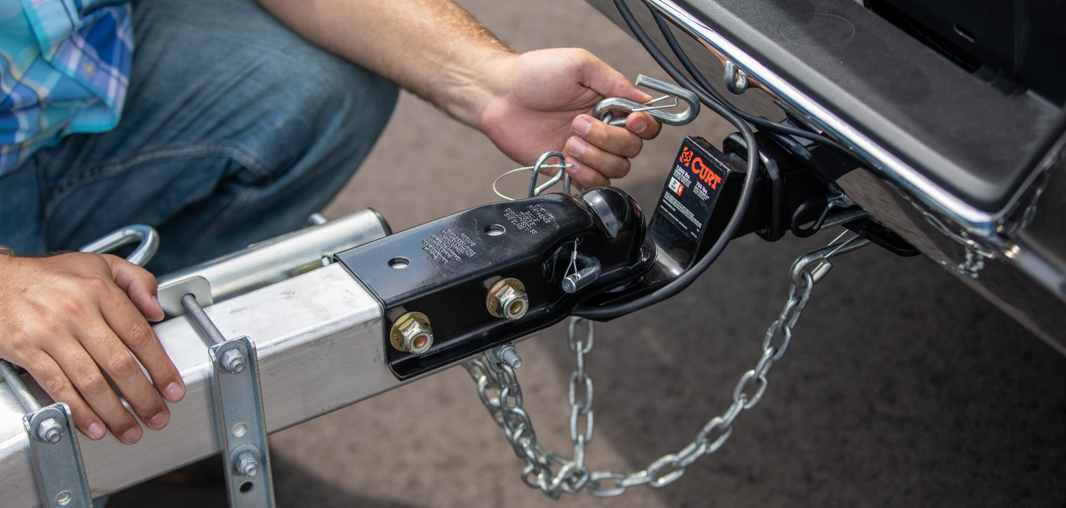

Trailer Parts & Accessories

Slide 2


Slide 3
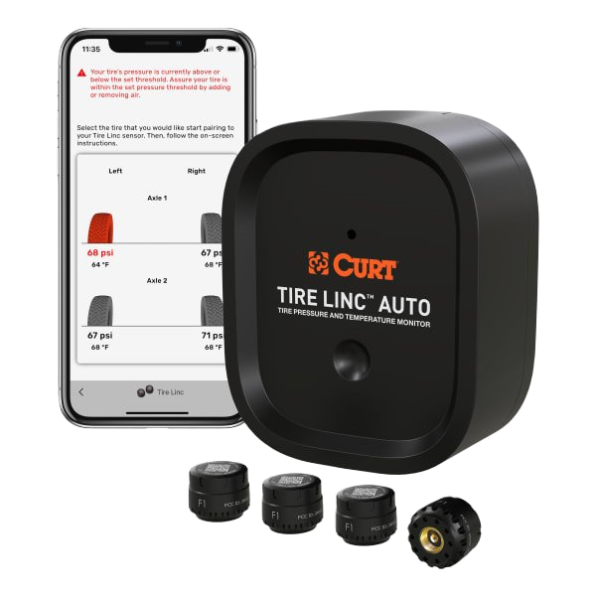
Trailer Parts & Accessories
Tire Linc™ Auto Tire Pressure Monitoring System
Provides push notifications when hazardous conditions occur to prevent blowouts
Connects wirelessly through your smartphone via Bluetooth connection
Repeater technology strengthens wireless signal for reliable connectivity
Can be permanently wired with provided splice-in wiring harness
Rechargeable 3.7V 5000mAh lithium battery for up to 60 hours of active use
Automatically enters low-power mode when not in motion to preserve battery
IP67-rated construction is dustproof and waterproof up to one meter

Slide 4
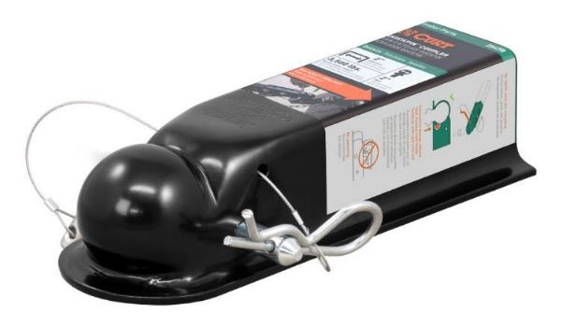
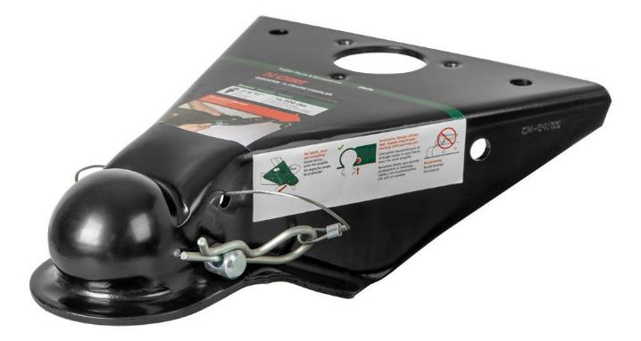
Trailer Parts & Accessories
QuickPin™ No-Latch Trailer Couplers
Innovative design allows fast, hassle-free trailer coupling with just one pin
No jamming or complicated hinging components prone to wear
Easier to use than traditional couplers
Fastens securely with included 1/2" diameter pin and clip (no substitutes)
No adjustments or tightening needed
Lasso lanyard secures pin to coupler to avoid missing pieces
Passes SAE-684 performance testing
Compatible with most existing coupler mounting hole configurations (hardware not included)
50-degree A-frame angle to fit most A-frame trailers

Slide 5
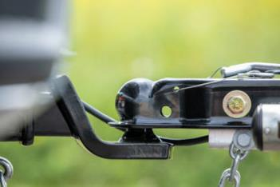
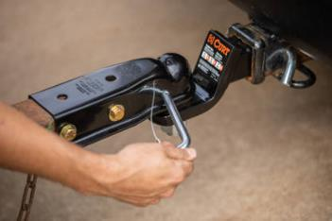
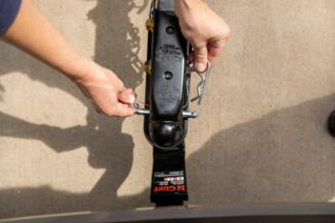
Trailer Parts & Accessories
QuickPin™ No-Latch Trailer Couplers
How it works:
Step 1: Drop trailer tongue
Replace your existing trailer coupler with the QuickPin™ no-latch coupler. Drop the trailer tongue down until the QuickPin™ coupler seats onto the trailer ball.
Step 2: Insert primary pin
Slide the QuickPin™ hitch pin into place. The unique design secures the coupler firmly in place without the need for a complicated hinging latch. No adjustment needed!
Step 3: Secure with safety clip
Secure the QuickPin™ hitch pin for travel with the included safety clip. A convenient lasso-style lanyard keeps the components together to avoid lost pieces.

Slide 6
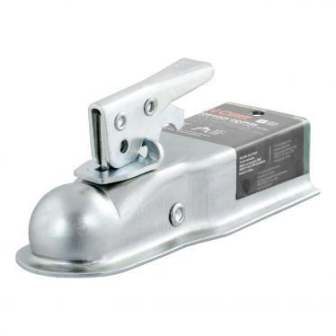
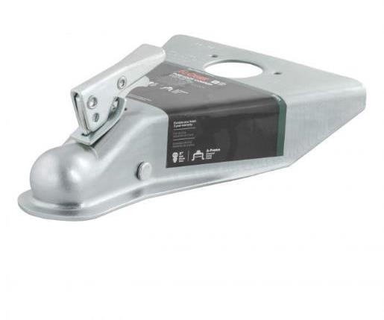
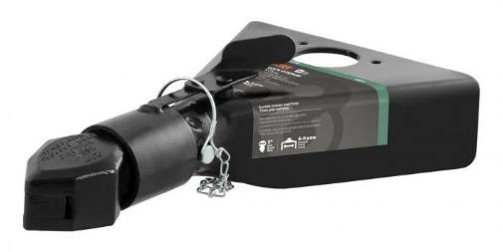
Trailer Parts & Accessories
A-Frame and Straight-Tongue Couplers
Available for A-frame or straight-tongue trailers and channel-mount style
Posi-lock, sleeve-lock and easy-lock latch styles
Features holes to accept a safety pin or coupler lock
Tested for safety in accordance with SAE J684

Slide 7
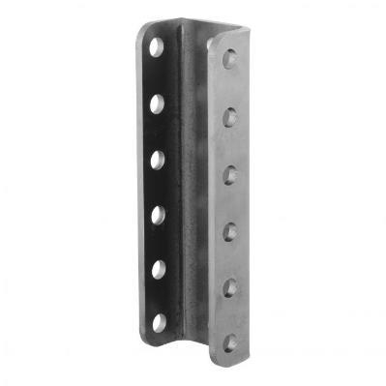
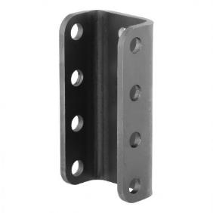
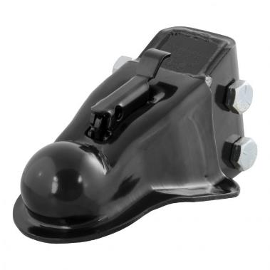
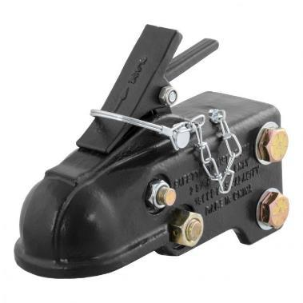
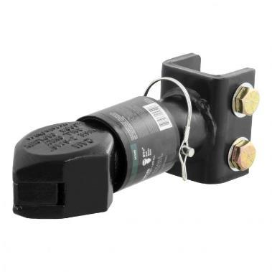
Trailer Parts & Accessories
Adjustable Couplers
Channel-mount allows for easy height adjustment
Compatible with CURT channels #48610 and #48650
Secured by a dual-bolt mounting system
#48610
#48650

Slide 8
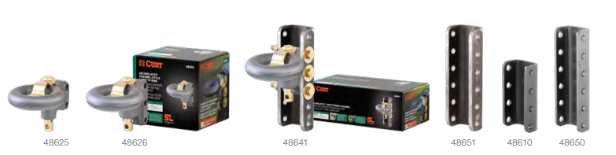
Trailer Parts & Accessories
Securelatch™ Channels & Lunette Rings
Drop-in pin accepts lock to deter theft
Strong 2-hole bolt pattern fits 3" channel only (#48625)
Heavy-duty 3-hole bolt pattern fits 2-3/4" channel only (#48626)
Cast iron construction for superior strength
Textured, dark grey teridium finish
Raw finish for immediate welding (channels only)
Yellow zinc-plated pin for long-lasting corrosion resistance

Slide 9
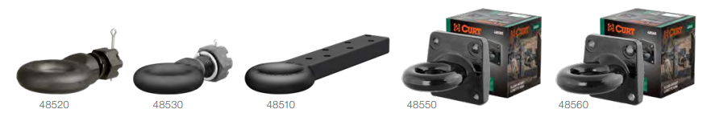
Trailer Parts & Accessories
Forged Lunette Rings
Single stud eliminates the need for a swivel-type pintle hook (#48520, #48530)
Threaded shank and castle nut for secure attachment to trailer (#48520, #48530)
Flat design allows drawbar to bolt quickly and easily to a trailer tongue (#48510)
Constructed from forged steel alloy for superior strength

Slide 10
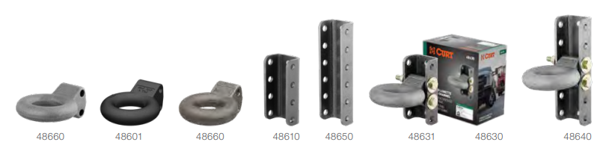
Trailer Parts & Accessories
Channels & Forged Lunette Rings
Height adjustment allows for precise trailer leveling
Constructed from forged steel for superior strength (rings only)
Constructed from one-piece, formed steel (channels only)

Slide 11
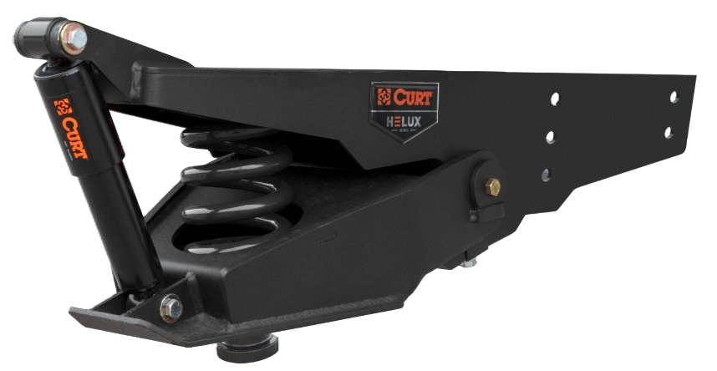
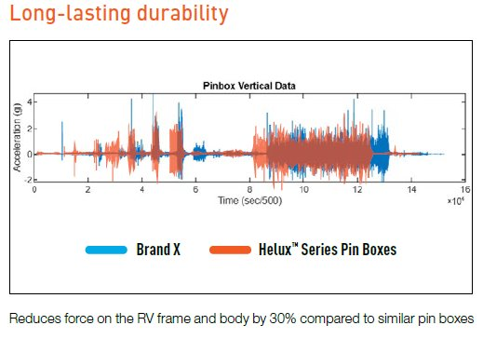
Trailer Parts & Accessories
HELUX™ Coil-Spring 5th Wheel Pin Boxes
Purchase verification required. Refer to the instruction sheet for pin weight measuring process
Virtually maintenance-free design improves user experience over airbags
Compatible with Rhino Box bolt-mounting pattern
Robust steel construction and black powder coat finish
Tested for safety in accordance with SAE J2638
Approved on Lippert RV frames (will not void warranty)
Not compatible with offset 5th wheel hitches
Mounting hardware included
Designed, welded, and coated in Indiana
Limited lifetime warranty (one-year finish, one-year parts)
Patent pending

Slide 12
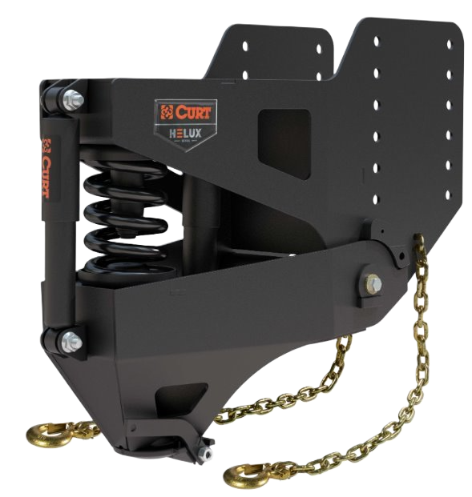
Trailer Parts & Accessories
HELUX™ Coil-Spring Gooseneck Pin Boxes
Purchase verification required. Refer to the instruction sheet for pin weight measuring process
Virtually maintenance-free design improves user experience over airbags
Compatible with Rhino Box bolt-mounting pattern
Robust steel construction and black powder coat finish
Tested for safety in accordance with SAE J2638
Approved on Lippert RV frames (will not void warranty)
Mounting hardware included
Limited lifetime warranty (one-year finish, one-year parts)
Designed, welded, and coated in Indiana
Notes
Not compatible with Rockerball cushion hitch gooseneck ball
Includes safety chains, cable-release kit, and mounting hardware
Greasing ball socket recommended to avoid galling of similar metals
Patent pending

Slide 13
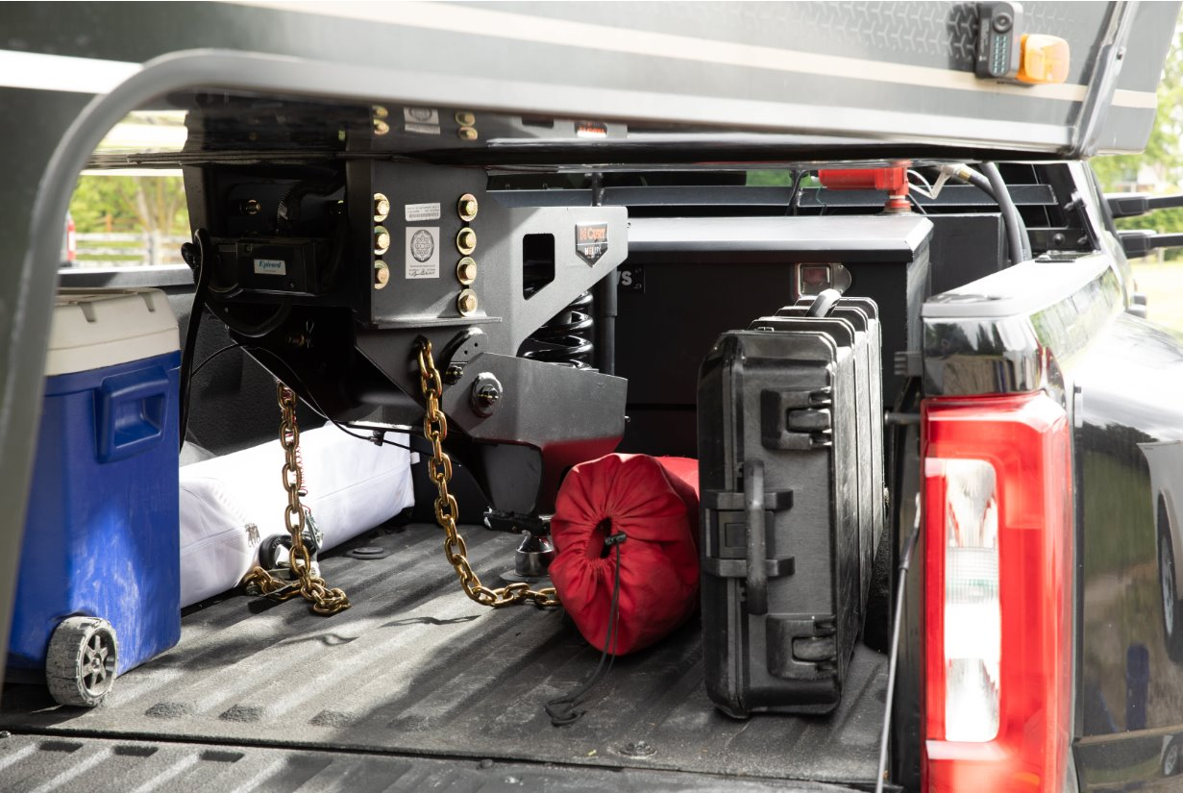
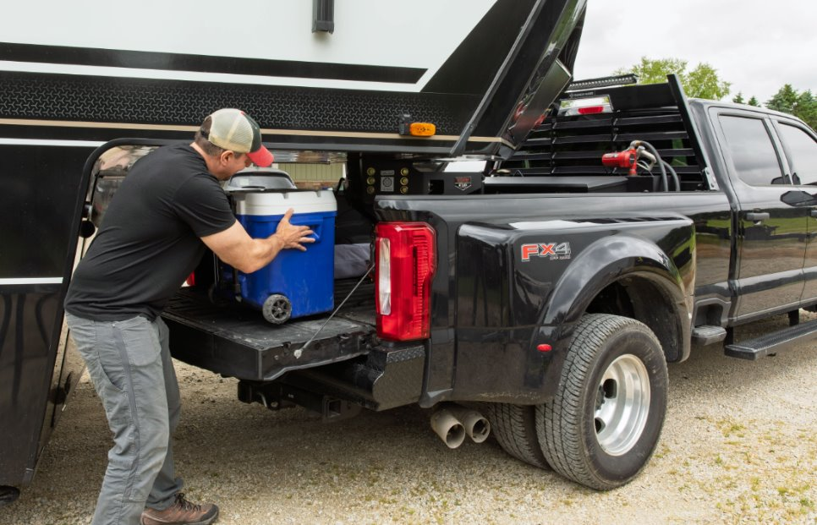
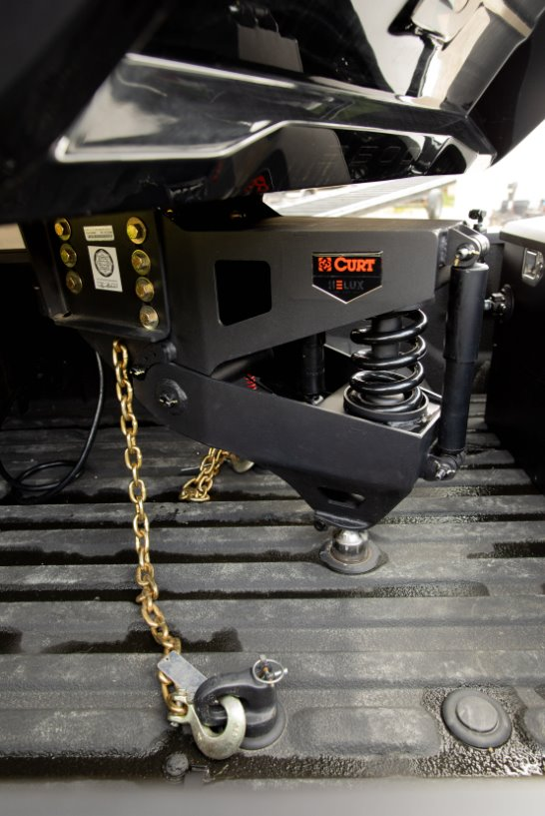
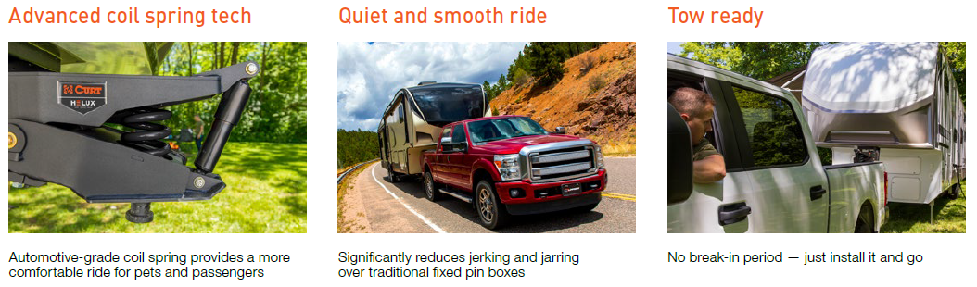
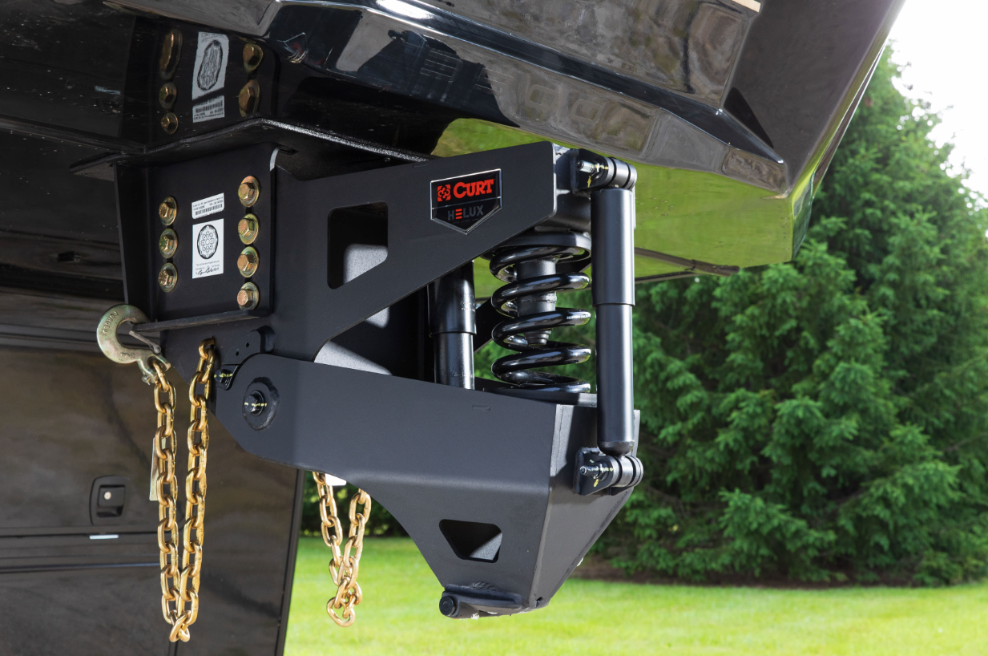
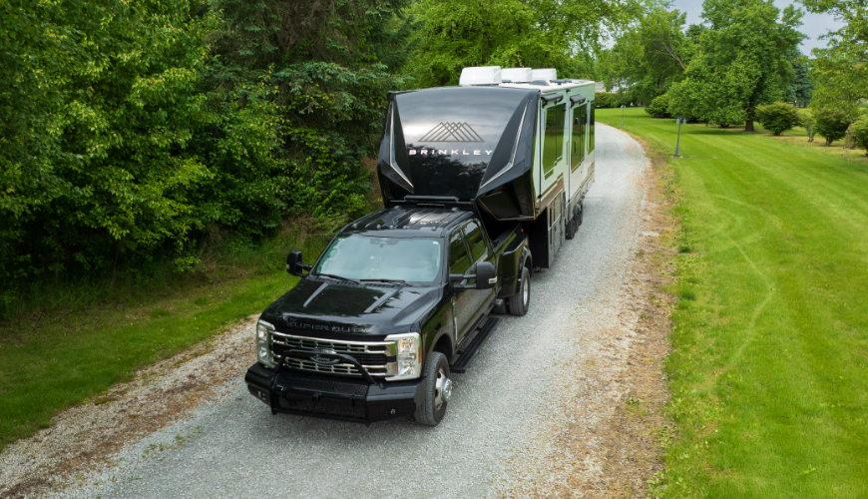
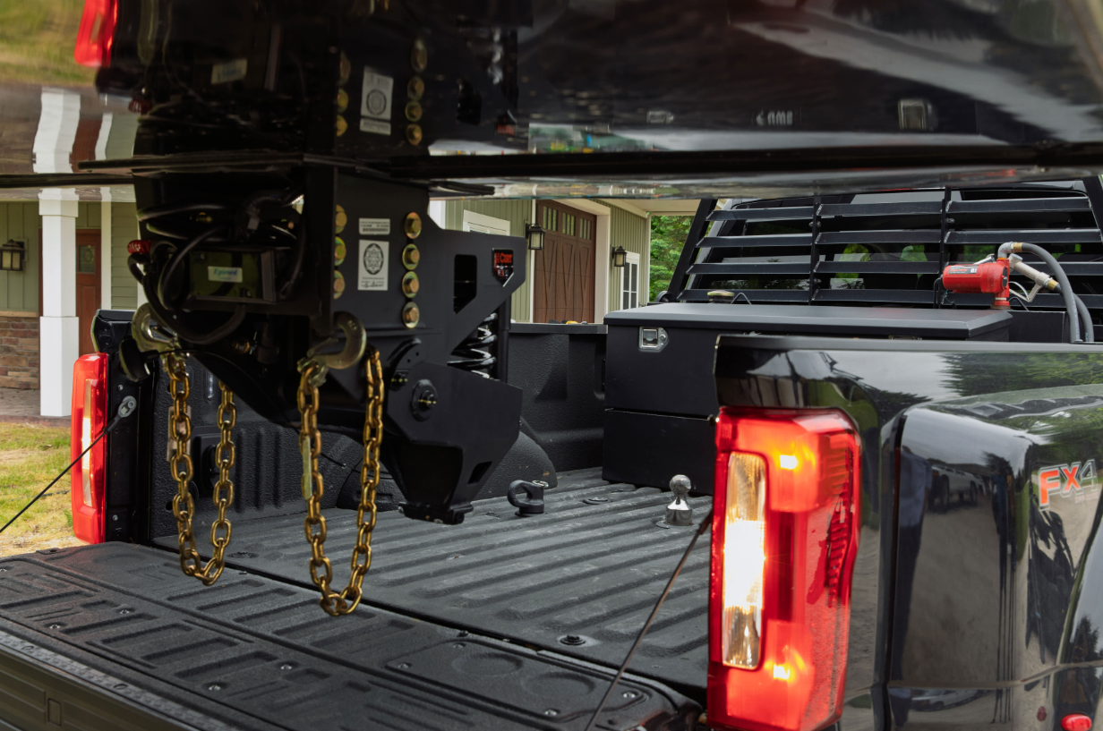
Trailer Parts & Accessories
HELUX™ Coil-Spring Gooseneck Pin Boxes
More Bed Space
Auto-latching coupler​
Allows for additional cargo space in the bed of your truck versus traditional 5th wheel towing​
Auto-latching coupler acceptsstandard 2-5/16” gooseneck ball​

Slide 14
Trailer Parts & Accessories
2-5/16" Adjustable Gooseneck Coupler, 30K
2-5/16" ball socket rated for 30,000 lbs. GTWR
Adjustable length with 8” of adjustment
Load-bearing pin features extra-wide, rubber coated handle for easy height adjustment
Self-centering locking plate for easier hookup
Easy-access lock handle for secure connection
Quality steel construction for dependable towing strength
Tested for safety to meet SAE J2638 specifications
Raw finish allows for immediate welding
Added material around pin holes to prevent hole elongation and reduce wear
Includes 4” inner tube, 4-1/2” outer tube

Slide 15
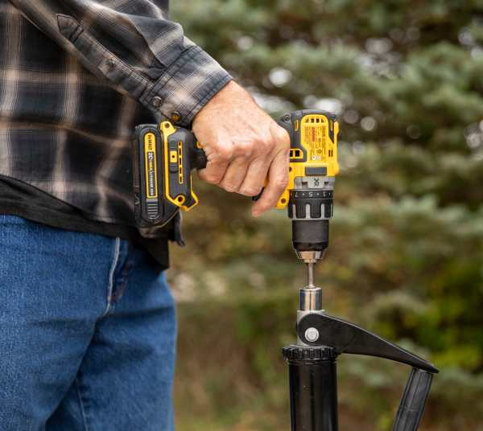
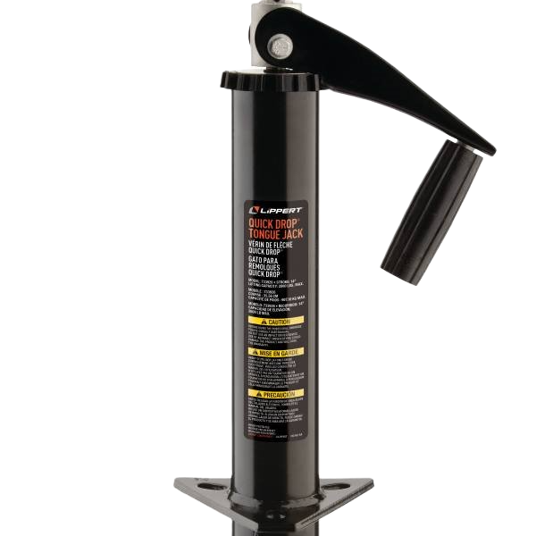
Trailer Parts & Accessories
Quick Drop® Drill-Operated A-Frame Jack by Lippert
Raise or lower jack using a power drill and 3/4" socket head (not included)
Fits most cargo, utility, and travel trailers
Includes manual hand crank for backup operation
Durable gloss black powder coat finish
Removable jack foot for increased trailer stability
2,000 lb. load capacity
14" stroke
5.4" footpad

Slide 16
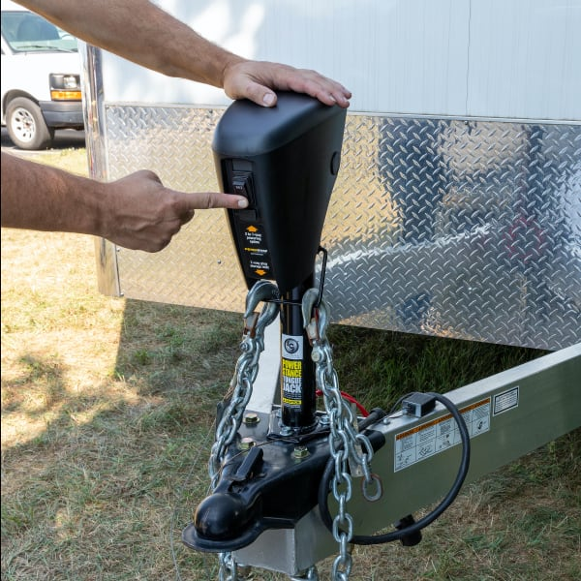
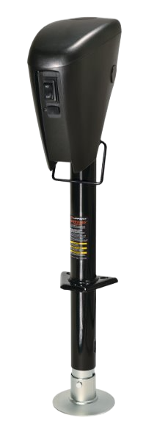
Trailer Parts & Accessories
Power Stance™ Electric A-Frame Jack by Lippert
Raises and lowers trailer tongue by using vehicle or trailer battery power
Can be hardwired into trailer or plugged into any vehicle 7-way RV blade
Four LEDs illuminate the area for nighttime use
Helical-cut gears reduce noise
Enhanced rocker switch for easy operation
Removable jack foot for increased trailer stability
Includes emergency hand crank for manual backup
3,500 lb. load capacity
18" travel

Slide 17
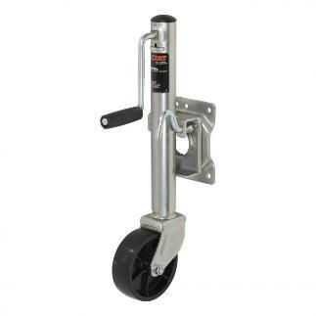
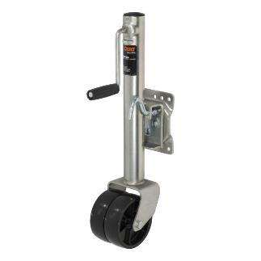
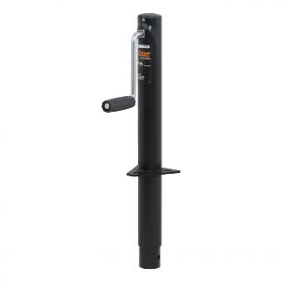
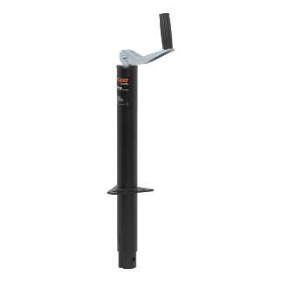
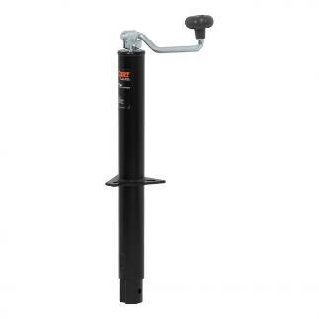
Trailer Parts & Accessories
Jacks
Marine Jacks
Caster wheel for trailer mobility and coupling
Side-wind handle raises or lowers trailer coupler
Swivel bracket allows jack to fully swing up and out of the way for travel
A-Frame Jacks
Designed to be mounted on an A-frame trailer tongue
Can bolted or welded on (hardware not included)

Slide 18
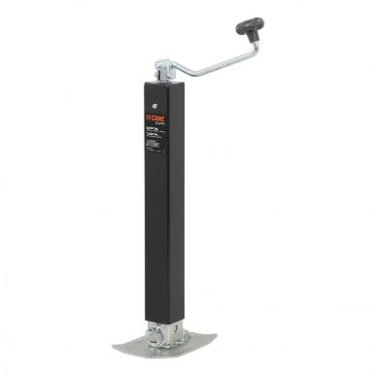
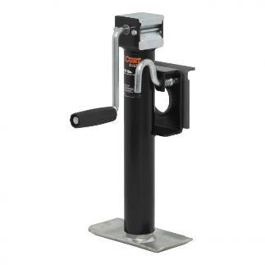
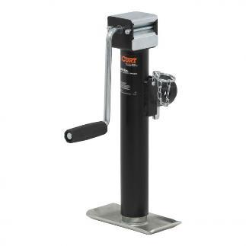
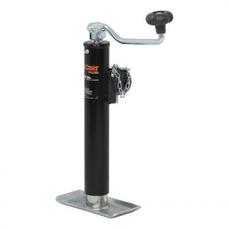
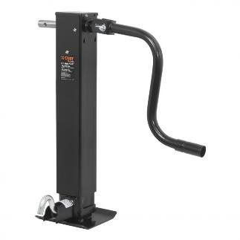
Trailer Parts & Accessories
Jacks
Swivel Jacks
Swivel bracket allows jack to fully swing up and out of the way during travel
Pull-pin keeps jack securely locked in place
Available in pipe-mount or bracket-mount style
Direct-Weld Square Jacks
Designed to weld directly to the trailer frame
Drop leg with spring return for fast retraction (#28512)
Pull-pin keeps jack leg securely locked in place

Slide 19
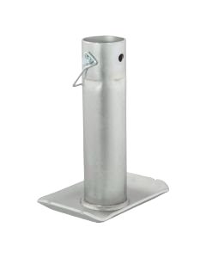
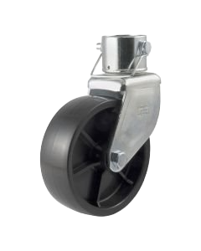
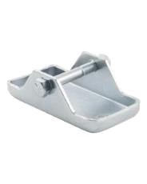
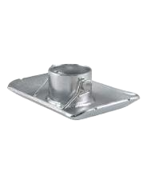
Trailer Parts & Accessories
Jack Accessories
Jack foot
Jack foot
Jack foot
Jack caster

Slide 20
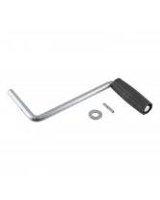
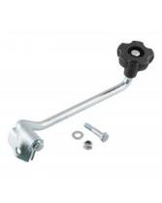
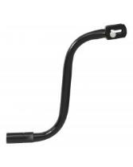
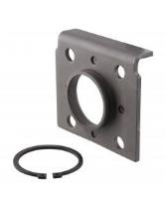




Trailer Parts & Accessories
Jack Replacement Parts
Jack handle
Jack handle
Jack handle
Swivel bracket
Pull pin
Caster wheel
Gear kit
Cap

Slide 21

Trailer Parts & Accessories
Hand Crank 2-Speed Winches
Compatible replacement for most DL and Fulton winches
Ideal for winching +20-foot-long boats onto boat trailer
High-quality, cold-forged steel construction for reliable performance
Solid gears provide superior strength vs. laminated gears
600-hour salt-spray-tested zinc plating for lasting corrosion resistance
Oil-impregnated metal bushings for smooth operation
Two input shafts and quick-detach handle for varying leverage

Slide 22




Trailer Parts & Accessories
Hand Crank 2-Speed Winches
#29520
Handle length: 10.6”
High Gear: 4.1:1 Low Gear: 10.25:1
Drum hub diameter: 25 mm
Drum hum width: 64 mm
#29526
Handle length: 10.6”
High Gear: 5.1:1 Low Gear: 12.7:1
Drum hub diameter: 25 mm
Drum hum width: 64 mm
Quick-release handle for low / high gear switching
#29532
Handle length: 9.6”
High Gear: 5.1:1 Low Gear: 15.8:1
Drum hub diameter: 28 mm
Drum hum width: 64 mm
#29538
Handle length: 9.6”
High Gear: 5.1:1 Low Gear: 15.8:1
Drum hub diameter: 45 mm
Drum hum width: 96 mm
Quick-release handle for low / high gear switching

Slide 23

Trailer Parts & Accessories
Hand Crank Brake Winches
Compatible replacement for most DL and Fulton winches
Ideal for lifting and hoisting applications, such as on light lifting towers
High-quality, cold-forged steel construction for reliable performance
Solid gears provide superior strength vs. laminated gears
600-hour salt-spray-tested zinc plating for lasting corrosion resistance
Oil-impregnated metal bushings for smooth operation

Slide 24



Trailer Parts & Accessories
Hand Crank Brake Winches
#29610
Handle length: 7”
Gear ratio: 4:2:1
Drum hub diameter: 56 mm
Drum hum width: 50 mm
#29615
Handle length: 10.6 ”
Gear ratio: 5:1
Drum hub diameter: 63 mm
Drum hum width: 56 mm
#29625
Handle length: 10.6”
Gear ratio: 15.8:1
Drum hub diameter: 83 mm
Drum hum width: 96 mm

Slide 25

Trailer Parts & Accessories
Hand Crank Winches
Constructed from high-strength, cold-forged steel
Equipped with a locking lever for increased safety
Broached pinion shaft securely engages the pinion
Base features slotted screw holes for flexible mounting
(for jet skis)

Slide 26




Trailer Parts & Accessories
Winch Cables & Straps
Made from 2" wide, no-stretch nylon web (straps), heavy-duty steel cable (cables)
Zinc-plated snap hook for easy, secure hookup
Limited lifetime warranty
Item Number | Break Strength | Strap Width | Strap Length
#29007 | 4,000 lbs. | 2" | 20'
#29450 | 3,300 lbs. | 2" | 15'
#29451 | 3,300 lbs. | 2" | 20'
#29460 | 4,200 lbs. | 3/16" steel | 25'
#29461 | 5,600 lbs. | 7/32" steel | 50'

Slide 27




Trailer Parts & Accessories
Safety Chains
Helps resist complete vehicle-trailer separation during a disconnect
Break strength capacities ranging from 2,000 up to 72,400 lbs.
Chain assembly must meet or exceed gross trailer weight
Available with S-hooks and clevis hooks
Protected by a durable zinc-plated finish
Safety chain hanger #45807 available for 2” shanks

Slide 28

Trailer Parts & Accessories
Transport Binder Chains
Designed for tying down and binding heavy-duty cargo
Grade 70 rating for superior tensile strength and abrasion resistance
Break strength capacities of 18,800 or 26,400 lbs.
Assembled with two clevis grab hooks for secure attachment
Protected by a durable yellow zinc-plated finish

Slide 29

Trailer Parts & Accessories

Slide 30

Trailer Parts & Accessories
Safety Cables
Coiled design keeps cables from dragging on the ground
Nylon coating protects cables from rust and allows for easier handling
Assembled with two safety latch hooks for secure attachment
Break strength capacities ranging from 3,500 up to 7,500 lbs.

Slide 31

Trailer Parts & Accessories

Slide 32


Trailer Parts & Accessories
Breakaway Kits
Activates electric trailer brakes in the event of a breakaway
Meets DOT requirements for holding / breakaway situations
Compatible with trailers with up to three axles
LED lights indicate a good charge, battery charging or low battery (#52042, #52044)
Bolt-on mounting system for secure installation on the trailer
Required in most states
Push-to-Test kit

Slide 33






Trailer Parts & Accessories
Hooks
Clevis Grab Hooks
Meets requirements for high-test chain
Hook pin and cotter pin provide an easy, secure attachment to safety chain
Constructed from high-strength, heat-treated steel
Safety Latch Clevis Hooks
Exclusive design and spring-loaded safety latch help ensure secure attachment
Meets requirements for high-test chain
Hook pin and cotter pin provide an easy, secure attachment to safety chain

Slide 34






Trailer Parts & Accessories
Hooks
Certified S-Hooks
Quickly and easily connects safety chains from trailer to tow vehicle
Tested for safety in accordance with SAE J684
Wire safety latch helps ensure secure attachment
Snap Hooks
Quickly and easily connects safety chains from trailer to tow vehicle
Spring-loaded safety latch helps ensure secure attachment
Patent# 5,664,304

Slide 35



Trailer Parts & Accessories
Hooks
Quick Links
Provides a quick connection for chains, cables, ropes or straps
Threaded link ensures secure attachment with the option to disconnect later
Requires no tools for installation

Slide 36




Trailer Parts & Accessories
Trailer-Mounted HD Rubber Wheel Chocks
Ridged bottom surface prevents chock slippage
Heavy-duty rubber and steel construction for lasting durability
Includes self-tapping screws and trailer frame mounting bracket
Convenient storage prevents dirt inside your truck or RV
Snap-ring clips with wire lanyard store chocks and prevents lost pieces
#22803
#22801
#22802

Slide 37

Trailer Parts & Accessories
Wheel Chocks
Perfect for chocking wheels on a parked trailer or adding safety during vehicle maintenance
Raised tread offers a better grip on the wheel
Saw-tooth edges on the base provide solid traction on the ground
Always to be used with vehicle brake
Not for commercial use

Slide 38








Trailer Parts & Accessories
Cargo Straps
Perfect for securing cargo in trailers, truck beds and more
Offers a superior tie-down method compared to bungee cords and rope
Cambuckle mechanism allows for direct tension on lighter loads
Ratchet mechanism allows for greater tension on heavy loads
Straps constructed from high-strength, woven nylon

Slide 39

Trailer Parts & Accessories

Slide 40






Trailer Parts & Accessories
Rings & Tie-Down Anchors
Recessed Rope Rings
Recessed design eliminates obstruction and provides a finished look
Adds a convenient anchor point for ropes, bungee cords or straps
Perfect for cargo management in trailers, trucks and vans
D-Rings
Square holes accept 3/8” carriage bolts (#83740 and #83742)

Slide 41



Trailer Parts & Accessories
Lashing Rings
Adds a heavy-duty anchor point for ropes, cables, straps or chains
Raw finish allows for ready welding of mounting bracket
Large opening offers a reliable anchoring point

Slide 42

Trailer Parts & Accessories

Slide 43
Trailer Parts & Accessories
Lippert Axle Program: Axles & Replacement Parts
Axles: We offer quick, free shipping for hundreds of the most common trailer axles, ready to ship same or next business day. This ensures minimal downtime for our customers.
Custom axle builds are ready to ship within 5-7 business days (customers should call Customer Service to request the axles we are not stocking for this program)
Replacement Parts: We offer premium axle replacement parts with universal compatibility with other major brands and the fastest ship time in the industry
Trusted Expertise: Our customers rely on our proven expertise and exceptional customer support in axle manufacturing and service.
USA-made Quality: Assembled in the USA, our axles meet the highest standards of craftsmanship, providing long-lasting performance.

Slide 44
Trailer Parts & Accessories
Lippert Axle Program: Key Features & Benefits
The fastest turnaround time in the industry
Speed in fulfillment: 1-2 days vs. 6-8 weeks
We stock hundreds of the most popular trailer axles that are ready to ship same or next business day
Custom options can ship within 5-7 business days
Every operation of manufacturing is quality tested and photo recorded
Our replacement parts are universally compatible with other brands
We offer robust customer support

Slide 45





Trailer Hitches
Safety Suite with OneControl Auto
Powered by a Bluetooth®-enabled system and the OneControl® app, The CURT safety suite provides ultimate protection and peace of mind for the road ahead.
True Course Emergency Sway Control Emergency braking system combats sway caused by side winds, slippery roads and sudden movement.
TireLinc Auto TPMS This system allows you to monitor tire pressure and temperature as you tow in real-time, helping you to stay aware and safe.
Echo Series Brake Controllers The Echo brake controller family connects through Bluetooth® and is compatible with an array of vehicles and towing applications.

Slide 46


Trailer Parts & Accessories
Limited Lifetime Warranty
CURT provides limited lifetime warranty coverage against defects in factory workmanship and materials for CURT products sold by authorized CURT dealers for use by retail (end use) consumers.
https://storage.googleapis.com/curt-group-warranties/CURT_Warranty.pdf

