Slide 1
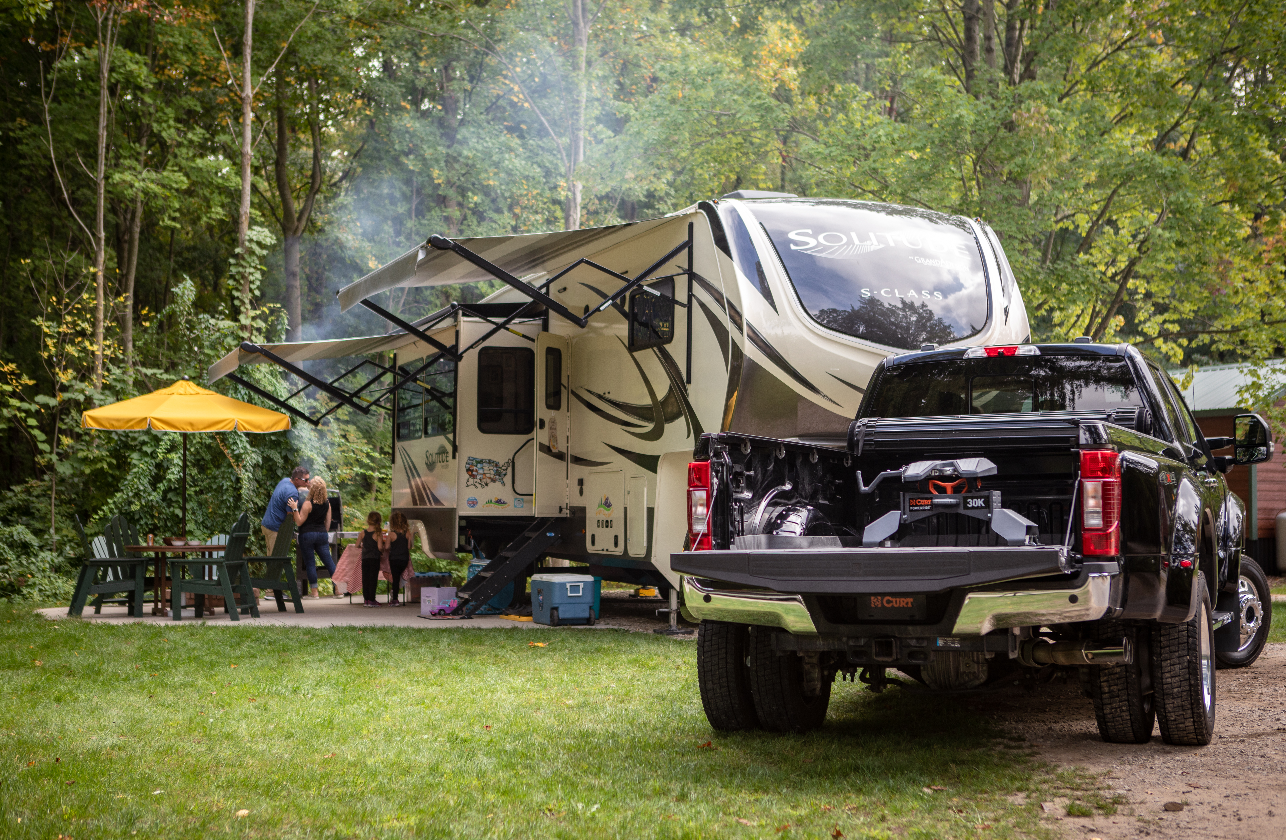

5th Wheel Hitches

Slide 2
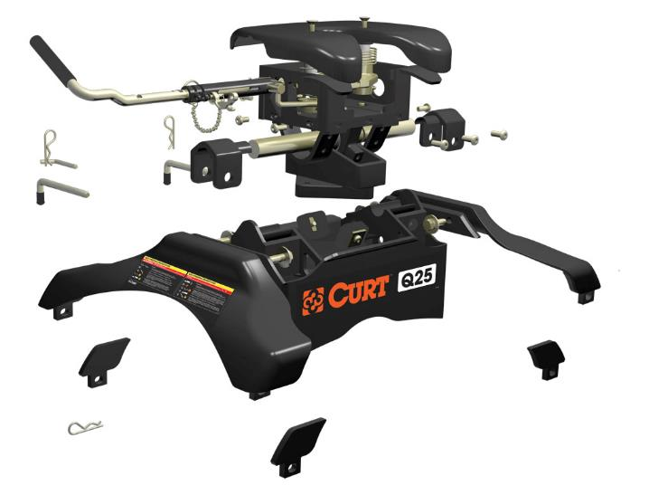
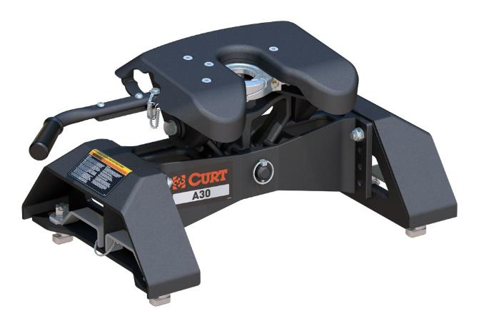
5th Wheel Hitches
The CURT 5th wheel line offers a range of weight capacities, versatile mounting options and more OEM puck system products than anyone else.
GTW capacities from 16K up to 30K
All 5th wheels available with legs, base rails, sliders, and OEM legs
X5™ gooseneck to 5th wheel adapter plates compatible with CURT and competitive gooseneck hitches
Tested to SAE J2638 standards for safety
Durable powder-coated finish

Slide 3
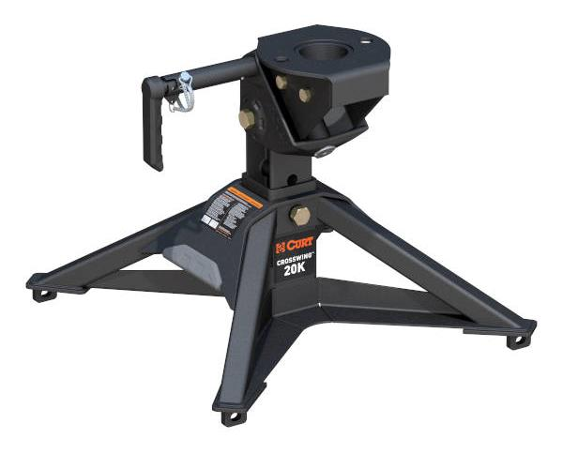
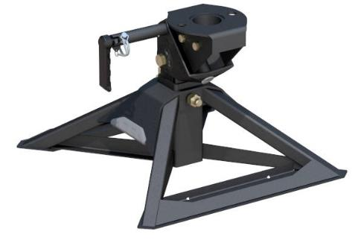
5th Wheel Hitches
CrossWing™ 20K
Premium steel construction offers robust 20,000-lb. capacity
65% lighter than most traditional 5th wheel hitches (main body weighs up to 70 lbs.)
Reinforced head connection point for superior strength and peace of mind
Easy, one-person installation and removal
Unique coupling system eliminates guesswork by offering visible contact surface
Head channel guides kingpin into place for easier hookup
Easy-to-reach release handle for ergonomic operation
CrossWing is compatible with rigid mount pin boxes. Do not use with articulating pin boxes such as Roto flex, Flex Air, Air Ride, or Helux
#16600 for industry-standard rails
#16051 for gooseneck mount

Slide 4

CrossWing video

Slide 5

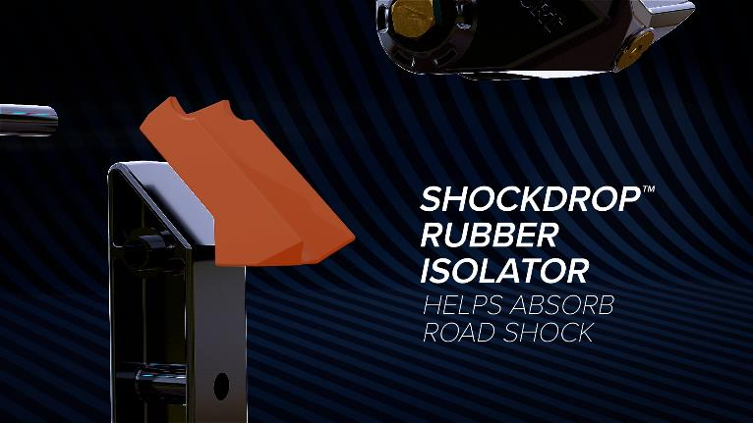
5th Wheel Hitches
CrossWing™ 20K
Features patent-pending ShockDrop™ technology to reduce jerking and jarring
Allows fore, aft and lateral head articulation when connecting on uneven terrain
Three points of height adjustment from 16-3/8" to 20-3/8" (#16600)
Coupling point offset rearward for added turning clearance (5" (#16600) or 8.4" (#16051))
Premium, carbide textured black finish for lasting rust resistance
High-grade steel design for added strength vs. aluminum
Tested for safety in accordance with SAE J2638

Slide 6
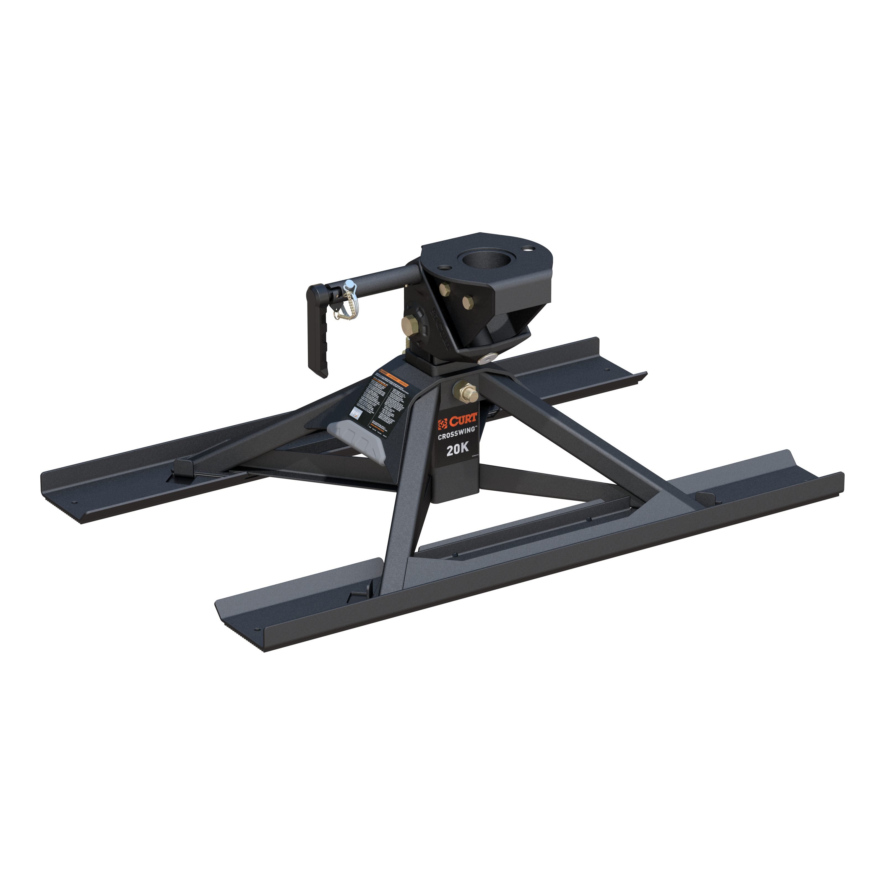
5th Wheel Hitches
CrossWing™ 20K Single-Point Kit
Mounts over the top of most standard height 2-5/16" aftermarket and OEM gooseneck balls
Bed protector supports distribute force across the truck bed, adding support and reducing bed wear
Coupling point offsets 8.4" rearward for added turning clearance
Three points of height adjustment from 17-1/2" to 21-1 2"

Slide 7
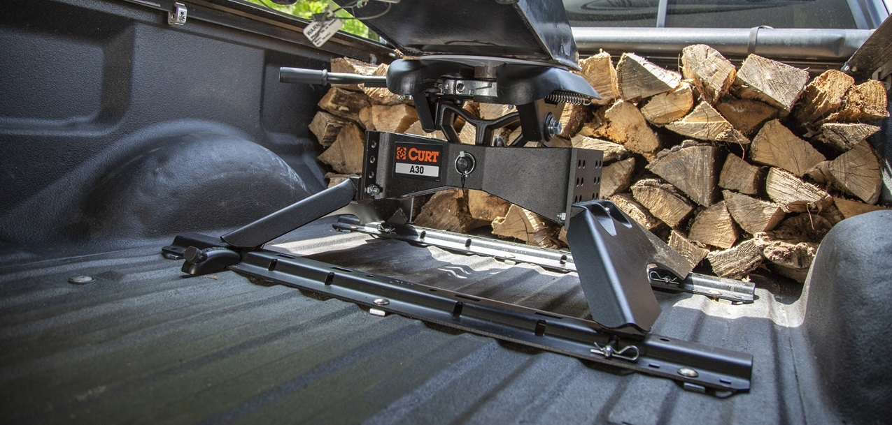
5th Wheel Hitches

Slide 8
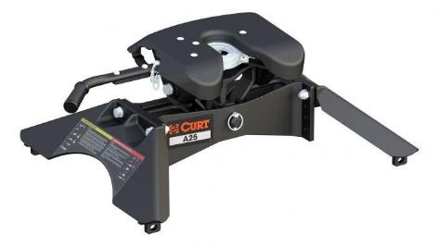
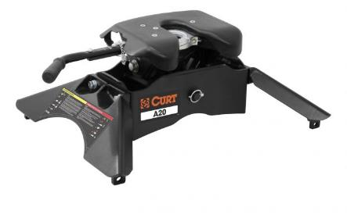
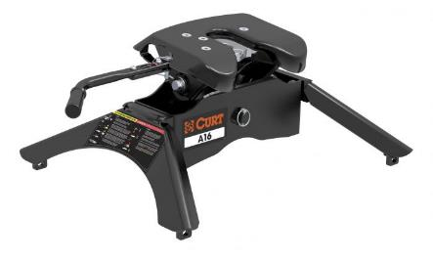
5th Wheel Hitches
A-Series™
The A-series™ is named for its articulating head design. The head is built on a patented cast yoke that offers a stable, quiet ride, even with large 5th wheel trailers.
This cast yoke also features torsion springs and poly-torsion inserts to support the head and add even more stability to the connection.
A30™ with GM puck system legs
A25™
A20™
A16™

Slide 9
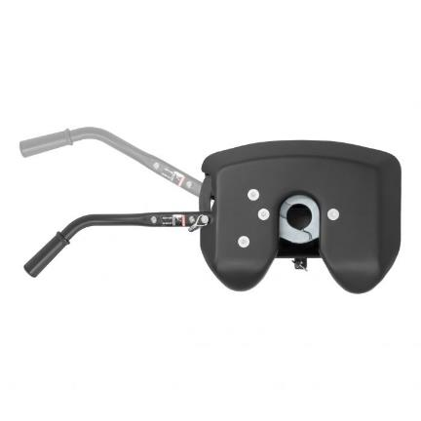
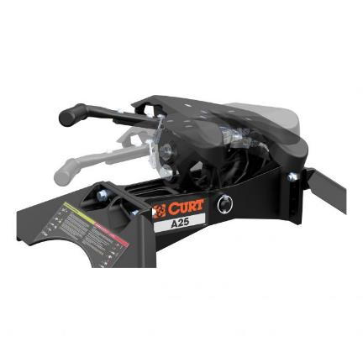
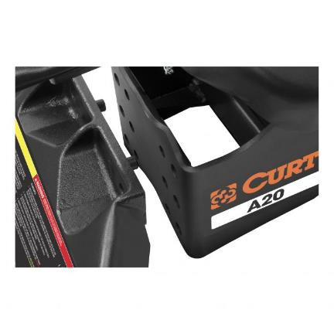
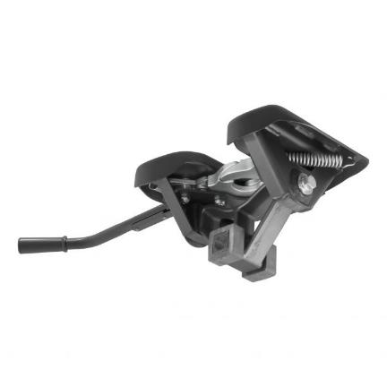
5th Wheel Hitches
A-Series™
Lockable handle self-resets to the ready-to-couple position after the hitch is uncoupled
Fully articulating torsion head for controlled coupling and a stable, quiet ride
Alignment pegs and easy-access bolts for simple leg attachment (excl A16)
Cast yoke and poly-torsion inserts suppress shock loads and reduce noise

Slide 10
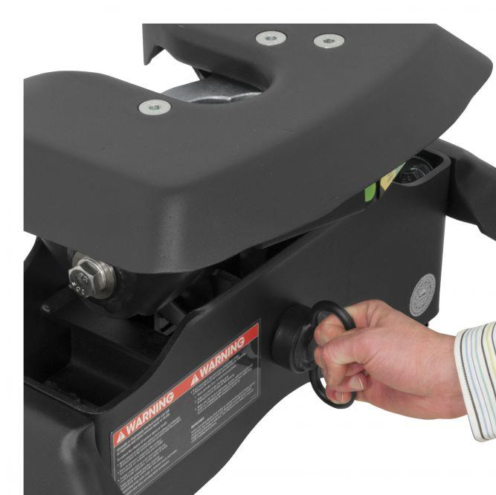
5th Wheel Hitches
A-Series™
Fast, one-pin head removal makes moving easy with smaller, lighter pieces
High-strength, interlocking cast jaws fully wrap the kingpin to minimize noise
Extra wide head opening for easier coupling
Constructed with a cast steel main body for a more precise build (A25 & A30 only)
Compatible with kingpin extension boxes, including common pivoting pin boxes (wedge #16992 required)
Patent# 8,827,298
Limited lifetime warranty

Slide 11
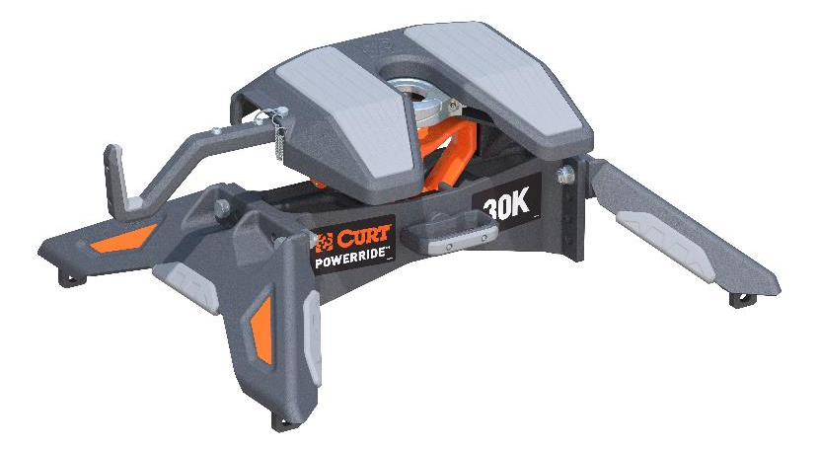
5th Wheel Hitches
PowerRide™ 30K
Tough, professional-grade capacity and enhanced functionality
Ergonomic, self-resetting handle for easier use from the side of the truck bed
Constructed with a cast steel main body for dependable strength
Multi-directional, cast yoke head for a smooth ride and less strain on the truck
Tested and rated to 30,000 lbs. GTW / 7,500 lbs. vertical load per SAE J2638 (must be used with #16205 base rails)
Integrated polyethylene plates for smooth operation, reduced wear and no grease
Fast, one-pin head removal makes moving easy with smaller, lighter pieces

Slide 12
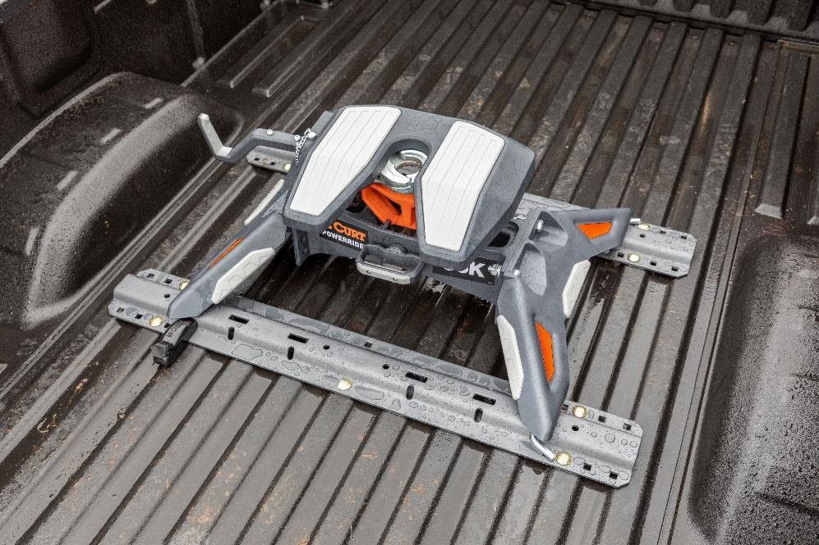
5th Wheel Hitches
PowerRide™ 30K
Strategic grip points for ergonomic moving and handling
Three-position coupling indicator clearly shows coupling status
Patented interlocking jaws for full kingpin contact and coupling security
Premium, textured, dark grey teridium finish for lasting rust resistance
6" height adjustment for greater versatility versus 3" options
No welding or fabrication required for installation
Patent# 8,827,298

Slide 13
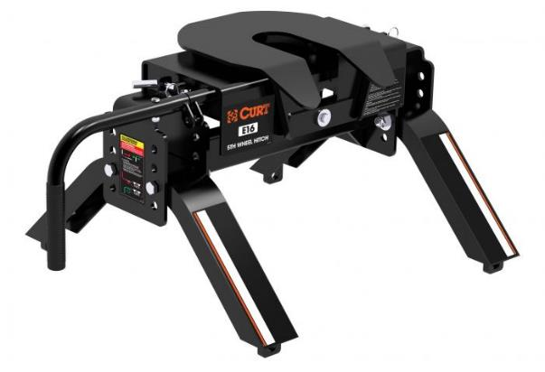
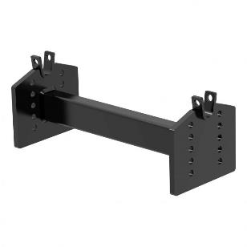
5th Wheel Hitches
E-Series™
Pivots on dual axes for 10° of lateral movement
Automatically locks for easy, secure coupling
Operates using a single handle
Mounts to all industry-standard base rails
Offers four height adjustment positions to adapt to each unique truck bed
Compatible with kingpin extension boxes, including common pivoting pin boxes (wedge #16991 required)
Limited lifetime warranty
E16™
#16505 adapter for use with rollers

Slide 14
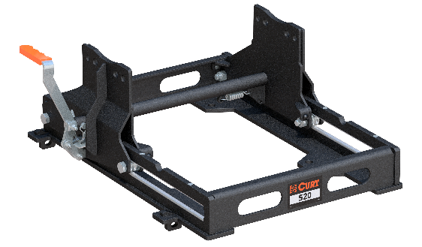
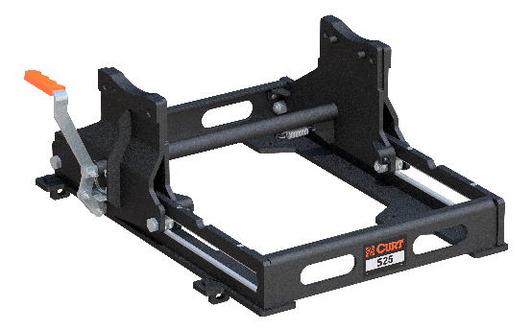
5th Wheel Hitches
S-Series™ Sliders
Up to 25,000 lbs. GTW / 6,250 lbs. vertical load
Smooth sliding between positions with no binding
Automatically latches in both directions so you only need to exit your truck once
Easy-to-reach lever arm
Lever lift motion allows for easy functionality versus traditional pull-out style
Mounts to all industry-standard base rails
Protected by a highly durable carbide powder coat finish
Limited lifetime warranty
#16564 (S20)
#16574 (S25)

Slide 15
5th Wheel Hitches
Quick Comparison
Features | PowerRide™ | CrossWing™ | A-Series™ | E-Series™
Pivoting Mechanism | Cast yoke with two pivot points | Articulating head | Cast yoke with two pivot points | 10° dual-pivoting head
Handle Operation | Single-throw, self-resetting handle | Single-throw, quarter-turn | Single-throw, self-resetting handle | Single handle
Head Opening | Extra-wide, self-aligning | Funnel system | Extra-wide, self-aligning | Self-aligning
Jaw Type | Dual, interlocking | Locking arm | Dual, interlocking | Locking bar
Coupling Indicator | Yes | Visible contact surface | Yes | No
Head Removal | One-pin | N/A | One-pin | Two-pin
Sidewinder Compatible | Yes (wedge required) | Yes (wedge required) | Yes (wedge required) | Yes (wedge required)
GTW Options | 30K | 20K | 16K, 20K, 25K, 30K | 16K
Finish | Teridium grey | Carbide black | Carbide black | Carbide black
Warranty | Limited Lifetime | Limited Lifetime | Limited Lifetime | Limited Lifetime

Slide 16
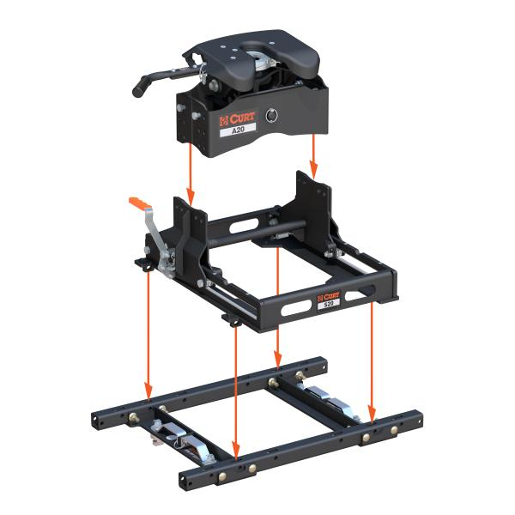
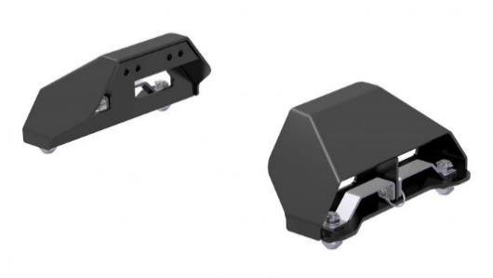
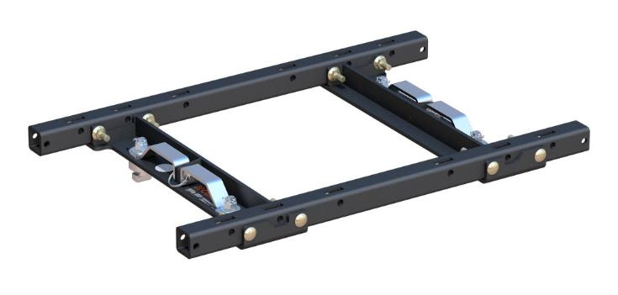
5th Wheel Hitches
Mounting Options
OEM Puck System Products
Allows CURT 5th wheel hitches to fit an OEM puck system
Convert the truck's puck system to industry-standard 5th wheel base rails
Legs and base rail options available
Simple quarter-turn anchoring system
Options available for Chevrolet, Ford, GMC, Nissan and Ram

Slide 17
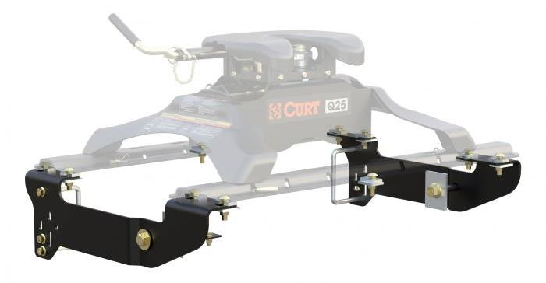
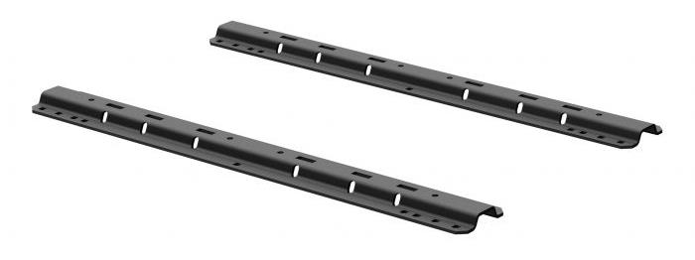
5th Wheel Hitches
Mounting Options
Custom Under-Bed Brackets
Vehicle-specific application reduces or eliminates drilling
Protected by a rust-resistant liquid A-coat
Industry-Standard Base Rails
Available in 25K and 40K capacities
Powder coat and liquid A-coat finish

Slide 18
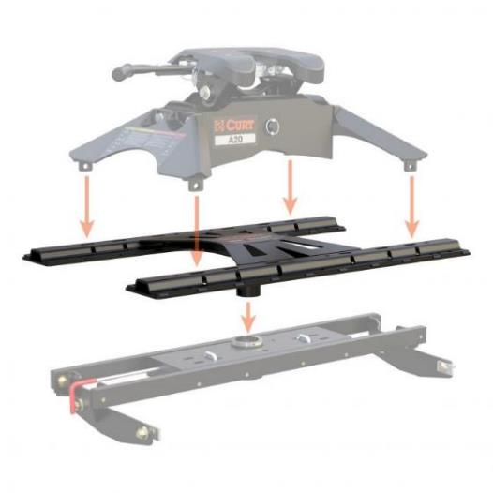
5th Wheel Hitches
Mounting Options
X5™ Adapter Plates
Converts EZr™, Double Lock™ or competitor goosenecks to 5th wheel rails
Compatible with CURT 5th wheels up to 20,000 lbs.
5th Wheel Sliders
Ideal for increasing clearance for short-bed trucks
Available in 20K and 25K capacities

Slide 19


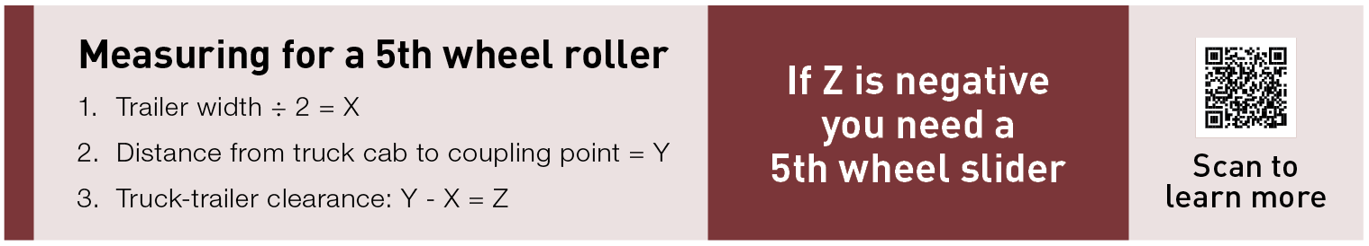
5th Wheel Hitches
How to Select a 5th Wheel Hitch
What size is the truck bed?
The length of the truck bed will determine which type of mounting platform the 5th wheel hitch requires: legs or a slider.
Long-bed (8 feet)
5th wheel legs are the standard 5th wheel mounting method. A long-bed truck should provide the necessary room for this option.
Short-bed (under 8 feet)
A 5th wheel slider is recommended on short-bed trucks. A slider adds clearance between the cab and the trailer when turning.

Slide 20
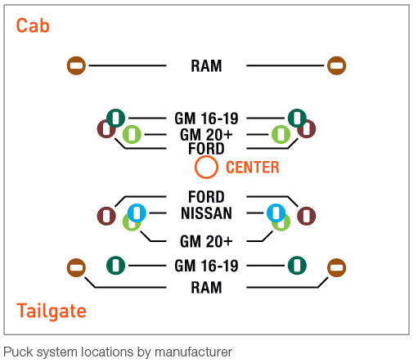
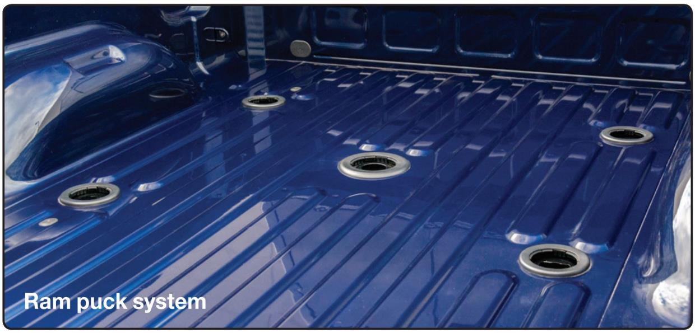
5th Wheel Hitches
How to Select a 5th Wheel Hitch
Does the truck have an OEM puck system?
Many trucks today, specifically from Ford, GM, Nissan, and Ram, come with a built-in mounting platform in the bed called a puck system. A puck system makes installing a CURT 5th wheel hitch very easy.
Long-bed
If the long bed has a puck system, select a 5th wheel hitch with OEM puck system legs or rails.
Short-bed
If the short bed has a puck system, select an OEM puck system slider or rail option.

Slide 21
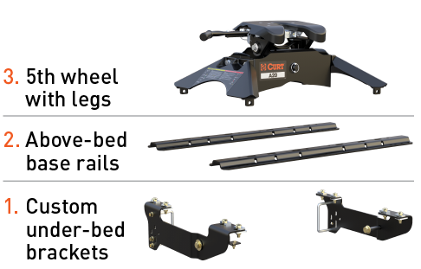
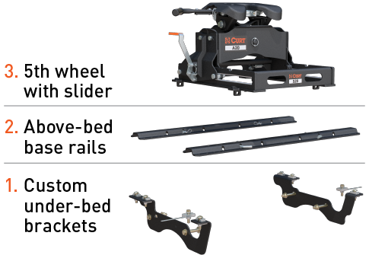
5th Wheel Hitches
How to Select a 5th Wheel Hitch
Does the customer prefer permanent base rails?
If your customer prefers fixed rails in the truck bed, select a vehicle-specific, under-bed bracket kit and corresponding base rails to mount the 5th wheel hitch.
Long-bed
Short-bed

Slide 22
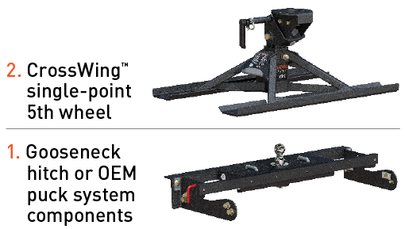
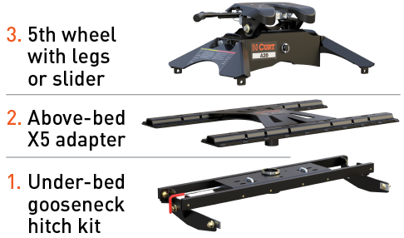
5th Wheel Hitches
How to Select a 5th Wheel Hitch
Does the customer have a gooseneck system in their truck bed?
If your customer prefers the option of a gooseneck hitch, allowing for complete removal of the 5th wheel system and providing and unobstructed truck bed, select one of the options below.
CrossWing™ 5th wheel
X5 adapter bed rail

Slide 23
5th Wheel Hitches
How to Select a 5th Wheel Hitch
Does the customer have a gooseneck system in their truck bed?
If your customer prefers the option of a gooseneck hitch, allowing for complete removal of the 5th wheel system and providing and unobstructed truck bed, select one of the options below.
CrossWing™ 5th wheel
X5 adapter bed rail

Slide 24
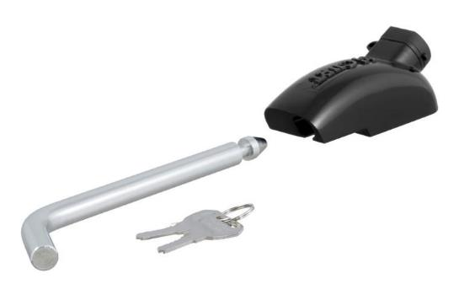
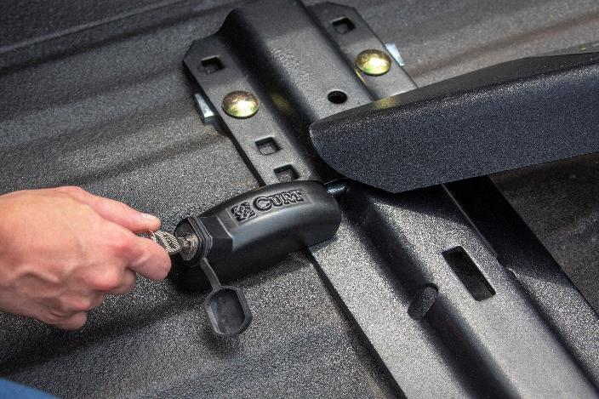
5th Wheel Hitches
Base Rail Lock #23256
Locks a 5th wheel hitch into the rails, taking the place of a pin & clip
Extra-long 1/2" diameter pin fits all industry-standard base rails
Rust-free aluminum housing with a durable black powder coat finish
Weather-resistant dust cap helps prevent internal corrosion
Easy-to-operate, 1/8-turn lock activation
Not compatible with OEM puck systems

Slide 25
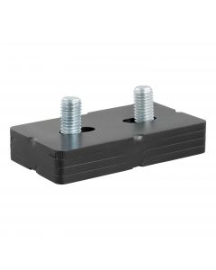
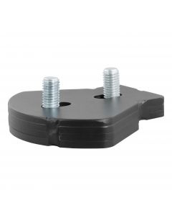
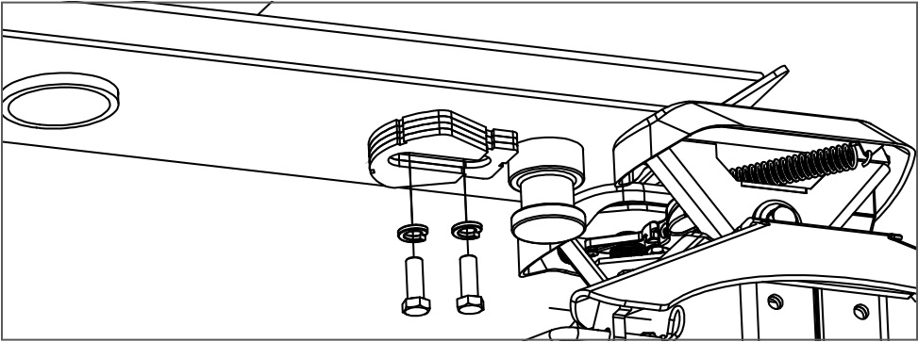
5th Wheel Hitches
5th Wheel Wedges
Allows CURT 5th wheel hitches to be used with rotating pin boxes, such as Sidewinder™ and Turning Point®
Bolts on behind the kingpin of the pin box to restrict movement between 5th wheel hitch and pin box
Durable carbide black powder coat finish
Made in USA (may include imported hardware)
Fits E-series™
Fits A-series™
Restricts movement between the 5th wheel hitch and the rotating pin box

Slide 26
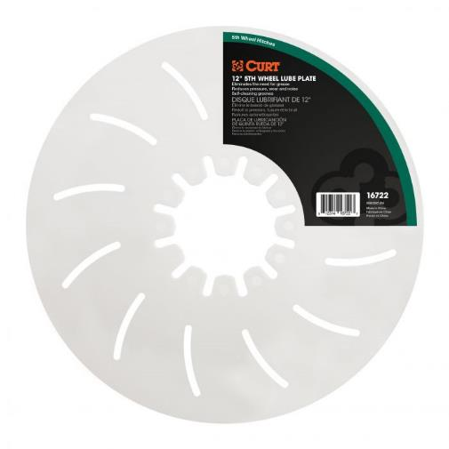
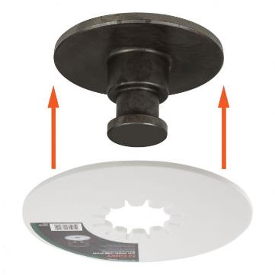
5th Wheel Hitches
Lube Plates
Provides a buffer between 5th wheel hitch head plate and kingpin pin box
Reduces normal wear and tear when towing
Eliminates messy grease deposits on hitch head plate
12” plate features self-cleaning grooves to maintain good lubrication
Easily fits on any standard kingpin
Constructed from tough polyethylene
Included with all 5th wheel hitches
12” diameter
10” diameter

Slide 27
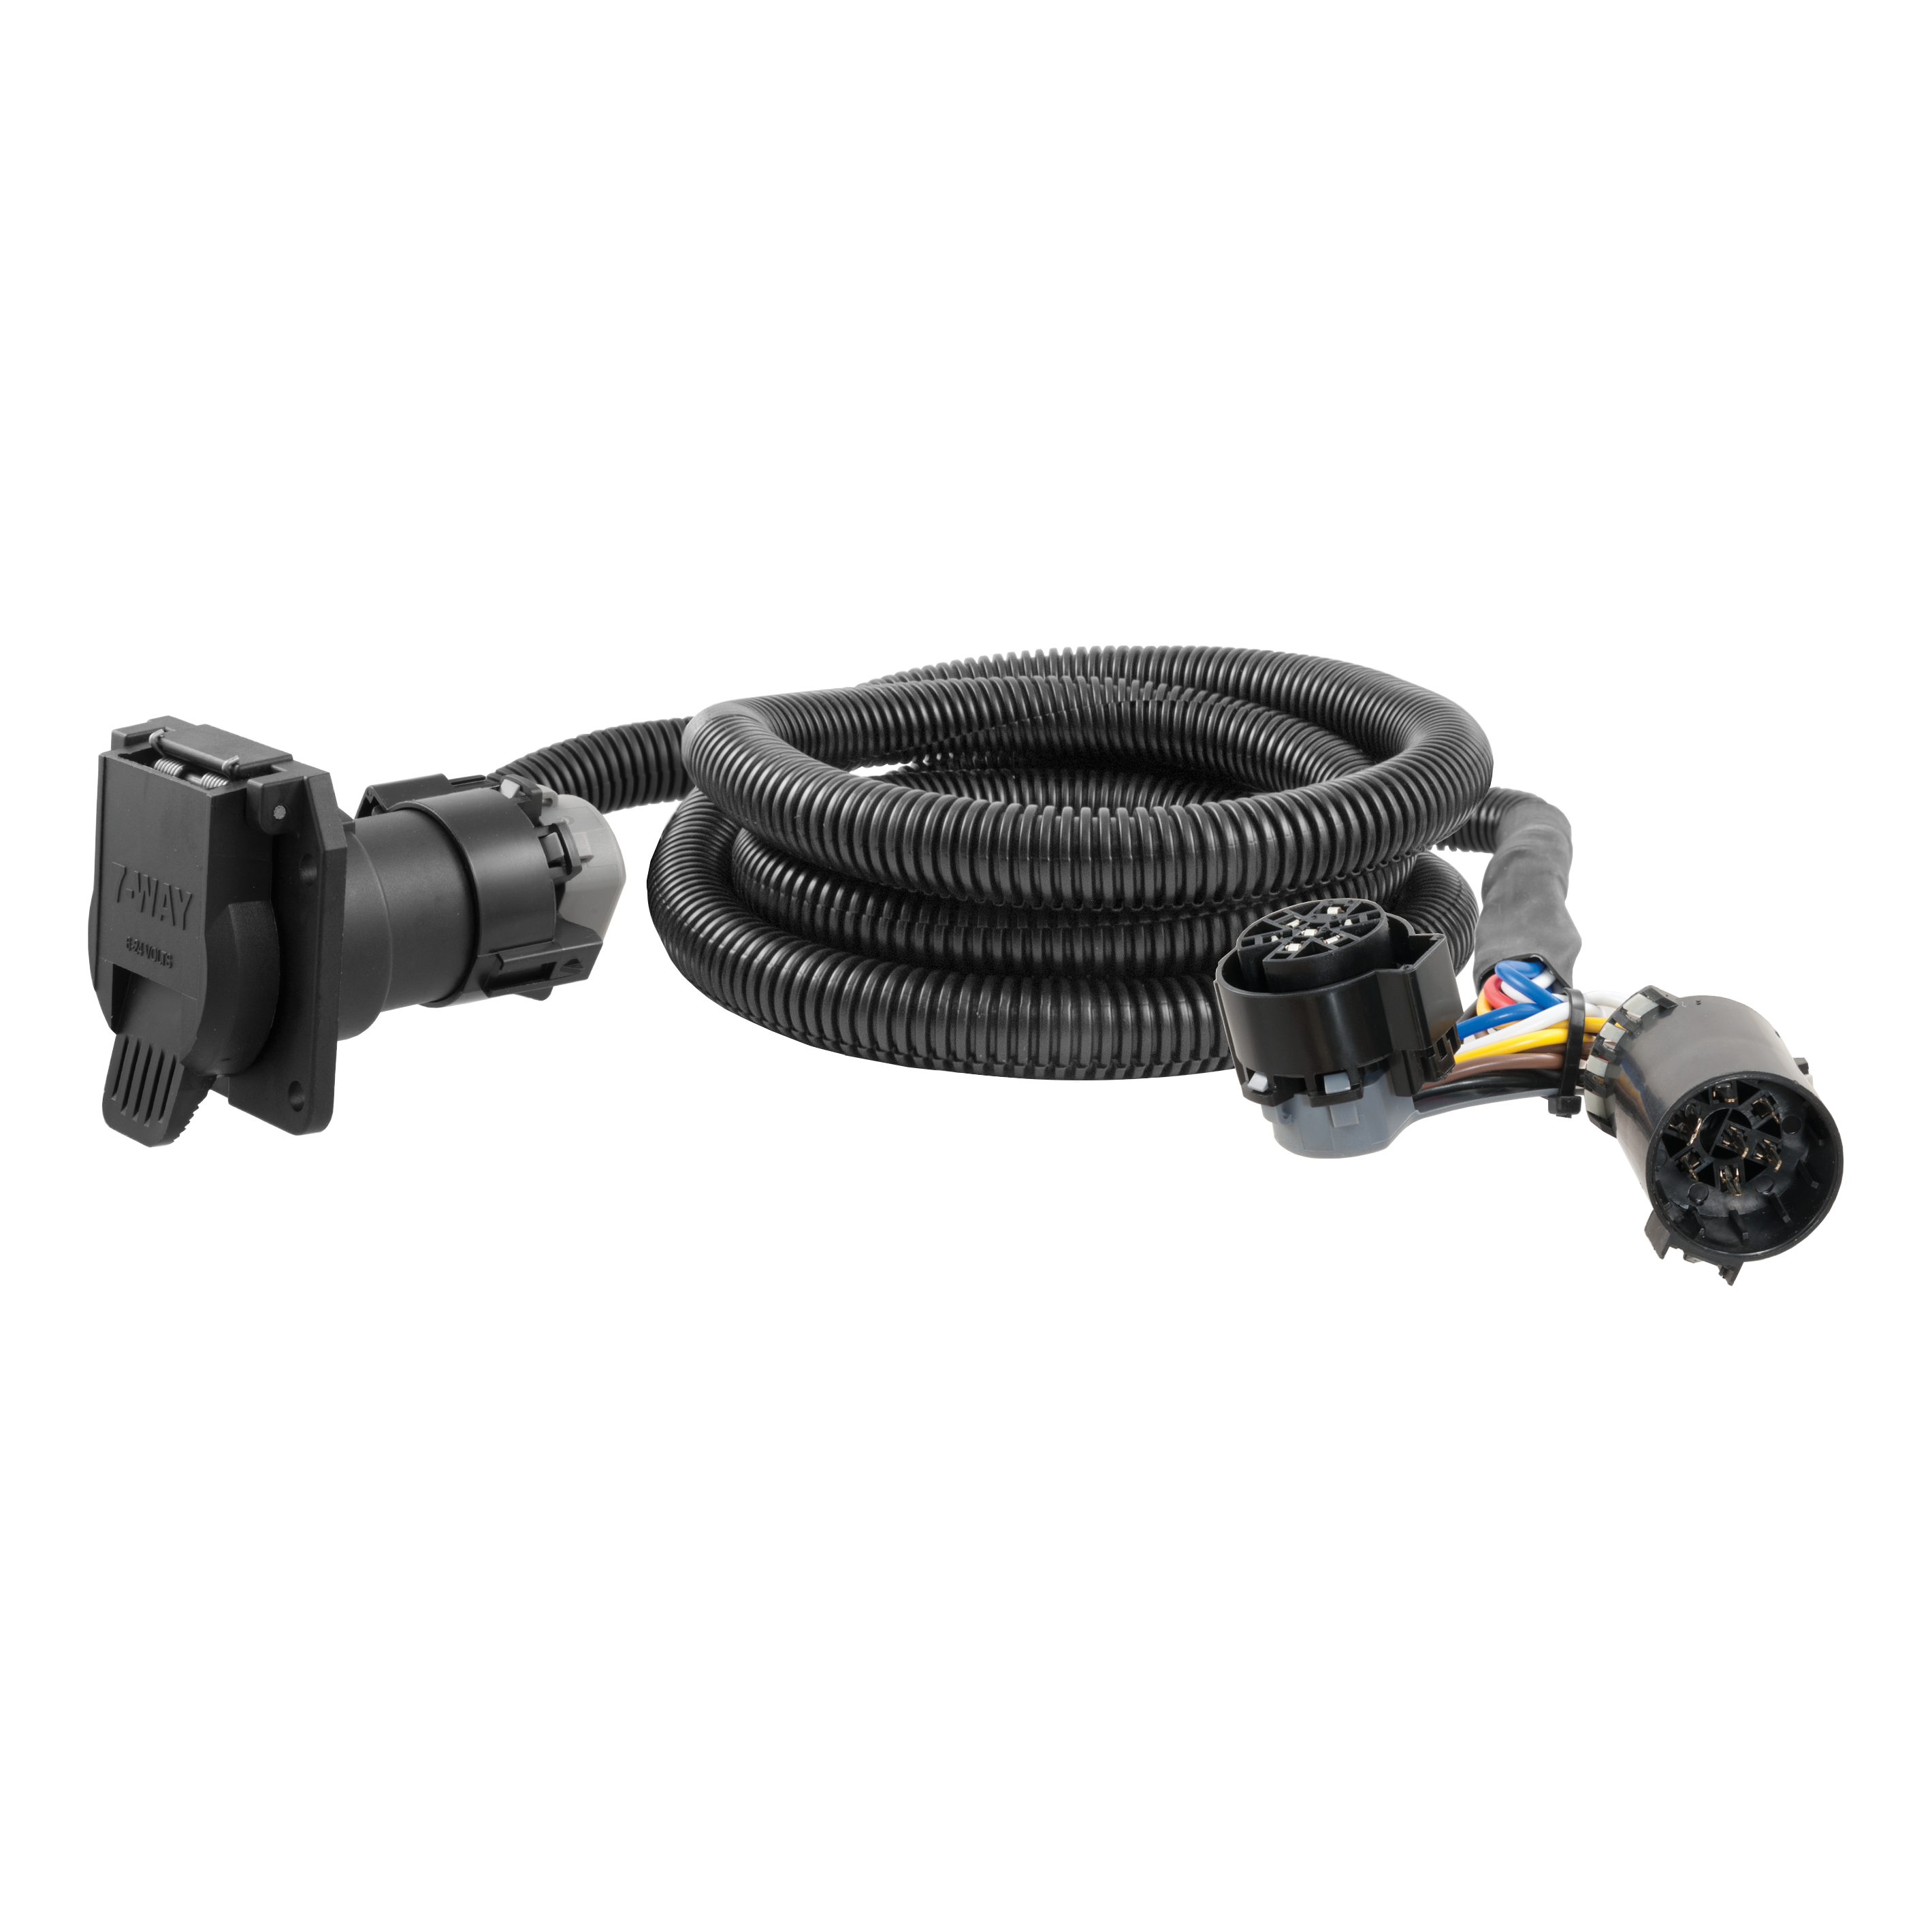
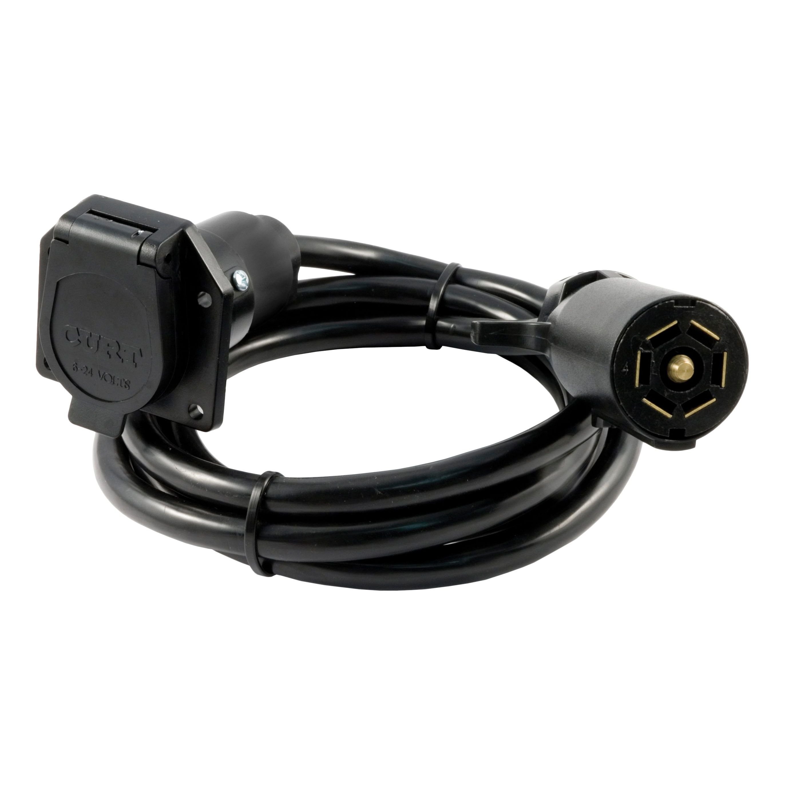
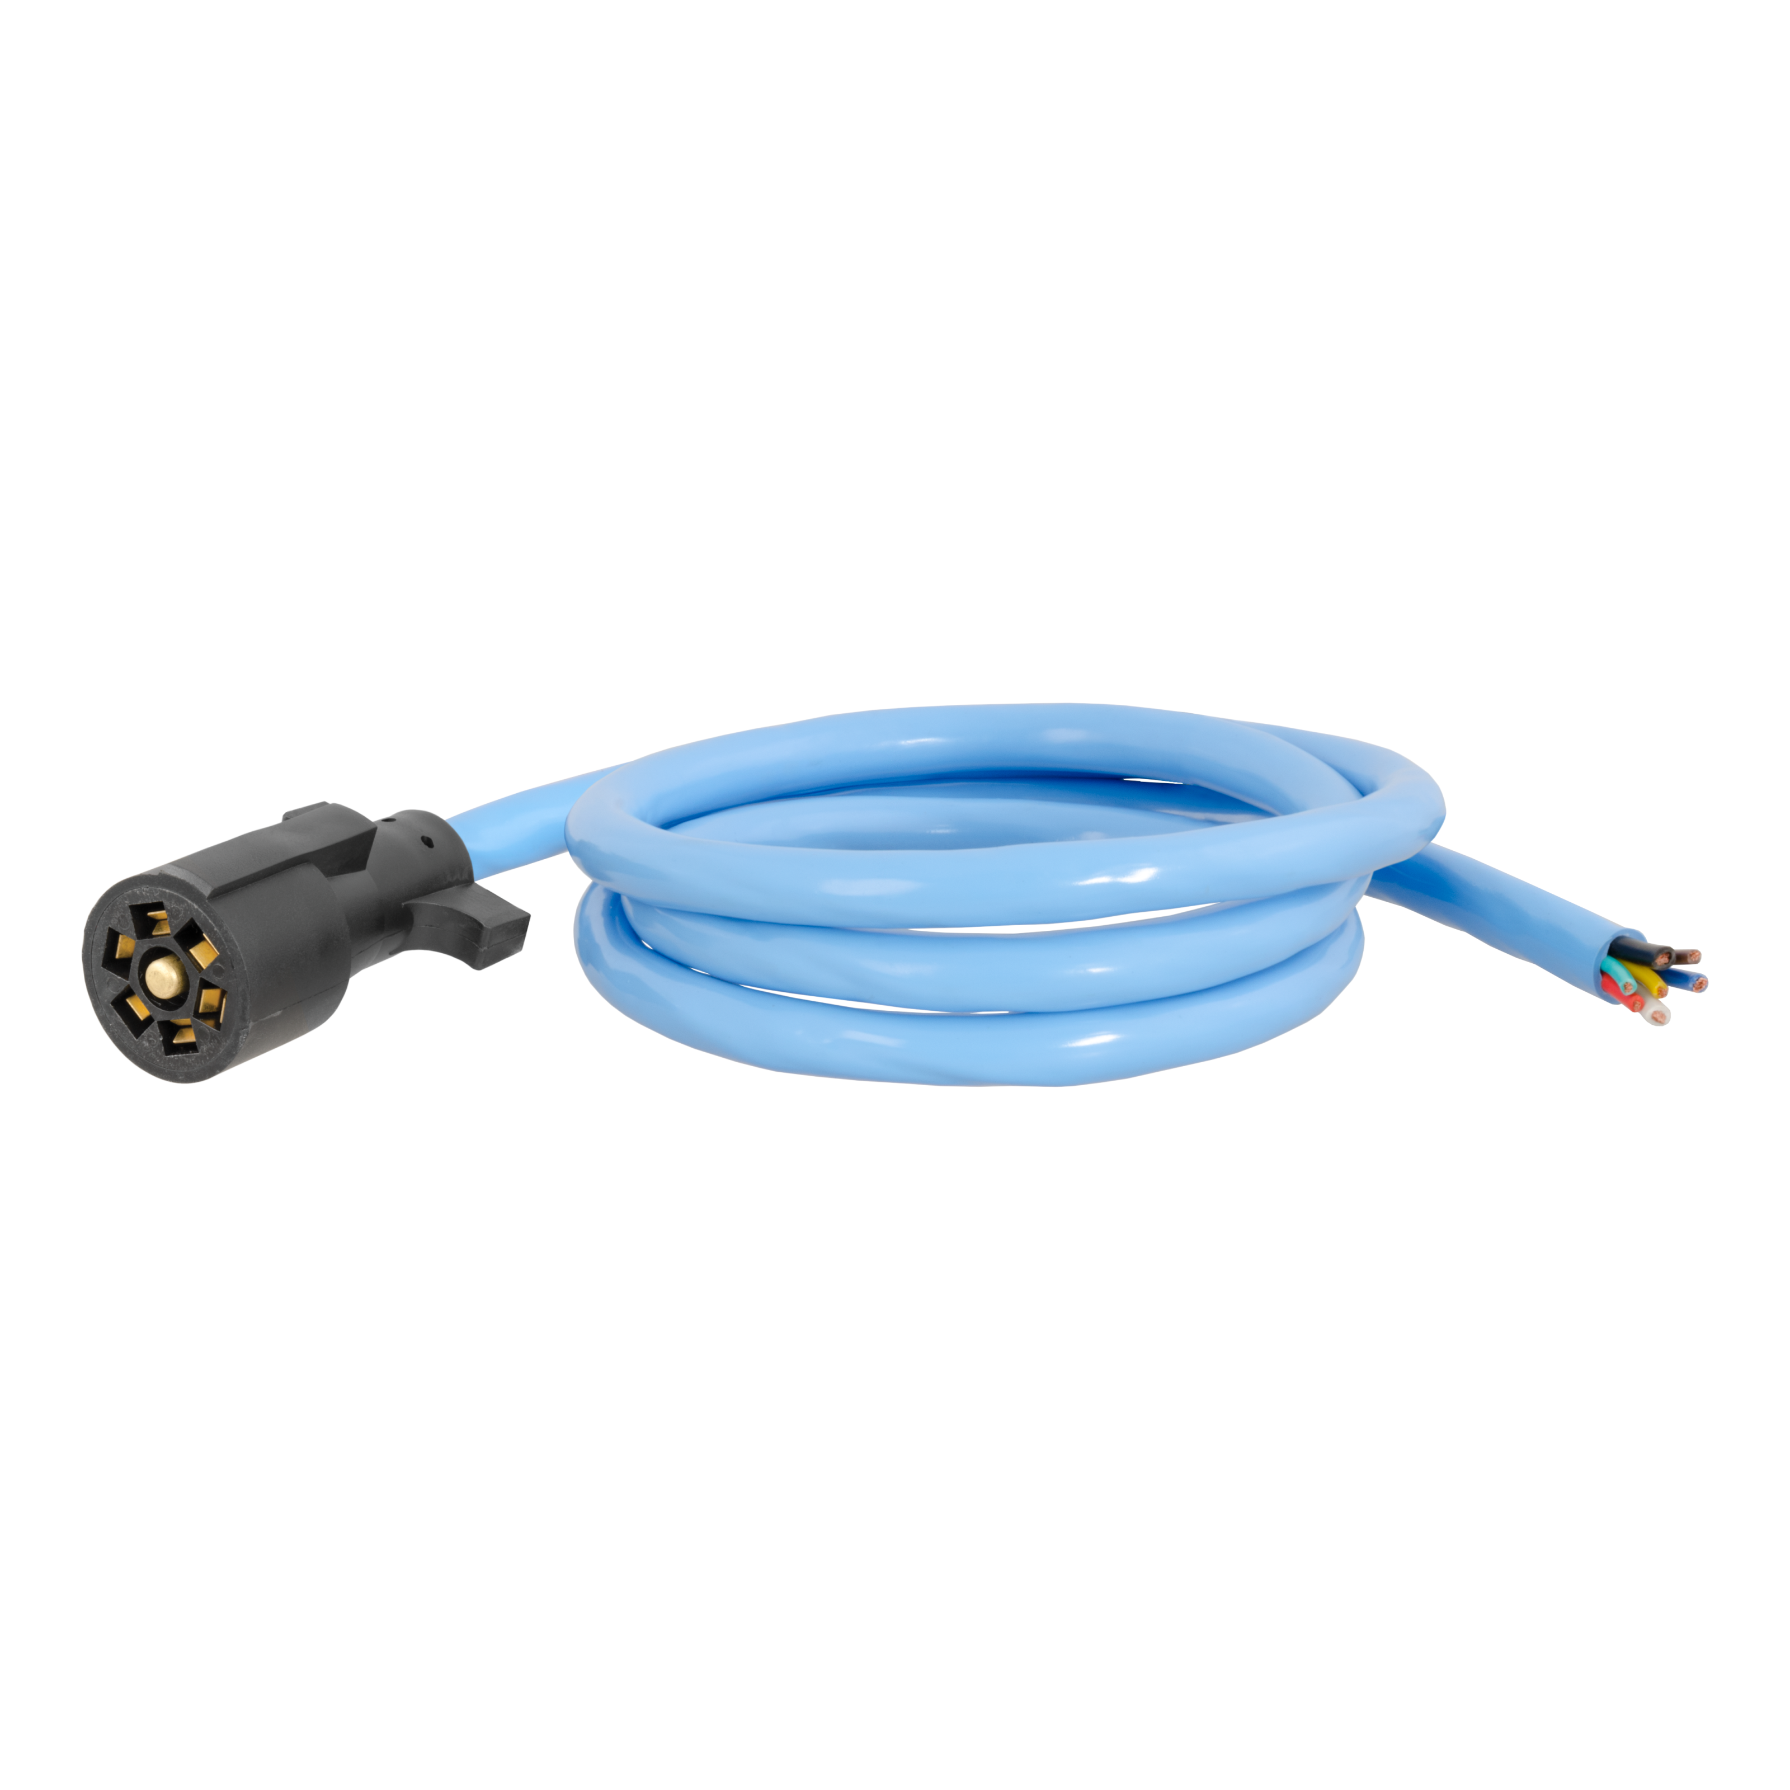
5th Wheel Hitches
Custom Wiring Extension Harnesses
Routes a 7-way RV blade socket into truck bed while retaining use of rear socket
Simple plug-and-play design
Allows for easy connection of gooseneck wiring
7-Way RV Blade Extension Harness
Routes existing 7-way RV blade socket into full-size pickup truck bed (7' length)
Universal size fits any 7-way RV blade socket
Replacement RV Blade Harness
Replaces the trailer-end plug of any 7-way harness
Soft thermoplastic elastomer casing remains flexible in cold weather
#56070 (7') / 56000 (10')
#56080
#56612

Slide 28
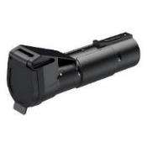
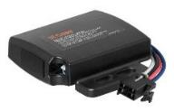

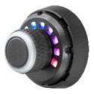
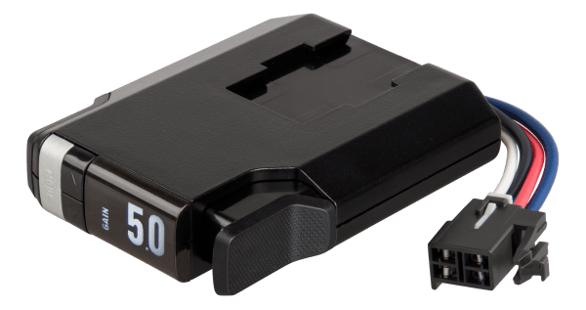
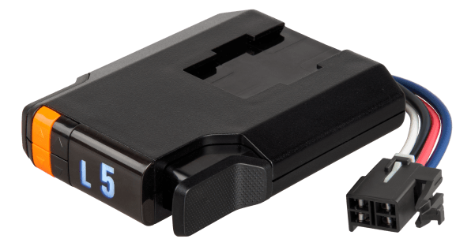

5th Wheel Hitches
Brake Controller Quick Comparison
Echo mobile
Echo under-dash
Echo in-line
Spectrum
TriFlex NEXT
Discovery NEXT
Venturer NEXT
Name | Part# | Axles / Brakes | Activation | Display | Mount Angle | Sleep Mode | Warranty
Echo mobile | 51180 | 1-2 / 2-4 | Proportional | Phone app | Any | N/A | Limited lifetime
Echo under-dash | 51190 | 1-4 / 2-8 | Proportional | Phone app | Any | Yes | Limited lifetime
Echo in-line | 51200 | 1-4 / 2-8 | Proportional | Phone app | Any | Yes | Limited lifetime
Spectrum | 51170 | 1-4 / 2-8 | Proportional | Tri-color LED | Any | N/A | Limited lifetime
TriFlex NEXT | 51146 | 1-4 / 2-8 | Proportional | LED Digital | Any | Yes | Limited lifetime
Discovery NEXT | 51126 | 1-4 / 2-8 | Time-delay | LED Digital | Any | Yes | Limited lifetime
Venturer NEXT | 51116 | 1-3 / 2-6 | Time-delay | LED Digital | Any | Yes | Limited lifetime

Slide 29


5th Wheel Hitches
HELUX™ Coil-Spring 5th Wheel Pin Boxes
Purchase verification required. Refer to the instruction sheet for pin weight measuring process
Virtually maintenance-free design improves user experience over airbags
Compatible with Rhino Box bolt-mounting pattern
Robust steel construction and black powder coat finish
Tested for safety in accordance with SAE J2638
Approved on Lippert RV frames (will not void warranty)
Not compatible with offset 5th wheel hitches
Mounting hardware included
Designed, welded, and coated in Indiana
Limited lifetime warranty (one-year finish, one-year parts)
Patent pending

Slide 30


5th Wheel Hitches

Slide 31

5th Wheel Hitches
HELUX™ Coil-Spring Gooseneck Pin Boxes
Purchase verification required. Refer to the instruction sheet for pin weight measuring process
Virtually maintenance-free design improves user experience over airbags
Compatible with Rhino Box bolt-mounting pattern
Robust steel construction and black powder coat finish
Tested for safety in accordance with SAE J2638
Approved on Lippert RV frames (will not void warranty)
Mounting hardware included
Limited lifetime warranty (one-year finish, one-year parts)
Designed, welded, and coated in Indiana
Notes
Not compatible with Rockerball cushion hitch gooseneck ball
Includes safety chains, cable-release kit, and mounting hardware
Greasing ball socket recommended to avoid galling of similar metals
Patent pending

Slide 32







5th Wheel Hitches
HELUX™ Coil-Spring Gooseneck Pin Boxes
More Bed Space
Auto-latching coupler​
Allows for additional cargo space in the bed of your truck versus traditional 5th wheel towing​
Auto-latching coupler acceptsstandard 2-5/16” gooseneck ball​

Slide 33


5th Wheel Hitches
Limited Lifetime Warranty
CURT provides limited lifetime warranty coverage against defects in factory workmanship and materials for CURT products sold by authorized CURT dealers for use by retail (end use) consumers.
https://storage.googleapis.com/curt-group-warranties/CURT_Warranty.pdf

