Slide 1
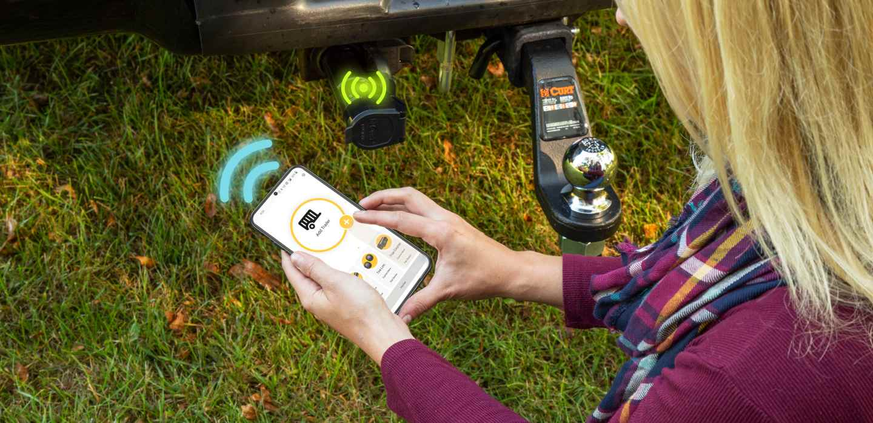

Brake Controllers

Slide 2
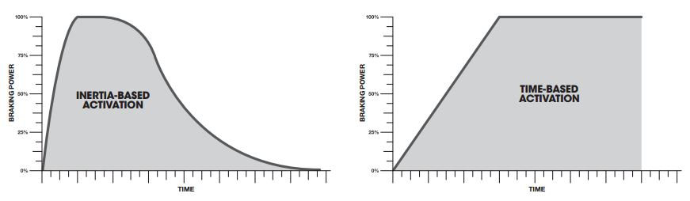
Brake Controllers
Two Types of Brake Controllers
Proportional activation
Using an integrated circuit called an accelerometer, proportional brake controllers (or inertia-based) sense the movement of the tow vehicle and adjust the power to the trailer brakes accordingly.
Time-delay activation
Time-delay brake controllers apply a steadily increasing amount of brake power, based on the gain setting.
Most states require a brake control on trailers over 3,000 lbs.

Slide 3
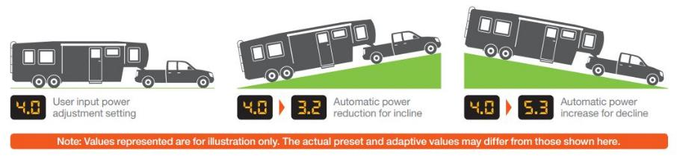
Brake Controllers
Two Types of Brake Controllers
Proportional activation automatically adjusts power output when going up or down a hill.

Slide 4
Brake Controllers
How to Select a Brake Controller
There are a few factors to consider when selecting a brake controller. The following questions will help determine which is the best fit.
What are they towing?
For heavy or fragile loads, proportional brake controllers perform smoother stops for less stress on the vehicle and trailer.
For lighter, non-sensitive loads, a time-delay controller may be sufficient.
How often do they tow?
If they tow frequently, a proportional controller is recommended.
If they tow only a few times a year, a proportional controller is still preferred to provide smooth stops. However, a time-delay controller can also be used.

Slide 5
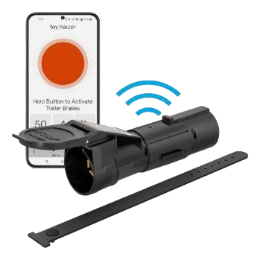
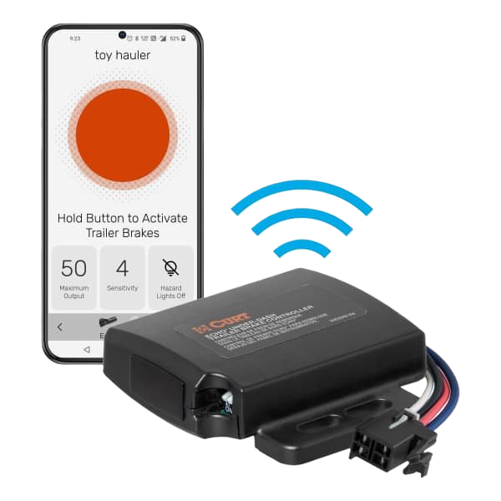
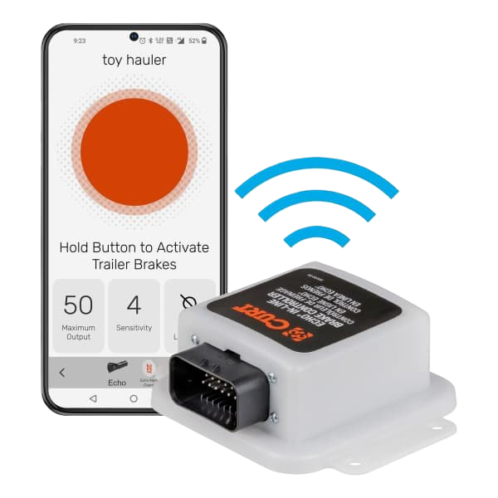
Brake Controllers
Echo® Series
Three Ways to Install
Echo Mobile #51180
Easy transfer between vehicles
Echo Under-Dash #51190
Interior-mounted below dash
Echo In-Line #51200
Exterior-mounted behind bumper

Slide 6

Brake Controls

Slide 7
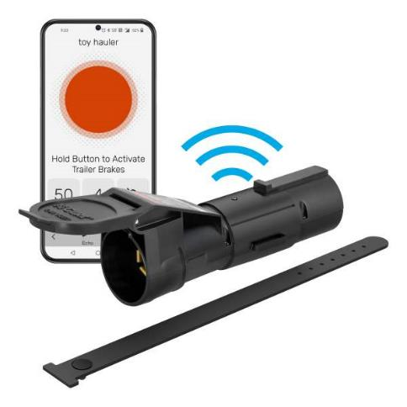
Brake Controllers
World’s First
Echo Mobile Brake Controller #51180
Wireless, portable design allows for easy transfer from one vehicle to another
Bluetooth connection to control all brake settings from your smartphone
Custom-designed app monitors brake activity and sends status updates
Allows incoming calls to be received while app is running
Triple-axis, motion-sensing accelerometer for highly responsive, smooth stops
Operates 2-6 trailer brakes at a time (1-3 axels)
Downloadable app available for Apple and Android OS

Slide 8
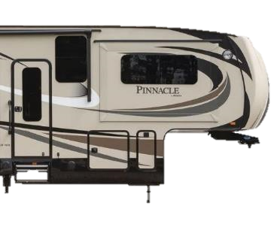
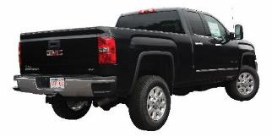
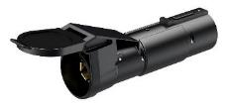
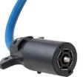
Brake Controllers
Echo Mobile Brake Controller #51180
Stores multiple vehicle-trailer profiles
Zero-tool, plug-and-play install between vehicle-trailer 7-way connectors
Potted circuit board is sealed off from the elements for lasting durability
Retention strap and locking tab help keep Echo firmly installed into 7-way
Multi-color LED indicator for easy setup and troubleshooting
Automatic calibration reduces setup requirements
Compatible with low-voltage systems, PWM systems, ABS and cruise control
Built-in reverse-polarity and short-circuit protection

Slide 9
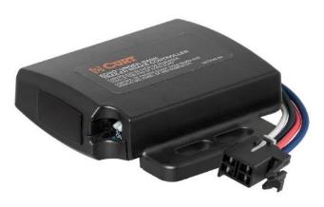
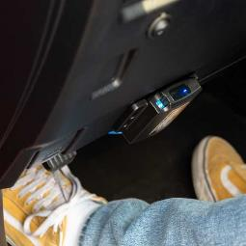
Brake Controllers
Echo® Under-Dash Brake Controller #51190
Bluetooth connection to control all brake settings from your smartphone
Module can be mounted out of sight
Plug-and-play install with vehicle-specific quick plug harness (sold separately)
Simple installation using included adhesive pad or zip ties
Triple-axis, motion-sensing accelerometer for highly responsive, smooth stops
Stores multiple trailer profiles
Operates 2-8 trailer brakes at a time (1-4 axles)
Downloadable app available for Apple iOS and Android OS

Slide 10
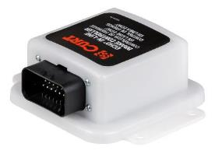
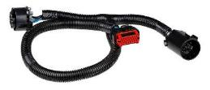
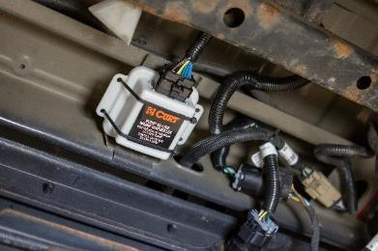
Brake Controllers
Echo® In-Line Brake Controller #51200
Bluetooth connection to control all brake settings from your smartphone
Plugs in behind existing 7-way socket with USCAR connectors
Waterproof enclosure seals and protects circuits against the elements
Simple installation using included adhesive pad or zip ties
Triple-axis, motion-sensing accelerometer for highly responsive, smooth stops
Stores multiple trailer profiles
Operates 2-8 trailer brakes at a time (1-4 axles)
Downloadable app available for Apple iOS and Android OS

Slide 11
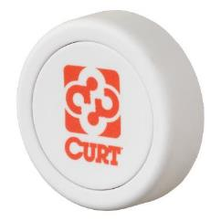
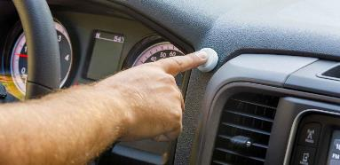
Brake Controllers
Echo® Manual Override Button #51189
Enables manual activation of trailer brakes, using Echo® and phone app
App must be running for button to operate
Wireless accessory supports hands-free driving
Compatible with Echo® and programmable for other Flic applications
Long-range Bluetooth maintains a strong connection
Includes double-sided adhesive pad for easy mounting on the dash
Small-footprint, 1-1/8" diameter
Includes CR2016 battery

Slide 12
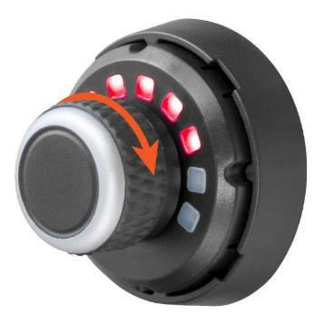
Brake Controllers
Spectrum™ Integrated Brake Controller #51170
Controls all brake settings with a simple push-button rotary knob
Clean, dash-mounted, OEM-style user interface with 10 tri-color LEDs
Main module can be mounted anywhere, at any orientation, out of sight
Highly responsive, smooth stops with triple-axis, motion-sensing accelerometer
Easily accessible manual override with the press of a button
Features two installation options: drill mount or surface adhesive mount

Slide 13
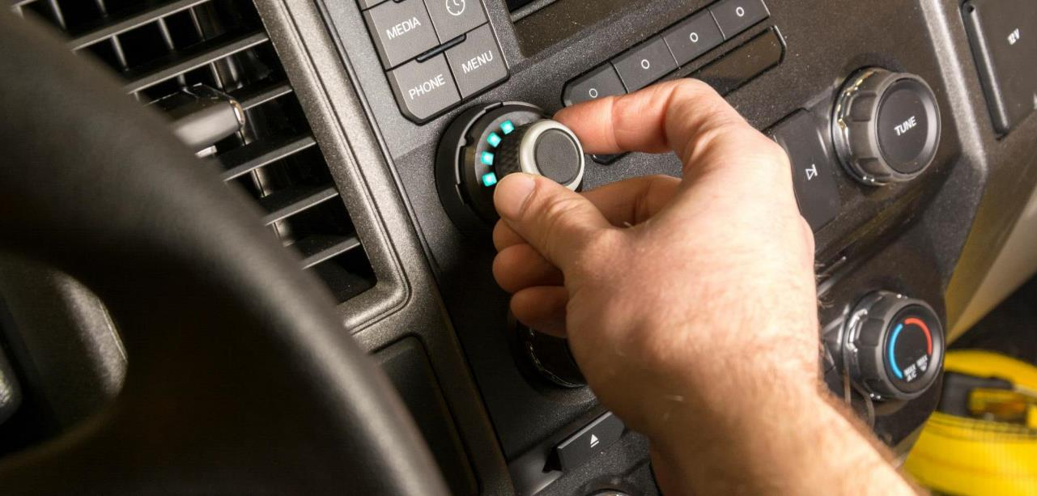
Brake Controllers

Slide 14
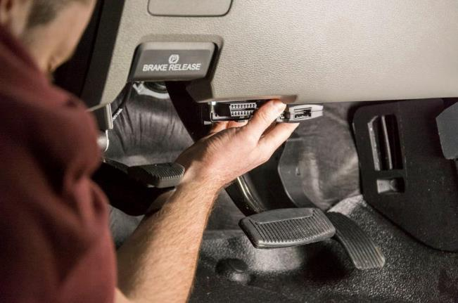
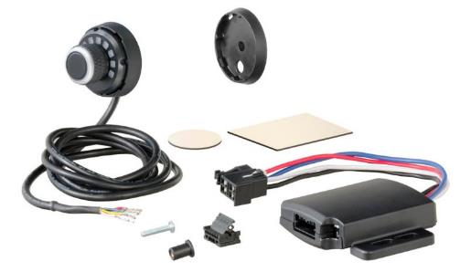
Brake Controllers
Spectrum™ Integrated Brake Controller #51170
Main module can be mounted anywhere, behind or below the dash, out of sight

Slide 15
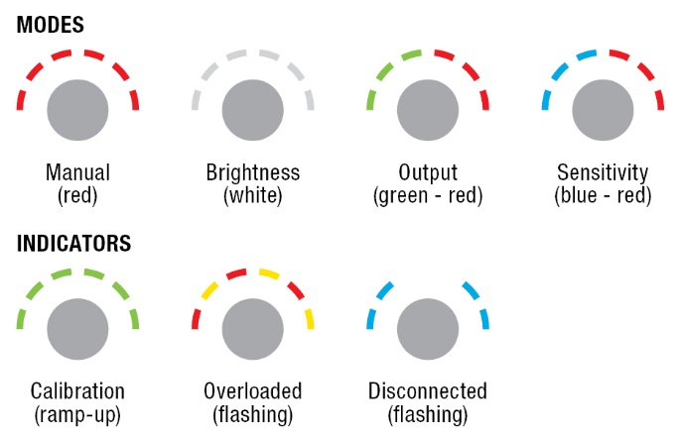
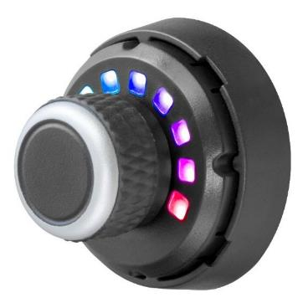
Brake Controllers
Spectrum™ Integrated Brake Controller #51170

Slide 16
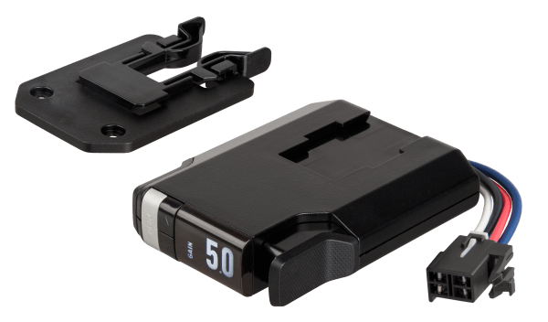
Brake Controllers
TriFlex™ NEXT Brake Controller #51146
Slim, low-profile design
Unique bracket system for improved clearance
Triple-axis, motion-sensing accelerometer for highly responsive, smooth stops
Clean, easy-to-read interface with full-text readout and troubleshooting
Plug-and-play install with vehicle-specific quick plug harness (sold separately)
Operates 2 - 8 brakes (1 -4 axles)

Slide 17
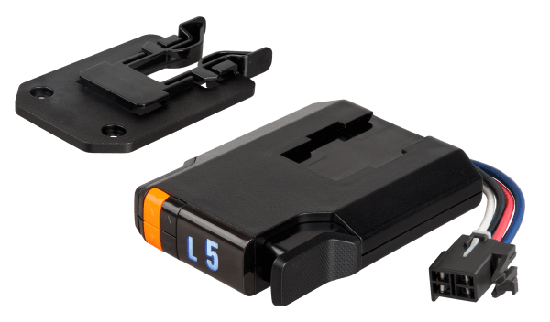

Brake Controllers
Time-Delay Brake Controllers
Discovery™ NEXT #51126
Slim, low-profile design
Unique bracket system for improved clearance
Increases brake power based on gain setting and sensitivity adjustment
Digital LED display
Operates 2 - 8 brakes (1 – 4 axles)
Venturer™ NEXT #51116
Slim, low-profile design
Unique bracket system for improved clearance
Increases brake power based on gain setting and sensitivity adjustment
Digital LED display
Operates 2 - 6 brakes (1 – 3 axles)

Slide 18
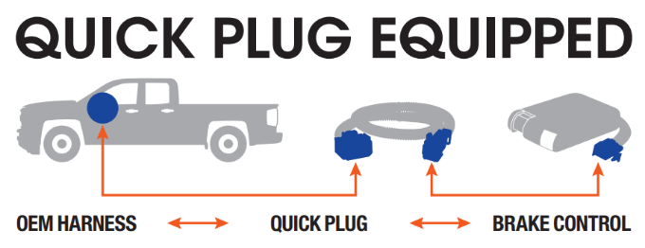
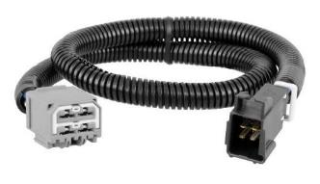
Brake Controller Harnesses
Brake Controller Installation
Equipped with quick plugs for fast, easy, vehicle-specific installation
Include mounting hardware
Optional spare bracket allows for convenient use of the same brake control in multiple vehicles

Slide 19
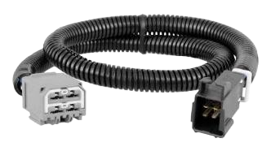
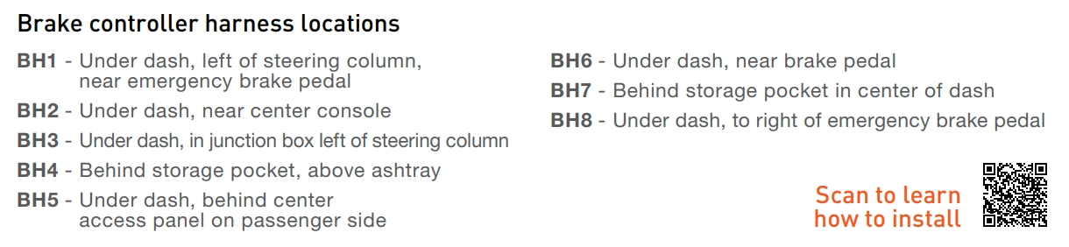
Brake Controller Harnesses
Brake Controller Harnesses
Quick plug harness installs in less than 10 minutes
Wire colors match standard brake controller harnesses
Includes 24" of 12-gauge wire for flexible installation
Slit-loom sleeve keeps wires contained and protected

Slide 20
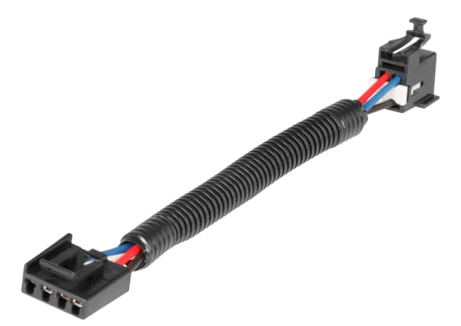
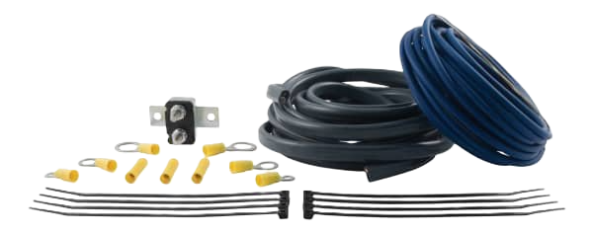
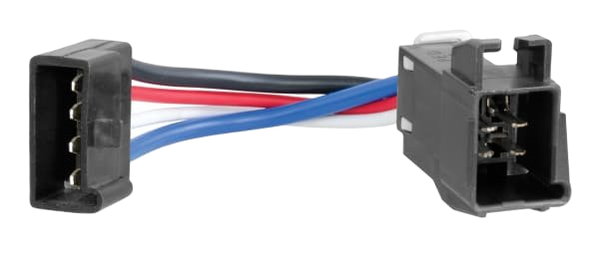
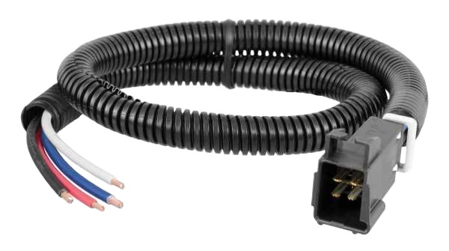
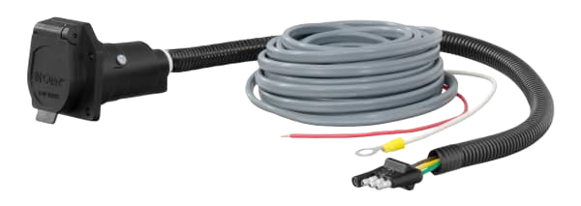
Brake Controller Accessories
Trailer Brake Controller Adapter Harness
Competitor-to-Curt Brake Controller Harness Adapter
Trailer Brake Controller Wiring Kit
4-Way Flat Electrical Adapter with Brake Controller Wiring
Universal Trailer Brake Controller Harness with Pigtails

Slide 21
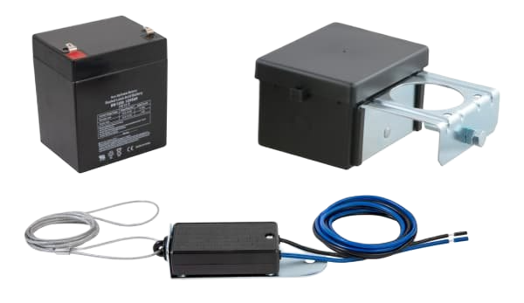
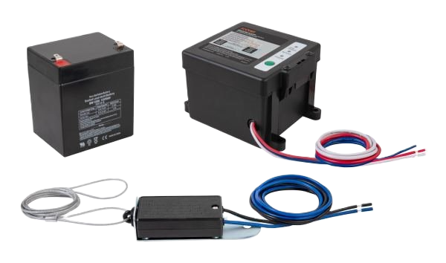
Breakaway Kits
Breakaway Kits
Activates electric trailer brakes in the event of a breakaway
Compatible with trailers with up to three axles
Cable lanyard connects tow vehicle to trailer breakaway battery
Meets DOT requirements for holding / breakaway situations
Required in most states

Slide 22

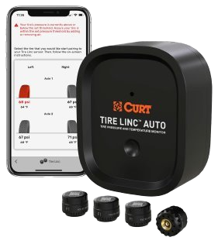
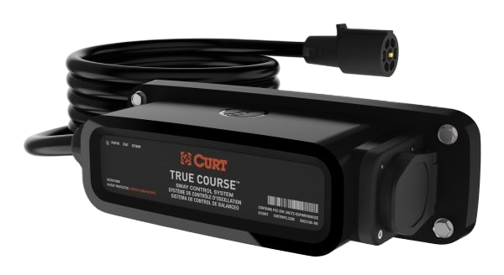
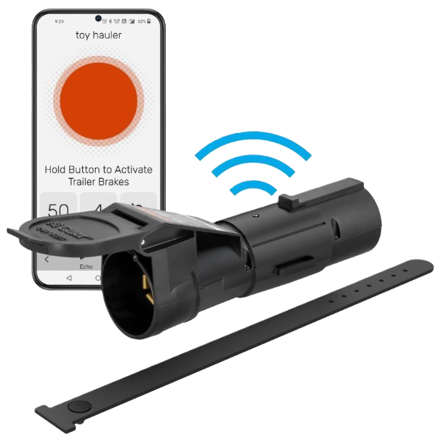
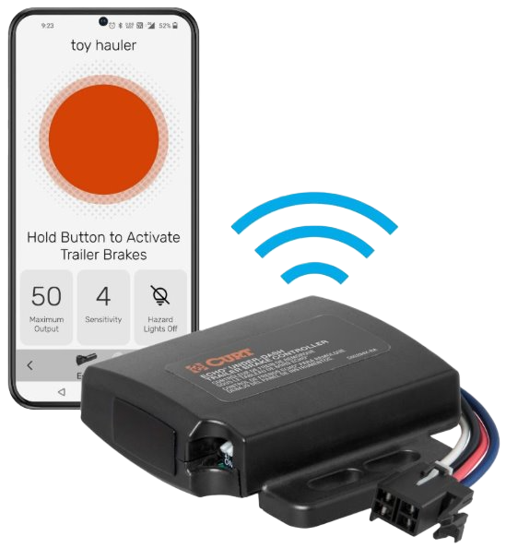
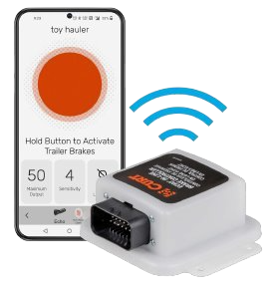
Safety Suite with Onecontrol Auto
Powered by a Bluetooth®-enabled system and the OneControl® app, the CURT safety suite provides ultimate protection and peace of mind for the road ahead.
True Course Emergency Sway Control Emergency braking system combats sway caused by side winds, slippery roads and sudden movement.
TireLinc Auto TPMS This system allows you to monitor tire pressure and temperature as you tow in real-time, helping you to stay aware and safe.
Echo Series Brake Controllers The Echo brake controller family connects through Bluetooth® and is compatible with an array of vehicles and towing applications.

Slide 23
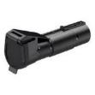



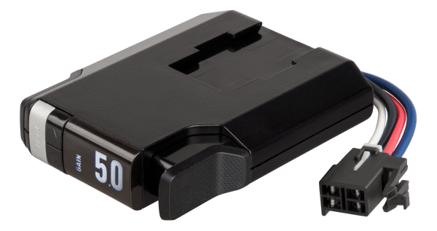
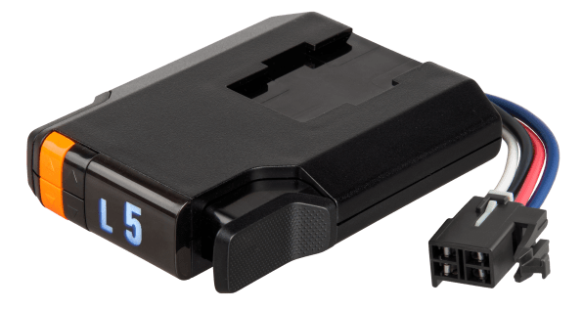
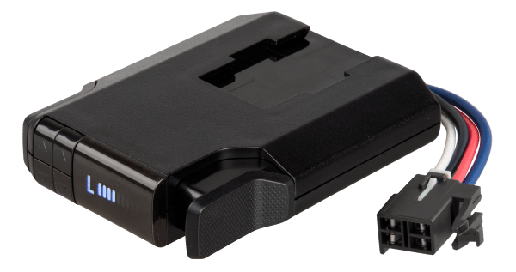
BRAKE CONTROLLERS
Brake Controller Quick Comparison
Echo mobile
Echo under-dash
Echo in-line
Spectrum
TriFlex NEXT
Discovery NEXT
Venturer NEXT
Name | Part# | Axles / Brakes | Activation | Display | Mount Angle | Sleep Mode | Warranty
Echo mobile | 51180 | 1-2 / 2-4 | Proportional | Phone app | Any | N/A | Limited lifetime
Echo under-dash | 51190 | 1-4 / 2-8 | Proportional | Phone app | Any | Yes | Limited lifetime
Echo in-line | 51200 | 1-4 / 2-8 | Proportional | Phone app | Any | Yes | Limited lifetime
Spectrum | 51170 | 1-4 / 2-8 | Proportional | Tri-color LED | Any | N/A | Limited lifetime
TriFlex NEXT | 51146 | 1-4 / 2-8 | Proportional | LED Digital | Any | Yes | Limited lifetime
Discovery NEXT | 51126 | 1-4 / 2-8 | Time-delay | LED Digital | Any | Yes | Limited lifetime
Venturer NEXT | 51116 | 1-3 / 2-6 | Time-delay | LED Digital | Any | Yes | Limited lifetime

Slide 24
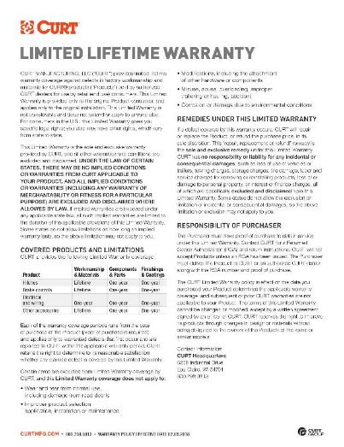
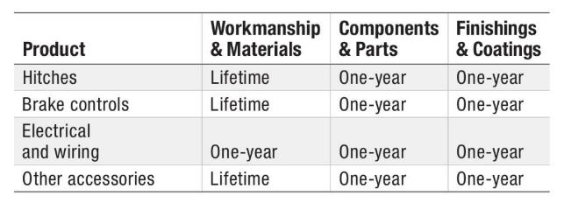
Brake Controllers
Limited Lifetime Warranty
CURT provides limited lifetime warranty coverage against defects in factory workmanship and materials for CURT products sold by authorized CURT dealers for use by retail (end use) consumers.
https://storage.googleapis.com/curt-group-warranties/CURT_Warranty.pdf

