Slide 1
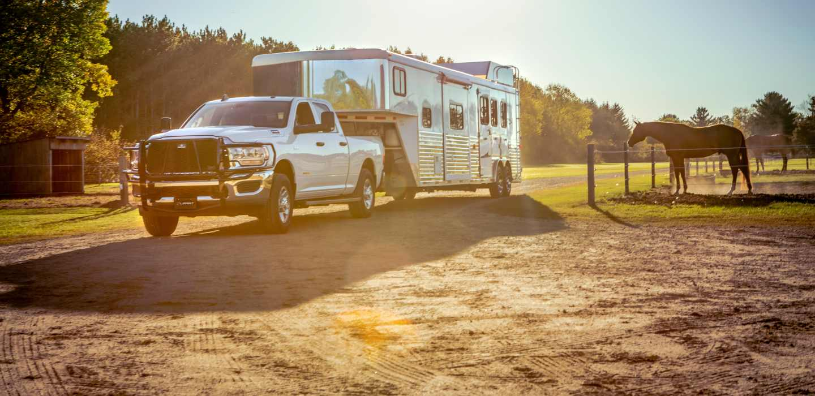

Gooseneck Hitches

Slide 2

Gooseneck Hitches

Slide 3
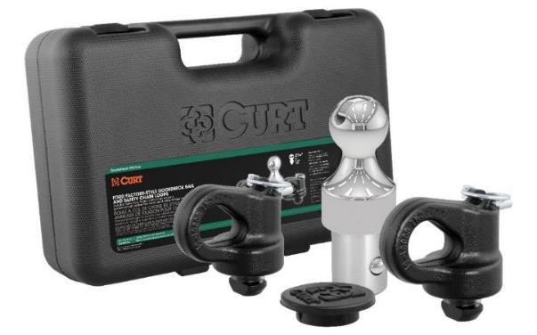
Gooseneck Hitches
OEM Puck System Gooseneck Kits
Available for Chevrolet, Ford, GMC, Nissan and Ram
Kits include ball, anchors, rubber hole cover and durable storage case
Heavy-duty, forged anchors with large chain hook openings
Simple, drop-in installation eliminates the need for tools
Tested for safety to meet U.S. VESC V-19 specifications
2-5/16” and 3” balls available
Limited lifetime warranty

Slide 4
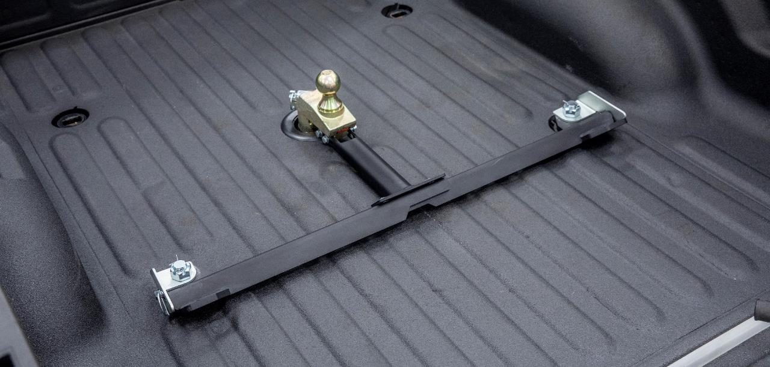
Gooseneck Hitches

Slide 5
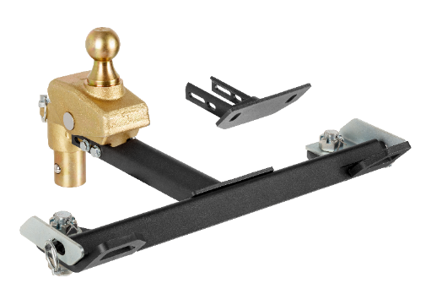
Gooseneck Hitches
Universal OEM Puck System Offset Gooseneck Ball
Provides extra 4” of rearward offset for improved turning and clearance
Rated for up to 30,000 lbs. gross trailer weight and 7,500 lbs. vertical load
Universal design fits Chevrolet, Ford, GMC, Nissan Titan XD and Ram puck systems
Quarter-turn anchoring system provides quick installation and removal
Anti-rotation arms provide stability and promote a smooth, steady tow
Adjustable anchors eliminate chucking between frame and pucks
All-in-one solution with integrated safety chains holders
60663 - Fixed ball
60668 - RockerBall

Slide 6

Gooseneck Hitches

Slide 7
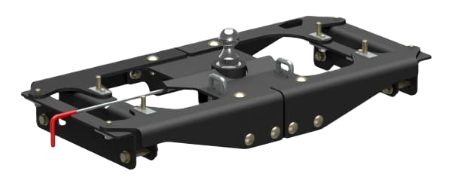
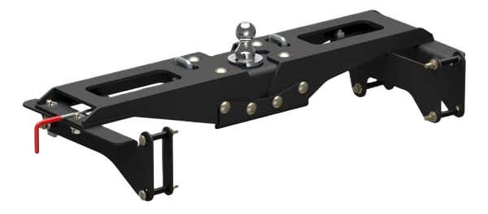
Gooseneck Hitches
PowerHaul™ Double-Lock Gooseneck Hitches
Applications for Ford, Ram, and GMC
Up to 38,000 lbs. GTW / 9,500 lbs. vertical load with included 2-5/16" ball
Up to 40,000 lbs. GTW / 10,000 lbs. vertical load when used with 3" ball (#60694)
Weight ratings are limited to vehicle manufacturer's stated capacities
Center locator eliminates the need to measure where the ball hole should be
Easy, one-person installation requires no lowering of exhaust or spare tire
Installation requires no bed removal, welding, or drilling except for truck bed holes
Double locking pins for superior trailer and trailer ball security

Slide 8


Slide 9
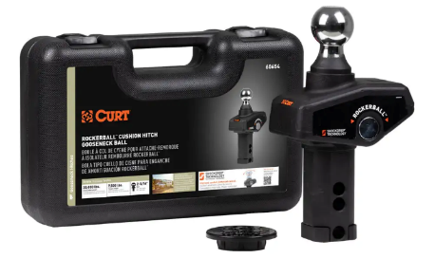
Gooseneck Hitches
RockerBall™ Cushion Hitch Gooseneck Ball #60654
Cushioned isolator improves ride comfort for animals and passengers
Offset pin dampens vertical chucking and fore-aft motion during starts and stops
Simple, drop-in installation to easily replace traditional gooseneck ball
Virtually maintenance-free with no airbag or bearings to service
2-5/16" diameter ball couples to most gooseneck trailers
Rated for up to 30,000 lbs. GTW and 7,500 lbs. vertical load limit
Tested for safety to meet SAE J2638 specifications

Slide 10
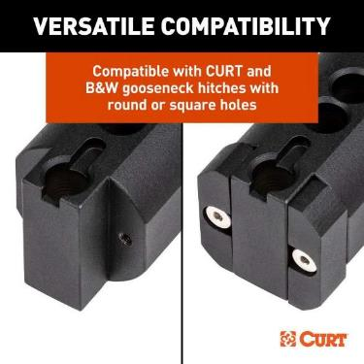
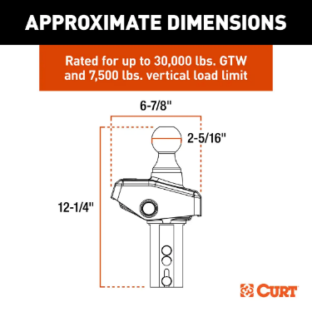
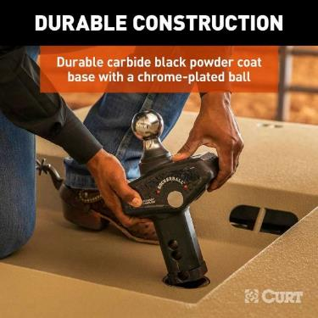
Gooseneck Hitches
RockerBall™ Cushion Hitch Gooseneck Ball #60654

Slide 11
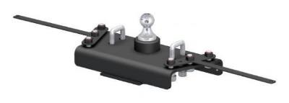
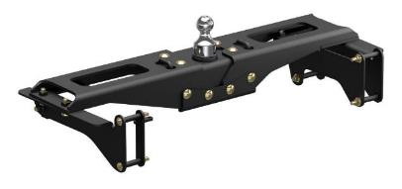
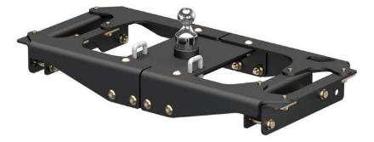
Gooseneck Hitches
PowerHaul™ OEM-Style Gooseneck Hitches
Available for Chevrolet, Ford, GMC and Ram
Requires no additional hardware or installation brackets
No drilling except the truck bed holes
Installation also requires no welding, bed flange trimming or bed removal
Easy, one-person installation on select models (all others install in 45 minutes or less)
Patented 2-5/16” ball quickly installs with 1/4-turn latch-locking system
Heavy-duty 5/8” safety chain anchors offer a secure hold for large trailers
Protected by a highly durable, rust-resistant, liquid A-coat
Tested for safety in accordance with SAE J2638
Ram
GM
Ford

Slide 12
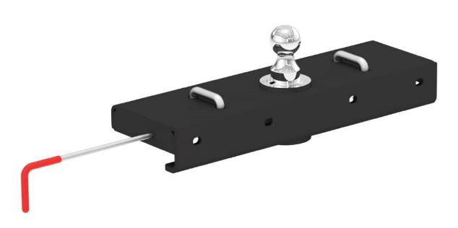
Gooseneck Hitches
Double Lock EZr™ Gooseneck Hitch
The CURT Double Lock EZr™ gooseneck hitch is designed to be faster and easier to install than any other gooseneck hitch on the market.
One-person installation
No measuring required
Flip-and-store ball
Optimum strength
Tested for safety in accordance with SAE J2638
Limited lifetime warranty

Slide 13
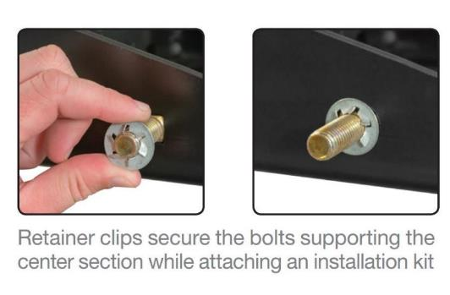
Gooseneck Hitches
What makes the EZr™ different?
One-Person Installation
Retainer clips secure the bolts supporting the center section while attaching the installation kit
Uses carriage bolts when possible for one-wrench tightening
No need to lower exhaust on Ford, GM and most Dodge / Ram models
No need to relocate cable hanger and ground wire on Dodge / Ram models
No welding or truck bed removal required

Slide 14
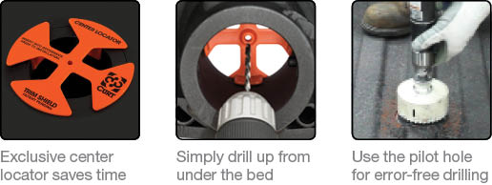
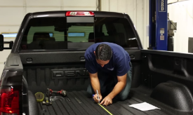
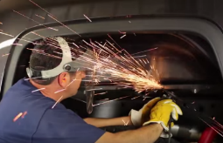
Gooseneck Hitches
What makes the EZr™ different?
No Measuring Required
Exclusive Center Locator eliminates the need to measure where the ball hole should be
Safety chain loop holes are drilled from the underside of the truck bed
No sheet metal cutting required along the inside of the fender to insert rails
Center Locator covered by patent# D685,299 S
Screenshots from competitor installation video

Slide 15
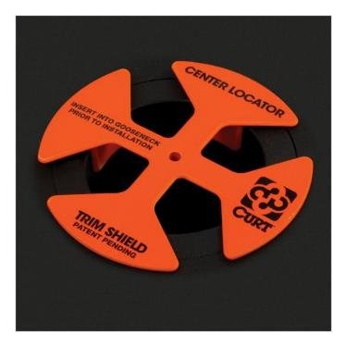
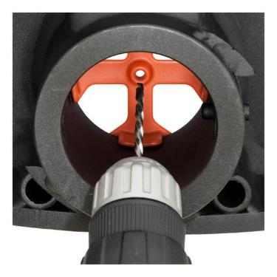
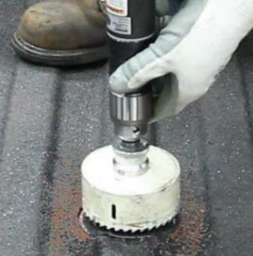
Gooseneck Hitches
How does the Center Locator work?
Place it into the ball hole and mount the center section
Drill a pilot hole up from under the truck bed
Use the pilot hole for error-free drilling Orange shavings indicate when to stop drilling

Slide 16
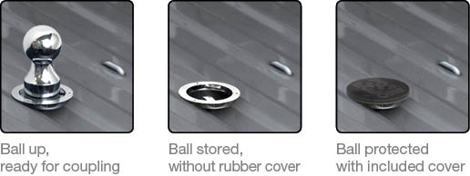
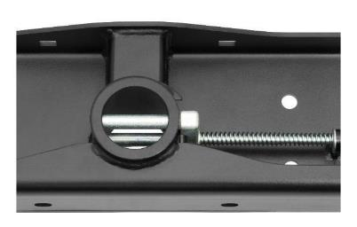
Gooseneck Hitches
What makes the EZr™ different?
Flip-and-Store Ball
Keeps truck bed free of obstructions and helps avoid trailer ball loss
Double-lock pins for superior strength
Rubber trim and hole cover provide protection and prevent corrosion
Removable chrome-plated 2-5/16” trailer ball fits most gooseneck trailers
Tested for safety in accordance with SAE J2638

Slide 17


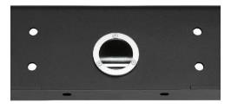


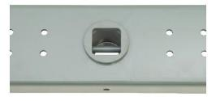
Gooseneck Hitches
What makes the EZr™ different?
Optimum Strength
Up to 30,000 lbs. GTW 7,500 lbs. vertical load
Strong 5/8" safety chain loops and 3/8" operating handle
Protected by a highly durable carbide powder coat finish
Meets proposed SAE J2638 testing protocols
Limited lifetime warranty
Double Lock EZr™ components
Competitor components

Slide 18
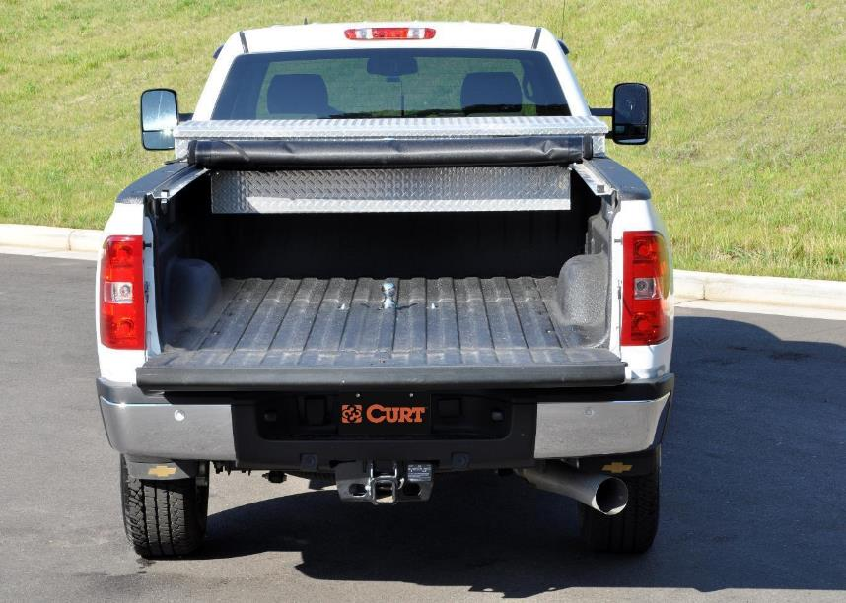
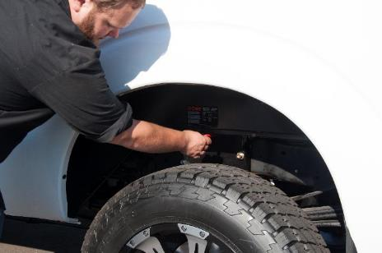
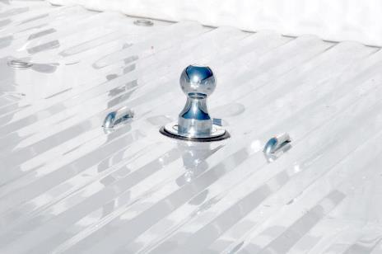
Gooseneck Hitches

Slide 19
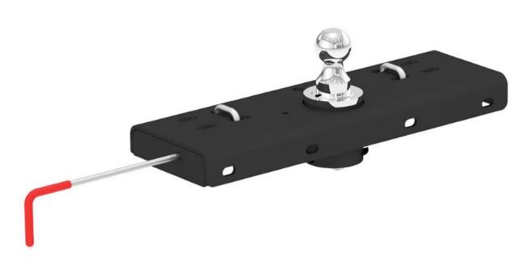
Gooseneck Hitches
Original Double Lock™ Gooseneck Hitch
Double locking pins for superior trailer and trailer ball security
Flip-and store ball keeps truck bed free of obstructions
Installation requires no welding or truck bed removal
Heavy-duty handle can be positioned on either side of the vehicle
Rubber hole cover helps prevent corrosion in trailer ball hole
Protected by a durable carbide powder coat finish
Tested for safety in accordance with SAE J2638

Slide 20
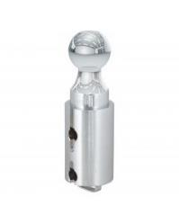
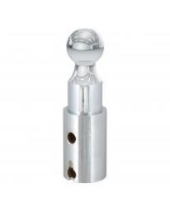
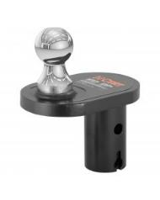
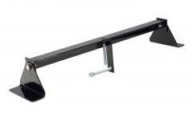

Gooseneck Hitches
Original Double Lock™ Accessories
Replacement ball
Raised ball (1” rise)
Offset ball (4” offset)
Rubber hole cover
Installation tool

Slide 21
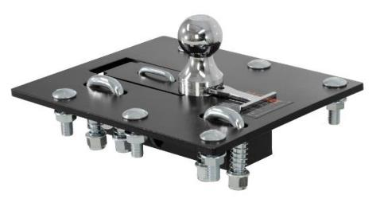
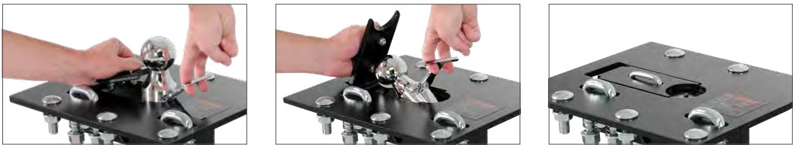
Gooseneck Hitches
Over-Bed Folding Ball Gooseneck Hitch
Folding ball design keeps truck bed free of obstructions
Permanently attached gooseneck ball cannot be loosened or stolen
Chrome-plated 2-5/16" trailer ball fits all standard gooseneck trailers
Protected by a highly durable carbide powder coat finish
#61052
Open storage cover
Lift T-handle & drop ball
Close cover to store ball

Slide 22
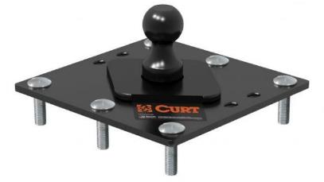
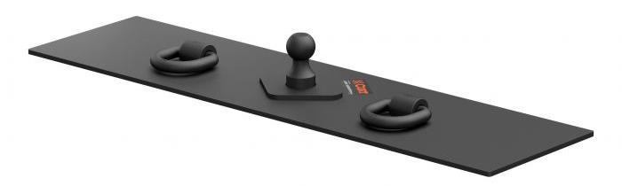
Gooseneck Hitches
Fixed Ball Gooseneck Hitch
Reinforcement required to reach max gross trailer weight rating
Protected by a highly durable carbide powder coat finish
30,000 lbs. GTW
7,500 lbs. vertical load limit
#61100
#65500

Slide 23
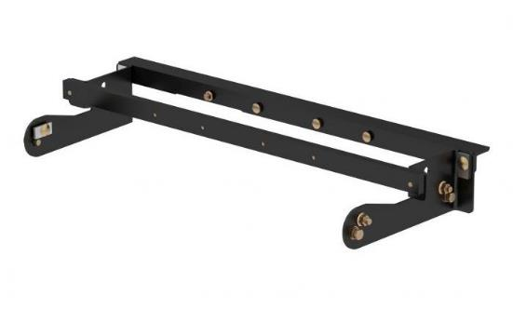
Gooseneck Hitches
Custom Brackets
Weight ratings are limited to vehicle manufacturer's stated capacities
Vehicle-specific design optimizes strength and installation time
Protected by a rust-resistant liquid A-coat
Includes grade-8 mounting hardware

Slide 24
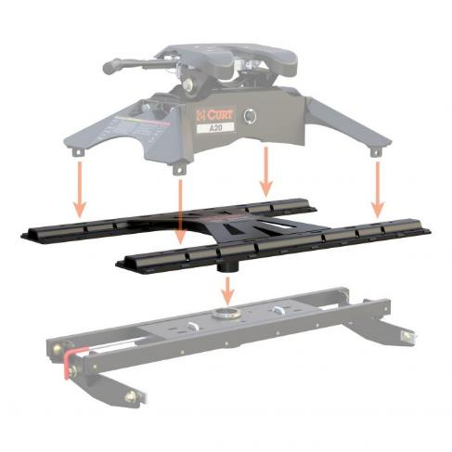
Gooseneck Hitches
X5™ Gooseneck-to-5th-Wheel Adapter Plates
Converts a gooseneck hitch into a set of standard 5th wheel base rails
Simple, secure design allows for fast installation and removal as needed
For use with CURT and competitive 5th wheels up to 20,000 lbs.
Accepts any standard CURT 5th wheel legs or slider (excludes OEM puck system)
Carbide powder coat finish and co-cured in a rust-resistant liquid A-coat
Available to fit Double Lock™, EZr™ and B&W Turnoverball®
Not compatible with OEM-style gooseneck hitches or turret-style pin boxes, such as Sidewinder™ or Turning Point™ (Trademark of First Brands Group

Slide 25
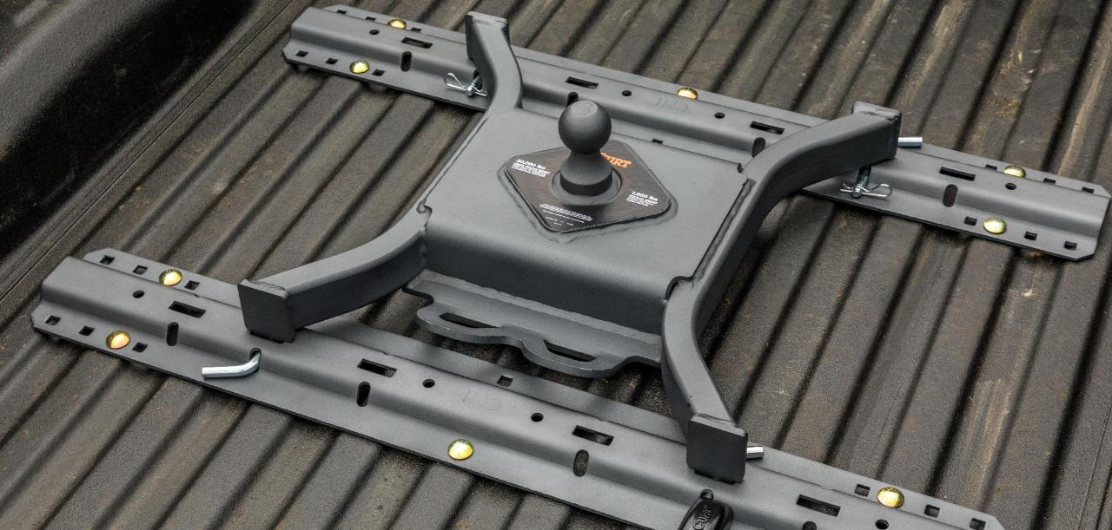
Gooseneck Hitches

Slide 26
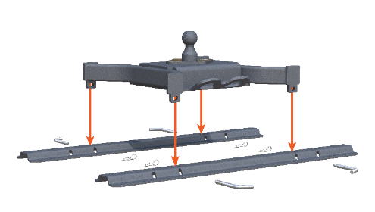
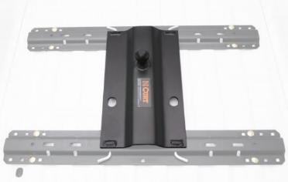
Gooseneck Hitches
5th Wheel Rail Gooseneck Hitches
Allows pickup trucks equipped with 5th wheel rails to tow gooseneck trailers
Mounts to all industry- standard 5th wheel rails
Four-pin installation and removal for easy truck bed access
Features a welded 2-5/16" trailer ball
#16055 can be positioned over the axle or flipped to provide a 3" rearward offset
Includes safety chain hookups, pins & clips
Protected by a durable carbide powder coat finish

Slide 27
Gooseneck Hitches
2-5/16" Adjustable Gooseneck Coupler, 30K
2-5/16" ball socket rated for 30,000 lbs. GTWR
Adjustable length with 8” of adjustment
Load-bearing pin features extra-wide, rubber coated handle for easy height adjustment
Self-centering locking plate for easier hookup
Easy-access lock handle for secure connection
Quality steel construction for dependable towing strength
Tested for safety to meet SAE J2638 specifications
Raw finish allows for immediate welding
Added material around pin holes to prevent hole elongation and reduce wear
Includes 4” inner tube, 4-1/2” outer tube

Slide 28
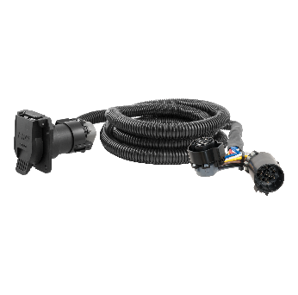
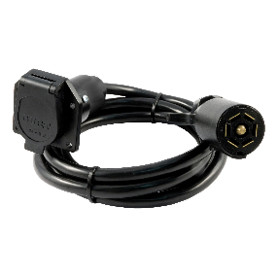
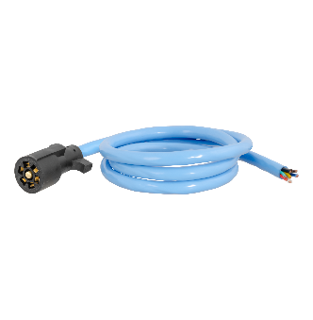
Gooseneck Hitches
Custom Wiring Extension Harnesses
Routes a 7-way RV blade socket into truck bed while retaining use of rear socket
Simple plug-and-play design
Allows for easy connection of gooseneck wiring
7-Way RV Blade Extension Harness
Routes existing 7-way RV blade socket into full-size pickup truck bed (7' length)
Universal size fits any 7-way RV blade socket
Replacement RV Blade Harness
Replaces the trailer-end plug of any 7-way harness
Soft thermoplastic elastomer casing remains flexible in cold weather
#56070 (7') / 56000 (10')
#56080
#56612

Slide 29
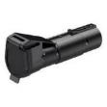



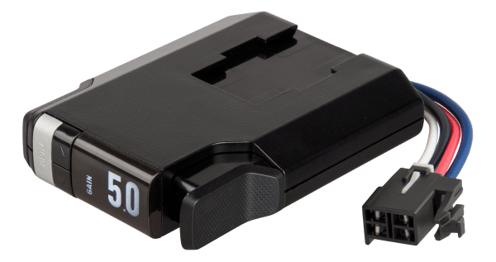
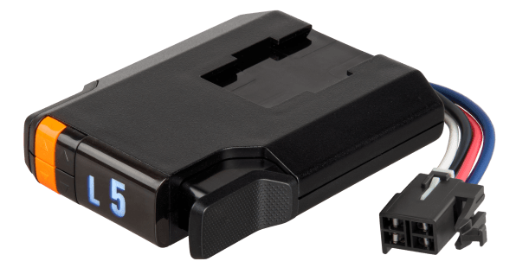
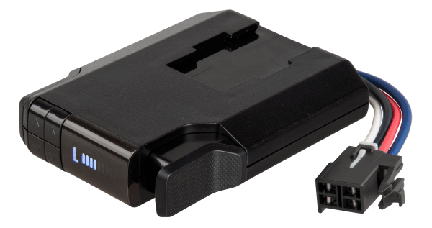
Gooseneck Hitches
Brake Controller Quick Comparison
Echo mobile
Echo under-dash
Echo in-line
Spectrum
TriFlex NEXT
Discovery NEXT
Venturer NEXT
Name | Part# | Axles / Brakes | Activation | Display | Mount Angle | Sleep Mode | Warranty
Echo mobile | 51180 | 1-2 / 2-4 | Proportional | Phone app | Any | N/A | Limited lifetime
Echo under-dash | 51190 | 1-4 / 2-8 | Proportional | Phone app | Any | Yes | Limited lifetime
Echo in-line | 51200 | 1-4 / 2-8 | Proportional | Phone app | Any | Yes | Limited lifetime
Spectrum | 51170 | 1-4 / 2-8 | Proportional | Tri-color LED | Any | N/A | Limited lifetime
TriFlex NEXT | 51146 | 1-4 / 2-8 | Proportional | LED Digital | Any | Yes | Limited lifetime
Discovery NEXT | 51126 | 1-4 / 2-8 | Time-delay | LED Digital | Any | Yes | Limited lifetime
Venturer NEXT | 51116 | 1-3 / 2-6 | Time-delay | LED Digital | Any | Yes | Limited lifetime

Slide 30
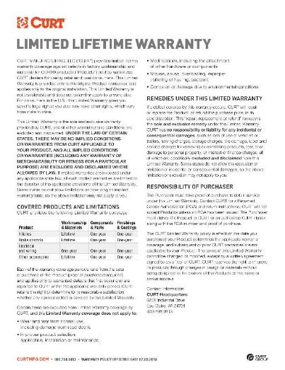

Gooseneck Hitches
Limited Lifetime Warranty
CURT provides limited lifetime warranty coverage against defects in factory workmanship and materials for CURT products sold by authorized CURT dealers for use by retail (end use) consumers.
https://storage.googleapis.com/curt-group-warranties/CURT_Warranty.pdf

