Slide 1
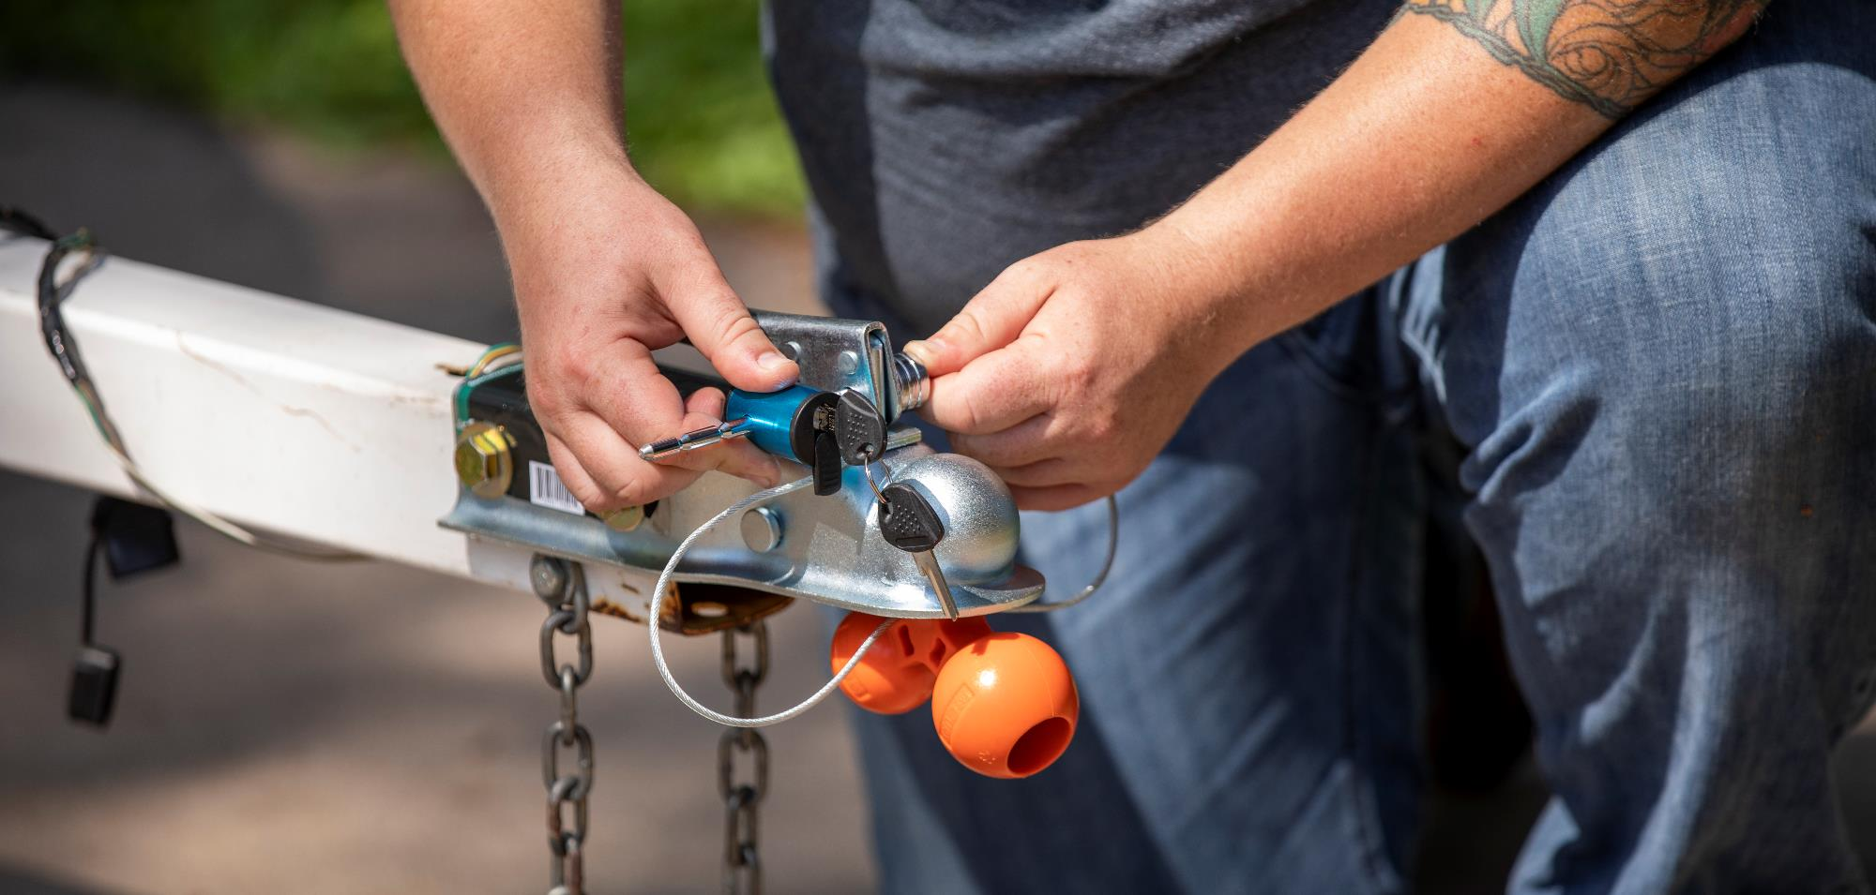

Towing Security

Slide 2
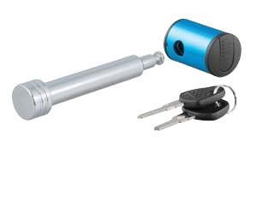
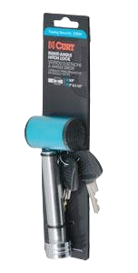
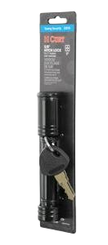
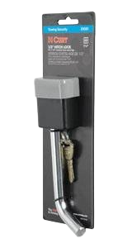
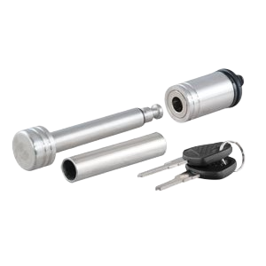
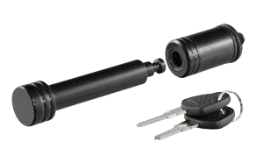
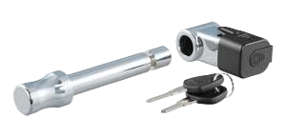
Towing Security
Hitch Locks
Easy-to-operate, 1/4-turn lock activation
Available to fit 1-1/4”, 2”, 2-1/2” and 3” receivers
Watertight dust cap prevents internal corrosion
Two keys included for added convenience
Space-saving, full-color retail packaging
Right-angle style provides ergonomic access to keyhole

Slide 3
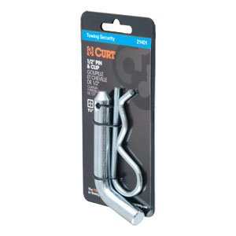
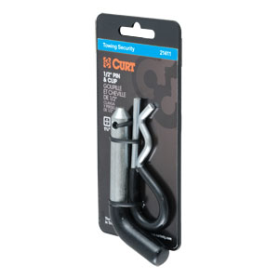
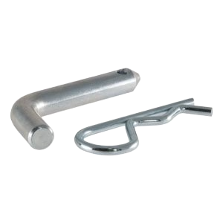
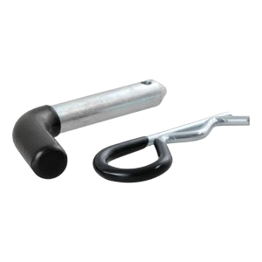
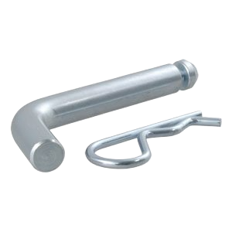
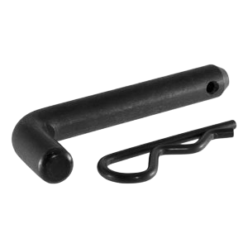
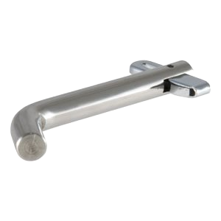
Towing Security
Hitch Pins
Secures ball mounts and other receiver tube inserts
Bent handle for an easier grip
Available to fit 1-1/4”, 2”, 2-1/2” and 3” receivers
Swivel pins available, no clip needed

Slide 4
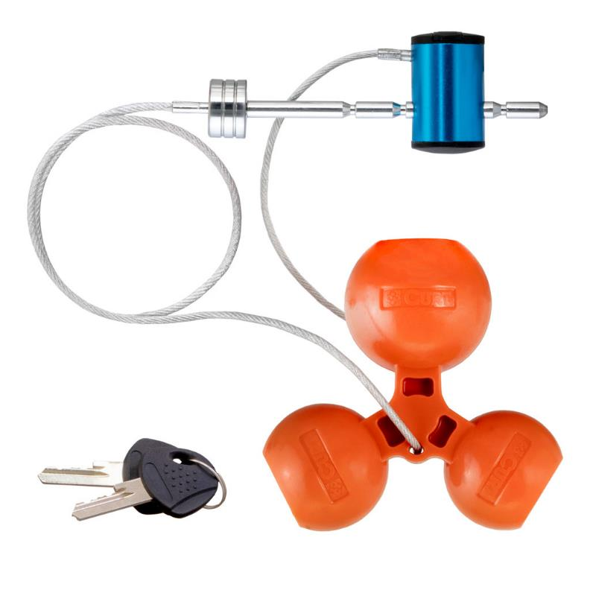
Towing Security
Universal Tri-Ball Coupler Lock #23082
Highly theft and tamper-resistant design with built-in safety measures
Unique tri-ball lock inserts into coupler and secures latch with lasso lock
Coupler lock can also be used while towing to secure the trailer
Simple lasso design keeps all components together, avoiding lost pieces
Glass-filled orange polymer for high strength and increased visibility
Universal design fits all standard coupler sizes: 1-7/8", 2" and 2-5/16"
1/4" pin allows adjustment to fit 1" to 3" coupler span
Easy-to-operate, 1/4-turn lock activation

Slide 5
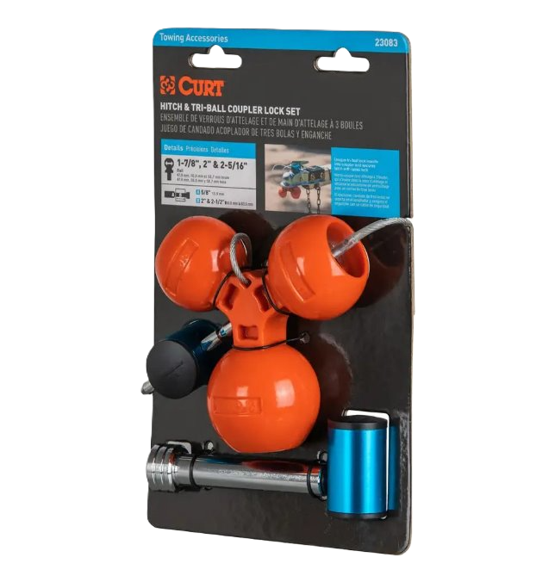
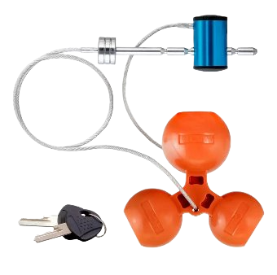
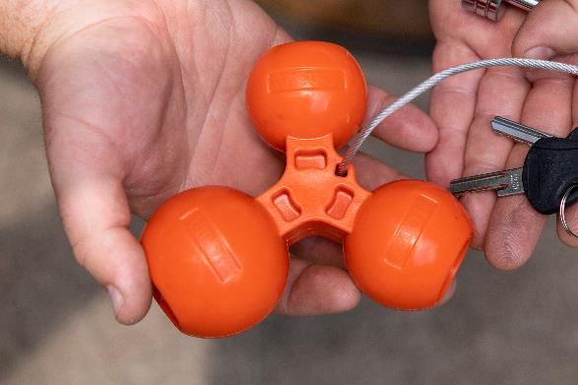
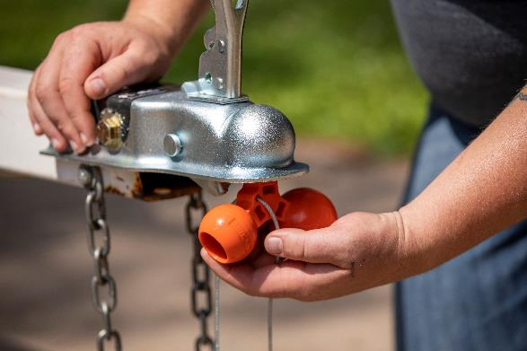
Towing Security
Universal Tri-Ball Coupler Lock #23082
Built-in safety points allow the ball to break off when forcefully tampered with, leaving the ball in the coupler and blocking hookup
Lasso design keeps all components together
Glass-filled orange polymer construction
Universal design fits 1-7/8" and 2-5/16" couplers
Hitch & Tri-Ball Coupler Lock Set, #23083

Slide 6
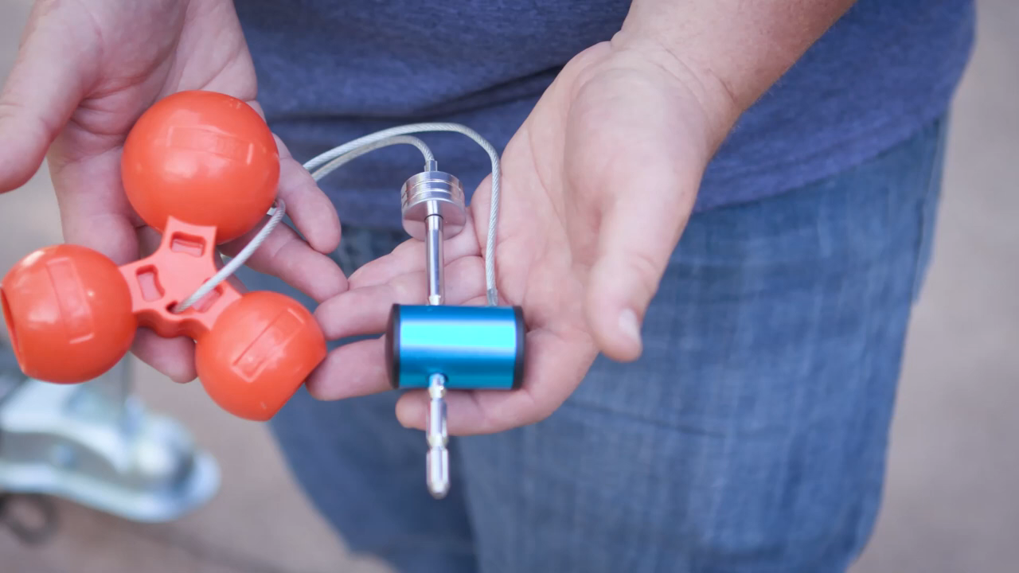

Slide 7
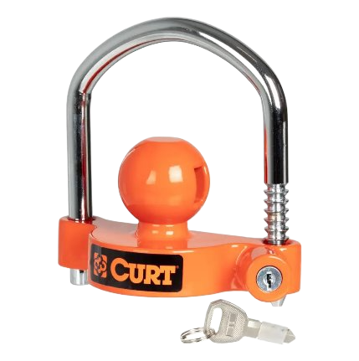
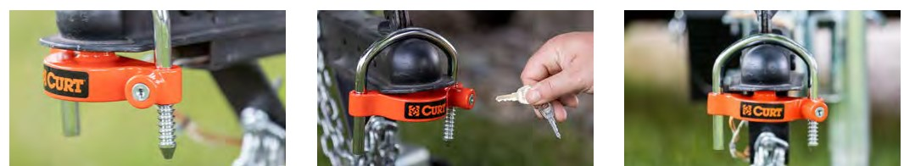
Towing Security
Universal Trailer Coupler Lock, #23090
Prevents trailer ball from being inserted into the coupler
Hardened steel and chrome-plated U-lock
Orange corrosion-resistant powder coat finish
Works on 1-7/8" or 2-5/16" coupler
U-lock inside width of 3-7/8" fits most trailers
Includes two keys for added convenience
Deters theft by securing the coupler with a durable ratcheting lock
Insert U-lock into the lock base and push downwards to secure the lock
Works with virtually all couplers so you can use it on multiple trailers

Slide 8
Towing Security
Universal Trailer Coupler Lock, Keyed Alike #23090-KA
Prevents trailer ball from being inserted into the coupler
Hardened steel and chrome-plated U-lock
Orange corrosion-resistant powder coat finish
Works on 1-7/8" or 2-5/16" coupler
U-lock inside width of 3-7/8" fits most trailers
Includes two keyed-alike keys for added convenience
Deters theft by securing the coupler with a durable ratcheting lock
Insert U-lock into the lock base and push downwards to secure the lock
Works with virtually all couplers so you can use it on multiple trailers

Slide 9
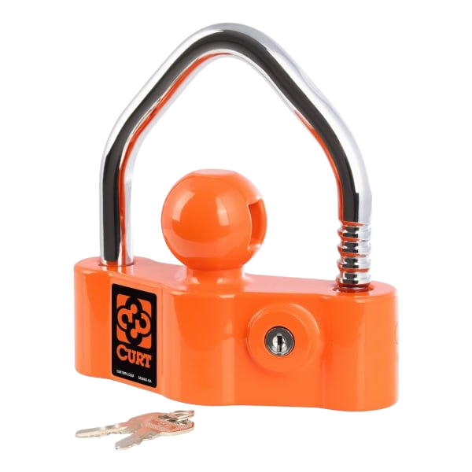
Towing Security
Universal Heavy-Duty Trailer Coupler Lock, #23091
Heavy-duty steel lock bar and aluminum body provide enhanced theft protection
Prevents trailer ball from being inserted into the coupler
Heavy-duty locking cylinder for added security
Orange corrosion-resistant powder coat finish
Bright color provides high-visibility theft deterrence
Universal design works on 1-7/8", 2”, or 2-5/16" couplers
U-lock inside width of 3-7/8" fits most trailers
Ratchet locking system with 10 locking positions for a precise fit
Easy, quick installation and removal
Includes two keys for added convenience

Slide 10
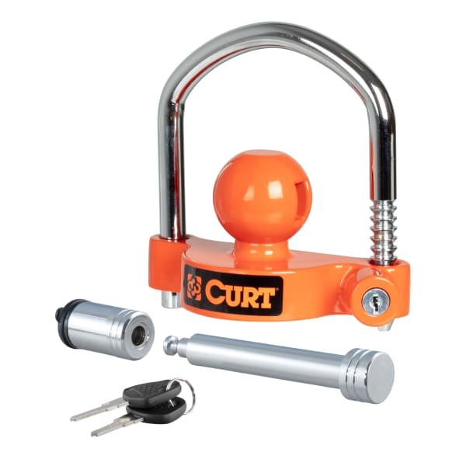
Towing Security
Hitch & Coupler Lock Set, #23092
Universal coupler lock works on 1-7/8", 2" or 2-5/16" couplers
U-lock inside width of 3-7/8" fits most trailers
Prevents trailer ball from being inserted into the coupler
Built with hardened steel and chrome-plated U-lock
Orange corrosion-resistant powder coat finish
Bright color provides high-visibility theft deterrence
Ratchet locking system offers easy operation
5/8" hitch lock pin fits 2" or 2-1/2" receiver tubes
Easy, quick installation and removal
Locks keyed alike for convenient one-key operation
Includes two keys for added convenience

Slide 11
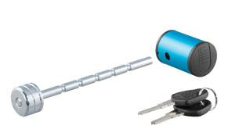
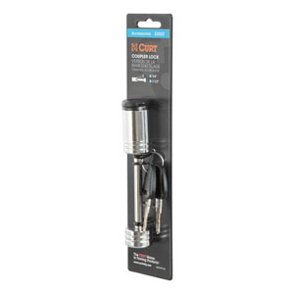
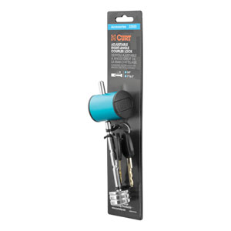
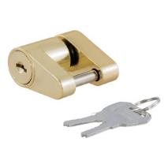
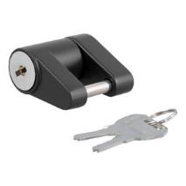
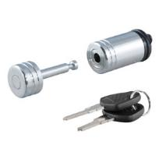
Towing Security
Additional Trailer Coupler Locks
Easy-to-operate, 1/4-turn lock activation
1/4” pin diameter available in spans up to 3-3/8”
Watertight dust cap prevents internal corrosion
Two keys included for added convenience
Space-saving, full-color retail packaging

Slide 12
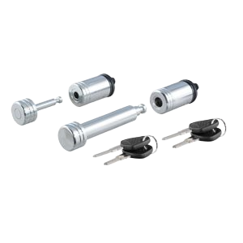
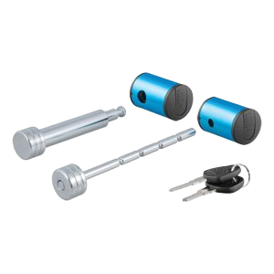
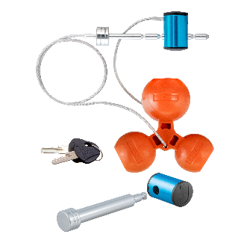
Towing Security
Hitch & Coupler Lock Sets
Locks keyed alike for convenient one-key operation
Four keys (2 keys for #23083) included for added convenience
#23527
#23505
#23083

Slide 13
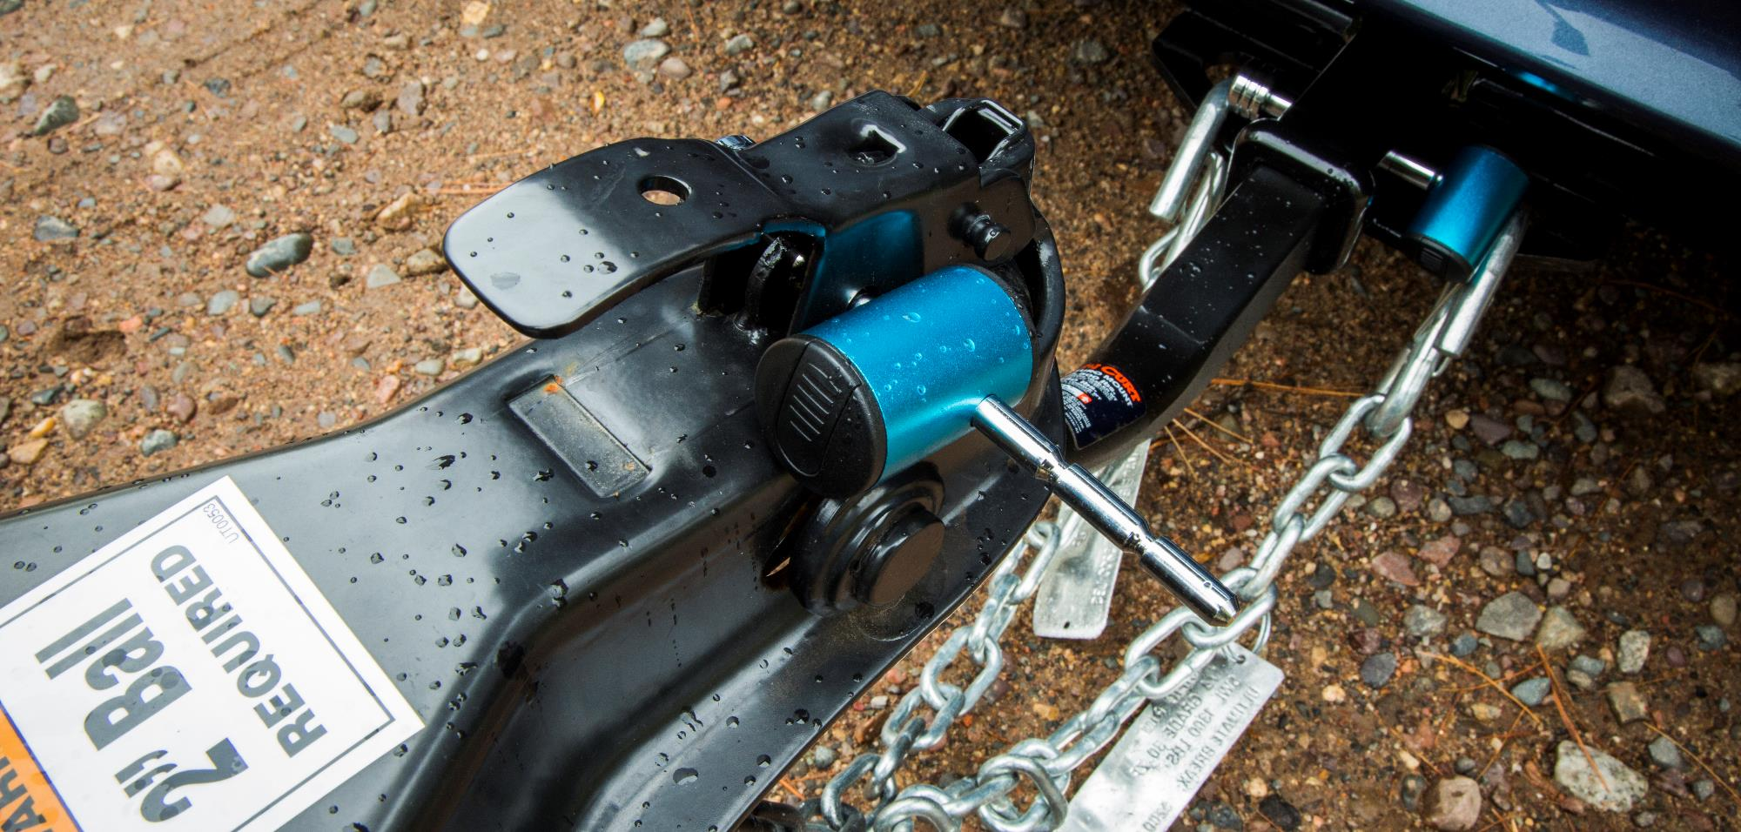
Towing Security

Slide 14
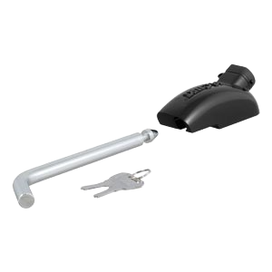
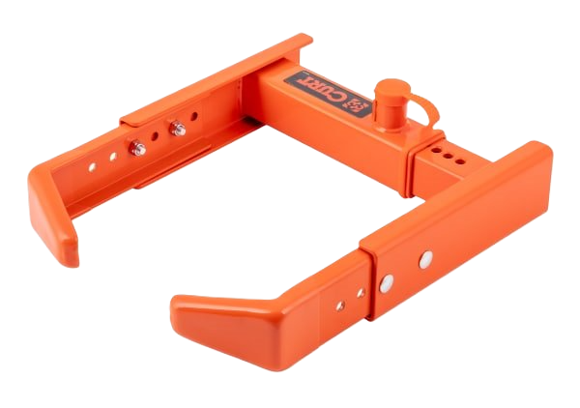
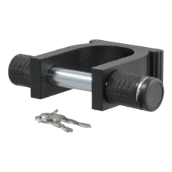
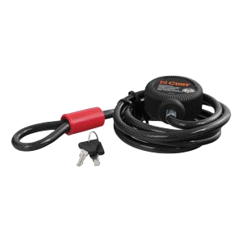
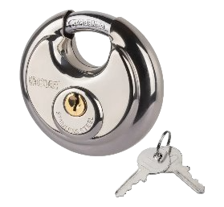
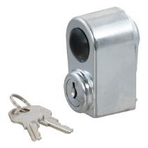
Towing Security
Specialty Locks
5th Wheel Rail Lock
5th Wheel Kingpin Lock
Adjustable Wheel Lock
Multi-Use Cable Lock
Spare Tire Lock
Stainless Steel Disc Lock

Slide 15
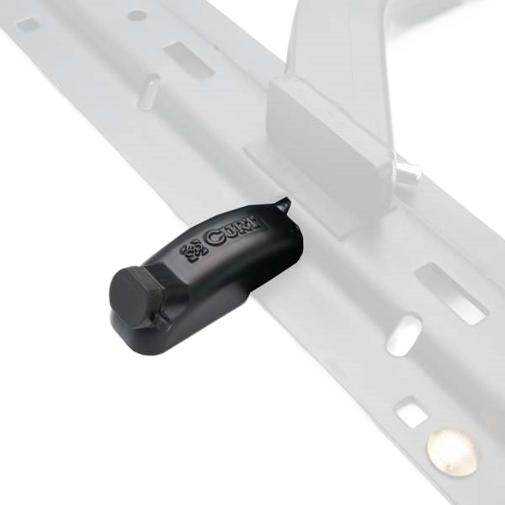
Towing Security
5th Wheel Hitch Lock, #23256
Locks a 5th wheel hitch into the rails, taking the place of a pin & clip
Extra-long 1/2" diameter pin fits all industry-standard base rails
Weather-resistant dust cap helps prevent internal corrosion
Easy-to-access, 1/8-turn lock activation
Includes two keys for added convenience

Slide 16
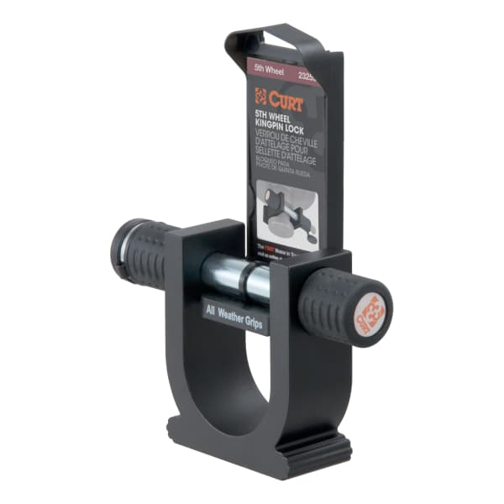
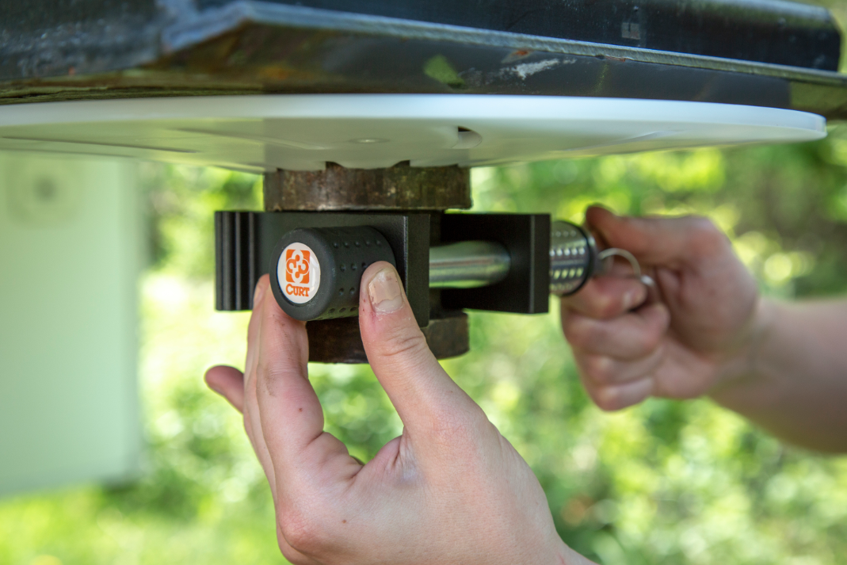
Towing Security
Kingpin Lock, #23255
Locks on to 5th wheel kingpin to deter theft
Built with an aluminum body for corrosion resistance
Two keys included for added convenience
Space-saving, full-color retail packaging

Slide 17

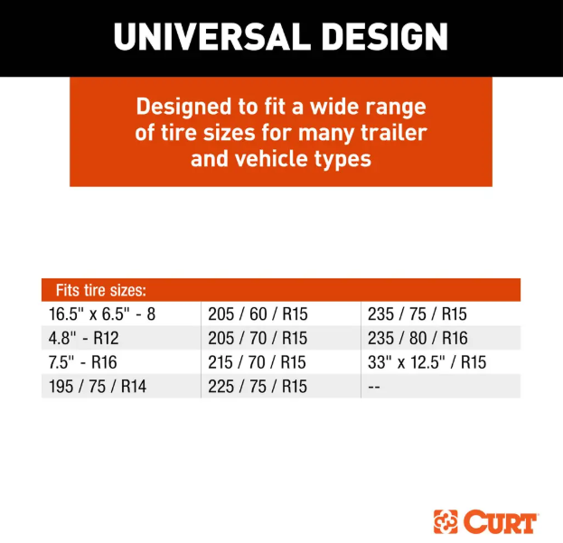
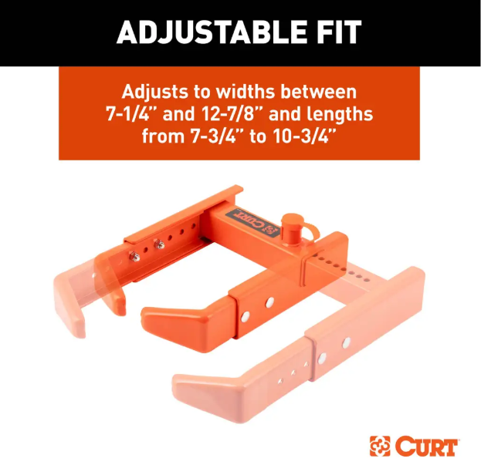
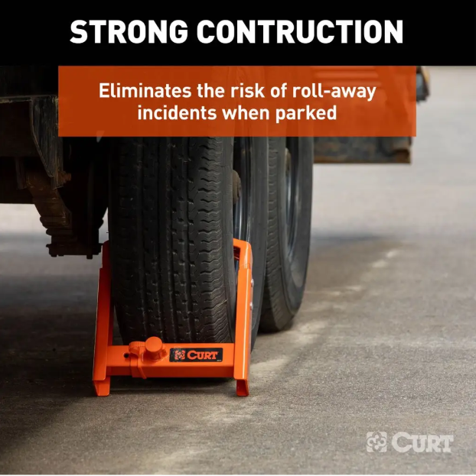
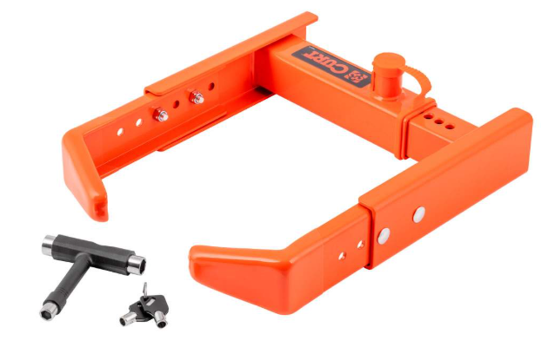
Towing Security
Adjustable Trailer Wheel Lock, #23176
Secures unattended trailers, RVs or vehicles by clamping onto the wheel
Fits most tire sizes, with a width of 7-1/4” to 12-7/8” and a length of 7-3/4” to 10-3/4”
Orange rubber-coated arms protect the wheel's finish
Powder coat finish for maximum protection against rust and corrosion
T-tool accessory for quick, easy adjustments
Watertight dust cap prevents internal corrosion
Includes two keys for added convenience

Slide 18
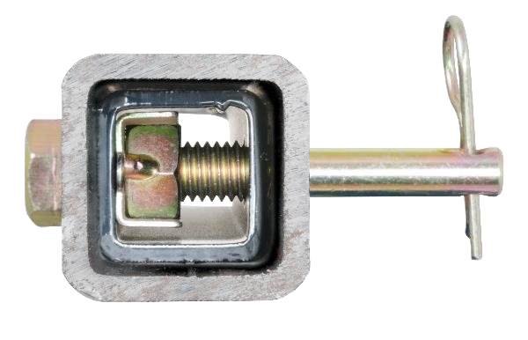
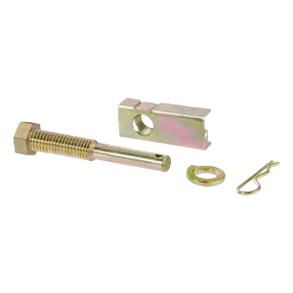


Towing Security
Anti-Rattle Hitch Pins
Stops rattling and prevents shank movement
Compatible with hollow-shank accessories only
Available to fit 1-1/4”, 2” and 2-1/2” shanks
Protected by a durable yellow zinc-plated finish

Slide 19




Towing Security
Anti-Rattle Hitch Clamps
Stops rattling and prevents shank movement
Compatible with hollow and solid shank accessories
No-tool installation and easy-to-adjust clamp lever
Available to fit 2” and 2-1/2” receivers
Lightweight aluminum and high-strength steel
Durable, clear finish for corrosion resistance
#22325
#45367​

Slide 20

Towing Security

Slide 21


Towing Security
Safety Pins
Quickly secures coupler latches, pintle hooks, jack legs or caster wheels
Square retainer wire clip provides added clearance
Protected by a durable zinc-plated finish

Slide 22


Towing Security
Limited Lifetime Warranty
CURT provides limited lifetime warranty coverage against defects in factory workmanship and materials for CURT products sold by authorized CURT dealers for use by retail (end use) consumers.
https://storage.googleapis.com/curt-group-warranties/CURT_Warranty.pdf

